Slide 1
Social Media Application
This project is an MIT-licensed open source project. It's an independent project with ongoing development made possible thanks to the support of the Faculty of Computer Science and Cybernetics.

Slide 2
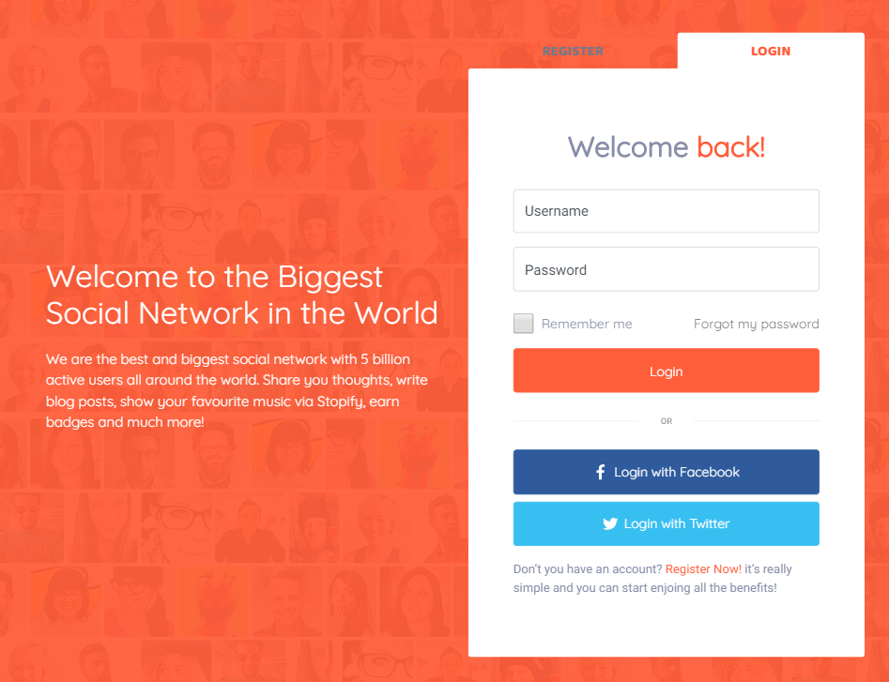
Introduction
Our project is presented as a social networking web application that provides users with the ability to share information. The users are able to post status updates, news, jokes, events and so on.
Using this social networking site to post about daily life allows friends and family members to keep in touch. Following the local reporters, businesses and private citizens who post information about the community give followers an opportunity to keep in touch with current events.

Slide 3
Main Functionality
Ability to create/modify/delete user account.
Adding posts on user page and commenting them.
Liking and commenting friends posts as well.
Adding and deleting friends.
Search system of finding users by key words.

Slide 4
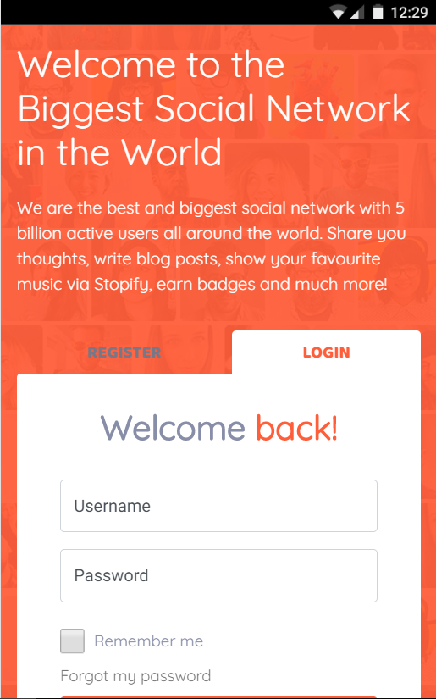
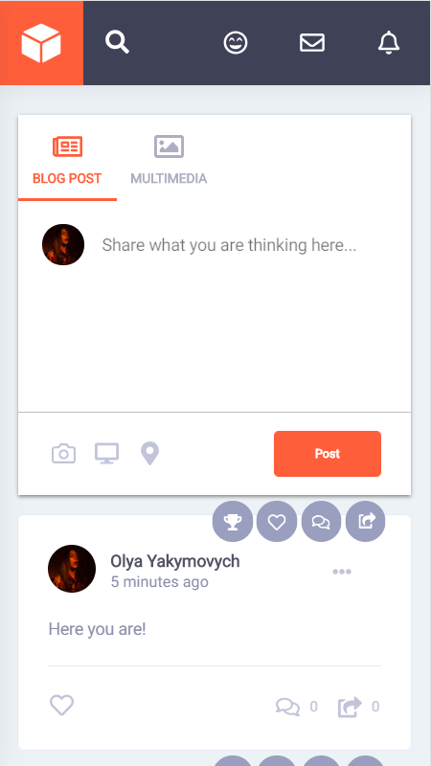
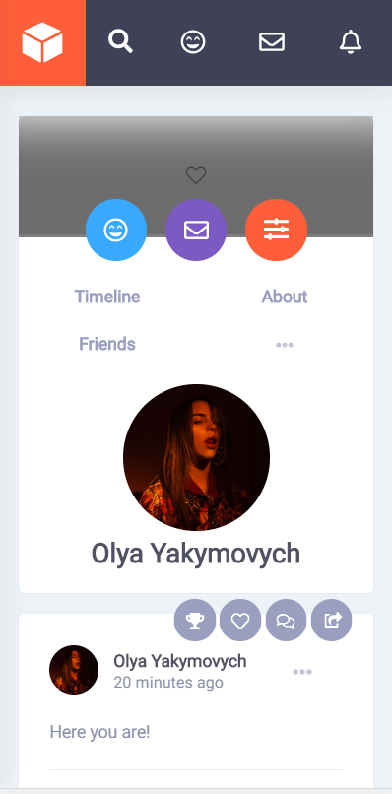
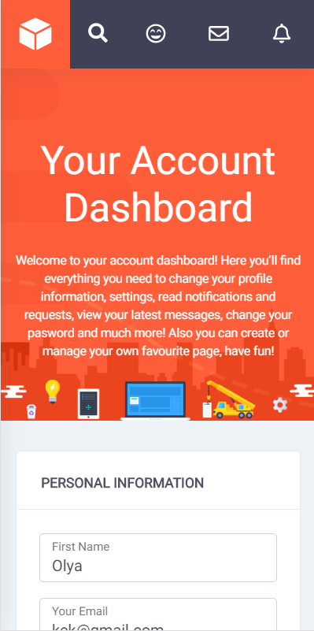
Structure of the Project
+ response web design
+ elements of adaptive web design
Settings
404 Page
Landing Page
Newsfeed Page
Profile Page

Slide 5










Architecture of the Project
(Front-End Part)

Slide 6


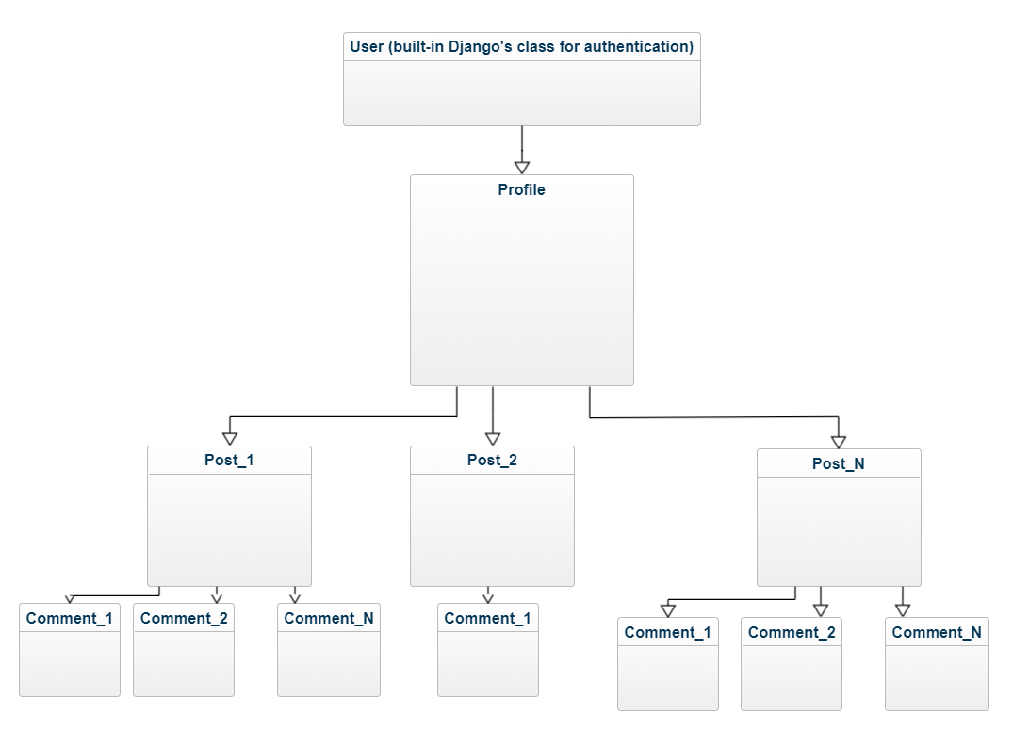


Architecture of the Project
(Back-End Part)

Slide 7

Project Overview

Slide 8
Future Plans
Stop writing commits like ‘fixed bugs’.
Add more functionality (add messaging, add friends groups and communities, add ability to subscribe to favourite pages, add calendar, add playlist, add profile analytics).
Deploy our server to any Internet Cloud Platform (for example Heroku).
Fix all the problems and bugs with UI/UX design and server.

Slide 9
Thanks for watching!
Check out our repository: https://github.com/yillprojects/media-project

