Slide 1
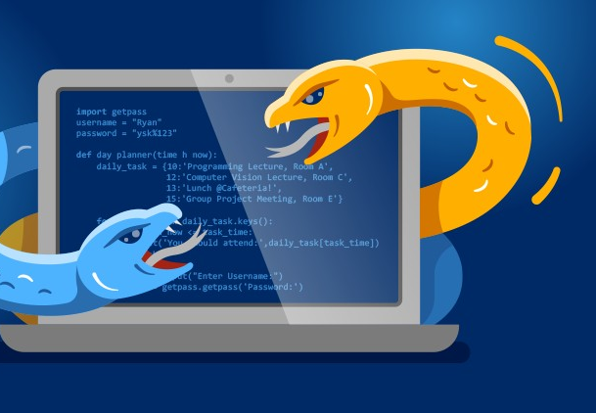

Python Fundamentals
By Yilmaz Mustafa

Slide 2
Generators

Slide 3
We've learned how to create functions with def and the return statement.
Generator functions allow us to write a function that can send back a value and then later resume to pick up where it left off.

Slide 4
This type of function is a generator in Python, allowing us to generate a sequence of values over time.
The main difference in syntax will be the use of a yield statement.

Slide 5
When a generator function is compiled they become an object that supports an iteration protocol.
That means when they are called in your code they don't actually return a value and then exit.

Slide 6
Generator functions will automatically suspend and resume their execution and state around the last point of value generation.
The advantage is that instead of having to compute an entire series of values up front, the generator computes one value waits until the next value is called for.

Slide 7
For example, the range() function doesn’t produce an list in memory for all the values from start to stop.
Instead it just keeps track of the last number and the step size, to provide a flow of numbers.

Slide 8
If a user did need the list, they have to transform the generator to a list with list(range(0,10))
Let’s explore how to create our own generators!

Slide 9
Iterators and Generators Homework
Solutions

Slide 10
