Slide 1
Short Course on Programming in C/C++
Organized by Onur Pekcan
Contributor Selim Temizer Instructor Hasan Yılmaz

Slide 2
Week 1 - Lecture
Today
We will cover;
Collection of data, Arrays
Arrays of Numerical Values
Accessing Array Elements
Initializing Arrays
Strings: Arrays of characters
Multi-dimensional Arrays
Functions
Function Definition
Function Call(call-by-value)
Function Prototypes(header files)
Recursion

Slide 3
Arrays
Arrays of Numerical Values
Array Declaration:
type name[SIZE];
Ex: int a[10];
Length: 10
Size: 10 x sizeof(int)
Location of a: the first element of a; i.e., a[0]
Ex: float b[20];
Length: 20
Size: 20 x sizeof(float)
a
a[0]
a[1]
a[2]
a[3]
a[4]
a[5]
a[6]
a[7]
a[8]
a[9]

Slide 4
Arrays
Accessing Array Elements
/* declaration */
int a[10];
/* I can use the elements of an array like a variable */
int b = a[8];
int c = 25 + a[2] - a[8] / a[0];
/* Like a variable, I can assign values to the elements */
a[2] = 25;
a[i] += 25 – a[2]++;

Slide 5
Arrays
Initializing Arrays
/* The following two are equivalent */
int a[3] = {1, 2, 3};
int a[] = {1, 2, 3};
float c[] = {.1 2.2 0.3};
/* If the number of initializers is less than the size of the array, the remaining ones are set to zero */
int a[8] = {1, 2, 3}; ➔ int a[8] = {1, 2, 3, 0, 0, 0, 0, 0};

Slide 6
Arrays
Strings: Arrays of characters
char a[3] = “AB”; ➔ char a[3] = {‘A’, ‘B’, ‘\0’};
char a[] = “AB”; ➔ char a[3] = {‘A’, ‘B’, ‘\0’};
char b[2] = “AB”; ➔ char b[2] = {‘A’, ‘B’};
You cannot use string functions on b since it does not have an ending mark, i.e., ‘\0’.

Slide 7
Arrays
Multi-dimensional Arrays
int a[] = {1, 2, 3};
int c[2][3] = {
{1, 2, 3},
{2, 3, 4},
};
int d[2][2][3] = {
{ {1, 2, 3}, {2, 3, 4}},
{ {5, 6, 3}, {7, 8, 4}},
};
c
0
1
2
0
c[0][0]
c[0][1]
c[0][2]
1
c[1][0]
c[1][1]
c[1][2]

Slide 8
Notes
Arrays cannot be copied
int a[10], b[10];
a = b; ➔ error!
Correct way: for(i=0; i < 10; i++) a[i] = b[i];
Arrays cannot be automatically initialized to a value:
int a[10];
a = 0; ➔ error!
Correct way: for(i=0; i < 10; i++) a[i] = 0;
If you try to access an array’s element with negative index or with an index which is bigger than its length, you would get a run-time error.

Slide 9
Examples
Write a program that asks the user to type 10 integers of an array. The program must compute and write the number of integers greater or equal to 10.

Slide 10
Solution
#include <stdio.h>
int N=10;
int main()
{
int t[10], i, nb = 0;
printf("Type 10 integers: \n“);
for (i=0; i<N; i++)
{
scanf(“%d”, &t[i]);
nb += ( t[i] >= 10 ); // note that true converts to 1, false to 0
}
printf("the number of integers greater or equal to 10 is: %d\n“, nb);
return 0;
}

Slide 11
Example
Write a C program that gets the number of students, then grades of students and calculate the average of the class, number of students which are under the average.
Sample I/O:
N grade1 grade2 .. gradeN
İnput:
3 55 45 80
Output:
average: 60
2 students are under the average.

Slide 12
Example
Write a program that asks the user to type 10 integers of an array and an integer V. The program must search if V is in the array of 10 integers. The program writes "V is in the array" or "V is not in the array".

Slide 13
Solution
#include <stdio.h>
int N = 10;
int main (){
int t[N], i=0, V ;
printf("Type 10 integers: \n“);
for (i = 0; i < N; i++)
scanf(“%d”, &t[i]);
printf("Type the value of V: “);
scanf(“%d”, &V);
for (i = 0; i < N; i++){
if (t[i] == V)
{
printf("V is in the array\n“); //If found, write and return
return 0;
}
}
printf("V is not in the array\n“); //If not found, write and return
return 0;
}

Slide 14
Functions
Function definition
return_type function_name(parameter declarations)
{
statement-1;
statement-2;
…
}
if is return_type not void, “return” statement has to be used:
return expression;

Slide 15
Functions
Function declaration
return_type function_name(list-of-params);
The parameters have to have the same types as in the function definition although the names of the parameters may differ.
Example:
int factorial(int N);
void print_matrix(int matrix[N][M]);
If a function is used before it is defined, it has to be declared first.

Slide 16
Functions
Function call
function_name(list of arguments)
Example:
Function declaration:
int greatest(int A, int B, int C);
Example function call:
printf(“%d\n”, greatest(10, 20, -10));

Slide 17
Functions
Call by Value
The arguments of the function are just copies of the passed data!
void f(int a)
{
a = 10 * a;
}
void g(int b)
{
b = 10;
f(b);
printf(“%d”, b);
}

Slide 18
Functions
Call by Value
So, what do we do? How can I get the changed value?
You can use the “return” statement for a variable.
If you have more than one variable, you can use global variables.
Or, you can use pointers!

Slide 19
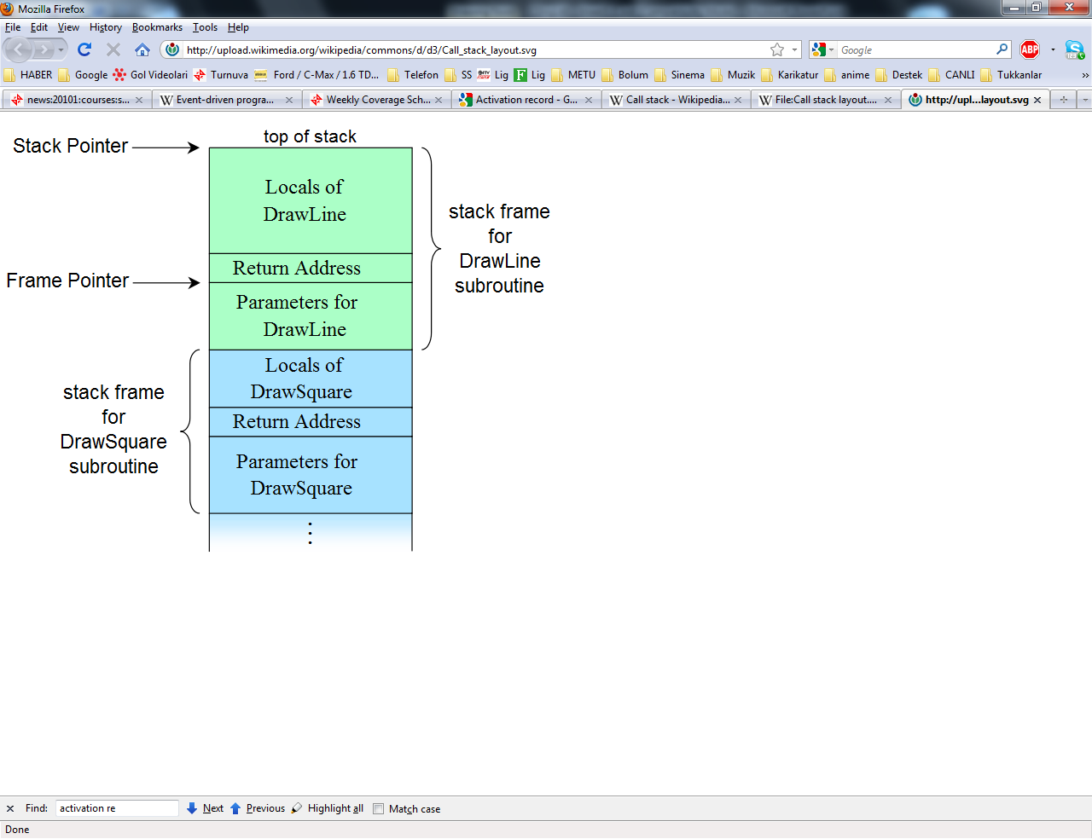
Functions
Tracking Function Calls
Function calls are
“traced” using call stack.

Slide 20
Functions
Namespaces
Determines where the definition of variables are valid!
Global space.
main() function space.
Block structures.

Slide 21
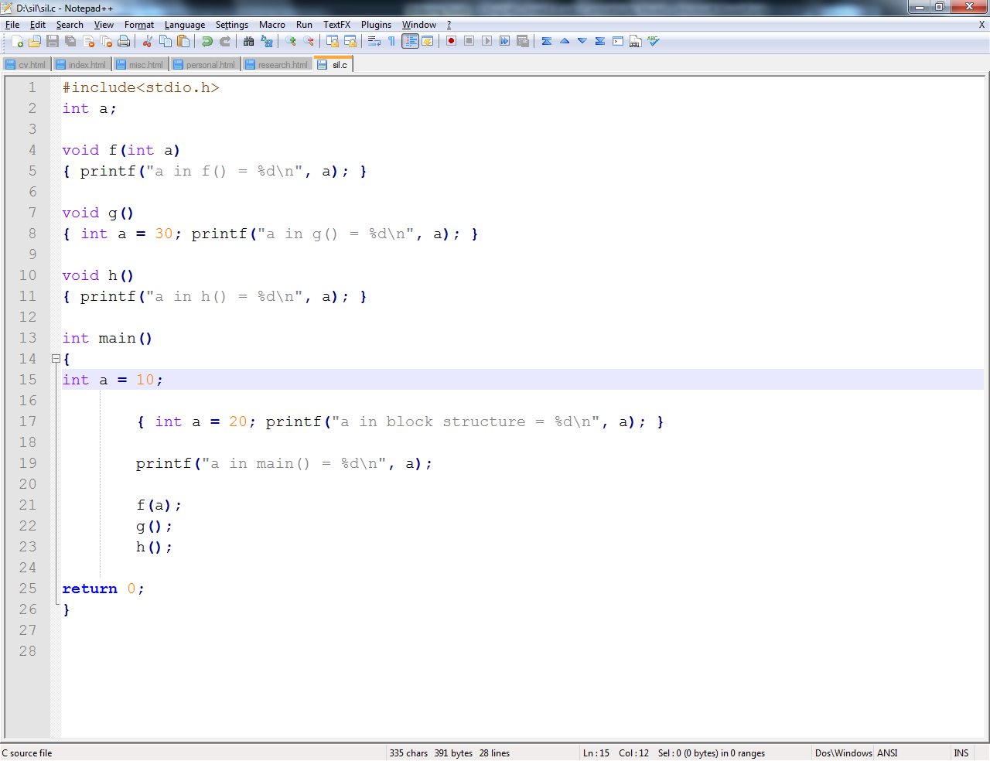
Namespace Example
Output:
a in block structure = 20
a in main() = 10
a in f() = 10
a in g() = 30
a in h() = 0

Slide 22
Block Structure
void f(int bP)
{
int aL;
aL = 3;
{
int aL;
aL = 4;
printf(“aL = %d\n”, aL);
}
printf(“aL = %d\n”, aL);
}
Block Structure:
Statements enclosed
within braces.

Slide 23
Functions
Function Prototypes
#include <stdio.h>
/* * If this prototype is provided, the compiler will catch the error * in main(). If it is omitted, then the error may go unnoticed. */
int fac(int n); /* Prototype */
int main(void){
printf("%d\n", fac()); /* Calling function */
/* Error: forgot argument to fac */
return 0;}
int fac(int n){ /* Called function */
if (n == 0)
return 1;
else
return n * fac(n - 1); }

Slide 24
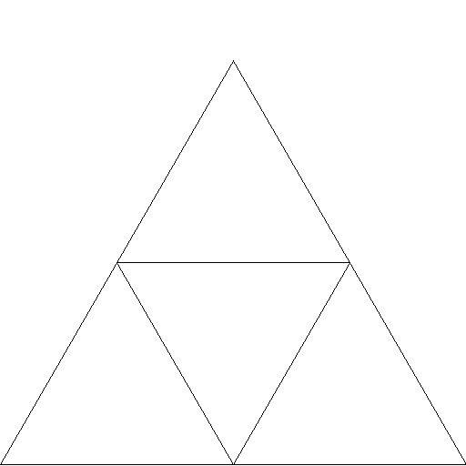
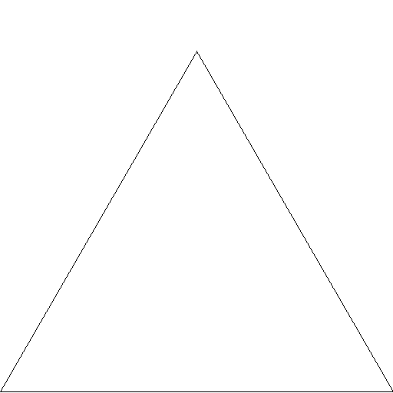
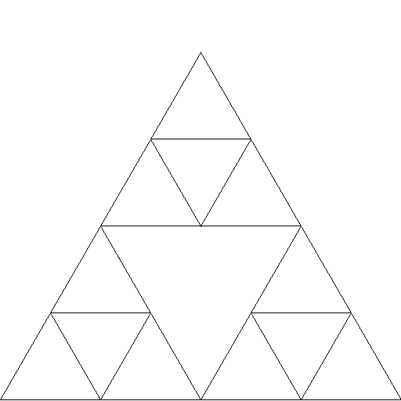
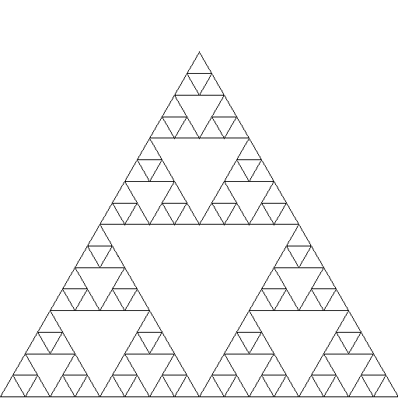
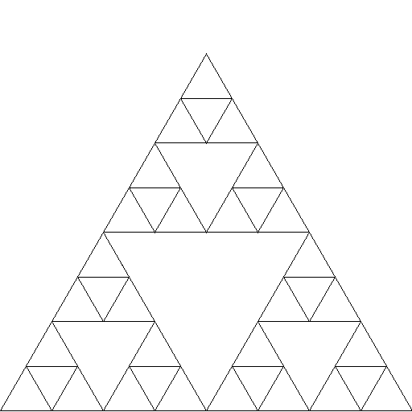
Functions
Recursion

Slide 25
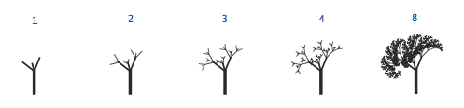
Recursion
Recursive Tree

Slide 26

Recursion
Towers of Hanoi
Computing the recurrence relation for n = 4:
hanoi(4) = 2*hanoi(3) + 1
= 2*(2*hanoi(2) + 1) + 1
= 2*(2*(2*hanoi(1) + 1) + 1) + 1
= 2*(2*(2*1 + 1) + 1) + 1
= 2*(2*(3) + 1) + 1
= 2*(7) + 1 = 15

Slide 27
Functions
Recursion
Function calls itself.
int factorial(int nP)
{
if(nP <= 1 )
return 1;
return nP * f(nP);
}
Limit:
The stack space!

Slide 28
Recursion vs Iteration
Recursion:
Limited number of calls
Easier to formulate/write
Iteration:
Not limited
More difficult to formulate/write

Slide 29
Examples
Write two functions named reverse1 and reverse2 with the prototypes:
void reverse1(int number);
int reverse2(int number, int reversed);
In order to test them write a main function

Slide 30
Solutions
void reverse1(int number)
{
int remain;
if(number < 10)
{ printf("%d", number);
return;
}
remain = number%10;
printf("%d", remain);
reverse1(number/10);
return;
}

Slide 31
Solutions
int reverse2(int number, int reversedNumber)
{
// printf("%d %d\n", number, reversedNumber);
/*if you want to see step by step delete comment of printf*/
int remain;
if(number < 10)
{
reversedNumber += number;
return reversedNumber;
}
remain = number%10;
reversedNumber = (reversedNumber + remain) * 10;
number /= 10;
return reverse2(number, reversedNumber);
}

Slide 32
Solutions
#include<stdio.h>
void reverse1(int number);
int reverse2(int number, int reversedNumber);
int main()
{
int number = 123;
int reversedNumber = 0;
//scanf("%d",&number);
reverse1(number);
reversedNumber = reverse2(number, 0);
printf("\n%d\n", reverse2(number,0));
return 0;
}
For this main function output is:
321
321

Slide 33
Examples
Write a function that takes a positive integer as input and returns the leading digit in its decimal representation. For example, the leading digit of 234567 is 2.
Write a boolean function that takes a positive integer n as an argument and returns true if n is prime, and false otherwise.
Bool isPrime(int number);

Slide 34

Another simple example for recursion: Fibonacci numbers
Let us write the recursive and the iterative solutions to fibonacci numbers

Slide 35
Naming Conventions
One option:
Append G to the end of the global variables.
Ex: bufferG, arrayG, namesG, wordsG
Append P to the end of parameters:
Ex: indexP, rangeP, numberP
Append L to the end of local variables:
Ex: tempL, indexL, resultL

Slide 36
Naming Conventions
Second option (should be combined with the first):
Use “i_” as a prefix for integers:
Ex: int i_number;
Use “f_” as a prefix for floats:
Ex: float f_division;
Use “c_” as a prefix for characters.
Use “str_” as a prefix for strings.
Use “a_” for arrays:
Ex: int i_a_numbers[10];

Slide 37
Modular Programming
“a.c” file:
#include “a.h”
int main()
{
f();
return 0;
}
void f()
{
…..
}
“a.h” file:
/* Include Directives */
#include<stdio.h>
/* Global Variables */
int flagG;
char wordG[10];
/* Function Declarations */
void f();

