Slide 1
Short Course on Programming in C/C++
Organized by Onur Pekcan
Contributor Selim Temizer Instructor Hasan Yılmaz

Slide 2
Week 1 - Lecture 1
Today
We will cover;
Overview of Programming Languages
Introduction to C, “Hello World”
Data Types and Expressions
Control Flow

Slide 3
Overview of Programming Languages
Functional Languages
Data environment is restricted
Functions recieve their parameters and return their result
No data regions are created
No Assignment
In fact, variables are functions
Higher-Order Functions
f0g(x) -> f(g(x))
Recursion
f(1) = 1
f(x) = f(x-1).(2x+1)
Problems are solved using only functions
Python, Haskell etc.

Slide 4
Overview of Programming Languages
Imperative Languages
Problem is solved by writing down a sequence of action units which are called statements.
Each statement performs either a change on the data environment of the program or changes the flow of execution.
Imperative programs are easy to translate to machine code
If statement1 is followed by statement2, in the machine code translations of these statements machine_code1 will also be followed by machine_code2
C, C++, Java, Php, Python etc.

Slide 5
Overview of Programming Languages
Logic Programming
In this paradigm, the programmer states the relations among the data as facts or rules(also referred as relations)
For example, facts can be information about who is whose mother and the rule can be a logical rule
Below is such a logical program in Prolog a well-known logical programming language.
mother(matilda, ruth).
mother(trudi, peggy).
mother(eve, matilda).
mother(eve, trudi).
grandmother(X,Y) :- mother(X,Z), mother(Z,Y).
?- grandmother(G,T).
G = eve, T = ruth
G = eve, T = peggy
?- grandmother(eve, matilda).
False.
?- grandmother(eve, X).
X = ruth
X = peggy
Prolog

Slide 6
Overview of Programming Languages
Object-Oriented Programming
The most common paradigm in commercial circles
Data and Action of Data are not seperated
An Object has some internal data and functions, so called methods.
Possible to create as many instances of an object
We will cover this paradigm later in C++
C++, Java, Php, Python etc.

Slide 7
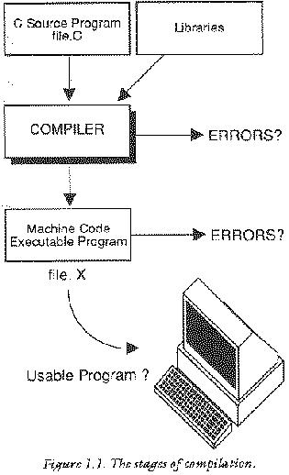
Introduction to C, “Hello World”

Slide 8
Introduction to C, “Hello World”
Printing "Hello World!"
#include<stdio.h>
int main()
{
printf("Hello World!\n");
return 0;
}

Slide 9
Data Types, Expressions
Data types
Type Conversion
Basic I/O
Arithmetic and Logical Expressions
Assignment
Statements

Slide 10
Data Types, Expressions
Data Types
Integer
String
Char
Float

Slide 11
Data Types, Expressions
Integer constants
short
int
unsigned int
long int
unsigned long int

Slide 12
Data Types, Expressions
String Constants
“deneme bir iki”
“deneme bir iki”\
“uc dort bes”
“deneme \” bir iki”

Slide 13
Data Types, Expressions
Character Constants
‘a’, ‘1’, ‘%’, …
‘\’’
‘c’ vs “c”

Slide 14
Data Types, Expressions
Floating Points
float
double
long double

Slide 15
Data Types, Expressions
Type Bytes Range
------------------------------------------------------------------------------------------------
short int 2 -32,768 -> +32,767
unsigned short int 2 0 -> +65,535
unsigned int 4 0 -> +4,294,967,295
int 4 -2,147,483,648 -> +2,147,483,647
long int 4 -2,147,483,648 -> +2,147,483,647
signed char 1 -128 -> +127
unsigned char 1 0 -> +255
float 4
double 8
long double 12

Slide 16
Data Types, Expressions
Declaration:
int a;
char c;
Initialization:
float x = 0.34;
int y = 2345;

Slide 17
Type Conversion
Automatic Type Conversion Rules
Example: c -> int, f -> float
c/f result -> float
Explicit Type Conversion
( cast-type ) expression
(int) 12.8 -> ?
(int) 12.8 * 3.2 -> ?
char,
short
int
long
float
double
long double
* Advice: Avoid automatic type conversion!

Slide 18
Basic I/O
Output
printf(format string, var1, var2, … )
Format string contains:
d: integers
f: float, double
e: float, double in exponential notation
c: character
s: string

Slide 19
Basic I/O
Input
scanf(format string, var1, var2, … )
var1, var2, ..: addresses of memory locations!
Format string contains:
d,i: integers
f: float, double
e: float, double in exponential notation
c: character
s: string

Slide 20
Example
Printing Integer, Char, using type conversion just when printing
Printing asci code of a char
Swapping

Slide 21
Arithmetic & Logical Expressions
Arithmetic Operators & Precedence
C uses infix notation: a + b * c
prefix notation: + a * b c
postfix notation: a b c * +
Operator | Type | Associativity
+ - | Unary | Right to left
* / % | Binary | Left to right
+ - | Binary | Left to right

Slide 22
Arithmetic & Logical Expressions
Increment, Decrement Operators
++a, --a
vs
a++, a--

Slide 23
Assignment
Compound Assignment Operators
variable = expression;
a = b;
+= -= *= /= %=
a += b; -> a = a + b;

Slide 24
Some examples
i += j = k;
i = j += k;
int i = 7;
int j = 3;
i = j = 5;
print(i,j) = ?

Slide 25
Simple Macros
For long and/or frequent constants:
#define PI 3.14159265
For long and/or frequent calculations:
#define Area(Radius) (4*PI*Radius*Radius)
… a = 10.0 + Area(2.0);

Slide 26
Example
A gasoline (‘benzin’) and diesel engine versions of the same car model consume different amounts of petrol: p_{g}, p_{d} (in liters per km), usually p_{g} > p_{d}. These two different versions of the same car model have different prices: c_{g}, c_{d} (usually, c_{g} < c_{d}).
Write a program that gets the values p_{g}, p_{d}, c_{g}, c_{d} as well as the price of 1 liter gasoline and 1 liter diesel from the user and calculates in how many kilometers the price difference these two versions is amortized.

Slide 27
Examples
main() { static int var = 5; printf("%d ",var--); if(var) main(); }
main() { float me = 1.1; double you = 1.1; if(me==you) printf(“Me & You"); else printf(“You & Me"); }

Slide 28
Example
#define square(x) x*x main() { int i; i = 64/square(4); printf("%d",i); }

Slide 29
Examples
#include <stdio.h> #define a 10 main() { #define a 50 printf("%d",a); }
void main() { int i=5; printf("%d",i++ + ++i); }

Slide 30
Control Flow
Selective Structures
Conditional Expressions and Statements
Nested Conditionals
Multiway Conditionals
Repetitive Structures
While loop
Do-while loop
For loop
Nested loops
Loop Interruption(break, continue)

Slide 31
Selective Structures
Conditional Expressions and Statements
Relational (<, <=, >, >=, ==, !=)
Logical Operators (&&, ||)
Changing the flow of the program
Conditional statements
Conditional expressions

Slide 32
Conditional Expressions and Statements
Relational Operators
< <= > >= == !=
False means 0 (zero)
True means anything that is not False (i.e., non-zero)
Operator | Type | Associativity
+ - ++ -- | Unary | Right to left
* / % | Binary | Left to right
+ - | Binary | Left to right
< <= > >= | Binary | Left to right
== != | Binary | Left to right
= *= /= %= += -= | Binary | Right to left
Example: a = b + c <= d + e == c - d

Slide 33
Conditional Expressions and Statements
Logical Operators
&& || !
Operator | Type | Associativity
+ - ++ -- ! | Unary | Right to left
* / % | Binary | Left to right
+ - | Binary | Left to right
< <= > >= | Binary | Left to right
== != | Binary | Left to right
&& | Binary | Left to right
|| | Binary | Left to right
= *= /= %= += -= | Binary | Right to left

Slide 34
Conditional Expressions and Statements
Changing the flow of the program
if statements
if(expr)
{ ….
}
else if(expr)
{…
}
…
else
{ … }
if(a > b)
printf(“a is bigger”);
else if(a < b)
printf(“b is bigger”);
else
printf(“a = b”);

Slide 35
Conditional Expressions and Statements
Changing the flow of the program
Common mistake with if statements
if( a = 10) { … }
if( a == 10); { … }

Slide 36
Conditional Expressions and Statements
Conditional Expression Operator
Conditional expression:
Expr ? True-expr : False-expr
int a = x > 10 ? 1 : 0;
Right-to-left associative.
X = c ? a : d ? e : f;
Precedence:
c ? X = a : X = b
‘?’ and ‘:’ bracket the expression. True-expr can have operators of any precedence without parentheses.
The False-expr part has lower precedence than all operators except ‘=‘ and ‘,’.

Slide 37
Conditional Expressions and Statements
Nested Conditionals
if( … )
if( … )
{….}
else
{….}

Slide 38
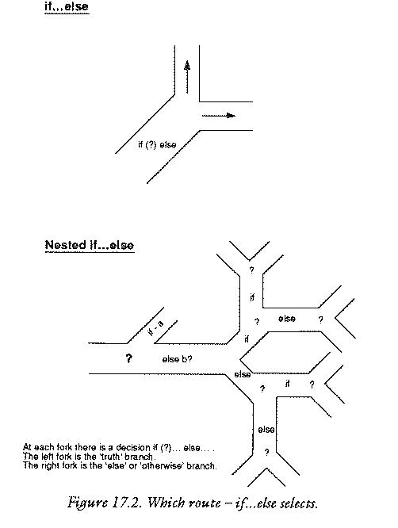
Conditional Expressions and Statements

Slide 39
Conditional Expressions and Statements
Multi-way conditionals: switch statements
switch(expr)
{
case value-1:
….
break;
case value-2:
….
break;
default:
….
break;
}

Slide 40
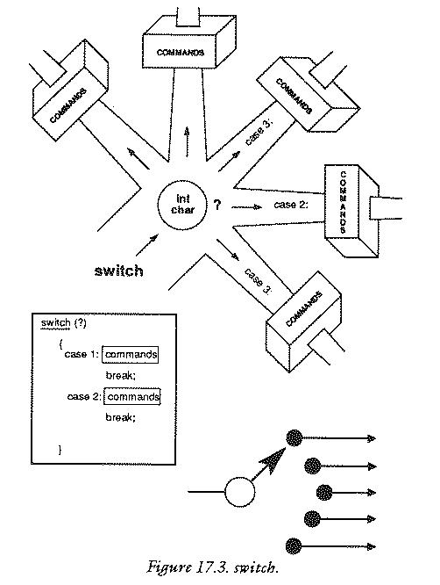
Conditional Expressions and Statements

Slide 41
Example
Making a basic calculator with addition, substraction, etc.
I/O:
5 a 6 -> 11
7 s 4 -> 3
3 m 9 ->27

Slide 42
Example
main() { int i=3; switch(i) { default: printf("zero"); case 1: printf("one"); break; case 2: printf("two"); break; case 3: printf("three"); break; } }
main() { int i=1; switch(i) { default: printf("zero"); case 1: printf("one"); case 2: printf("two"); break; case 3: printf("three"); break; } }

Slide 43
Example
Write a C program that classifies a given character into one of the following:
Number
Uppercase letter
Lowercase letter
Operator
Whitespace

Slide 44
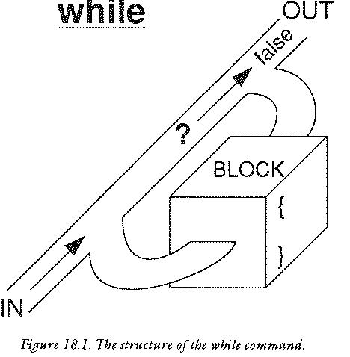
Repetitive Structures

Slide 45
Repetitive Structures
while loop
Initialization;
while( expr )
statement;
Initialization;
while( expr )
{
statement;
statement;
statement;
}
Bad examples:
while( x = 1)
{
x = getchar();
}
x = 0.0;
while( x != 1.0 )
{
x += 0.005;
}

Slide 46
Example
Factorial
int N, fact = 1;
scanf(“%d”, &N);
while( N > 0 )
{ fact *= N--; }

Slide 47
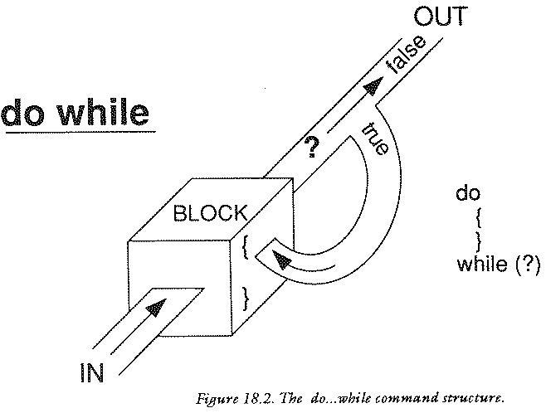
Repetitive Structures

Slide 48
Repetitive Structures
do-while loop
Initialization;
do
statement
while( expr );
statement;
Initialization;
do
{
statement;
statement;
statement;
} while( expr );
do
{
x = getchar();
putchar(x);
} while( x != EOF );

Slide 49
Repetitive Structures
for loop
Initialization;
for( expr1; expr2; expr3 )
statement
Initialization;
for( expr1; expr2; expr3 )
{
statement;
statement;
statement;
}
for( j = 0; j < N; j++)
printf(“j: %d\n”, j);
for(i=0, j=0;
i < 0 & j > N; i++, j--);
for( ; ; i++ )
{
if( i > 0 ) return 0;
}

Slide 50
Nested Loops
You can have loops within loops:
for(i=0; i<N; i++)
{
for(j=0; j<N; j++)
{
….
}
}

Slide 51
Loop Interruption
break;
Stop the loop/iteration and continue with the statement after the loop.
Usable with while, for and do-while
while(…)
{ …
break;
….
}
statement-X;
while( 1 )
{
c = getchar();
if( c == EOF)
break;
putchar( c );
}

Slide 52
Loop Interruption
continue;
Skips the remaining statements in the loop and continues with the “loop head”.
Usable with while, for and do-while
while(…)
{ …
continue;
….
}
Sum = 0;
for(i=0; i<N; i++)
{
if( i%2 == 0 )
continue;
sum = sum + i;
}

Slide 53
Example
Write a program that gets two number from the user and then prints the numbers between those. If they are equal, warn the user and request again.

Slide 54
Example
Write a C code that multiplies two numbers without using *, / or %.

Slide 55
Example
Write a program that reverse a given number.
e.g.
1984->4891
Write a program that reverse a given string.
e.g.
Hasan -> nasaH

