Slide 1
Short Course on Programming in C/C++
Organized by Onur Pekcan
Contributor Selim Temizer Instructor Hasan Yılmaz

Slide 2
Week 1 – Lecture3
Today
We will cover;
Arrays and Pointers
Basic of Pointers
Array-Pointer Referencing Duality
Strings
Dynamic Memory Management
Function and Pointers(call-by-reference)
Multidimensional Arrays and Pointers
Pointers to Pointers
Pointer to Functions

Slide 3
Arrays and Pointers
Why do we need pointers?
For dynamic memory management!
If you don’t know the amount of data that your program will process, you need pointers!
If your program requires a lot of deletions/insertions of new data, you might want to use linked lists and hence, you need pointers!
Comparing data / objects / functions:
You can check whether two entities are the same by comparing their addresses, for example (note that if the size of the data are different, this might not work)
Better control over the memory!

Slide 4
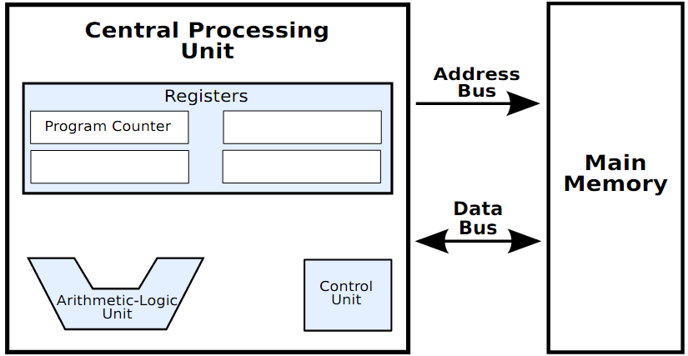
A Brief Summary of the Von Neumann Architecture

Slide 5
A Brief Summary of the Von Neumann Architecture
32bits
A char
An int
Memory is byte addressable!

Slide 6
A Brief Summary of the Von Neumann Architecture
Then, it is more convenient to view
memory as a single array of 8-bit data.

Slide 7
Basics of Pointers
Pointer definitions
* used with pointer variables
int *myPtr;
Defines a pointer to an int (pointer of type int *)
Multiple pointers require using a * before each variable definition
int *myPtr1, *myPtr2;
Can define pointers to any data type
Initialize pointers to 0, NULL, or an address
0 or NULL – points to nothing (NULL preferred)

Slide 8
Good Programming Practice
Include the letters ptr in pointer variable names to make it clear that these variables are pointers and thus need to be handled appropriately
Initialize pointers to prevent unexpected results.

Slide 9
Memory & Data & Addresses & Variables
124
125
int a;
the address of a?
126
127
128
129
130
131
a
132
133
134
131
135
136
137
138
139

Slide 10

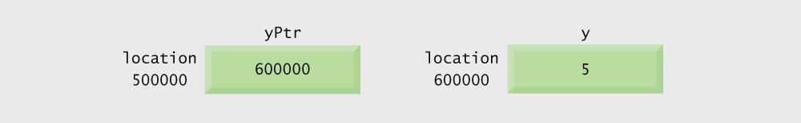
Graphical representation of a pointer pointing to an integer variable in memory.

Slide 11
How to get addresses in C?
124
125
int a;
&a
126
127
128
129
130
131
Address of a!
a
132
133
134
135
136
137
138
139

Slide 12
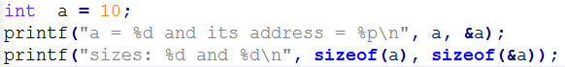
Variable and its address
This is the output:
a = 10 and its address = 0xbfefb304
sizes: 4 and 4
The output depends on the architecture!!
sizeof(a) → depends on the width of the memory
sizeof(&a) → depends on the length/size of the memory

Slide 13
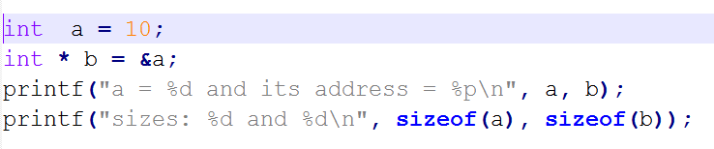
Variable, addresses and pointers
The data type storing addresses are called pointers!
int * , char * , float * , double *

Slide 14
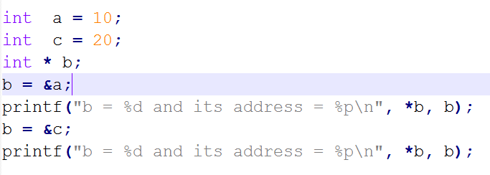
Pointers and changing what they point to
b = 10 and its address = 0xbfdac9b4
b = 20 and its address = 0xbfdac9b0
Addresses are data itself (actually, they are integers!)

Slide 15
Pointers
int a = 10;
int * b = &a;
*b = 20;
a = 2 / *b + 25;
Initialization is important since a pointer initially points to an arbitrary memory position, which may not belong to your program!
A good practice:
int *a = NULL;

Slide 16
Pointer arithmetic
int *a;
printf(“a = %p a+1 = %p”, a, a+1);
a = 0xbff30330 a+1 = 0xbff30334
char *c;
printf(“c = %p c+1 = %p”, c, c+1);
c = 0xbff30337 c+1 = 0xbff30338
So, the difference depends
on the data type!

Slide 17
Pointer arithmetic
Pointer arithmetic is independent of the data type.
In other words, if p is a pointer, p+1 points to the next object (whether it is int, char, float or double).
So, p+1 is not necessarily the next byte in the memory!!!
So, then, how can we check the number of bytes between two pointers? Two options:
(p2 – p1) * sizeof(int)
→ for integers
((int)p2 – (int)p1)

Slide 18
Pointer arithmetic
We have the following defined for pointers as well:
int *a = &b;
a++, ++a
a--, --a
Pointer operators(&, *) has the same precedence with ++, -- (and unary +, -)!!
They are right-to-left associative!!
*++cp → *(++cp)
*cp++ → *(cp++)

Slide 19
void and NULL pointers
A pointer initially has an arbitrary value; i.e., it points to something arbitrary.
Make it a habit to assign all pointers to NULL first.
int * a = NULL;
void *
Generic pointer
Useful especially in cases where we don’t know the type of the data beforehand!

Slide 20
Pointer Comparison
Equality comparison is meaningful between:
Pointers of the same type
A pointer with a void pointer
A pointer and a NULL pointer
The result is true if the operands point to the same object
For other relational operators (<, <=, >, >=):
Result is based on the relative addresses of the objects pointed to.

Slide 21
Pointer Comparison: Example
if( p != NULL ) *p = 10;
char string[100];
char* p = &string[10];
if( p < &string[80] )
printf(“A”);
if( p > string )
printf(“B”);
Write the strlen() function using pointers.

Slide 22
Pointer Conversion
similar to conversion of regular data types (i.e., int, float, double, char, ..), we can convert pointers:
int * a;
double *d;
a = (int *) d;
While converting a pointer to a pointer of a bigger data type, you have to be cautious.
In old architectures, you have to be careful while converting to small data types as well:
ip = (int *) cp;

Slide 23
Pointer & Strings
char * cp;
cp = “abc”;
The following is possible:
char a = cp[0];
If you do the following, you would get segmentation fault:
cp[0] = ‘A’;

Slide 24
Pointer & Strings
char * cp;
cp = “abc”;
cp[0] = ‘A’;
vs
char c[] = “abc”;
c[0] = ‘A’;
void f(char *c)
{
c[0] = ‘A’;
}
~~~~~~~
f(“abc”); /* Seg. Fault */

Slide 25
Implement some string functions with pointers
int strlen(char *sP);
void strcpy(char *destP, char *sourceP);

Slide 26
Dynamic Memory Management
sizeof() operator
void * malloc(size_t size);
void * calloc(size_t nobj, size_t size);
void * realloc(void *p, size_t size);

Slide 27
Dynamic Memory Management
void free(void *p);

Slide 28
Example
Assume that you have numbers given on separate lines and that you do not know how many numbers there are in each line.
The task is to read the numbers on each line and compute an average of the numbers on each line.
Two cases:
The number of lines & the number of numbers on each line is known.
Neither the number of lines nor the number of numbers on each line is known.

Slide 29
Pointers & Functions
Remember that functions are called in C by “call by value”?
Now we can make “call by reference”
void f(int *N)
{
*N = 10;
}
It is actually a “fake” call by reference.

Slide 30
Returning Multiple Values
Now, we can return multiple values:
void f(int N, int *O, double *P)
{
*O = N * N;
*P = sqrt(N)
}

Slide 31
Examples
c = *++cp
c = *cp++
c = ++*cp
c = *--cp
c = *cp--
c = --*cp
c = (*cp)--
c = (*cp)++

Slide 32
Example
Write the factorial function in a recursive way with the following declaration:
void fact(int N, int * result);
Write the factorial function in a recursive way with the following declaration:
void fact(int *N);

Slide 33
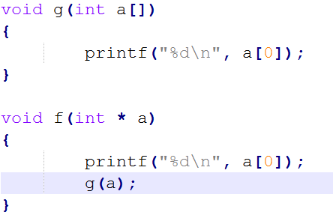
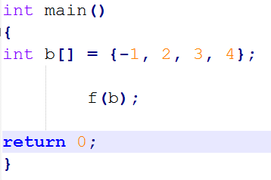
Array vs. Pointer
Array is basically a constant pointer
int a[] = {1, 2, 3};
int *b = a;

Slide 34
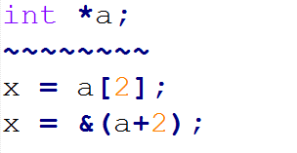
Array vs. Pointer
Array is basically a constant pointer
Hence, I can use a pointer like an array:
Identical

Slide 35
Array vs. Pointer
What does “an array is constant pointer” mean?
It means that things like following are not possible (for the following definitions: int a[3]; int *b;):
a = b;
a++;

Slide 36
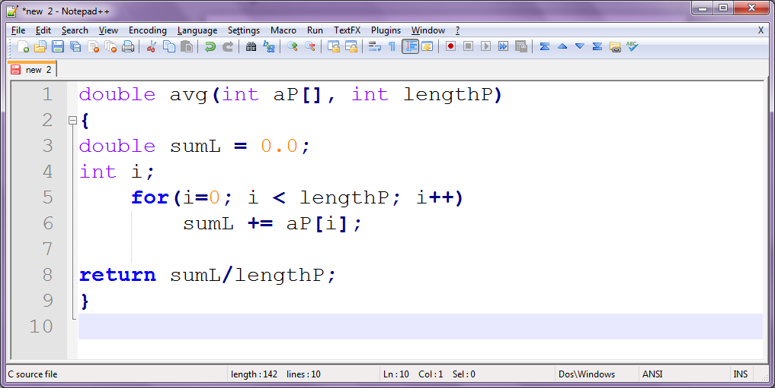

Array vs. pointer
Arrays as function arguments
v.s.

Slide 37
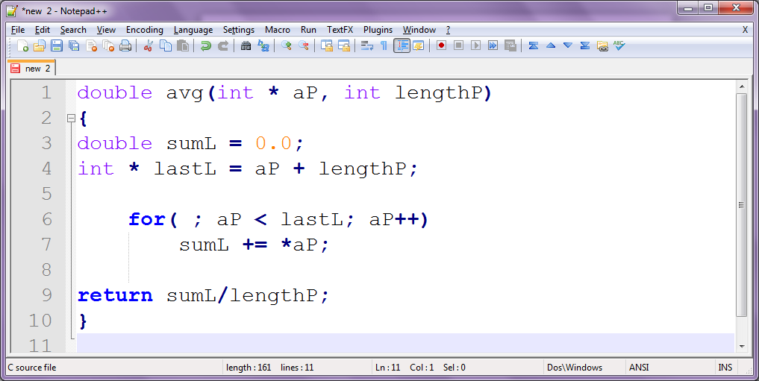
Array vs. pointer
Arrays as function arguments
v.s.

Slide 38
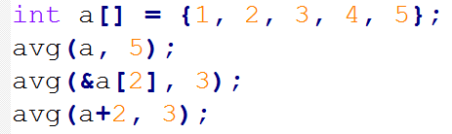
Array vs. pointer
For either of the above definitions, the
following are valid:

Slide 39
Multi-dimensional Arrays & Pointers
Compare the following:
int a[M][N];
int *a[N];
int (*a)[N];

Slide 40
Pointer to Pointers
Compare the following (there is no limit on the level of ‘pointing’ to pointers):
int *a;
int **b;
int ***c;

Slide 41
Pointers to Functions
Pointer to function
Contains address of function
Similar to how array name is address of first element
Function name is starting address of code that defines function
Function pointers can be
Passed to functions
Stored in arrays
Assigned to other function pointers

Slide 42
Pointers to Functions
Example: bubblesort
Function bubble takes a function pointer
bubble calls this helper function
this determines ascending or descending sorting
The argument in bubblesort for the function pointer:
int ( *compare )( int a, int b )
tells bubblesort to expect a pointer to a function that takes two ints and returns an int
If the parentheses were left out:
int *compare( int a, int b )
Defines a function that receives two integers and returns a pointer to a int

