Slide 1
Short Course on Programming in C/C++
Organized by Onur Pekcan
Contributor Selim Temizer Instructor Hasan Yılmaz

Slide 2
Week 2 – Lecture1
Today
We will cover;
Structures and Unions
Basic of Structures
Structures and Functions
Structures and Arays
Self-Referential Structures(Structures Containing Pointers)
Unions & Enumerations
File Processing with C
Reading from & Writing to Files

Slide 3
Basics of Structures
struct person{
int age;
char gender;
char * name;
};
struct person ali =
{10, ‘m’, “Ali Veli”};
Structures and why we need them
Why do we need them?
Grouping
Modularity
Flexibility
…
printf("%d %c %s\n", ali.age, ali.gender, ali.name);

Slide 4
Basics of Structures
Syntax of Structures
Definition
struct <type_label> {
<var_type> <var_name>;
<var_type> <var_name>;
….
<var_type> <var_name>;
<var_type> <var_name>;
};
Usage
struct new_str <var_name1>, <var_name2>, …;
Intialization:
struct new_str <var_name1> = {value1, value2, …, valueN};
Individual Elements:
new_str.<var_name> = <value>
Basically, you can use members of a struct like a variable.

Slide 5
Basics of Structures
Initialization of Structures
struct student {
int age;
char gender;
char * name;
int grades[3];
};
struct student ali =
{21, ‘m’, “Ali Veli”, {60, 70, 80}};
struct student veli = {21};
➔ initializes the rest of the members to zero.

Slide 6
Basics of Structures
Typing and Assignment of structs
The following are two different data types for C:
struct {char a; int b;} var1;
struct {char a; int b;} var2;
struct str1 { char a; int b; } var3;
struct str2 { char a; int b; } var4;
For the first and the second cases, since no explicit name was given to the structure, we can’t declare a new variable that has the same type as var1 and var2.

Slide 7
Basics of Structures
Typing and Assignment of structs
You can assign structs of the same type to each other. E.g.:
struct str_type {char a; int b;};
struct str_type a = {‘m’, 10};
struct str_type b = a;

Slide 8
Basics of Structures
The “.” (dot) operator
For accessing the members of a structure, we use the dot operator:
struct str_type {char a; int b;} var1;
var1.a = ‘m’;
The dot operator has the same precedence with [], & and ->
These operators are left-to-right associative.

Slide 9
Basics of Structures
Size of a struct
You can use the sizeof operator on structures.
The size of a struct may be more than the sum of the sizes of its members.
For example:
struct str_type {char a; int b;} var1;
➔ The size of var1 is probably more than 5 (due to
data alignment with memory words)
However, the following is probably 2 times the size of an int:
struct str_type2 {int a; int b;} var2;

Slide 10
Basics of Structures
Nested structures
You can use one struct within another one:
struct name_str {
char * first_name;
char * last_name;
};
struct person {
struct name_str name;
int age;
char gender;
}
struct person ali =
{{“ali”, “veli”}, 10, ‘m’};
struct name_str name =
{“veli”, “deli”};
ali.name = name;
ali.name.first_name =
“Deli”

Slide 11
Basics of Structures
Structure Pointers
struct person ali =
{{“ali”, “veli”}, 10, ‘m’};
struct person * person_ptr;
person_ptr = &ali;
(*person_ptr).age = 20;
➔ person_ptr->age = 20;
Using pointers to structures is better/faster than using structures directly especially in the case of function calls.

Slide 12
Basics of Structures
typedef
typedef struct struct_name
{
/* variables */
} struct_name_t;
struct_name_t struct_name_t_instance;

Slide 13
Example
#include <stdio.h>
struct database {
int id_number;
int age;
float salary;
};
int main()
{
struct database employee; /*There is now an employee variable that has modifiable*/
// variables inside it.
employee.age = 22;
employee.id_number = 1;
employee.salary = 12000.21;
}
#include <stdio.h>
struct database {
int id_number;
int age;
float salary;
};
int main()
{
struct database *employee; /*There is now an employee variable that points a structure*/
// variables inside where it points.
employee->age = 22;
employee->id_number = 1;
employee->salary = 12000.21;
}

Slide 14
Example
#include <stdio.h>
struct student { int id; char *name; float percentage; } student1, student2, student3;
int main() {
struct student st;
student1.id=1; student2.name = "Angelina"; student3.percentage = 90.5;
printf(" Id is: %d \n", student1.id); printf(" Name is: %s \n", student2.name); printf(" Percentage is: %f \n", student3.percentage);
return 0;
}
Output:
Id is: 1
Name is: Angelina
Percentage is: 90.500000

Slide 15
Structures & Functions
You can define a new structure within a function.
In that case, the definition of that structure is accessible only within that function.
You can pass structures as parameters to a function.
A function can return a structure as its value.
Since call-by-value means copying the members of structures, pointers are preferred as function parameters for structures.

Slide 16
Structures & Functions
What is wrong with the following?
struct str {int a; char b;};
struct str * f()
{
struct str a;
return &a;
}
Correct way:
struct str {int a; char b;};
struct str * f()
{
struct str * a =
(struct str *)
malloc(
sizeof(struct str) );
return a;
}

Slide 17
Structures and Arrays
Arrays of structures
struct student {
int age;
char * name;
int grades[3];
};
struct student
shortc_students[20];
struct student students[2] = {
{10, “Ali”, {10, 20, 30},
{20, “Veli”, {20, 30, 40}}
}

Slide 18
Self Referential Structures
Structures Containing Pointers
Members of a structure can be pointers, as we have seen before:
struct student {
int age;
char * name;
int * grades;
};
A structure can include a pointer to itself:
struct student {
int age;
char * name;
struct student * friends;
int num_of_friends;
};

Slide 19
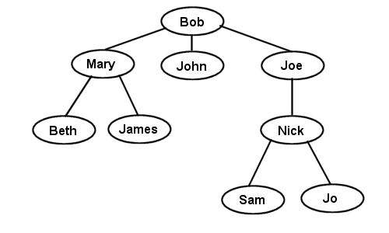
Family Tree Example with Structures
Each person has:
a name, age, social security number.
a father and a mother.
siblings
friends
daughters and sons
Given such a family tree, you can implement functions to find:
the grandparents of a given person,
the cousins of a given person,
the grandsons of a person,
etc.

Slide 20
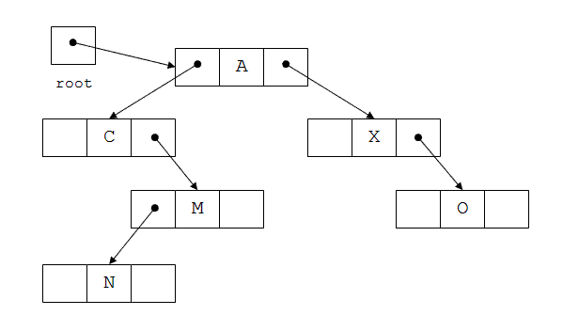
Structures & Pointers: Trees

Slide 21
Structures & Pointers: Trees
Traversal of a tree
Pre-order traversal:
A C M N X O
In-order traversal:
C N M A X O
Post-order traversal:
N M C O X A

Slide 22
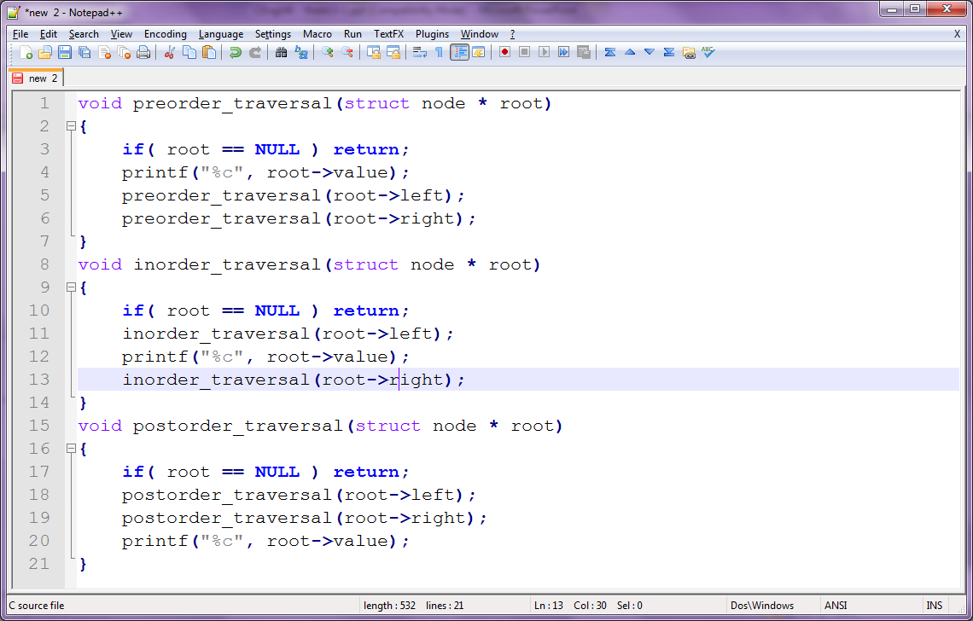
Structures & Pointers: Trees

Slide 23
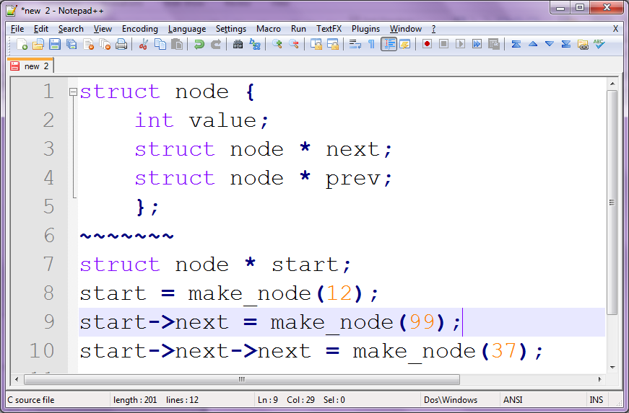
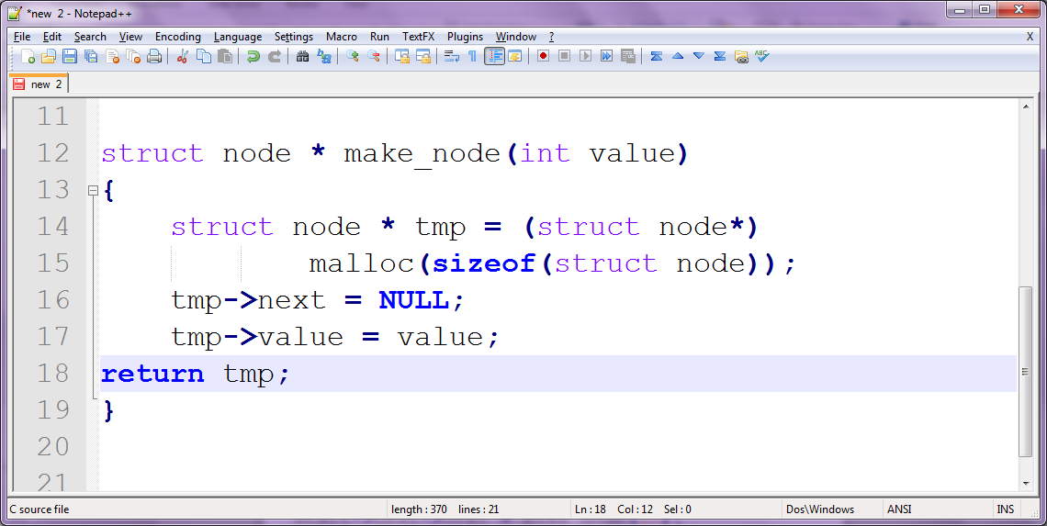
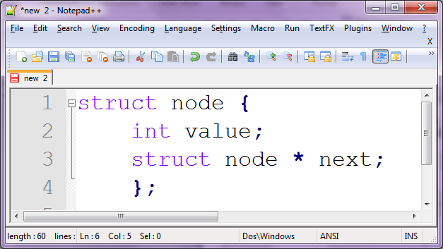

Structures & Pointers: Linked Lists

Slide 24
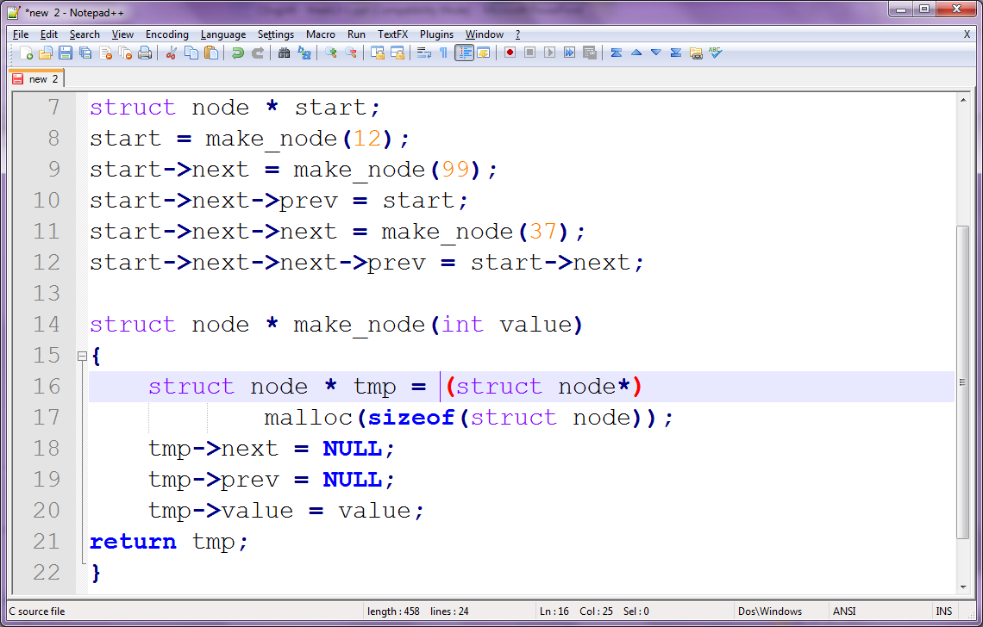
Structures & Pointers: Doubly Linked Lists

Slide 25
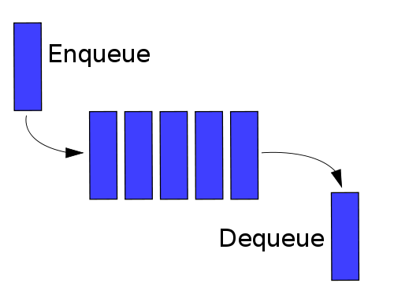
Application of Linked Lists: Queues

Slide 26
Problem 1
Write a C program to store the information of 30 students(name, roll number and marks) using structures. Then, display the information of students

Slide 27
Problem 2
Write a C program to add two distances entered by user in feet-inch system. To perform this program, create a structure containing elements feet and inch. [Note: 12 inch = 1feet]

Slide 28
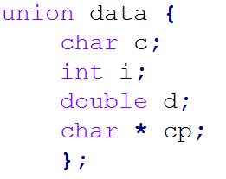
Unions
Allows different types of data to share the same memory location!
Variables c, I, d and cp share the same memory location
The size of data is the biggest of the following:
sizeof(c)
sizeof(i)
sizeof(d)
sizeof(cp)

Slide 29
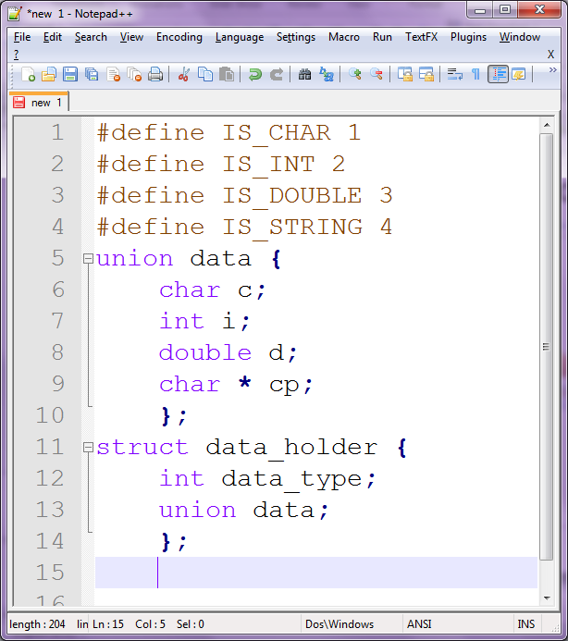
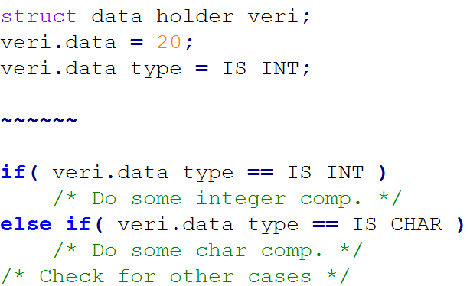
Unions

Slide 30
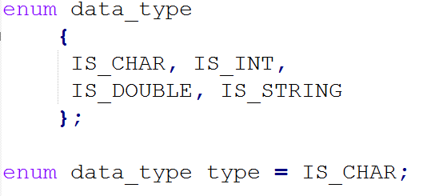
Enumerations

Slide 31
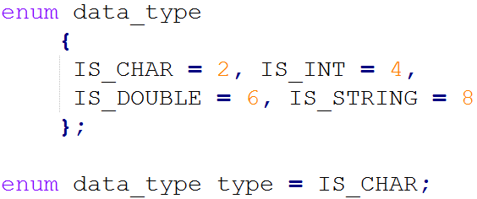
Enumerations
They are essentially integers.
The members get values starting from 0.
Values can be assigned to the members as follows:

Slide 32
struct vs union vs enum
What is the difference between them?
Why do we have them?

Slide 33
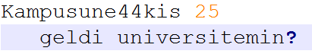
Example
Assume that you are given random set of characters of three types arbitrarily:
white space
alphabet letters
numbers
others
Orn:
The problem is to partition these different types of data into homogeneous parts & print the partitions when requested.

Slide 34
File Processing with C
Files
Files are just collections of bytes
One dimensional data from bytes
When we work with files, they are processed byte by byte.
010101000011101010101110101010101000011110101001…

Slide 35
Files & Streams
File: a stream of bytes
Text stream
Binary stream
Types of I/O:
Unbuffered
Fully buffered
Line buffered

Slide 36
Buffers & Buffering
Why do we have buffers?
Synchronization between processes or hardware components.
Ex: I/O, telecommunication networks.
Pooling for collecting data before processing:
Ex: printing, online video streaming.
…

Slide 37
FILE structure
When a file is opened, a FILE structure (called file pointer) is associated.
FILE holds the following which are necessary for controlling a stream:
the current position in the file
error indicator
end-of-file indicator
pointer to the associated buffer
After the processing is finished, FILE should be closed.

Slide 38
Standard Streams in C
When a program starts, it is given three streams:
stdin: terminal keyboard or an input file
stdout: screen or any re-directed file
stderr: screen or any re-directed file
Ex:
./my_prog < in.txt 1> out.txt 2> err.txt
Why do we have stderr?

Slide 39
Types of File Processing
Sequential
Read the bytes in sequence
Random Access
Read the bytes at a given position in the file

Slide 40
Opening and Closing Files in C
FILE* fopen(const char *filename, const char * filemode)
int fclose(FILE *filepointer)
int fflush(FILE *filepointer)
filemode can be:
“r” → Open file for reading.
“w” → Open file for writing. Delete old contents if it exists already.
“a” → Create a new file or append to the existing one.
“r+”, “w+”, “a+” → input & output
An additional “b” can be appended to the file mode for binary I/O.

Slide 41
Operations on Files
int remove(const char *filename)
int rename(
const char *oldname,
const char *newname)

Slide 42
Sequential File I/O in C
int fscanf(FILE *fp, const char * format, …)
int fprintf(FILE *fp, const char * format, …)
int fgetc(FILE *fp)
int fputc(int c, FILE *fp)
char *fgets(char *s, int n, FILE *fp)
char *fputs(const char *s, FILE *fp)

Slide 43
Random Access in C
int fseek(FILE *fp, long offset, int whence)
long ftell(FILE *fp)
void rewind(FILE *fp)
whence:
SEEK_SET, SEEK_END, SEEK_CUR
size_t fread(void *s, size_t sz, size_t n, FILE *fp)
size_t fwrite(const void *s, size_t sz, size_t n, FILE *fp)

Slide 44
Error Handling in File I/O
int feof(FILE *fp)
int ferror(FILE *fp)
void clearerr(FILE *fp)

Slide 45
More on Preprocessing
#ifdef
#endif

Slide 46
Example
Write a program that does simple encryption on a text file.

