Slide 1
Metin Madenciliği
LSTM ile metin Sınıflandırma
Hafta 10-2
Doç.Dr. YILMAZ KAYA

Slide 2
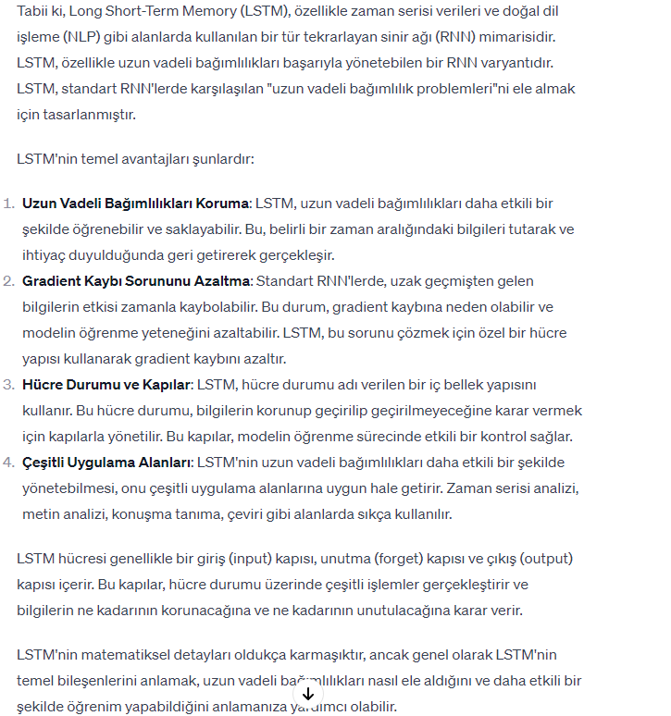

Slide 3
Veri Alma
filename = "factoryReports.csv";
data = readtable(filename,'TextType','string');
head(data)
data.Category = categorical(data.Category);
figure
histogram(data.Category);
xlabel("Class")
ylabel("Frequency")
title("Class Distribution")

Slide 4
Eğitim-Test Oranlarına Bölme
cvp = cvpartition(data.Category,'Holdout',0.2);
dataTrain = data(training(cvp),:);
dataValidation = data(test(cvp),:);
textDataTrain = dataTrain.Description;
textDataValidation = dataValidation.Description;
YTrain = dataTrain.Category;
YValidation = dataValidation.Category;
figure
wordcloud(textDataTrain);
title("Training Data")

Slide 5
Önişlemler
documentsTrain = preprocessText(textDataTrain);
documentsValidation = preprocessText(textDataValidation);
documentsTrain(1:5)

Slide 6
Dökümanların Sıralanması
enc = wordEncoding(documentsTrain);
documentLengths = doclength(documentsTrain);
figure
histogram(documentLengths)
title("Document Lengths")
xlabel("Length")
ylabel("Number of Documents")
sequenceLength = 10;
XTrain = doc2sequence(enc,documentsTrain,'Length',sequenceLength);
XTrain(1:5)
XValidation = doc2sequence(enc,documentsValidation,'Length',sequenceLength);

Slide 7
LSTM Ağı
inputSize = 1;
embeddingDimension = 50;
numHiddenUnits = 80;
numWords = enc.NumWords;
numClasses = numel(categories(YTrain));
layers = [ ...
sequenceInputLayer(inputSize)
wordEmbeddingLayer(embeddingDimension,numWords)
lstmLayer(numHiddenUnits,'OutputMode','last')
fullyConnectedLayer(numClasses)
softmaxLayer
classificationLayer]

Slide 8
LSTM ağı Özellikleri
options = trainingOptions('adam', ...
'MiniBatchSize',16, ...
'GradientThreshold',2, ...
'Shuffle','every-epoch', ...
'ValidationData',{XValidation,YValidation}, ...
'Plots','training-progress', ...
'Verbose',false);

Slide 9
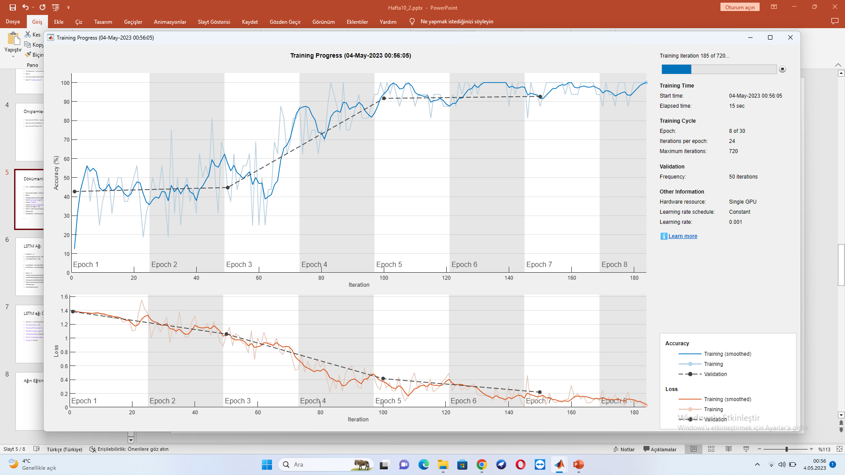
Ağın Eğitimi
net = trainNetwork(XTrain,YTrain,layers,options);

Slide 10
Yeni veriler için Tahmin
reportsNew = [ ...
"Coolant is pooling underneath sorter."
"Sorter blows fuses at start up."
"There are some very loud rattling sounds coming from the assembler."];
documentsNew = preprocessText(reportsNew);
XNew = doc2sequence(enc,documentsNew,'Length',sequenceLength);
labelsNew = classify(net,XNew)

Slide 11
Tüm Kod
Açıklamada
Notes:
filename = "factoryReports.csv";
data = readtable(filename,'TextType','string');
head(data)
data.Category = categorical(data.Category);
figure
histogram(data.Category);
xlabel("Class")
ylabel("Frequency")
title("Class Distribution")
cvp = cvpartition(data.Category,'Holdout',0.2);
dataTrain = data(training(cvp),:);
dataValidation = data(test(cvp),:);
textDataTrain = dataTrain.Description;
textDataValidation = dataValidation.Description;
YTrain = dataTrain.Category;
YValidation = dataValidation.Category;
figure
wordcloud(textDataTrain);
title("Training Data")
documentsTrain = preprocessText(textDataTrain);
documentsValidation = preprocessText(textDataValidation);
documentsTrain(1:5)
enc = wordEncoding(documentsTrain);
documentLengths = doclength(documentsTrain);
figure
histogram(documentLengths)
title("Document Lengths")
xlabel("Length")
ylabel("Number of Documents")
sequenceLength = 10;
XTrain = doc2sequence(enc,documentsTrain,'Length',sequenceLength);
XTrain(1:5)
XValidation = doc2sequence(enc,documentsValidation,'Length',sequenceLength);
%LSTM
inputSize = 1;
embeddingDimension = 50;
numHiddenUnits = 80;
numWords = enc.NumWords;
numClasses = numel(categories(YTrain));
layers = [ ...
sequenceInputLayer(inputSize)
wordEmbeddingLayer(embeddingDimension,numWords)
lstmLayer(numHiddenUnits,'OutputMode','last')
fullyConnectedLayer(numClasses)
softmaxLayer
classificationLayer]
options = trainingOptions('adam', ...
'MiniBatchSize',16, ...
'GradientThreshold',2, ...
'Shuffle','every-epoch', ...
'ValidationData',{XValidation,YValidation}, ...
'Plots','training-progress', ...
'Verbose',false);
net = trainNetwork(XTrain,YTrain,layers,options);
reportsNew = [ ...
"Coolant is pooling underneath sorter."
"Sorter blows fuses at start up."
"There are some very loud rattling sounds coming from the assembler."];
documentsNew = preprocessText(reportsNew);
XNew = doc2sequence(enc,documentsNew,'Length',sequenceLength);
labelsNew = classify(net,XNew)
function documents = preprocessText(textData)
% Tokenize the text.
documents = tokenizedDocument(textData);
% Convert to lowercase.
documents = lower(documents);
% Erase punctuation.
documents = erasePunctuation(documents);
end

