Slide 1
Metin Madenciliği
Doç.Dr. Yılmaz KAYA
Hafta 27
1D-CNN ile Sınıflandırma

Slide 2
Bu örnekte 1D-CNN ile Metin sınıflandırma işlemi gerçekleştirilmiştir.

Slide 3
Verinin Alınması
data = readtable("factoryReports.csv");
head(data)
cvp = cvpartition(data.Category,Holdout=0.2);
dataTrain = data(training(cvp),:);
dataValidation = data(test(cvp),:);

Slide 4
Önişlemler
documentsTrain = preprocessText(dataTrain.Description);
TTrain = categorical(dataTrain.Category);
classNames = unique(TTrain)
numObservations = numel(TTrain)
documentsValidation = preprocessText(dataValidation.Description);
TValidation = categorical(dataValidation.Category);
function documents = preprocessText(textData)
documents = tokenizedDocument(textData);
documents = lower(documents);
end

Slide 5
Belgeleri 1D-CNN için vektörlere dönüştürme (Tek boyutlu hale getirme)
enc = wordEncoding(documentsTrain);
numWords = enc.NumWords
XTrain = doc2sequence(enc,documentsTrain);
XValidation = doc2sequence(enc,documentsValidation);

Slide 6
1D-CNN Ağı Tanımı
Kod Açıklamada
Notes:
embeddingDimension = 100;
ngramLengths = [2 3 4 5];
numFilters = 200;
minLength = min(doclength(documentsTrain));
layers = [
sequenceInputLayer(1,MinLength=minLength)
wordEmbeddingLayer(embeddingDimension,numWords,Name="emb")];
lgraph = layerGraph(layers);
numBlocks = numel(ngramLengths);
for j = 1:numBlocks
N = ngramLengths(j);
block = [
convolution1dLayer(N,numFilters,Name="conv"+N,Padding="same")
batchNormalizationLayer(Name="bn"+N)
reluLayer(Name="relu"+N)
dropoutLayer(0.2,Name="drop"+N)
globalMaxPooling1dLayer(Name="max"+N)];
lgraph = addLayers(lgraph,block);
lgraph = connectLayers(lgraph,"emb","conv"+N);
end
numClasses = numel(classNames);
layers = [
concatenationLayer(1,numBlocks,Name="cat")
fullyConnectedLayer(numClasses,Name="fc")
softmaxLayer(Name="soft")
classificationLayer(Name="classification")];
lgraph = addLayers(lgraph,layers);
for j = 1:numBlocks
N = ngramLengths(j);
lgraph = connectLayers(lgraph,"max"+N,"cat/in"+j);
end
figure
plot(lgraph)
title("Network Architecture")

Slide 7
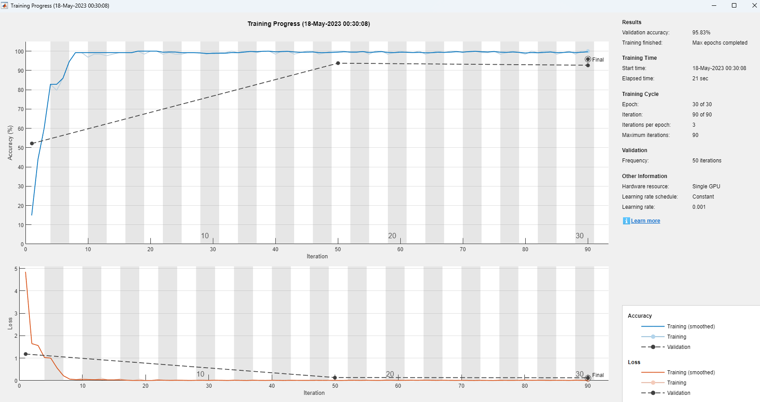
Ağın Eğitimi
options = trainingOptions("adam", ...
MiniBatchSize=128, ...
ValidationData={XValidation,TValidation}, ...
OutputNetwork="best-validation-loss", ...
Plots="training-progress", ...
Verbose=false);
net = trainNetwork(XTrain,TTrain,lgraph,options);

Slide 8
Ağın Test Edilmesi ve Karışıklık Matrisi
YValidation = classify(net,XValidation);
figure
confusionchart(TValidation,YValidation)
accuracy = mean(TValidation == YValidation)

Slide 9
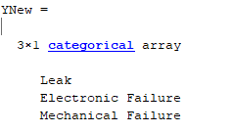
Yeni Veriler için Tahminler
reportsNew = [
"Coolant is pooling underneath sorter."
"Sorter blows fuses at start up."
"There are some very loud rattling sounds coming from the assembler."];
documentsNew = preprocessText(reportsNew);
XNew = doc2sequence(enc,documentsNew);
YNew = classify(net,XNew)

Slide 10
Tüm Kod
açıklamada
Notes:
data = readtable("factoryReports.csv");
head(data)
cvp = cvpartition(data.Category,Holdout=0.2);
dataTrain = data(training(cvp),:);
dataValidation = data(test(cvp),:);
documentsTrain = preprocessText(dataTrain.Description);
TTrain = categorical(dataTrain.Category);
classNames = unique(TTrain)
numObservations = numel(TTrain)
documentsValidation = preprocessText(dataValidation.Description);
TValidation = categorical(dataValidation.Category);
enc = wordEncoding(documentsTrain);
numWords = enc.NumWords
XTrain = doc2sequence(enc,documentsTrain);
XValidation = doc2sequence(enc,documentsValidation);
embeddingDimension = 100;
ngramLengths = [2 3 4 5];
numFilters = 200;
minLength = min(doclength(documentsTrain));
layers = [
sequenceInputLayer(1,MinLength=minLength)
wordEmbeddingLayer(embeddingDimension,numWords,Name="emb")];
lgraph = layerGraph(layers);
numBlocks = numel(ngramLengths);
for j = 1:numBlocks
N = ngramLengths(j);
block = [
convolution1dLayer(N,numFilters,Name="conv"+N,Padding="same")
batchNormalizationLayer(Name="bn"+N)
reluLayer(Name="relu"+N)
dropoutLayer(0.2,Name="drop"+N)
globalMaxPooling1dLayer(Name="max"+N)];
lgraph = addLayers(lgraph,block);
lgraph = connectLayers(lgraph,"emb","conv"+N);
end
numClasses = numel(classNames);
layers = [
concatenationLayer(1,numBlocks,Name="cat")
fullyConnectedLayer(numClasses,Name="fc")
softmaxLayer(Name="soft")
classificationLayer(Name="classification")];
lgraph = addLayers(lgraph,layers);
for j = 1:numBlocks
N = ngramLengths(j);
lgraph = connectLayers(lgraph,"max"+N,"cat/in"+j);
end
figure
plot(lgraph)
title("Network Architecture")
options = trainingOptions("adam", ...
MiniBatchSize=128, ...
ValidationData={XValidation,TValidation}, ...
OutputNetwork="best-validation-loss", ...
Plots="training-progress", ...
Verbose=false);
net = trainNetwork(XTrain,TTrain,lgraph,options);
YValidation = classify(net,XValidation);
figure
confusionchart(TValidation,YValidation)
accuracy = mean(TValidation == YValidation)
reportsNew = [
"Coolant is pooling underneath sorter."
"Sorter blows fuses at start up."
"There are some very loud rattling sounds coming from the assembler."];
documentsNew = preprocessText(reportsNew);
XNew = doc2sequence(enc,documentsNew);
YNew = classify(net,XNew)
function documents = preprocessText(textData)
documents = tokenizedDocument(textData);
documents = lower(documents);
end

