Slide 1
Metin Madenciliği
Doç. Dr. Yılmaz KAYA
Öznitelik Çıkarımı
Kelime Çantası, Kelime Frekans, Ters Metin Frekans Skorlama

Slide 2
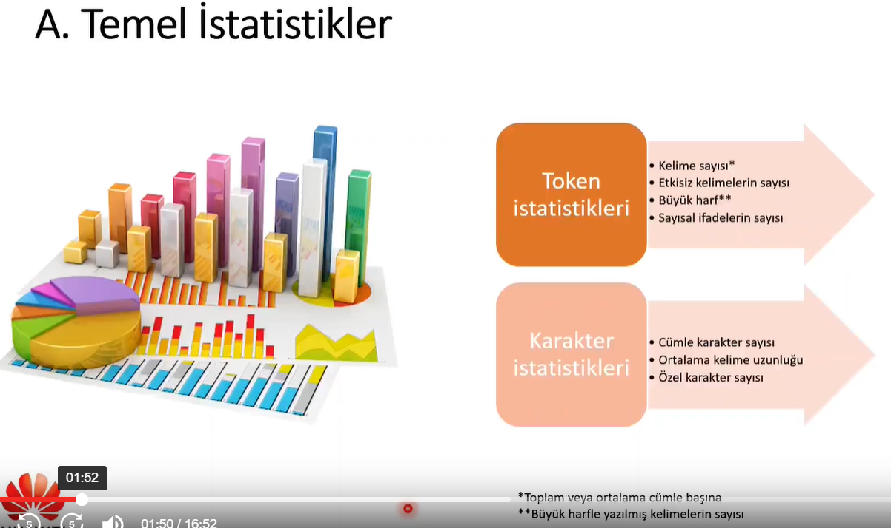

Slide 3
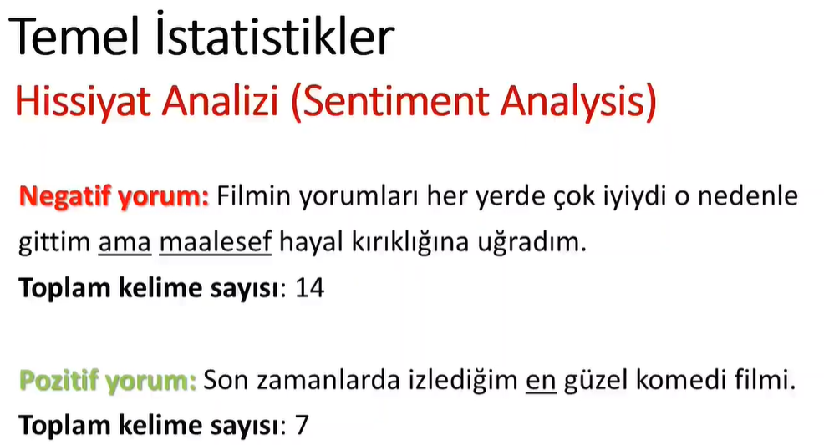

Slide 4
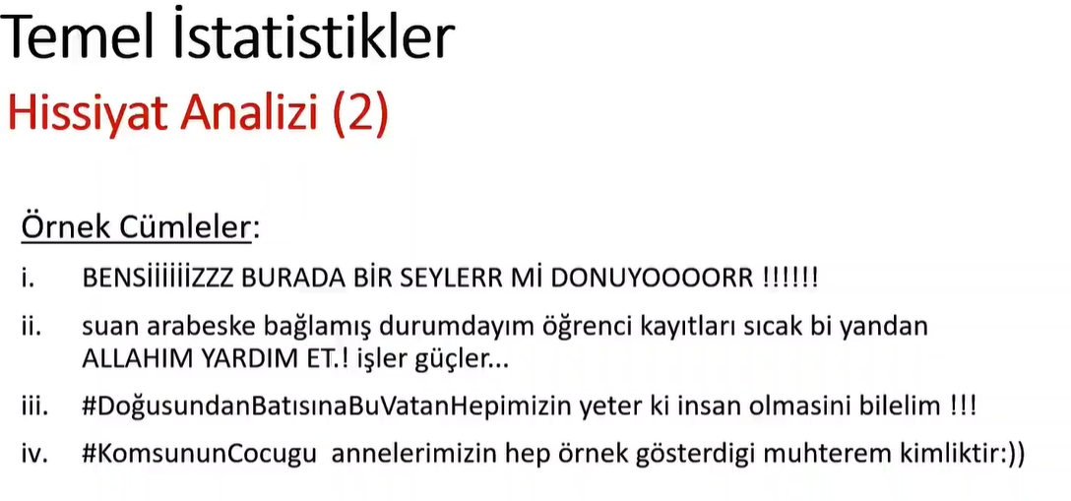

Slide 5
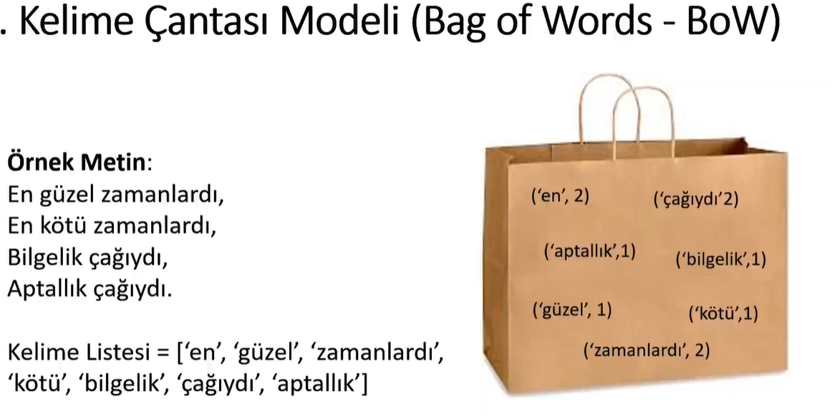

Slide 6
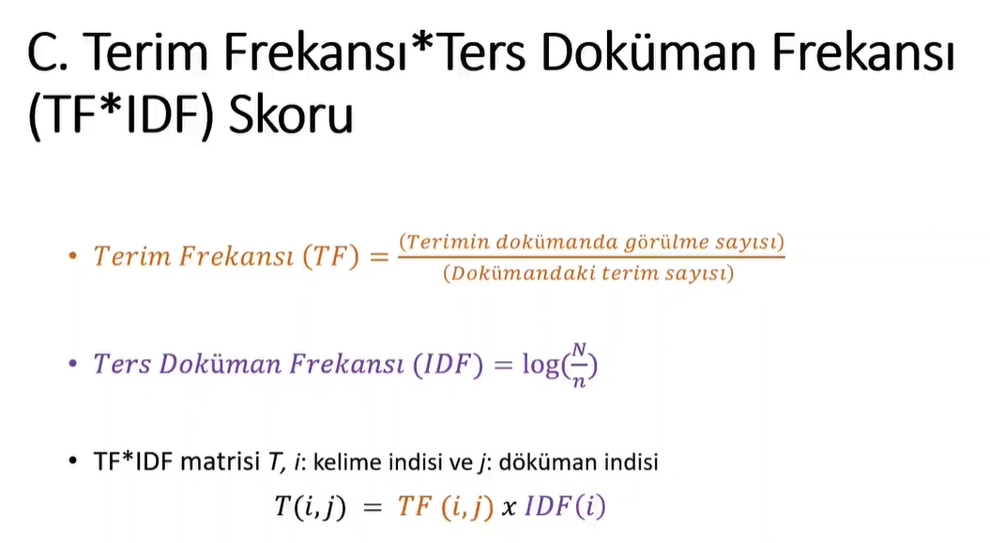

Slide 7
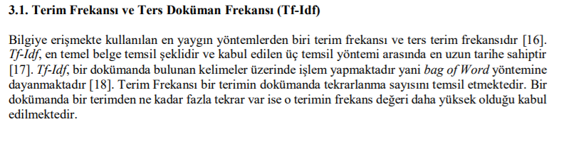
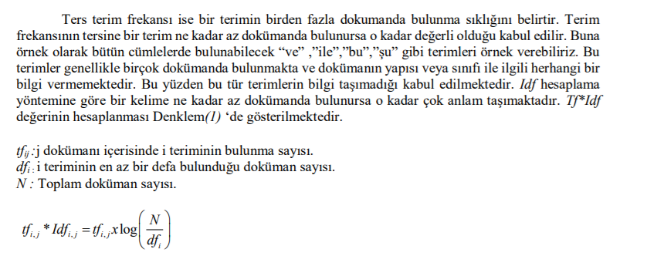

Slide 8
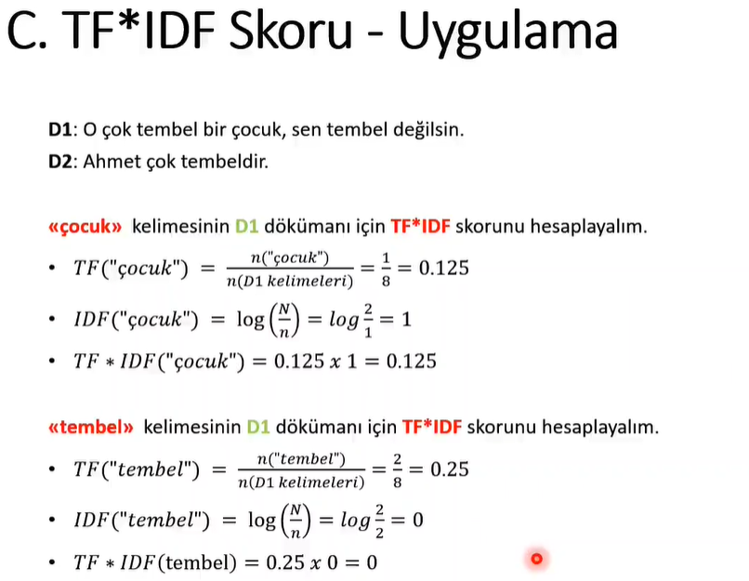
 | K1 | K2 | K3 | K4 | K5
D1
D2
D3
D4

Slide 9
Matlab Uygulamaları-1
filename = "sonnetsPreprocessed.txt";
str = extractFileText(filename);
textData = split(str,newline);
documents = tokenizedDocument(textData);
bag = bagOfWords(documents)
M = tfidf(bag);
full(M(1:10,1:10))

Slide 10
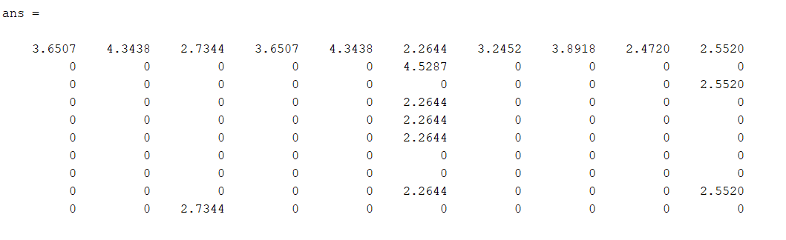

Slide 11
Yeni Belgelerden tf-idf Matrisi Oluşturun
filename = "sonnetsPreprocessed.txt";
str = extractFileText(filename);
textData = split(str,newline);
documents = tokenizedDocument(textData);
bag = bagOfWords(documents)
newDocuments = tokenizedDocument([
"what's in a name? a rose by any other name would smell as sweet."
"if music be the food of love, play on."]);
M = tfidf(bag,newDocuments)

Slide 12
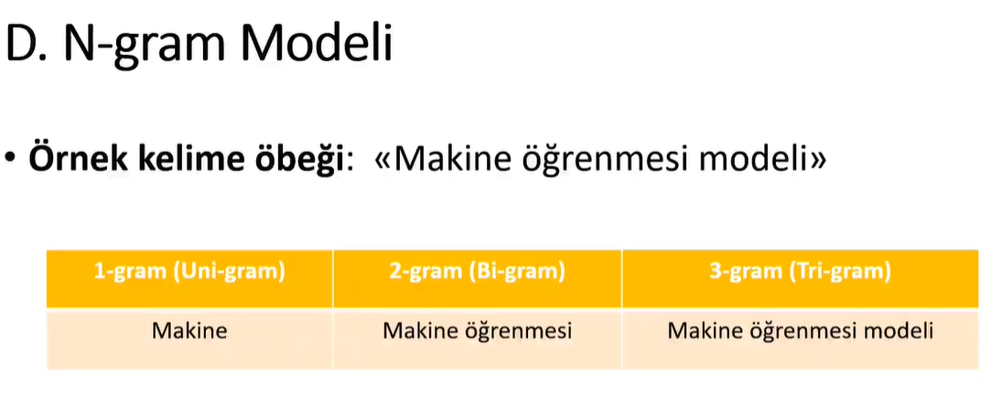

Slide 13
