Slide 1
Metin Madenciliği
Doç.Dr. YILMAZ KAYA
Hafta 9
Matlab String Fonksiyonlar

Slide 2
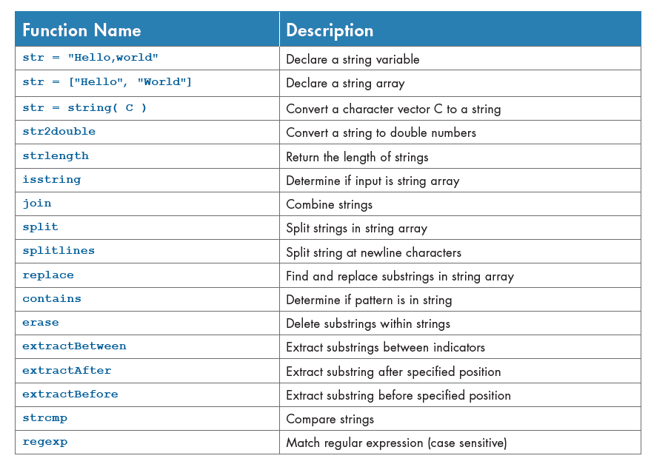

Slide 3
str2double
X = str2double('1,200.34')
str = {'2.718','3.1416';
'137','0.015'};
X = str2double(str)

Slide 4
strlength
str = "Hello, World"
L = strlength(str)

Slide 5
isstring
chr = 'Mary Jones'
tf = isstring(chr)

Slide 6
join
str = ["Carlos","Sada";
"Ella","Olsen";
"Diana","Lee"]
newStr = join(str)

Slide 7
split
names = ["Mary Butler";
"Santiago Marquez";
"Diana Lee"]
names = split(names)

Slide 8
splitlines
str = "In Xanadu did Kubla Khan";
str = str + "\n" + "A stately pleasure-dome decree"
str = compose(str)
newStr = splitlines(str)

Slide 9
replace
str = "Hide the numbers in: (508) 555-1234"
pat = digitsPattern(1)
newStr = replace(str,pat,"#")

Slide 10
contains
str = ["Mary Ann Jones","Paul Jay Burns","John Paul Smith"]
pat = "Paul";
TF = contains(str,pat)

Slide 11
erase
str = ["the quick brown fox jumps";
"over the lazy dog"]
newStr = erase(str,"the ")
match = ["the ","quick ","lazy "];
newStr = erase(str,match)

Slide 12
extractBetween
str = "The quick brown fox"
newStr = extractBetween(str,"quick "," fox")
str = ["The quick brown fox jumps";"over the lazy dog"]
newStr = extractBetween(str,["quick ";"the "],[" fox";" dog"])

Slide 13
extractAfter
str = "The quick brown fox"
newStr = extractAfter(str,"quick ")
str = ["The quick brown fox jumps";"over the lazy dog"]
newStr = extractAfter(str,["quick ";"the "])

Slide 14
extractBefore
str = "The quick brown fox"
newStr = extractBefore(str," brown")
str = ["The quick brown fox jumps";"over the lazy dog"]
newStr = extractBefore(str,[" brown";" dog"])

Slide 15
strcmp
s1 = 'Yes';
s2 = 'No';
tf = strcmp(s1,s2)
s1 = 'upon';
s2 = {'Once','upon';
'a','time'};
tf = strcmp(s1,s2)

