Slide 1





2024-2025 Spring Semester
AUTOMATED UI TESTING
Student: Nurcan Yılmaz
Student ID: B201202019
Department: Software Engineering
Supervisor: Dr. Beyza Eken
Sakarya University • Faculty of Computer and Information Sciences
page 01

Slide 2
Nurcan Yılmaz & Dr.Beyza Eken
CONTENTS
1- Introduction
The criticality of quality in web applications
5- Proposed Framework
Architecture & Technologies
2- Problem Statement
Challenges in modern web testing
6- Experimental Results
Performance & Efficiency Gains
3- Research Objectives
Addressing Testing Definitions
7- Conclusion & Future Work
Impact & Next Steps
4- Research Methodology
Approach & Scope
8- Questions & Thank You
Q&A Session
page 02
https://github.com/yilmaznurcan/SWE402-SeniorDesignProject

Slide 3
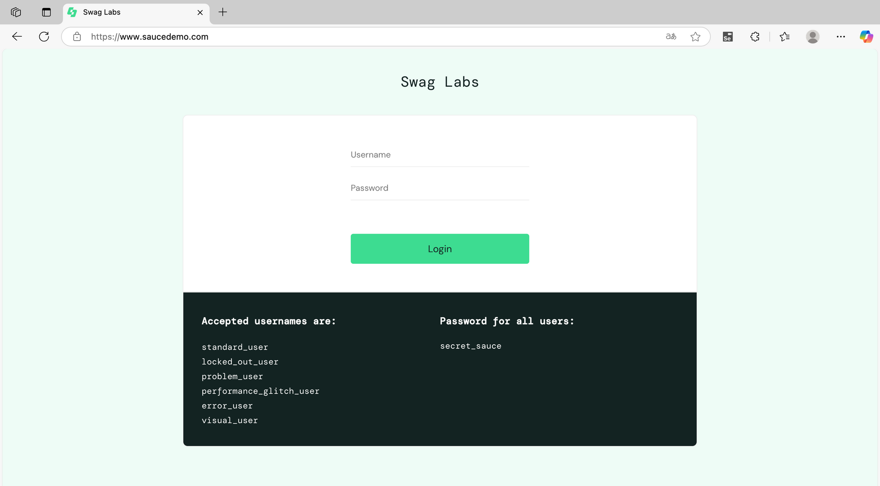
Nurcan Yılmaz & Dr.Beyza Eken
1. INTRODUCTION:
THE CRITICALITY OF QUALITY IN WEB APPLICATIONS
Web Development & E-commerce
Rapid evolution and high stakes environment where quality directly impacts business success and customer satisfaction.
Quality Assurance
Paramount for revenue generation and customer satisfaction. Poor quality leads to lost customers and revenue.
Limitations of Manual Testing
Inefficiency and scalability issues make manual testing inadequate for modern web applications.
Introduction to Automated Testing
A necessary evolution to address the challenges of modern web application testing at scale.
https://github.com/yilmaznurcan/SWE402-SeniorDesignProject
page 03

Slide 4






Nurcan Yılmaz & Dr.Beyza Eken
2. PROBLEM STATEMENT:
CHALLENGES IN MODERN WEB TESTING
Scalability Challenges
Manual processes don't scale with application growth, leading to bottlenecks in testing workflows.
Regression Testing Overhead
Costly and inefficient manual regression testing with frequent application updates.
Test Data Management Complexity
Difficult to manage diverse test data scenarios manually, leading to incomplete coverage.
Cross-browser Compatibility Issues
Inconsistent behavior across different browsers creates reliability concerns for end users.
Reporting & Traceability Limitations
Lack of comprehensive insights and detailed reporting in manual testing approaches.
https://github.com/yilmaznurcan/SWE402-SeniorDesignProject
page 04

Slide 5

Nurcan Yılmaz & Dr.Beyza Eken
3. RESEARCH OBJECTIVES:
ADDRESSING TESTING DEFICIENCIES
Primary Objectives
Framework Architecture Design
Create scalable and maintainable testing architecture that can grow with application complexity.
Advanced Reporting Integration
Provide detailed insights and comprehensive test reporting capabilities.
Cross-browser Compatibility Validation
Ensure consistent functionality across different browsers and browser versions.
Secondary Objectives
Page Object Model Evaluation
Assess the effectiveness of POM design pattern in test maintenance.
Parallel Execution Implementation
Reduce overall testing time through efficient parallel test execution strategies.
QA Efficiency Impact Assessment
Measure the impact on overall quality assurance process efficiency.
Comprehensive Test Coverage
Cover critical workflows and user journeys in e-commerce applications.
https://github.com/yilmaznurcan/SWE402-SeniorDesignProject
page 05

Slide 6


Nurcan Yılmaz & Dr.Beyza Eken
4. RESEARCH METHODOLOGY:
APPROACH & SCOPE
Approach
1.
2.
3.
4.
Literature Review
Framework Design
Experimental Validation
Case Study Analysis
Analysis of existing testing frameworks and methodologies
Framework Design
Architecture design and implementation planning
Testing on SauceDemo platform with real scenarios
Performance evaluation and results analysis
page 06
https://github.com/yilmaznurcan/SWE402-SeniorDesignProject

Slide 7

Nurcan Yılmaz & Dr.Beyza Eken
Scope
Limitations
Web-based E-commerce UI Testing
Desktop browsers: Chrome and Edge
Critical user workflows validation
Automated regression testing
No mobile application testing
No performance testing coverage
No security testing implementation
No API or database testing
page 07
https://github.com/yilmaznurcan/SWE402-SeniorDesignProject

Slide 8






Nurcan Yılmaz & Dr.Beyza Eken
5. PROPOSED FRAMEWORK:
ARCHITECTURE & TECHNOLOGIES
Architecture & Technologies
Modular & Layered Architecture: Separation of Concerns
Selenium WebDriver: Browser automation engine
Maven: Dependency management & build automation
JUnit 5: Core testing framework with parallel execution
Log4j2: High-performance logging system
Allure Reporting: Comprehensive test reports
https://github.com/yilmaznurcan/SWE402-SeniorDesignProject
page 08

Slide 9
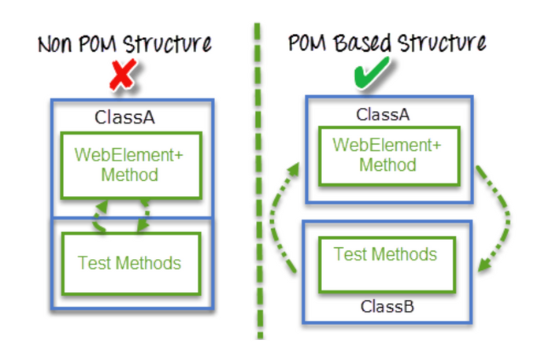
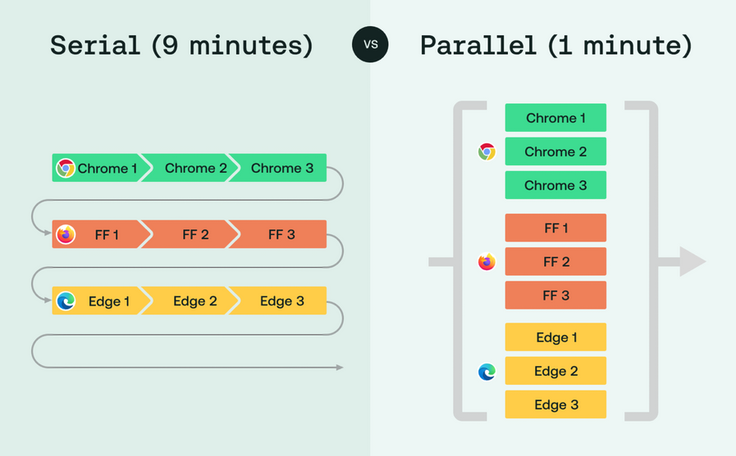
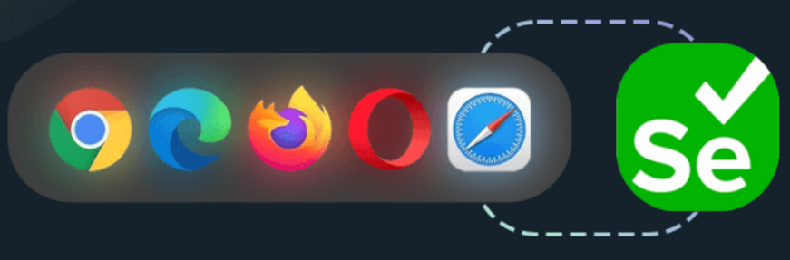
Nurcan Yılmaz & Dr.Beyza Eken
Core Implementations
Configuration-Driven Test Data: Flexible test data management
Page Object Model (POM): Enhanced reusability and maintainability
Parallel Execution: Improved test execution speed
Utility Components: BaseTest, ConfigReader, WaitingTimes
Advanced Reporting: Detailed test insights and analytics
Cross-Browser Testing: Chrome and Edge compatibility
Robust Error Handling: Comprehensive exception management
https://github.com/yilmaznurcan/SWE402-SeniorDesignProject
page 09

Slide 10
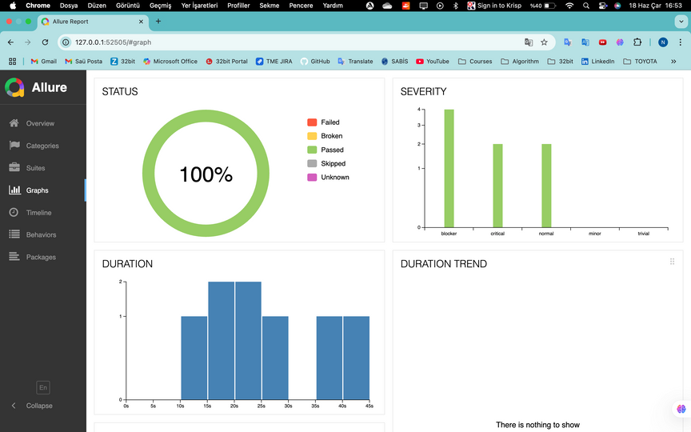
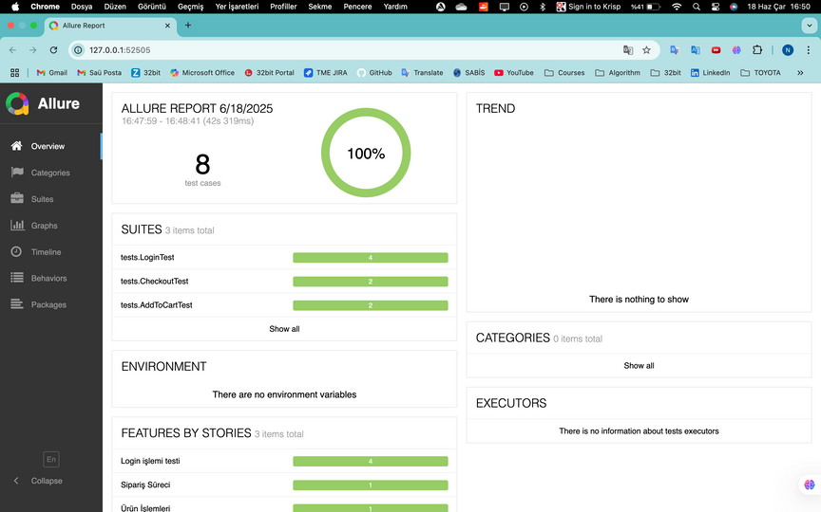
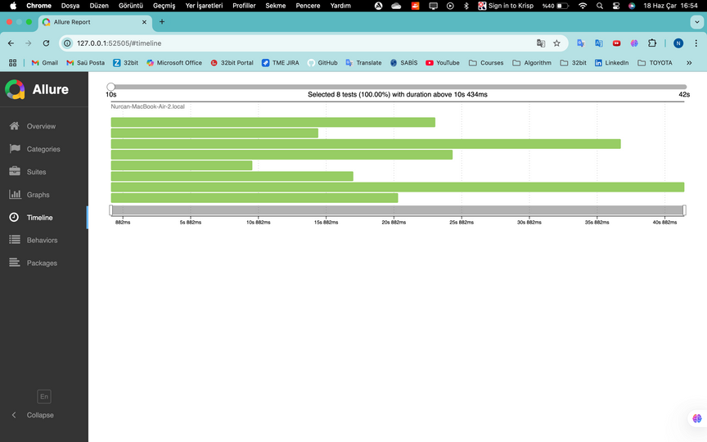
Nurcan Yılmaz & Dr.Beyza Eken
6. EXPERIMENTAL RESULTS:
PERFORMANCE & EFFICIENCY GAINS
Test Platform: SauceDemo (e-commerce workflows: Login, Cart, Checkout)
Cross-browser Compatibility: Consistent performance across Chrome & Edge browsers
page 10
https://github.com/yilmaznurcan/SWE402-SeniorDesignProject

Slide 11


Nurcan Yılmaz & Dr.Beyza Eken
7. CONCLUSION & FUTURE WORK:
IMPACT & NEXT STEPS
Summary of Contributions
Scalable Architecture
Designed specifically for e-commerce applications with modular approach
Advanced Parallel Testing
Implemented efficient parallel execution reducing overall testing time
Cross-browser Validation
Comprehensive testing across multiple browser environments
Modern Reporting & Logging
Integrated advanced reporting with detailed insights and analytics
Reusable Design
Page Object Model implementation ensuring maintainability and reusability
https://github.com/yilmaznurcan/SWE402-SeniorDesignProject
page 11

Slide 12

Nurcan Yılmaz & Dr.Beyza Eken
Future Work
CI/CD Pipeline Integration
Seamless integration with continuous integration and deployment processes
AI-driven Test Case Generation
Machine learning algorithms for automatic test case creation and optimization
Mobile Application Testing Extension
Extending framework capabilities to support mobile application testing
Performance Testing Integration
Adding performance and load testing capabilities to the framework
API Testing Support
Comprehensive API testing integration for full-stack validation
https://github.com/yilmaznurcan/SWE402-SeniorDesignProject
page 12

Slide 13
Nurcan Yılmaz & Dr.Beyza Eken
THANK YOU!
Questions & Discussion
Contact Information
Nurcan Yılmaz: nurcan.yilmaz5@ogr.sakarya.edu.tr
Dr. Beyza Eken: beken@sakarya.edu.tr
I am now open to any questions you may have.
https://github.com/yilmaznurcan/SWE402-SeniorDesignProject
page 13

