Slide 1
ALGORITHMIC TRADING GROUP PROJECT
Contest-Horizon
Equity-Gold Vote
LIVE MODEL
90 / 0 / 10 / 0
ACWI / AGG / GLD / BSV
A systematic ETF allocation model for the June live competition
Rule-based.
Weekly.
Long-only.
Team 05 | Yi Long, Fouad Al Khadra, Riyad Mazari | June 30, 2026

Slide 2
A. STRATEGY OBJECTIVE
Strategy objective: pursue upside with discipline
Our goal under the assignment constraints:
maximize contest-period upside without losing rule discipline.
Growth first
Rule-based
Aggressive
Auditable
one-month live window
same Friday process
high ACWI, not 100%
data in, CSV out
Not a minimum-volatility portfolio. A contest-ready allocation with explainable risk.
02

Slide 3
A. FINANCIAL RATIONALE
Financial rationale: three asset roles
ACWI
GLD
AGG / BSV
Growth engine
Diversifier
Defense layer
Global equity beta
Non-equity risk source
Bond / Treasury ballast
Default return driver
Small normal sleeve
Stress-regime fallback
Normal markets: seek return. Stress markets: rotate into defense.
03

Slide 4
B. METHODOLOGY
Methodology: two states, four signals
Normal state
Defensive state
ACWI vs GLD vote
Normal formula
Trigger
Response
Momentum
3M
ACWI = 50% + 10% x votes
ACWI below 200D
+
negative 3M return
Reduce ACWI
rotate to
GLD / AGG / BSV
Persistence
6M
Vote ladder
Trend
200D
0
1
2
3
4
50
60
70
80
90
Risk
63D
lower row = ACWI %;
GLD receives balance
25pp weekly turnover cap
Aggressive by default, defensive by rule.
04

Slide 5
B. METHODOLOGY
Implementation: weekly model pipeline
Prices
→
Signals
→
Regime
→
Target
→
Rebalance
→
CSV
Stress trigger
Defensive rotation
Turnover rule
ACWI below 200D average and negative 3M return
Move mechanically toward GLD, AGG, and BSV
If total change exceeds 25pp, the move is scaled toward the model target.
05

Slide 6
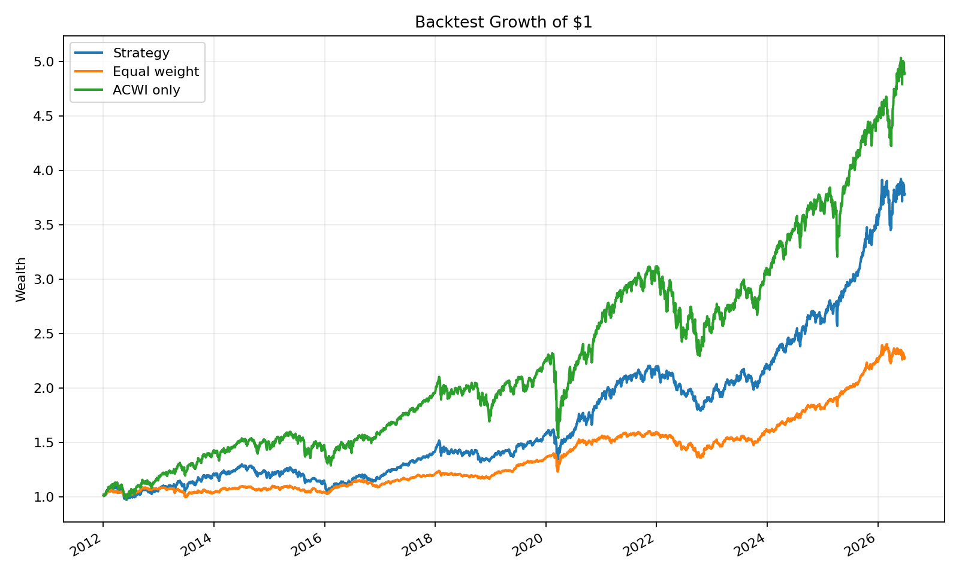
C. BACKTESTING
Backtest: return-seeking, not pure equity
2012–2026 backtest
Portfolio
Ann. Ret
Vol
Sharpe
Strategy
9.65%
11.36%
0.85
Equal weight
5.88%
6.77%
0.87
ACWI only
11.61%
16.20%
0.72
Interpretation: the strategy gives up some upside versus ACWI-only to reduce drawdown, while materially outperforming equal weight in return.
06

Slide 7
C. ROBUSTNESS & VALIDATION
Validation: contest-horizon windows
20-trading-day windows approximate the June live period.
Portfolio
Mean 20D
Median 20D
5% tail
Positive rate
Strategy
0.87%
1.09%
-4.58%
66.1%
Equal weight
0.55%
0.50%
-2.27%
63.2%
ACWI only
1.00%
1.47%
-6.15%
66.7%
Key trade-off
ACWI-only has the highest historical 20D mean, but the strategy has a materially better 5% tail and a defendable allocation rule.
07

Slide 8
D. LIVE IMPLEMENTATION
Live implementation: submissions and June readout
May 29 / Jun 01
Jun 05
Jun 12
Jun 19
Jun 26
90 / 0 / 10 / 0
90 / 0 / 10 / 0
90 / 0 / 10 / 0
90 / 0 / 10 / 0
90 / 0 / 10 / 0
Estimated strategy return
ACWI
GLD
Latest allocation
-2.17%
-1.08%
-11.64%
90 / 0 / 10 / 0
Jun 01 to Jun 29
Jun 01 to Jun 29
Jun 01 to Jun 29
ACWI / AGG / GLD / BSV
What worked
What hurt
ACWI kept stronger medium-term momentum, trend, and volatility than GLD.
The 10% GLD sleeve reduced pure-equity upside during a weak gold tape.
08

