Slide 1
STB
Q2

Slide 2
Qns 2a
Data Analysis and
key takeaways
EDA:
Nationality Analysis (Focus on top 5) [‘a5’]
Percentage of visitors per nationality
Percentage of total spending per nationality
Average spending per nationality
Purpose against nationality
Travel Terminal Analysis
Approach on where to advertise high spenders

Slide 3
Percentage of visitors per nationality
Indonesia
China
India
Australia
Malaysia
The Top 5 countries exceed more than 50% of the entire visitors per nationality visiting Singapore.
Indonesia and China combine takes up more than 25% of all visitors

Slide 4
The Top 5 expenditure from the above countries exceeds more than half of the total expenditure from other countries
Percentage of total expenditure per nationality
China (Exceeded Indonesia)
Indonesia
India
Australia
Japan (Exceed Malaysia)
Suggestions:
Reduce language barriers with language translation information within cultural, accommodations and fnb to reduce inertia to spend

Slide 5
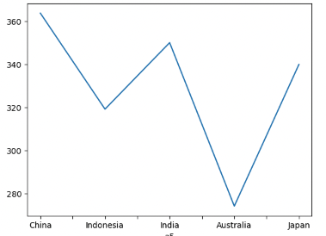
The average expenditure per nationality per night for the top 5 countries with the most visitors
Percentage of total expenditure per nationality
Average Expenditure per nationality per night stay
China
India
Japan
Indonesia
Australia
Top 5 Countries
Suggestions:
The type of dining options, cultural, accommodations and shops could be better focus to attract high spending on China, Indian and Japan tourist

Slide 6
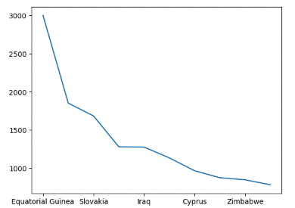
Highest average expenditure per nationality per night
Highest Average expenditure per nationality
Average Expenditure per nationality per night stay
1. Equatorial Guinea $3000
2. Sao Tome and Principe $1849
3. Slovakia $1681
4. Morocco $1277
5. Iraq $1274
6. Jordan $1131
7. Cyprus $963
Top 5 Countries
Observations:
High net worth individual from EMEA regions with much higher willingness to spend per night stay could range between 800-1800 and hit highs of 3000 SGD
Suggestions:
Ensure that high quality luxury accommodations are made possible to encourage more spending

Slide 7
Investigating Purpose against nationality
Purpose vs Nationality
Observations:
Large number of Indonesians seeking healthcare related services within Singapore
Large number of Indonesians and China visitor seeking for business related as compared to other nationality

Slide 8
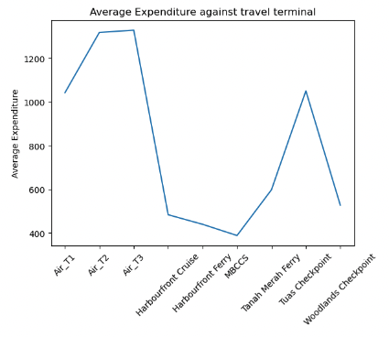
Travel Terminal Analysis
Suggestions:
Air Terminal T2, T3 have highest average expenditure but much lower at T1. Could investigate cause link to poor infrastructure for access or lack of advertising
Surprising high average expenditure from Tuas checkpoint.

Slide 9
Qns 2B
Hotel & Travel companions analysis
Assumptions:
Length of stay > 1
Find out average cost per night for individual
Drop outliers
Average cost per night on average of citizens ( Might take median due to skewness)
Form ranking of hotel through pricing
High quality hotels attract a certain group more than others
Plot graph to observe difference in groups
Determine Correlation

Slide 10
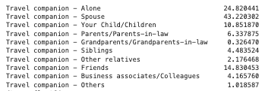
Correlation between travel companion & hotel
Overall Distribution

Slide 11
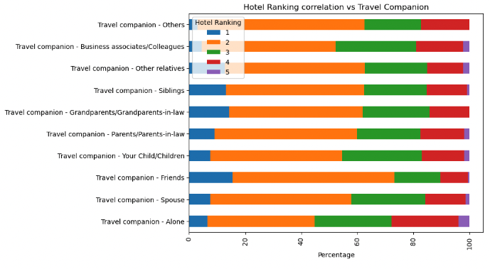
Correlation between travel companion & hotel
Overall Distribution
Ranking of hotel according to average price per night.
Observations: 1. Rank 2 hotels maintain a relative constant percentage throughout all groups
2. Rank 1 and 5 have an inverse relationship especially noticeable for ‘Alone’ and ‘Friends’ category
Main Observations
The correlation seems to imply that there is higher willingness to spend on luxury hotels when alone/business (likely paid by business) or with elders within family.

Slide 12
Qns 2C
Hotel & Travel companions analysis
Purpose Analysis [‘pov5’, ‘b13b_firstmention’]
Breakdown which type of “purpose” spends more money
Profession Analysis[‘f3’]
Total spending per profession

Slide 13
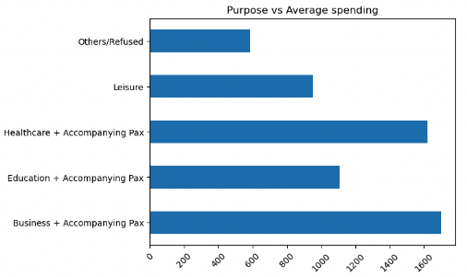
Average Spending against purpose
Overall Distribution
Observations: 1. Business and Healthcare are 2 high spending areas
Suggestions
1. Increase amount of business events and conference to attract higher number of
Individuals to visit Singapore boosting the overall spending for business
2. Target more individuals from Indonesia and China seeking medical to increase overall total spending.

Slide 14
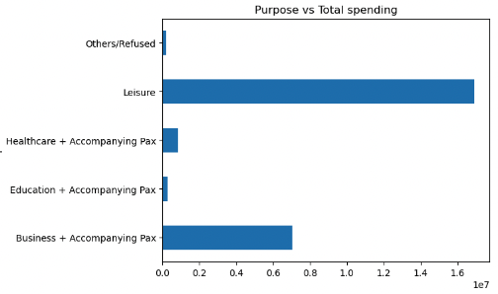
Total Spending against purpose
Overall Distribution
Observations: ’Leisure’ carries the highest total amount due to huge percentage of visitors visiting for leisure.
Suggestion
Average Spending for leisure is much lower than business. Incentives higher quality events might change the overall spending behavior of visitors coming for leisure

Slide 15
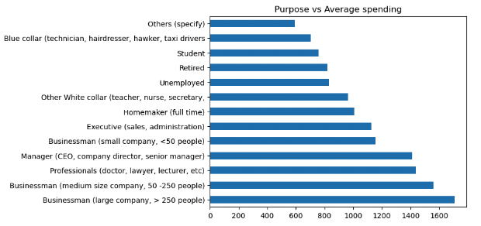
Average Spending against Profession
Overall Distribution
Observations:
Most groups follows the expected behavior as average expenditure is likely a factor of overall income.
‘Homemaker (full time)’ does not follow this theory their income might come from other sources such as their spouse.
Suggestion
Events targeting professional seeking improvement and forming connection for business venture would be a good idea to increase spending for top 5 of groups (business/working professional)

Slide 16
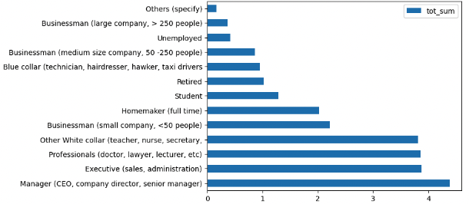
Total Spending against Profession
Overall Distribution
Observations:
Businessman (medium, large company) have a relative low total despite having a high average spending
Suggestion
Attract Businessman with companies of medium and large size as these individuals although small in numbers has much higher spending capacity
Encourage a culture of improvement for companies targeted through workshops and events for networking and professional connections

