Slide 1
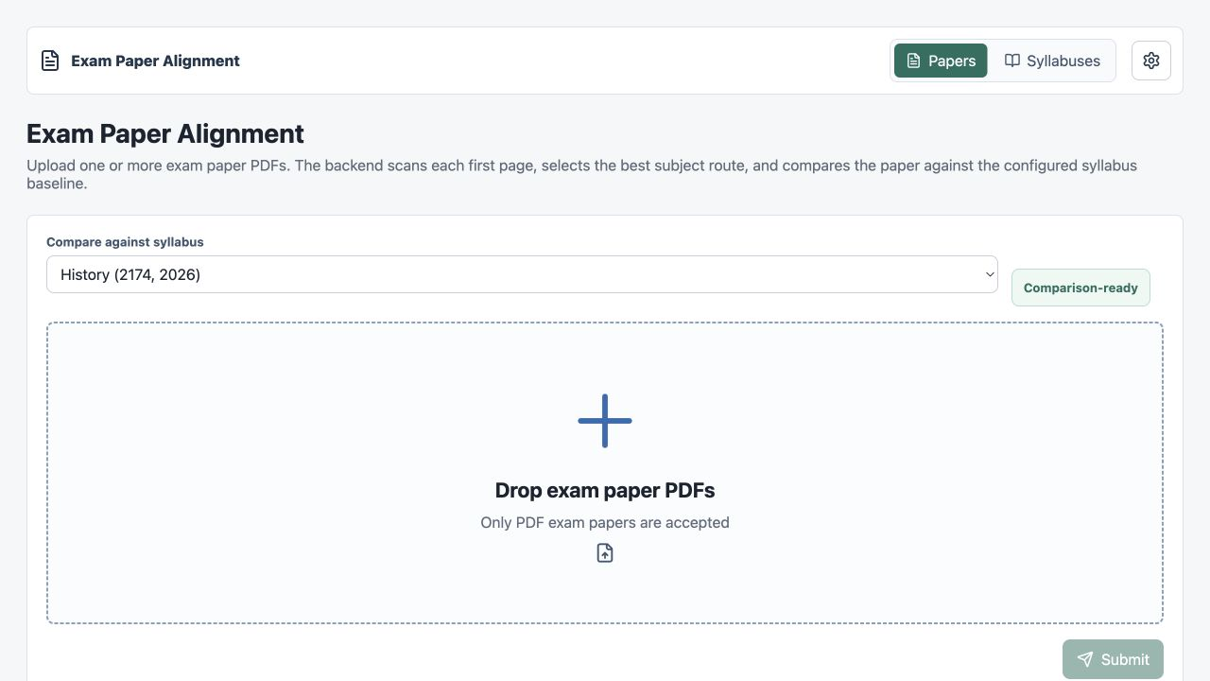
Exam Paper Analytical Tool
Syllabus-objective alignment, topic weightage balance, evaluation, and generalisation strategy
React frontend for batch paper upload, syllabus management, LLM settings, and report download
FastAPI backend for PDF ingestion, route resolution, extraction, alignment, weightage, and report artefacts
Evaluation harness separates extraction success from AI mapping quality
Management briefing with technical implementation detail
History Exam Paper AI Alignment Prototype
01

Slide 2
CURRENT IMPLEMENTATION
What Was Built
Step 1: Upload
Step 2: Route
Step 3: Extract
Step 4: Compare
Step 5: Evaluate
Step 6: Export
One or more exam PDFs enter through the React UI.
First-page model scan resolves the configured syllabus route.
PDF text, questions, marks, sources, and pages become structured JSON.
Questions map to objectives/topics; rules and weightage are computed.
Reference-answer evaluator checks accuracy, completeness, and hallucination.
JSON, Word, ZIP, audit logs, and intermediate artefacts are persisted.
Design principle
The system avoids free-form AI verdicts. It emits structured, traceable claims that a teacher or reviewer can challenge.
History Exam Paper AI Alignment Prototype
02

Slide 3
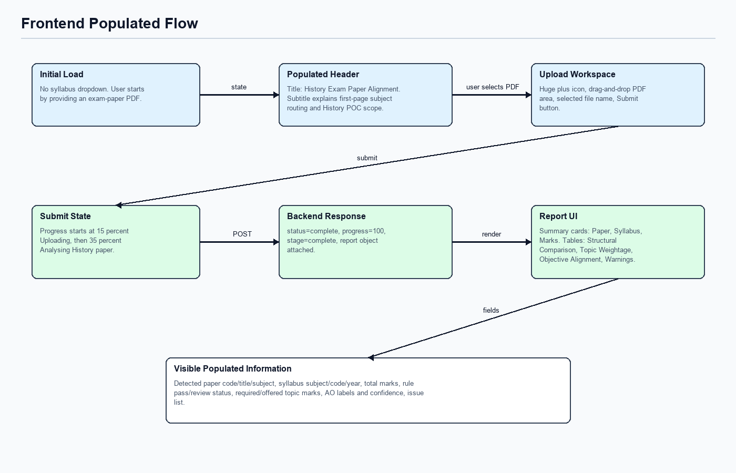
REACT + VITE
Frontend: Teacher-Facing Control Surface
Papers tab: PDF-only dropzone, batch upload, progress states, report tabs, JSON/Word/ZIP downloads.
Syllabuses tab: SEAB URL or direct PDF ingestion with streamed event timeline and original PDF preview.
Settings panel: model provider, base URL, model discovery, timeout, and connection test.
Report view: structure, failed checks, topic weightage, objective alignment, and evidence pages.
Key files: App.tsx, client.ts, UploadDropzone.tsx, ComparisonReport.tsx, ModelSettingsPanel.tsx
History Exam Paper AI Alignment Prototype
03

Slide 4
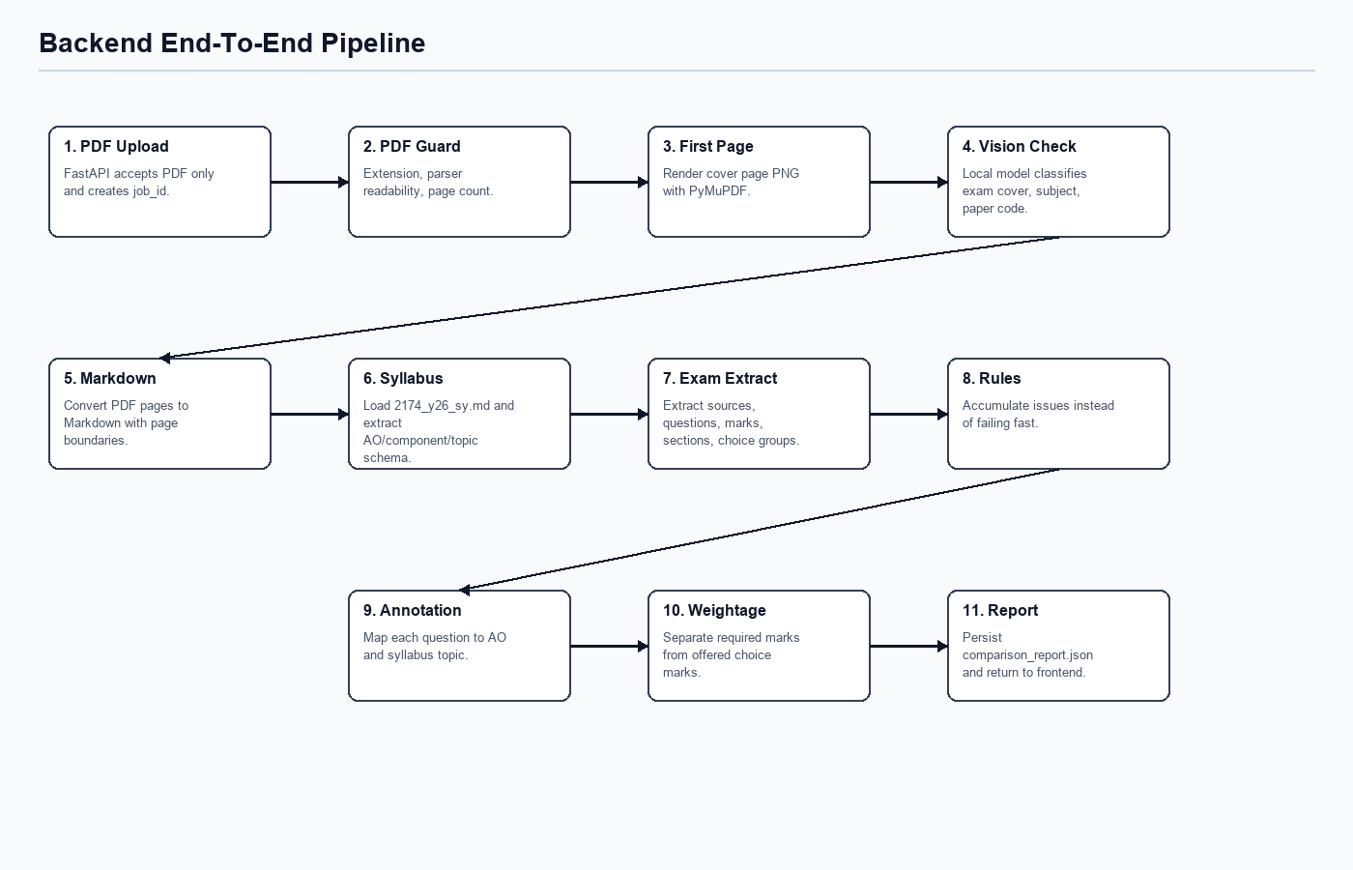
FASTAPI + TYPED SCHEMAS
Backend: Traceable Analysis Pipeline
Route resolution
First-page classification resolves configured syllabus route or stops with an explicit route issue.
Extraction and rules
PDF Markdown plus syllabus JSON produce questions, sources, structure metrics, and rule checks.
Alignment and reports
Question annotations feed required/offered topic weightage and final ComparisonReport exports.
History Exam Paper AI Alignment Prototype
04

Slide 5
SCHEMAS AND ARTEFACTS
Data Contracts Make AI Claims Reviewable
Object
Purpose
Review value
Clean Report Assembly Flow
ExamPaper
Questions, sources, marks, pages
Grounds paper structure
Syllabus
SyllabusDocument
Objectives, components, topics
Defines baseline
Comparison report
Question mapping
Exam paper
Question Annotation
Objective/topic mapping plus evidence
Audits AI reasoning
TopicWeightage
Required vs offered marks
Shows topic balance
Rule checks
Topic weightage
ComparisonReport
Checks, issues, metrics, downloads
Management-ready output
Inputs and checks feed one final report payload.
Persisted outputs include original upload, first-page image, Markdown, raw model response, raw extraction, exam structure, report JSON, and audit log.
History Exam Paper AI Alignment Prototype
05

Slide 6
SPECIMEN PAPER 1
History Paper 1 Result: Structure Extracted Cleanly
50
9
6
0
candidate marks
questions extracted
sources traced
pipeline issues
History Exam Paper AI Alignment Prototype
06

Slide 7
BALANCE ANALYSIS
Topic Weightage: Required vs Offered Marks
Interpretation
Section A concentrates compulsory marks on WWII Europe.
Reviewer action
Confirm whether this is intended for the paper or should be diversified in future papers.
Note: reviewed reference mappings illustrate the expected AI output; fresh mock runs correctly expose mapping uncertainty.
History Exam Paper AI Alignment Prototype
07

Slide 8
QUALITY CONTROL
Evaluation: What The Scorer Catches
Run | Exact | Complete | Hallucination | Meaning
Reference set | 1.0000 | 1.0000 | 0.0000 | Target output matched
Fresh mock | 0.2143 | 0.5357 | 0.3214 | Extraction passes; mapping uncertain
Accuracy: exact and textual similarity against expected structured keys.
Completeness: required fields are present, including objectives and topic-weightage rows.
Hallucination: predicted values must be supported by paper text or the reviewed reference answer.
Operational lesson: model output should be evaluated separately from pipeline health.
History Exam Paper AI Alignment Prototype
08

Slide 9
REUSABLE PIPELINE, SUBJECT-SPECIFIC RULES
Generalising Beyond History
Reusable
Subject-specific
Production controls
PDF validation
Assessment objectives
Self-hosted model
First-page routing
Component rules
Prompt versioning
Markdown extraction
Choice policies
Teacher review queue
Syllabus ingestion
Topic taxonomy
Audit logs
LLM JSON prompts
Evidence expectations
Data retention
Report exports
Reference answer sets
Fallback behaviour
Conclusion: the architecture generalises, but each subject needs a reviewed rule pack and answer set before high-stakes use.
History Exam Paper AI Alignment Prototype
09

Slide 10

DEPLOYMENT CONSIDERATIONS
Practical Usage And Next Steps
Use as a teacher-review assistant, not an autonomous approval engine.
Run self-hosted models through LM Studio, Ollama, or OpenAI-compatible endpoints for local governance.
Require evidence pages and ambiguity notes for all alignment claims.
Add subject packs incrementally: syllabus JSON, extraction profile, rule checks, prompt tests, reference answer set.
Improve next: real-model benchmark set, UI screenshots, reviewer feedback loop, and confidence calibration.
Recommended governance
Keep human sign-off, preserve audit logs, and review uncertain mappings before acting.
History Exam Paper AI Alignment Prototype
10

