Slide 1
How Climate Change Affects U.S. Corn and Wheat Yields
Yilong Xu
https://github.com/yilongxu-usc/dsci510_fall2025_final_project

Slide 2
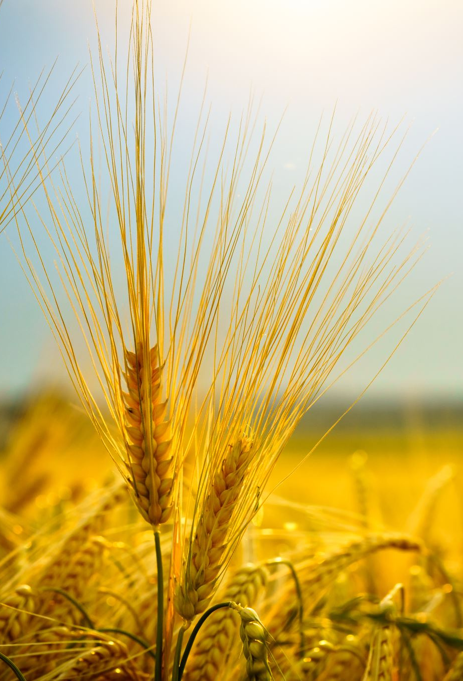
Introduction
Project Goal：To examine how temperature and precipitation relate to corn and wheat yields across different U.S. states from 1970–2024
Key Questions：
  Do corn and wheat respond differently to temperature and precipitation?
  Are climate–yield relationships consistent across states, or highly regional?
  Which climate variable appears more influential on crop yield?
Approach：Integrating USDA crop yield data with NOAA climate records and apply correlation, regression, and trend analysis at the state level

Slide 3
Data Sources
Date Range: 1970/01/01- 2024-12-31
Dataset | Description | Type | Format | Data Size
Corn Yield Data, USDA NASS | Provides annual corn yield (bushels per acre) for U.S. states. Shows how corn productivity varies geographically and how yields change over time | API Call | HTML response > json > CSV | 13000+ rows, 3 columns
Wheat Yield Data, USDA NASS | Contains annual wheat yield statistics for U.S. states Works together with corn yield data to provide two independent agricultural indicators |  | HTML response > json > CSV | 22000+ rows, 3 columns
Monthly temperature and precipitaion | Provides monthly average temperature (TAVG) and total precipitation (PRCP) for multiple U.S. climate stations Used to compute annual climate metrics (mean temperature, accumulated precipitation) matched by state |  | HTML response > json > CSV | 6000+ rows, 7 columns

Slide 4
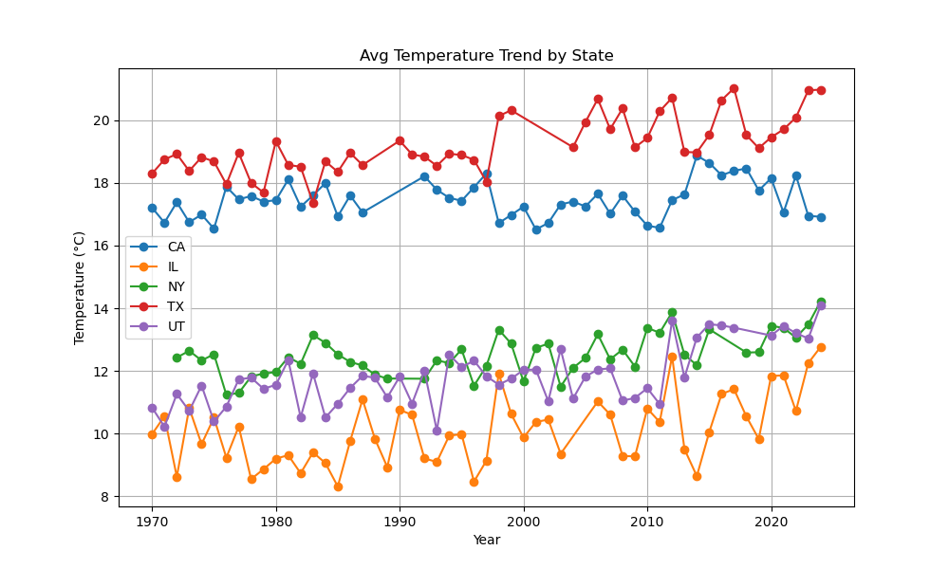
Temperature Trends Across States (1970–2024)
All five states exhibit a clear long-term warming trend from 1970 to 2024, although the rate and magnitude differ by state.
Texas consistently records the highest average temperatures, remaining well above other states throughout the entire period and showing a persistent upward trend, especially after the late 1990s
California also shows sustained warming, with relatively high average temperatures compared to northern states and a noticeable increase since the 1980s, though with some mid-period variability
Illinois and New York remain cooler overall, but both display gradual warming over time, with more pronounced increases in the most recent decades (post-2000)
Utah demonstrates the greatest year-to-year variability, with sharper short-term fluctuations around its warming trend, suggesting higher climate variability relative to the other states
The warming signal becomes more pronounced after 2000, indicating accelerated temperature increases across most states in the last two decades

Slide 5
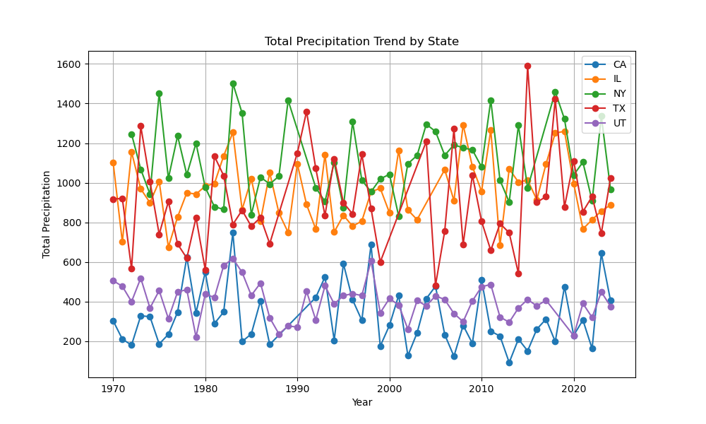
Precipitation Trends (1970–2024)
Total precipitation exhibits substantial year-to-year variability across all five states, with no smooth or uniform long-term trend comparable to temperature
New York and Texas generally experience higher annual precipitation totals, frequently exceeding other states, but both also show pronounced fluctuations, including occasional extreme wet years.
Illinois displays moderate precipitation levels with noticeable interannual variability, but without a clear long-term increasing or decreasing trend across the full period
California remains consistently the driest state, with lower total precipitation values throughout the time series and sharp fluctuations that highlight its sensitivity to wet and dry years
Utah records relatively low to moderate precipitation, with pronounced variability but no persistent long-term trend, suggesting precipitation changes are dominated by short-term climate variability rather than gradual shifts
Compared to temperature trends, precipitation patterns are more irregular and episodic, indicating weaker long-term signals and stronger influence of year-specific climate conditions

Slide 6
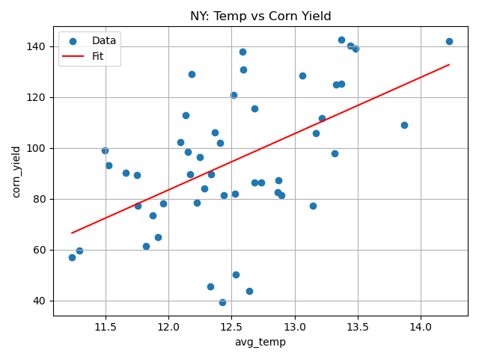
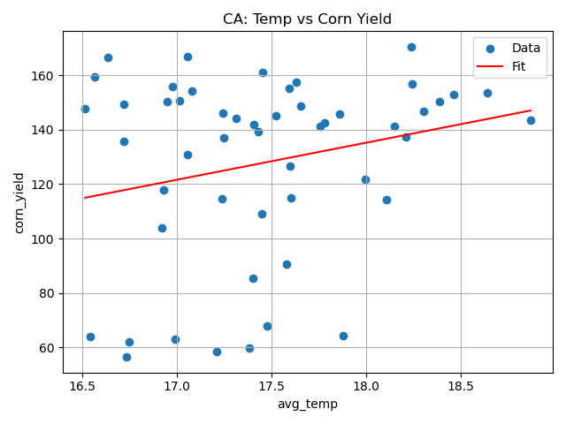
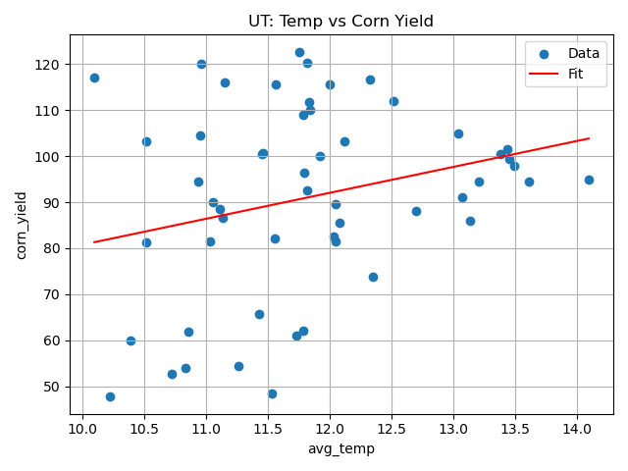
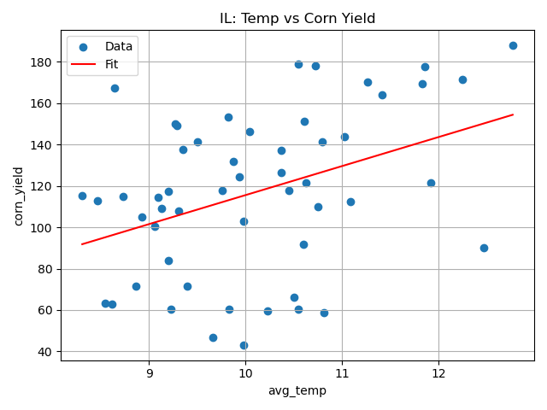
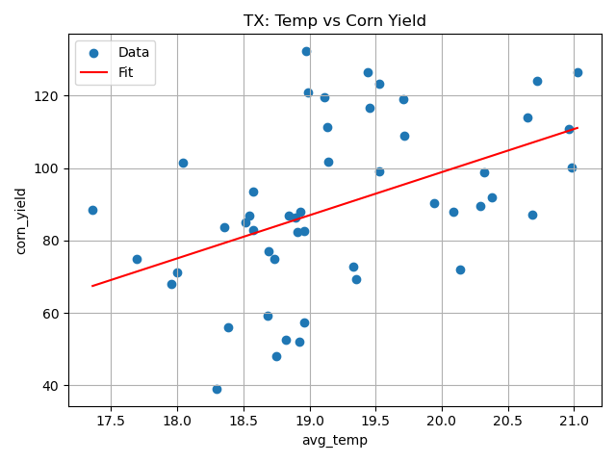
Effect of Temperature on Corn Yields (per state)
Each point represents a state-level annual observation, pairing average temperature with corn yield for that year

Slide 7
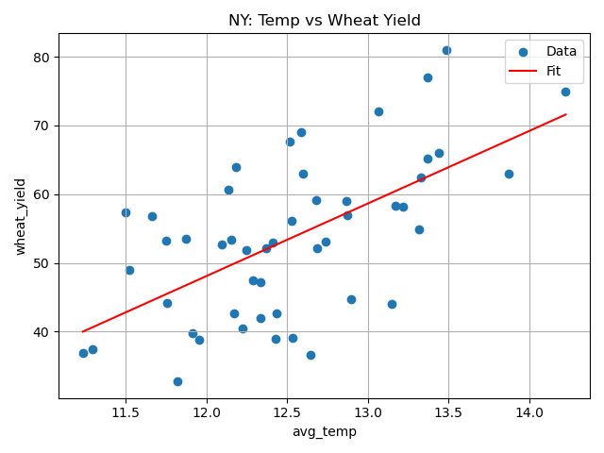
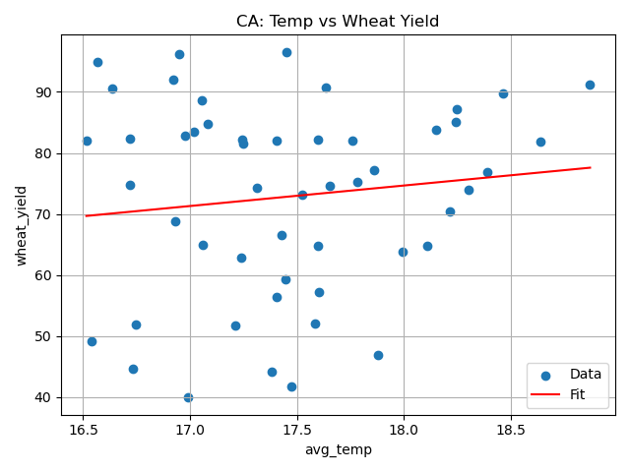
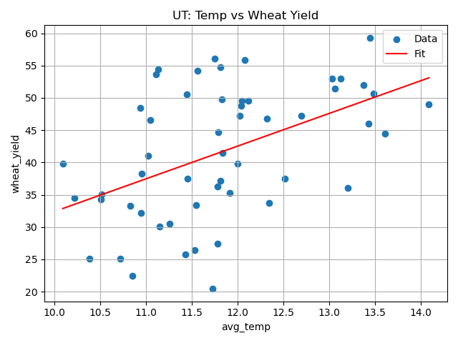
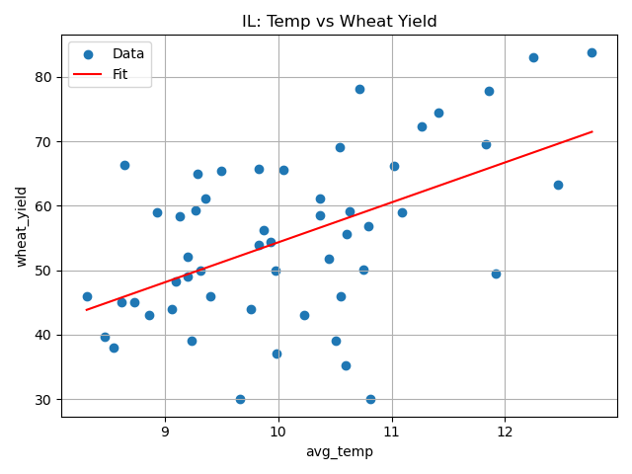
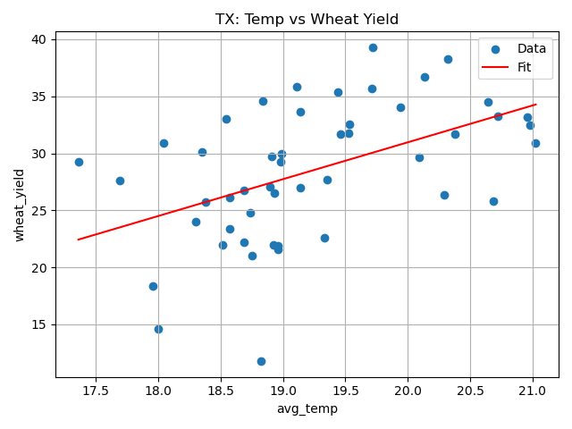
Effect of Temperature on Wheat Yields (per state)
Each point represents a state-level annual observation, pairing average temperature with wheat yield for that year

Slide 8
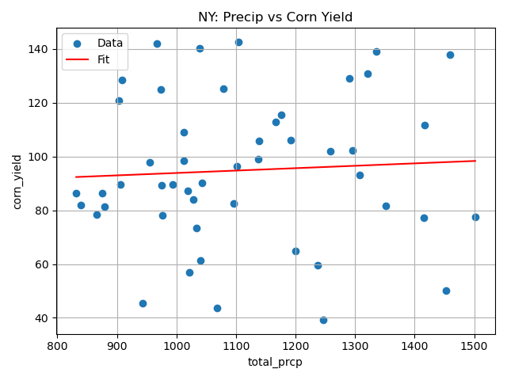
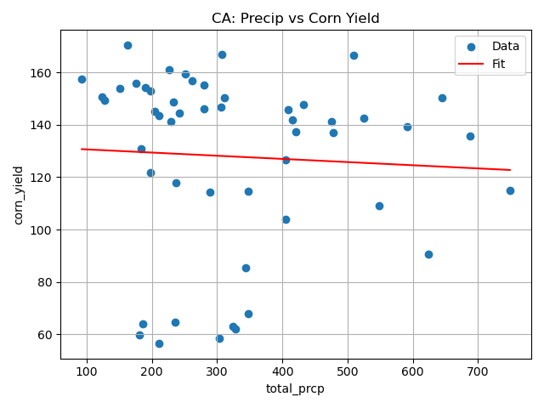
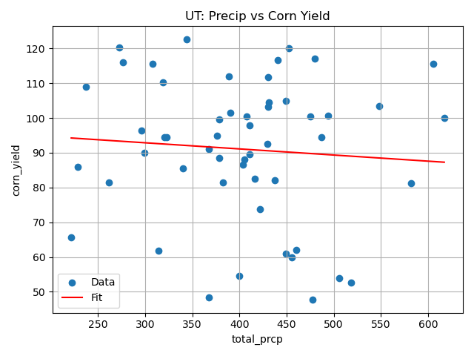
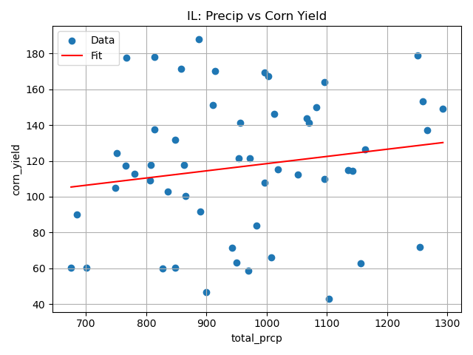
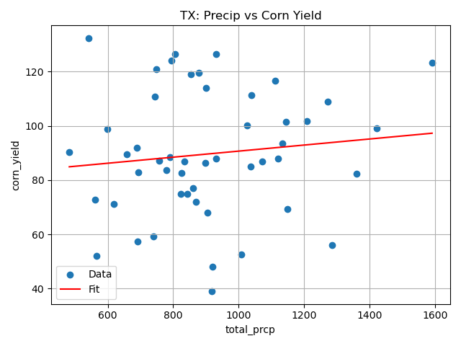
Effect of Precipitation on Corn Yields (per state)
Each point represents a state-level annual observation, pairing average precipitation with corn yield for that year

Slide 9
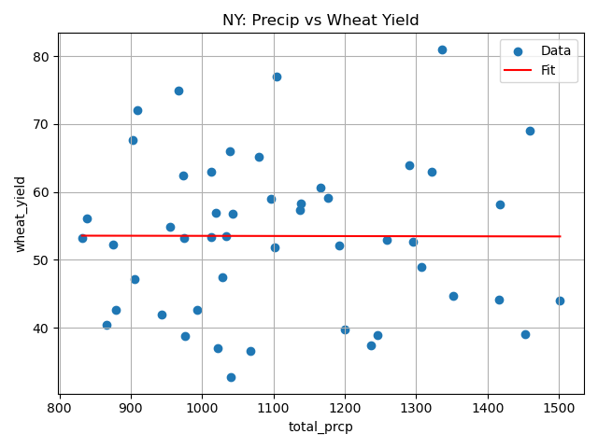
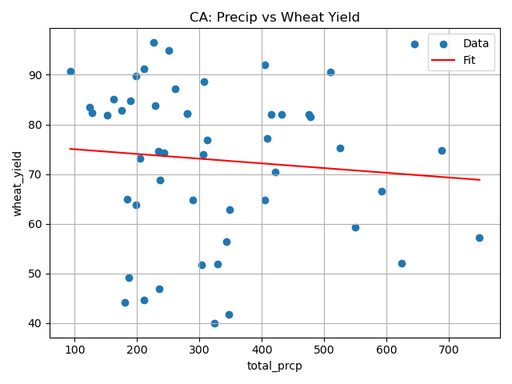
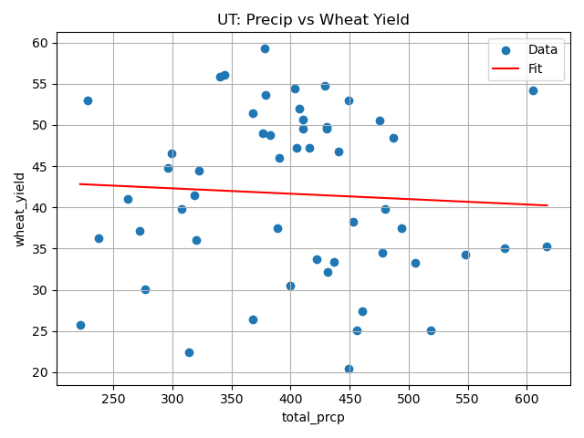
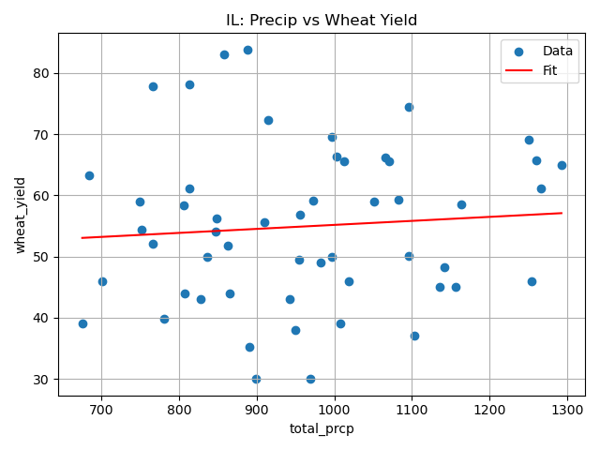
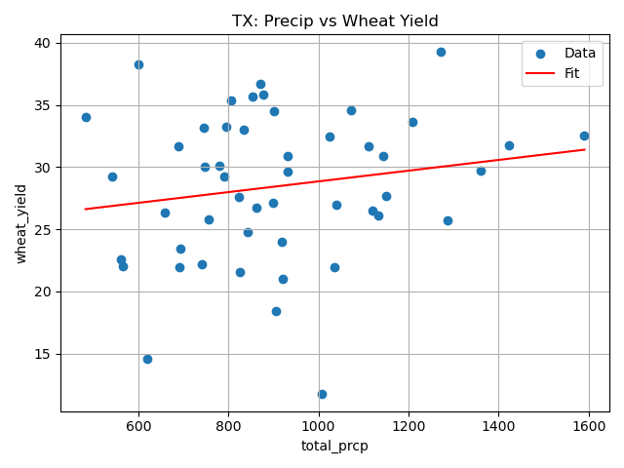
Effect of Precipitation on Wheat Yields (per state)
Each point represents a state-level annual observation, pairing average precipitation with corn wheat for that year

Slide 10
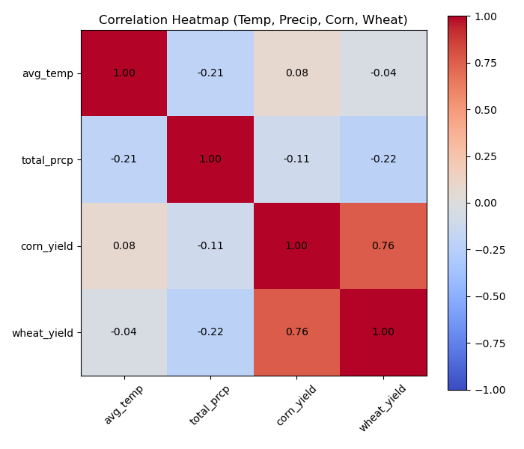
Heatmap
Corn and wheat yields are strongly positively correlated (r ≈ 0.76), indicating that years with higher corn yields tend to also have higher wheat yields across states.
Average temperature shows very weak correlations with both corn (r ≈ 0.08) and wheat yields (r ≈ −0.04), suggesting no strong linear relationship between temperature and crop yields at this aggregated scale.
Total precipitation is weakly negatively correlated with both corn (r ≈ −0.11) and wheat yields (r ≈ −0.22), indicating a slight tendency for higher precipitation to coincide with lower yields, though the relationship is modest.
Temperature and precipitation are weakly negatively correlated (r ≈ −0.21), implying that warmer years tend to be slightly drier, but the relationship is not strong
Overall, neither temperature nor precipitation alone is a strong predictor of crop yield, highlighting that crop performance is influenced by more complex interactions beyond simple annual climate averages

Slide 11
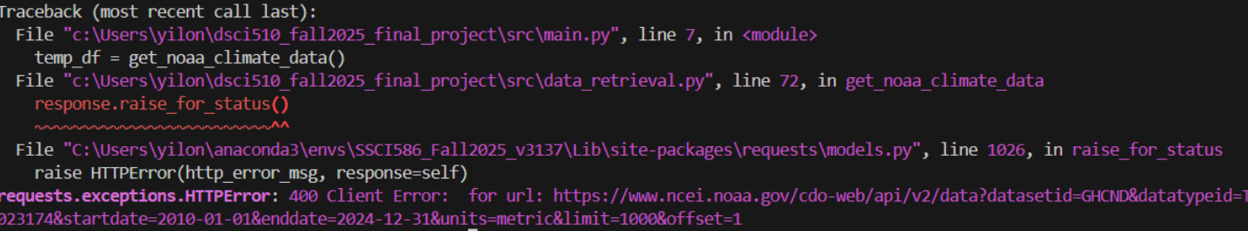
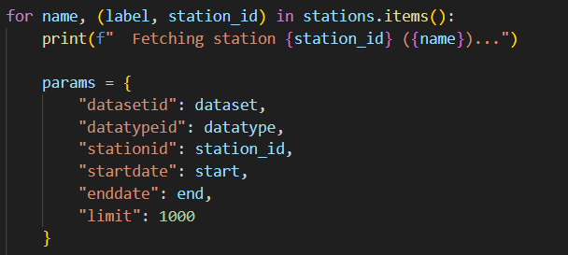
Challenges
Getting reliable climate data from the NOAA API
Frequent 400 (Bad Request) Errors
NOAA API Limitations Not Documented Clearly
Instead of trying to download all climate data at once, I rewrote the function, so it requests each station individually, catching failures without stopping the whole program

Slide 12
Thank you & Questions

