Slide 1
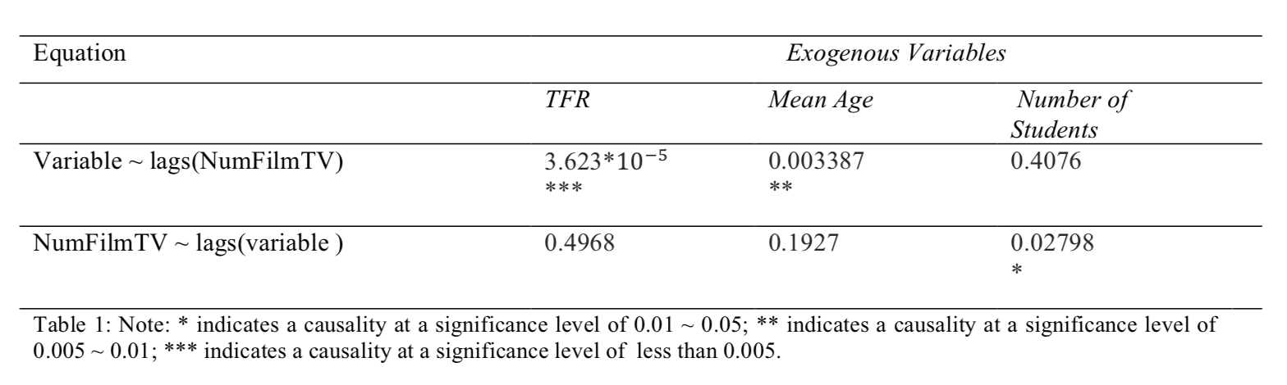
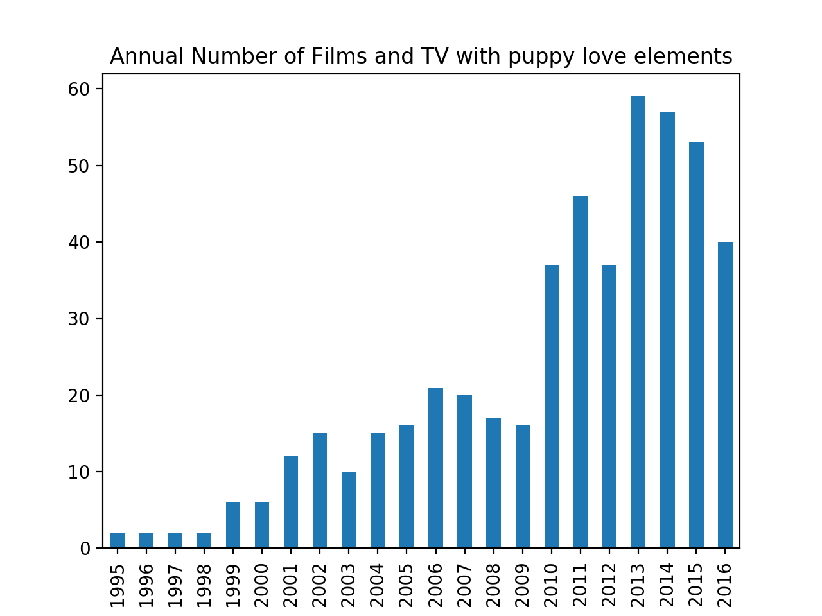
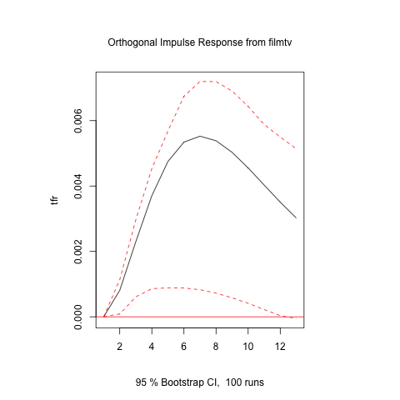
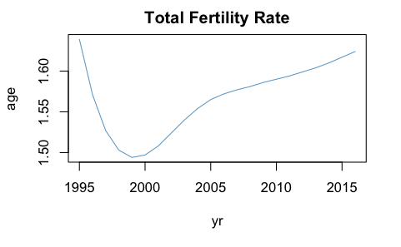
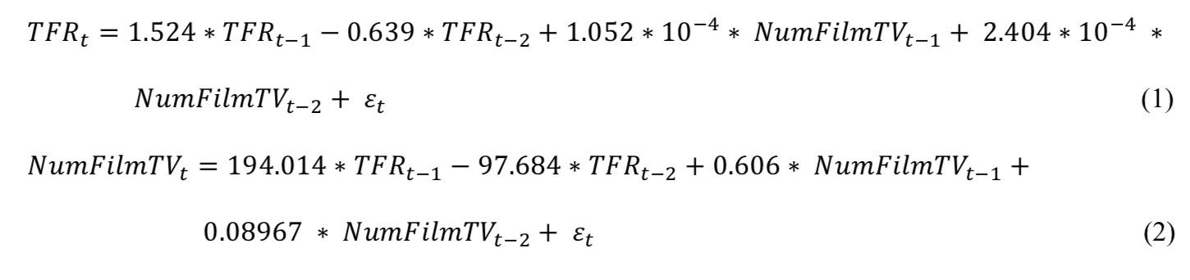
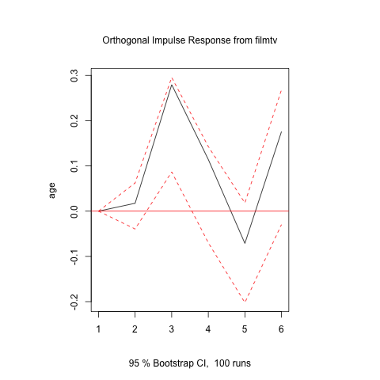
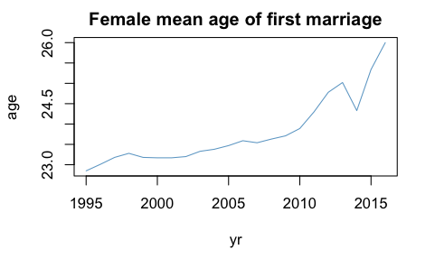
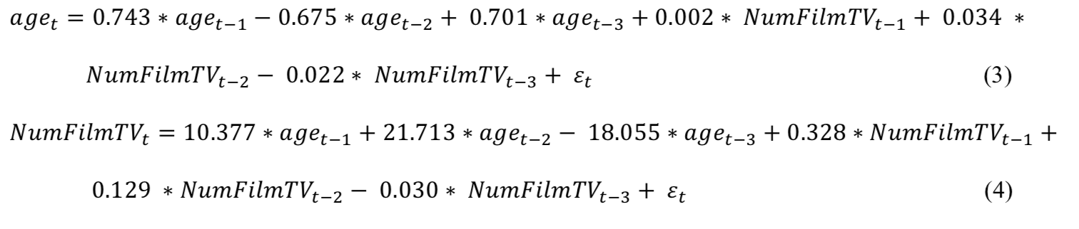
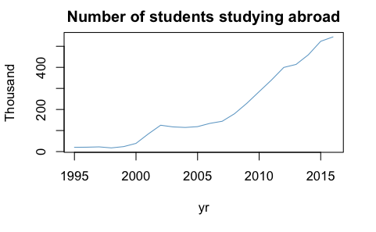
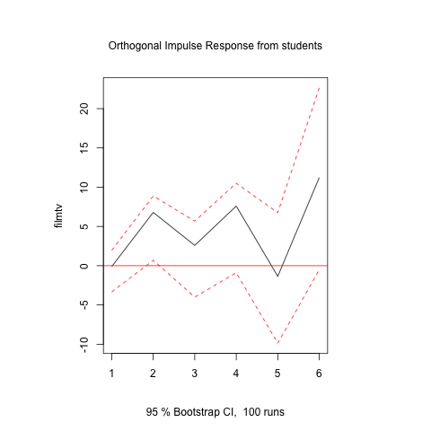
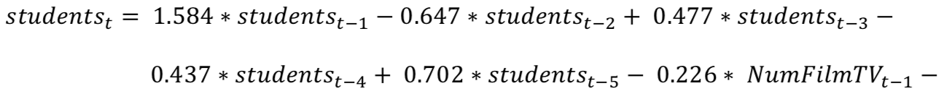
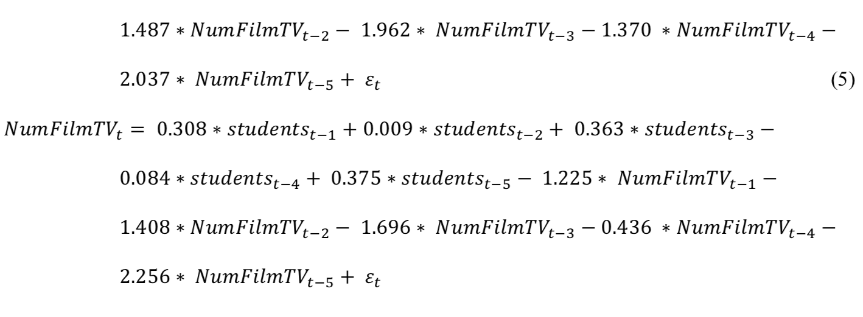
Yilun Dai
INTRODUCTION
Number of Films and TV as an Indicator of Attitude
RESULTS
CONCLUSION
“Zao Lian”(Chinese word: 早恋), Chinse term of puppy love, has been a unique taboo in Socialist China from 1950s to early 2000s. “Zao Lian” is most commonly defined as dating or having a love relationship before college. Policy makers formulated punitive policies on school rules and issued strict censorships on films and tv series to prevent and suppress “Zao Lian”. In recent years (since late 2000s), however, there is an increasing tolerance on puppy love in the Chinese society. Middle school and high school students are holding hands on campus without worrying about being expelled; TV series with young lovers at school are streaming on major TV networks. Past literatures provided historical and structural explanations for the formation and the development of this taboo through qualitative analysis of documents and interviews, but few has addressed the reason why the Chinese society changes its attitude towards “Zao Lian” in recent years using computational tools. This research uses computational tools and constructs statistical models to examine factors that are likely to cause this change.
I used Python to scrape film and TV information from Douban, a Chinese film and movie rating website. Films and TV series with the three tags “Mainland China”, “School”, and “Romance” are scraped and I created a time series of the annual number of films and TV series produced.
Granger Causality Test calculates and compares the p-values of the two equations in a VAR model and selects the equation with the smaller p-value.
Response of TFR to Impulse from the number of films and tv series
FACTORS THAT MIGHT CONTRIBUTE TO THIS CHANGE
VAR MODELS
VAR(2) Model for TFR and the Number of Films and TV series
Response of Female’s average age at First Marriage to Impulse from the number of films and tv series
VAR(3) Model for Female’s Average Age at First Marriage and the Number of TV series
VAR(5) Model for Number of Students Studying Abroad (In 1,000) and the Number of TV series
Response of the number of films and tv series to the Impulse from the number of students (in 1,000)
Note:

