Slide 1
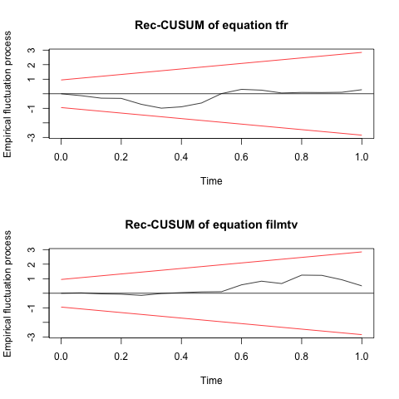
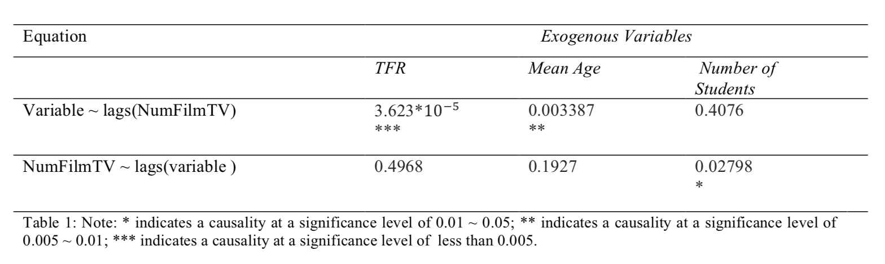
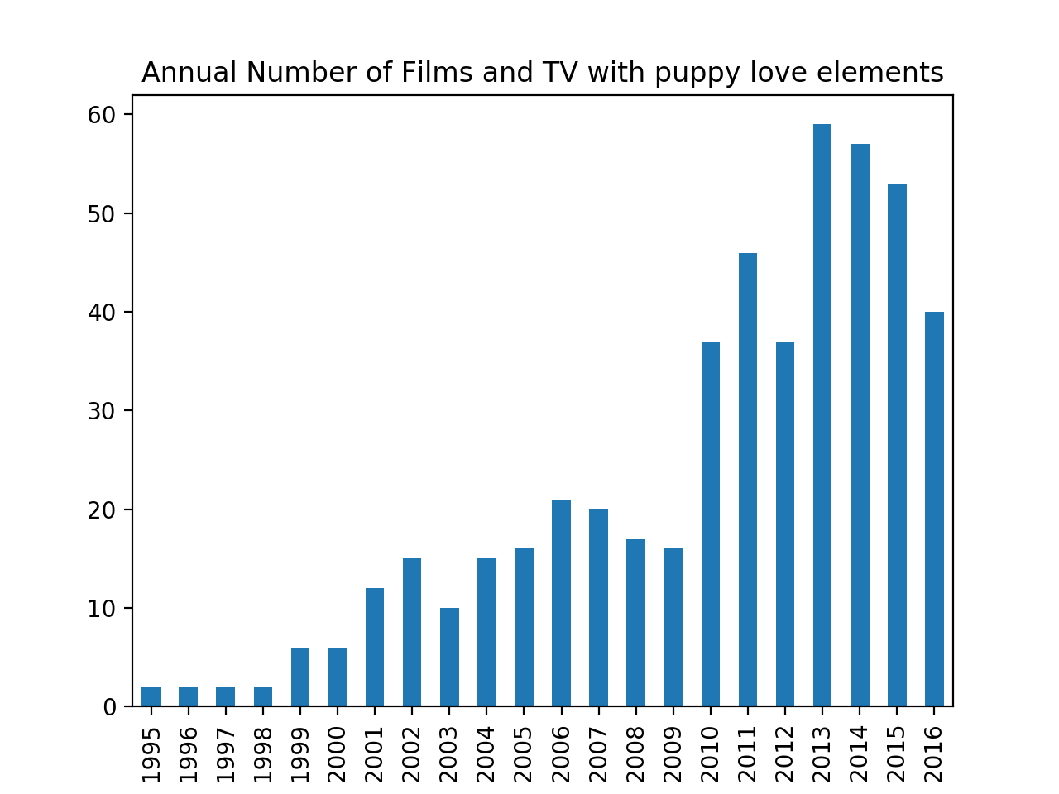
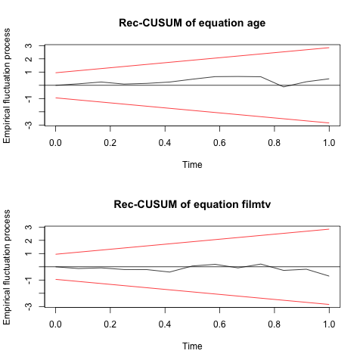
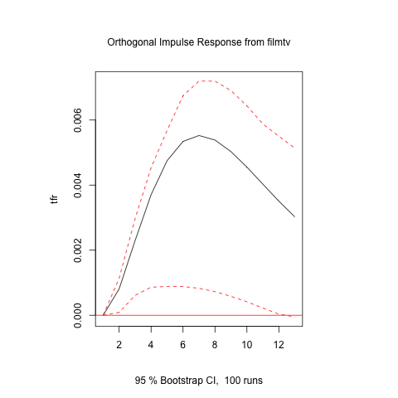
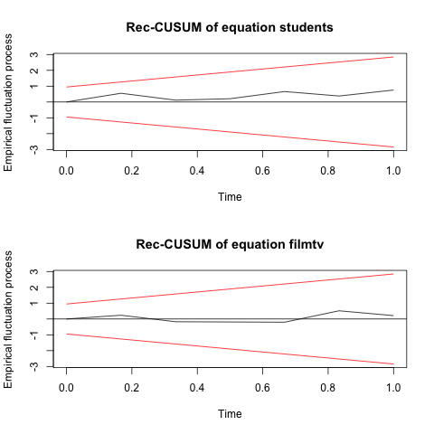
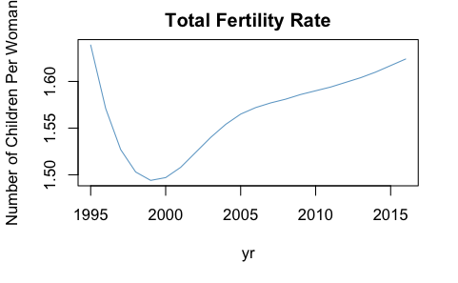
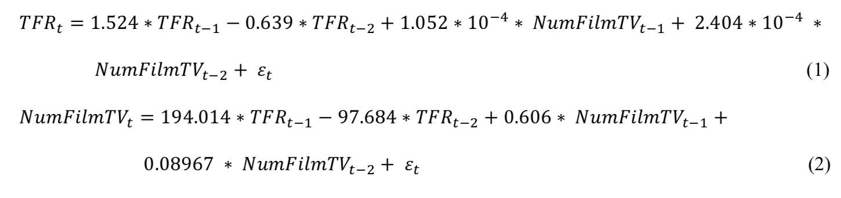
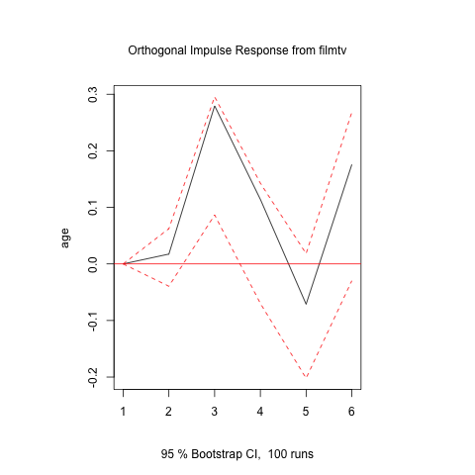
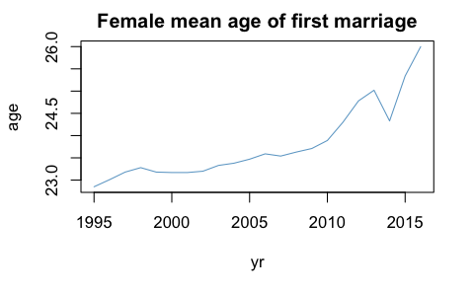
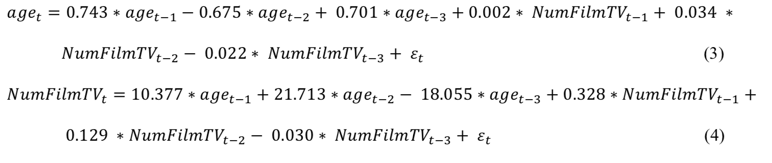
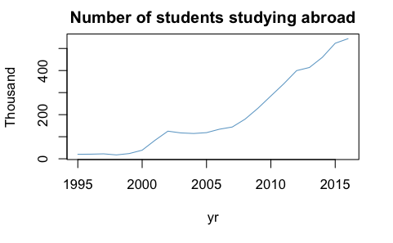
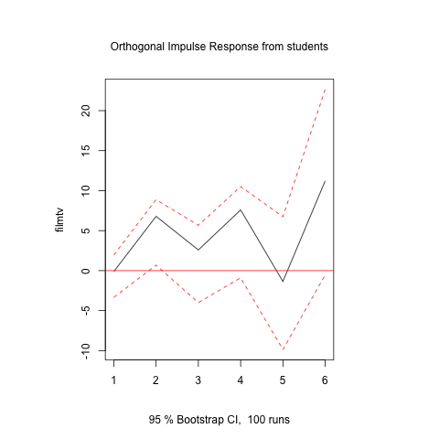
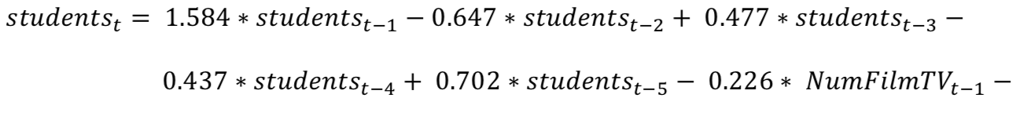
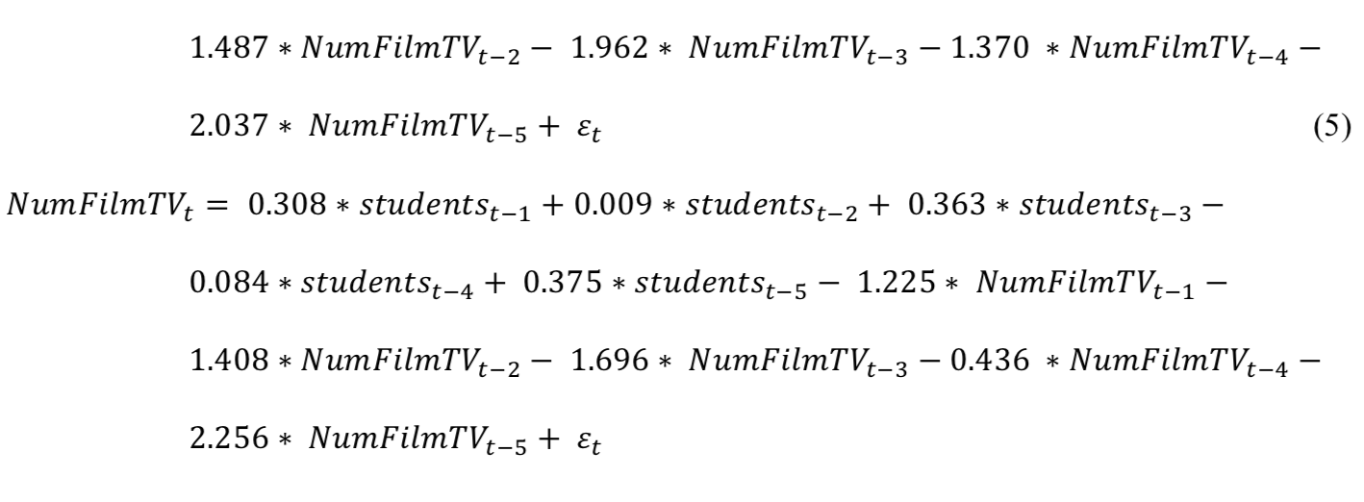
WHY HAVE THE CHINESE BECOME MORE TOLERANT OF ZAO LIAN
A Functional Analysis
Yilun Dai
INTRODUCTION
Number of Films and TV as an Indicator of Attitude
RESULTS
Validation
“Zao Lian”(Chinese word: 早恋), Chinse term of puppy love, has been a unique taboo in Socialist China from 1950s to early 2000s. “Zao Lian” is most commonly defined as dating or having a love relationship before college. Policy makers formulated punitive policies on school rules and issued strict censorships on films and tv series to prevent and suppress “Zao Lian”. In recent years (since late 2000s), however, there is an increasing tolerance on puppy love in the Chinese society. Middle school and high school students are holding hands on campus without worrying about being expelled; TV series with young lovers at school are streaming on major TV networks. Past literatures provided historical and structural explanations for the formation and the development of this taboo through qualitative analysis of documents and interviews, but few has addressed the reason why the Chinese society changes its attitude towards “Zao Lian” in recent years using computational tools. This research uses computational tools and constructs statistical models to examine factors that are likely to cause this change and to provide functional explanations for the change.
I used Python to scrape film and TV information from Douban, a Chinese film and movie rating website. Films and TV series with the three tags “Mainland China”, “School”, and “Romance” are scraped and I created a time series of the annual number of films and TV series produced.
Granger Causality Test calculates and compares the p-values of the two equations in a VAR model and selects the equation with the smaller p-value.
Residuals are stable, random, and they do not break in later steps.
Response of TFR to Impulse from the number of films and tv series
FACTORS THAT MIGHT CONTRIBUTE TO THIS CHANGE
VAR MODELS
CONCLUSION
VAR(2) Model for TFR and the Number of Films and TV series
The Chinese society’s attitude towards Zao Lian, specifically, the number of films and TV series with Zao Lian component in previous years, can be used predict China’s Fertility Rate and the average female’s age of first marriage, contrary to the hypothesis that TFR and the average female’s age of first marriage have causal effects on the change in the attitude towards Zao Lian. However, a change in number of students studying abroad has a positive causal effect on the attitude towards Zao Lian. Policy makers are adjusting the society’s perception on Zao Lian in order to facilitate new marriage and fertility policies, because average marriage age has been postponing and TFR has been low. On the other hand, an increasing number of Chinese students studying abroad demonstrates diversifying forms of education in China. As ways to obtain high-quality higher education are no longer solely score-based, the purpose to reduce the negative effect of Zao Lian on exam results becomes less significant.
Response of Female’s average age at First Marriage to Impulse from the number of films and tv series
VAR(3) Model for Female’s Average Age at First Marriage and the Number of TV series
REFERENCES
Diebold, F.X. (2015), Forecasting, Department of Economics, University of Pennsyl- vania, http://www.ssc.upenn.edu/~fdiebold/Textbooks.html
Pan, S., Parish, W., & Huang, Y. (2011). Love and Sex of Chinese Teenagers: A Random Sampling Based on Census of populations aged 14-17. Chinese Youth Studies, 12(7), 55.
Salganik, Matthew J. 2017. Bit by Bit: Social Research in the Digital Age. Princeton, NJ: Princeton University Press. Open review edition.
Shen, Y. (2015). Too young to date! The origins of zaolian (early love) as a social problem in 20th- century China. History of Science, 53(1), 86.
Wang,J. (2013,August31).Puppy love no longer taboo [Electronic version].Shanghai Daily Zhang, E. (2005). Rethinking Sexual Repression in Maoist China: Ideology, Structure and the Ownership of the Body. Body and Society, 11(3), 9.
VAR(5) Model for Number of Students Studying Abroad (In 1,000) and the Number of TV series
Response of the number of films and tv series to the Impulse from the number of students (in 1,000)
CONTACT INFORMATION
Yilun Dai
Social Sciences Division,
The University of Chicago
Email: yilundai@uchicago.edu
Data sources: the World Bank and the National Bureau of Statistics of the People’s Republic of China

