Slide 1

async programming in JS Part1
your desire to avoid the mess of callbacks is not justification for blocking, synchronous code
(@getify, Kyle Simpson)

Slide 2
Obsah
Part 1 Lesson #9
Part 2 Lesson #10
async, paralell, concurrent
async function, continuation, async tasks
concurrent „processes“ coordination
noninteracting/independent
interacting
cooperation
concurrent „processes“ coordination
interaction patterns
async styles
callbacks
cooperative concurrency
async styles (continued)
promises
generators
async await
timers
....

Slide 3
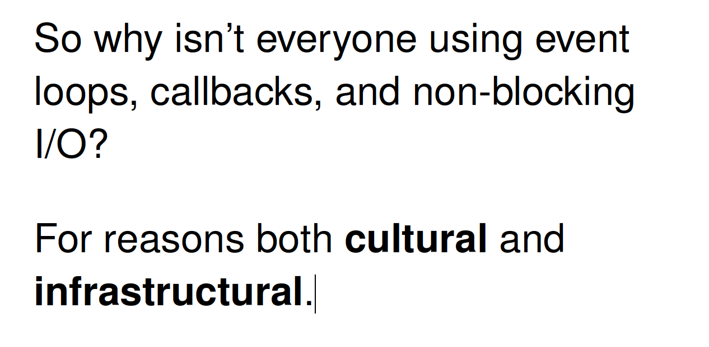


Why we need this lesson ?
Developeri sú leniví naučiť sa a používať async patterny a radi skĺznu ku komfortnému a prirodzenejšiemu
synchrónnemu a
buffrovanému kódu
Node.js a JavaScript je o
asynch a
chunk processingu
Ak to nechcete, programujte v inom jazyku....
Už teraz je dosť zlých JS knižníc a kódov na svete....
your desire to avoid the mess of callbacks is not justification for blocking, synchronous code (@getify, Kyle Simpson)
That's just not really how our brains appear to be set up.

Slide 4
Introduction (RECAP)
When your JS program makes async operation, you set up the "response" code in a function (commonly called a "callback"), and the JS engine tells the hosting environment, "Hey, I'm going to suspend execution for now, but whenever you finish with that request, and you have some data, please call this function back.“ (@getify)
Cooeration of JS engine and hosting environment
Chunks of program – main and functions
Event loop
Až do nedávna (Promises) vlastne JS ako jazyk nemal žiadnu notáciu pre asynchronicitu. Callback ako taký nič nevraví o asynchronicite ale bol to dostupný spôsob ako ju zapísať ....

Slide 5
What is async , parallel and concurrency
Async
async is about the gap between now and later
Implementation: Event loop
Granularity: function is single event loop queue entry
Parallel
things being able to execute at the same instant of time
Implementation: processes, threads
Granularity: Each statement is broken to several low-level operations
Concurrency
several higher level „tasks“ occuring within same time frame (simultaneously).
Not necesarilly in the same instant of time (paralell).
Notes:
Definitions good enough for JS

Slide 6
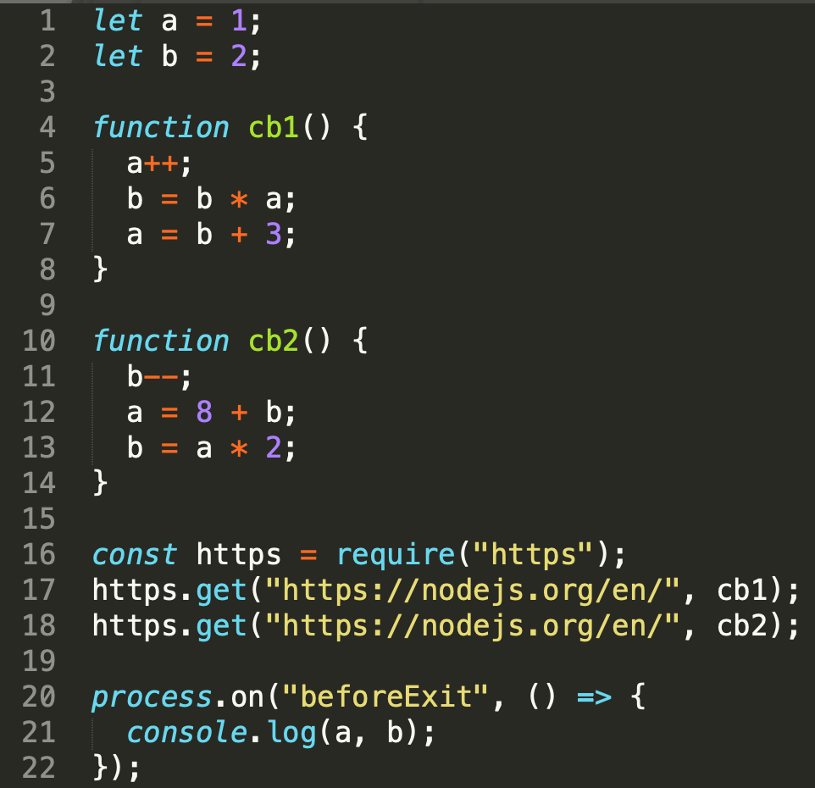
Async and Concurrency
1)
„compile“
4
10
global
cb1
cb2
V8 stack
1
2
16
17
18
20
5
6
7
11
12
13
21
node
2)
4
10
global
cb2
cb1
time
1
2
16
17
18
20
11
12
13
5
6
7
21
wait in queue
async: some code happends now [1,2,...] and some later [5,5,6], [11,12,13],[21]
concurrent: callbacks happen in certain timeframe but not in predictable and controllable order
run-to-completion: function is „atomic“ unit and must execute as whole, there is no chance for (11,5,12,... to happen)
$ node ./concurrency.js
11 22
$ node ./concurrency.js
11 22
$ node ./concurrency.js
183 180
$ node ./concurrency.js
11 22
/samples/concurrency.js
Notes:
Because cb1() can't be interrupted by cb2(), and cb2() can't be interrupted by cb1(),
this program only has two possible outcomes depending on which starts running first –
if threading were present, and the individual statements in cb1() and cb2() could be interleaved, the number of possible outcomes would be greatly increased

Slide 7
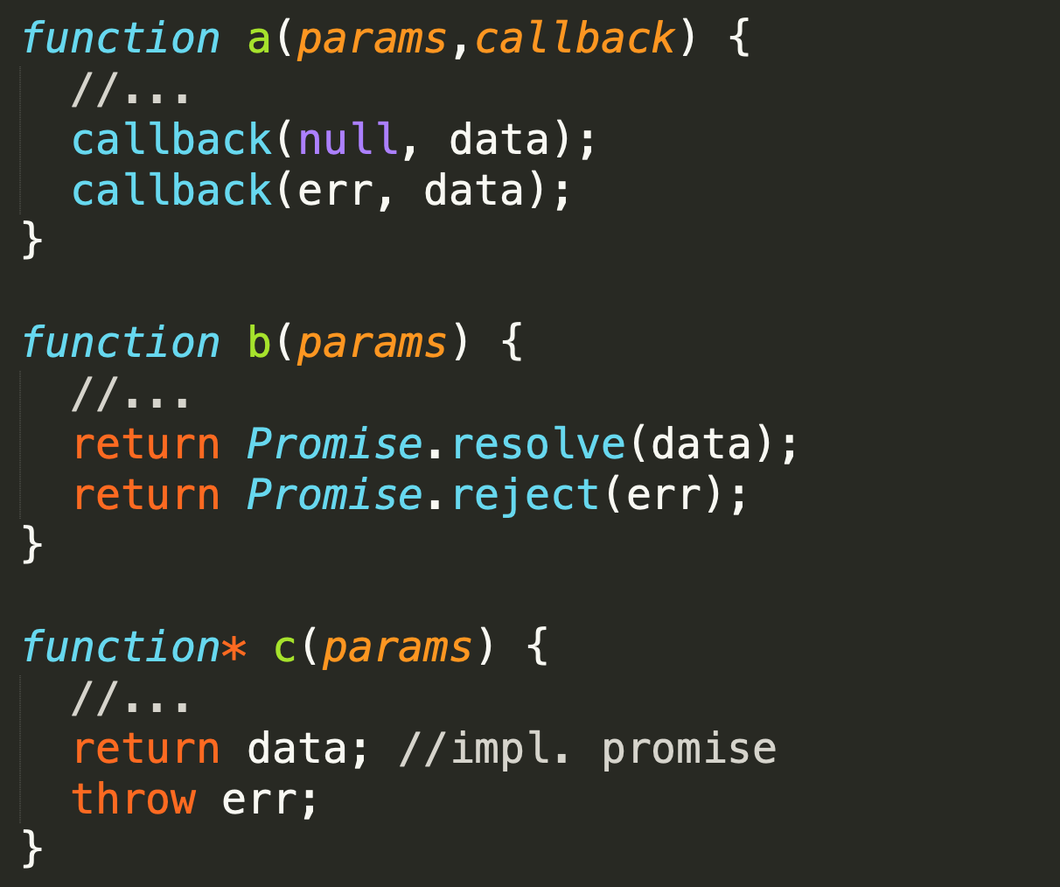
Async function
now
later
V8 stack
Pod async funkciou budeme zjednodušenie rozumieť jednu z konštrukcií, ktorá nám umožní zapísať, že niečo sa deje NOW a potom LATER. V zásade existujú 3 možnosti:
funkcia, ktorá v signatúre očakáva callback
funkcia, ktorá vracia Promise
AsyncFunctionDeclaration

Slide 8
Async process
fs.mkdtemp
http.get
()=>fs.writeFile
cb
on(data)
on(end)
V8 stack
async procesom alebo taskom budeme rozumieť logickú úlohu pozostávajúcu z viacerých časovo oddelene vykonávaných chunkov kódu
V príklade zobrazené dva procesy:
Zápis do temp súboru
Čítanie dát z web stránky

Slide 9
Concurrency coordination
Noninteracting
As two or more "processes" are interleaving their steps/events concurrently within the same program, they don't necessarily need to interact with each other if the tasks are unrelated. If they don't interact, nondeterminism is perfectly acceptable.
Interaction
More commonly, concurrent "processes" will by necessity interact, indirectly through scope and/or the DOM. When such interaction will occur, you need to coordinate these interactions to prevent "race conditions“.
Coperative concurrency
Another expression of concurrency coordination is called "cooperative concurrency.“ The goal is to take a long-running "process" and break it up into steps or batches so that other concurrent "processes" have a chance to interleave their operations into the event loop queue.
„process“ or „task“
in the majority of slides here, it means higher abstraction of some logical process to be performed (process server response, animate rotation of globe, print response results, process client request) of various granularity (viac funkcií volaných later)

Slide 10
Async Patterns
to explain async concepts let‘s first understand types of tasks we want to solve, name them and understand how they can be implemented

Slide 11
Čo riešime za úlohy
Všetci už vieme, že JS je:
asynchrónny,
single threaded (nikdy nebežia dve veci naraz v JS stacku)
atomický a run-to-completion na úrovni funkcie
Potom čokoľvek programujeme nejaký top level async process treba posudzovať z hľadiska async patternov
buď jednotlivo
alebo ako ich kombináciu
ES/JS a node.js majú limitovaný zabudovaný mechanizmus na ovládanie interaction medzi úlohami, na riešenie cooperative concurency (async.js a iné knižnice)

Slide 12
Čo riešime za úlohy – klasifikácia vzorov
series/parralel - musia ísť úlohy za sebou (series) alebo môžu íst paralelne (parallelne)
results passing/cummulating - ak idú za sebou potrebuje tá ďalšia dáta z predošlej, alebo nám záleží len na poradí vykonania
[] of async-functions/[] of data + worker – robím rôzne veci, alebo robím to isté nad inými dátami
[] / queue, doWhilst,... - je zoznam úloh konečný alebo je dynamický a úlohy pribúdajú alebo odbúdajú
try, race – potrebujem výsledok len prvej dokončenej úlohy
limits –paralell limits, timeouts
errors – kedy a ako sú signalizované chyby

Slide 13
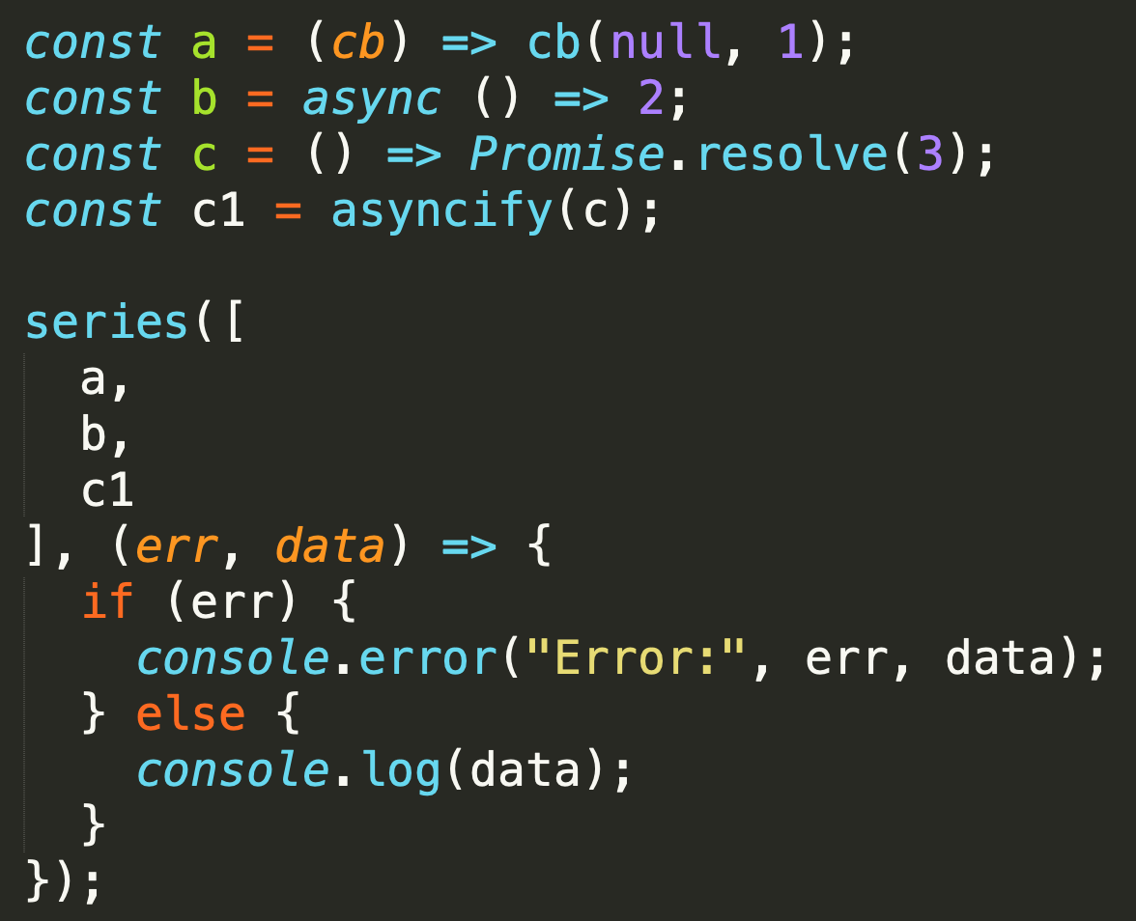
async-function
Following examples of patterns are applicable on all 3 types of async functions
standard node callbacks
native async
promise returning
non-native asyncs retuning promise can be also used if wrapped in asyncify

Slide 14
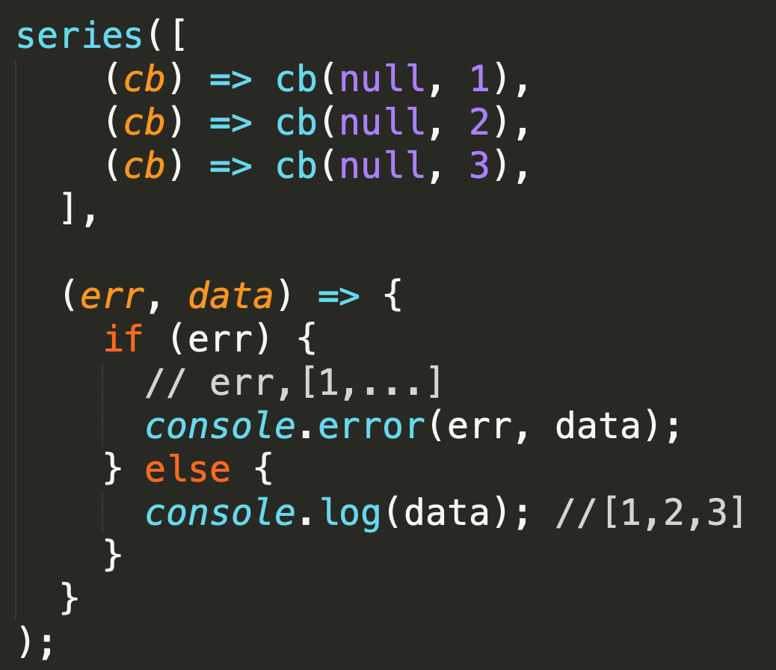
Series
simplest sequential
Use when:
tasks are dependent on order of execution not on data from previous task
data returned from tasks can be collected in final callback

Slide 15
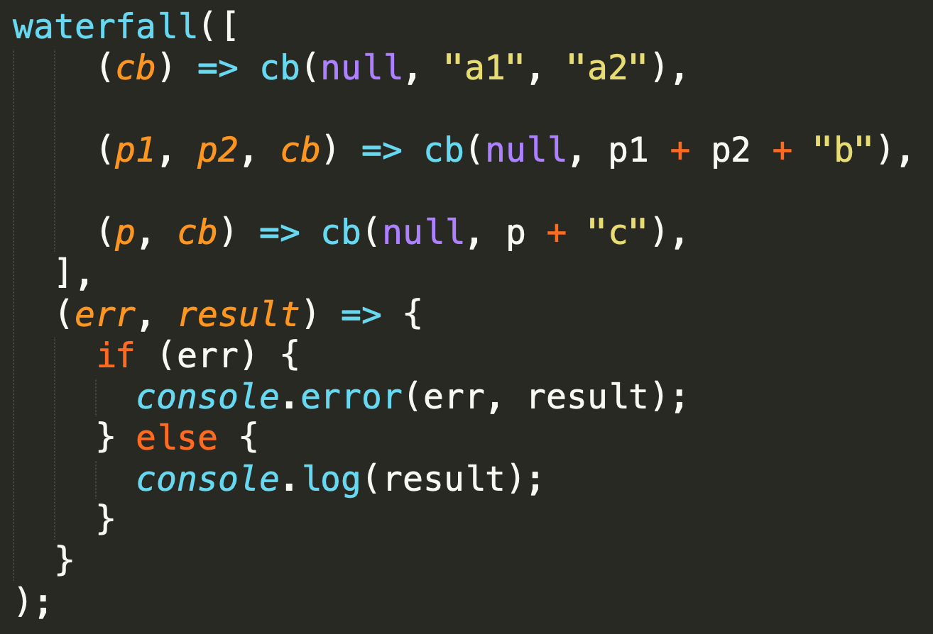
Waterfall
sequential
Use when:
tasks are data from previous task
next task gets data from returned from previous task
final callback gets data of last task

Slide 16
tryEach
sequential
Use when:
you have more alternatives to perform the task and first succesfull is enough
next task gets data from returned from previous task
final callback gets data of last task

Slide 17
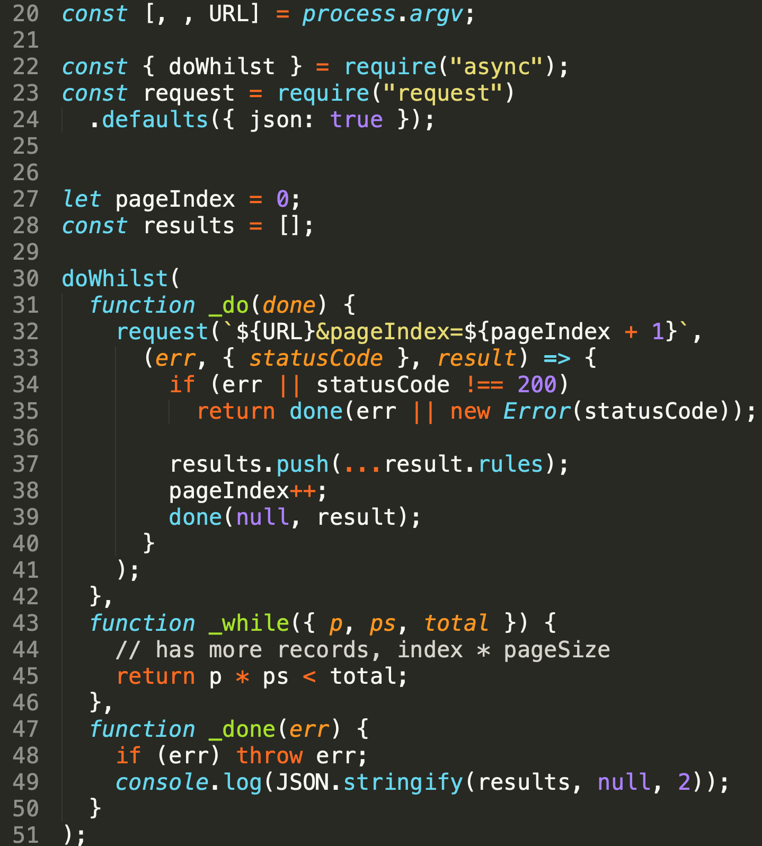
doWhilst
sequential – do...while for async functions,
do, while and done are all functions, while is sync test
Use when:
algorithms is best desribed by do...while but
do contains some async function
last
real life example: sonar API, paged search
/samples/sonar-rules-cli.js

Slide 18
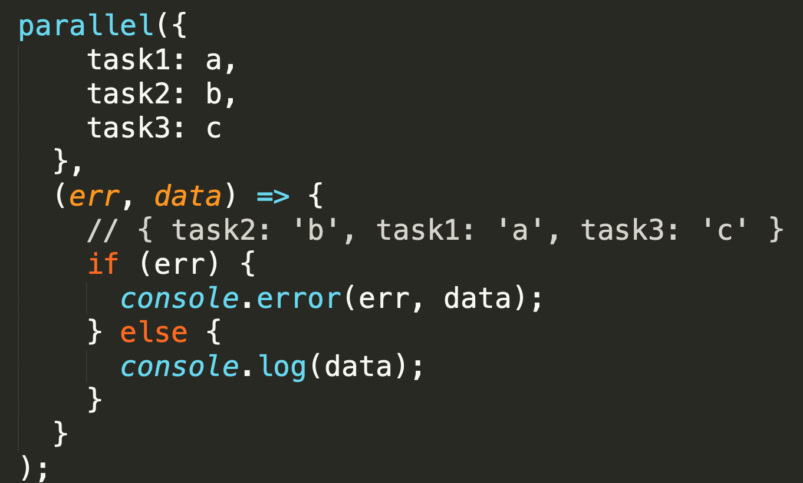
parallel
parallel
Use when:
you have independent processes
you need to wait for all of them to execute and then continue
you want to collect results from all of them

Slide 19
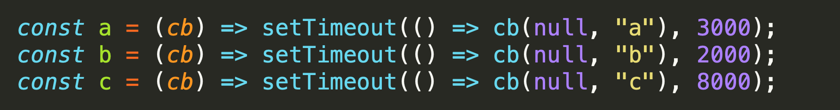

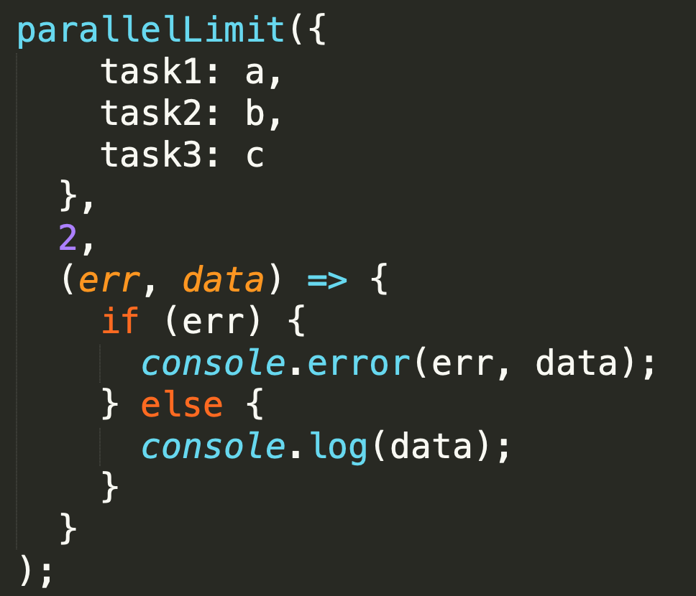
parallelLimit
The same as parallel but runs a maximum of limit async operations at a time.
koľko približne bude trvať tento program ?
ak limit je 2 ?
a tasky trvajú 3,2 a 8 sekúnd

Slide 20
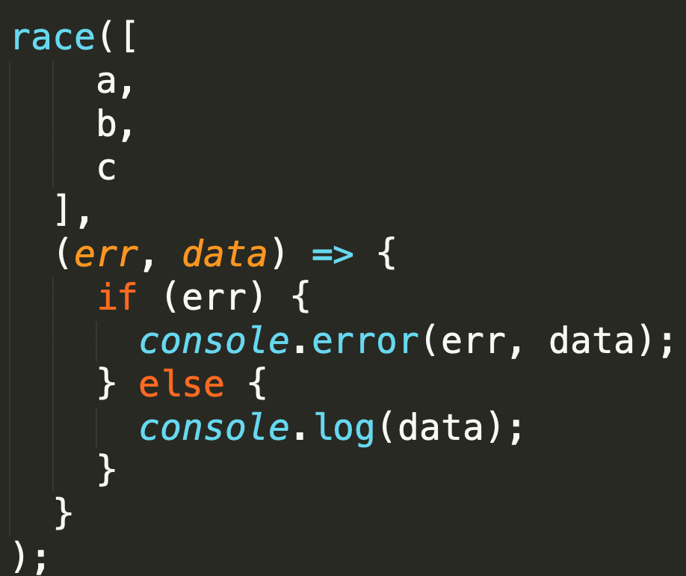
race
parallel - Once any of the tasks complete or pass an error to its callback, the main callback is immediately called.
Use when:
podobne ako sekvenčný tryEach teda ak máte alternatívne algoritmy a stačí vám výsledok najrýchlejšieho
Ale pozor:
ak najrýchlejší spadne aj callback sa zavolá z chybou
v ok aj v err scenári - nik nezabezpečí odplánovanie tých spustených timerov
koľko teda pobeží tento program
po callback ?
po úplný koniec node procesu ?

Slide 21
auto, autoInject
executes in best order based on requirements
Deklaratívny zápis čo chcete dosiahnuť a čo na každý task potrebujete

Slide 22
Queue
parallel
Use when:
ak neviete dopredu zoznam taskov a postupne pribúdajú

Slide 23
Patterns - for tasks/ flows coordination
coordinating various async tasks represented by different async functions
or chunks (cargo), or datas (queue)
for serial and parallel usage
declarative dependencies and automatic ordering with auto

Slide 24
Patterns – for data collections
when you want to run same async algorithm over collection of data
mostly Array functions: map, filter, .... just with async function as callback (iteratee)

Slide 25
Patterns – for single function
basic async patterns and helpers to be applied on function.
Mostly return wrapped function suitable for another async usage.

Slide 26
Callbacks

Slide 27
Callbacks
When your JS program makes async operation, you set up the "response" code in a function (commonly called a "callback"), and the JS engine tells the hosting environment, "Hey, I'm going to suspend execution for now, but whenever you finish with that request, and you have some data, please call this function back.“ (@getify)

Slide 28
Callback signatures
We have already met several callbacks during revious lessons:
cb(err, data)
cb(err)
cb(data)
cb(err, data, data2)
TODO: examples from node and npm modules API

Slide 29
Callbacks (+)
callbacks are by far the most common way that asynchronycity in JS programs is expressed and managed
Indeed, the callback is the most fundamental async pattern in the language
Countless JS programs, even very sophisticated and complex ones, have been written upon no other async foundation than the callback
The callback function is the async work horse for JavaScript, and it does its job respectably
https://github.com/getify/You-Dont-Know-JS/blob/master/async%20%26%20performance/ch2.md

Slide 30
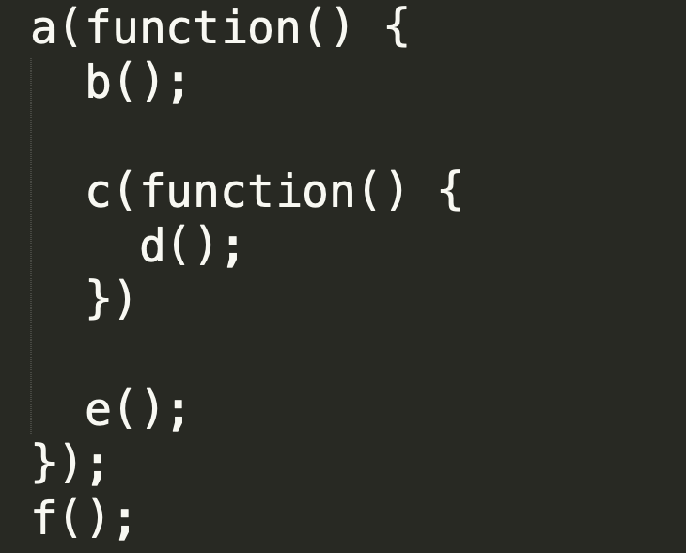

Order of code and execution

Slide 31
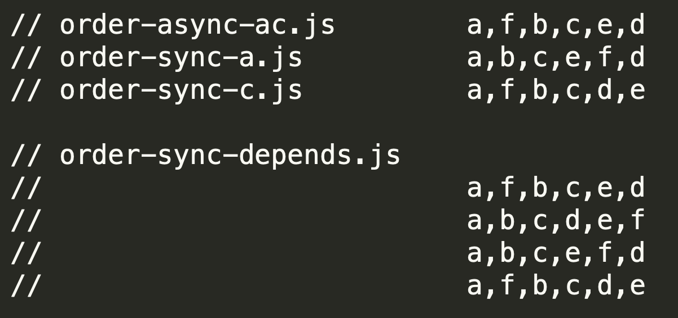
Order of code and execution
prednasky/09-async/samples/callbacks/order-*.js

Slide 32
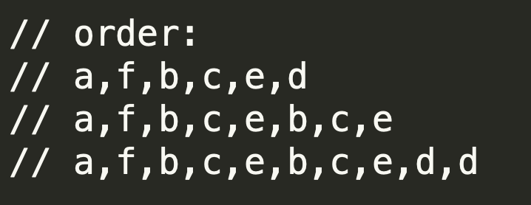
Number of callbacks
prednasky/09-async/samples/callbacks/order-*.js

Slide 33
Callbacks (-)
It turns out that how we express asynchrony (with callbacks) in our code doesn't map very well at all to that synchronous brain planning behavior
The reason it's difficult for us as developers to write async evented code, especially when all we have is the callback to do it, is that stream of consciousness thinking/planning is unnatural for most of us.
We think in step-by-step terms, but the tools (callbacks) available to us in code are not expressed in a step-by-step fashion once we move from synchronous to asynchronous.
And that is why it's so hard to accurately author and reason about async JS code with callbacks: because it's not how our brain planning works.
https://github.com/getify/You-Dont-Know-JS/blob/master/async%20%26%20performance/ch2.md

Slide 34
Callbacks (-)
callback hell
order of code is not sequential
hardcoded continuations (names of next functions)
error handling paths
cluttered code hard to reason about
... indentation ... is just side effect not helping previous real problems
with callback we trust the 3rd party (the one who calls our function) to
call us only once (but it can call us multiple times, or not at all)
call us in the async or sync fashion but not snyc one time and async second time
solvable with some boilerplate code but clutter

Slide 35
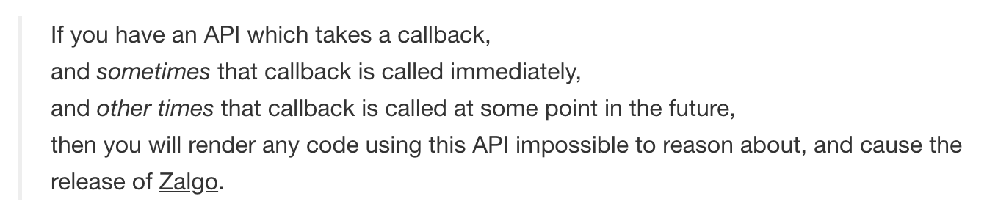
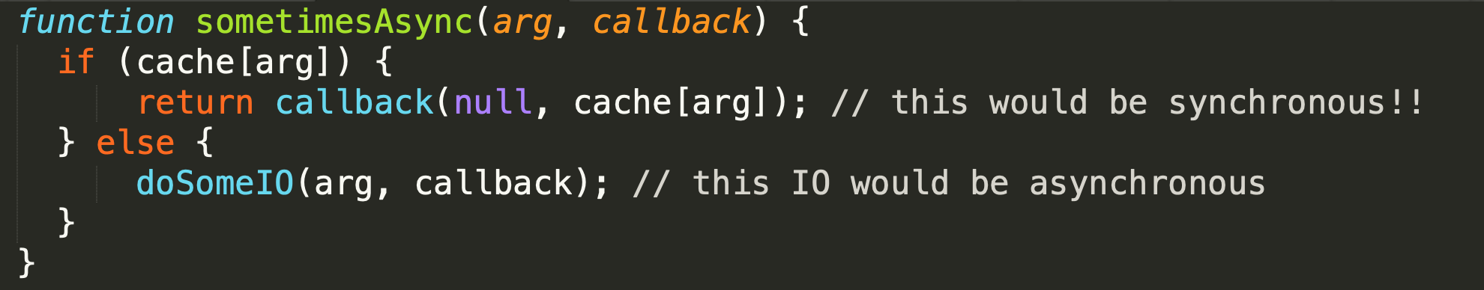
sometimes-async-function
http://blog.izs.me/post/59142742143/designing-apis-for-asynchrony
https://blog.ometer.com/2011/07/24/callbacks-synchronous-and-asynchronous/
prečo je takato async funkcia problém (ozaj v skratke):
nemôžte sa spoľahnúť na poradie (viď predošlý príklad)
b,c,e .... e vs.
b,c,d,e
Maximum call stack size exceeded

Slide 36
sometimes-async-function, never called, multiple call – solutions ?
Sometimes:
As authors: Do not produce sometimes sync, async functions
As consumers: When consuming sometimes async function wrap it with async.ensureAsync(fn)
Never:
As authors: it is bug, do all callback paths coverage with your tests
As consumers: wrap your functions with async.timeout(fn)
Multiple:
As authors: it is bug, do all callback paths coverage with your tests
As consumers: ???

Slide 37
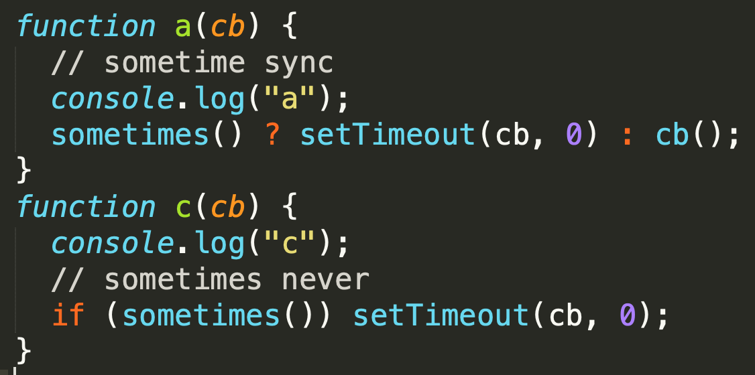

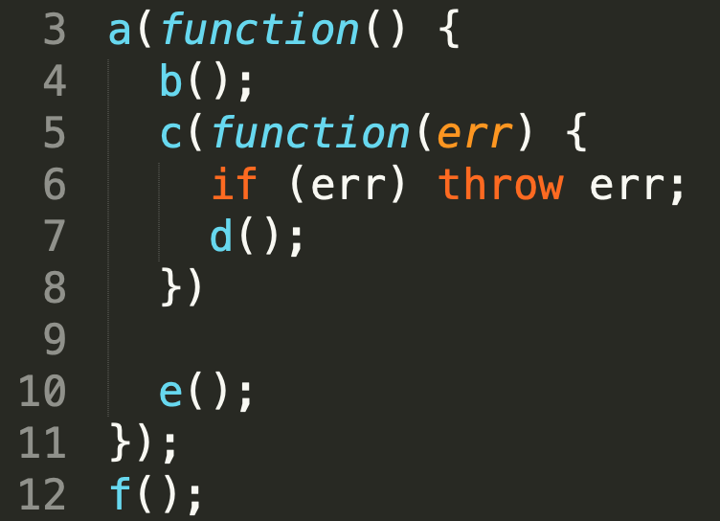
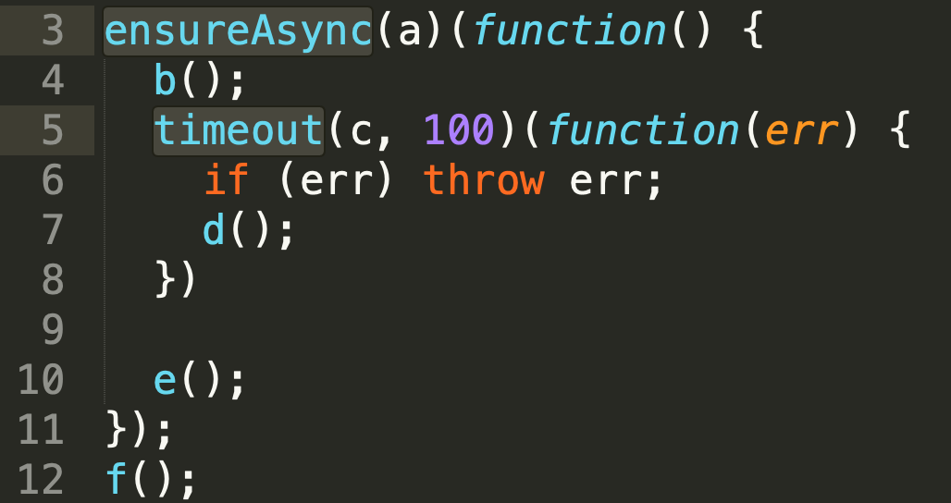
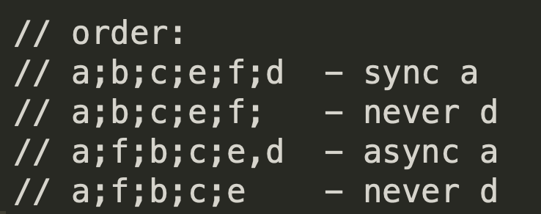
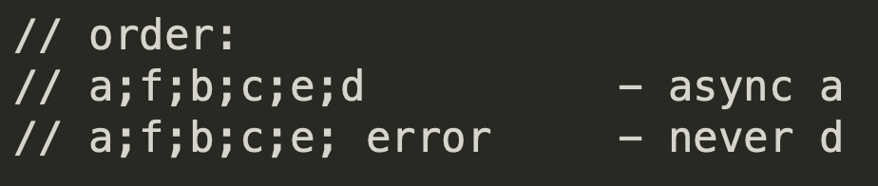
solutions async.ensureAsync and async.timeout

Slide 38
Cooperative Concurrency

Slide 39
Cooperative Concurrency
What:
The goal is to take a long-running "process"
and break it up into steps or batches or chunks
so that other concurrent "processes" have a chance to interleave their operations into the event loop queue
Why:
to receive better performance of simultaneously running processes in single threaded environment
This applies to both Noninteracting and Interacting „processes“

Slide 40
Cooperative Concurrency
if callback takes a lot of time,
eg. processes a lot of data items in „loop“
nothing else can happen:
in browser – no rendering, no clicks, ....
on web server – no other requests can be served
The idea is to split processing to „chunks“,
give up stack after processing partial chunk
schedule next chunk processing
this brings chance for user or other events to start other processes
brings better perceived performance and responsivness
long callback 500ms
x
y
wait in queue
space for user interacion
2 processes interleaving
3 processes interleaving
x
y
x
y
x
y
x
y
x
y
z
x
y
z
wait in queue
other process

Slide 41
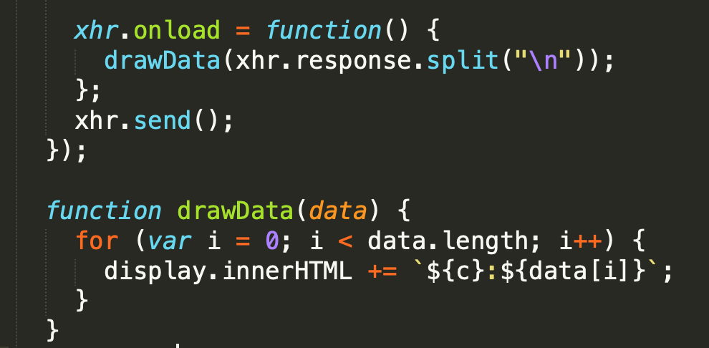

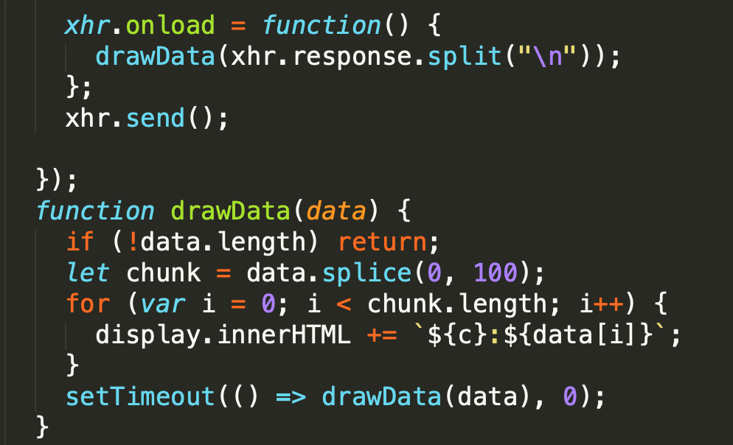
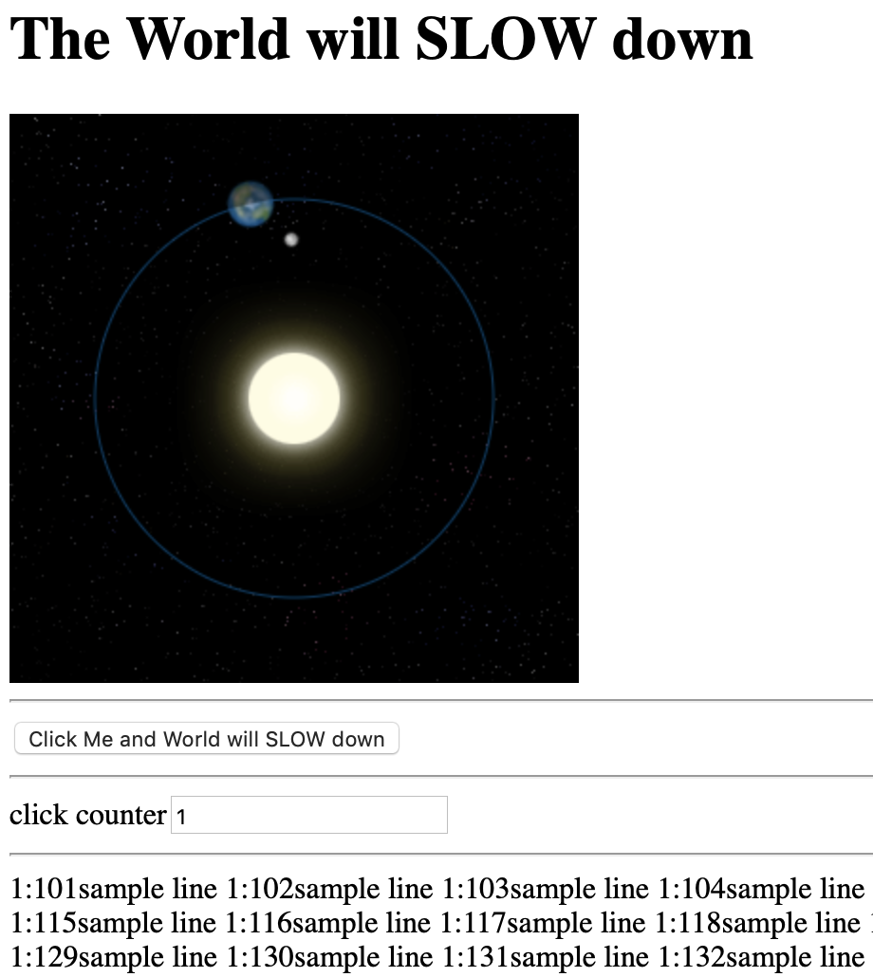
Cooperative Concurrency Demo The World will stop vs. The World will slow down
04-async/samples/cooperative/bad
04-async/samples/cooperative/good

Slide 42
Cooperative Concurrency
What to do to be cooperative:
Split data to several chunks process with one function (previous sample)
for loop vs recursion
async recursion
async for ....
another async patterns
Split sequence of sync calls to several async calls in async sequence pattern
sequence of asyncified functions

Slide 43
sequence of asyncified functions
TODO: sample

Slide 44
Timers

Slide 45
Timers

Slide 46

_aux

Slide 47
setTimeout timers in browsers vs. node
it's important to note that setTimeout(..) doesn't put your callback on the event loop queue. What it does is set up a timer; when the timer expires, the environment places your callback into the event loop, such that some future tick will pick it up and execute it.
https://github.com/getify/You-Dont-Know-JS/blob/master/async%20%26%20performance/ch1.md
tak ako to je v node su sucastou event loopu IMHO....

Slide 48
ES6 now specifies how the event loop works
ES6 now specifies how the event loop works, which means technically it's within the purview of the JS engine, rather than just the hosting environment. One main reason for this change is the introduction of ES6 Promises, which we'll discuss in Chapter 3, because they require the ability to have direct, fine-grained control over scheduling operations on the event loop queue (see the discussion of setTimeout(..0) in the "Cooperation" section).

Slide 49
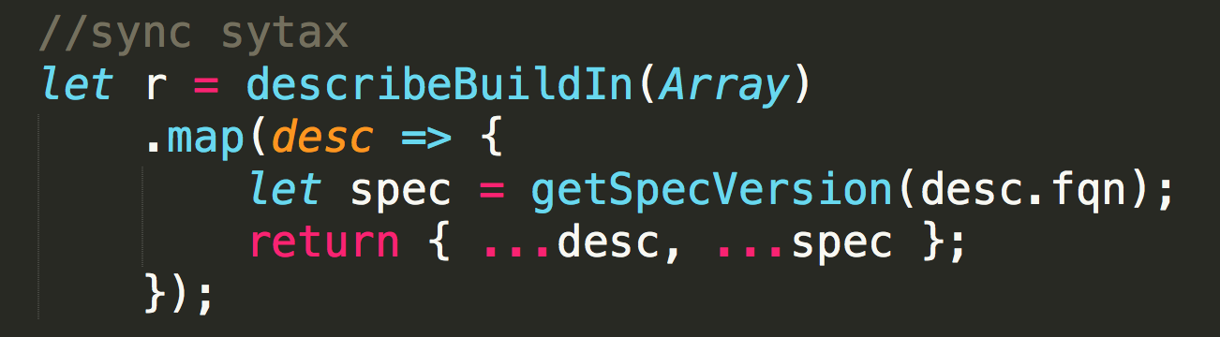
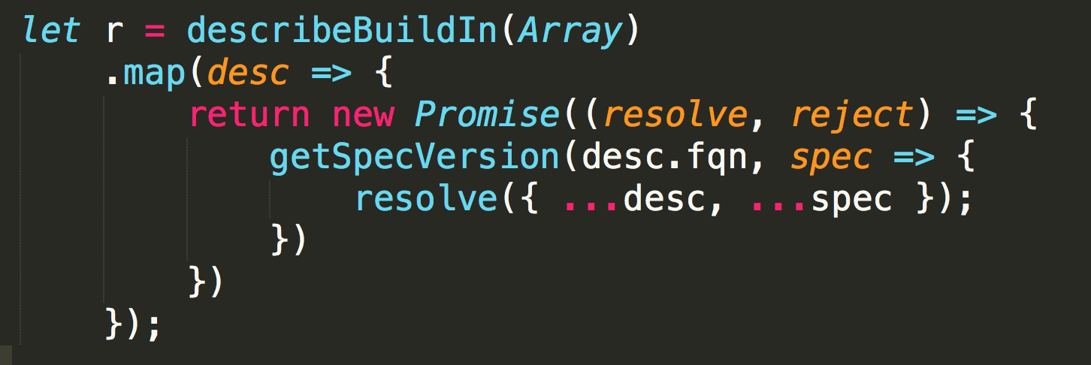
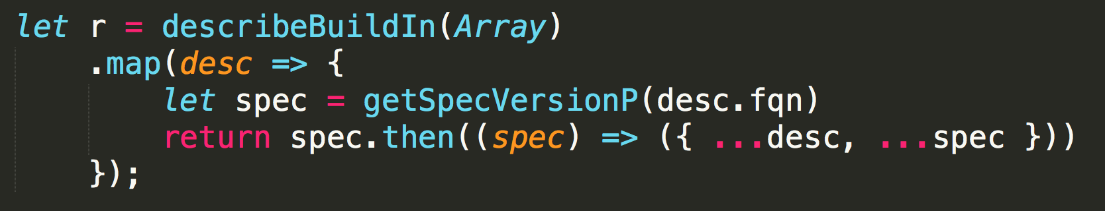
Map with async operation
TODO: pure callback version

Slide 50
npm co
Generator based control flow goodness for nodejs and the browser,
using promises, letting you write non-blocking code in a nice-ish way.
v4

Slide 52
https://jakearchibald.com/2017/async-iterators-and-generators/
https://medium.com/javascript-scene/the-hidden-power-of-es6-generators-observable-async-flow-control-cfa4c7f31435
https://medium.com/@deaniusaur/how-to-stream-json-data-over-rest-with-observables-80e0571821d3
https://medium.com/@fknussel/a-simple-observable-implementation-c9c809c89c69
https://rxjs-dev.firebaseapp.com/guide/observable

