Slide 1
cvicenie 03

Slide 2
Obsah
Kontrola zadani z minuleho cvika (a skupina), b skupina je obodovana
Styly kodov z prednasky na node.js FileSystem API
6 bodov
OO programming
2 body
9b za cvicenie
node.js API – materialy a vysvetlenie
mocha async testy vysvetlenie
pet projects – bonusove ulohy

Slide 3
flat(o) 4b
Implementujte funkciu flat ktora zozbiera vseky member z prototype chainu a setne ich na object samotny
2b za test
2b za implementaciu

Slide 4
node.js Filesystem API
01-prednaska/node-core-modules.pptx

Slide 5
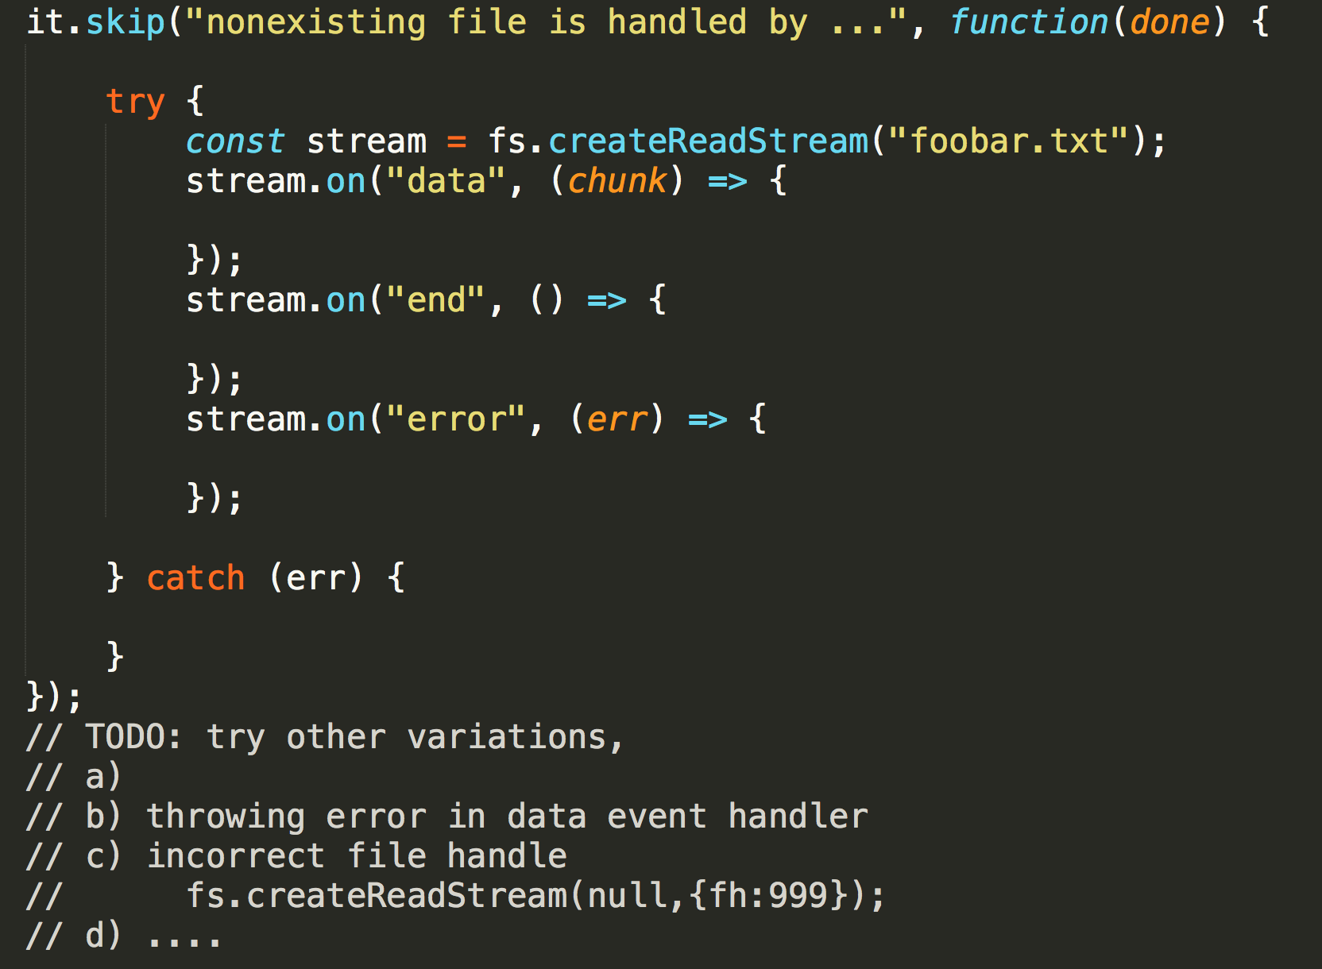
Zadanie 03-01 – 2body error-handling-events.js
Exploratory testing - error handling in evented paradigm
wawjs-cvicenie03
Cviciaci: vysvetlit async testing (done() callback)
Studenti: spravit 3 varianty z asertami na toto:

Slide 6
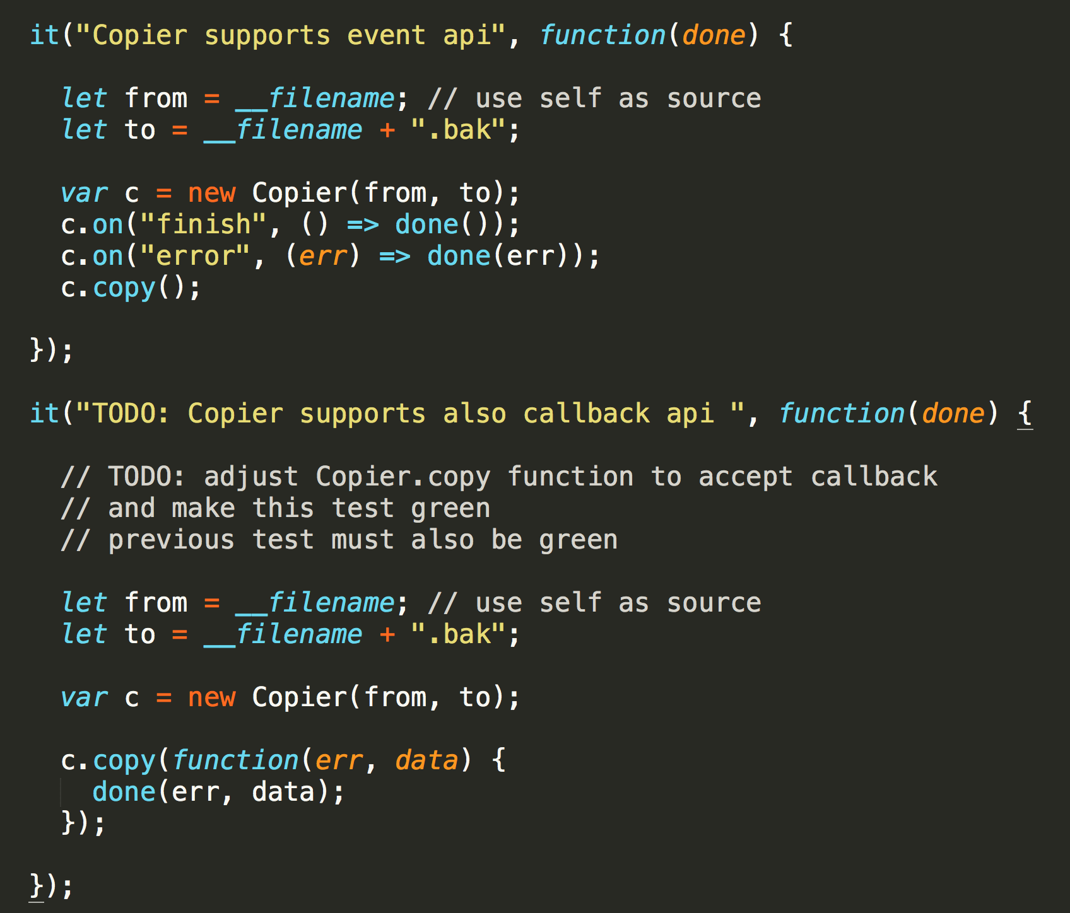
Zadanie 03-02 – 2 body - Copier.spec.js
Konverzia event api na callback
Copier.spec.js
2 body

Slide 7
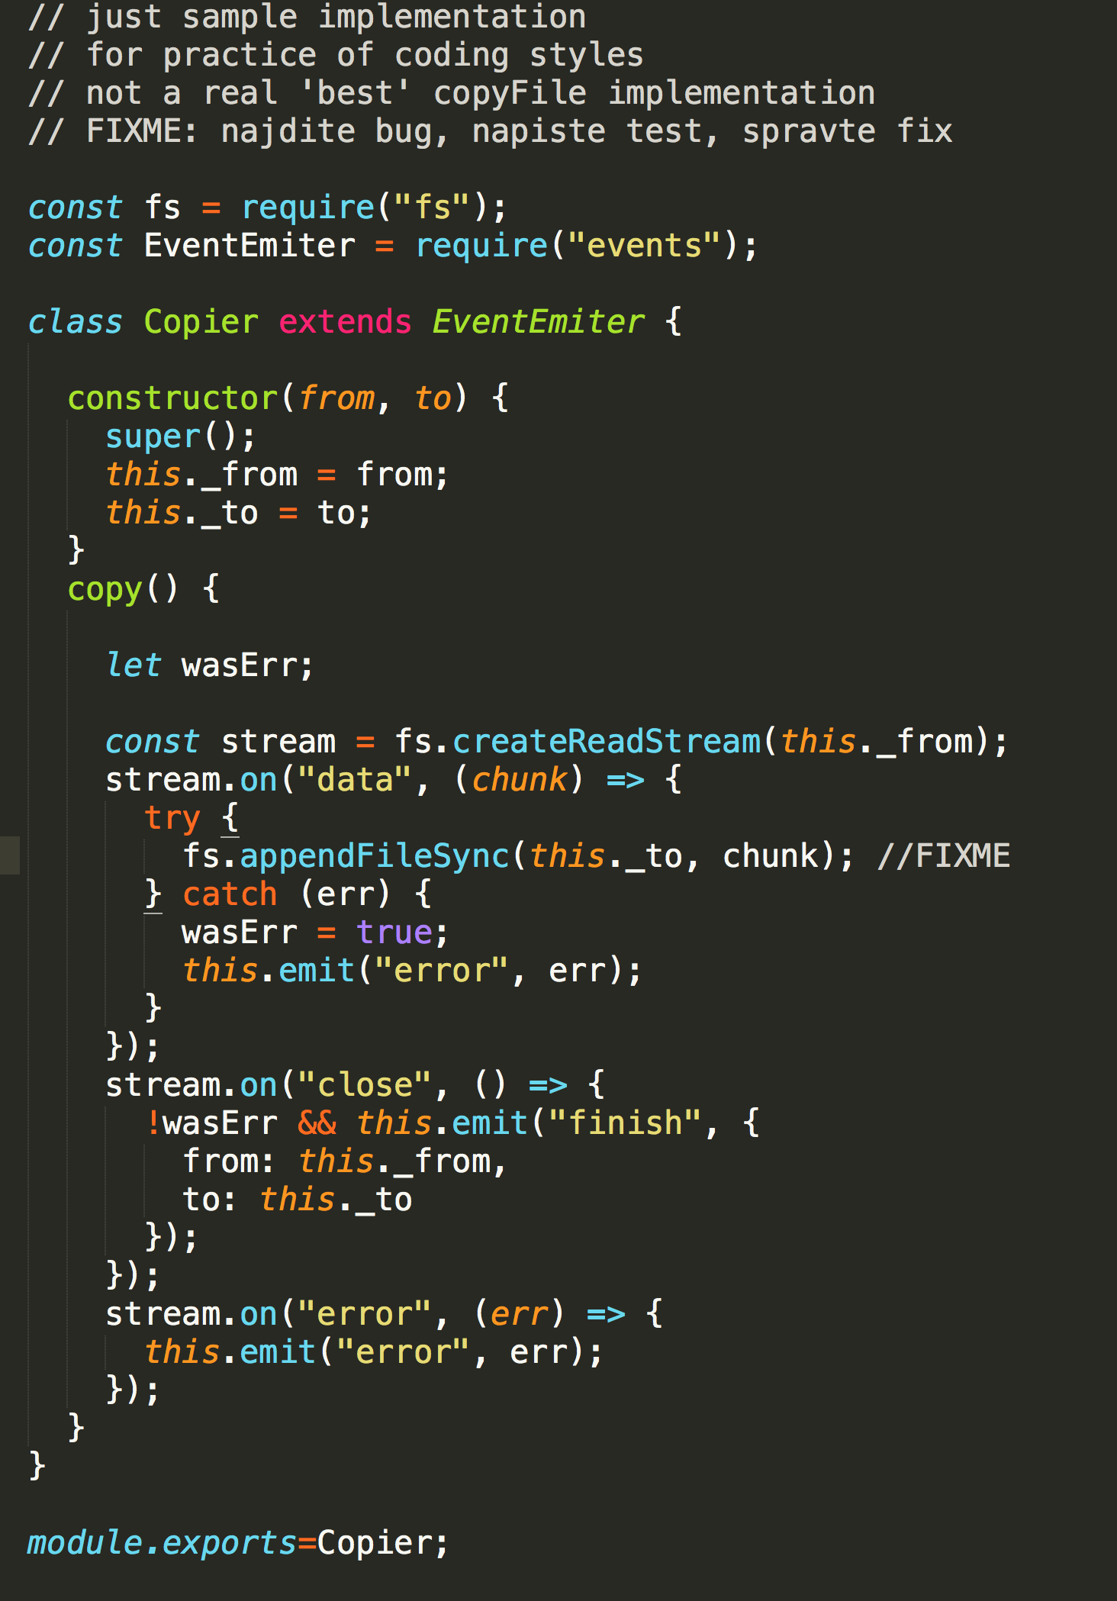
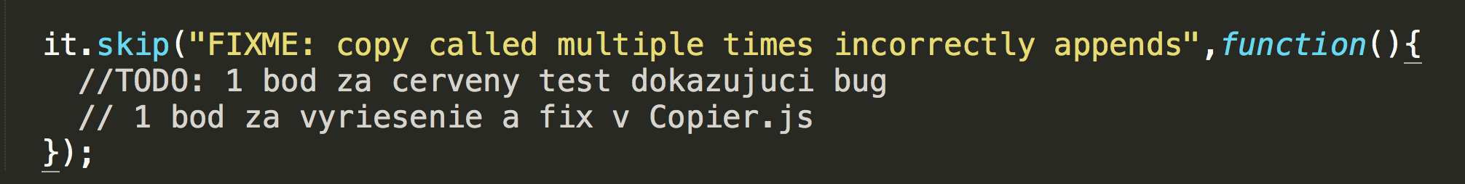
Zadanie 03-03 – 2 body – FIXME Copier.spec.js, Coppier.js
Napiste test scenar simulujuci bug (padajuci test)
1 bod
spravte fix (vsecky testy zelene)
1 bod

Slide 8
Zadanie 03-04 – 3b, Copier.js with no classes
Reimplementujte povodny Copier.js tak aby nepouzival classes a zaroven bol EventEmitter
vid prednasky o OO z dnesneho dna
3b ak budu testy zelene z novym Copier2.js modulom

Slide 10
Pet projects
https://github.com/ainthek
https://github.com/ainthek/nconv
https://github.com/ainthek/abbreviations-extractor
https://github.com/ainthek/bakery
https://github.com/ainthek/mrequire
https://github.com/ainthek/video-tools
Projekty co mna zaujimaju:
https://github.com/kucherenko/jscpd
https://github.com/ainthek/plato-reports
Projekty z vasich zadani
Missing node.js libs
html
mail
json,yaml, …
xml
xlsx, csv, odt….

