Slide 1
Week 1, 2
20201495 Seohyun Yim

Slide 2
Introduction to computer vision
Computer vision : providing computers the ability to see and understand images
Applications
IBM Watson to analyze and properly identify classes of carbonate rock
quantify soft skills and conduct early candidate assessments to shortlist the candidates
tagging videos with keywords based on the objects that appear in each scene → security footage
check for degrees of rust and other structural defects of electric towers
take high resolution images from different angles
cut up the images into a grid of smaller images
develop a custom image classifier that detects the presence of metal structure versus other structure versus non-metal objects(determine which areas of the image contain metal)
create another custom classifier to determine the level of rust based on certain structural guidelines or criteria

Slide 3
Recent research
Facebook - detecting objects in images
self-driving cars - avoid obstacles and prevent collisions
Image-to-image translation
The UC Berkeley Research Team - Everybody Dance Now
: converting an image from one representation of a scene to another
: video of a person performing dance moves -> the person's dance moves transferred to an amateur target

Slide 4
Brainstorming my own applications
" What problems could computer vision solve?"
start from an existing problem
narrow it down by industry
ex) automotive, manufacturing, human resources, insurance, healthcare, ...

Slide 5
Image processing pipeline
1. Acquisition and storage : image needs to be captured, stored on device as a file
2. Load into memory and save to disk : image needs to be read from the disk into memory, stored using data structure, and data structure needs to be serialized into an image file
3. Manipulation, enhancement, and restoration
run few transformations no the image
enhance image quality
restore image from noise degradation

Slide 6
Image processing pipeline
4. Segmentation : to extract objects of interest
5. Information extraction/representation : to represent in alternative form
6. Image understanding/interpretation
Image classification (ex. whether an image contains a human object or not)
Object recognition (ex. finding the location of the car objects in an image with a bounding box)

Slide 7
What is a digital image
: a rectangular array of numbers - quantized samples obtained from the grid
Intensity values
darker shades of gray have lower values and lighter shades have higher values (0~255, black as 0 and white as 255)
if reduce the number of intensity values on the right image → low contrast
RGB - color values are represented as different channels, and each channels has its own intensity values
each of channels and pixels can be accessed by row and column index

Slide 8
What is a digital image
Image mask used to identify objects
intensities corresponding to the person are represented with one and the rest are zeros
video sequence is a sequence of images → each frame of the video
Image formats
JPEG (Joint Photographic Expert Group image)
PNG (Portable Network Graphics)
: these formats reduce file size and have other features

Slide 9
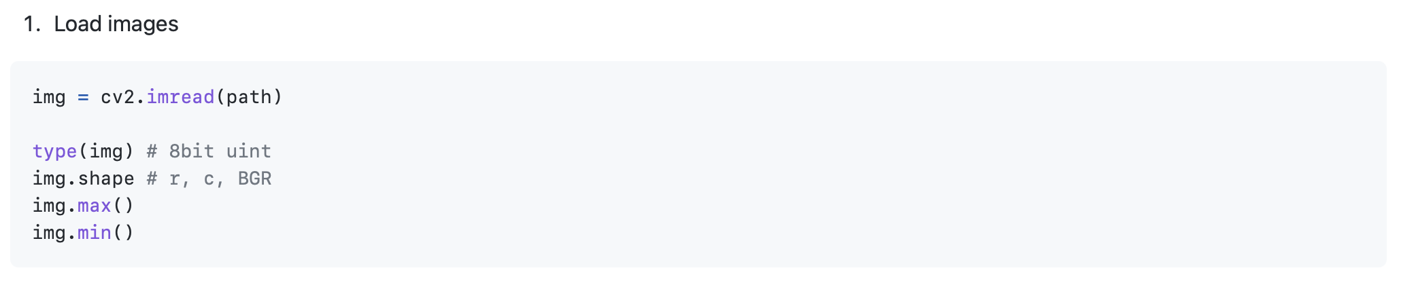
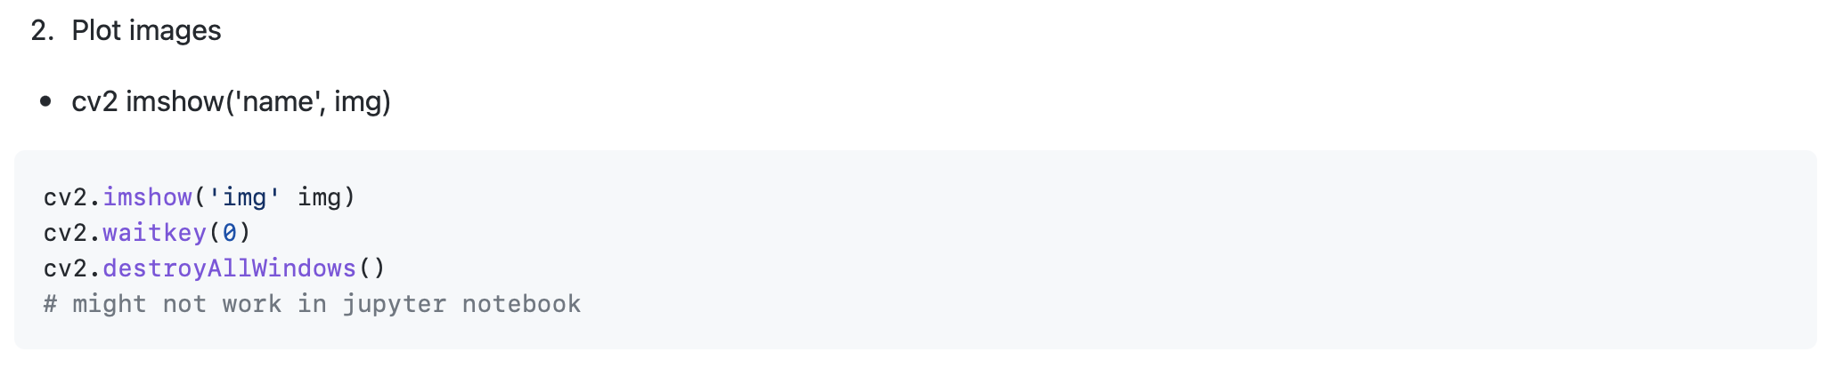
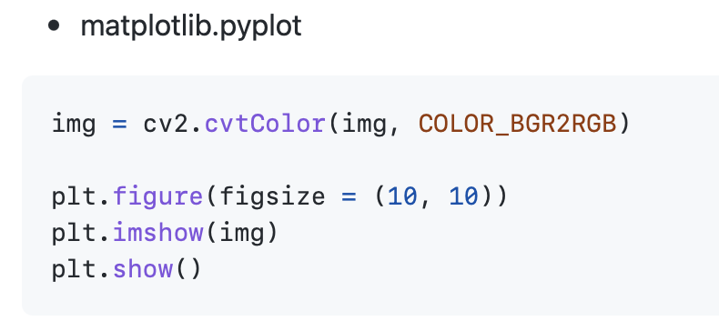
Image processing with OpenCV

Slide 10
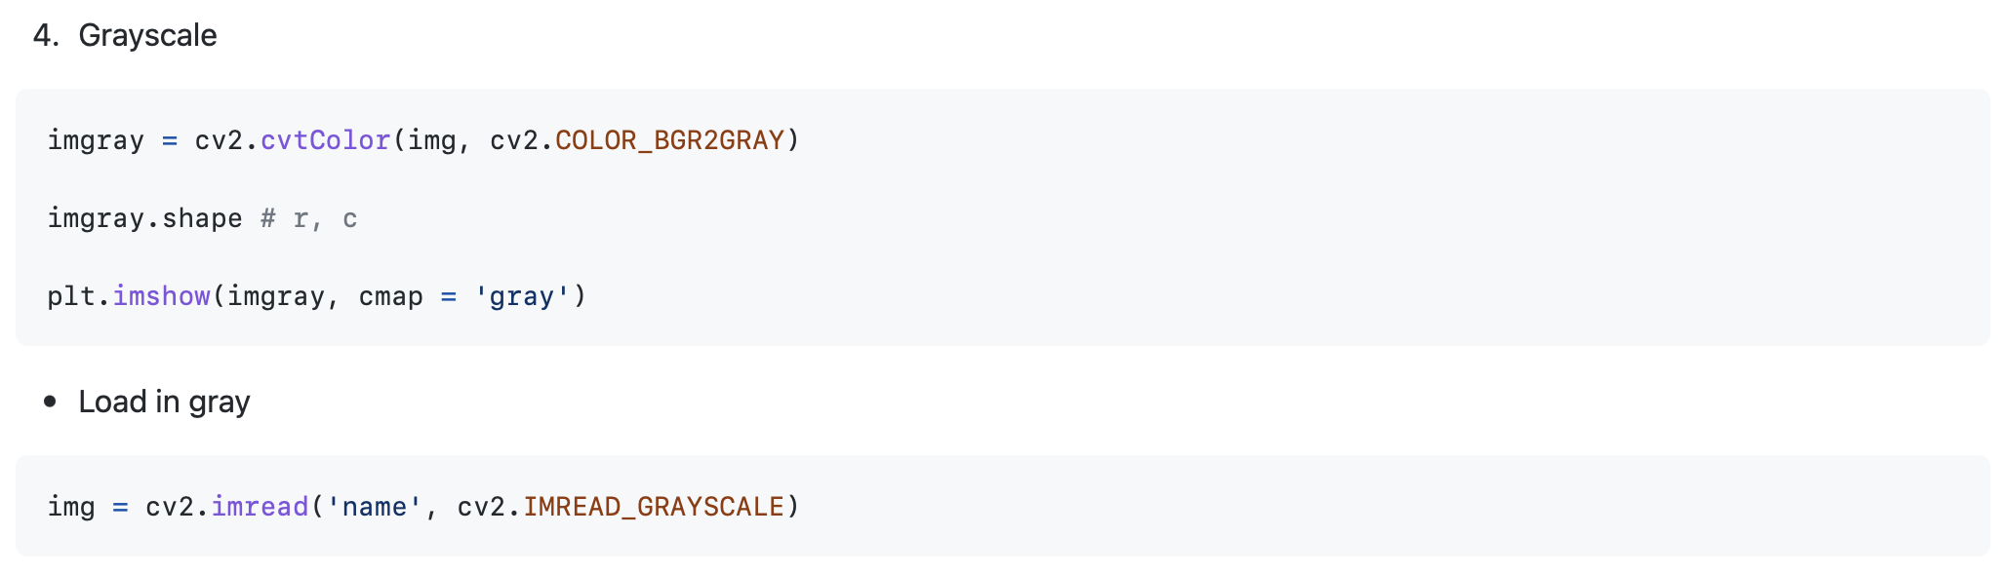
Image processing with OpenCV

Slide 11
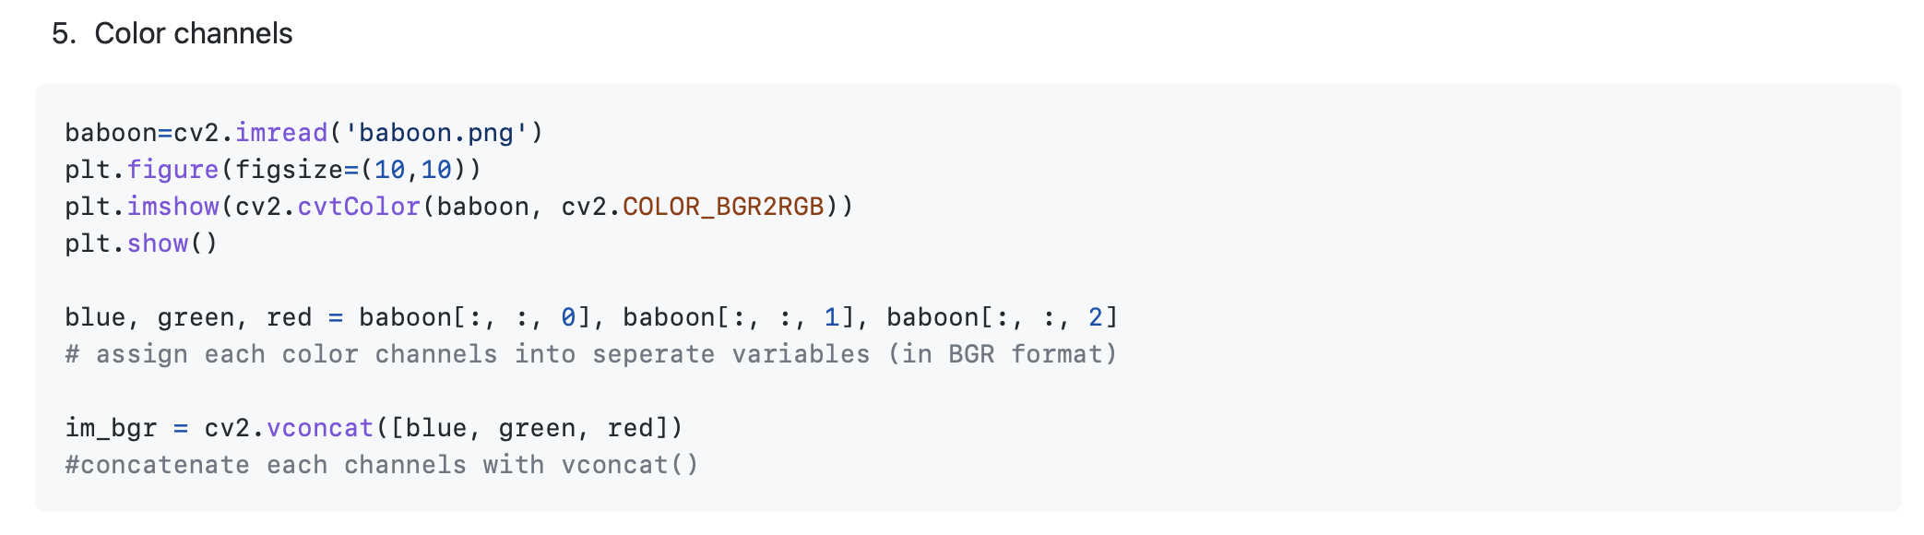
Image processing with OpenCV

Slide 12
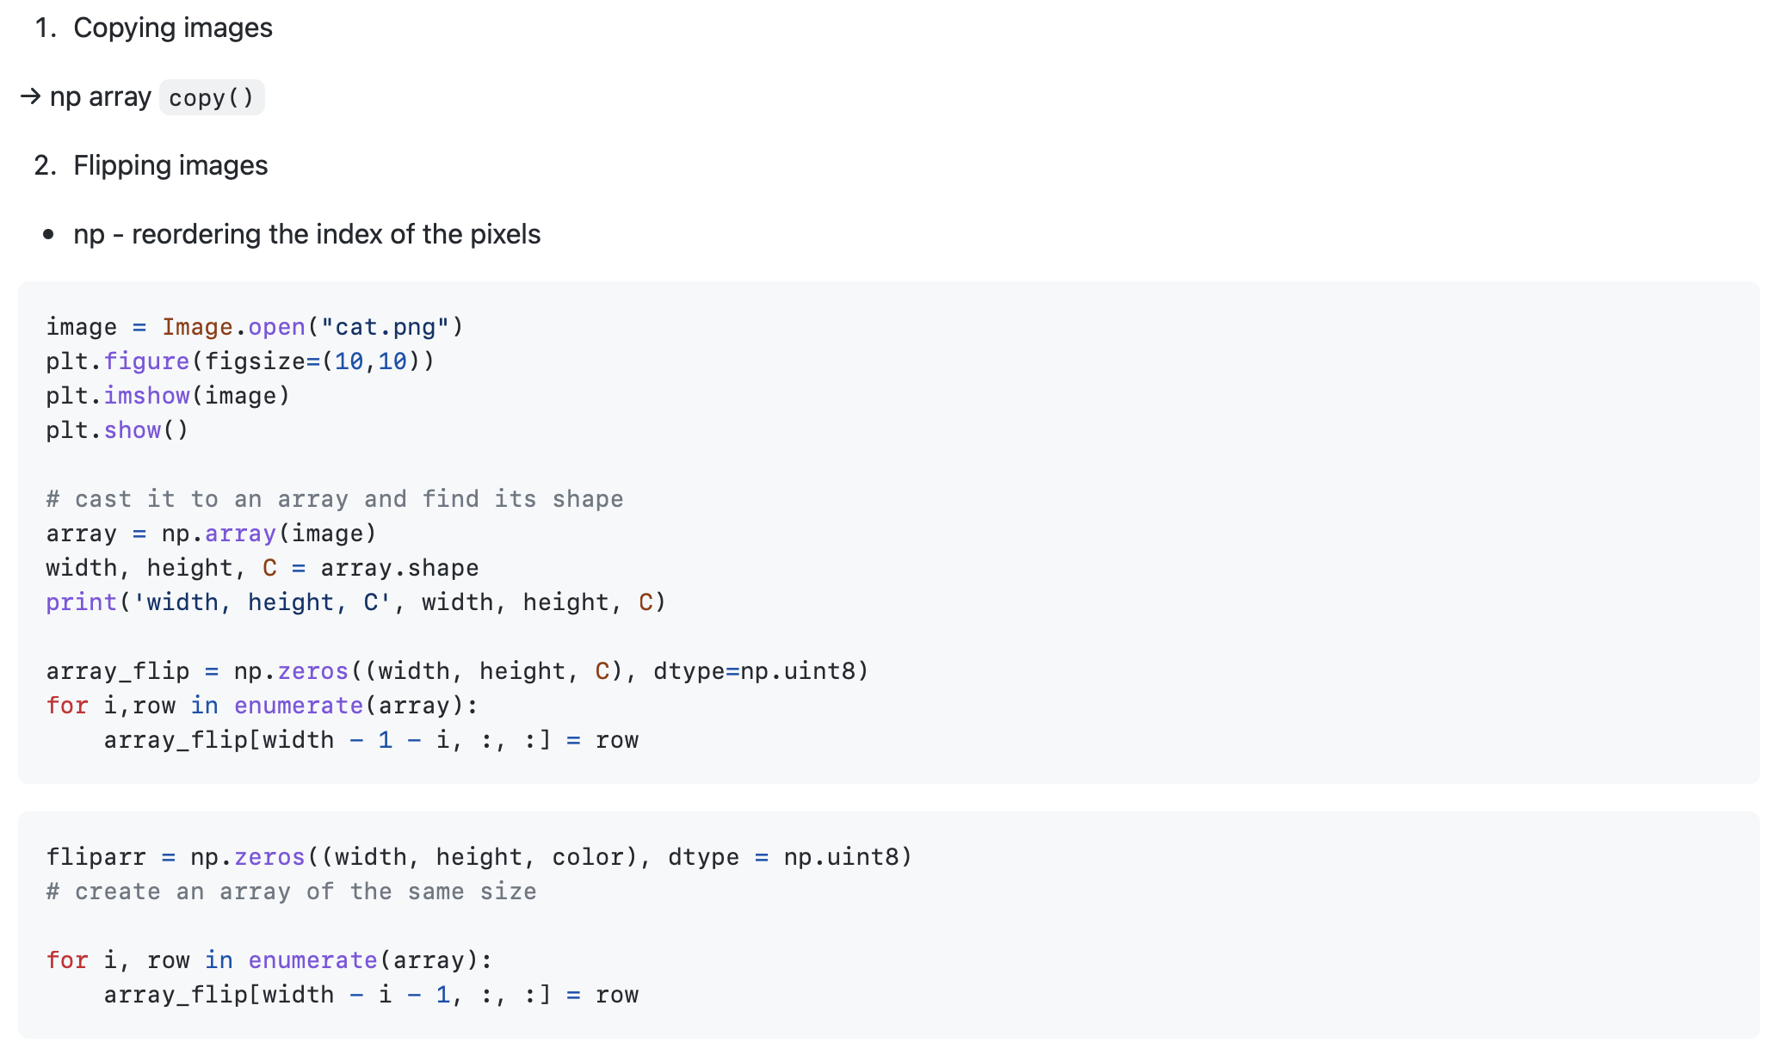
Manipulation with OpenCV

Slide 13
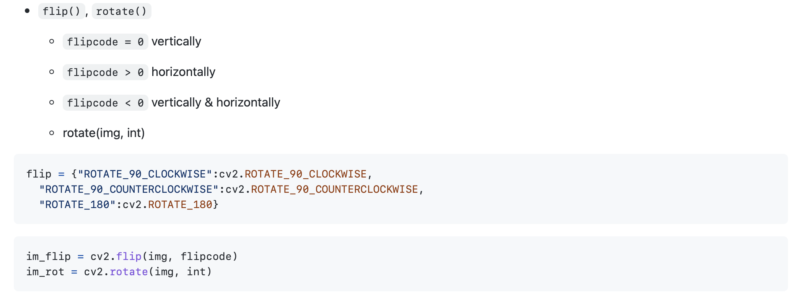
Manipulation with OpenCV

Slide 14

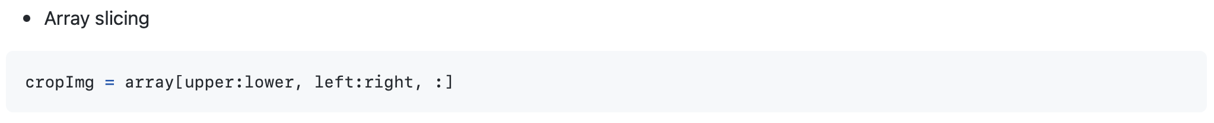
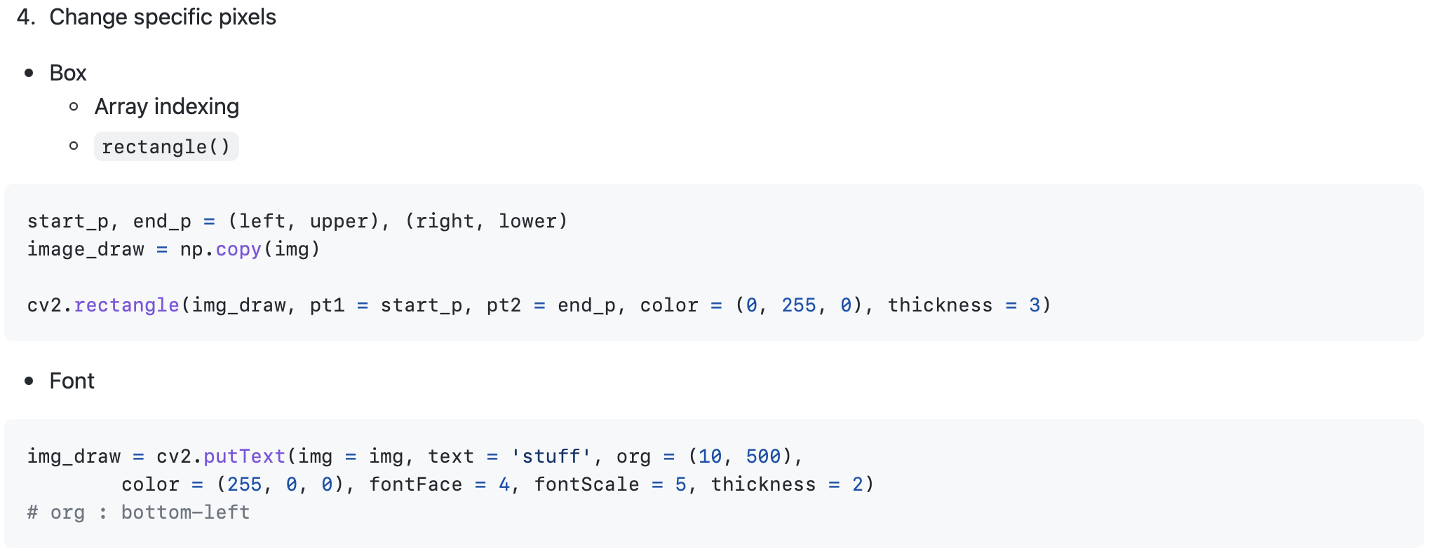
Manipulation with OpenCV

Slide 15
Manipulation with OpenCV

Slide 16
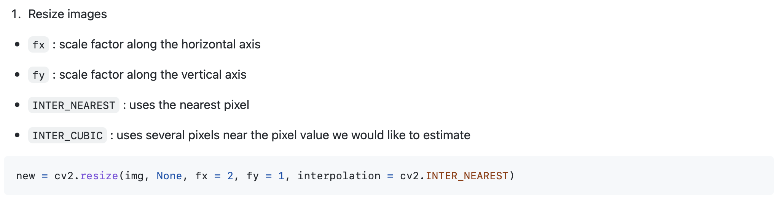
Geometric transforms & Mathematical Operations with OpenCV

Slide 17
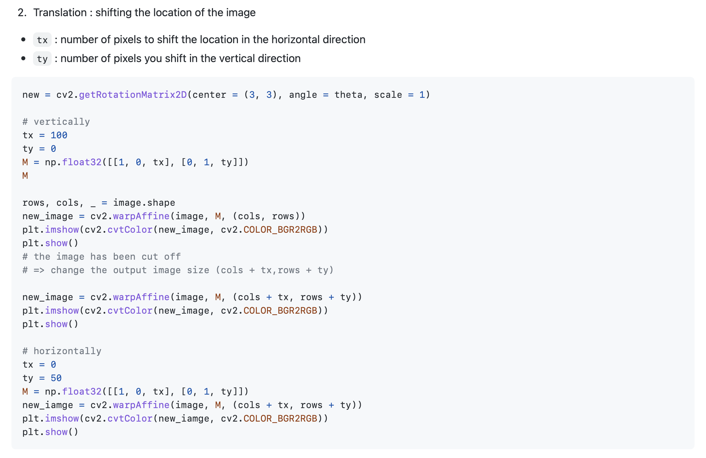
Geometric transforms & Mathematical Operations with OpenCV

Slide 18
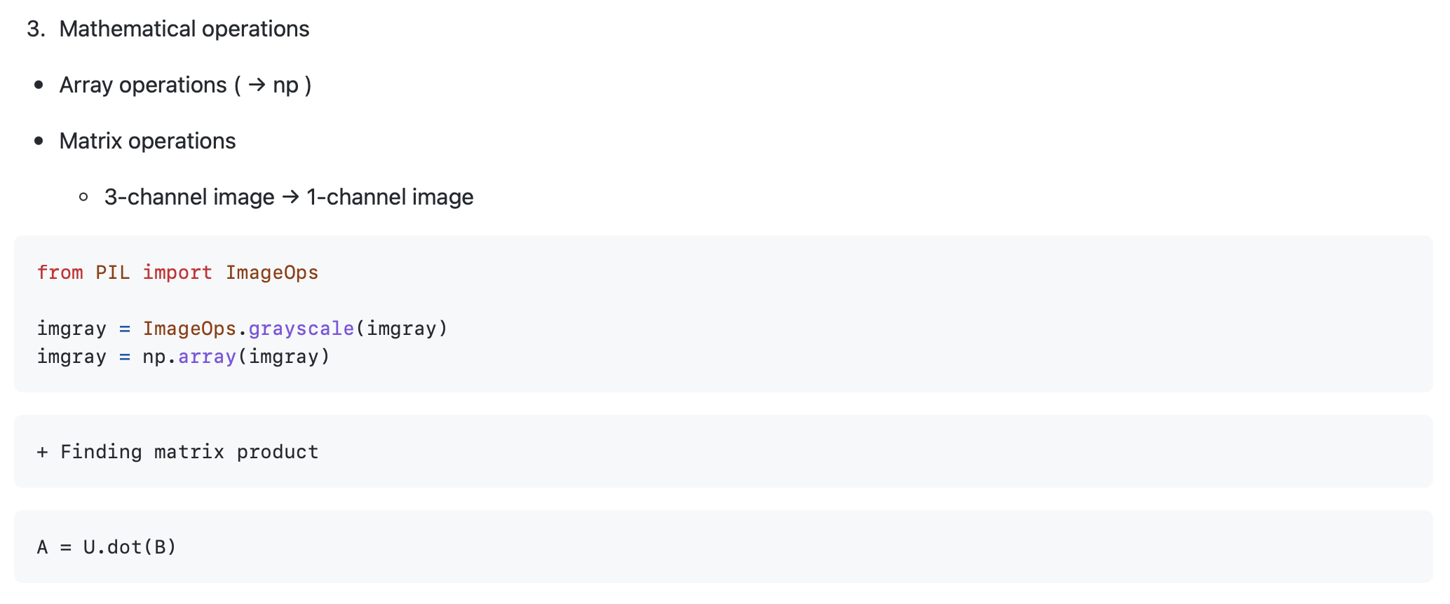
Geometric transforms & Mathematical Operations with OpenCV
Finding matrix product

Slide 19
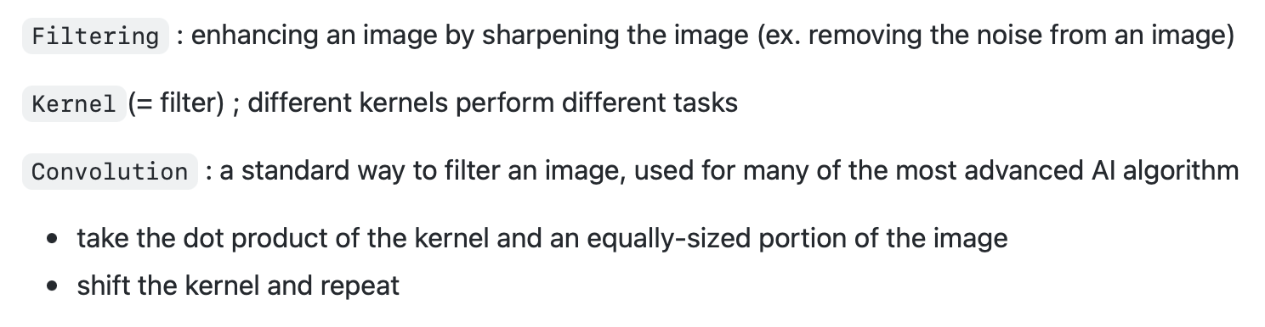
Spatial filtering with OpenCV

Slide 20
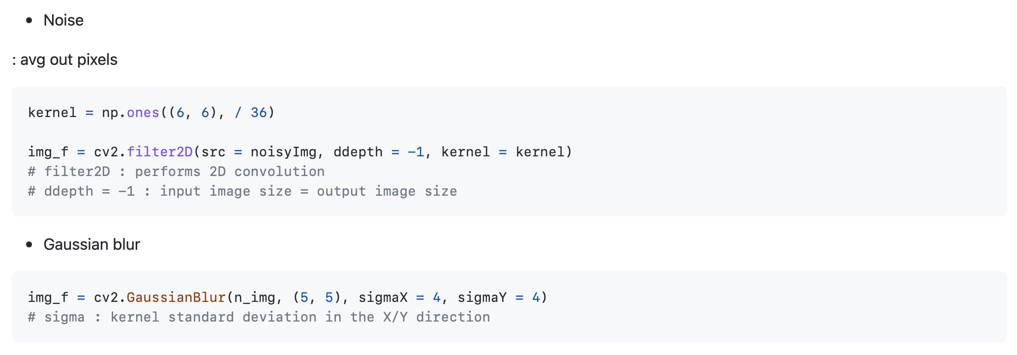
Spatial filtering with OpenCV

Slide 21
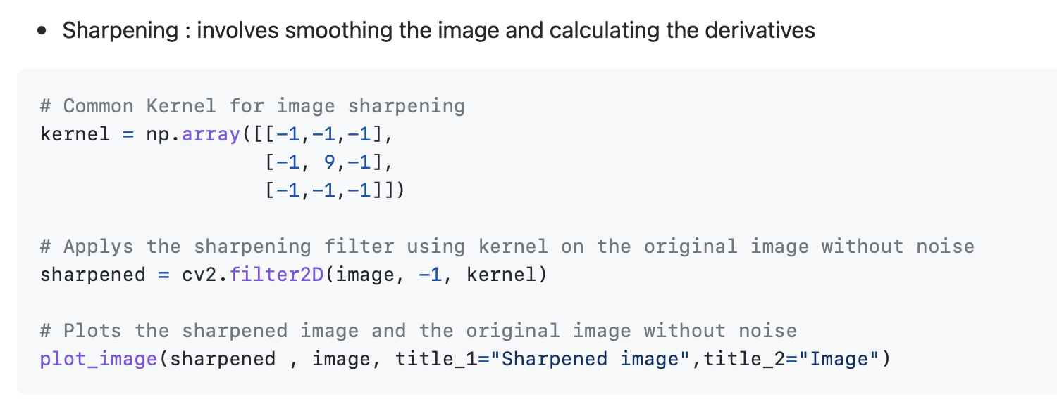
Spatial filtering with OpenCV

Slide 22
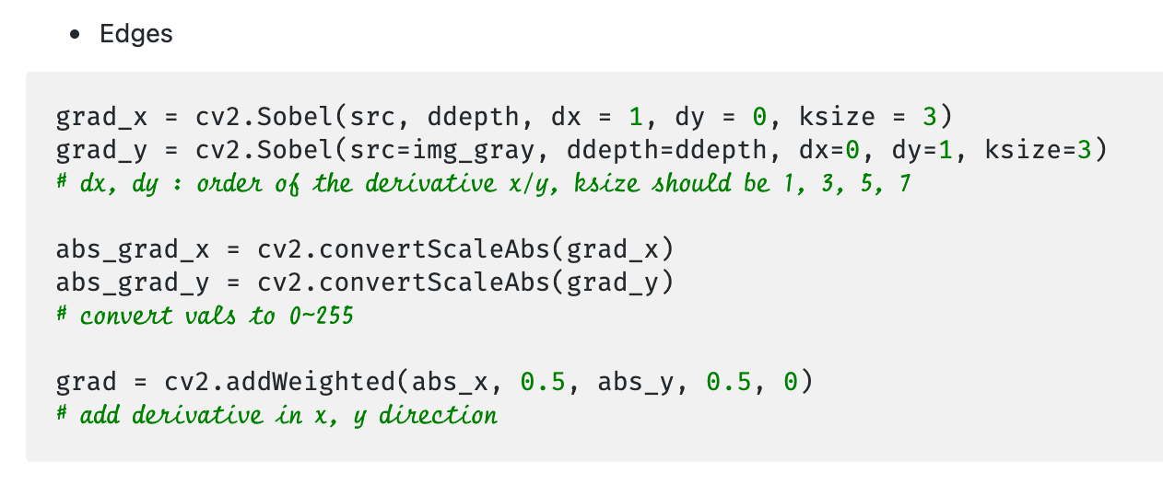
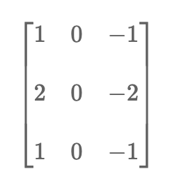
Spatial filtering with OpenCV
approximates the derivative by convolving the image with the following kernel

Slide 23
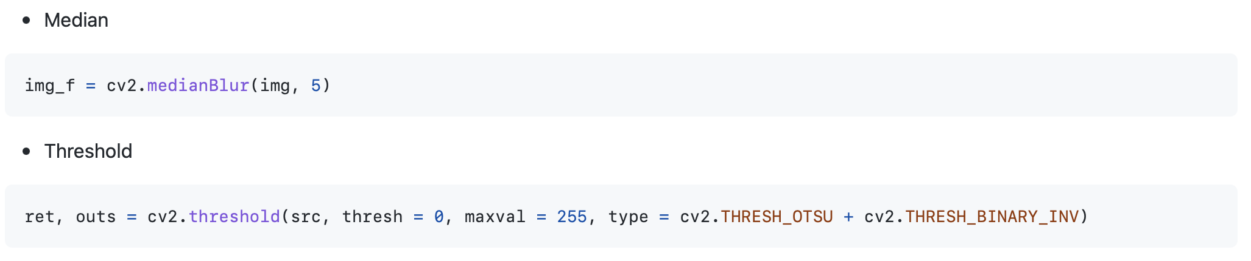
Spatial filtering with OpenCV
: central element replaced with median value (increases the segmentation between the object and the background)

Slide 24
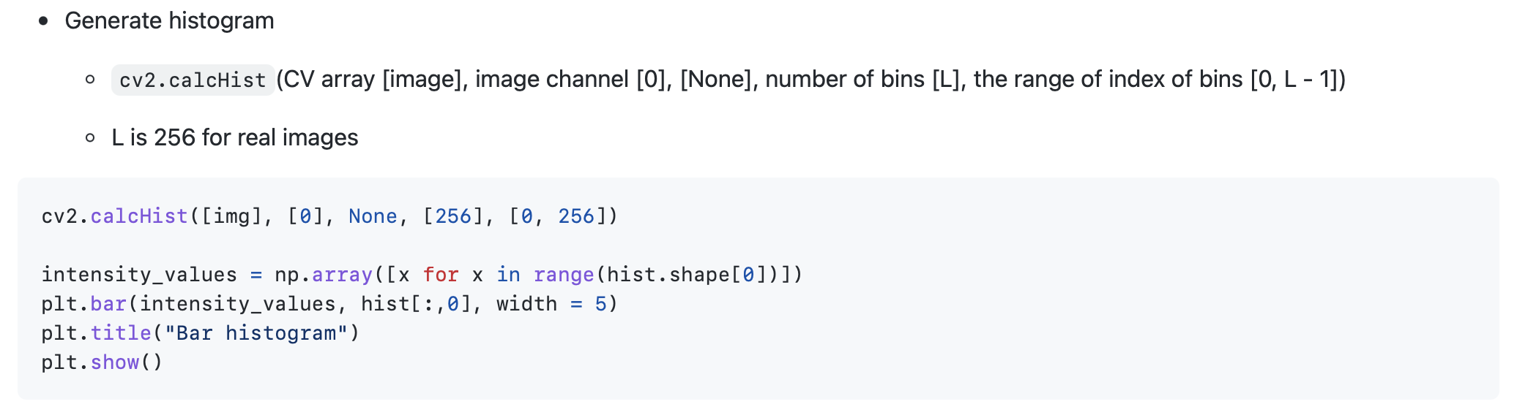
Histogram : counts the number of occurrences of the intensity values of pixels

Slide 25
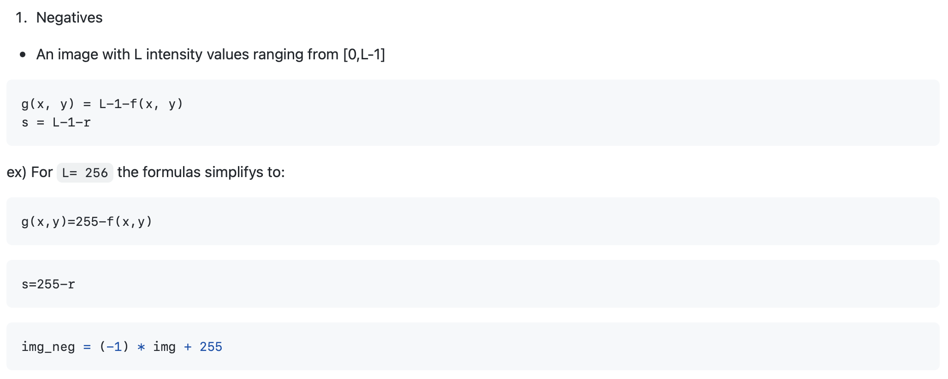
Histogram – Intensity transformations

Slide 26
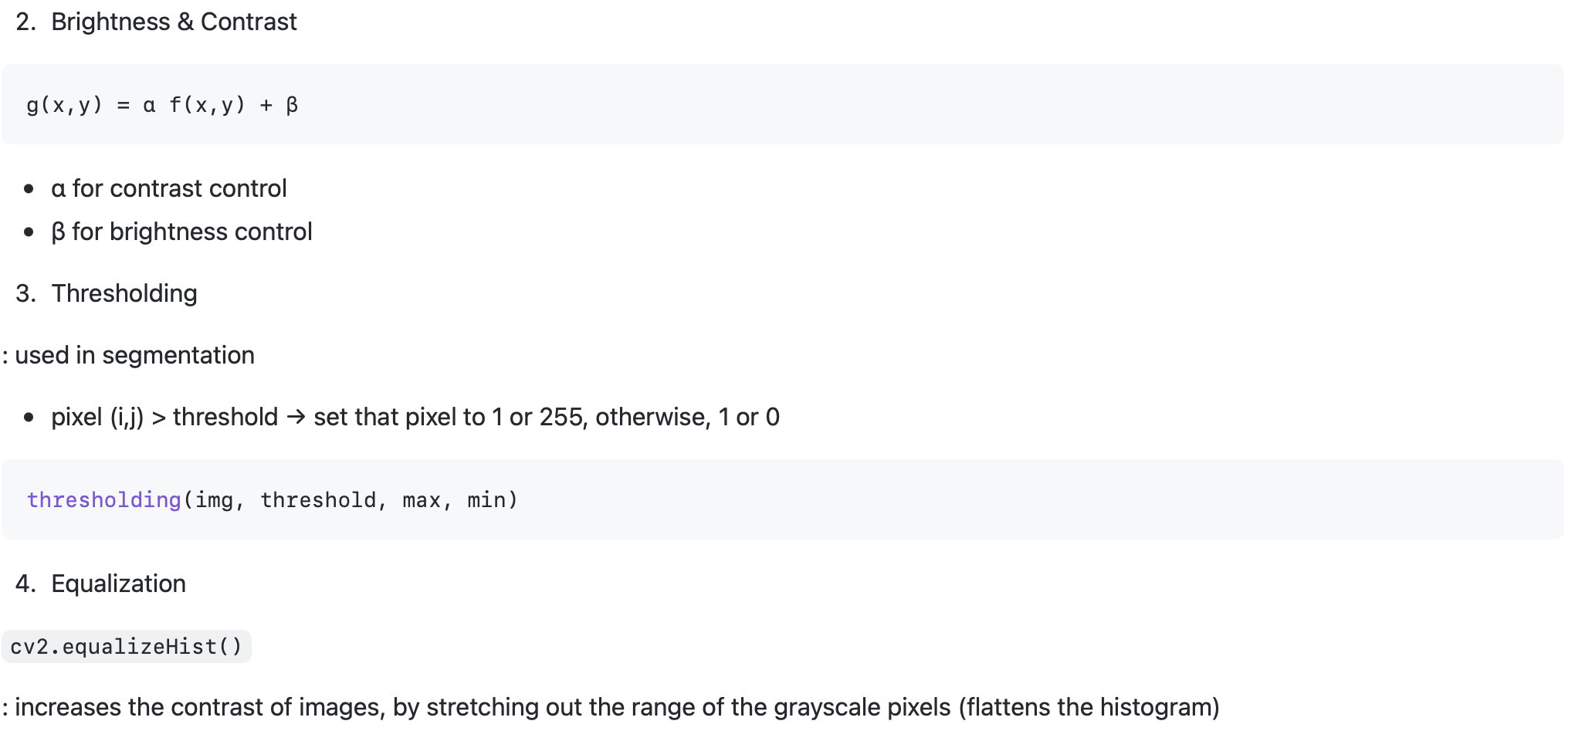
Histogram – Intensity transformations

