Slide 1
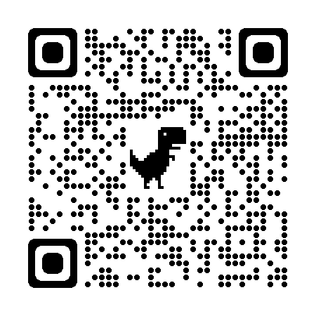

BIFROST: Reinventing WiFi Signals Based on Dispersion Effect for Accurate Indoor Localization
Yimiao Sun, Yuan He*, Jiacheng Zhang, Xin Na, Yande Chen, Weiguo Wang, Xiuzhen Guo
School of Software and BNRist, Tsinghua University
http://tns.thss.tsinghua.edu.cn/sun/
Tsinghua
SUN Group
Notes:
Thank you, Professor Du.
Hello everyone. I’m Yimiao Sun, a third-year Ph.D. student from Tsinghua University.
It's a great honor to be here to share our work:
BIFROST: Reinventing WiFi Signals Based on Dispersion Effect for Accurate Indoor Localization

Slide 2

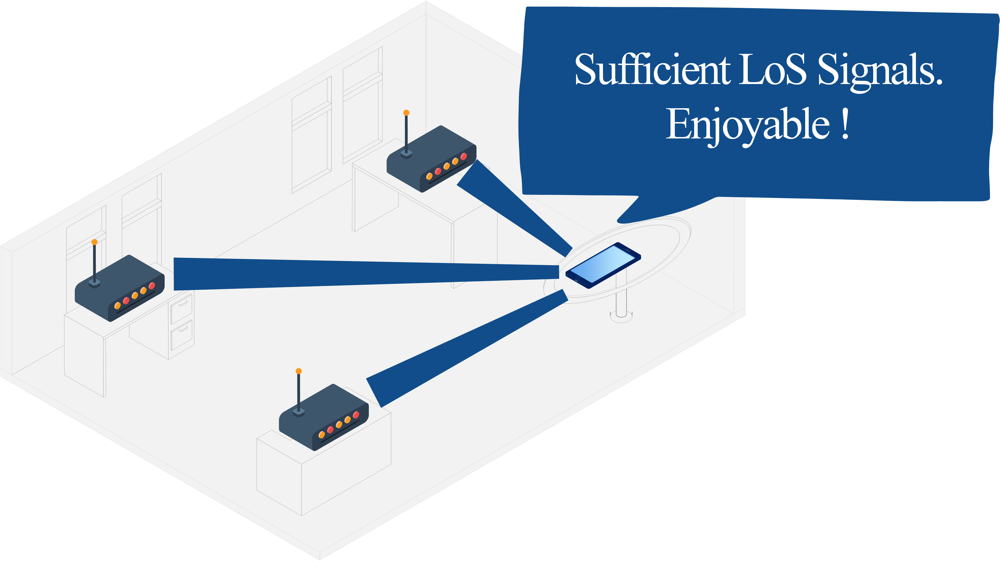
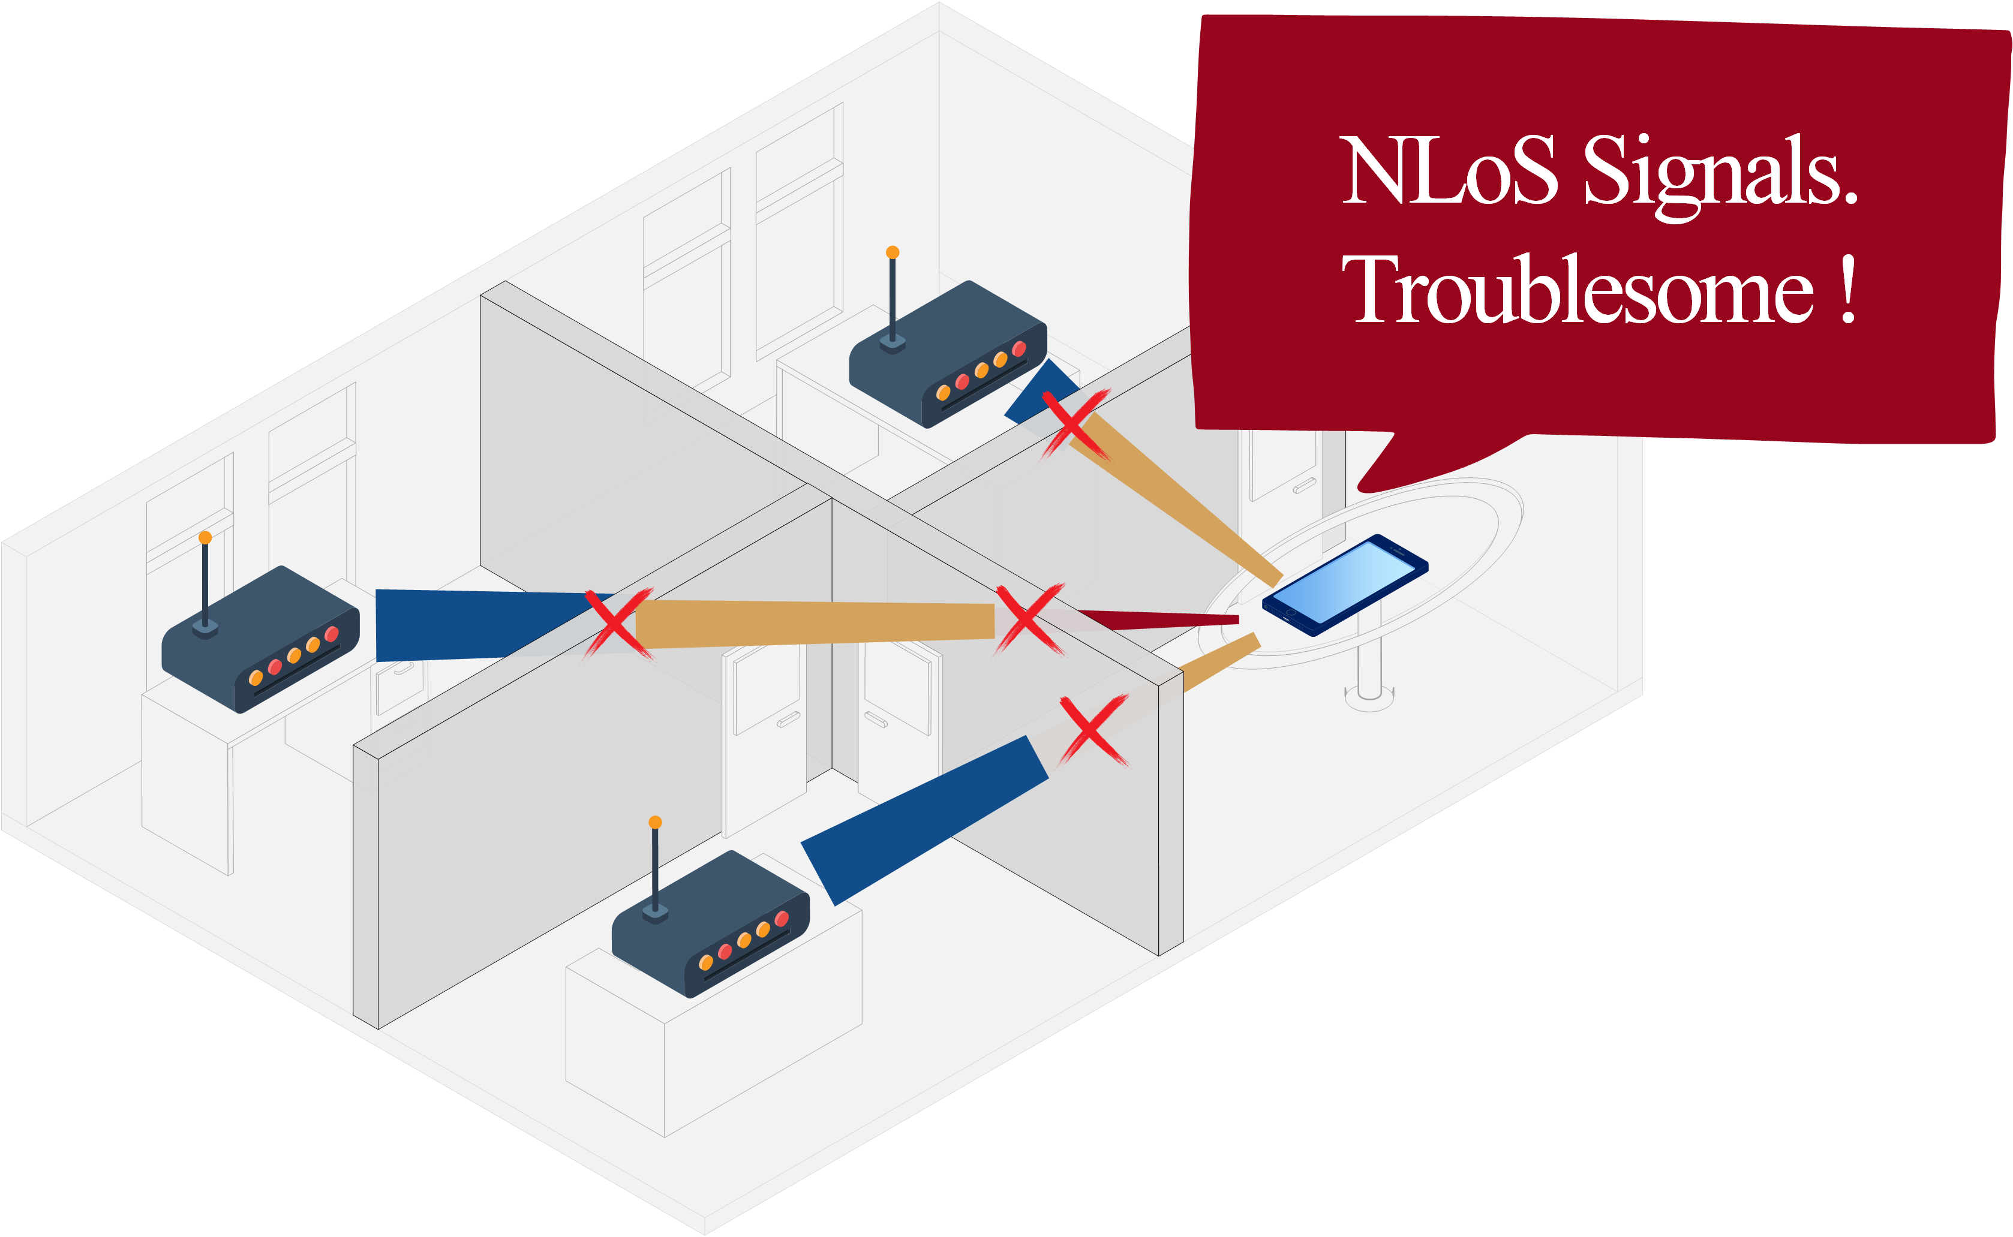
Indoor WiFi Localization: LoS vs. NLoS
Ideal Scenario
Practical Scenario
Problem: Indoor blockages are everywhere, so the WiFi APs in LoS scenarios may be rare.
Motivation
BIFROST
Challenge
Design
Evaluation
Conclusion
Notes:
WiFi-based device localization is a key technology for smart applications.
Generally, traditional methods calculate locations by estimating the AoA or ToF of signals from WiFi APs.
They often require the WiFi APs to be set in line of sight to provide accurate estimations.
However, a critical problem is often ignored that
Indoor blockages are everywhere, so the WiFi APs in LoS scenarios may be rare.

Slide 3
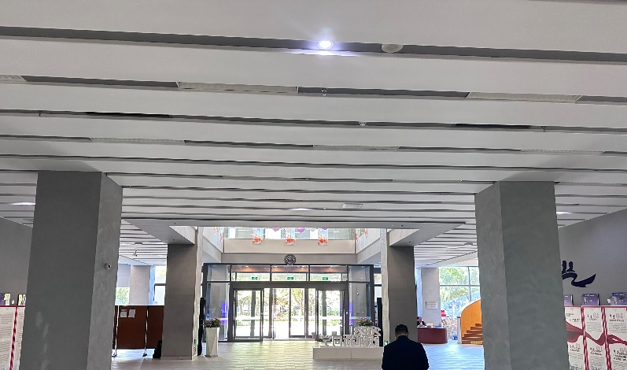
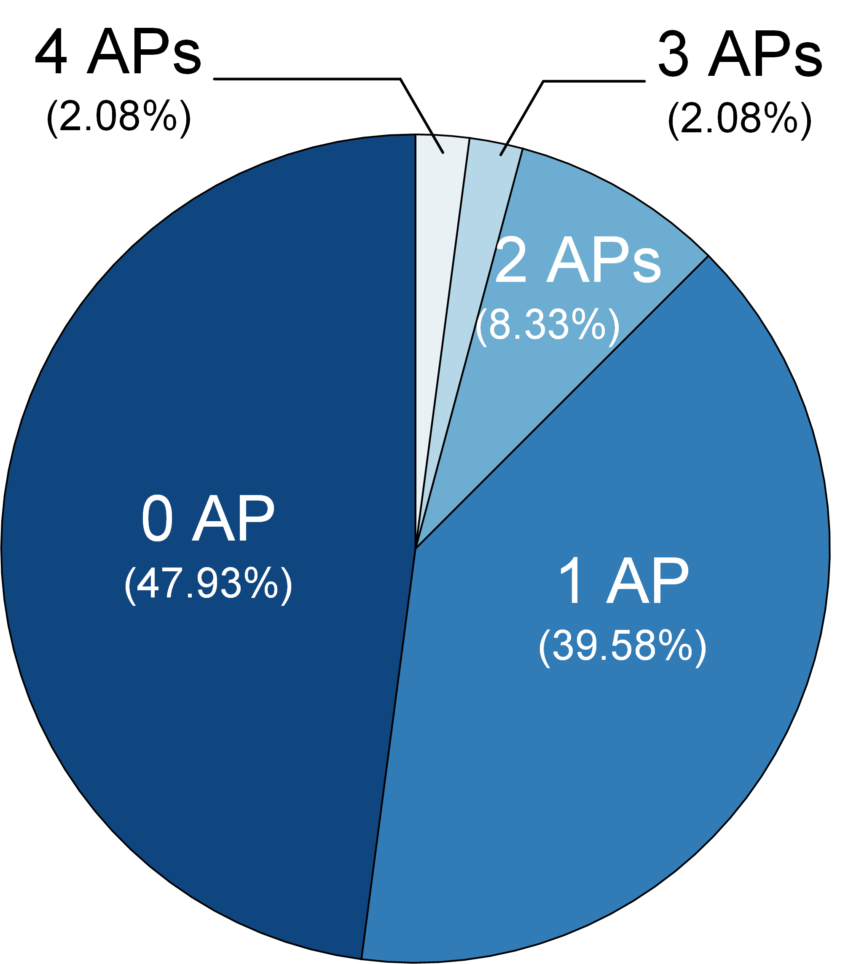
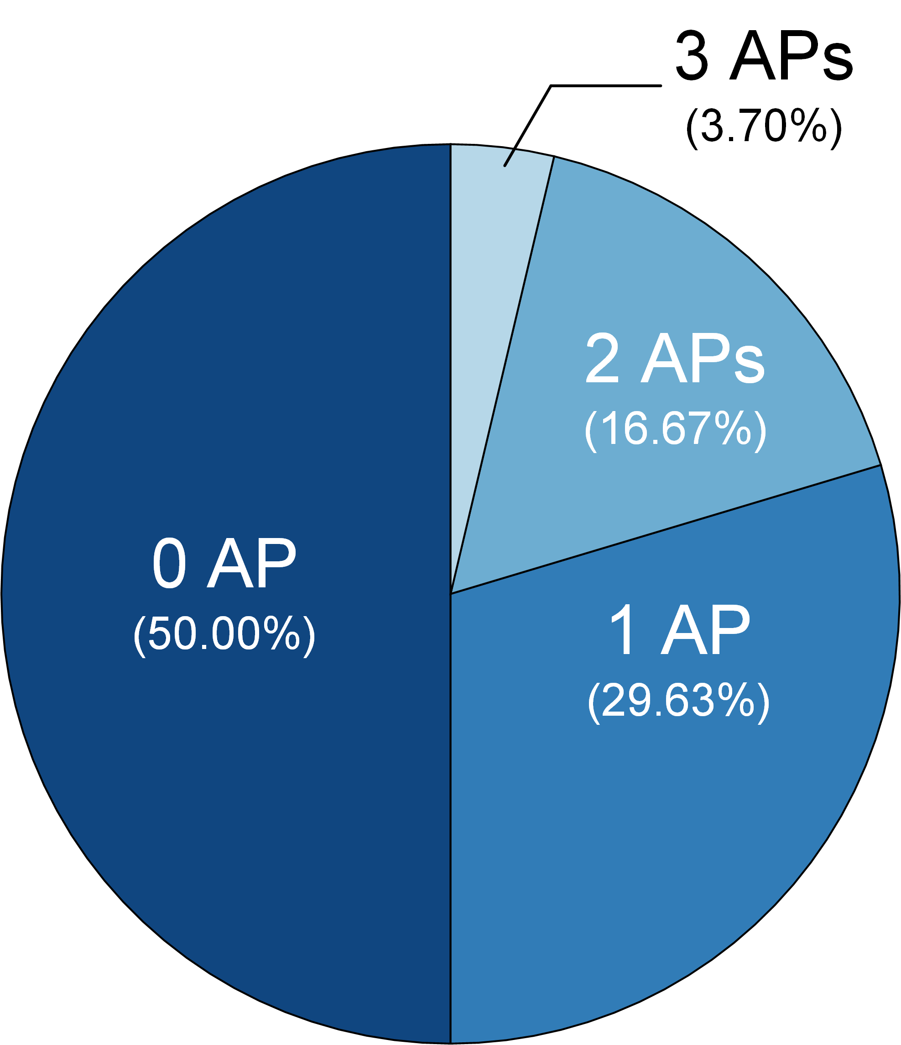
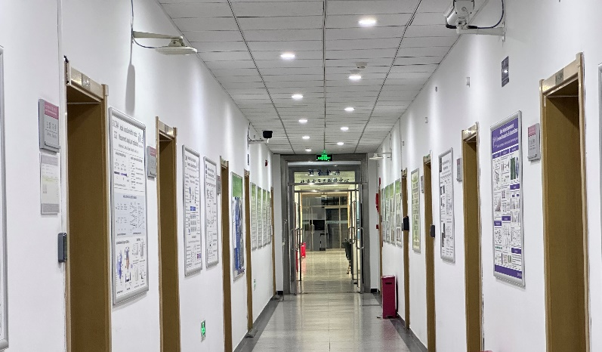
Most Indoor Rooms Can’t See any LoS AP
Library (48 rooms)
Office (54 rooms)
Less than 5% rooms can see sufficient LoS APs in our real-world investigations.
Motivation
BIFROST
Challenge
Design
Evaluation
Conclusion
Notes:
So how about the proportion of the LoS WiFi APs in the real-world indoor settings?
To figure out this question, we conduct an investigation in a library and an office in our school.
We count the LoS APs in every space separated by walls, such as halls, classrooms, meeting rooms and corridors.
The investigation results show that only less than five percent rooms can have at least three line of sight aps.
Moreover, in nearly half of all the rooms, there is not even one LoS AP available.

Slide 4
Most Indoor Rooms Can’t See any LoS AP
How to localize a device when LoS APs are insufficient?
Library (48 rooms)
Office (54 rooms)
The chance to receive sufficient LoS signals is less than 5% in our real-world investigations
Motivation
BIFROST
Challenge
Design
Evaluation
Conclusion
Notes:
So, we wonder that
How to localize a device when LoS APs are insufficient?

Slide 5
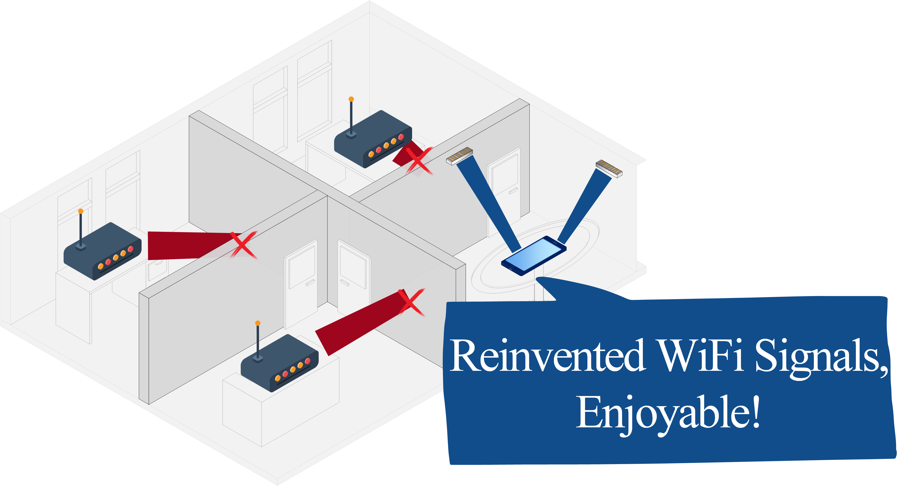
Our Solution
Solution: Reinventing the ambient WiFi signals to create the LoS paths for indoor localization.
Motivation
BIFROST
Challenge
Design
Evaluation
Conclusion
Notes:
Here is what we think
Now that the contradiction is between the need for line-of-sight signal and the lack of line-of-sight signal,
so why don’t we reinvent the ambient WiFi signals to transform the NLoS WiFi signals
into the signals that can be used for localization?

Slide 6
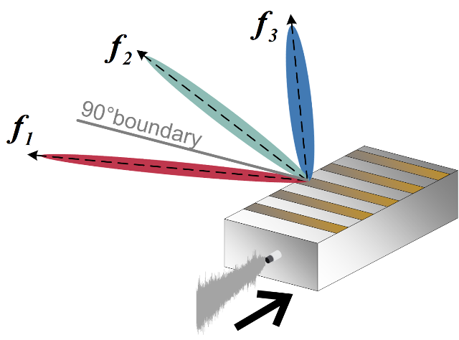
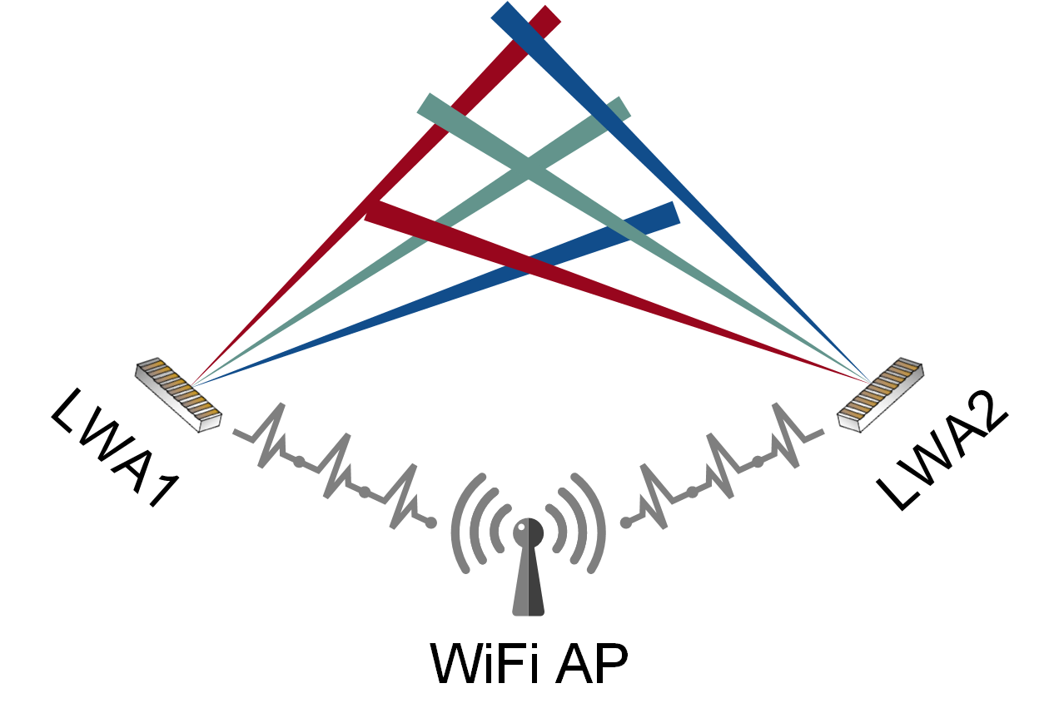
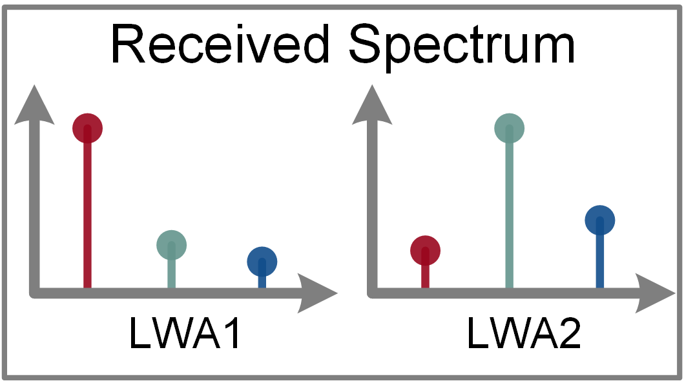
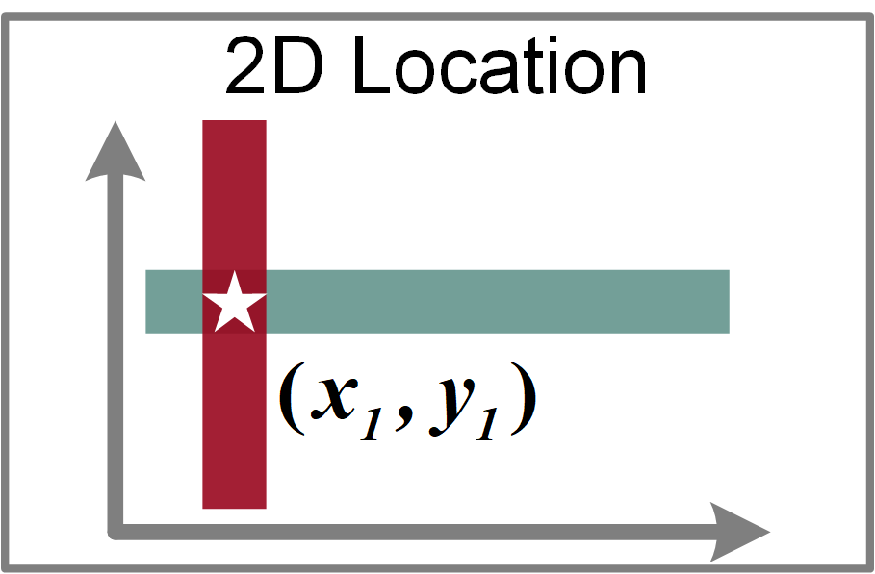
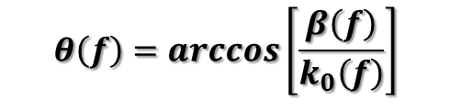
Key Technique
Frequency and Spatial
Division Multiplexing (FSDM)
Basic Idea
  Employ two LWAs to radiate FSDM signals
  Capture frequencies of the two FSDM signals
  Estimate AoAs and location by finding the frequencies with the highest energy.
$$θ\left(f\right)=\arccos\left[\frac{β\left(f\right)}{k_{0}\left(f\right)}\right]$$
Leaky Wave Antenna (LWA): Signals with different frequencies will be radiated to different directions.
Motivation
BIFROST
Challenge
Design
Evaluation
Conclusion
Notes:
Inspired by the research progress on leaky wave antenna in recent years,
We exploit leaky wave antenna and dispersion effect of wireless signals to achieve this purpose.
The abbreviation of leaky wave antenna is LWA.
It can receive signals and radiate them at different frequencies towards different directions.
So the signal will show frequency and spatial division multiplexing features, and we can call it FSDM feature.
Our insight is that we can deploy two LWAs to transform the ambient WiFi signals to the FSDM signals.
So if the target device is at different locations, it can receive signals with different frequencies
As a result, it can estimate AoAs and location by simply analyzing the received spectrum.

Slide 7
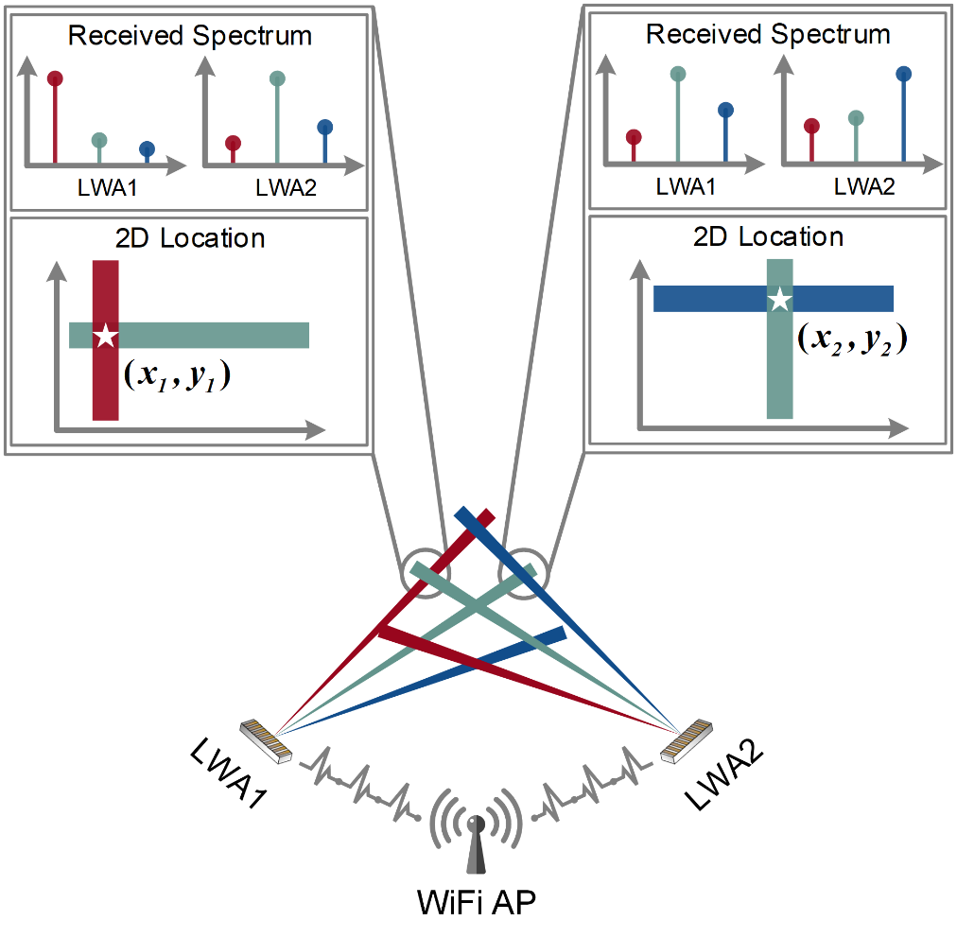
BIFROST
Frequency and Spatial
Division Multiplexing (FSDM)
High-level Principle
Where there is WiFi signal,
one can be localized.
$$θ\left(f\right)=\arccos\left[\frac{β\left(f\right)}{k_{0}\left(f\right)}\right]$$
Motivation
BIFROST
Challenge
Design
Evaluation
Conclusion
Notes:
Based on the above insight, we propose our novel approach, called BIFROST.
BIFROST is the name of a rainbow bridge In Norse mythology, and we use this name to highlight the dispersion effect of LWA
BIFROST can work in any environment with WiFi coverage, no matter whether the WiFi AP is LoS or NLoS.
In other words, BIFROST can achieve the goal that where there is WiFi signal, one can be localized.

Slide 8
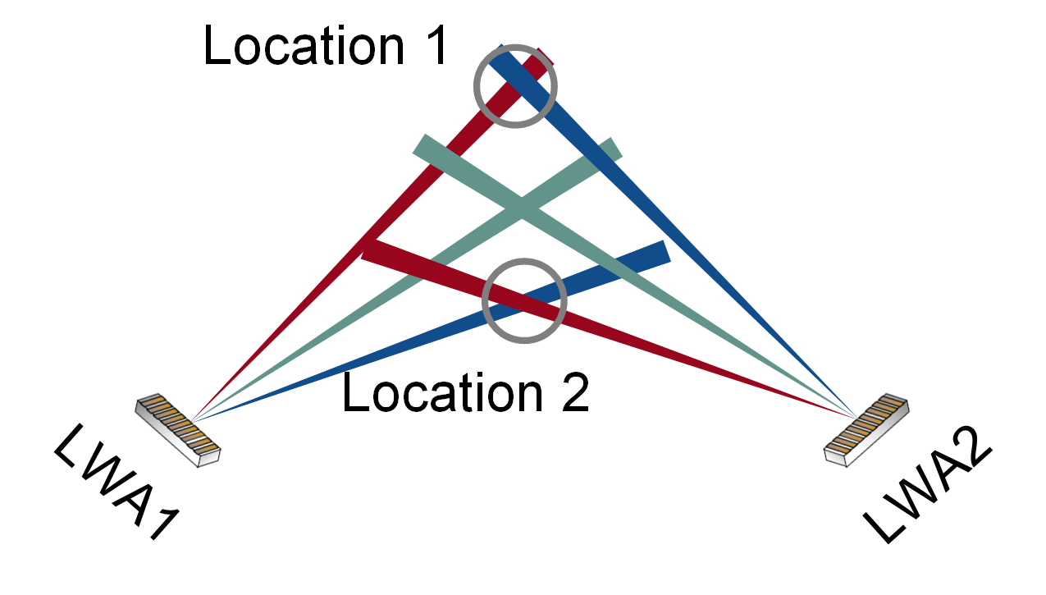
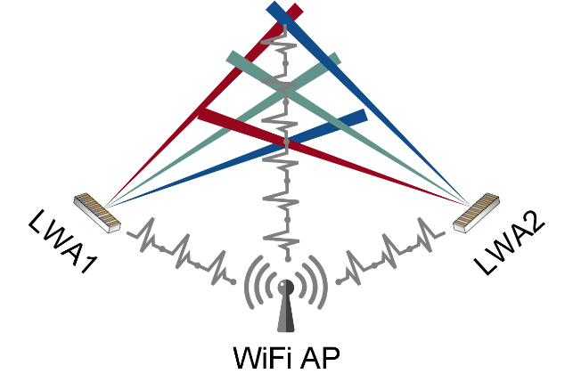
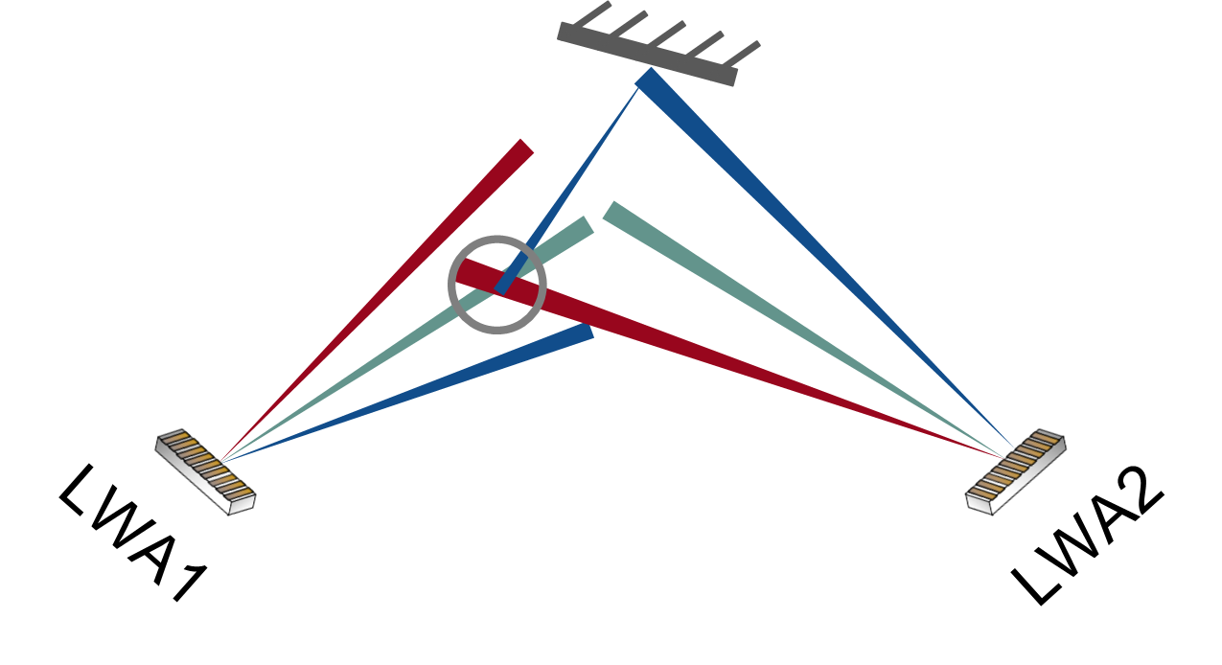
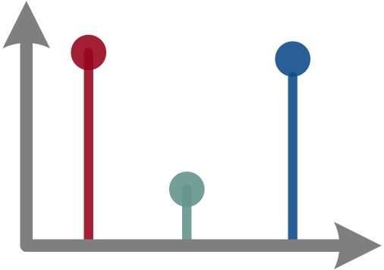
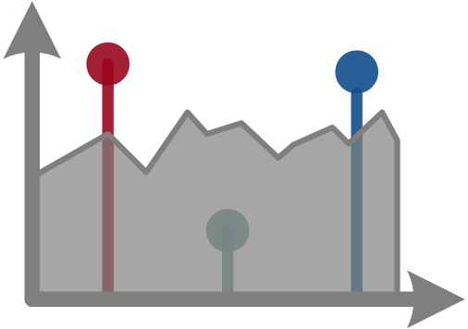
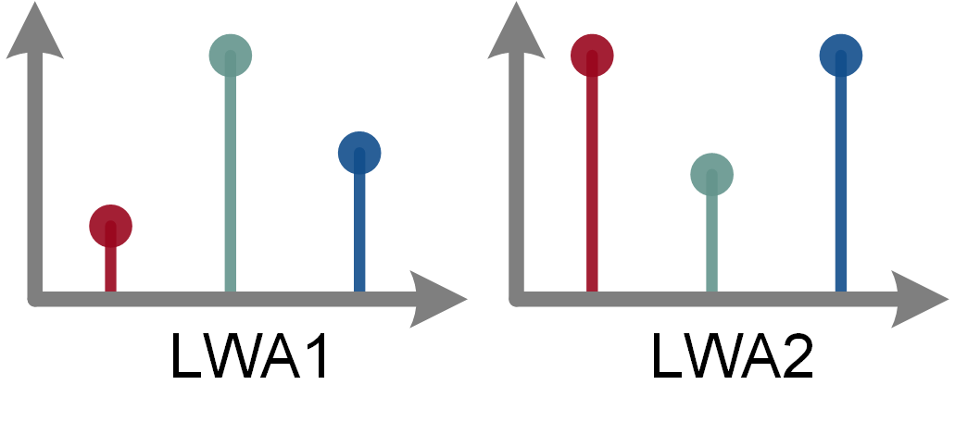
Challenges
Challenge 1
Challenge 2
Challenge 3
How to distinguish the two different LWAs?
How to extract FSDM signal from WiFi signal?
How to mitigate the indoor multipath effect?
Different locations obtain the same frequencies, causing location ambiguity.
FSDM and WiFi signals operate within the same band, leading to interference.
Indoor multipath effect affects the quality of receiving the FSDM signals.
Motivation
BIFROST
Challenge
Design
Evaluation
Conclusion
Notes:
However, to achieve this goal, the following challenges must be tackled in our design.
The first challenge is the ambiguity between different LWAs.
As we use two LWAs to provide two AoAs for the target, how to distinguish them may be a problem
it is almost impossible for the target to distinguish one LWA from the other. This may lead to the ambiguity of location and even the breakdown of our system.

Slide 9
Challenges
Challenge 1
Challenge 2
Challenge 3
How to distinguish the two different LWAs?
How to extract FSDM signal from WiFi signal?
How to mitigate the indoor multipath effect?
Different locations obtain the same frequencies, causing location ambiguity.
FSDM and WiFi signals operate within the same band, leading to interference.
Indoor multipath effect affects the quality of receiving the FSDM signals.
Motivation
BIFROST
Challenge
Design
Evaluation
Conclusion
Notes:
The second challenge is the interference from the WiFi signals.
As the FSDM signals are transformed from existing WiFi signals,
they are in the same frequency band and can be received by a target device
Directly using such signals leads to incorrect AoA estimation.
the two types of signals operate within the same frequency band and can be simultaneously received by a target device.

Slide 10
Challenges
Challenge 1
Challenge 2
Challenge 3
How to distinguish the two different LWAs?
How to extract FSDM signal from WiFi signal?
How to mitigate the indoor multipath effect?
Different locations obtain the same frequencies, causing location ambiguity.
FSDM and WiFi signals operate within the same band, leading to interference.
Indoor multipath effect affects the quality of receiving the FSDM signals.
Motivation
BIFROST
Challenge
Design
Evaluation
Conclusion
Notes:
The third challenge is the indoor multipath effect.
As we all know, multipath effect in the indoor environment may seriously affect the localization accuracy.
Next we're going to introduce our design to address these challenges.

Slide 11
How to distinguish the two different LWAs?
Ambiguity between Different LWAs
Different locations
The same spectrums
Problem: Another signal property, besides frequency, must be explored to distinguish the two LWAs
Motivation
BIFROST
Challenge
Design
Evaluation
Conclusion
Notes:
As for the first challenge, it may be a problem for the target to distinguish the two LWAs in frequency domain.
So we wonder if we can distinguish them in another domain, other than the frequency?

Slide 12
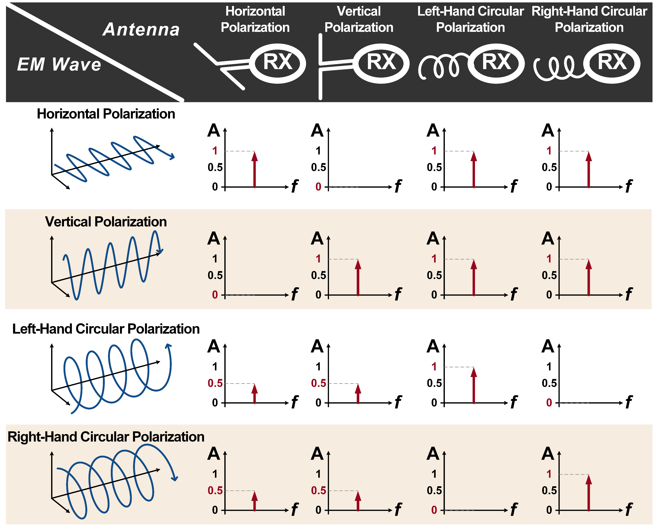
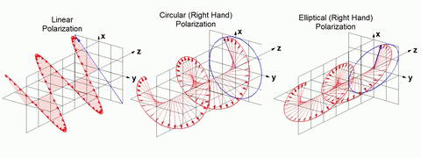
Signal Polarization
Polarization Mismatch
Solution: Exploiting orthogonal polarization to cancel the ambiguity between the two different LWAs
Motivation
BIFROST
Challenge
Design
Evaluation
Conclusion
Notes:
The answer is yes. Besides frequency, the wireless signal has many other properties, such as amplitude, phase, polarization and so on.
We find that if the LWAs can generate orthogonal polarized signals, they can be distinguished.
For example, if we use a vertical polarized LWA to receive a vertical polarized signal, the RSS will be high.
But if we use this LWA to receive a horizontal signal, the RSS will be zero.
Thus, we can assign the two LWAs with different polarizations to distinguish them.

Slide 13
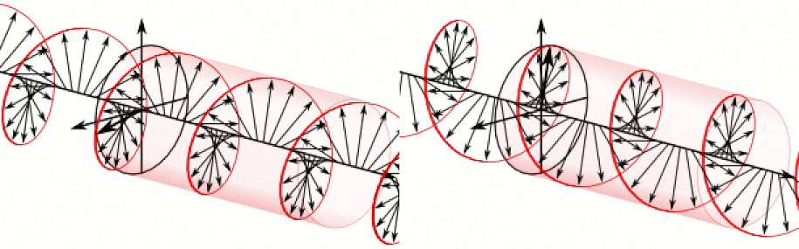
Signal Polarization
LHCP is orthogonal to RHCP
RHCP
LHCP
Polarization Mismatch
Solution: Exploiting orthogonal circular polarization (LHCP & RHCP) to cancel the ambiguity between the two different LWAs
Motivation
BIFROST
Challenge
Design
Evaluation
Conclusion
Notes:
However, when the orientation of antenna changes, the vertical or horizontal polarization will also change,
this may result in the polarization mismatch and wrong results.
So, we choose circular polarization to achieve a more stable performance.
Circular polarization includes left-hand and right-hand, In other words, LHCP and RHCP.
They won’t change even the orientation of antenna changes.
And they are orthogonal to each other.

Slide 14
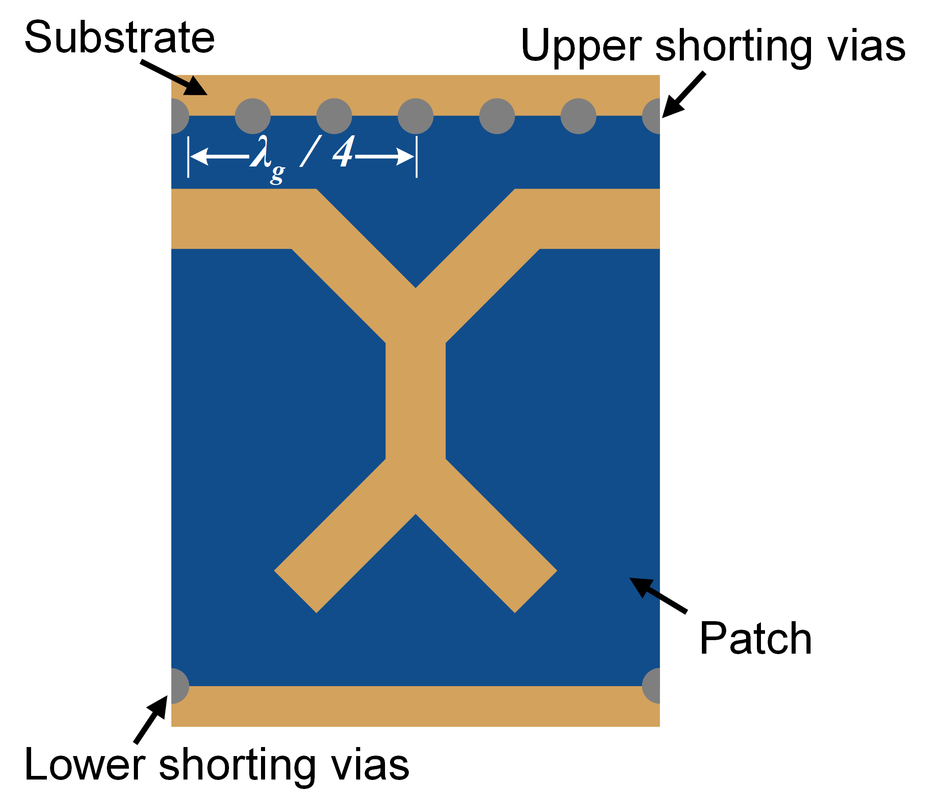
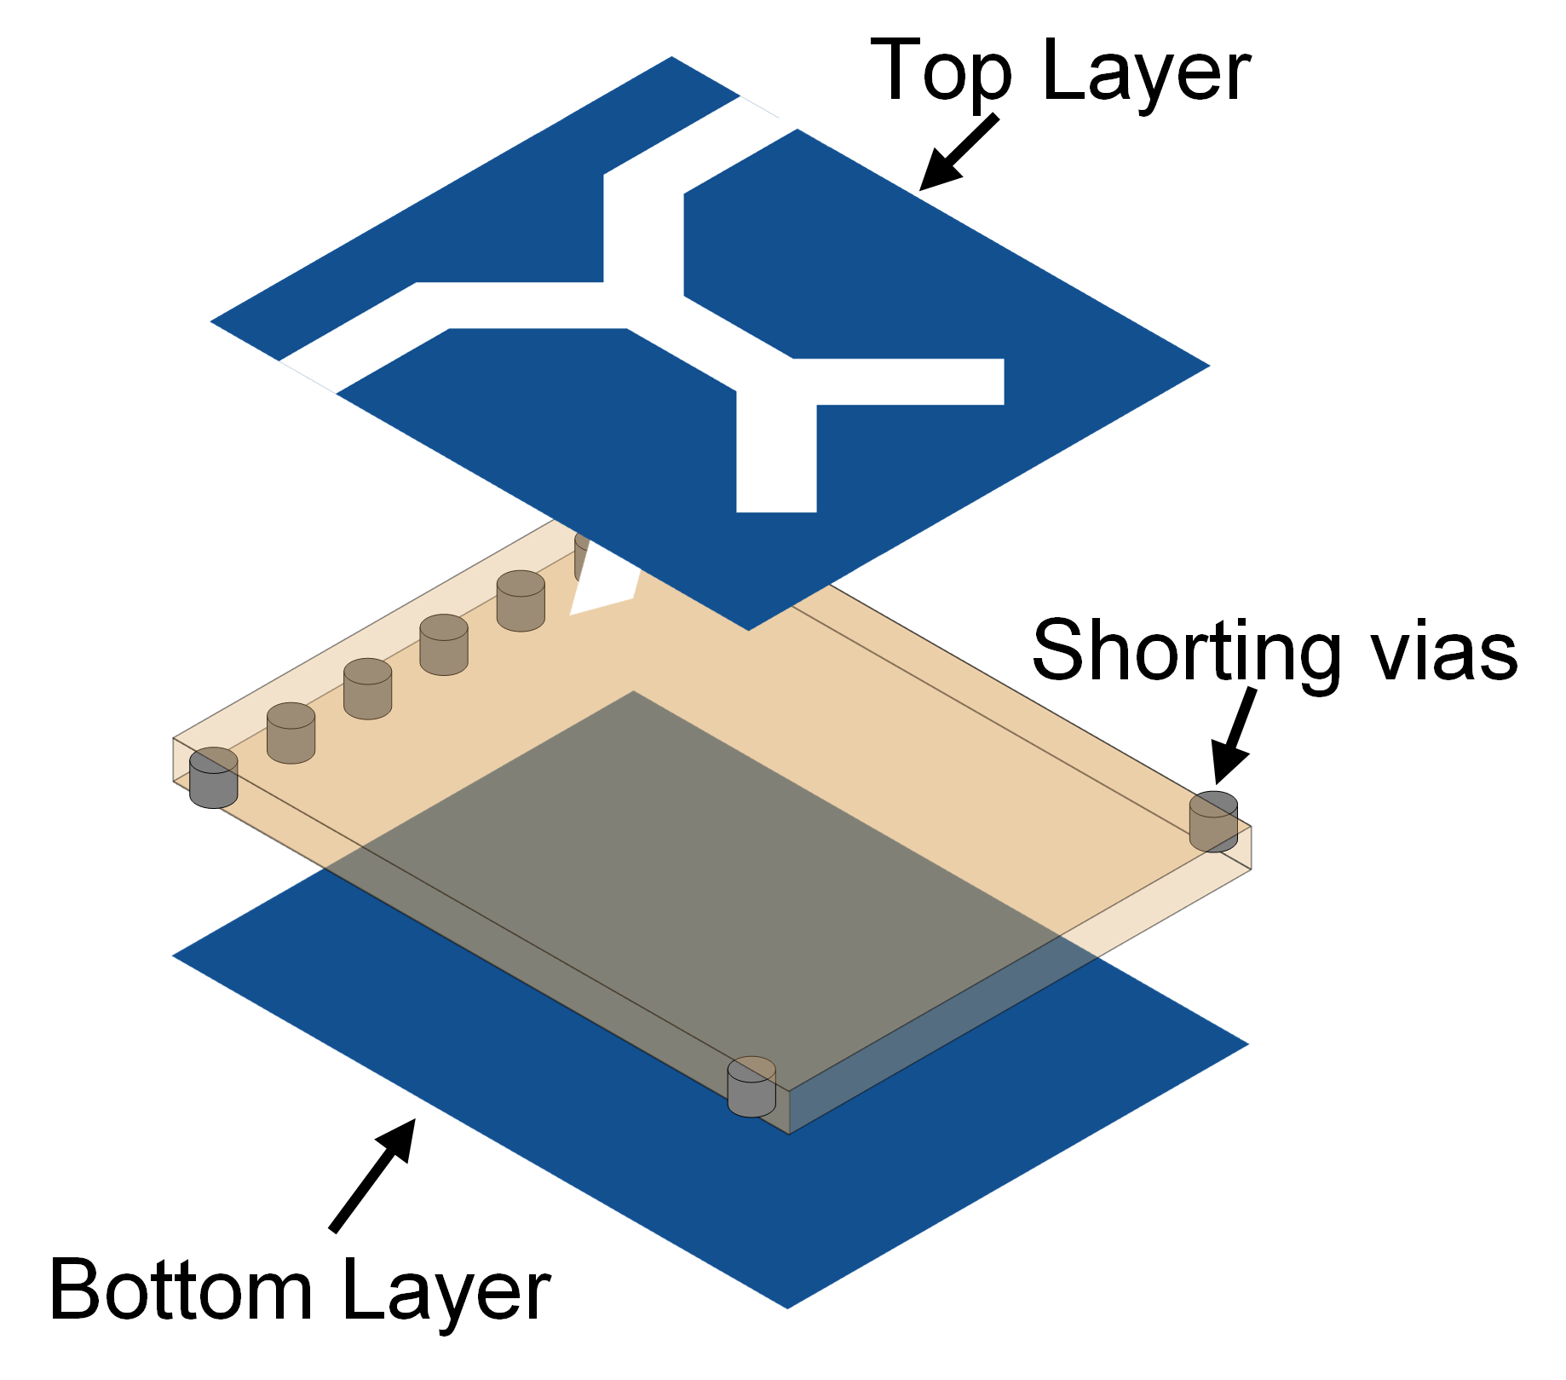
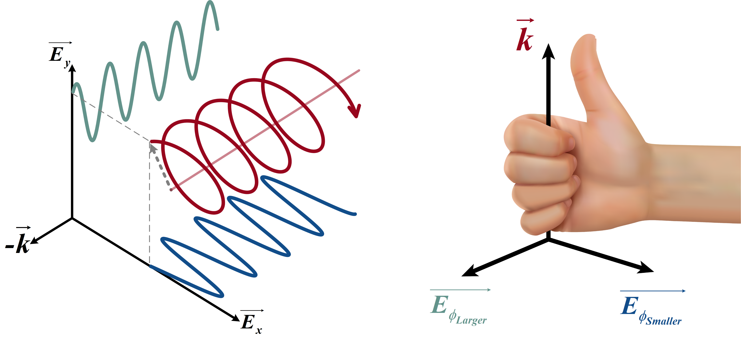
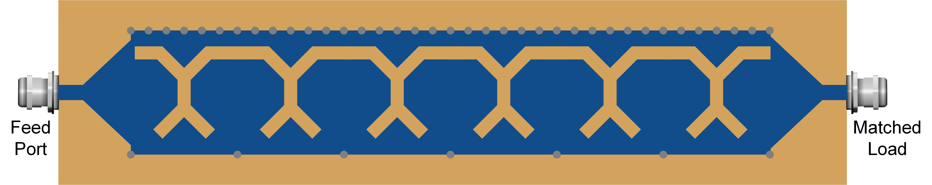
CPLWA Design
General View of CPLWA
CP signal synthesis
Unit
Layered structure
Complete design
CPLWA: Orthogonal circular polarized signals can be generated by switching the signal feed port. The emitted signal is both CP and FSDM
Motivation
BIFROST
Challenge
Design
Evaluation
Conclusion
Notes:
We specially design a CPLWA that can generate both LHCP and RHCP signals, by simply changing the signal feed port.
The final structure of our proposed CPLWA is shown in the left figure.
So, we can use two of this CPLWA
One uses the left port to generate LHCP signal, while the other uses the right port to generate RHCP signal
Therefore, the ambiguity can be canceled.
The CP signal can be viewed as the integration of the vertical and horizontal polarized signals,
And LHCP and RHCP depends on the phase difference between the two signals.
Based on this principle,

Slide 15
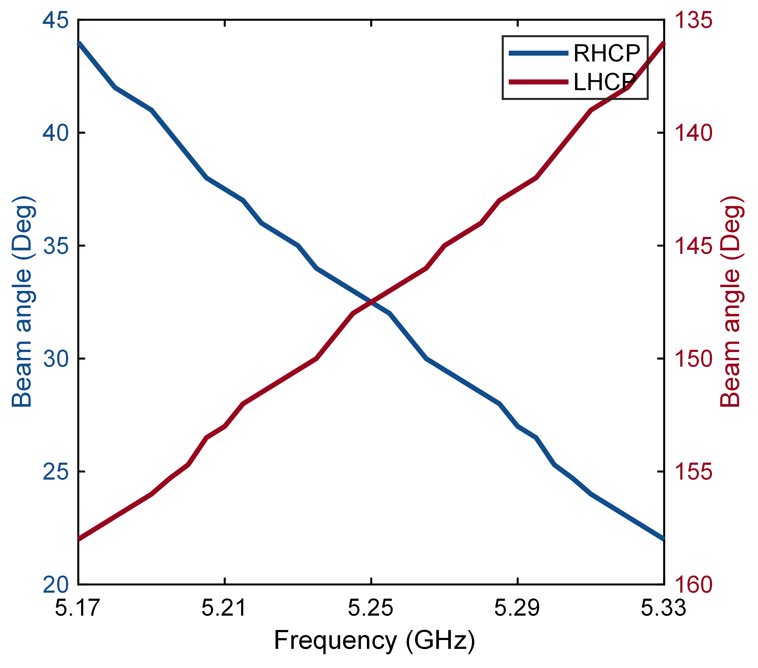
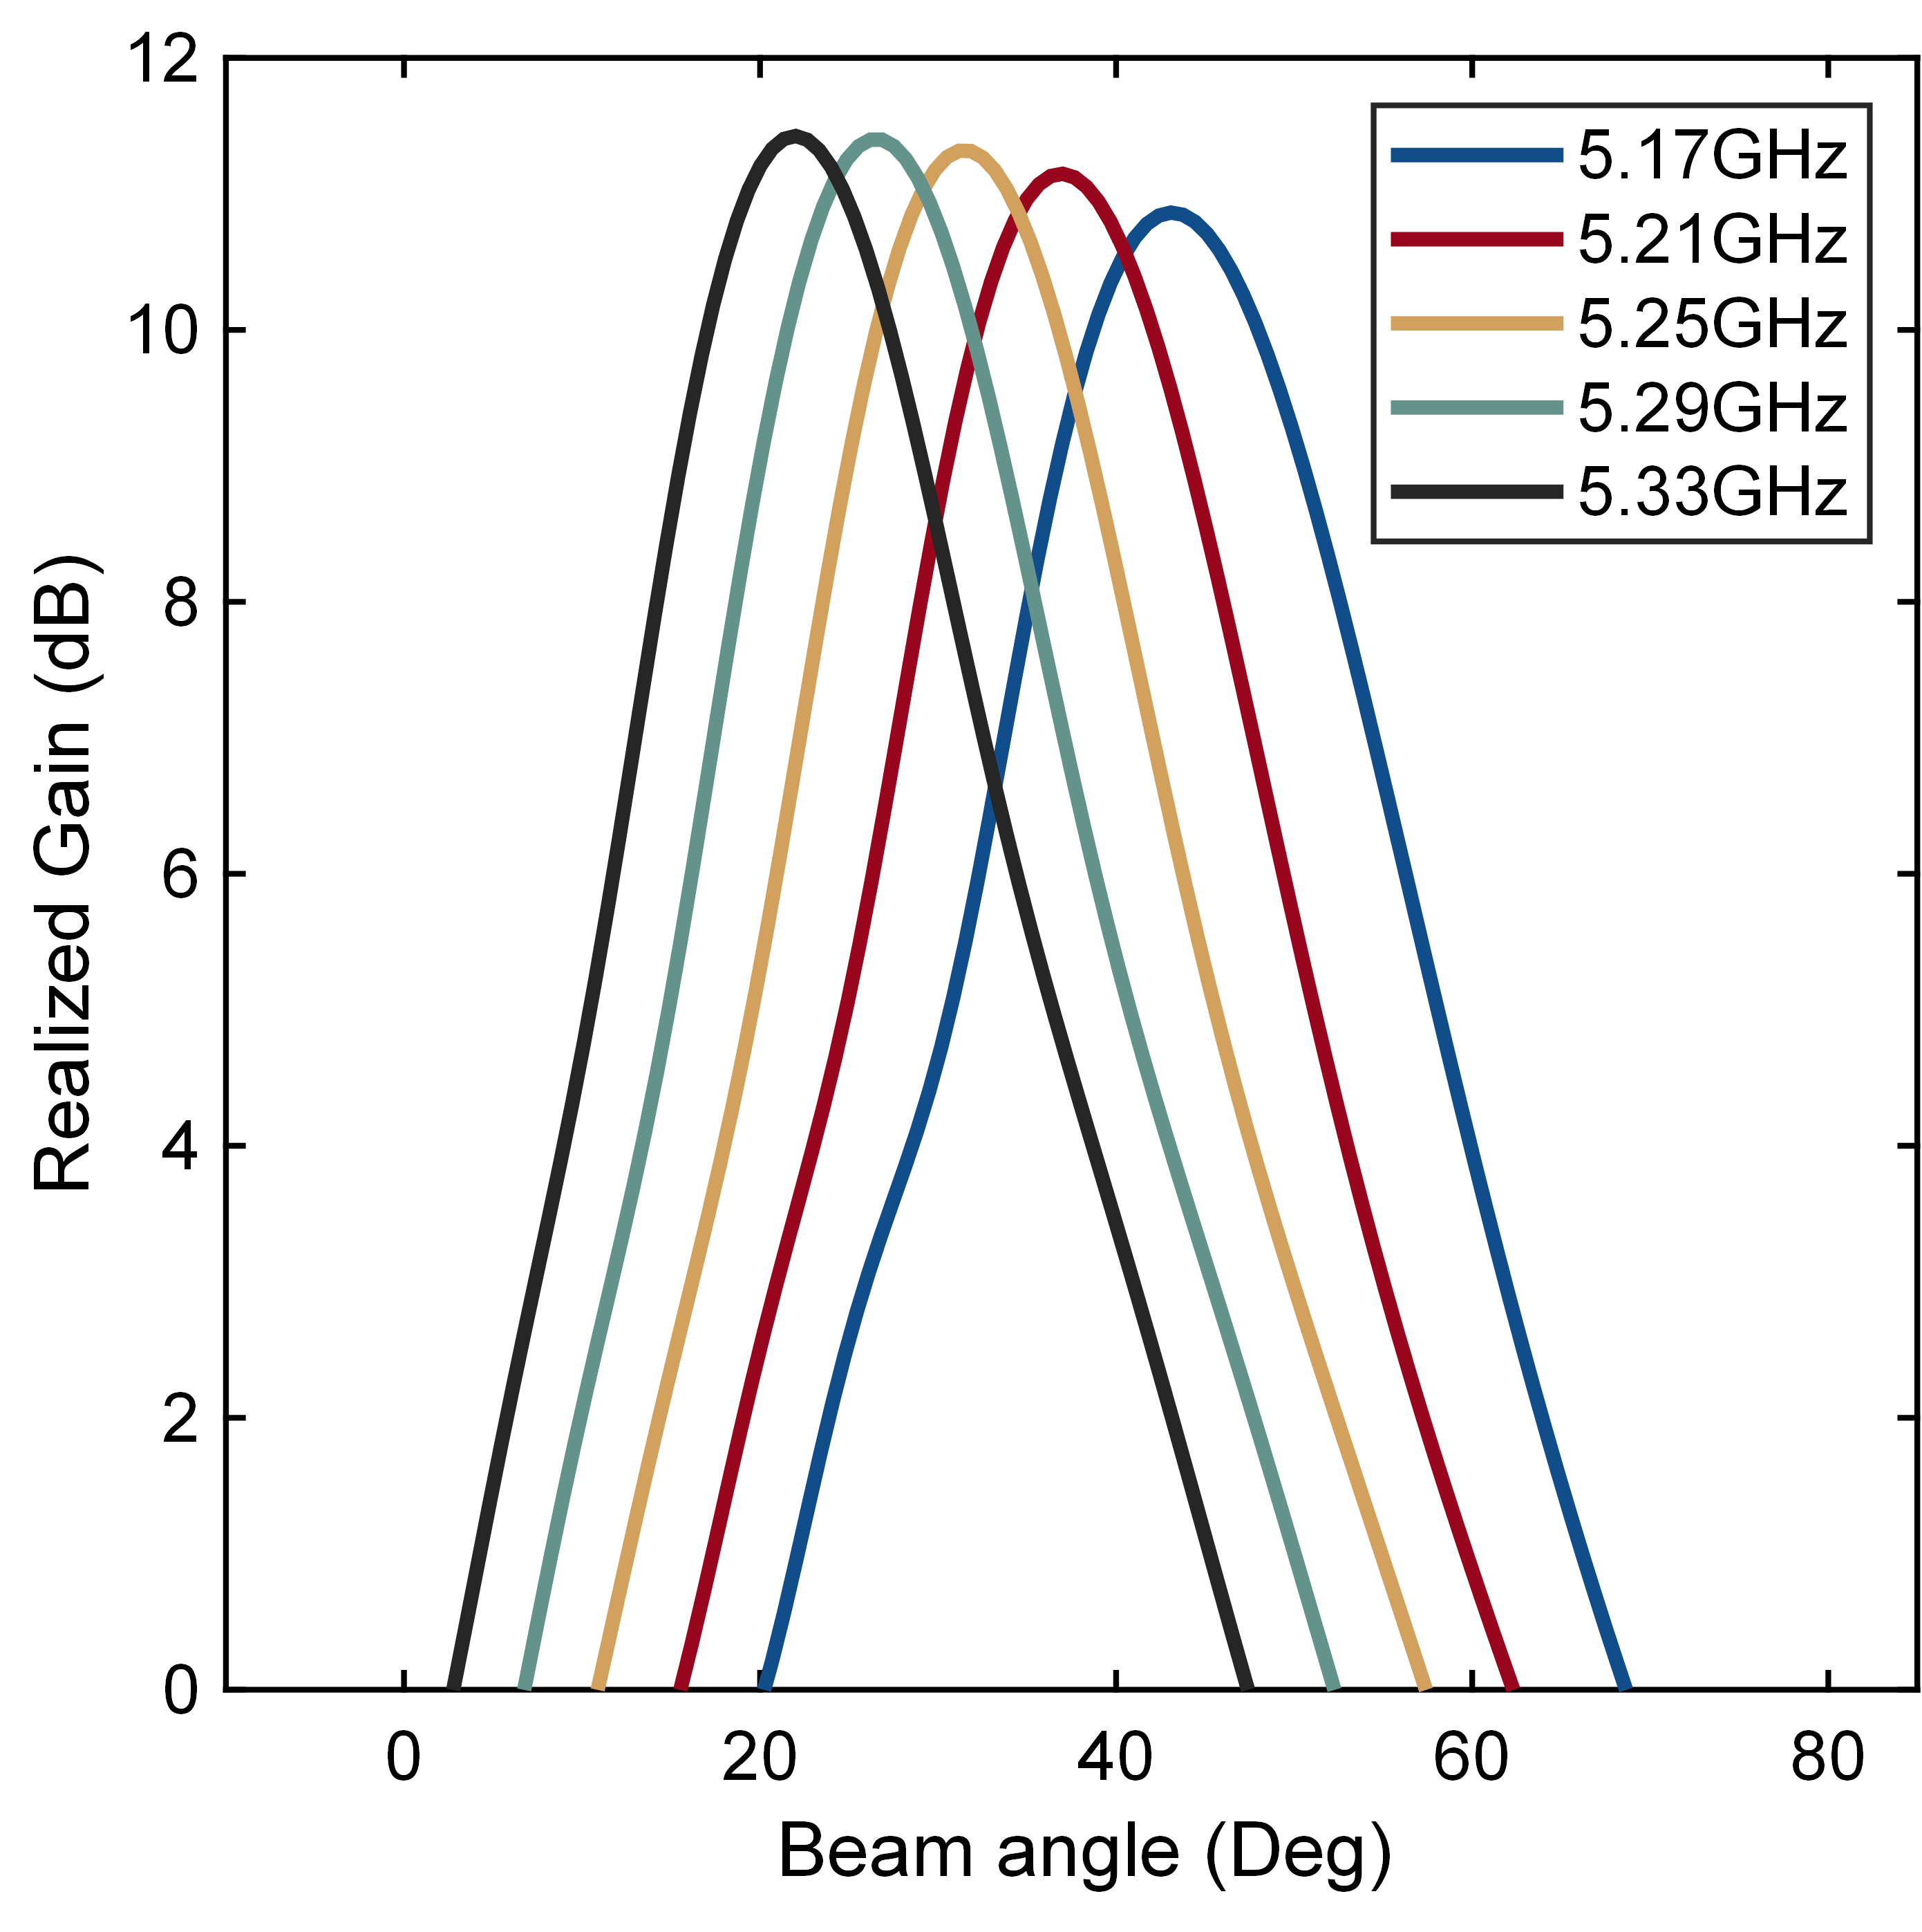
CPLWA Design
General View of CPLWA
Quick Validation
Unit
Layered structure
Main beam direction
Realized gain
Complete design
CPLWA: Orthogonal circular polarized signals can be generated by switching the signal feed port. The emitted signal is both CP and FSDM
Motivation
BIFROST
Challenge
Design
Evaluation
Conclusion
Notes:
This CPLWA works on 5.17GHz-5.33GHz WiFi band, while this structure and design methodology are universally applicable for other frequencies and bandwidths
The validation results show that the energy of the FSDM signal concentrates on the correct direction, and their realized gains are all above 11.5dB.
So, we can use two of this CPLWA, and one use the left port to signal input port to generate LHCP signal, while the other use the right port to generate RHCP signal
Therefore, the ambiguity can be canceled.

Slide 16
How to extract FSDM signal from WiFi signal?
Signal Extraction from the Interfered Frequency Band
WiFi and FSDM signals in the same space
Overlapped noisy spectrum
Problem: FSDM signals and WiFi signals operate within the same frequency band, so they may interfere with each other.
Motivation
BIFROST
Challenge
Design
Evaluation
Conclusion
Notes:
The second challenge is the interference from the WiFi signals.
As the CP signal and WiFi signal work in the same band
We should accurately find the frequency of CP signals
When BIFROST works, LWAs need the WiFi signal as input, and the target device may also need it for data communication.
However, the WiFi signal may interfere with the reception of the CP signal.

Slide 17
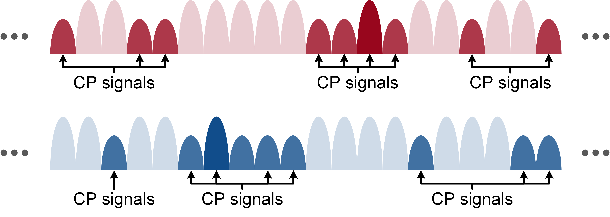
Duty-cycled Operating Manner
Identify CP Signals by Duty-cycled Operating Manner
Solution: LWAs are periodically turned on and off to identify frequencies corresponding to the CP signal by analyzing the variation of received spectrum.
Motivation
BIFROST
Challenge
Design
Evaluation
Conclusion
Notes:
To deal with such interference, the LWAs are designed to work in a duty-cycled way.
In other word, LWAs are periodically turned on and off.
So there will be distinctive variation on the signal amplitude at the frequencies of CP signals
The target device is able to detect this variation by analyzing the subcarriers in WiFi CSI.
Then the frequency of CP signals can be selected.

Slide 18
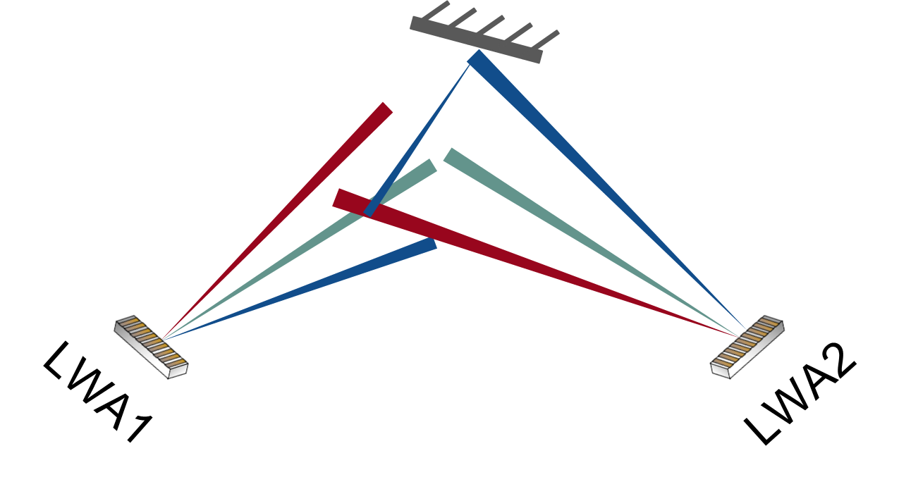
How to mitigate the indoor multipath effect ?
Indoor Multipath Effect
Undesired reflection
Distorted received spectrum
Problem: The multipath effect in the indoor environment may seriously affect the quality of the received FSDM signals and the localization accuracy.
Motivation
BIFROST
Challenge
Design
Evaluation
Conclusion
Notes:
The third challenge is the indoor multipath.
The target may identify the frequency of multipath signal as that of LoS signal, and result in a wrong localization result.
So, we should try to mitigate the influence of multipath as much as possible.

Slide 19
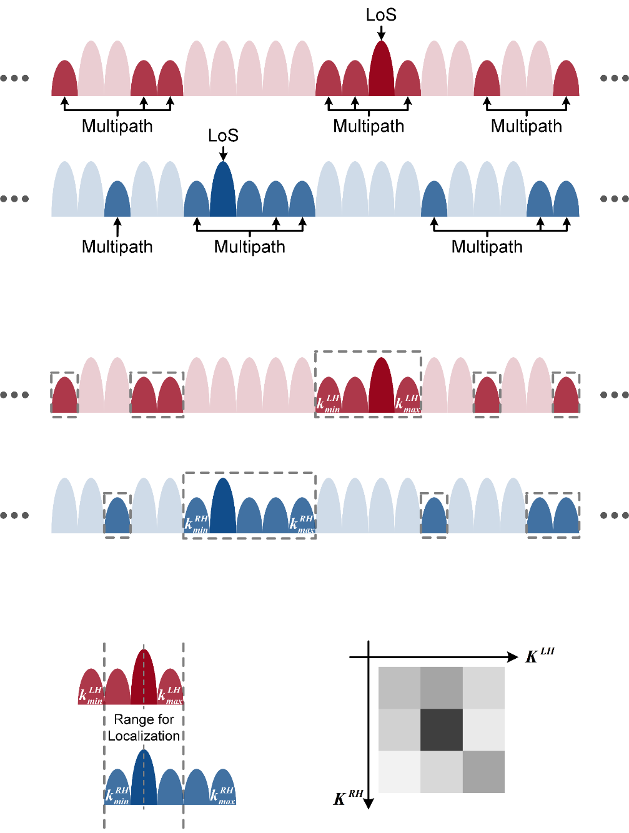
Clustering and Filtering Multipath Signals
Workflow of Selecting Correct Frequencies
  Cluster the selected subcarriers corresponding to CP signals
  Find the cluster with the highest integrated energy
  Align subcarriers bearing the highest energy in reserved clusters of RHCP and LHCP signals
  Keep the common part of clusters
  Multiply the two reserved sequences to form a matrix and output the weighted average value of the matrix.
For more detail, please refer to our paper.
Motivation
BIFROST
Challenge
Design
Evaluation
Conclusion
Notes:
Thus, we develop an algorithm to estimate the frequency of LoS signals and filter multipath signals.
We first map frequencies of FSDM signals with subcarriers in CSI
and cluster adjacent subcarriers to find the subcarrier cluster that is most likely contain the frequency of the Line of sight signal.
Then, we purify this cluster as much as possible to estimate the frequencies of the Line of sight signal.
Due to the time limits, please refer to our paper for more details.

Slide 20
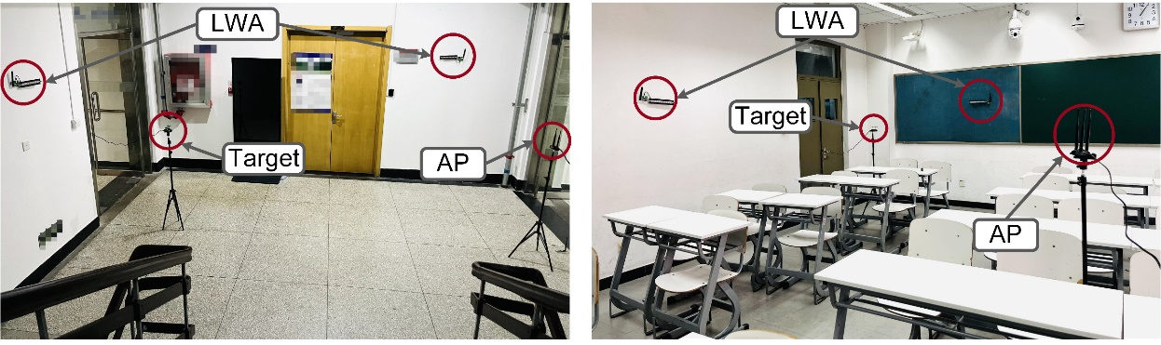
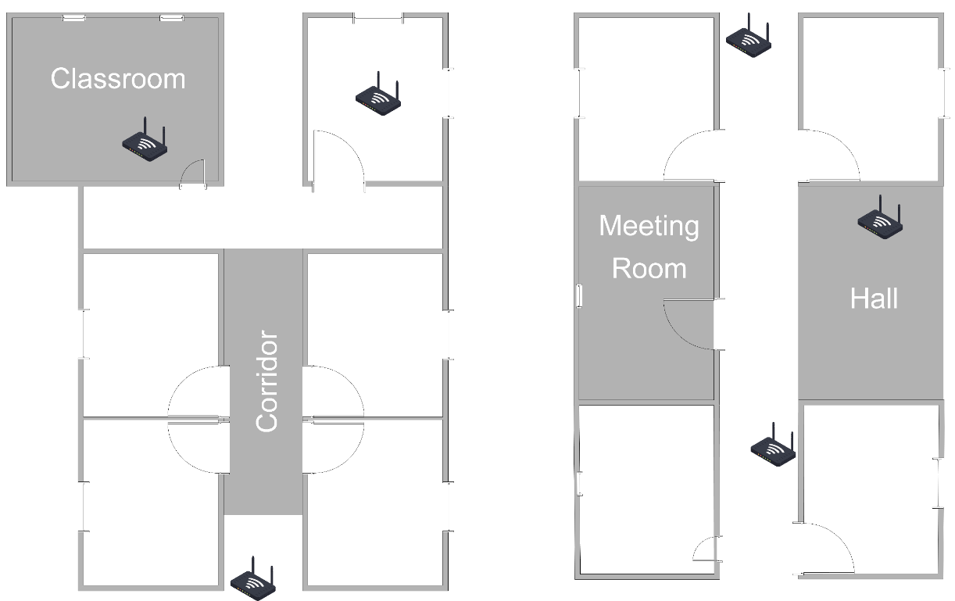
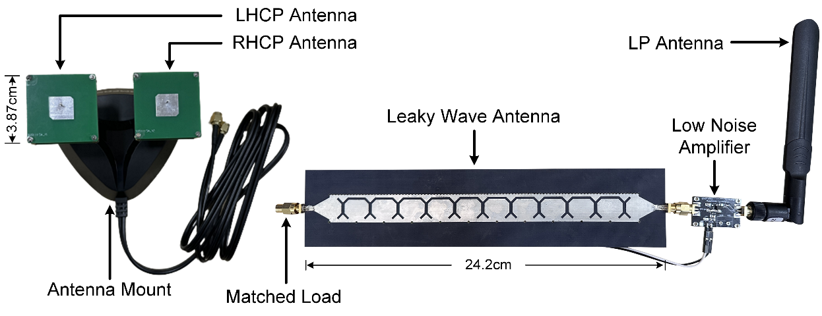


Implementation
Hall and Classroom Scenarios
The Realistic AP Deployment
(Hall: 6.2 m$×$ 4.5 m)
(Classroom: 10.6 m$×$ 7.1 m)
Localized Target and the LWA
(Frequency Band: 5.17 GHz ~ 5.33 GHz)
Motivation
BIFROST
Challenge
Design
Evaluation
Conclusion
Notes:
We implement two low-cost PCB based LWAs
The LWAs works at 5.17GHz-5.33GHz, which obeys the 802.11ax protocol.
And evaluate the performance of BIFROST in four different indoor scenarios, hall, meeting room, corridor and classroom.
As the right figure shows, we deploy multiple WiFi APs strictly based on the real-world settings.
So in some scenarios, there is no LoS WiFi signals.

Slide 21
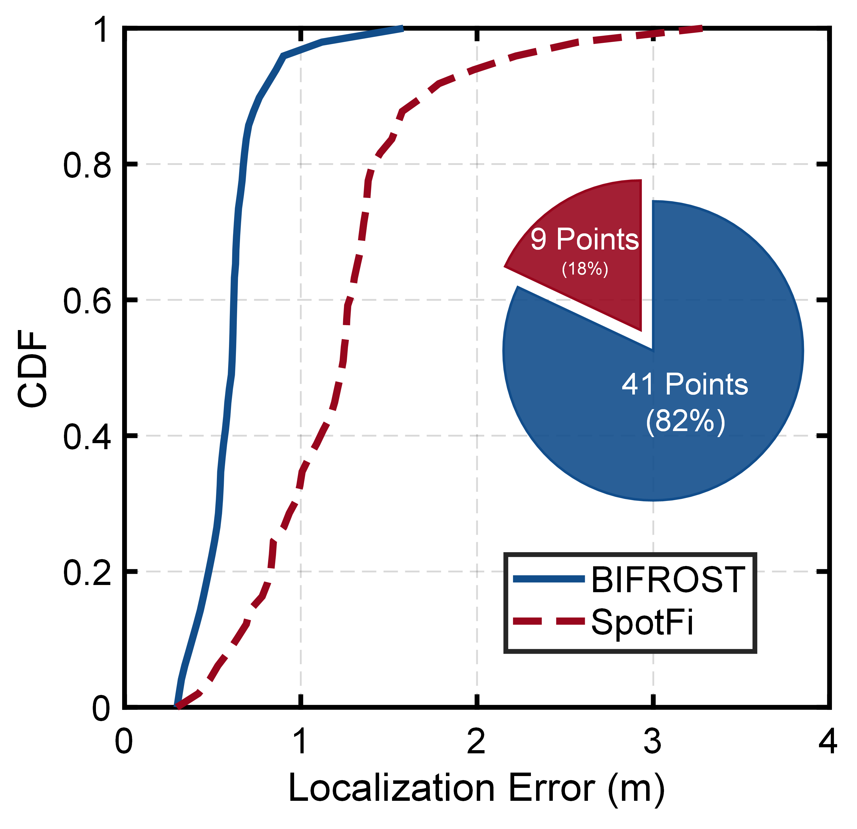
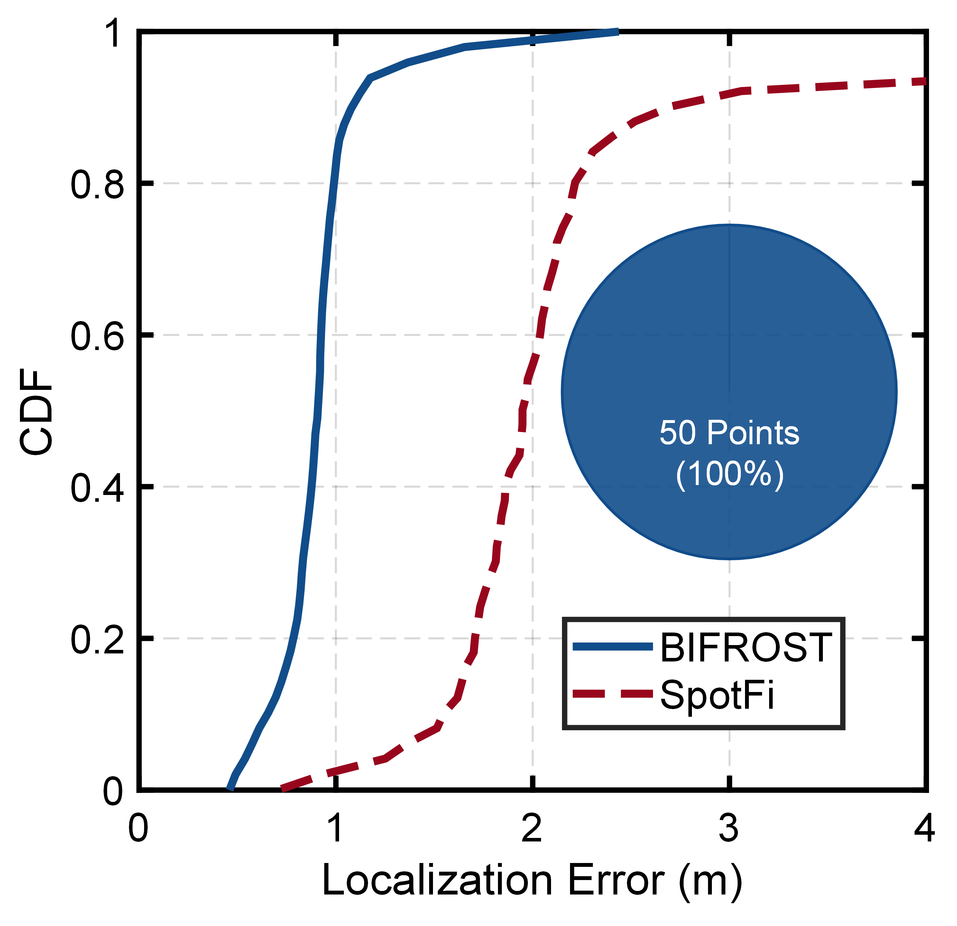
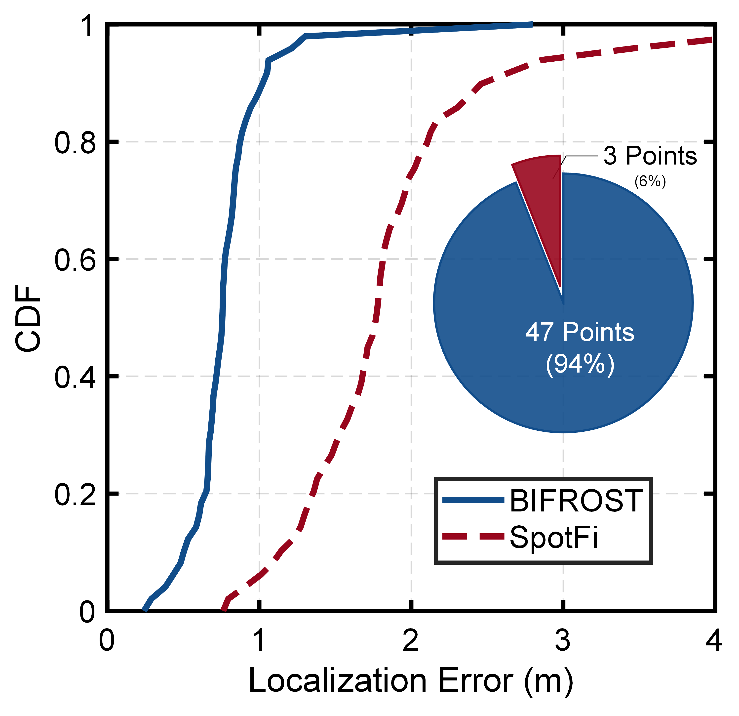
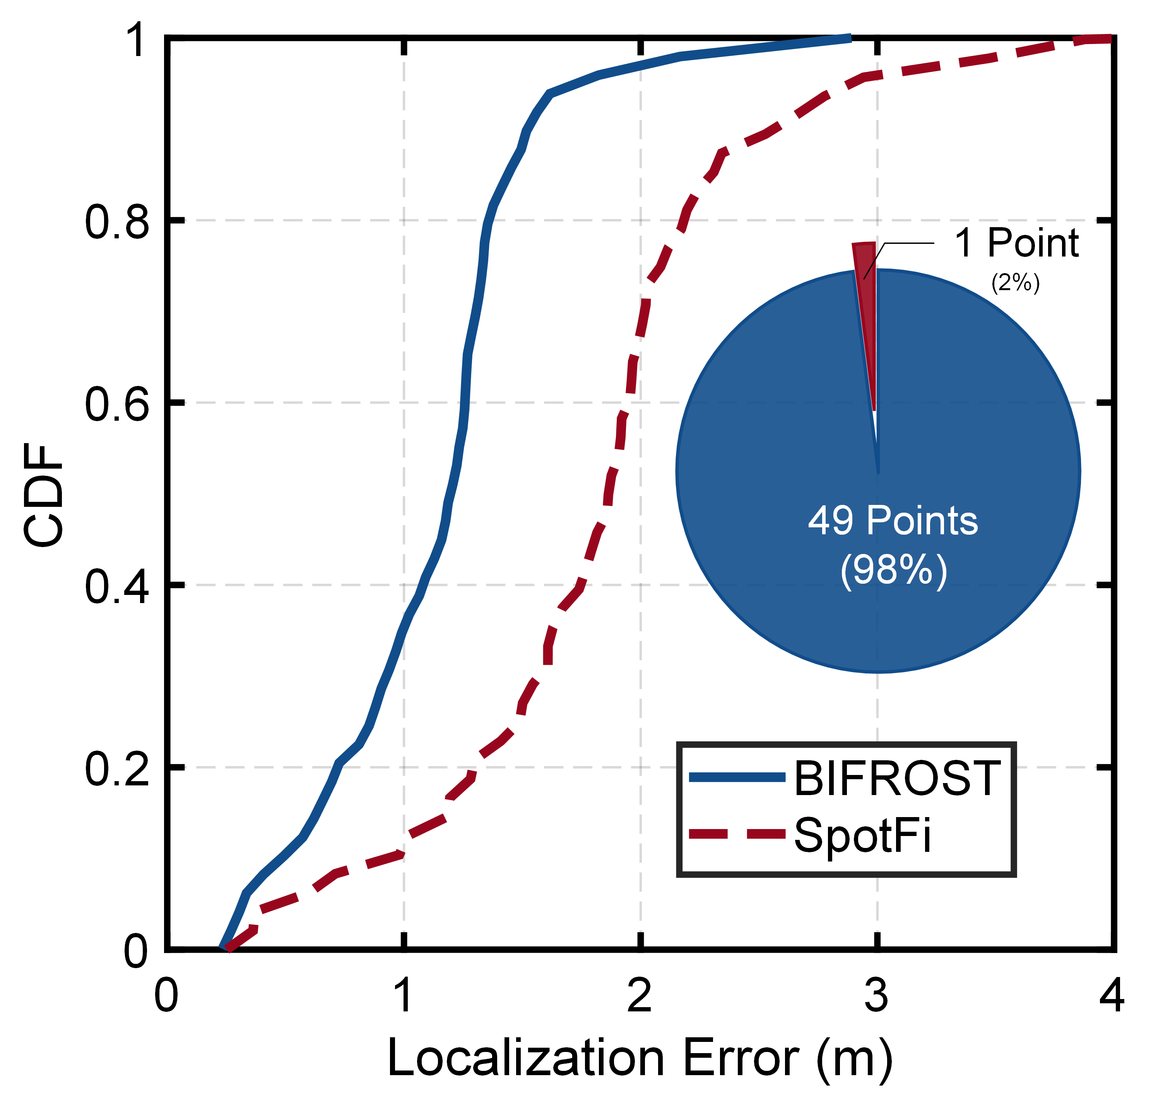
Overall Performance
The Realistic AP Deployment
Hall
Corridor
Meeting Room
Classroom
The median error of BIFROST is 0.81m, 52.35% less than that of SpotFi
in the arguably realistic indoor settings.
Motivation
BIFROST
Challenge
Design
Evaluation
Conclusion
Notes:
We first compare the performance of BIFROST and SpotFi in the four scenarios.
Due to the lack of LoS WiFi APs, SpotFi can't perform at its best.
Through all experiments, the median error of BIFROST is zero point eight one m, which is nearly fifty percent less than that of SpotFi
BIFROST outperforms SpotFi at most locations, except where the target can see at least three LoS APs.
However, results show that in this realistic setting, the chance for SpotFi to achieve better performance is less than seven percent.

Slide 22
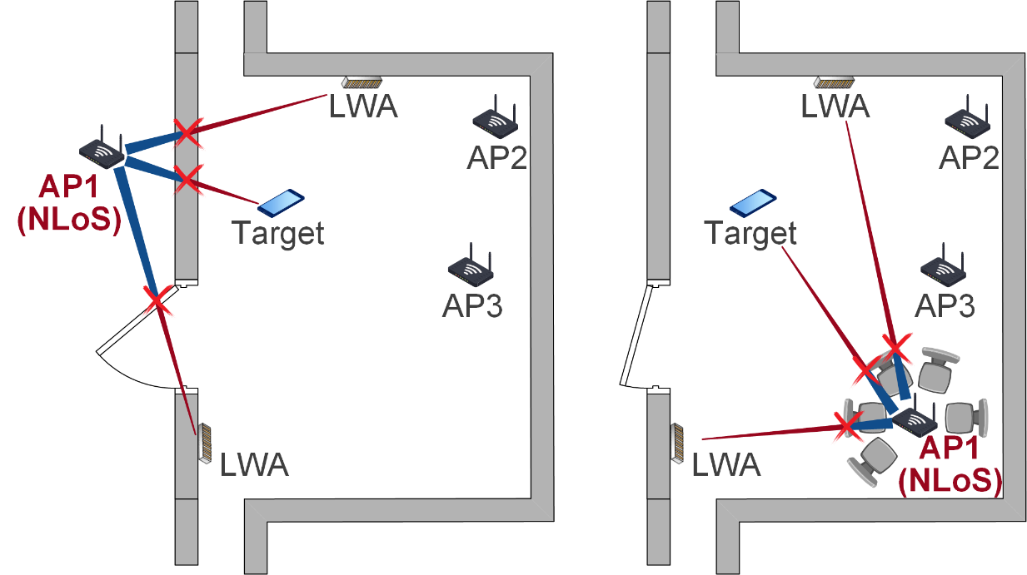
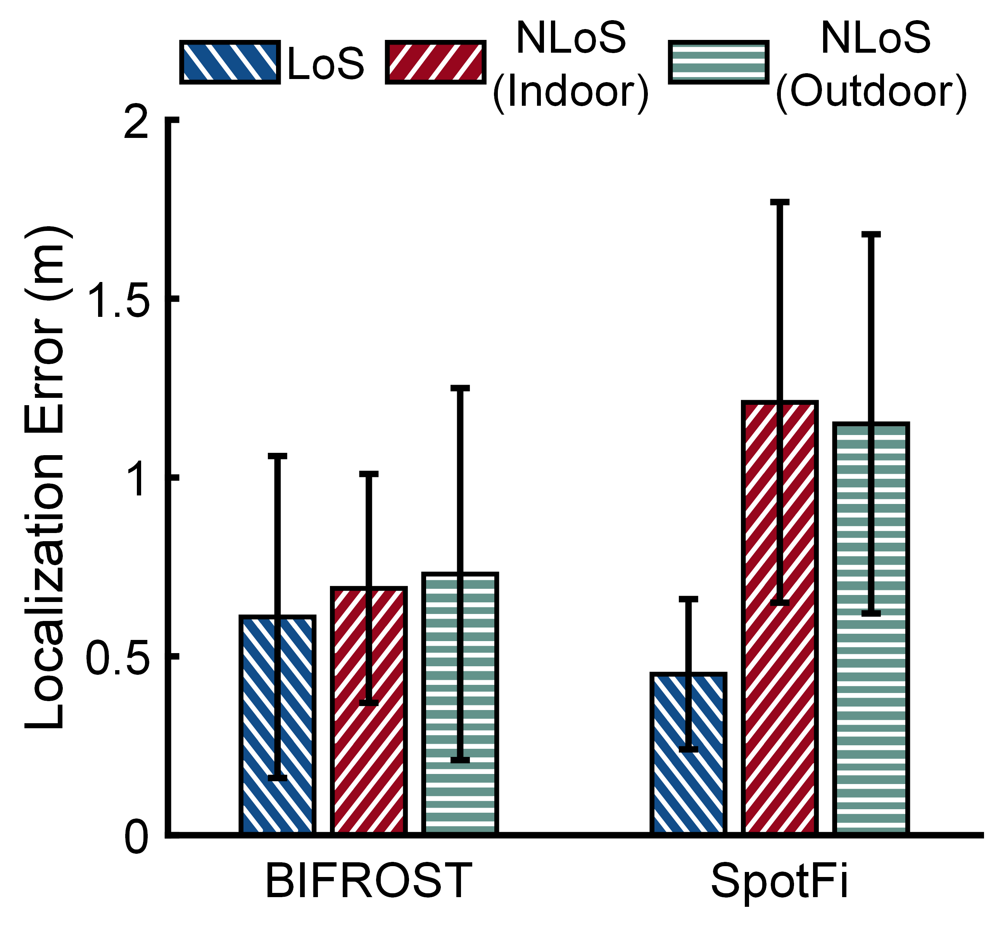
Performance in NLoS
The NLoS AP outdoors
The NLoS AP indoors
Performance comparison
BIFROST provides stable performance when the AP is in LoS and NLoS.
In NLoS scenarios, BIFROST achieves more accurate results than SpotFi.
Motivation
BIFROST
Challenge
Design
Evaluation
Conclusion
Notes:
As BIFROST is proposed to deal with the problem of lack of LoS APs, so its performance in NLoS scenarios is important.
Thus, we conduct two groups of experiments to compare the performance of BIFRSOT and SpotFi in NLoS scenarios.
We set AP1 in the NLoS, either behind the wall or surrounded by obstacles.
BIFROST uses AP1 to localize, and SpotFi uses all three APs to localize.
Results show that in both of two NLoS scenarios, BIFROST achieves more accurate results
In the first group, we deploy the target and the LWAs in a hall. AP1 is set behind the wall while AP 2 and 3 are in LoS.
BIFROST uses AP1 to localize, and SpotFi uses all three APs to localize.
In the second group, all three APs are set in the same room, but AP1 is surrounded by several obstacles.
In both of two NLoS scenarios, BIFROST achieves more accurate results
Besides, the performance of BIFROST doesn’t degrade drastically in NLoS settings.

Slide 23
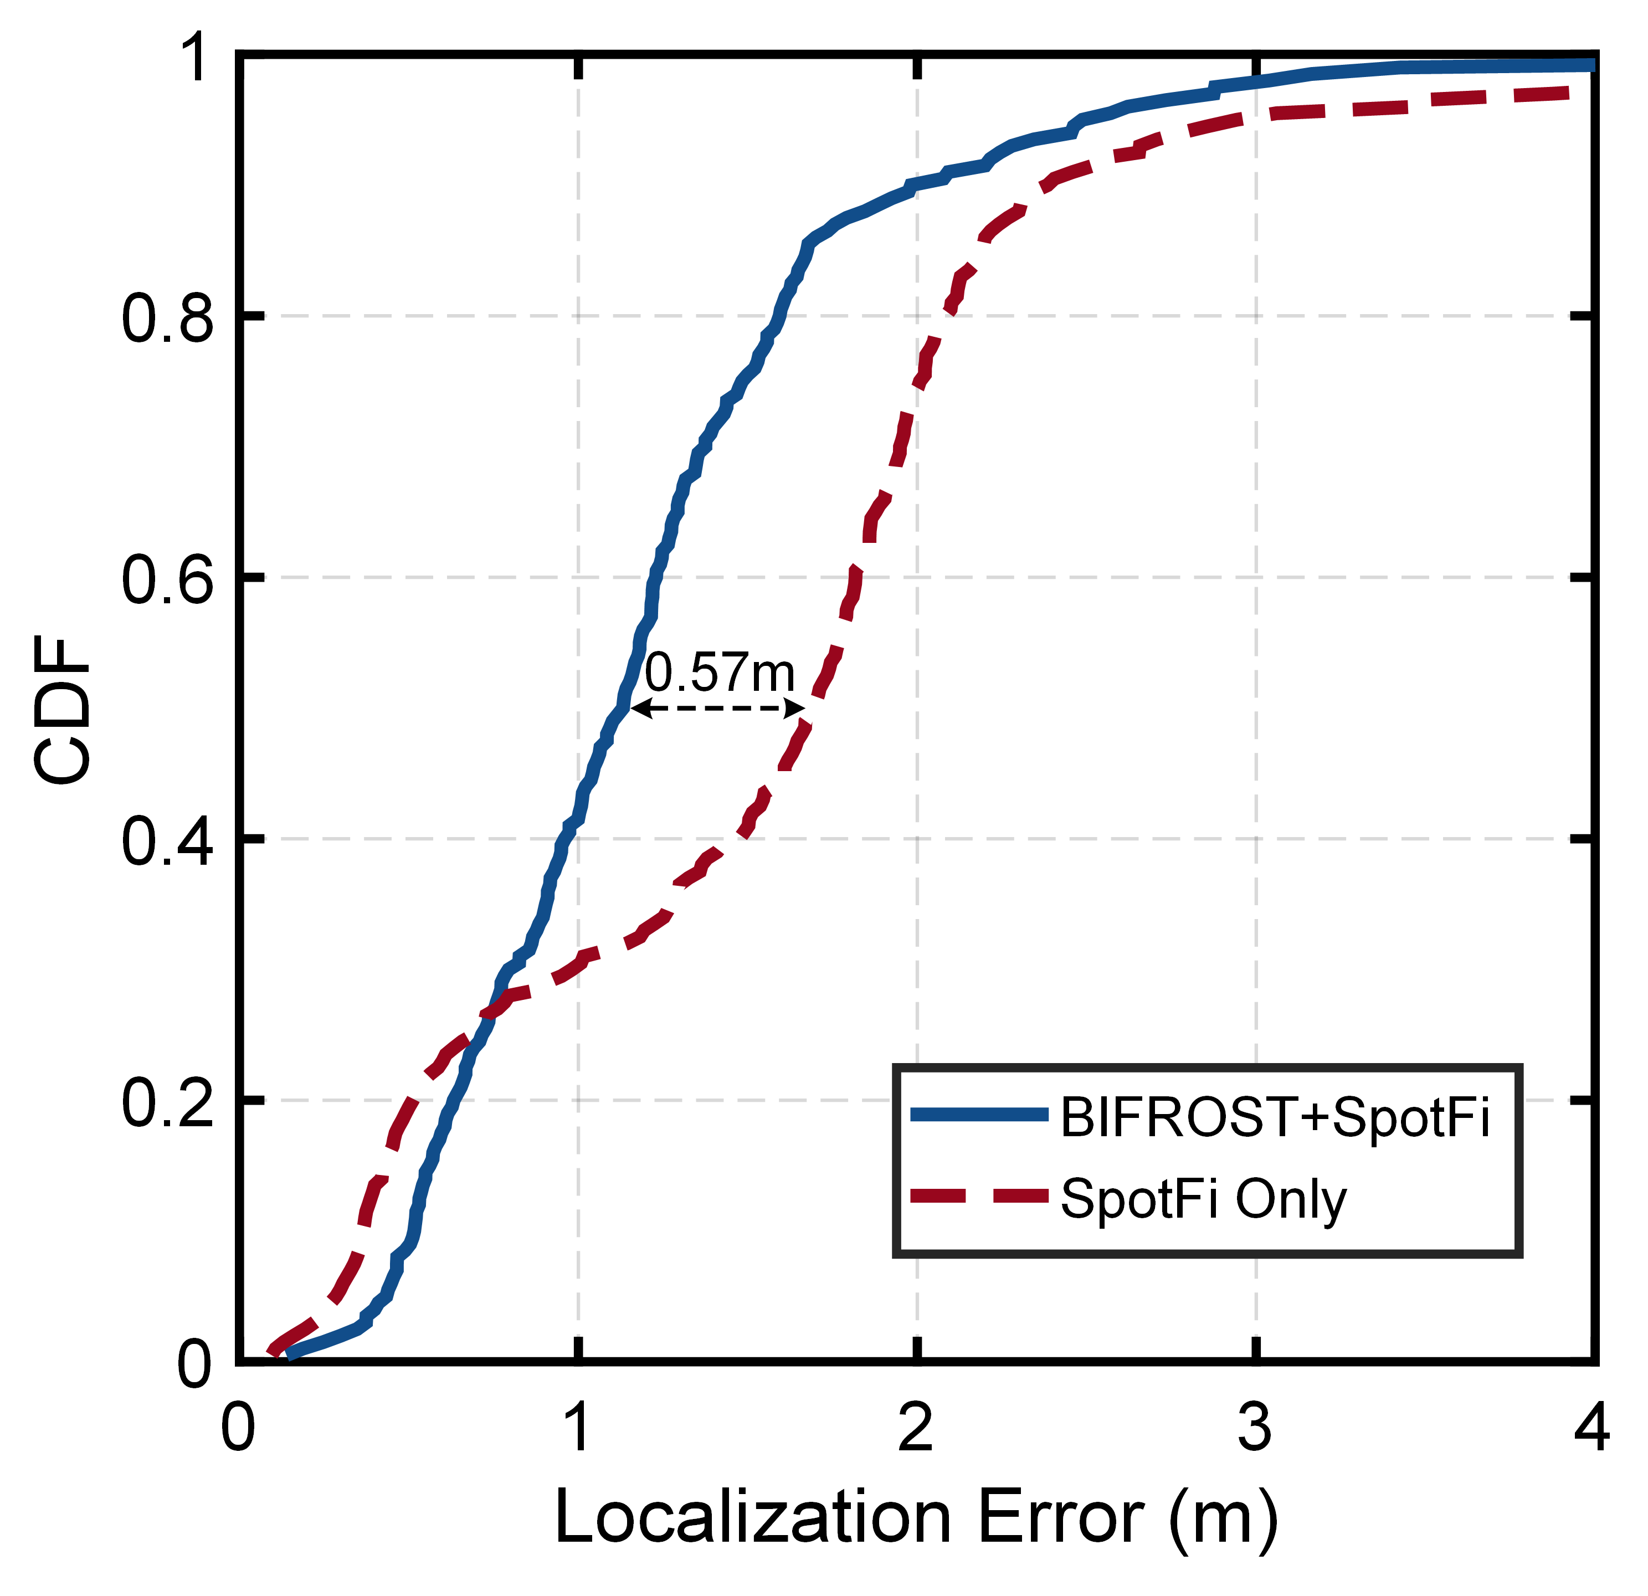
Performance Enhancement
BIFROST can enhance localization accuracy of existing localization techniques and achieve 33.54% error reduction (From 1.70m to 1.13m).
Motivation
BIFROST
Challenge
Design
Evaluation
Conclusion
Notes:
Besides from working independently, BIFROST is also expected to work with other methods in the real world setting.
So we further investigate if Bifrost can aid SpotFi to improve localization accuracy where the LoS APs are limited.
Results show that BIFROST can enhance localization accuracy of SpotFi to achieve nearly thirty-three percent error reduction

Slide 24
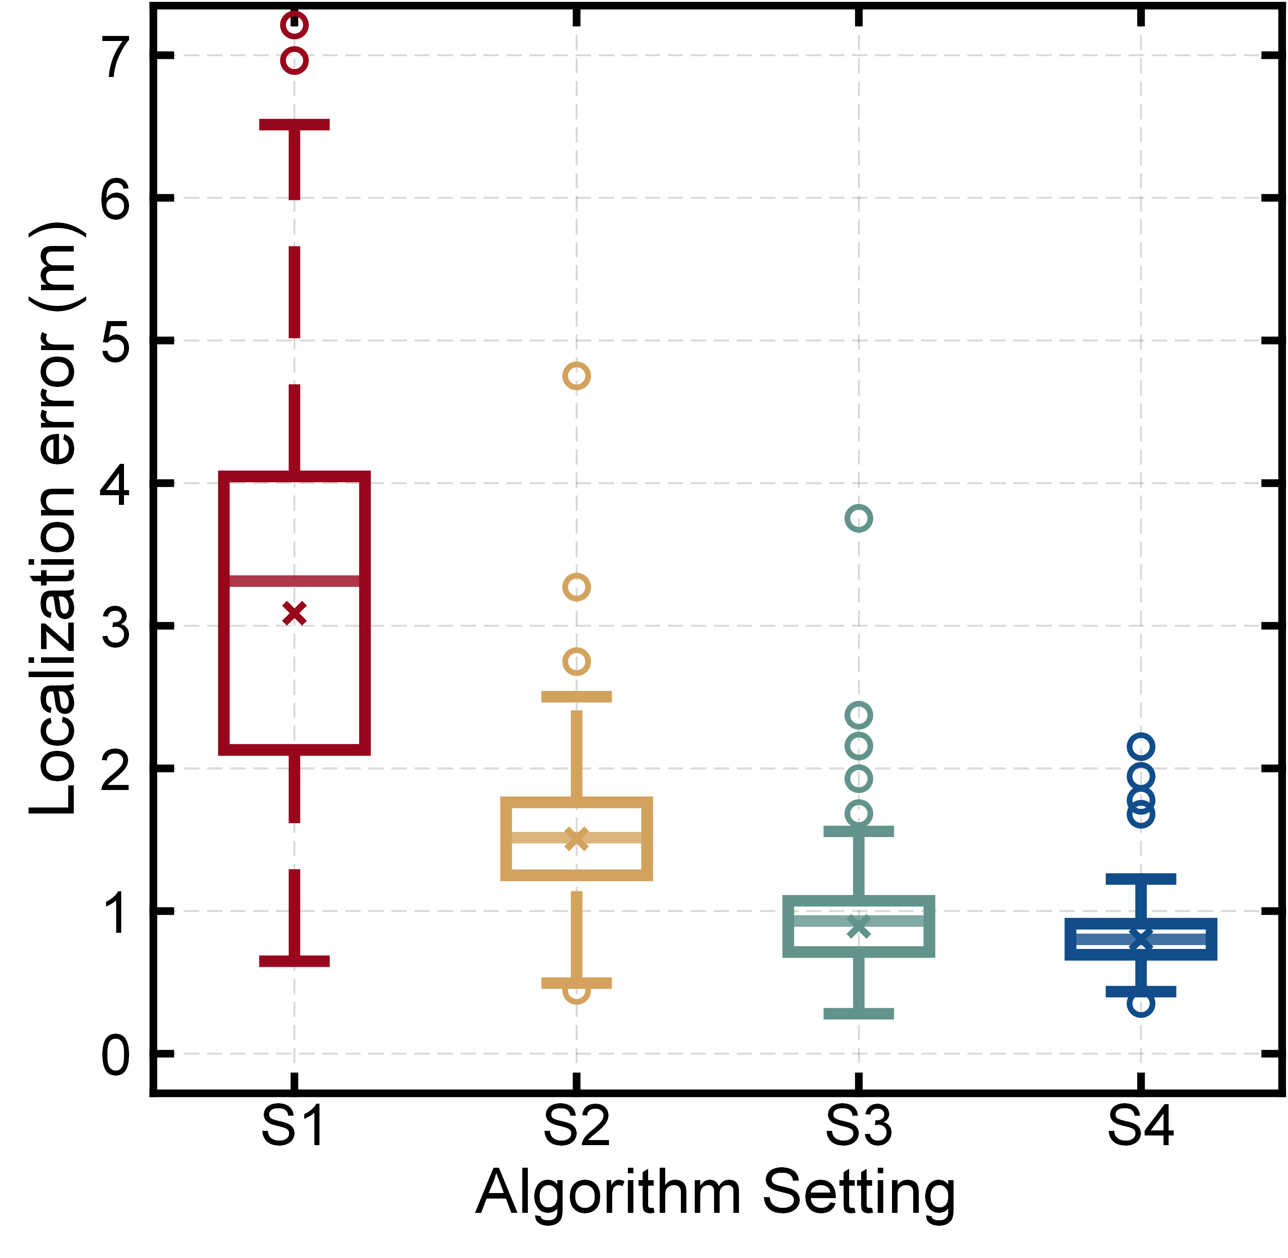
Ablation Study
Settings of ablation study
  S1: Localizing with raw data.
  S2: only ①identifying the frequencies of CP signals.
  S3: ① identifying the frequencies of CP signals and ② filtering out the multipath signal.
  S4: ① identifying the frequencies of CP signals, ② filtering out the multipath signal and ③ purifying the LoS signal for localization.
Each sub-module in our algorithm owes necessity
and contribution to the better localization performance.
Motivation
BIFROST
Challenge
Design
Evaluation
Conclusion
Notes:
Next, we conduct an ablation study.
Results show that each sub-module in our algorithm contributes to the better performance

Slide 25
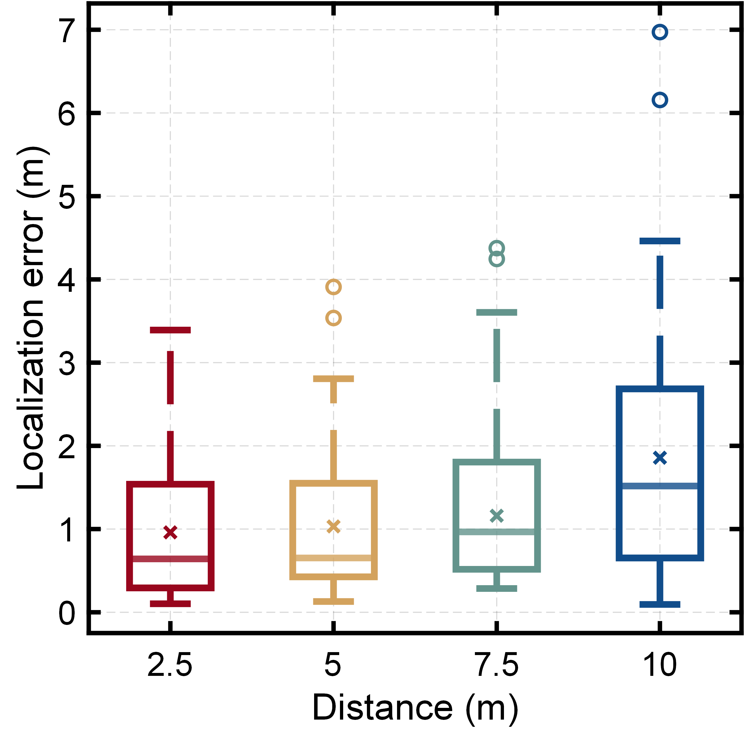
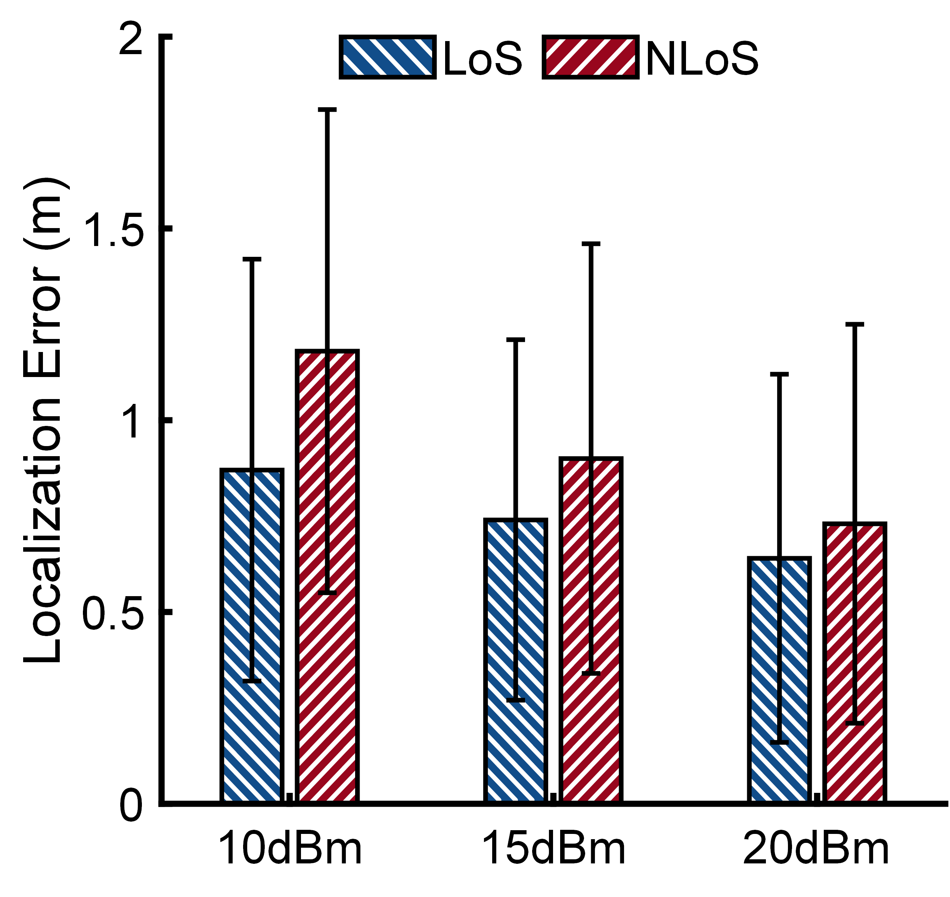
Impacting Factors
Distance between AP and LWAs
Transmission power
These factors influence BIFROST’s performance differently,
yet the absolute accuracy never degrades drastically.
Motivation
BIFROST
Challenge
Design
Evaluation
Conclusion
Notes:
Then, we analyze the impact of different factors on the performance of BIFROST.
Specifically, as the distance between AP and LWAs increase, the localization error will increase.
Besides, as the transmission power increase, the localization error will reduce.
Although these factors influence the system performance differently, yet the absolute accuracy never degrades drastically

Slide 26
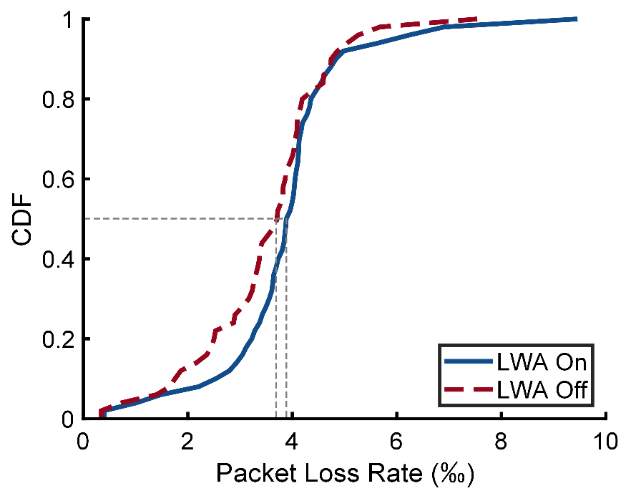
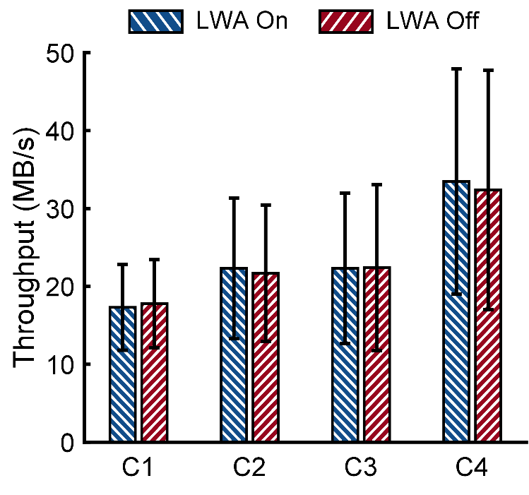
Impact on Communication
Impact on the AP and the target
Impact on other WiFi connections
BIFROST has a negligible impact on the communication quality of either the link between the AP and the target or other WiFi connections.
Motivation
BIFROST
Challenge
Design
Evaluation
Conclusion
Notes:
Finally, as BIFROST reuse the ambient WiFi signals, one may curious about its impact on the WiFi connections.
So we conduct experiments to evaluate the packet loss rate of the target and throughput of other wifi links.
As the results show, the deployment of BIFROST has almost no impact on the link between the AP and the target or other links.

Slide 27
Conclusion
BIFROST tackles a significant problem, namely the limited availability of LoS signals, to enhance the availability of indoor WiFi locali-zation.
The key innovation is the exploration of the signal polarization and dispersion effect, which embodies the concept of RF computing.
BIFROST can either improve the performance of other methods, or operate independently to outperform the STOA, without affecting the ongoing data communication of WiFi networks.
Motivation
BIFROST
Challenge
Design
Evaluation
Conclusion
Notes:
To summarize, we in this paper propose BIFROST, which can enhance the availability of indoor WiFi localization
The key innovation of BIFROST is the exploration of the signal polarization and dispersion effect
this innovation embodies the concept of RF computing
BIFROST can either operate independently or improve the performance of other methods
And its function doesn’t affect the WiFi networks.

Slide 28
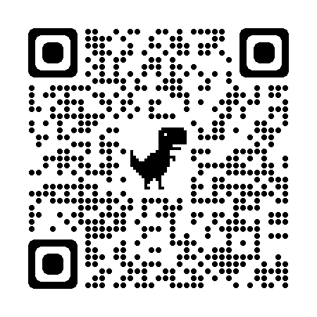
BIFROST
Thank You!
Please find more details in:
http://tns.thss.tsinghua.edu.cn/sun/
https://yimiao-sun.github.io/
28
Notes:
Thanks for your listening.
And Please visit our website for more details.

