Slide 1


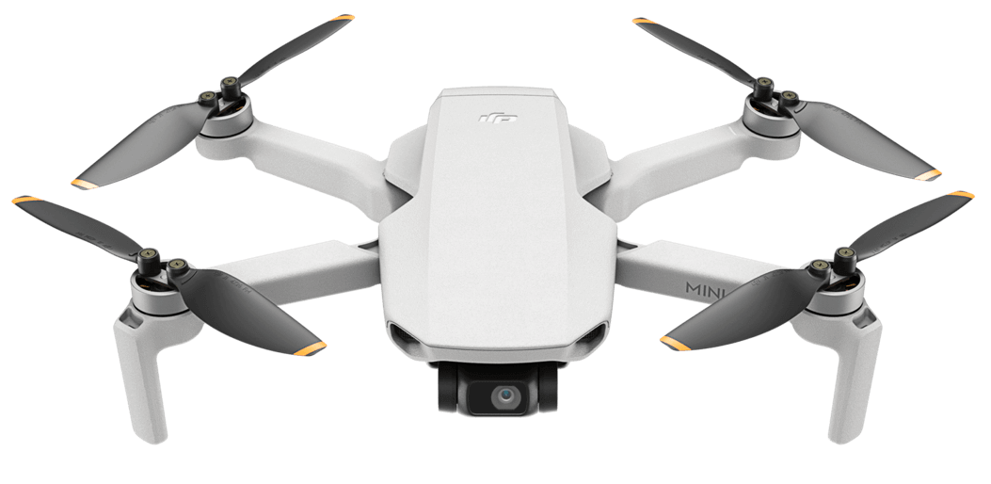
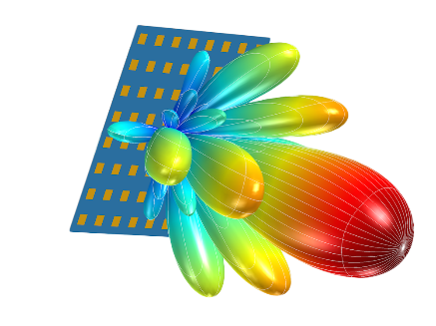
mmHawkeye: Passive UAV Detection with
a COTS mmWave Radar
Jia Zhang¹, Xin Na¹, Rui Xi², Yimiao Sun¹, Yuan He¹
¹Tsinghua University
²University of Electronic Science and Technology of China
Notes:
Hello，everyone, my name is Jia Zhang. I’m a Ph.D candicate at Tsinghua University. Today, I’m going to share our recent work: “mmHawkeye: Passive UAV Detection with a COTS mmWave Radar”.

Slide 2
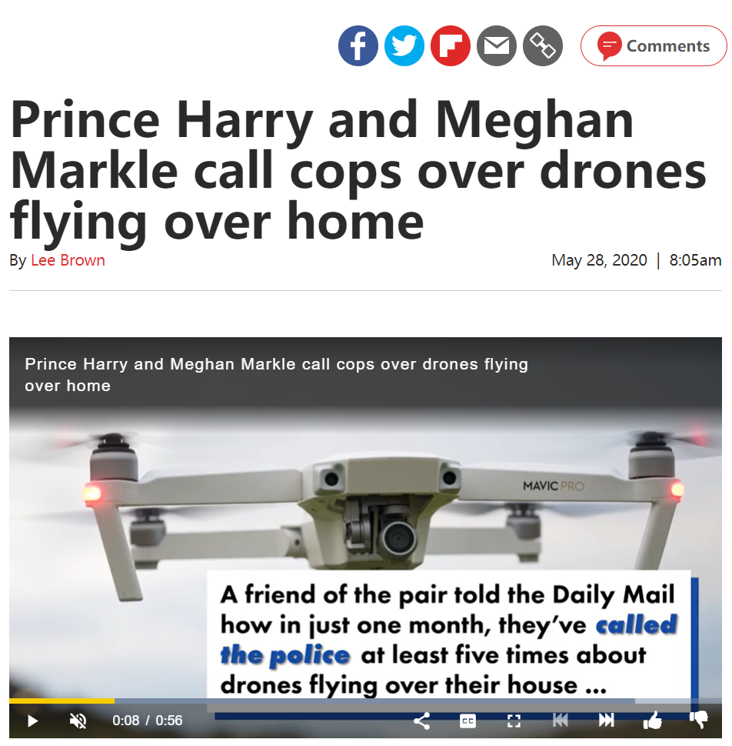
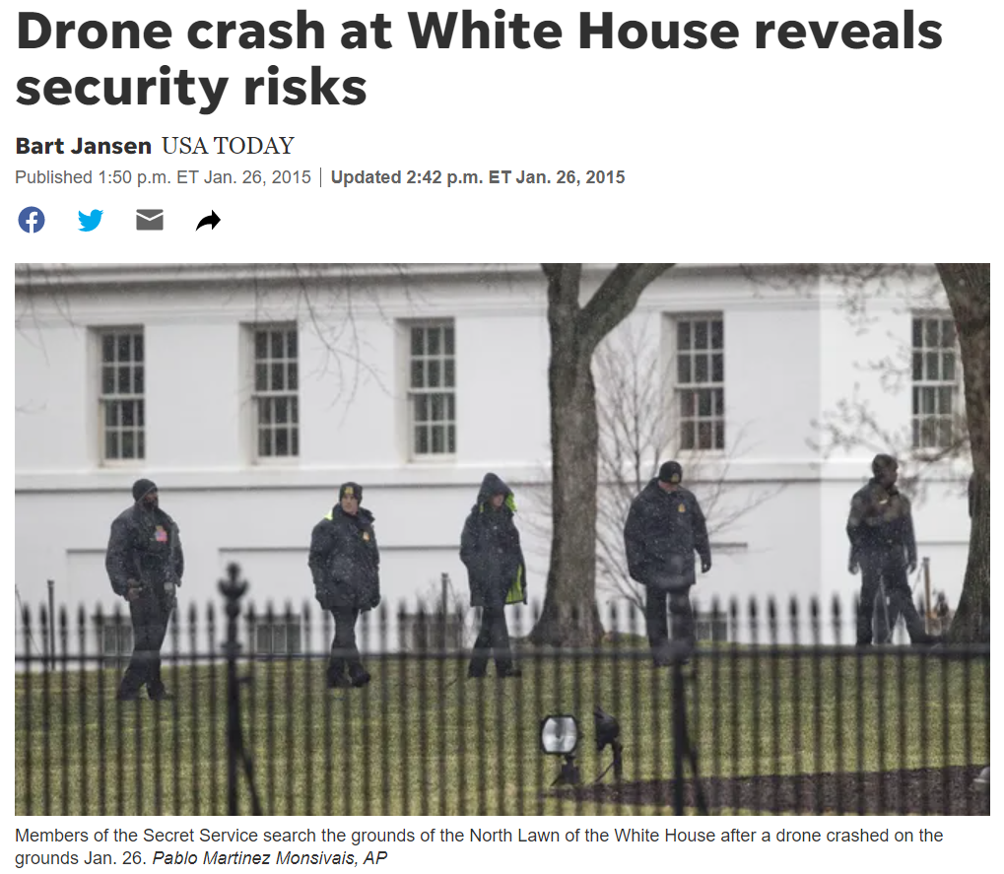
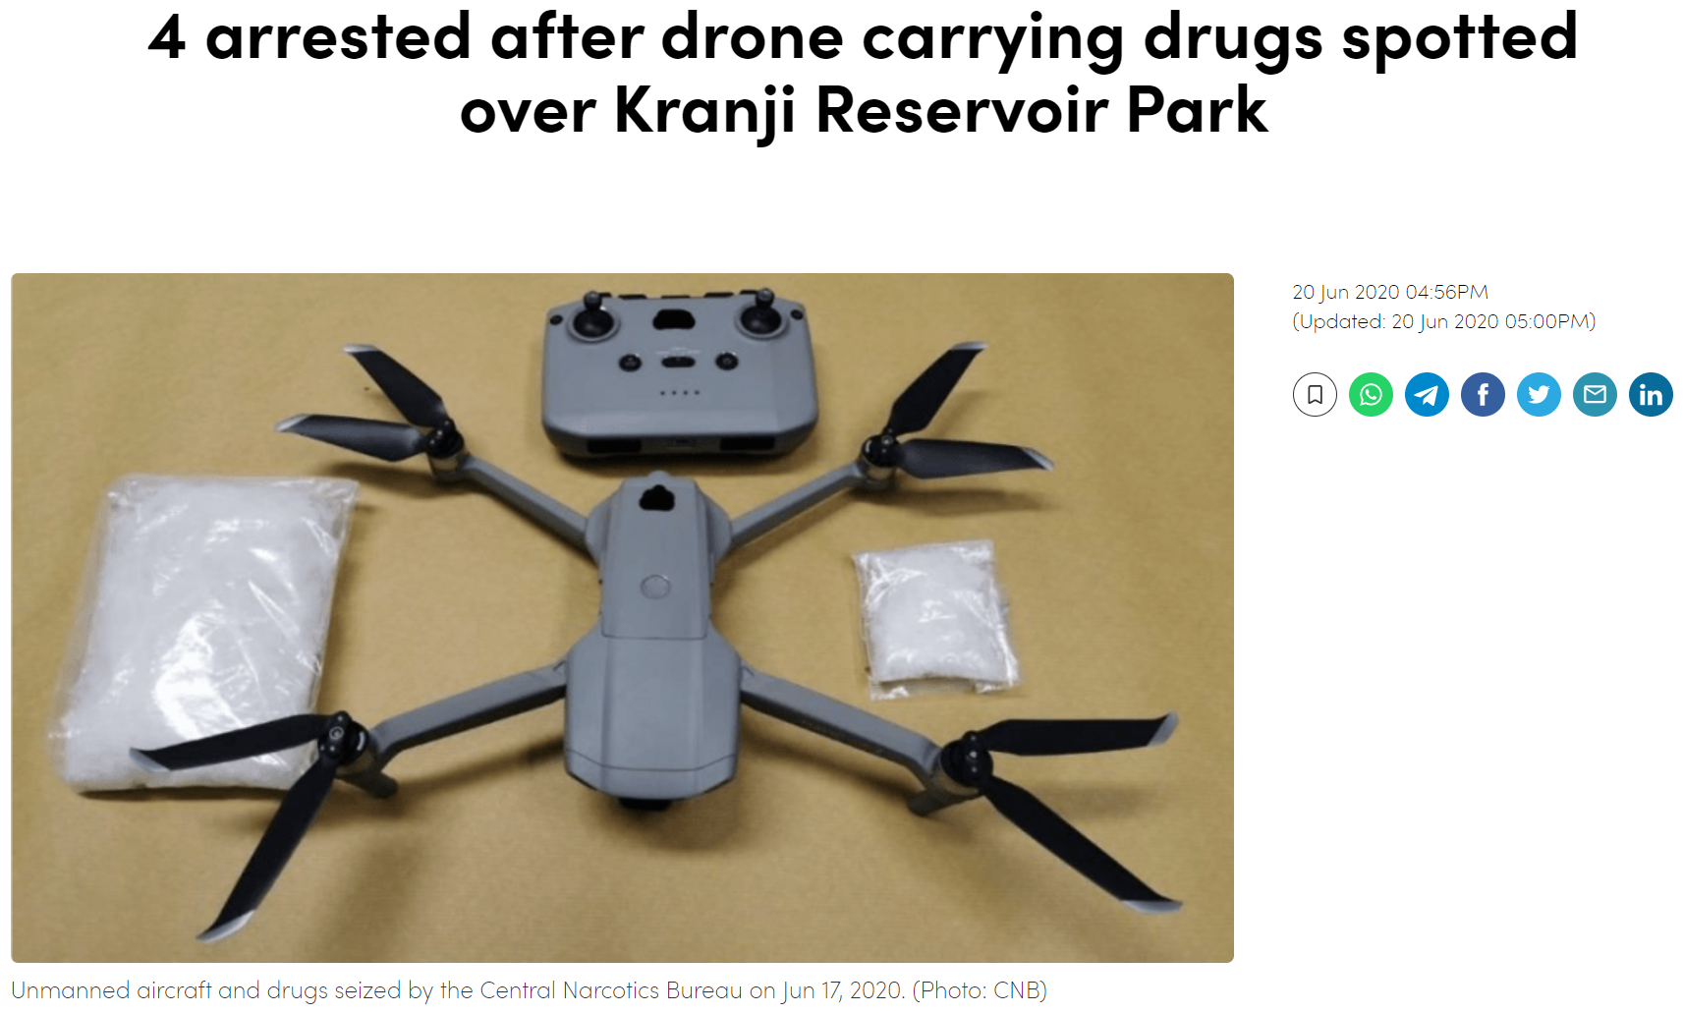
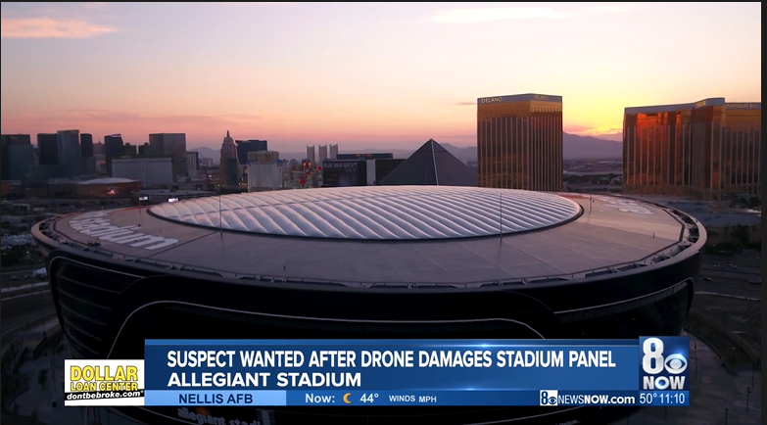
The potential threat of small UAVs
Intrusion into personal space
Illegal item delivery
Public safety threat
Human injury
1/18
Notes:
With the popularity of small UAVs, the potential threat (si ruai te) of small UAVs has received widespread attention, such as intrusion (in chu shen) into personal space, illegal (yi li gou) item delivery and human injury.

Slide 3
The potential threat of small UAVs
Intrusion into personal space
Illegal item delivery
Public safety threat
Human injury
1/18
Notes:
Among them, intrusion into personal space is most concerned, as it threats our daily privacy and safety. A UAV can easily intrude personal space at height to conduct illegal activities, such as candid photography or even theft (sai fu te). how to detect them has become an extremely important and urgent (er zhen te) problem.

Slide 4
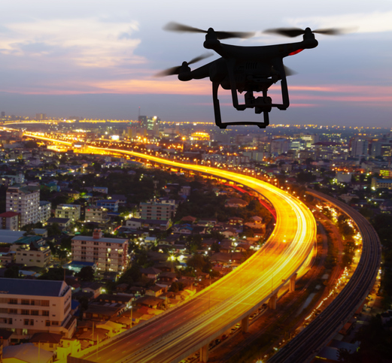
Expected performance of UAV detection system
Passive detection
Long-distance detection
Low-cost and easy to deploy
Generic for various UAVs
1/18
Notes:
We find that a UAV detection system should be able to meet the following goals: (click) First, it can passively detect UAVs without the cooperation of them. (click) Second, it can detect the presence of a UAV at height; (click) Third, the system should be low-cost and easy to deploy. (click) Finally, it should be generic (zhen nai rui ke) to detect various UAVs.

Slide 5

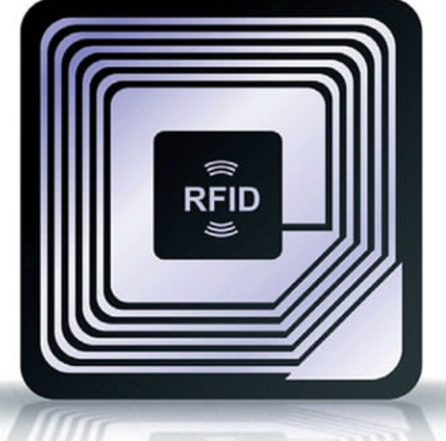

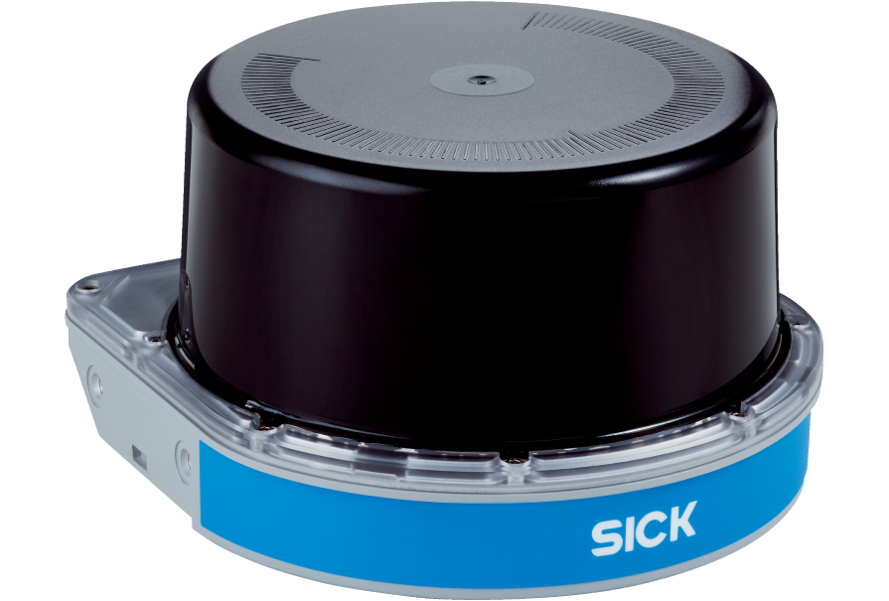
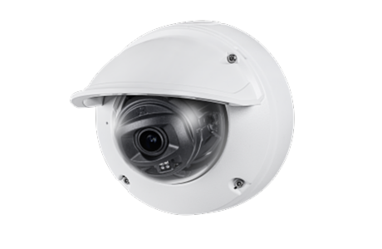

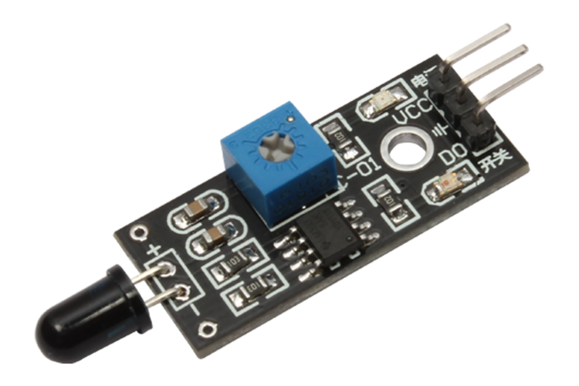
Potential UAV detection solution
Passive detection
NFC
Long-distance detection
Low-cost and easy to deploy
Acoustics
Lidar
mmWave
Generic for various UAVs
Camera
IR
2/18
Notes:
To achieve such performance, we consider potential UAV detection solutions, including acoustic-based, mmWave-based, camera-based, lidar-based and so on.

Slide 6
Advantages of the mmWave radar
Accurate tracking capability
Wide detection FoV
Work in various illumination and noise conditions
Low-cost and easy to deploy
3/18
Notes:
We find that the mmWave radar is well suitable for UAV detection in daily usage scenarios because of its accurate tracking capability (kei pu ability) and wide detection FoV. It can further work in various illumination (yi lu mi nation) and noise conditions. And finally, it’s low-cost and easy to deploy.

Slide 7
Challenge of mmWave-based UAV detection system
The weak reflected signal from the small UAV at height
The dynamic and unpredictable motion of the non-cooperative UAV
The tightly coupled inherent UAV features and motion-related features
The above factors lead to the very low SNR and the uncertainty of the UAV-reflected signals
4/18
Notes:
However, accurate UAV detection with a COTS mmWave radar is not easy. (click)First, the limited transmission power of the COTS radar, the small size of the UAV, and the long distance make the reflected signal from the UAV very weak. (click)Second, the motion of the non-cooperative UAV is dynamic and unpredictable, which makes it very difficult to extract the reflected signal of the UAV from the received signals. (click) Finally, the UAV-reflected signals contain both the inherent (in hei ren te) UAV features and the motion-related features, which are tightly coupled with one another. (click) these challenges lead to very low SNR and uncertainty of the UAV-reflected signals.

Slide 8
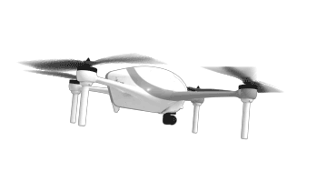
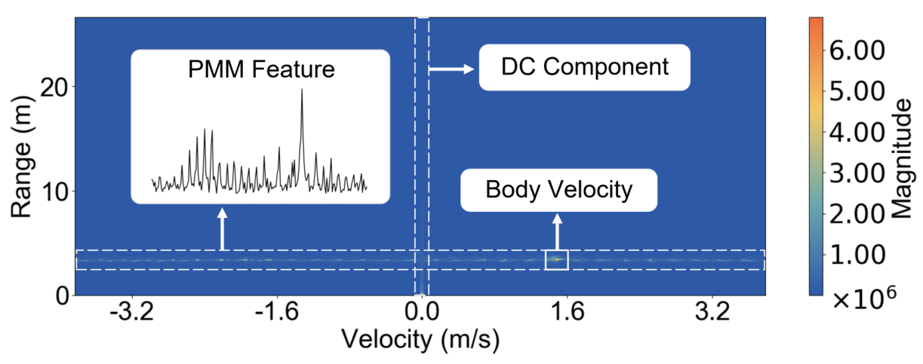
Periodic micro-motion (PMM) feature
A unique signal feature is required to extract the UAV-reflected signals
Motion-independent
Stable over time
Consistent across various UAVs
Distinguishable from noise
Periodic propeller rotation
The PMM feature of a six-wing UAV
5/18
Notes:
To solve above challenges, we want to exploit [ai ke si pu lao ai te] a unique signal feature that can help us to extract and identify the UAV-reflected signals. It should be motion-independent, stable over time, consistent across various UAVs and distinguishable from noise. (click) Our finding is that the periodic micro-motion of the UAV, such as propeller rotation, can be converted into stable and consistent features in the frequency of reflected signals.(click) Specifically, the periodic micro-motion always induces periodic frequency modulation of the reflected signal, resulting in a series (sei rui si) of periodic peaks in the frequency spectrum. This feature can be used to help us to extract the UAV-reflected signals.

Slide 9
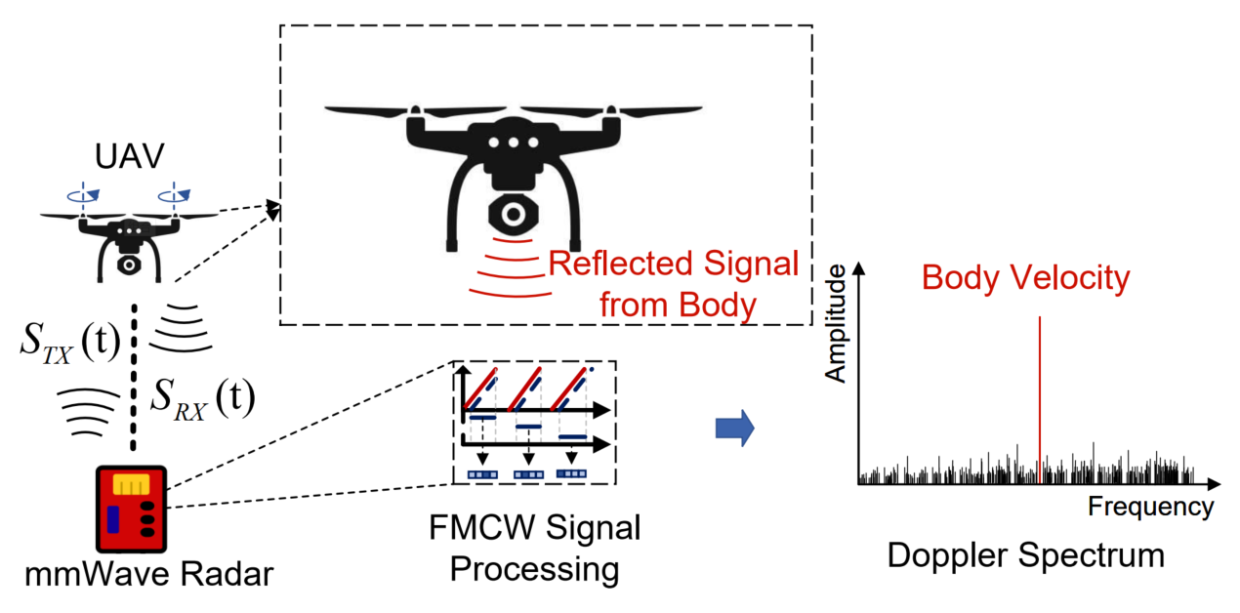


The model of UAV-reflected signal
After Range-FFT:
$$S\left(t\right)=αexp⁡[j4πf_{c}R(t)/c]$$
After Doppler-FFT:
$$S\left(f\right)=FFT\left(S\left(t\right)\right)=αδ(f−2vf_{c}/c)$$
6/18
Notes:
We further model the reflected signal of the UAV. We first ignore the influence of the UAV micro-motion. Only considering the signal reflected by the UAV body, (click) we can obtain its body velocity through the classic Range-Doppler-FFT.

Slide 10
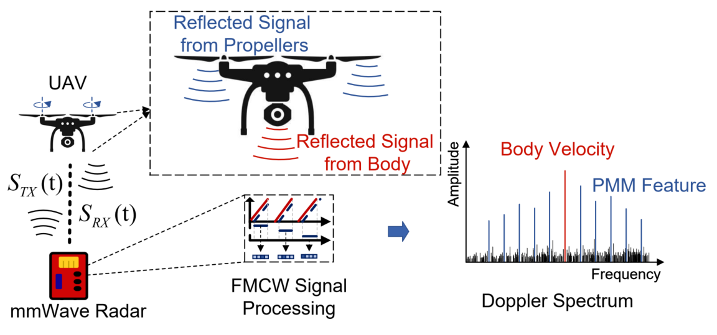

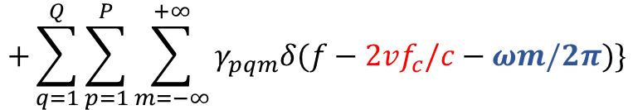

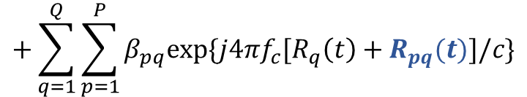

The model of UAV-reflected signal
After Range-FFT:
$$S\left(t\right)=αexp⁡[j4πf_{c}R(t)/c]$$
$$+\sum_{q=1}^{Q}{\sum_{p=1}^{P}{β_{pq}exp⁡\{j4πf_{c}[R_{q}\left(t\right)+R_{pq}(t)]/c\}}}$$
Propeller position:
$$R_{pq}\left(t\right)∝r_{pq}∗cos⁡(ωt+φ_{pq})$$
After Doppler-FFT:
$$S\left(f\right)=FFT\left(S\left(t\right)\right)=αδ(f−2vf_{c}/c)$$
$$+\sum_{q=1}^{Q}{\sum_{p=1}^{P}{\sum_{m=−∞}^{+∞}{γ_{pqm}δ(f−2vf_{c}/c−ωm/2π)}\}}}$$
7/18
Notes:
The model becomes a bit more complex when the micro-motions of the UAV are considered. (click) The reflected signal of the UAV includes the signal reflected from the body and from the propellers. (click) Due to the propeller rotation, its position changes periodically, (click) such periodic micro-motions lead to a series of periodic peaks in the Doppler-FFT results. We call these peaks the PMM features.

Slide 11


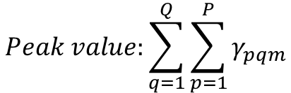

The model of UAV-reflected signal
The PMM feature:
$$Peak Pos: 2vf_{c}/c+ωm/2π$$
$$m∈Z$$
$$Peak value:\sum_{q=1}^{Q}{\sum_{p=1}^{P}{γ_{pqm}}}$$
$$m∈Z$$
8/18
Notes:
In the PMM feature, the interval between the peaks is the same and only determined by the propeller rotation speed. While the peak values are more complex and related to the UAV relative position and the UAV structure. We find that the peak interval is a more stable feature and is suitable for UAV tracking and identification.

Slide 12
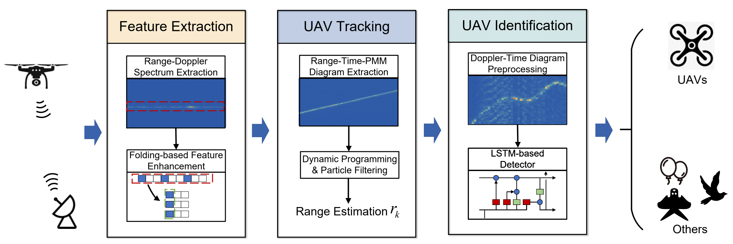
mmHawkeye: Passive UAV detection with the PMM feature
9/18
Notes:
With this feature, we propose mmHawkeye, which solves the UAV detection problem in three steps. (click) mmHawkeye first extracts the Range-Doppler spectrum with Range-Doppler FFT. It then uses spectrum folding technique to enhance the PMM feature. (click) With continuous feature extraction，mmHawkeye can obtain the distribution of PMM features in space and time, which is called the Range-Time-PMM diagram. To resist the impact of unpredictable UAV motions, we design a tracking algorithm based on Dynamic programming and particle filter to obtain the tracking result. (click) After that, mmHawkeye continuously extract the doppler spectrum and use these spectrums to achieve UAV identification.

Slide 13
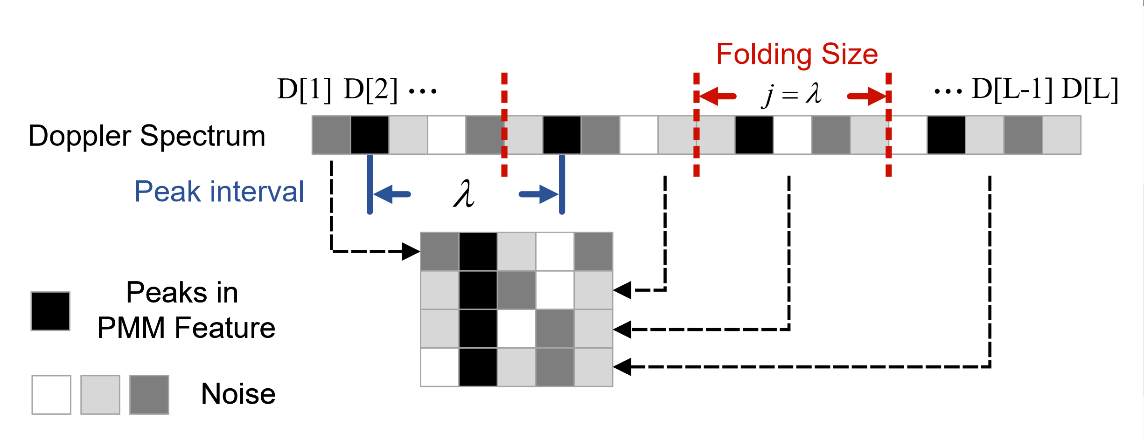
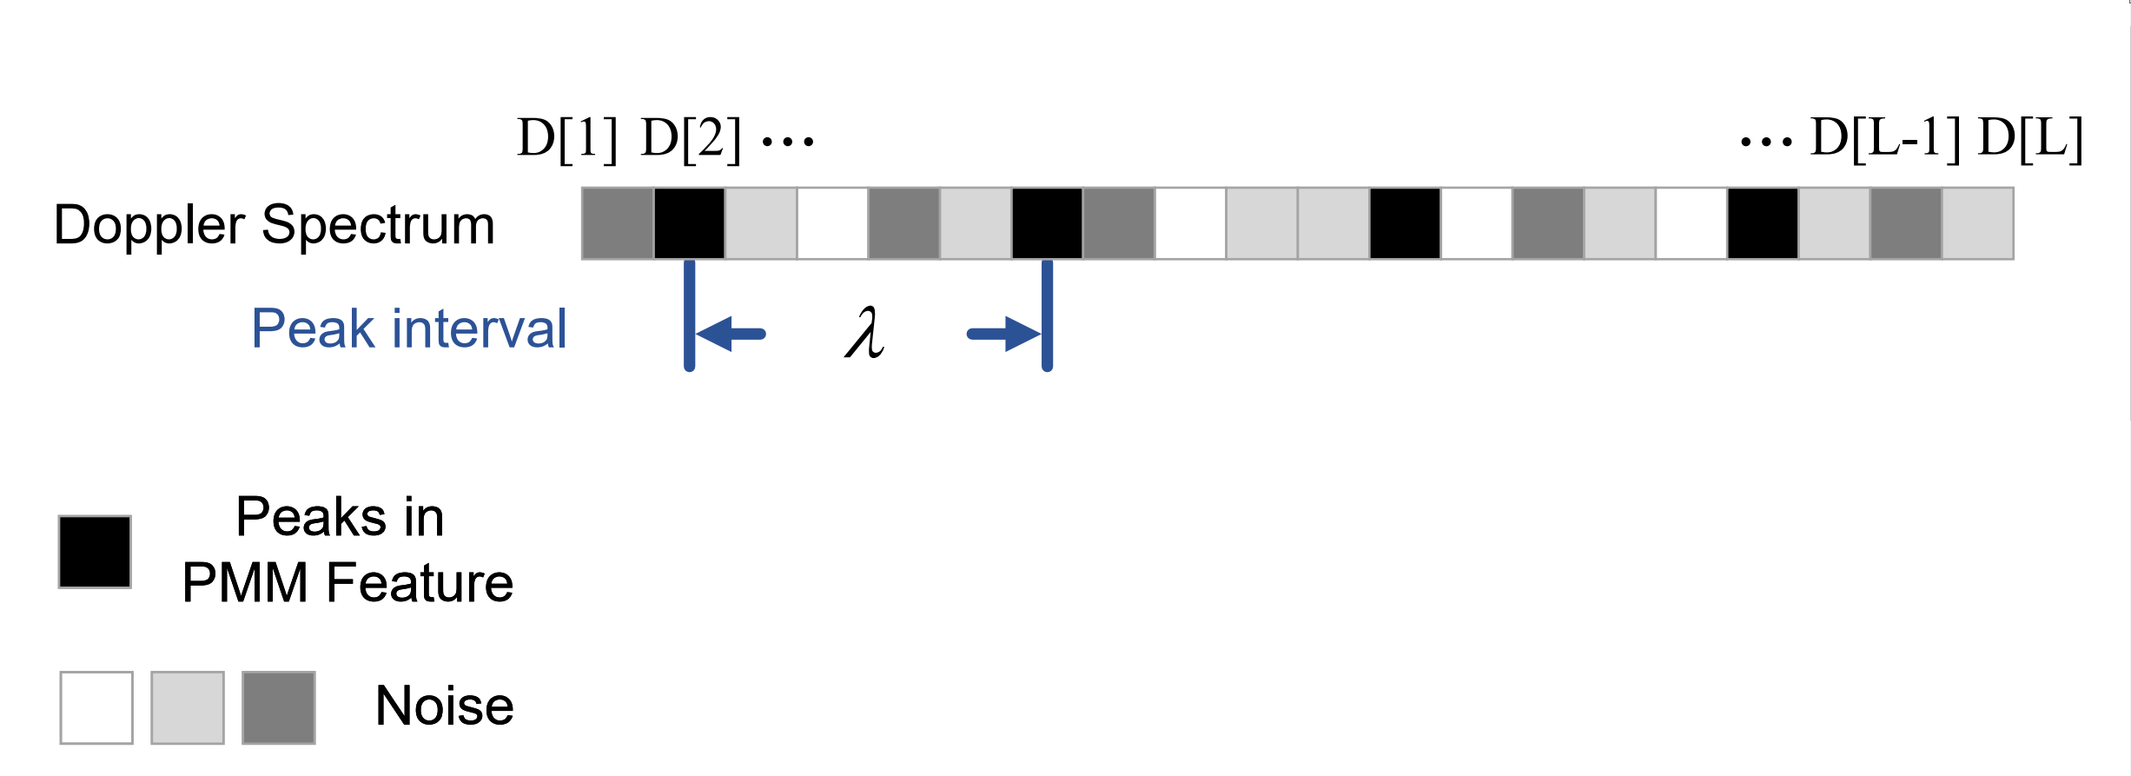
Feature extraction
Challenge 1: The weak reflected signal from the small UAV at height.
10/18
Notes:
After obtaining the Doppler spectrum at each range bin, the PMM feature appear in the Doppler spectrum corresponding to the UAV position. However, considering that the propeller rotation speed is unpredictable, the peak interval in the PMM feature is uncertain and variable.

Slide 14
Feature extraction
Challenge 1: The weak reflected signal from the small UAV at height.
10/18
Notes:
To solve this problem, we first employ the folding technique, which can align the periodic peaks when the folding size is the same as the peak interval.

Slide 15
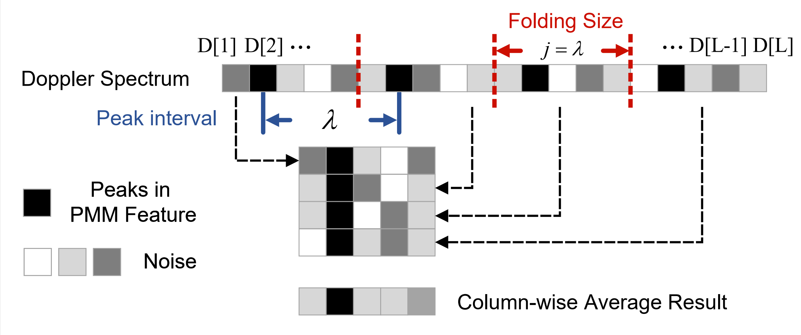
Feature extraction
Challenge 1: The weak reflected signal from the small UAV at height.
10/18
Notes:
A significant enhance peak will appear in the column-wise averaged result. To find the right folding size, we traverse (chui verse) all integers (in te zher) in an empirical (ai mu pei rui kou) range as the folding size. The largest average value is selected as the enhanced feature.

Slide 16
UAV tracking
Challenge 2: The dynamic and unpredictable motion of the non-cooperative UAV.
…
Range
…
…
…
Time
Range-Time-PMM Diagram (RPMM)
11/18
Notes:
After the feature extraction module, the enhanced feature at each timeslot and at each range bin can be obtained, these feature values can make up a Range-Time-PMM diagram. We call it as R-PMM. Since the UAV's Doppler spectrum has a larger feature value, the UAV trajectory corresponds to the maximum path in R-PMM.

Slide 17







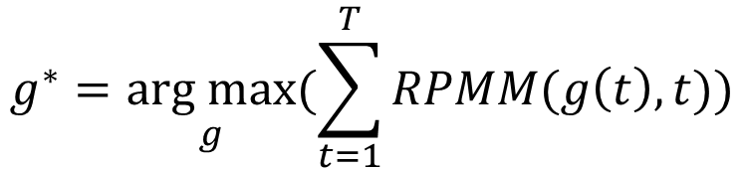
UAV tracking
Challenge 2: The dynamic and unpredictable motion of the non-cooperative UAV.
…
The maximum path:
Range
$$S_{54}$$
$$g^{∗}=\underset{g}{arg max}{(\sum_{t=1}^{T}{RPMM(g\left(t\right), t}))}$$
$$S_{32}$$
$$S_{33}$$
$$S_{43}$$
…
$$S_{21}$$
$$s.t. |g\left(t\right)−g\left(t−1\right)|≤K$$
$$2K$$
…
…
Time
Range-Time-PMM Diagram (RPMM)
11/18
Notes:
We use dynamic programming to find the maximum path, which can be obtained by solving such an optimization problem. Considering that the UAV's trajectory always changes continuously, (click)we use the UAV's maximum range variation as the constraint to reduce the tracking error. After that, we apply the particle filter to the tracking results to further reduce the error.

Slide 18
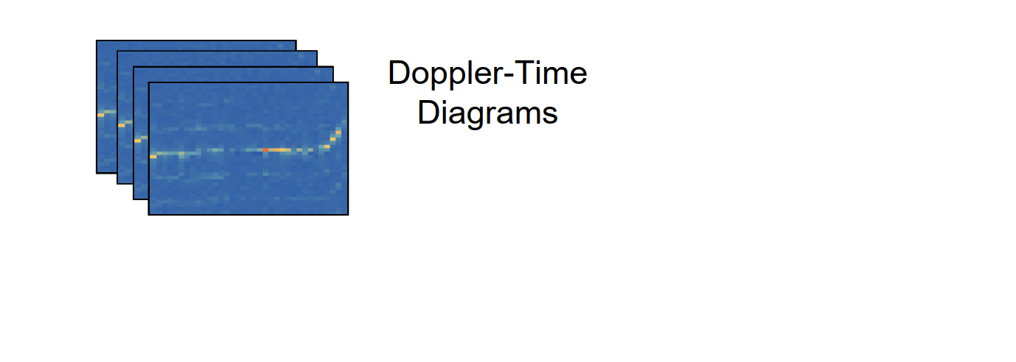
UAV identification
Challenge 3: The tightly coupled inherent UAV features and motion-related features.
12/18
Notes:
After obtaining the tracking results, mmHawkeye continues to extract the Doppler spectrum from the target to form Doppler-time diagrams. These diagrams can be used to distinguish UAV from other objects.

Slide 19
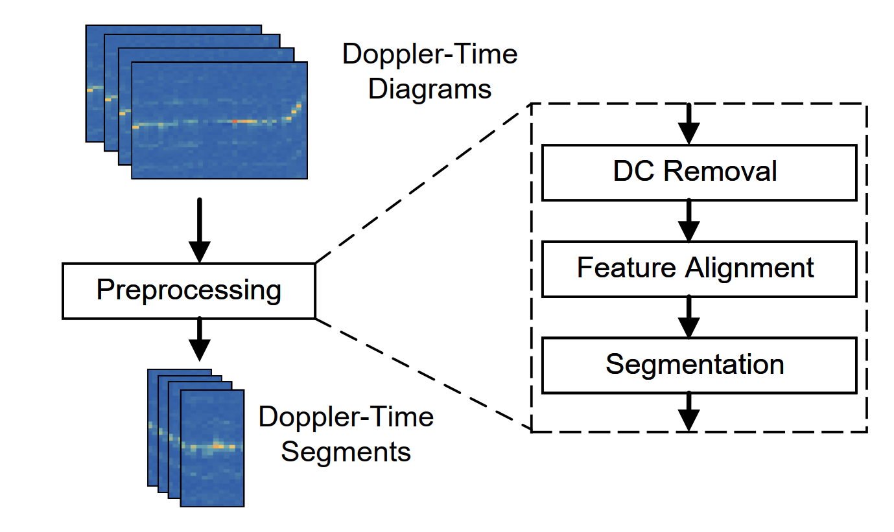
UAV identification
Challenge 3: The tightly coupled inherent UAV features and motion-related features.
12/18
Notes:
Considering that both the DC component and the dynamic body velocity will affect the identification of PMM features, we first remove the DC component, and then align the UAV body velocity at each moment to improve the significance of the PMM features.

Slide 20
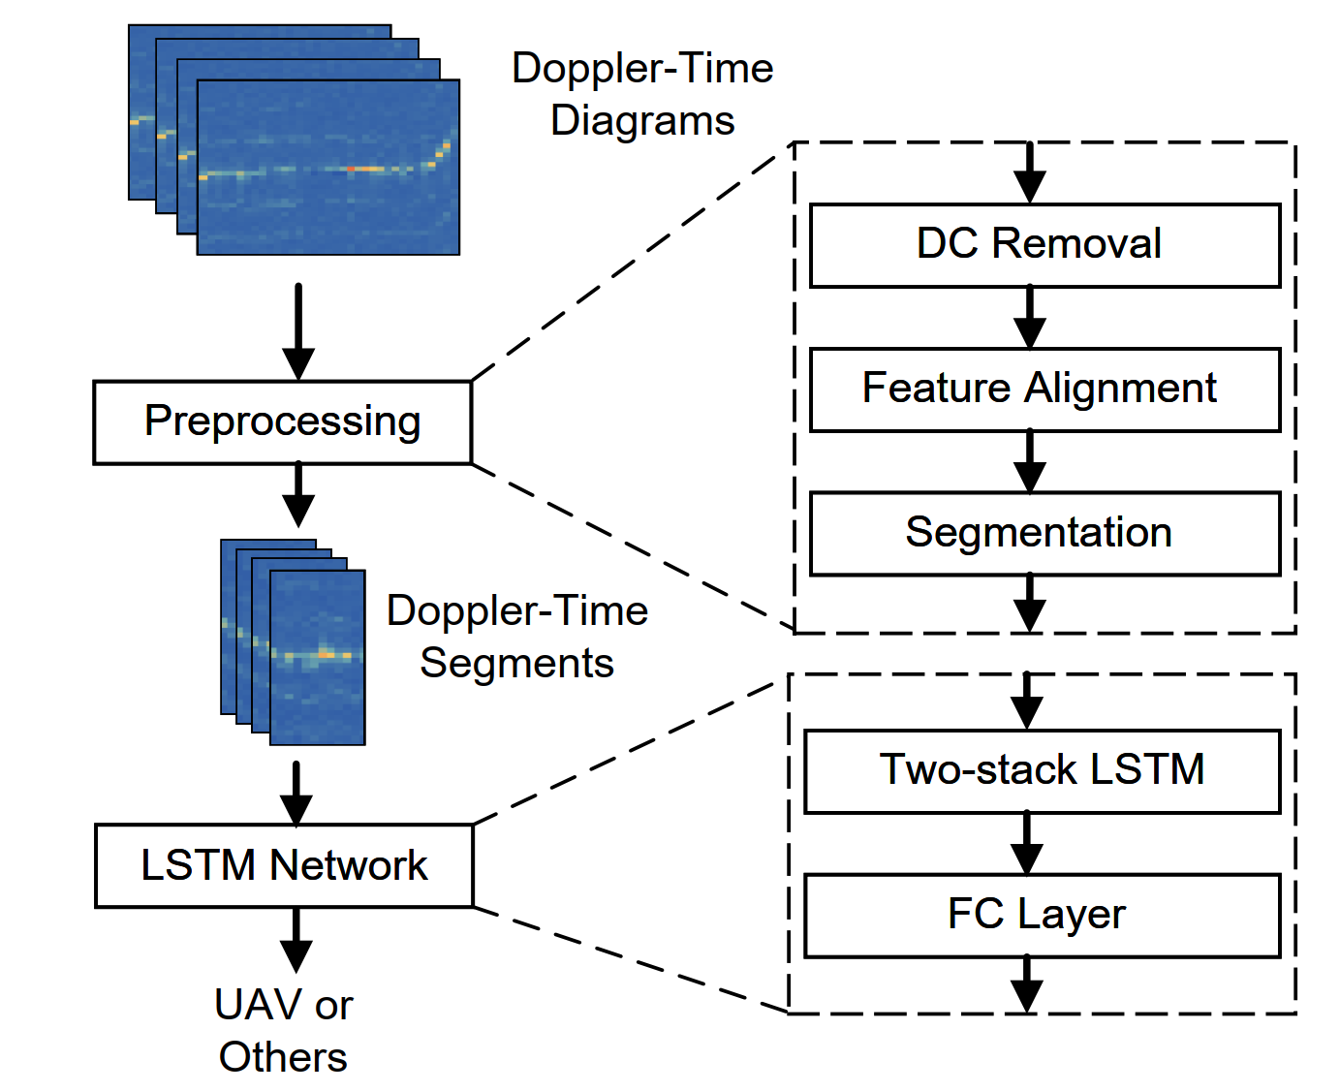
UAV identification
Challenge 3: The tightly coupled inherent UAV features and motion-related features.
12/18
Notes:
Finally, we feed these Doppler-Time segments into a two-layer LSTM network to judge whether these segments are from a UAV or other objects. The LSTM network is very suitable for such a binary classification problem.

Slide 21
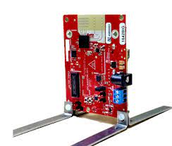
Evaluation
Notes:
Then we introduce the evaluation of mmHawkeye.

Slide 22
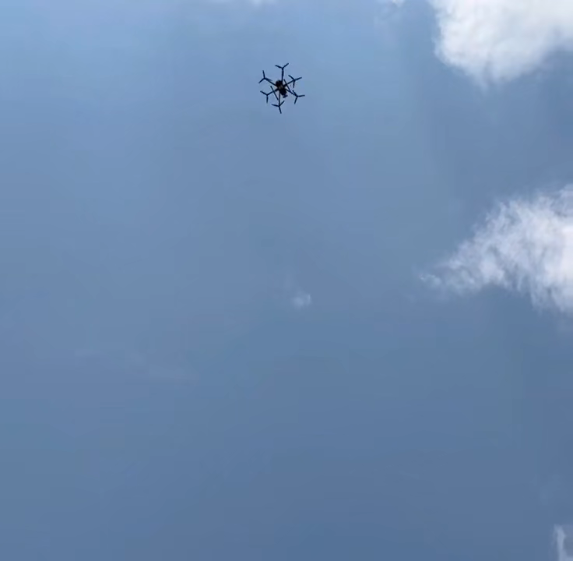
Implementation
The experiment scenario
13/18
Notes:
(click) We first present our experiment scenario.

Slide 23
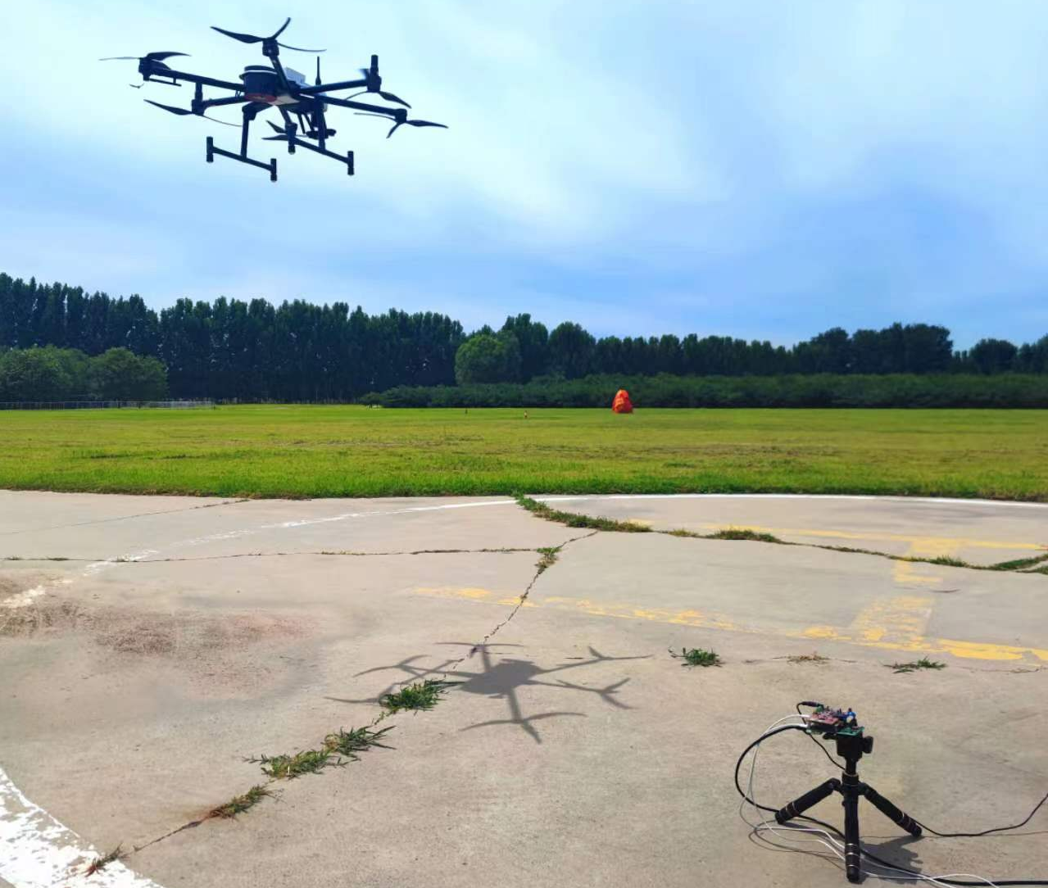
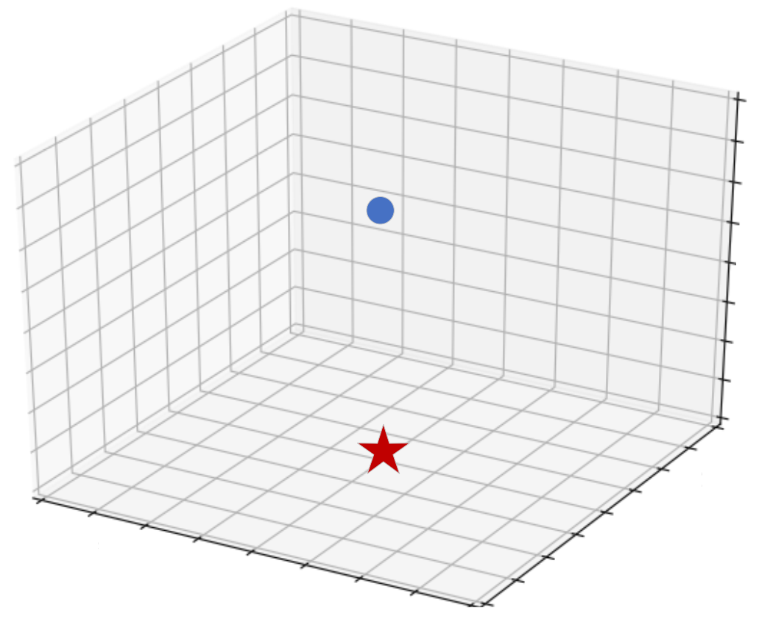
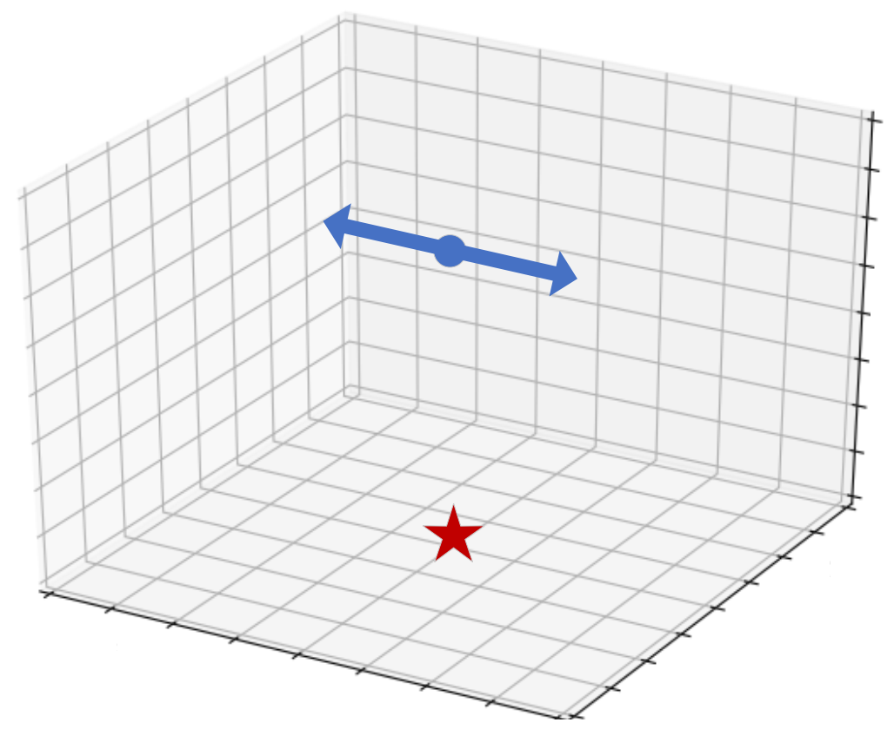
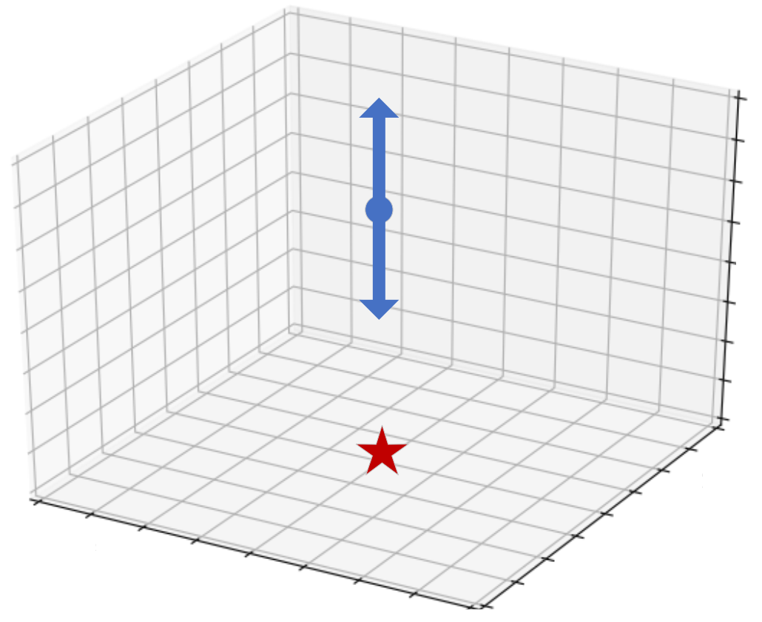
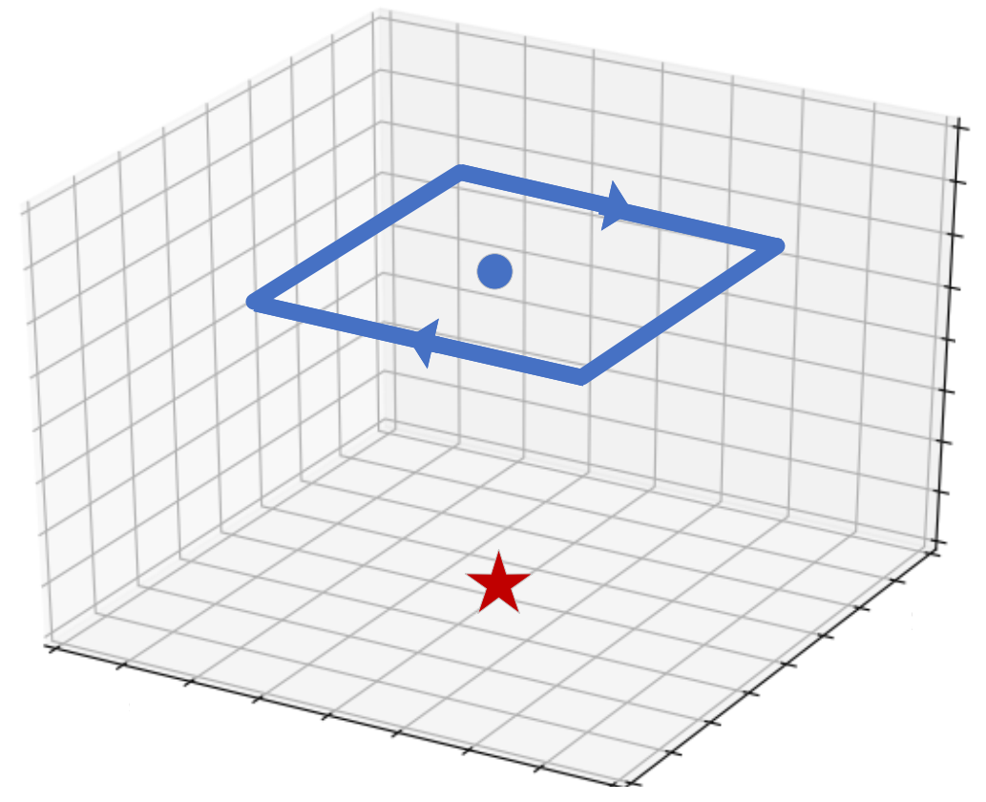
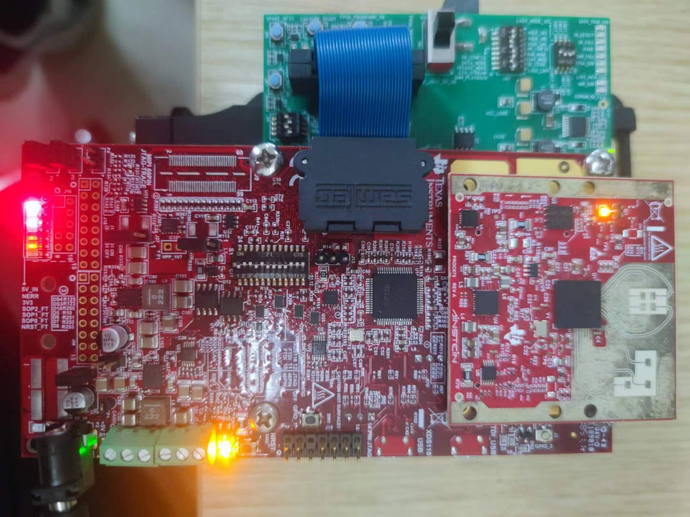
Implementation
Hovering
Horizontal
Implementation on a COTS mmWave radar TI IWR6843ISKODS.
A six-wing UAV with three blades per propeller is used as the detection target.
The RTK module is used to provide the ground truth of the UAV location.
More than 4000 seconds of signal is collected.
Six-wing UAV
Radar
Trajectory
Vertical
Square
mmWave Radar
The experiment scenario
13/18
Notes:
Specifically，(click) We implement mmHawkeye based on a commercial mmWave radar. (click) A six-rotor UAV is used as the detection target, (click) The UAV is equipped with an RTK module to provide centimeter-level ground truth. (click) And more than four thousand seconds of signal is collected for evaluation.

Slide 24
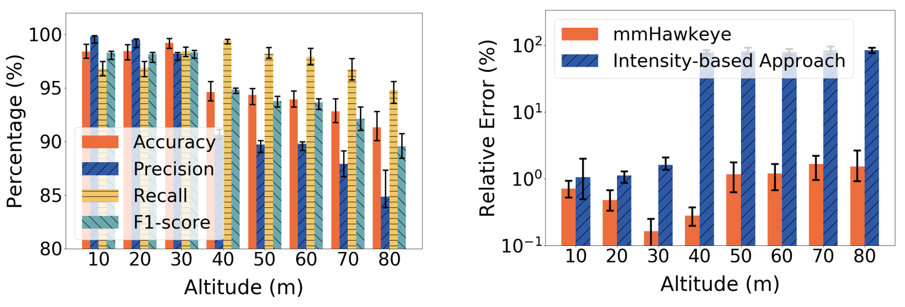
Overall performance
mmHawkeye achieves an UAV detection accuracy of 95.8% and a relative range error of 0.9% at a detection range up to 80m.
14/18
Notes:
We first evaluate the overall performance of mmHawkeye. The UAV altitude varies from 10m to 80m. The overall detection accuracy of mmHawkeye reaches 95.8% (ninty five point eight percent). With the UAV altitude increasing, the detection accuracy decreases. The reason is that as the UAV altitude increase, the PMM features becomes weaker and sometimes incomplete, leading to the decrease of the detection accuracy. We also evaluate the tracking performance. mmHawkeye can achieve a relative (ruai lei ti wu) range error of 0.9% at a detection range up to 80m, much better than that of the intensity-based approach.

Slide 25
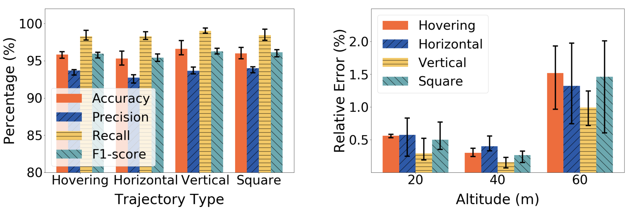
Accuracy v.s. trajectory
mmHawkeye works well with different UAV trajectories.
15/18
Notes:
Then we consider the impact of the UAV trajectory. The flight trajectories include hovering, horizontal flight, vertical flight and flying with a horizontal square. The results show that the detection accuracy varies slightly across different trajectories. The reason is that as the micro-motion of the UAV always exists (ei ge zei si ce), the PMM feature remains consistent. The range errors also vary slightly with the types of UAV trajectory. These results show that mmHawkeye works well with different UAV trajectories.

Slide 26
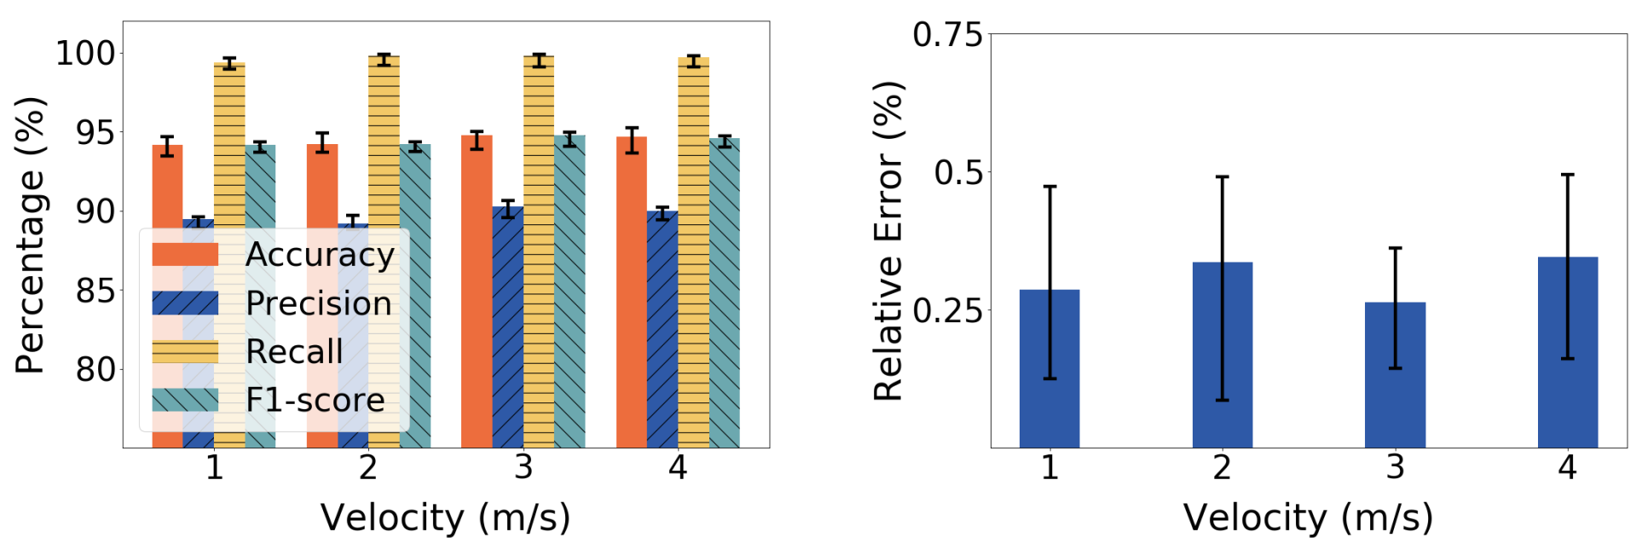
Accuracy v.s. velocity
mmHawkeye is indeed applicable with various UAV velocities.
16/18
Notes:
Then we consider the impact of the UAV velocity. The results show that the UAV velocity have limited impact on both the detection performance and the tracking performance. (click) It means that mmHawkeye is indeed applicable (ai pu lei kei bou) with various UAV velocities.

Slide 27
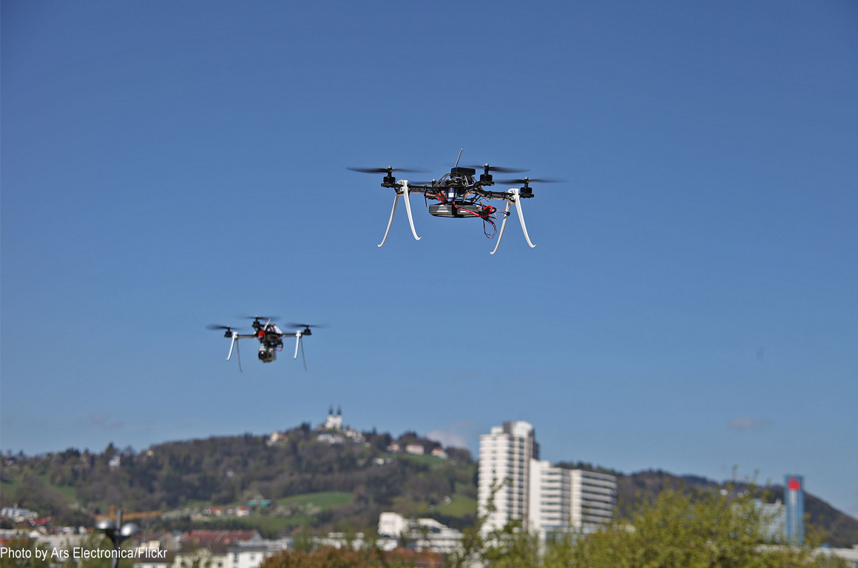
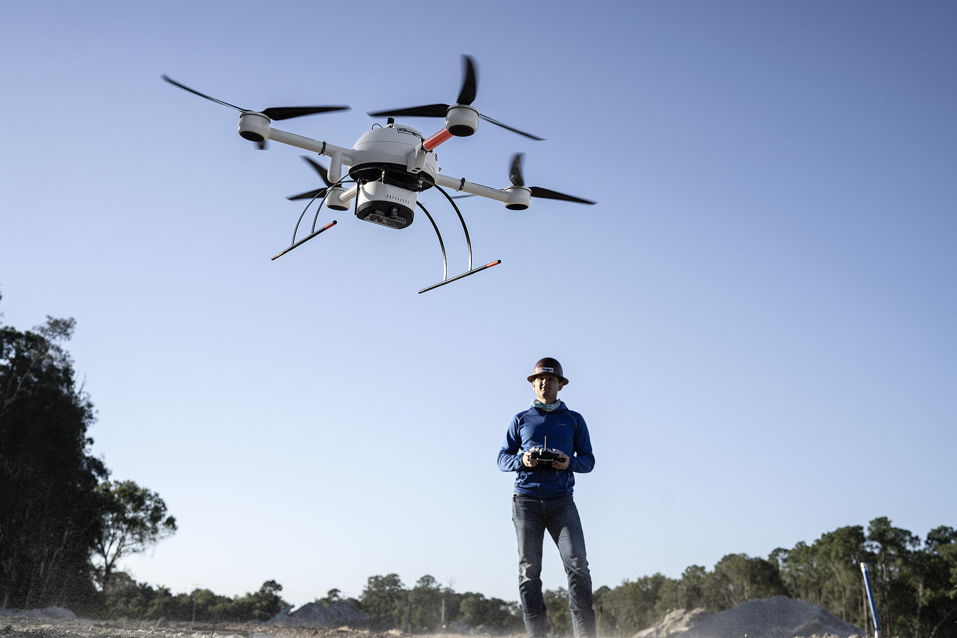
Future work
Multi-UAV detection
Short-range detection
Trajectory crossover problem
Multiple PMM features
17/18
Notes:
mmHawkeye can be extended in the following two diretions. On the one hand, since our system detects UAV through PMM features in the range dimension, it can be naturally [ˈnætʃ(ə)rəli] (nai tually) extended to multi-UAV detection scenarios. However, (click) the trajectory crossover problem needs to be carefully solved. On the other hand, when the distance between UAV and radar is close, the UAV can no longer be considered as a whole and each part may occupy (ao ke you pai) different range bins. (click) In this case, there will be multiple PMM features. We can exploit these features to further sense the UAV.

Slide 28
Conclusion
The first mmWave-based long-range UAV detection approach.
Provides a tailored design based on the PMM feature to fully utilize the low-SNR and uncertained UAV’s reflected signals for UAV detection.
Implemented on the commercial device TI IWR6843ISKODS board and evaluated through experiments conducted under various settings.
18/18
Notes:
In conclusion, we propose mmHawkeye, the first mmWave-based long-range UAV detection approach. We provides a tailored (tei le er de) design based on the PMM feature to fully utilize the low-SNR and uncertained UAV’s reflected signals for UAV detection. our system is implemented on the commercial device and evaluated under various settings.

Slide 29

Thanks
Q & A
Jia Zhang
j-zhang19@mails.tsinghua.edu.cn
Notes:
That’s all, thank you very much.

Slide 30
Backups
Notes:
1. Angle results ? Due to the limited number of the antennas on the commercial mmWave radar, its angle resolution have large error. Since we aim to achieve accurate UAV detection, we focus on the range estimation results.

Slide 31
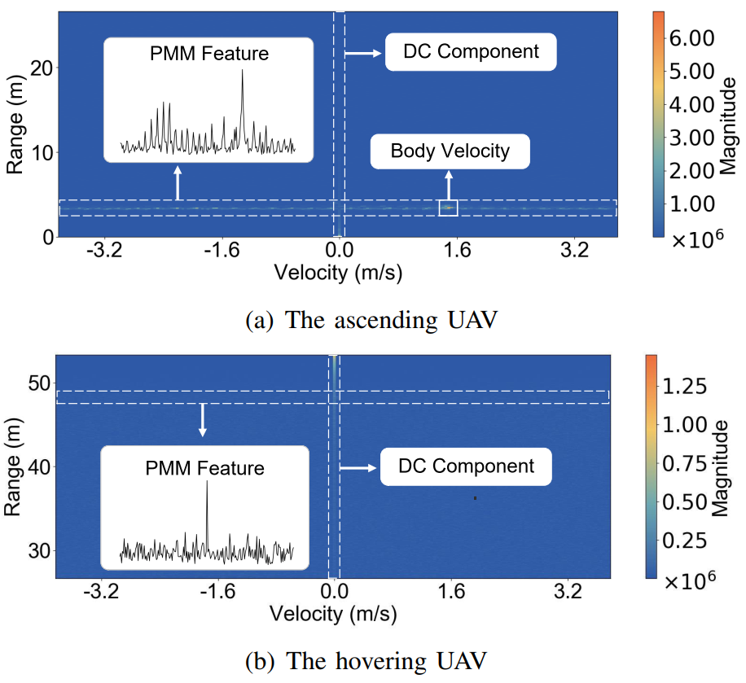
Preliminary

Slide 32
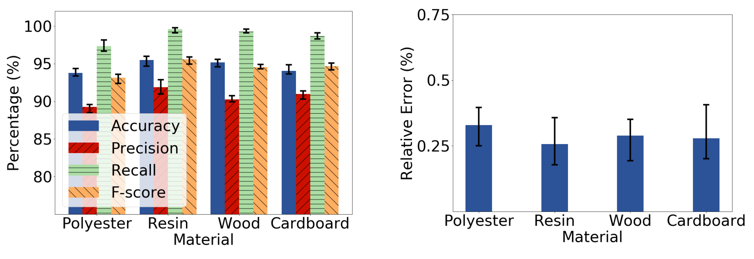
Accuracy v.s. obstacle

Slide 33
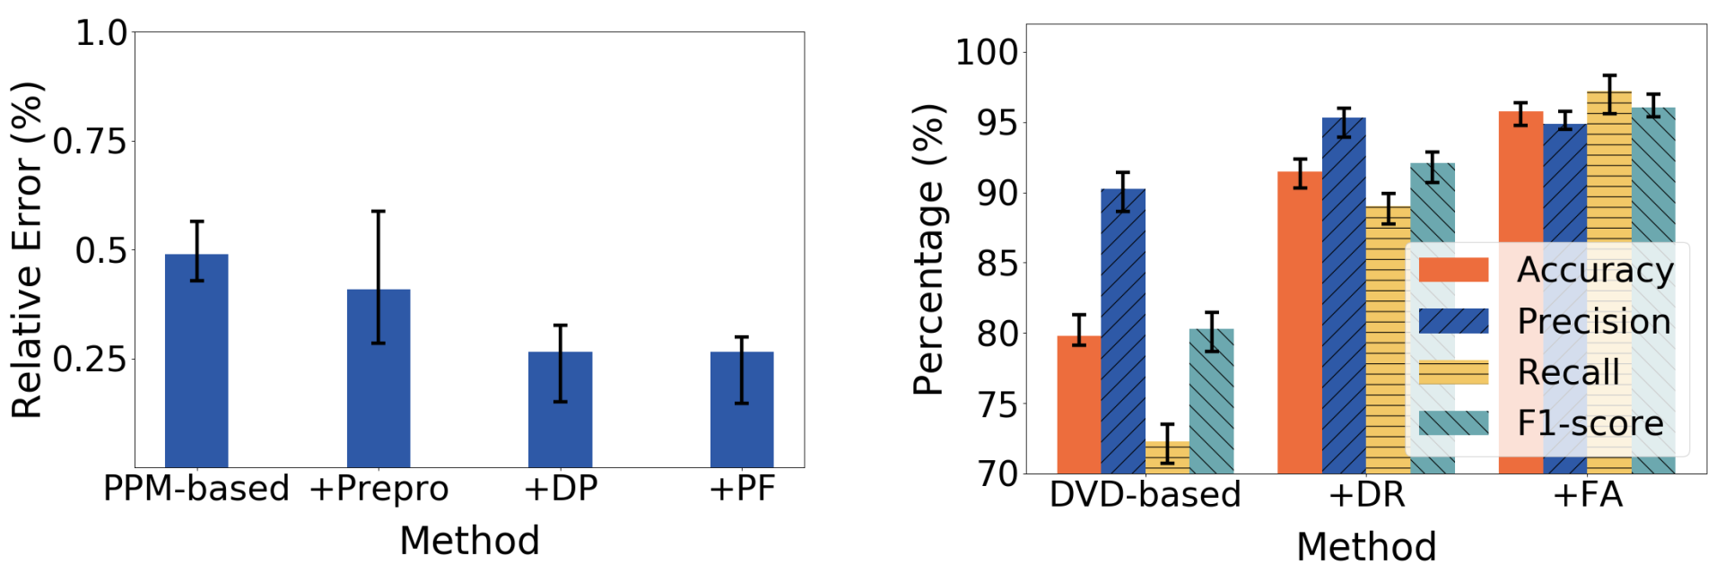
Ablation study
17/18
Notes:
最后，我们进行了消融实验。结果显示动态规划可以显著减少定位误差而粒子滤波可以降低定位误差的方差。另一方面，质量分量去除可以显著提升识别准确度。
Finally, we conduct the ablation study. The results show that dynamic programming can significantly reduce the range error and the particle filtering can reduce the variance of the range error. On the other hand, the DC removal can significantly improve the detection accuracy.

