Slide 1

Trident: Interference Avoidance in Multi-reader Backscatter Network via Frequency-space Division
Yang Zou, Xin Na, Xiuzhen Guo, Yimiao Sun, Yuan He*
School of Software and BNRist, Tsinghua University
Notes:
Hello every, I’m Yang Zou, a one-year doctoral student from Tsinghua University.
It’s my great honor to share our work
Trident: Interference avoidance in multi-reader backscatter network via frequency-space division

Slide 2




Dense reader deployment
Deploying a backscatter network in a large area requires a dense deployment of readers for full coverage.
Notes:
Backscatter is an enabling technology for battery-free sensing in many industrial IoT applications.
As the deployment scale expanding, one often needs to deploy multiple readers densely to cover all the tags in the area.

Slide 3



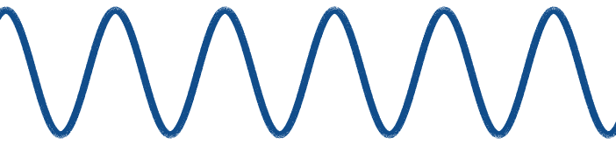



Interference in the multi-reader network
Tag
Tag
The backscattered signals from a tag are likely to reach another reader and induce undesired interference.
Notes:
We hope that each reader communicates with tags within its coverage.
However, the actual backscattered signals from a tag are likely to reach another reader, which is outside the communication range, and leads to undesired interference.

Slide 4
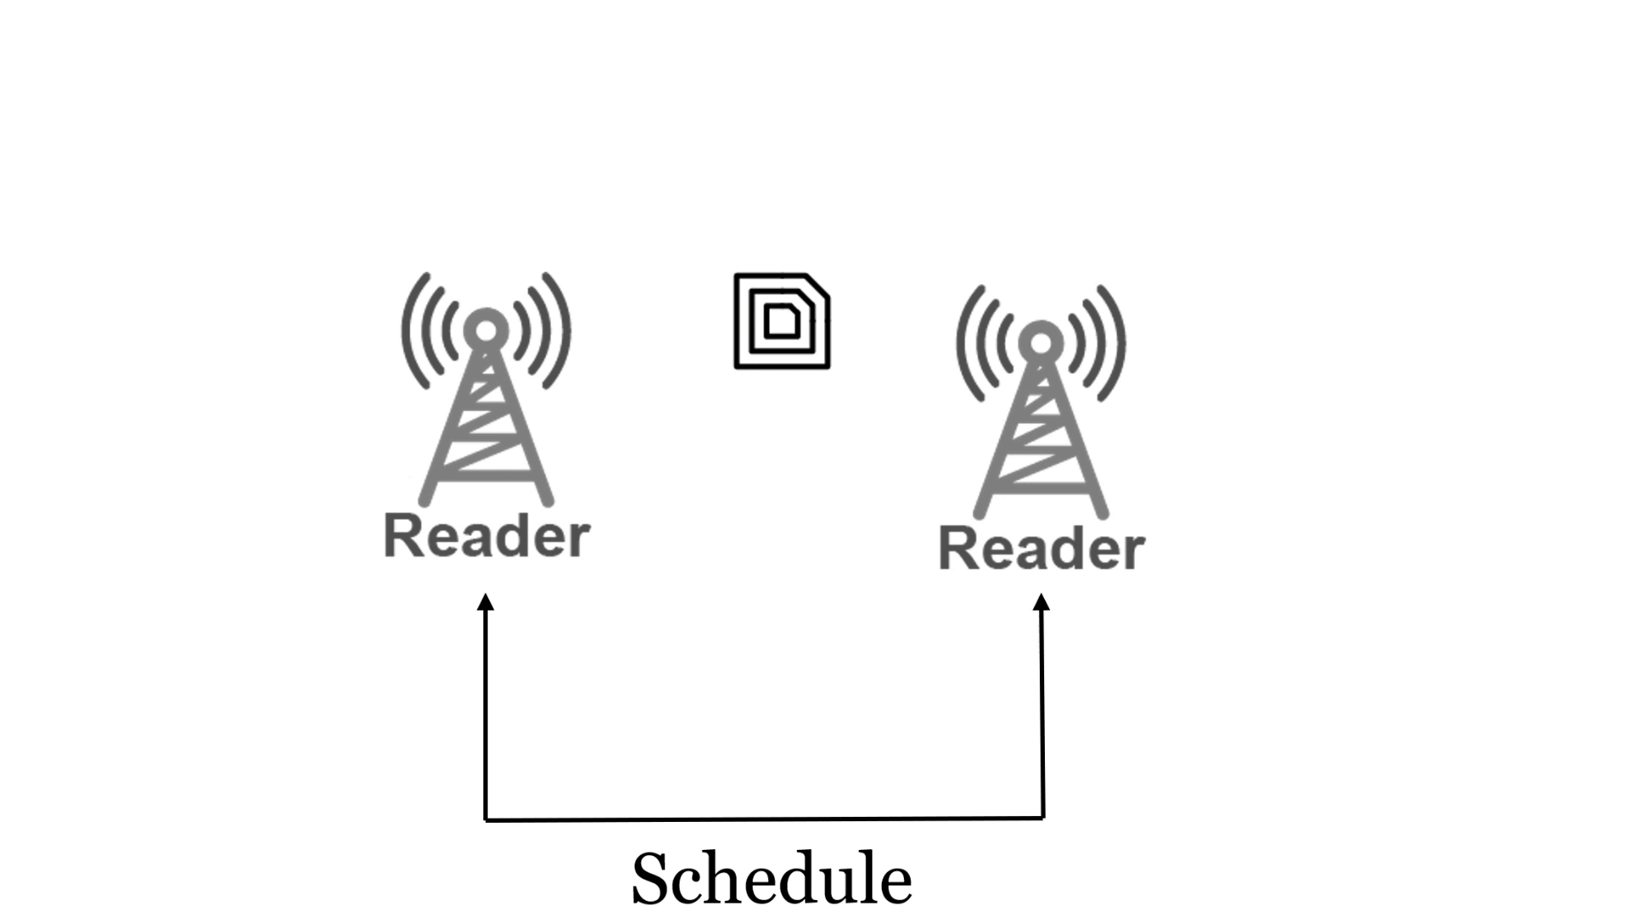
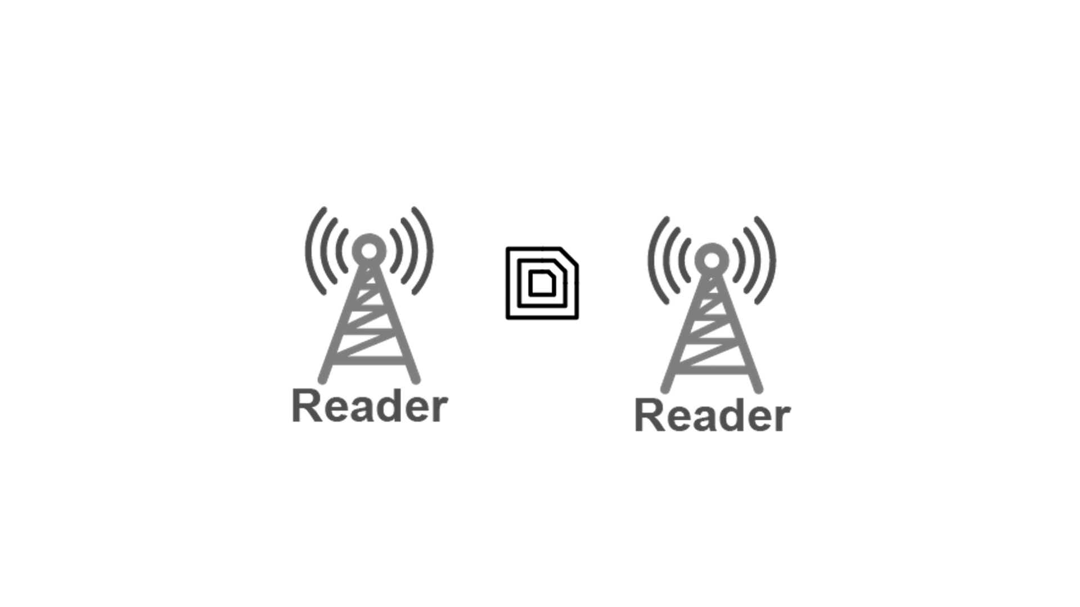
Avoid interference in the time domain
TDMA-based method
CSMA-based method
These methods avoid interference in the time domain, however, at the cost of the network throughput.
Notes:
Conventional methods generally based on TDMA or CSMA.
In the TDMA methods, reader are coordinated into different slots, and in the CSMA methods, reader listens to the channel before its reading.
Both can avoid interference indeed, however at a cost of the network throughput.
Because they sorely focus on the readers and avoid interference in the time-domain.

Slide 5
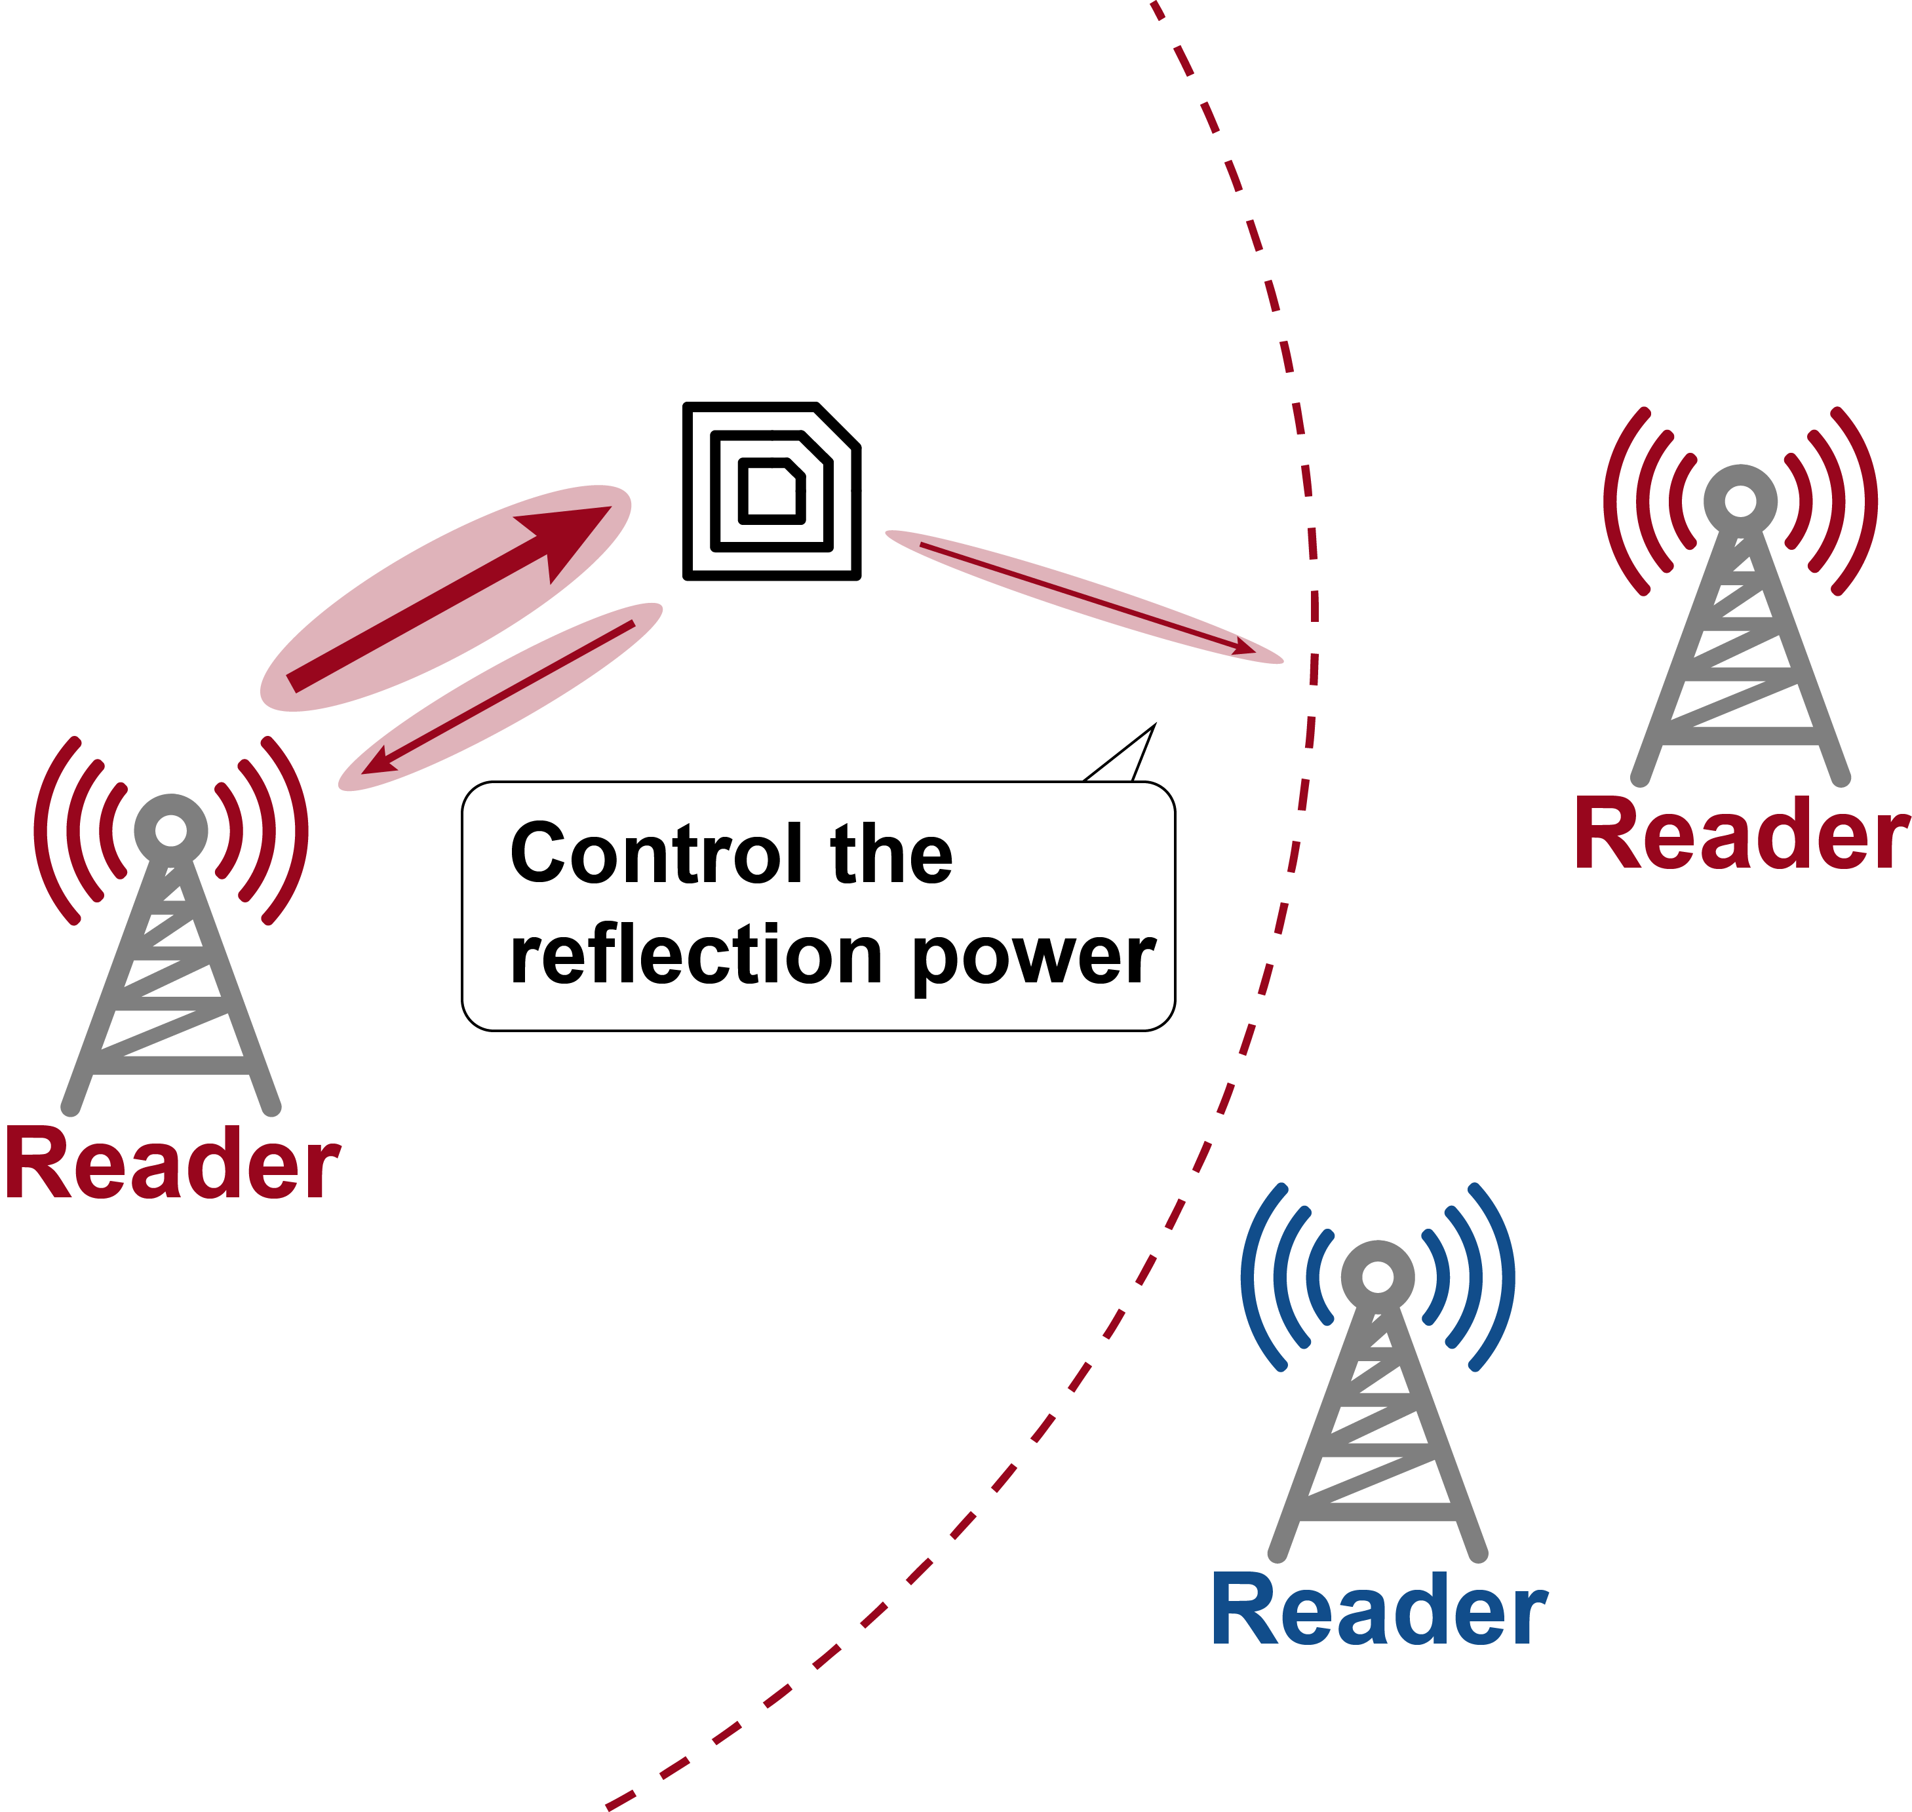
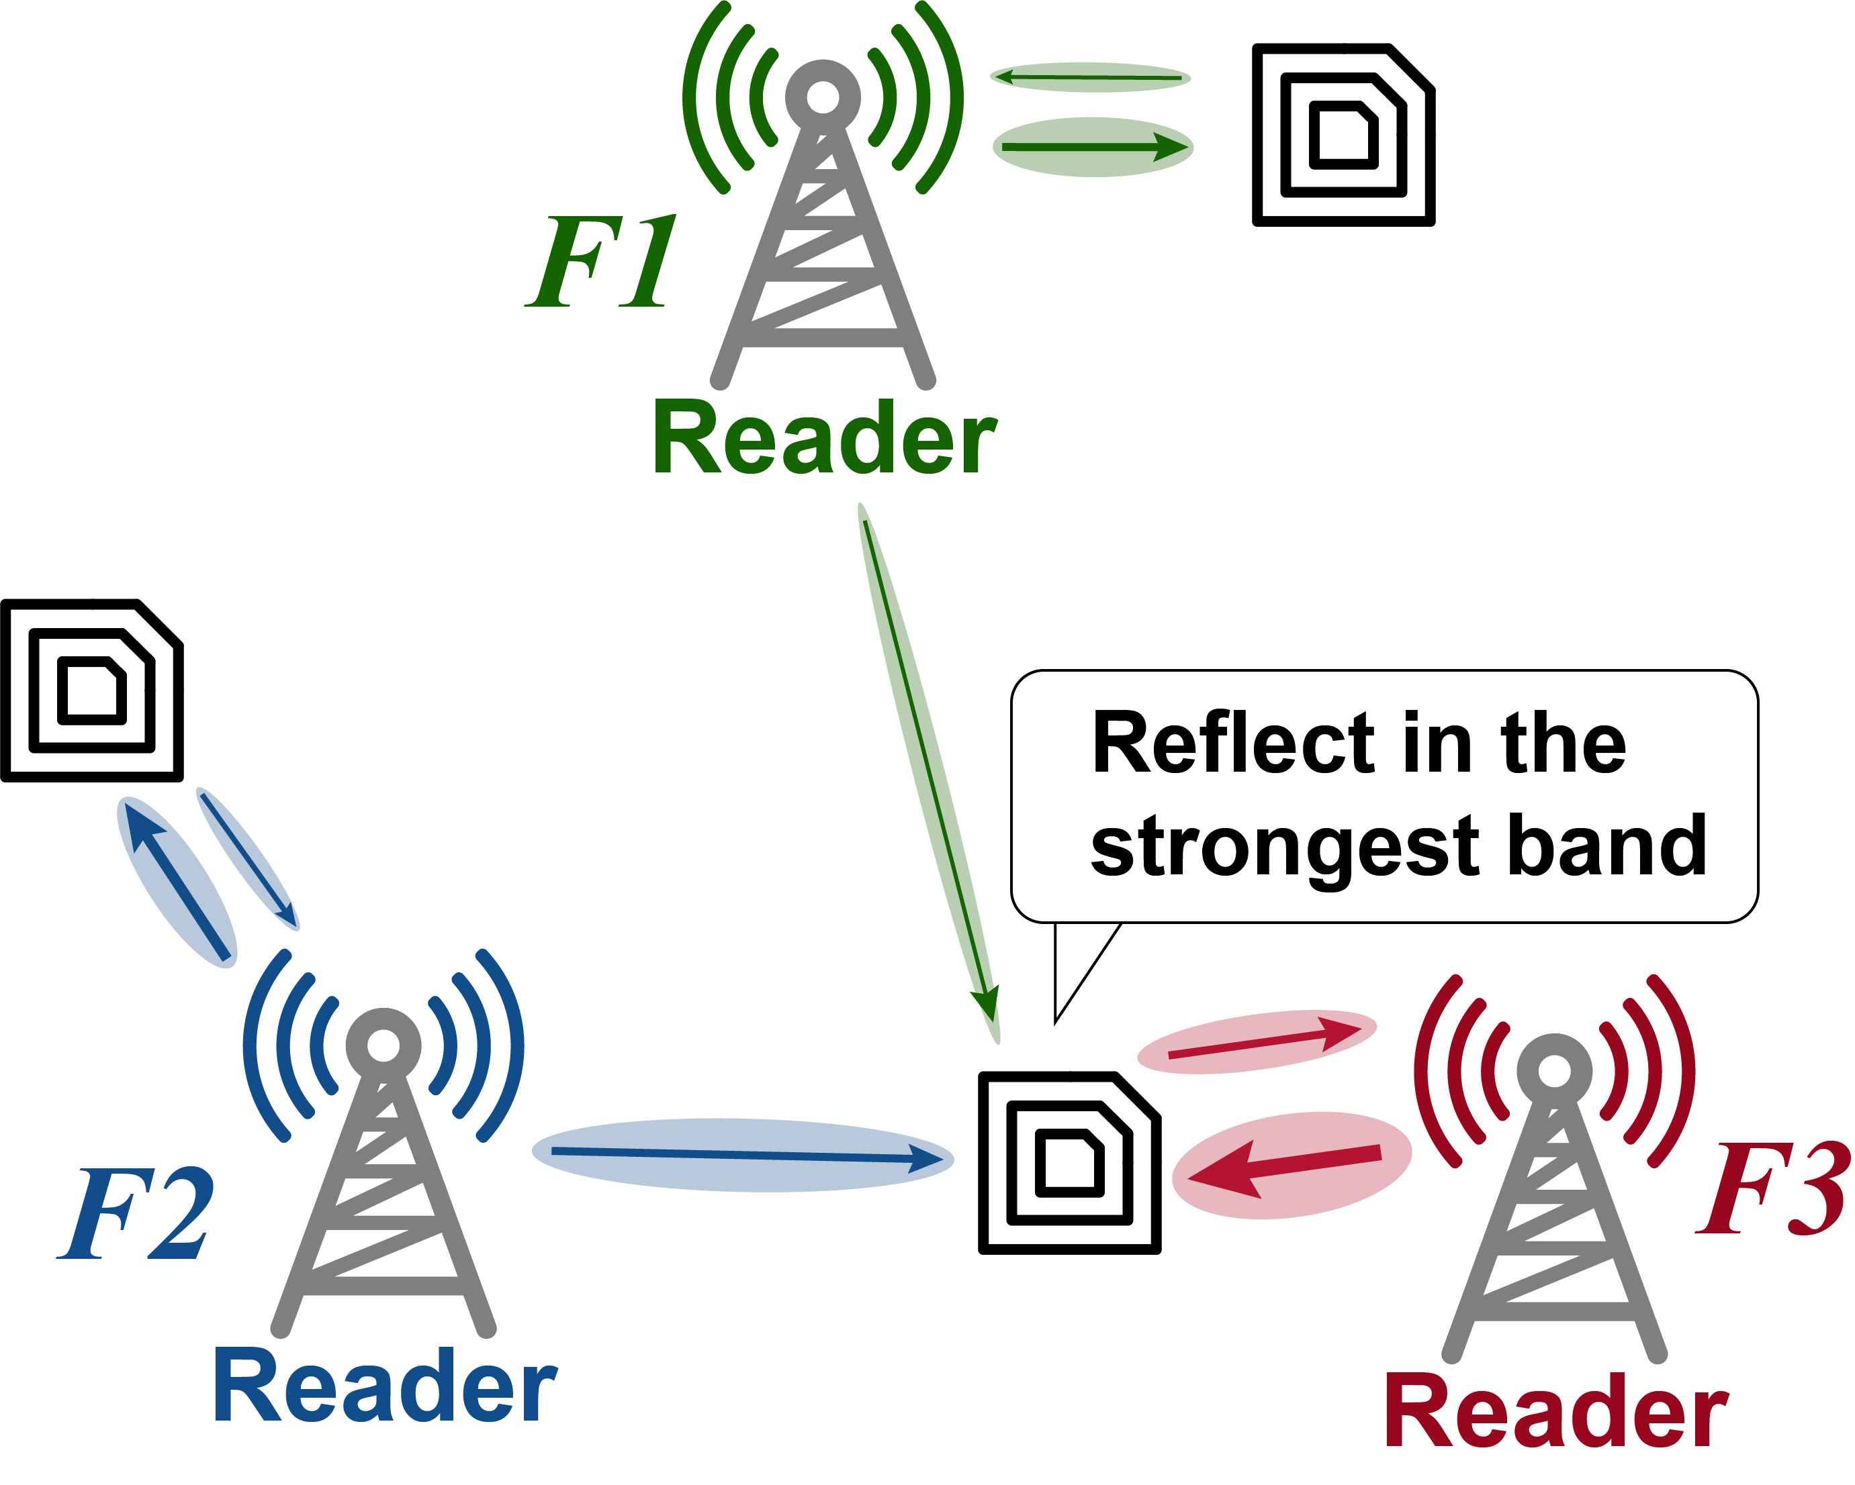
Trident
Frequency division
Space division
Enable the tag to avoid interference in the frequency-space domain.
Notes:
To enhance the overall network throughput, we consider avoiding interference by utilizing other multiplexing space.
We propose Trident, a novel of backscatter tag to avoid interference in frequency and space domain.
In a backscatter network, where adjacent readers operating in different bands, our tag select the strongest band, and modulate on this specific band.
This is frequency division.
Furthermore, our tag controls its reflection power, in case of interfering the remote reader which operates in the same band.
This is space division.
In this way, all the devices can work concurrently, and we believe that the throughput can be enhanced.

Slide 6
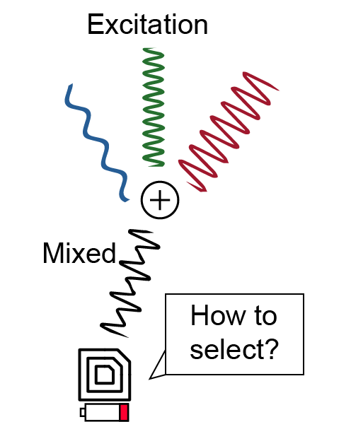
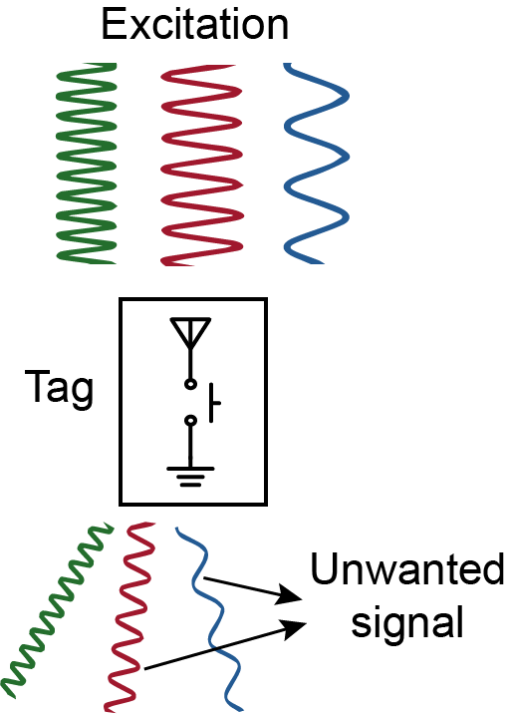
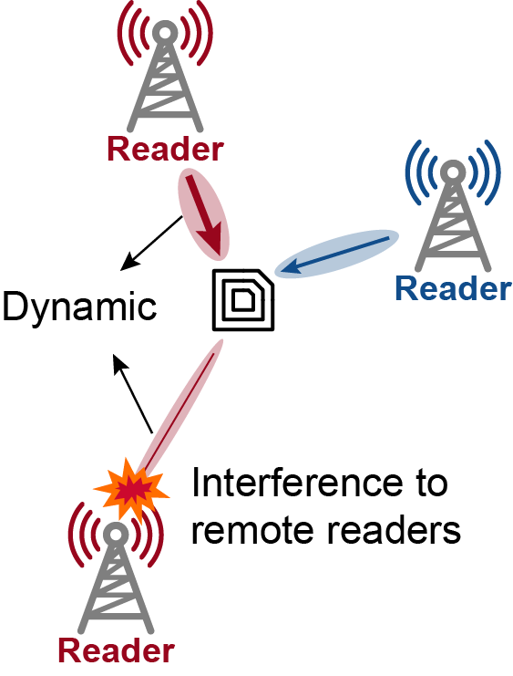
Challenge
Challenge 1
Challenge 2
Challenge 3
How to select the strongest band with limited power?
How to generate reflection signals in a specific band?
How to control the reflection power in a dynamic channel?
Notes:
However, to achieve this goal, we have to tackle three daunting challenges:
The limited power budget, the broad-band reflection and the dynamic reflection power.
// 这里的三个问题需要强调，字体和简洁性都需要调整

Slide 7
Challenge
Challenge 1
Challenge 2
Challenge 3
How to select the strongest band with limited power?
How to generate reflection signals in a specific band?
How to control the reflection power in a dynamic channel?
Notes:
The first challenge is the highly limited power budget.
As we design the tag to select the strongest band, how to enable this in limited power budget is a problem for us.
We achieve this in two steps: extracting the signals from different bands and comparing them to find the strongest band.

Slide 8
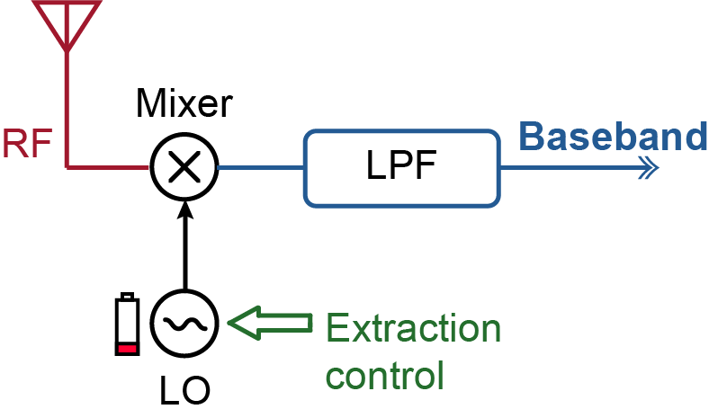
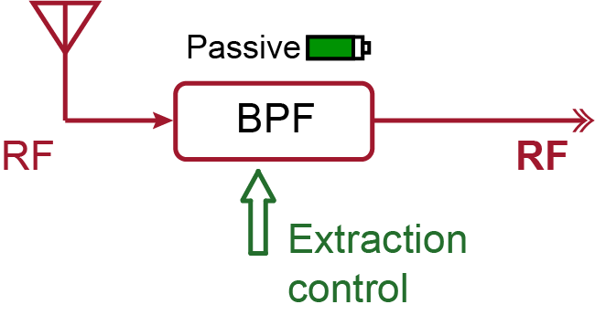
Signal extraction
Baseband Extraction
RF Extraction
Innovation: avoid using baseband signals and instead perform the signal extraction directly in the RF domain.
Notes:
We focus on the first step: signal extraction.
Traditional methods often rely on a local oscillator to down-convert the input RF signal to the baseband, followed by using a low-pass filter to extract the signal.
However, the LO for down-converting consumes a significant amount of power.
Therefore, we consider avoiding the LO and moving the signal extraction from the baseband to the RF domain. This requires us to introduce a new low-power frequency-selective device.

Slide 9
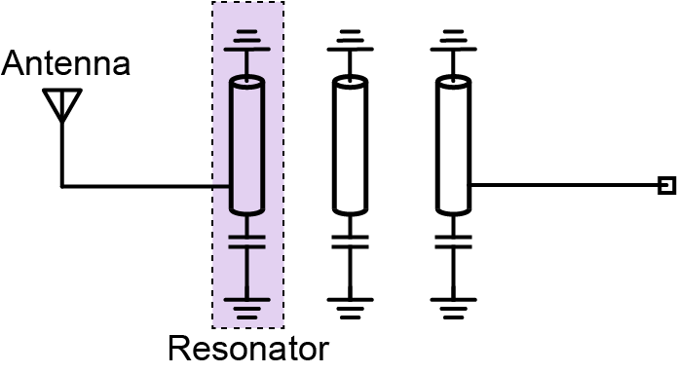
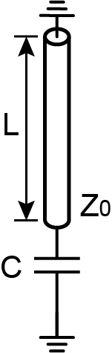
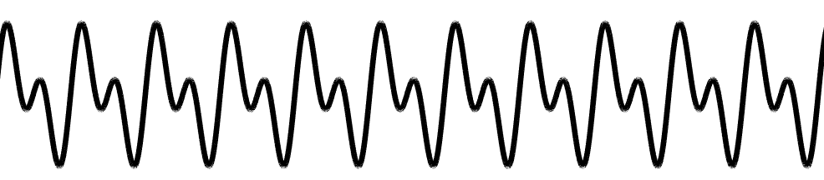
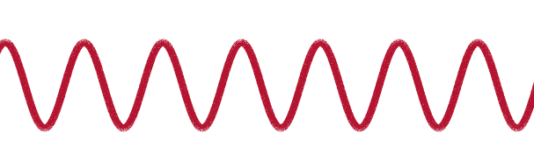
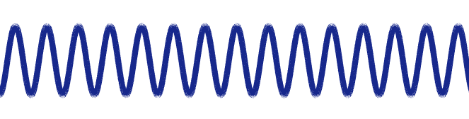
Comb-line filter
Resonator
Couple
Speed of light
Characteristic impedance
Comb-line filter: extract the signal whose frequency is near the resonance point.
Load Capacitor
Load capacitor
Notes:
We introduce the comb-line filter, the comb-line filter consists of three coupled resonators.
If the signal frequency is close to the resonation frequency, the signal can pass the filter, or it will be reflected.
The resonation frequency is determined by the formula on the right.
We notice that if we can change the value of the load capacitor, we can change the resonation frequency and pass signals with different frequencies.

Slide 10
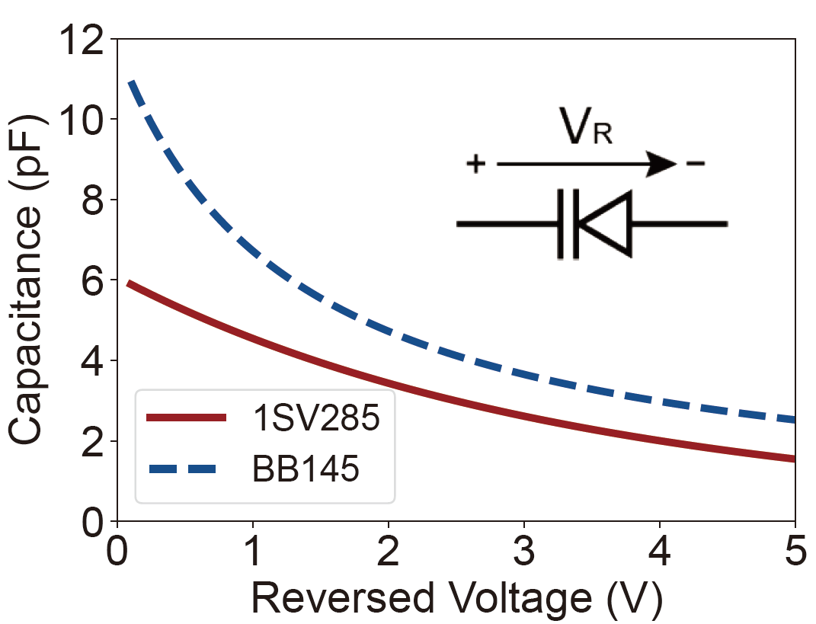
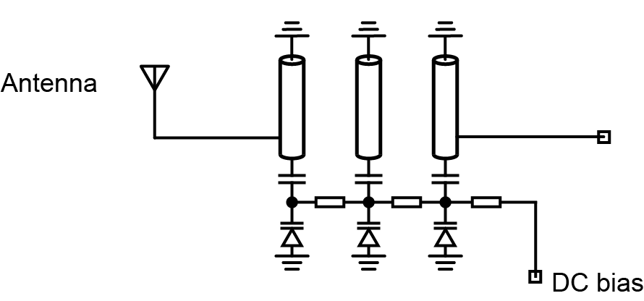
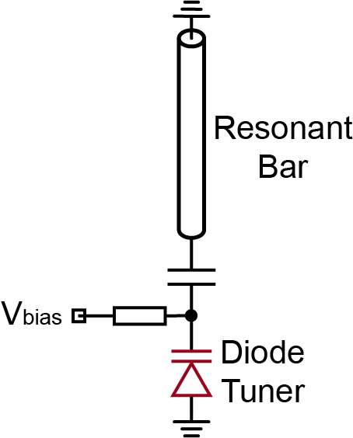
Comb-line filter
nA
Voltage
V1
V2
nA
Capacitance
Voltage tuning comb-line filter: Adjust the bias voltage to extract signals in different bands.
Passband
Notes:
We utilize the varactor as the load capacitor. As we increase the reversed bias voltage of the varactor, its capacitance will decrease significantly.
Thus, we can adjust the bias voltage to control the filter’s passband, and eventually extract different frequency components directly from the RF excitation signals.
It should be noticed that the current of the varactor is only several nano-amperes. So, the power consumption can be neglected.

Slide 11
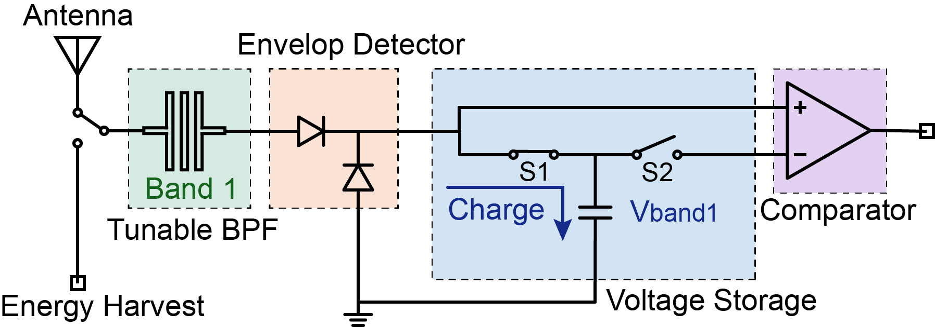
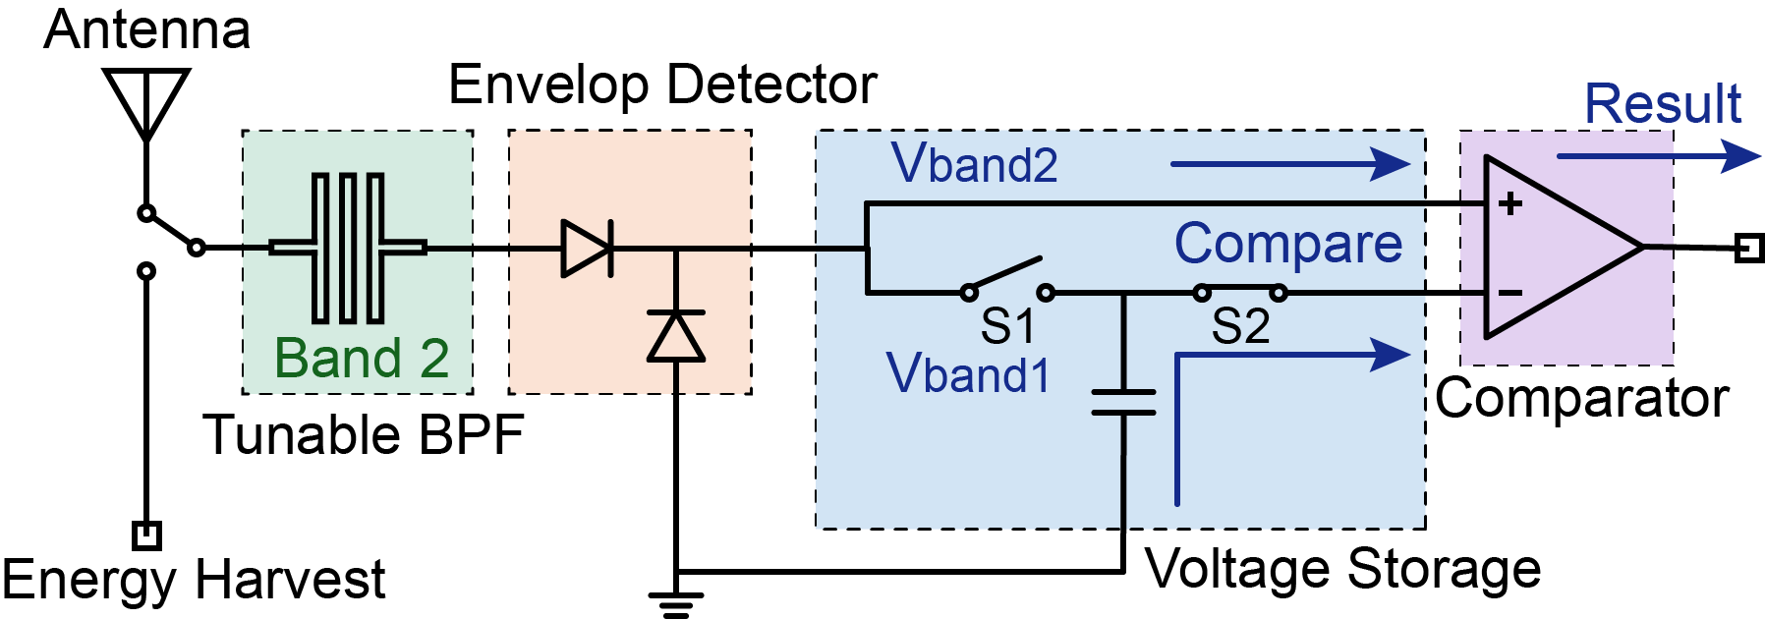
Signal comparison
Step 1: Charge
Step2: Compare
Two-step comparison: extract signals from two bands, store the detection voltage of the previous one and compare it with the next one.
Notes:
The next step is signal comparison.
We first extract the signals from two frequency bands.
Then we store the detection voltage of the first band in the capacitor and compare with the second band.
Thus, we can get the comparison result of the strength of the two bands.
Using pairwise comparison, we can select the band with the strongest signal.

Slide 12
Challenge
Challenge 1
Challenge 2
Challenge 3
How to select the strongest band with limited power?
How to generate reflection signals in a specific band?
How to control the reflection power in a dynamic channel?
Notes:
The second challenge is the broad-band reflection. The traditional backscatter reflects the signals across the whole band.
As we leverage the frequency domain to avoid interference, how to achieve frequency-selective backscatter is still a missing piece in the state of the art.

Slide 13
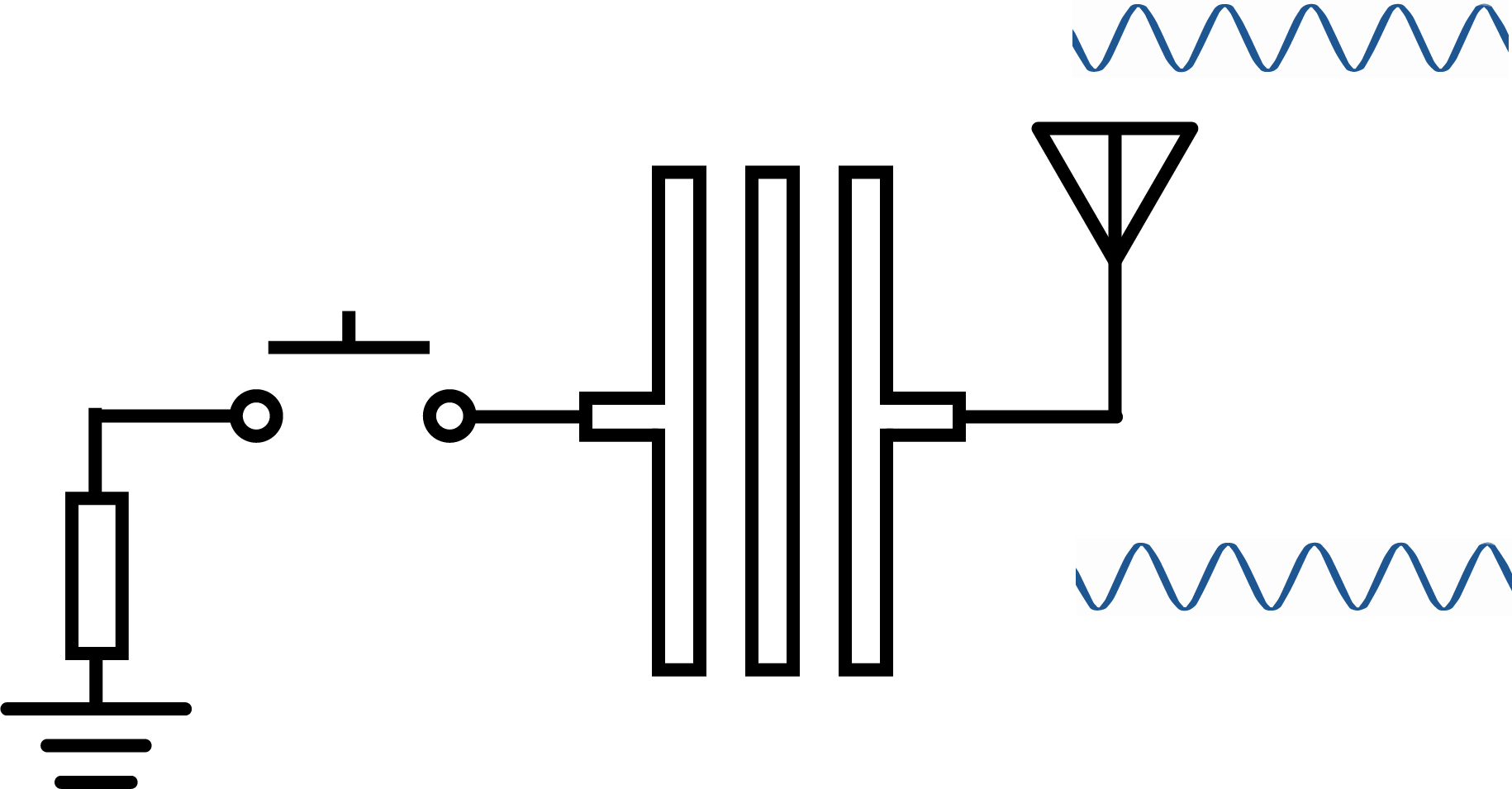
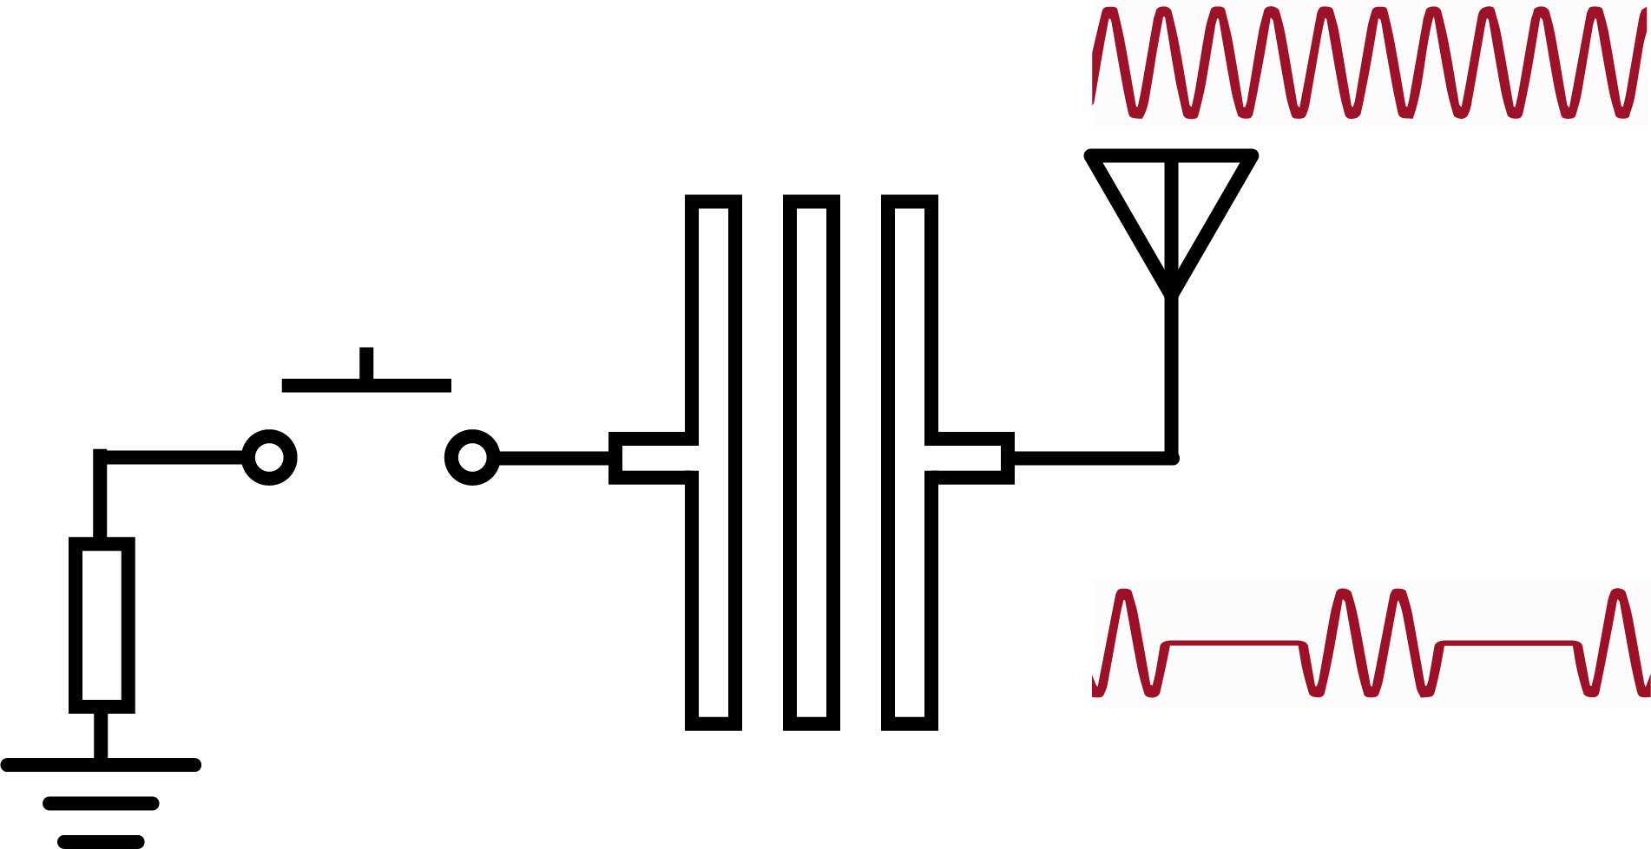

Frequency-selective backscatter
Out of band: Reflect directly
In band: Modulate & reflect
Control
signal
Comb-line Filter
Comb-line Filter
Apply distinct RF operations to signals in different frequency bands to achieve the frequency-selective reflection.
Notes:
We consider achieving the frequency-selective backscatter by applying distinct RF operations to signals in different frequency bands. Specifically, we leverage the reflection feature of the comb-line filter here.
For the signals out of the filter’s passband, the RF operation is to reflect them directly before the filter, and the reflection signals remain unmodulated.
As for the signals in the filter’s passband, they can pass the filter and reach the RF switch. So, the reflection signals can be modulated by the control signal.
Thus, we eventually generate backscattered signals in the specific passband.

Slide 14
Challenge
Challenge 1
Challenge 2
Challenge 3
How to select the strongest band with limited power?
How to generate reflection signals in a specific band?
How to control the reflection power in a dynamic channel?
Notes:
The third challenge is the dynamic reflection power.
As we control the reflection strength to avoid interference in the space domain.
How to ensure power controlling under the dynamic channel conditions remains a challenging issue.

Slide 15
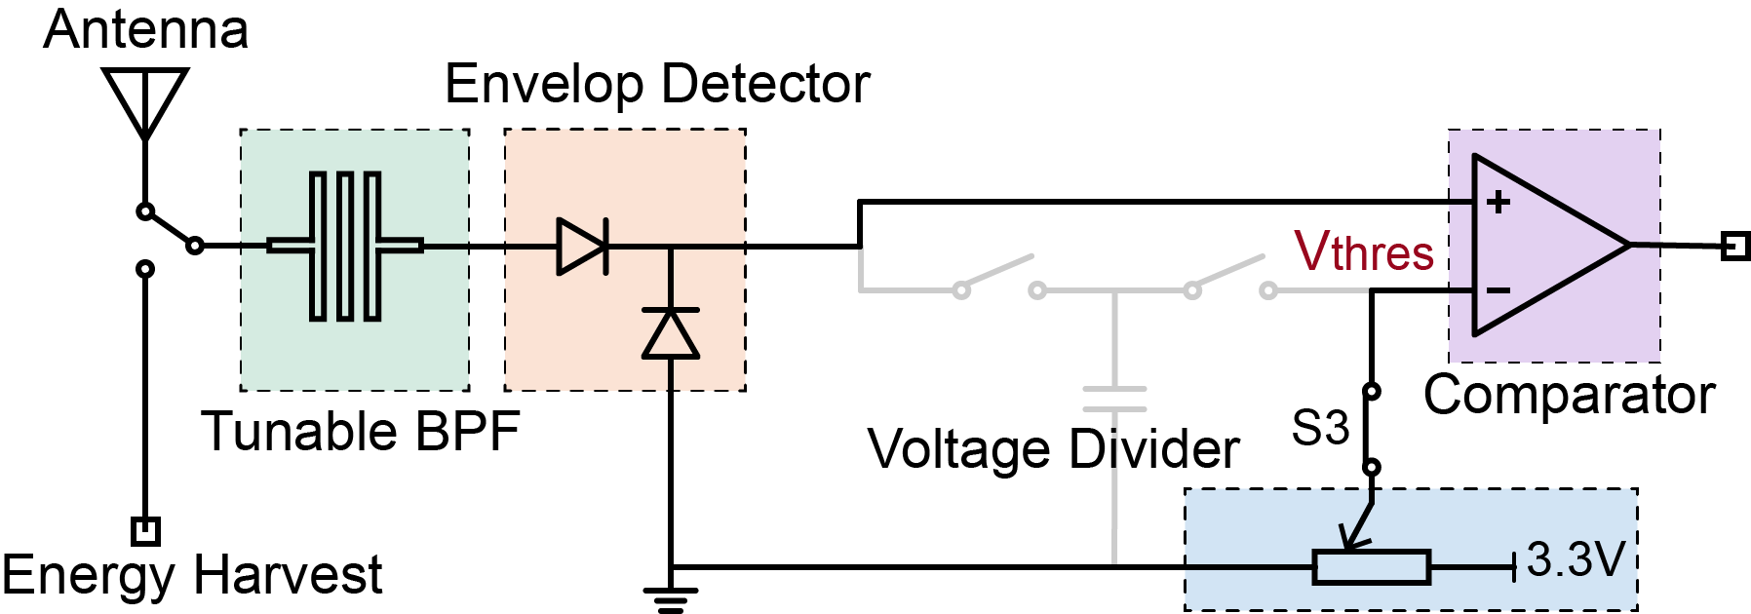
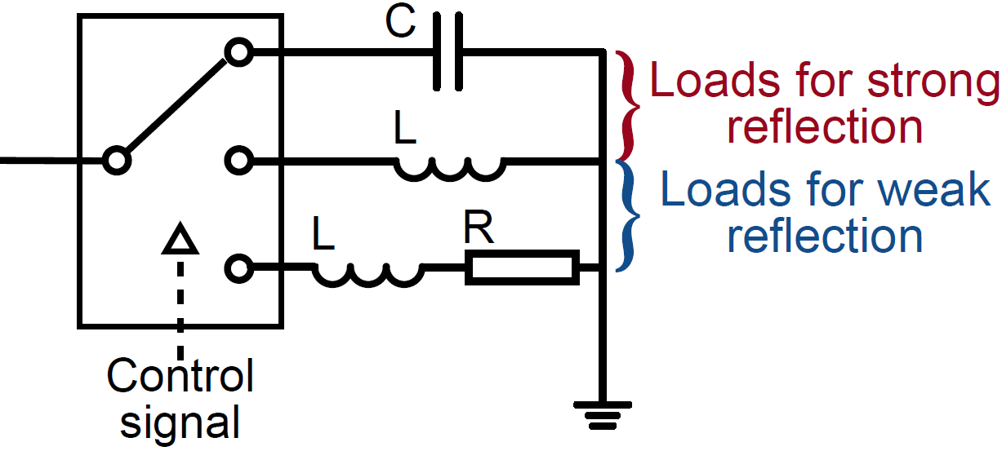
Reflection power adjuster
Step 1: Detect power
Step 2: Select loads
Reflection power adjuster: Detect excessively strong excitation and select proper loads to control the reflection strength.
Notes:
We develop a reflection power adjuster.
In the adjuster, we first detect the excessive excitation by comparing it with a threshold.
If the excitation is too strong, we choose the inductor and the series of inductor and resistor for weak reflection.
Or the tag will choose the capacitor and the inductor for strong reflection.

Slide 16
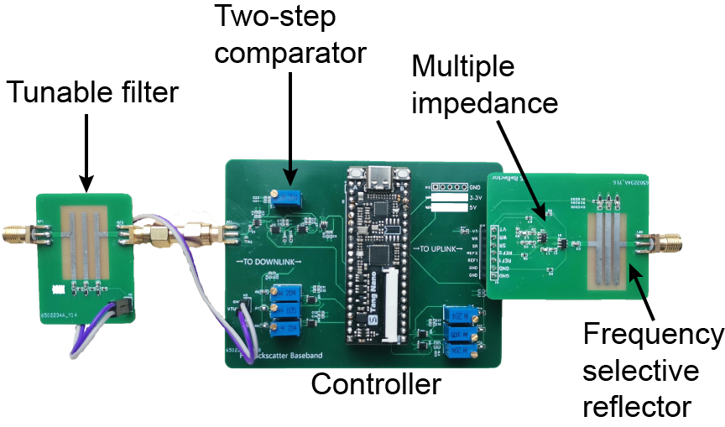
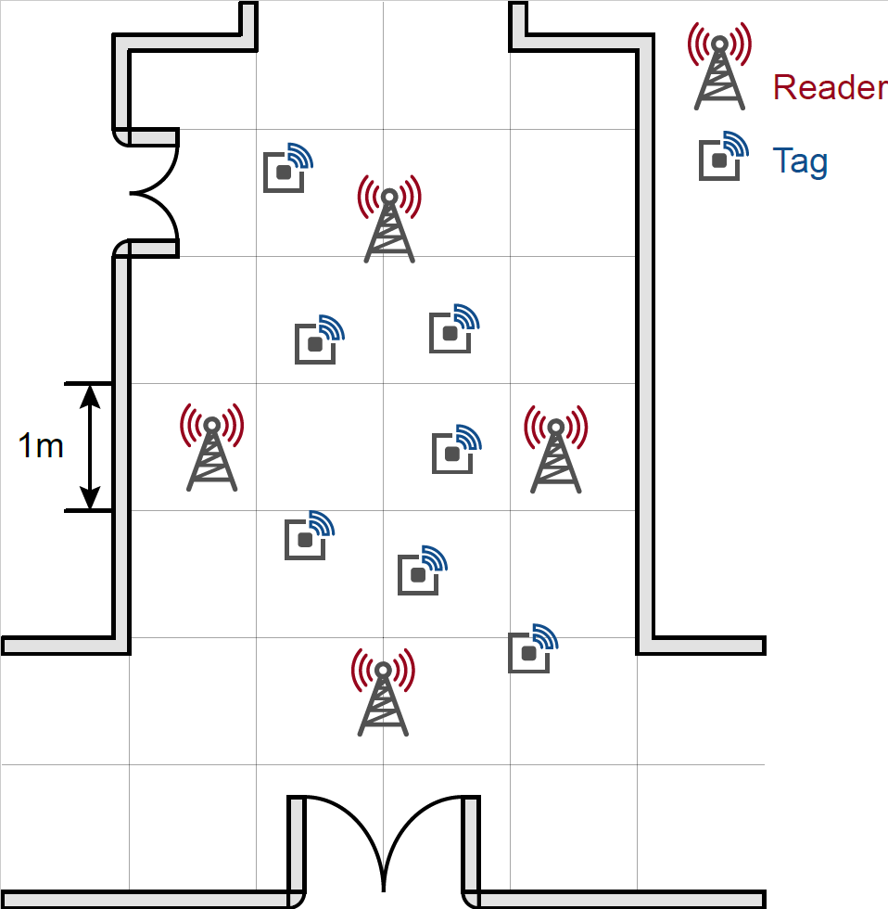
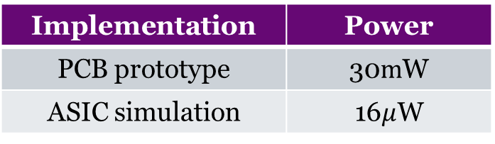
Implementation
Trident tag
The network deployment
Power consumption
Implementation | Power
PCB prototype | 30$m$W
ASIC simulation | 16$μ$W
Notes:
We build a prototype of our design on PCB.
We evaluate the power consumption. Our PCB prototype consumes 30 milliwatts and the ASIC simulation reports 16 microwatts.
Then we deploy a 4 reader with 7 tags network in a corridor.
We evaluate our network and compare its throughput with the TDMA network’s.

Slide 17
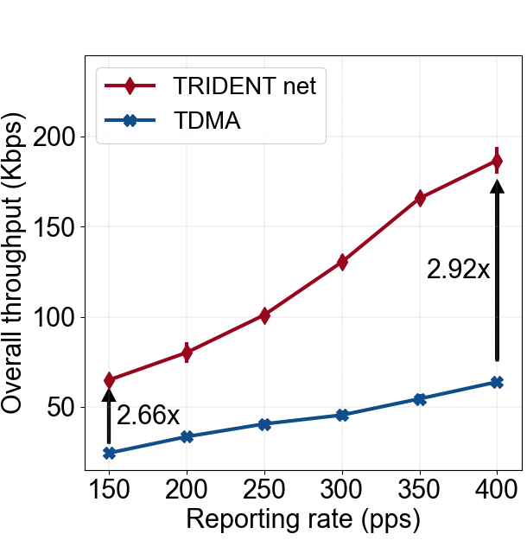
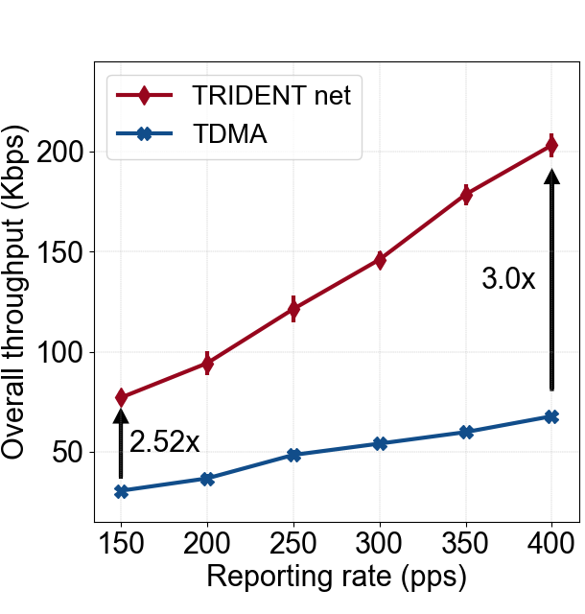
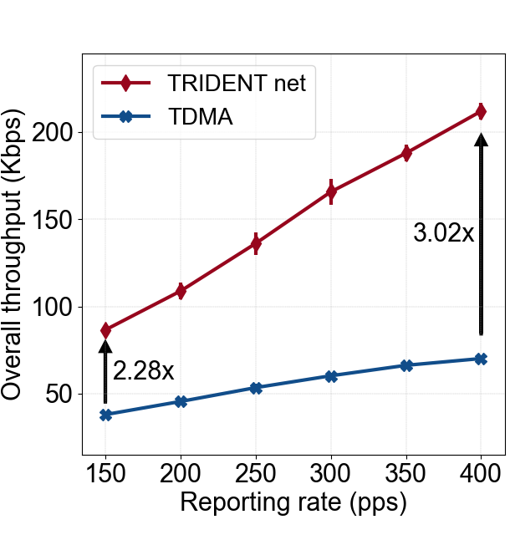
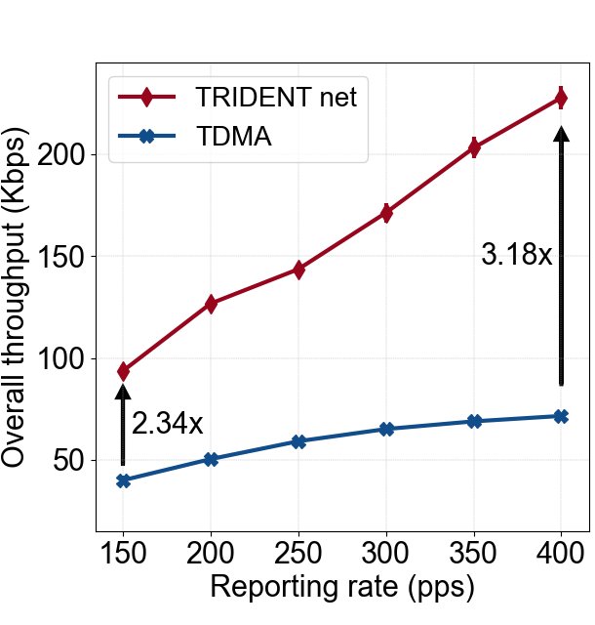
Overall performance
Deploy 4 tags
Deploy 5 tags
Deploy 5 tags
Deploy 7 tags
Trident demonstrates a throughput improvement of 2.28x-3.18x across various numbers of tags and reporting rates compared to the TDMA method.
Notes:
We first compare the performance of Trident and the TDMA network in different numbers of tags and reporting rates.
Because readers do not need to operate intermittently, Trident’s throughput is 2.28 times to 3.18 times higher than the traditional TDMA network.

Slide 18
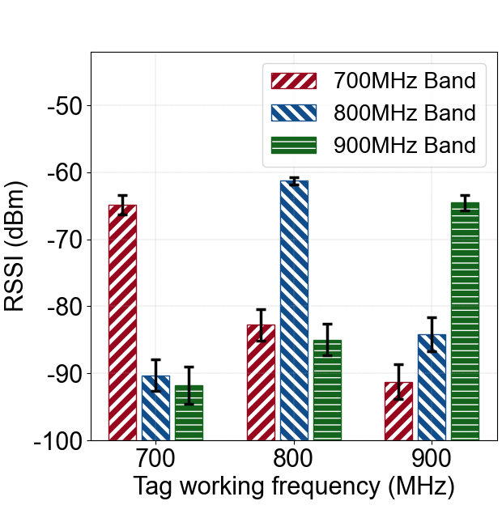
Frequency selectivity of reflector
Settings:
1. set the operating frequency bands of the tag;
2. measure the strength of the backscattered signal received by the reader in different bands.
The out-of-band suppression is more than 18dB, which demonstrates the good frequency selectivity of Trident’s reflector.
Notes:
We conduct some ablation study.
First, we evaluate the frequency selectivity of the reflector.
We manually set the operation and excite the tag with signals of different frequency.
We measure the strength of backscattered signal, and we find that the out-of-band suppression is more than 18 dB, which means good frequency selectivity.

Slide 19
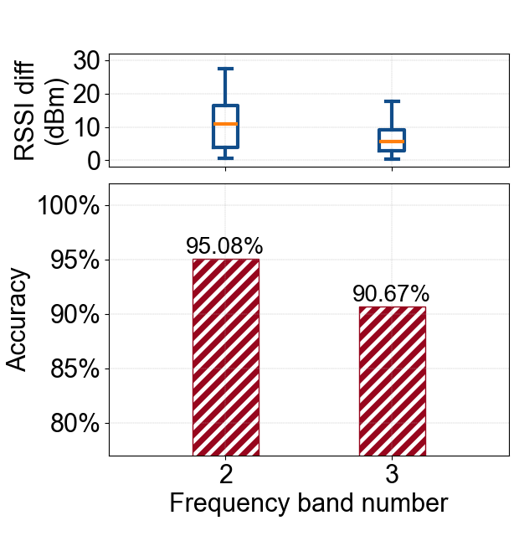
Accuracy of band selection
Trident can identify the frequency band with the strongest excitation signal with the accuracy of 95.08%.
Notes:
Then we evaluate the accuracy of band selection.
We deploy 2 or 3 readers and deploy the tag randomly.
We measure the RSSI of different bands at the tag’s position and compare the tag’s selection result with the RSSI measurement result.
The result shows that the accuracy of band selection achieves 95.08%.

Slide 20
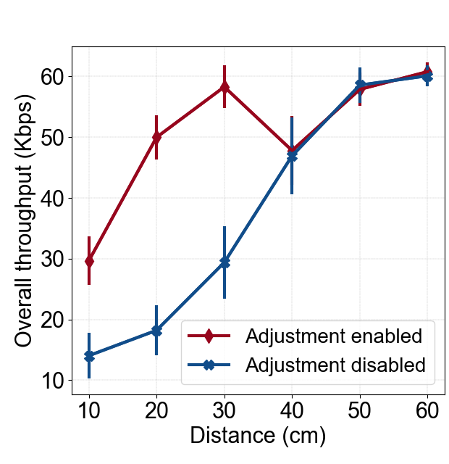
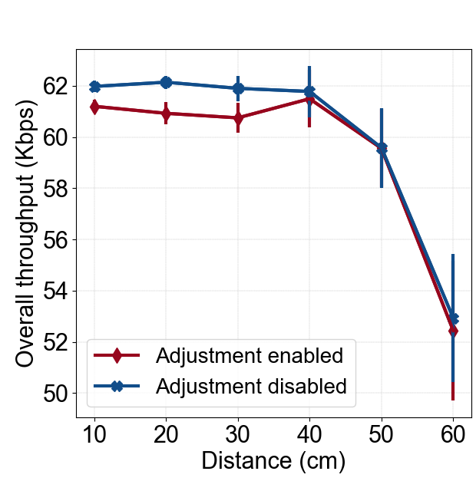
Throughput increment by adjusting power
Throughput of the interfered tag
Throughput of the interfering tag
Power adjustment can alleviate the interference significantly, while causing negligible throughput loss.
Notes:
Last, we evaluate the throughput increment by adjusting power.
We find that if the adjustment is disabled, the throughput of interfered tag decrease quickly, as the interfering tag being closer to its reader.
If the adjustment is enabled, the throughput of interfered tag is relatively high, and the loss of interfering tag’s throughput is negligible.

Slide 21
Conclusion
We propose Trident, avoiding interference in the multi-reader backscatter network via frequency-space division to enhance the throughput of the whole network.
The key innovation is the exploration of the direct RF signal process on the tag, enabling the signal extraction and frequency-selective backscatter.
Trident demonstrates a throughput improvement of 2.28x-3.18x compared to the traditional TDMA-based scheme, without consuming more energy.
Notes:
We propose Trident, a novel backscatter tag design which avoids interference via frequency and space division
The key innovation of Trident is enabling the direct RF signal process on the tag, achieving signal extraction and frequency selective reflection.
And Trident can improve the performance several times compared to the TDMA-based methods.

Slide 22

Trident
Thank You!
Please find more details in:
http://tns.thss.tsinghua.edu.cn/sun/
22
Notes:
Thanks for your listening.
And please refer to the paper and visit our website for more details.

Slide 23
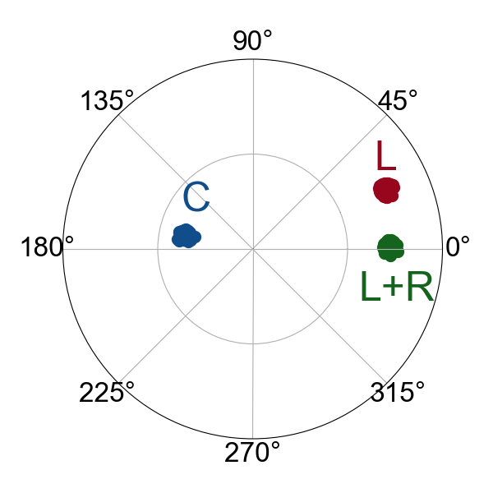
Reflection power adjuster
The reflection power is determined by the difference of reflection coefficient.
The difference of L and L+R is small, bringing weaker reflection

Slide 24
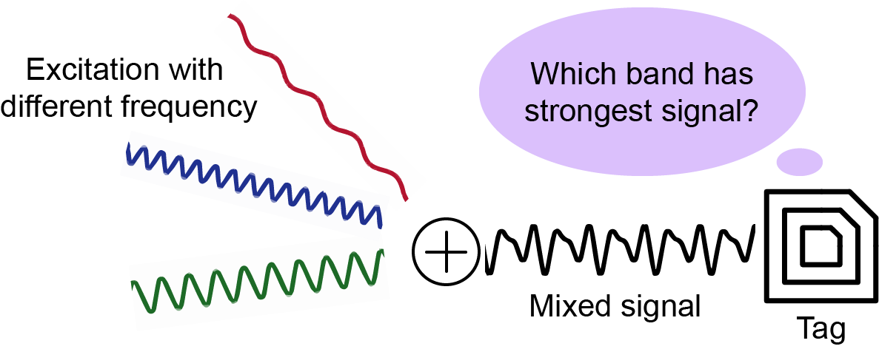
Low-power band selection
Tag receives mixed signals with different frequency components
Problem: How to select the band with strongest excitation on a tag, whose power budget is highly limited.
Notes:
For the first challenge, it’s hard to select strongest band with limit power budget.
So, we wonder if we can divide the excitation into different frequency component with a passive filter.
And compare the strength of these different component to select the strongest band.

Slide 25
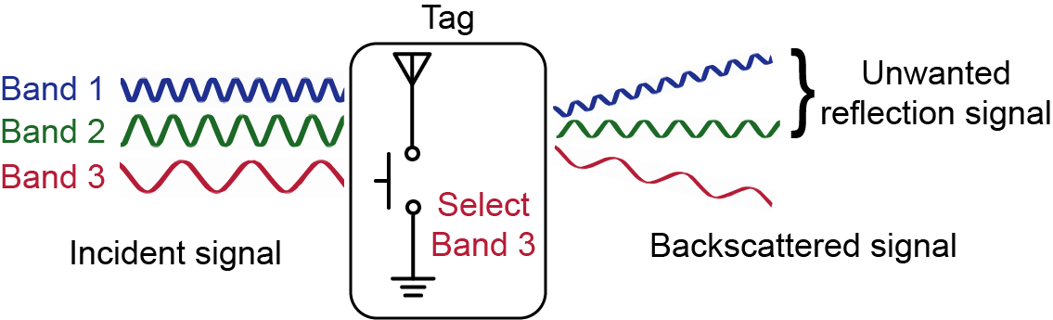
Frequency-selective reflection
Tag backscatters signals across the whole frequency range
Problem: How to generate backscattered signal in only one of the multiple frequency bands?
Notes:
The second challenge is broad-band reflection.
As the tag’s antenna and RF-switch is wideband components and respond to the whole frequency band.
We consider add a frequency selective component, such as a filter, in the reflection RF chains.

Slide 26
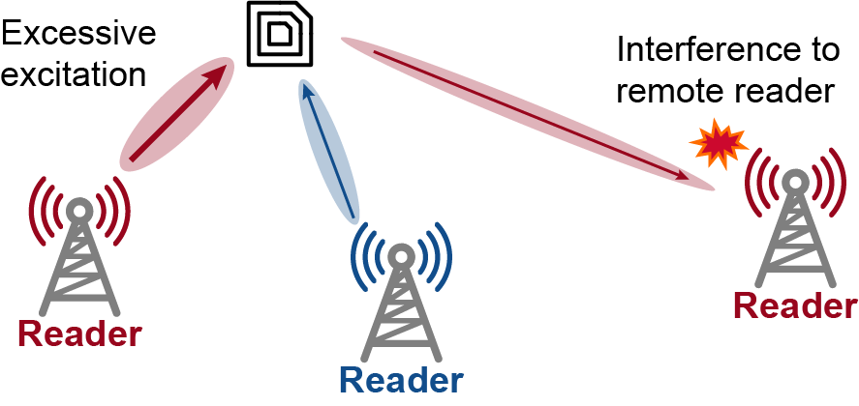
Reflection power adjust
Excessive excitation causes interference to remote readers
Problem: How to ensure the efficacy of power control under dynamic wireless channel condition?
Notes:
The third challenge is the dynamic reflection power.
As the wireless channel is uncertain, the tag might receive excessive excitation and generate too strong reflection.
This will cause interference to remote reader operating in the same band.
So, we should finely control the reflection power.

Slide 27
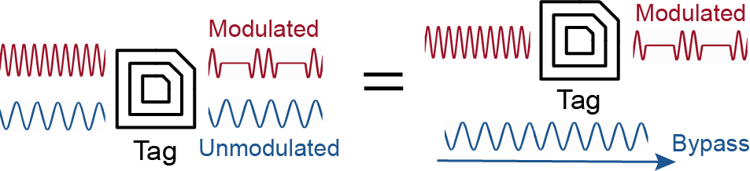
Backscatter in a specific band
Notes:
To generate reflection signals only in a specific frequency band, we consider carefully applying different operations to the RF signals in different bands.
We modulate the reflection signal only in one band and keep others unmodulated.
Those unmodulated reflections are treated as static reflections in the environment and will be eliminated.
In this way, the tag bypasses the excitation signals in other bands, and backscatters only in the desired frequency band.

Slide 28
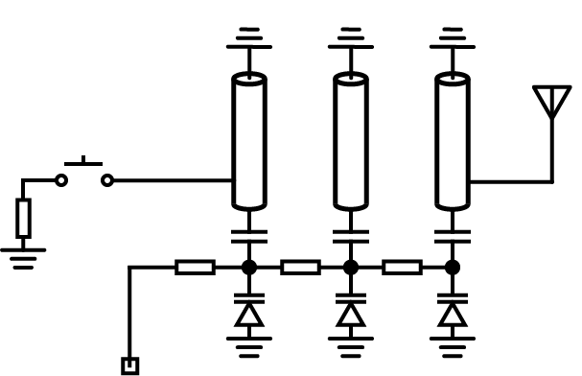
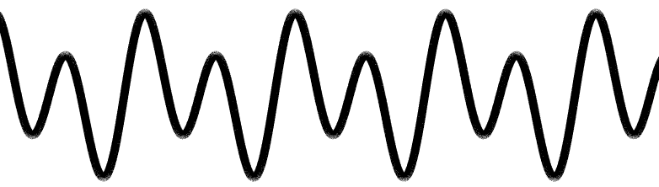

Frequency-selective reflection
Control signal
Incident signal
Generate backscattered signals only in band 1
Tuning the voltage to select band
V1
Comb-line filter
Manipulate RF signals in different frequency bands to achieve the frequency-selective reflection.
Notes:
We consider achieving the frequency-selective reflection by applying distinct RF operations to signals in different frequency bands. Specifically, we leverage the reflection feature of the comb-line filter here.
For the signals out of the filter’s passband, the RF operation is to reflect them directly before the filter, and the reflection signals remain unmodulated.
For the signals in the filter’s passband, they can pass the filter and reach the RF switch. So, the reflection signals can be modulated by the control signal.
Thus, we eventually generate backscattered signals in the specific passband.

