Slide 1



ELASE: Enabling Real-time Elastic Sensing
Resource Scheduling in 5G vRAN
Yulong Chen, Junchen Guo, Yimiao Sun,
Haipeng Yao, Yunhao Liu, Yuan He†
1Tsinghua University, China 2Alibaba Group, China
3Beijing University of Posts and Telecommunications, China
Notes:
Hello everyone. I’m Yulong Chen, a second-year master student from Tsinghua University.
It's a great honor to be here to share our work:
ELASE: Enabling Real-time Elastic Sensing Resource Scheduling in 5G vRAN

Slide 2

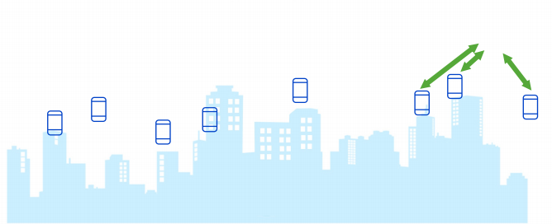

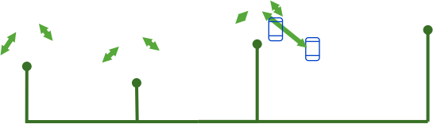

Paradigm: Integrated Sensing and Communication
Cellular Network
CSI sampling problem
Wi-Fi Network
Excepted CSI samples for sensing
RAN
Time
CSI samples in actual communication
Time
Uneven spacing
No data
Low sampling rate
CSI sampling problem
Insight: Cellular networks have the characteristics of wide distribution and centralized RF resource scheduling.
Motivation
Challenge
Design
Evaluation
Conclusion
Notes:
Integrated Sensing and Communication has been witnessed to be a new paradigm of wireless sensing in 5G
networks. Users can benefit from pervasive sensing applications in various scenarios with no communication penalty.
The widely deployed networks currently include cellular networks and WiFi networks。
But Wi-Fi networks adopt mechanisms like CSMA/CA and the deep coupling between preamble signals and data packets.
This will produce an unstable sampling rate of the sensing signals.
Differently, the centralized resource scheduling and the separation of data and control channels in
Cellular networks can offer a stable CSI.

Slide 3


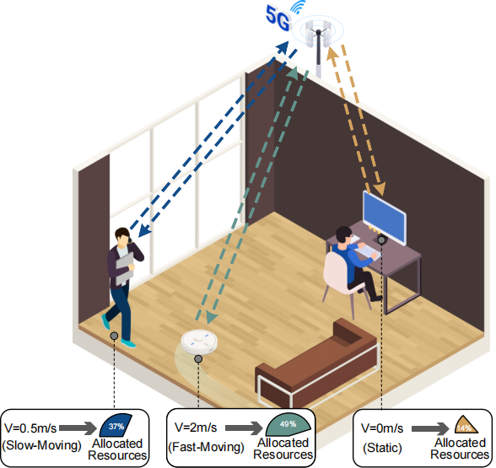

Scheduling sensing resource in multi-target scenarios
Signal Processing
Algorithms
Artificial Intelligence
Multi-stream Infrastructure
Scheduling the limited sensing resources among multi targets should be in parallel with the algorithm optimization and the infrastructure upgrading.
Motivation
Challenge
Design
Evaluation
Conclusion
Notes:
In existing ISAC works with 4G LTE and 5G NR, we find that the majority of them have considered reducing the sensing errors by applying advanced signal processing algorithms, emerging artificial intelligence technologies, multi-stream infrastructure. These topics are more or less discussed in other RF signal based works and similar solutions can be found.
We think Scheduling the limited sensing resources among multi targets is important. It is in parallel with the algorithm optimization and the infrastructure upgrading.
Take the scenary in the figure as an example. The moving speed varies among different user devices and varies over time. It is inappropriate for base stations to allocate fixed and average sensing resources to each device. Due to the centralized resource scheduling capability and inspired by the data plane scheduler, we would like to design one RS scheduler to simultaneously boost the sensing quality and reduce the resource waste in the multi-target sensing
scenarios.

Slide 4
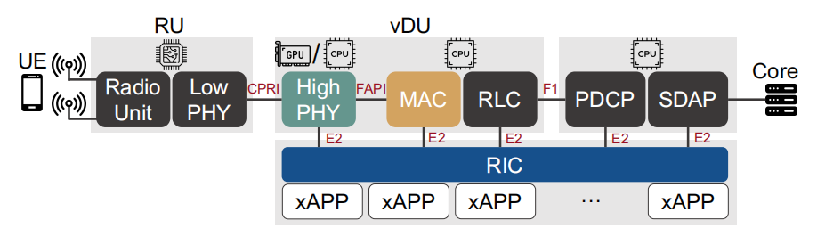
Virtual Radio Access Networks
Protocol stack of 5G vRAN
Motivation
Problems
Design
Evaluation
Conclusion
Notes:
In traditional hardware-based black-box mobile networking infrastructure, only large device vendors can edit base station
and efforts have to be spent on the hardware modification.
Fortunately, the emerging 5G mobile networking technology named vRAN offers a more flexible way to deploy a RS scheduler.
Figure shows the typical data-plane structure of the 5G vRAN protocol stack, from bottom to top including PHY layer,MAC layer ,RLC layer and so on.
we mainly focus on PHY’s channel estimation module for the CSI retrieving and MAC’s scheduler module for the
elastic SRS scheduling.

Slide 5
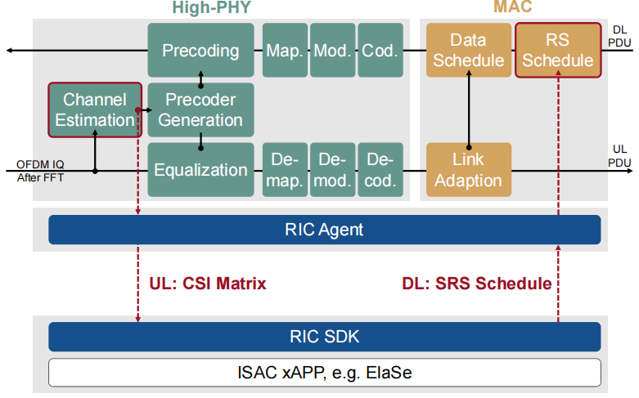
Virtual Radio Access Networks
Insight: The interface of its protocol stack gives us the opportunity of deploying a dedicated RS scheduler on demand..
Motivation
Problems
Design
Evaluation
Conclusion
Notes:
vRAN specifies a group of standardized interoperation interfaces, which enables the dynamic service
loading and parameter adjustment.
Before channel estimation , the RIC agent can get CSI Matrix, and RIC can execute SRS scheduling instructions in the MAC layer.

Slide 6
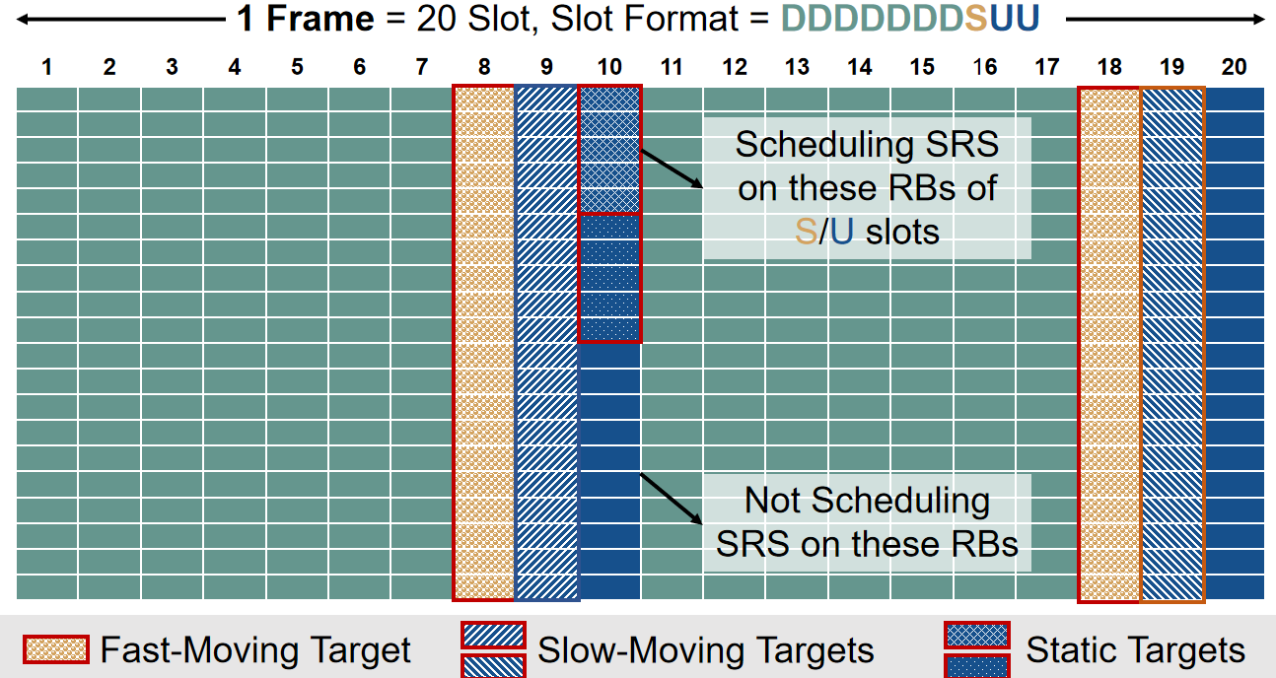
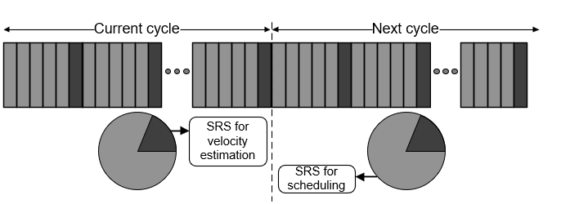
Technical challenges
Matching demands with RS
CSI sampling problem
Eliminating scheduling delays
Motivation
Problems
Design
Evaluation
Conclusion
Notes:
Though 5G vRAN shows promise in the wireless sensing applications, we have to tackle the following technical challenges before turning the above RS scheduler extension into a practical system:
First, how to match sensing demands with sensing resources?
Within the scope of our research, there is currently no work focusing on sensing resource scheduling in 5G networks. The criteria for estimating sensing resources, defining sensing demands, and matching them are not clear.
Second, how to eliminate scheduling delays? We hope that the scheduler's resource allocation plan will change as soon as the demands of UEs change, but scheduling delays still exist inevitably. The scheduling delays come from the execution time of the state recognition algorithm and its requirement for recording some sampling points.

Slide 7
ElaSe: Design overview
UE state recognition
SRS resource scheduling
Eliminating delays
Predictive Scheduling Scheme
Delay between the UE acquiring sensing resources and its state change.
We utilize the existing low sampling rate SRS available in
communication and derive the velocity as an indicator of demands.
Mapping indicator to SRS resources
Resource allocation algorithm.
Motivation
Problems
Design
Evaluation
Conclusion
Notes:
ElaSe maps different speeds to the bandwidth and sampling rate of SRS, and optimizes resource utilization through resource allocation algorithms.
The velocity of each UE is calculated by the base station at the end of current cycle. And then we use this velocity to schedule resources in the next cycle.

Slide 8
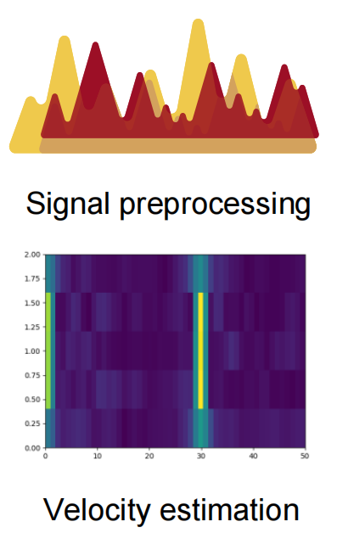


UE state recognition
UE state recognition
Data preprocessing
Noise cancellation
Fading enhancement
Frequency estimation
f
$$f_{0}$$
$$v=\frac{λ∗f_{0}}{2}$$
the median value
Motivation
Problems
Design
Evaluation
Conclusion
Notes:
method propesed by CIL

Slide 9
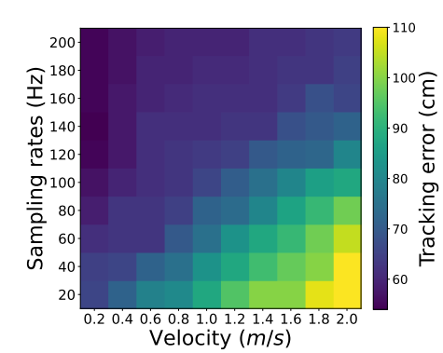
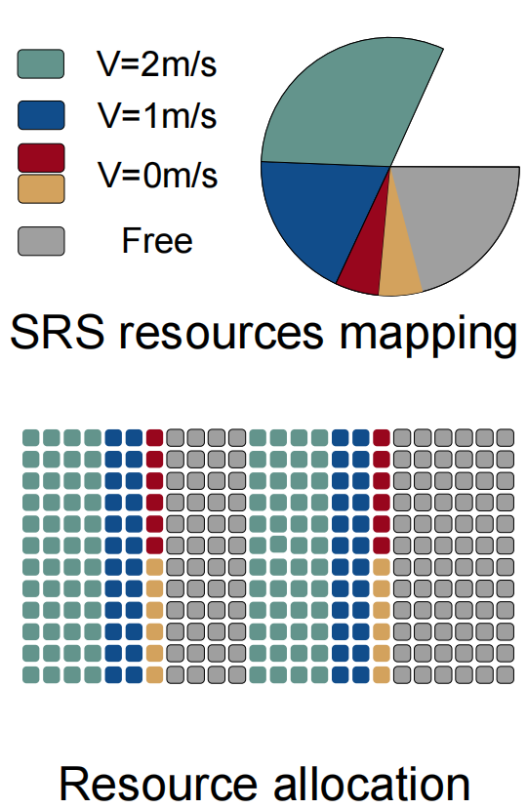
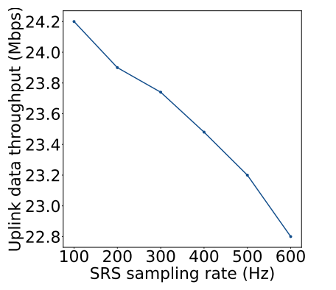

SRS resource scheduling
SRS resource scheduling
Effects of SRS slot numbers
on data throughput:
Variant tracking errors under different velocities and sampling rates.
Uplink data throughput using SRS with different time slot numbers.
Motivation
Problems
Design
Evaluation
Conclusion
Notes:
After obtaining the velocity of each UE, it is necessary to map the velocity to sensing resources. SRS resources is decides by both sampling rates and SRS bandwiths. The bandwith is related to the status or the sensing tasks of each UE. our system allow the UE to set the bandwidth. if the UE doesn’t set, The base station classifies UEs into two states: stationary and moving; thus setting corresponding bandwidth.
For the sampling rate, Assuming the UE is sampled once after the same displacement, we establish a positive correlation between the sampling rate and velocity value. The figure one shows xxx. The localization method adopts a modified super-resolution method from SpotFi. When the velocity grows, its necessary to give a higher sampling rate.
Before we introduce the resource allocation algorithm, let’s have a look at Effects of SRS slot numbers
on data throughput. the uplink data throughput decreases as SRS slot numbers increase. The throughput with 600 slots is 5.8% less than that with 100. The reason is sensing resources and communication resources are mutually exclusive in the OFDMA structure.
Therefore, the resource allocation algorithm wants to minimize the total number of SRS time slots, It combines the sensing
resource demands of some UEs when the sum doesn’t exceed the upper limit of running bandwidth,

Slide 10

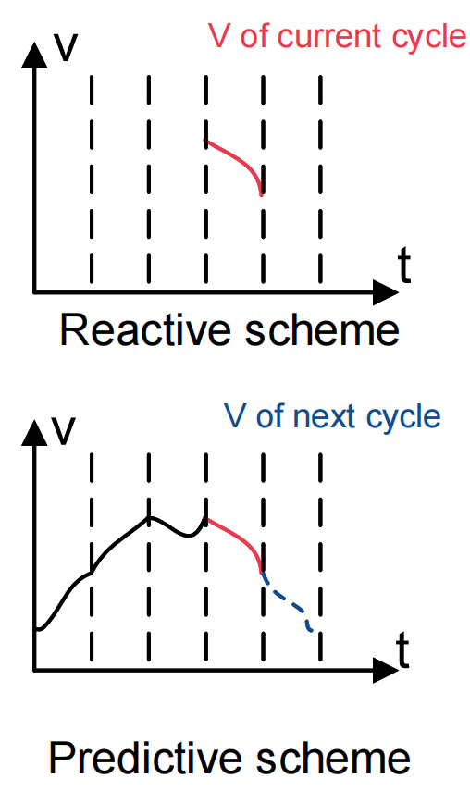


Elimination of scheduling delays
Elimination of scheduling delays
Edge Server
Historical velocity data of the UE in past cycles
RAN
User
Equipments
Motivation
Problems
Design
Evaluation
Conclusion
Notes:
The third part is Elimination of Scheduling Delays. remembering we calculate the velocity of current cycle and schedules resources of the next cycle. the Reactive Scheduling Scheme uses the current velocity to schedule. The idea behind it is that the speed will not change frequently.This scheme is useful enough in some scenaries but introduces a delay of one cycle
between the change in the UE’s velocity and the adjustment of allocating sensing resources.
In response to this challenge, we propose the Predictive Scheduling Scheme. Although the base station
lacks knowledge of the UE’s velocity in the next cycle during resource scheduling, it can gather historical velocity data of
the UE in multiple past cycles. By utilizing this historical data, the base station uses the current acceleration and one Kalman filter to predict the velocity in the next cycle. We use feedback mechanism, to improve the effect of predictions based on actual observed velocity data.

Slide 11
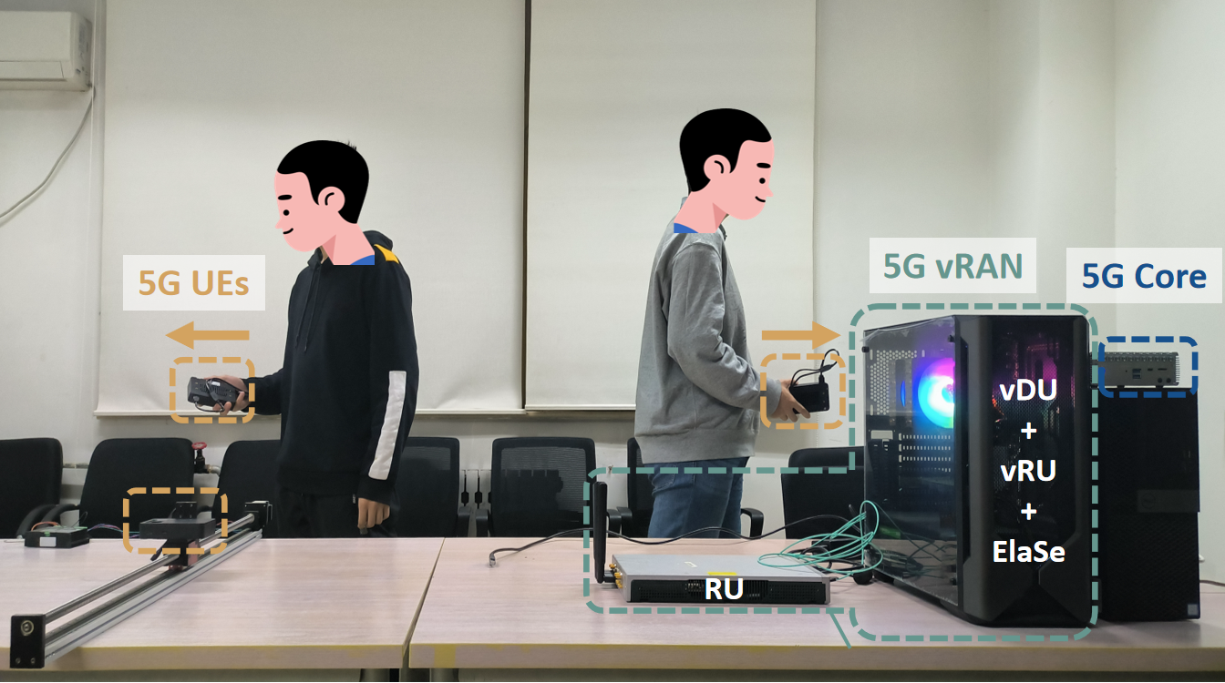

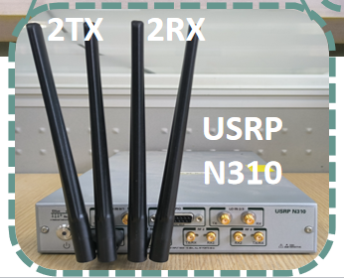
Implementation
A complete 5G testbed
5G vRAN: Adopt OpenAirInterface (open-sourced) and run at 3.7GHz.
5G core network: Adopt free5GC.
5G UEs: Use commercial 5G Customer Premise Equipment with no hardware and software modifications.
Motivation
Problems
Design
Evaluation
Conclusion
Notes:
we build a complete 5G testbed including a 5G base
station and multiple commercial 5G UEs. The 5G base station
consists of the 5G vRAN and the 5G core network. Details of
these components are listed as follows:
The baseline is a scheme that uses the original SRS with
a sampling rate of 100 Hz and a whole bandwidth, evenly
allocated to UEs.

Slide 12
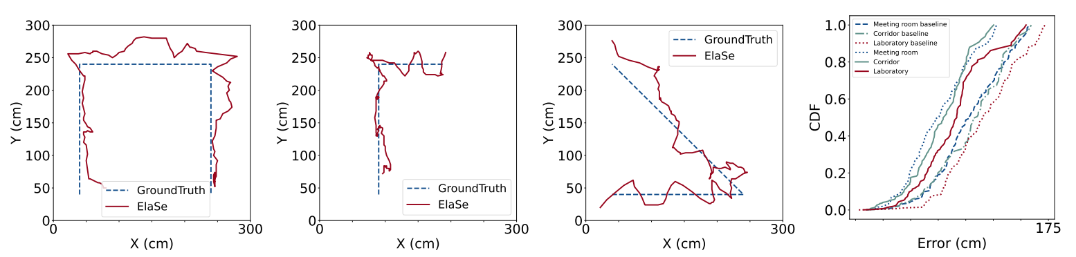
Overall Performance
Meeting room with few multipath effects (5m×4.2m)
Narrow corridor(5m×2m)
Laboratory with rich multipath effects (5m×4m)
CDF of Tracking Error
The median tracking error of ElaSe is 0.60m,0.63m,0.78m,
respectively,34% less than that of baseline scheme without scheduling.
Motivation
Problems
Design
Evaluation
Conclusion

Slide 13
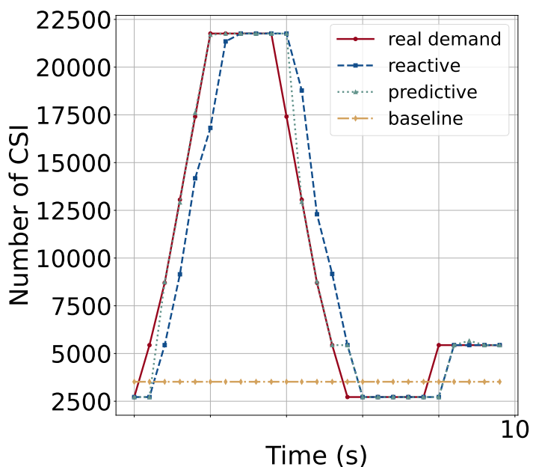
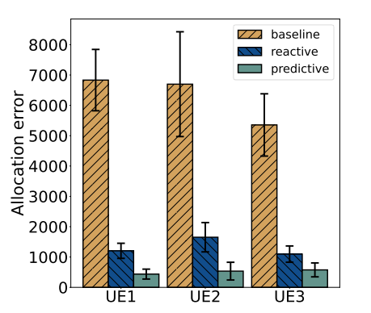
Allocation Error
The resource allocation error is defined as the absolute difference between the number of SRS allocated to one UE and the real demand in one cycle.
Demand and allocaton over 10s.
Resource allocation error of three schemes.
The resource allocation error of predictive scheme is 63% less than that of reactive scheme .
Motivation
Problems
Design
Evaluation
Conclusion

Slide 14
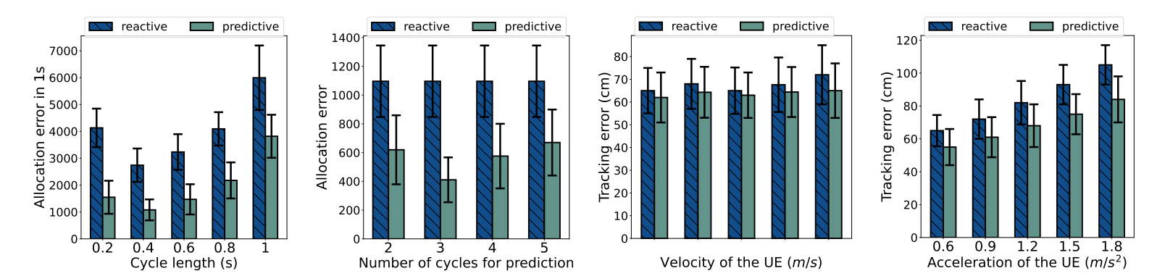
Impacting Factors
Length of the scheduling cycle
Length of prediction window
UE velocity
UE acceleration
The predictive scheduling scheme works well in different conditions.
Motivation
Problems
Design
Evaluation
Conclusion

Slide 15
Conclusion
ElaSe is the first sensing resource scheduler in 5G networks and schedules RS elastically and in time.
Experiments under real-world scenarios show that ElaSe can schedule sensing resources appropriately, achieving small trajectory tracking errors and resource allocation errors.
ElaSe decouples the user state recognition and resource scheduling modules so other sensing tasks can use this loosely coupled framework.
Motivation
Problems
Design
Evaluation
Conclusion

Slide 16
ELASE
Thank You!

