Slide 1
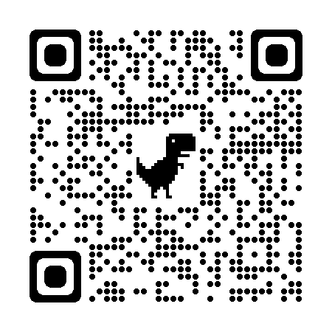

RFinder: Pinpoint the Invisible RFID Tags in the Prefabricated Buildings
Jiacheng Zhang, Meng Jin, Yimiao Sun, Weiguo Wang, Jia Zhang, Xin Na, Xiuzhen Guo, Yuan He*
School of Software and BNRist, Tsinghua University
http://tns.thss.tsinghua.edu.cn/sun/
Tsinghua
SUN Group

Slide 2

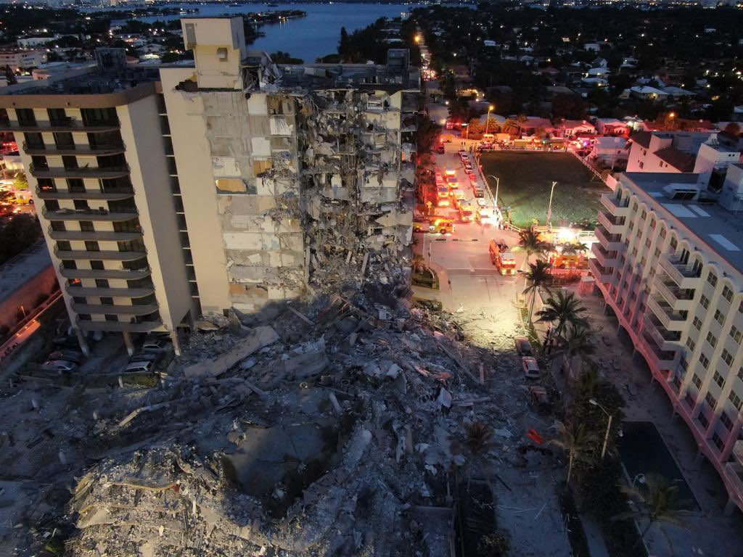
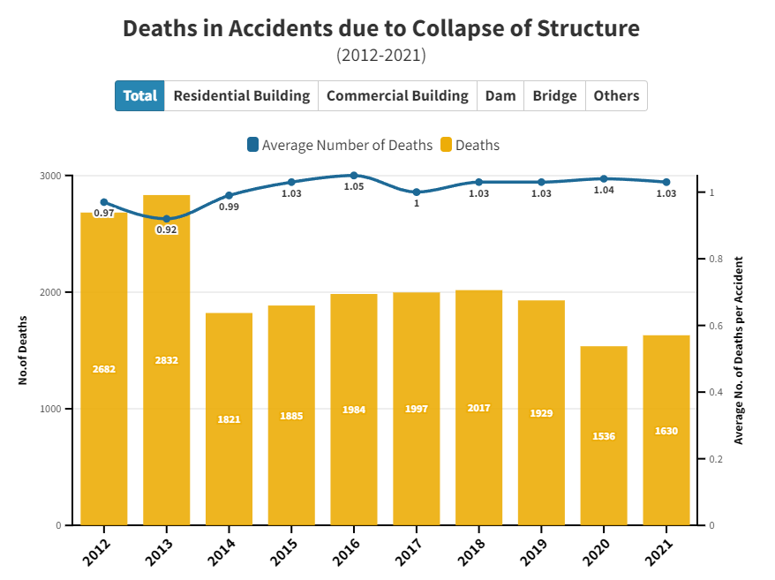
Building Quality Control Is Important
2021 Miami, 98 deaths
Thousands of deaths due to building collapse
Problem: Poorly constructed buildings lead to life-threatening accidents,
such as the collapse of buildings and bridges.

Slide 3
Building Quality Control Is Important
2021 Miami, 98 deaths
Thousands of deaths due to building collapse
Monitoring structural health of a building
is very important !
Problem: Poorly constructed buildings lead to life-threatening accidents,
such as the collapse of buildings and bridges.

Slide 4
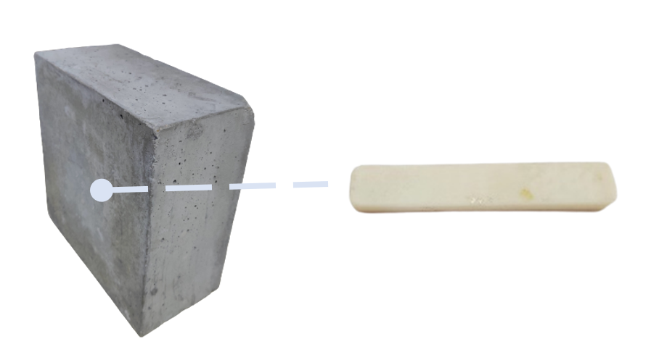
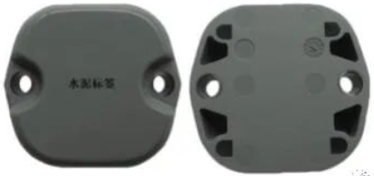


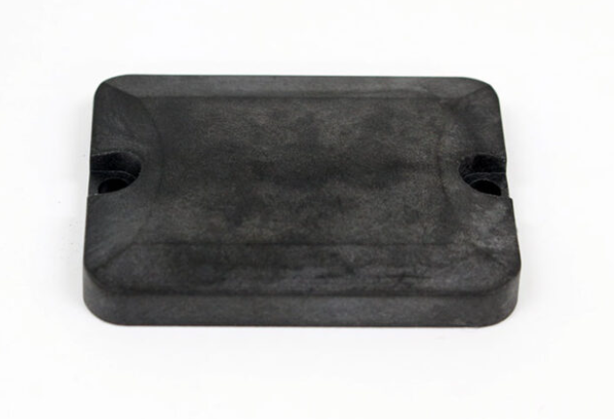
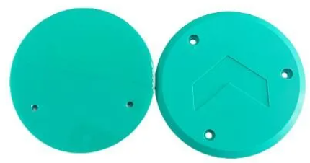
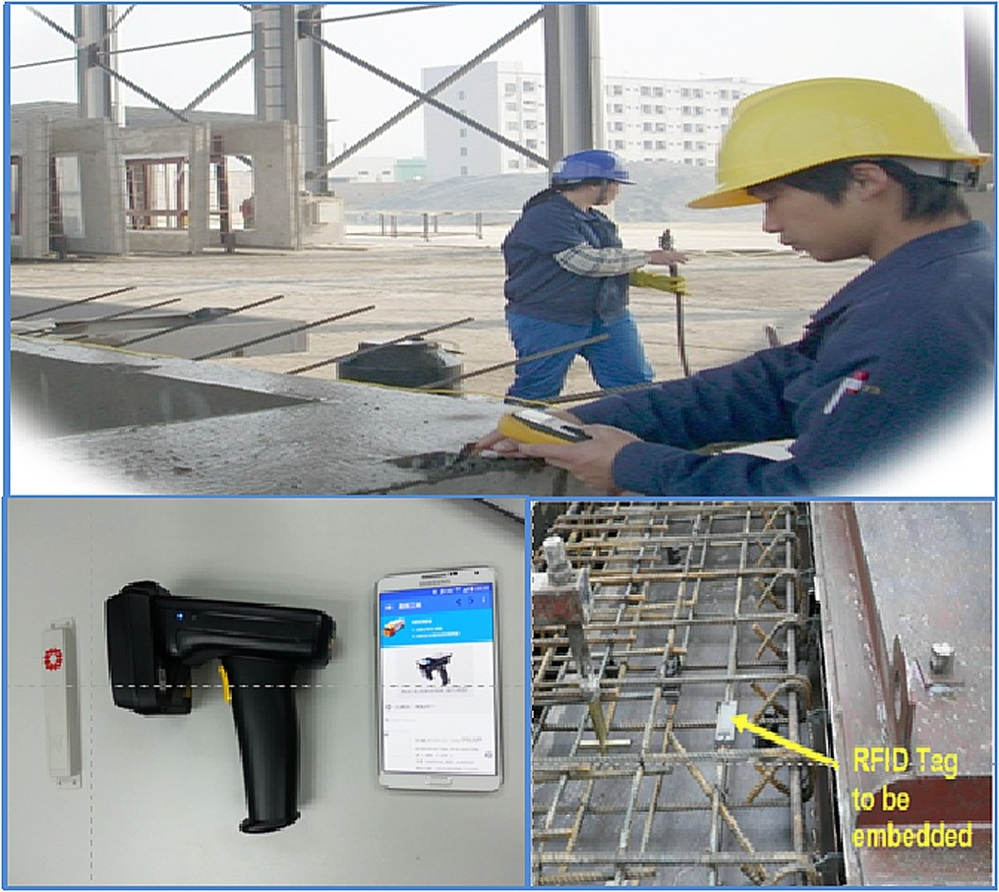
RFID-based Prefabricated Components
RFID tag in a prefabricated component
Prefabricated Components management
Different types of commercial prefabricated components with buried RFID tag
RFID tags can be embedded in prefabricated component (e.g., concrete) to monitor the structural health of the building.

Slide 5
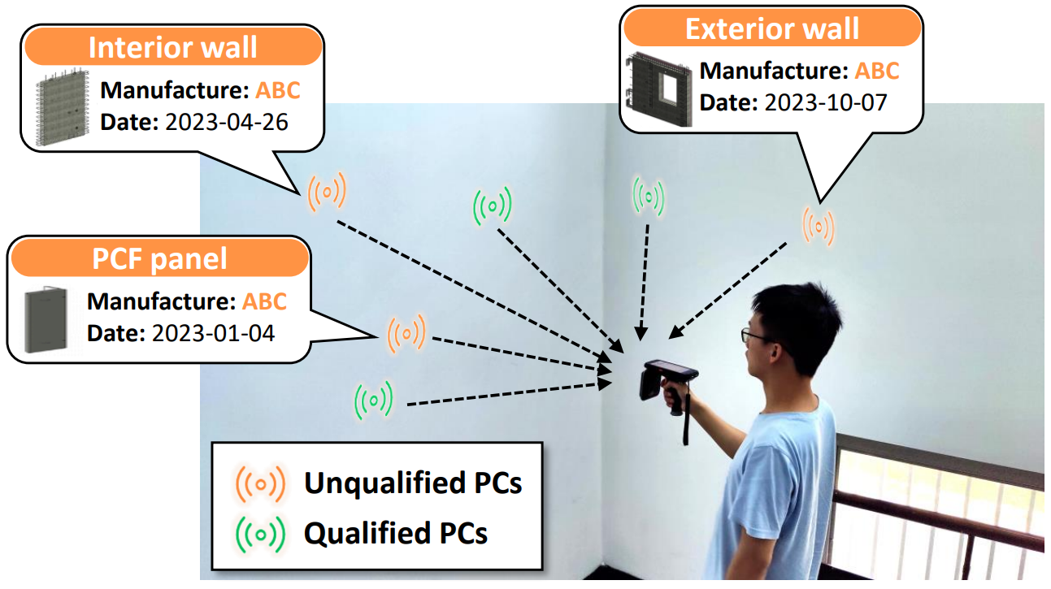
Prefabricated Component Localization
Localizing the RFID tag helps workers to find the location of the prefabricated component, and help them to trace the source of the component.

Slide 6
Prefabricated Component Localization
How to localize a tag in densely stacked prefabricated components?
Problem: When querying a tag embedded in a component, all the tags around respond their information. It’s difficult to distinguish these response.

Slide 7
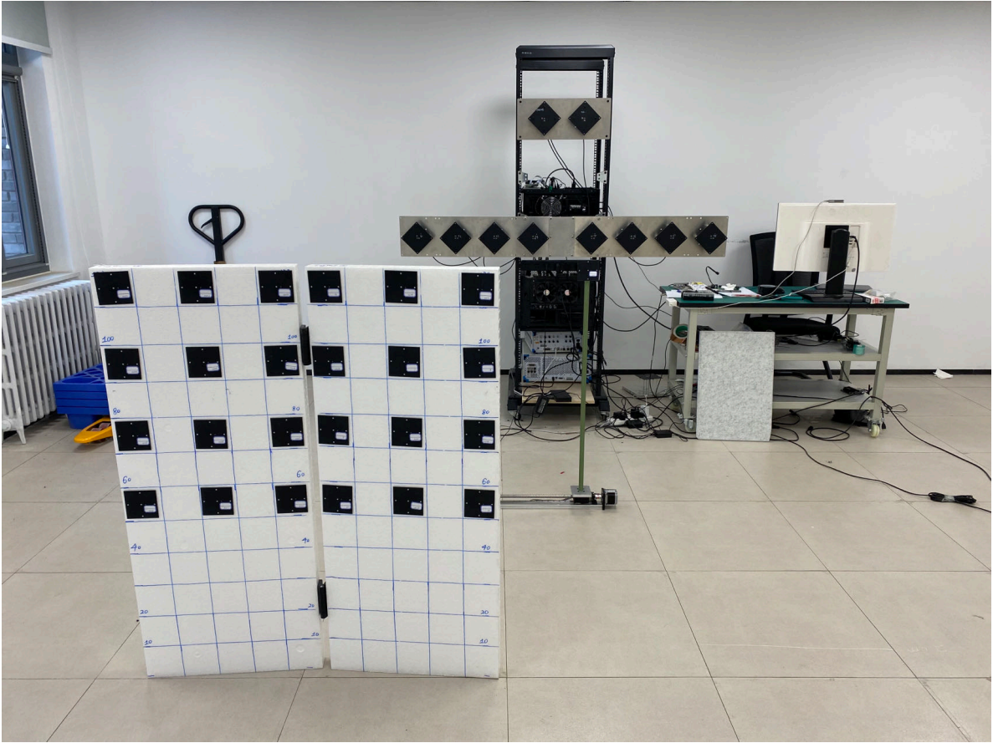
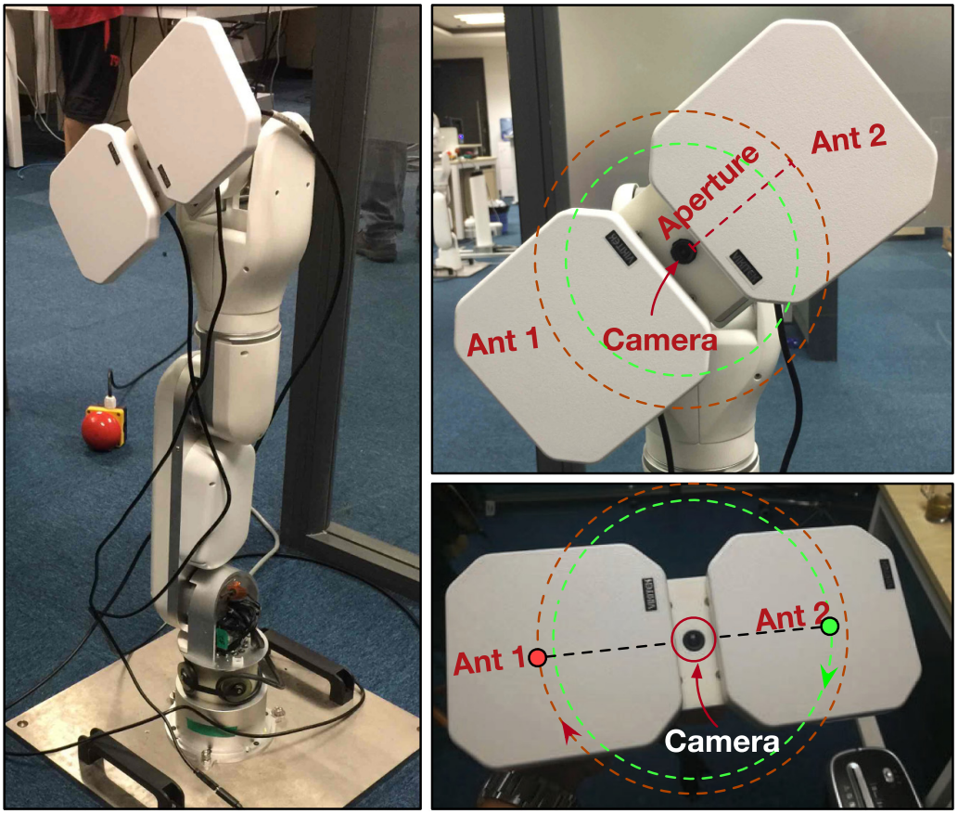
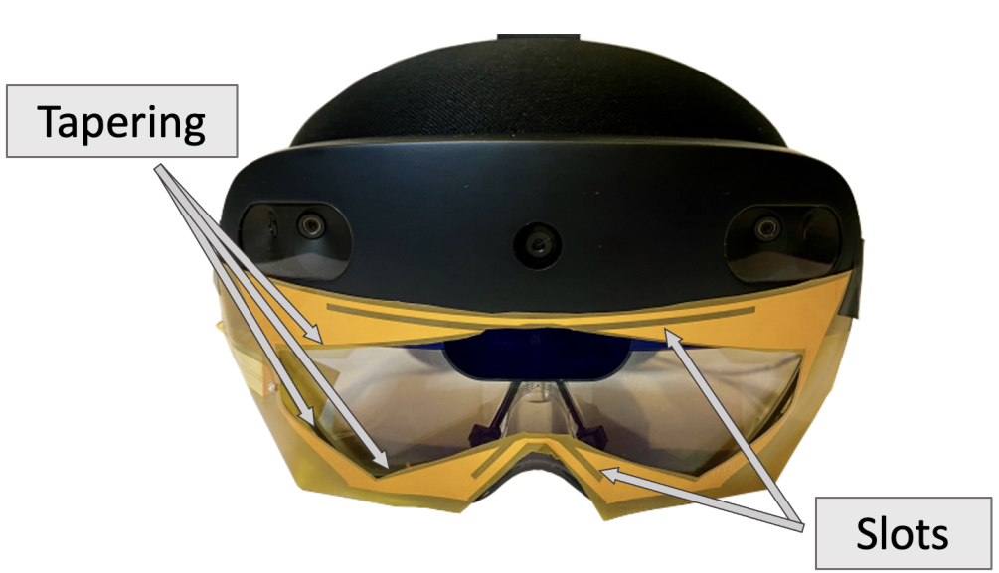
Existing approaches
Antenna Array
Mobile Robots
Vision + RFID
Unavailable on portable devices and
not easy convenient for workers to use
Moving on well-defined trajectories and not suitable for handheld human mobility
Not suitable for construction sites where illumination and user motion may change

Slide 8
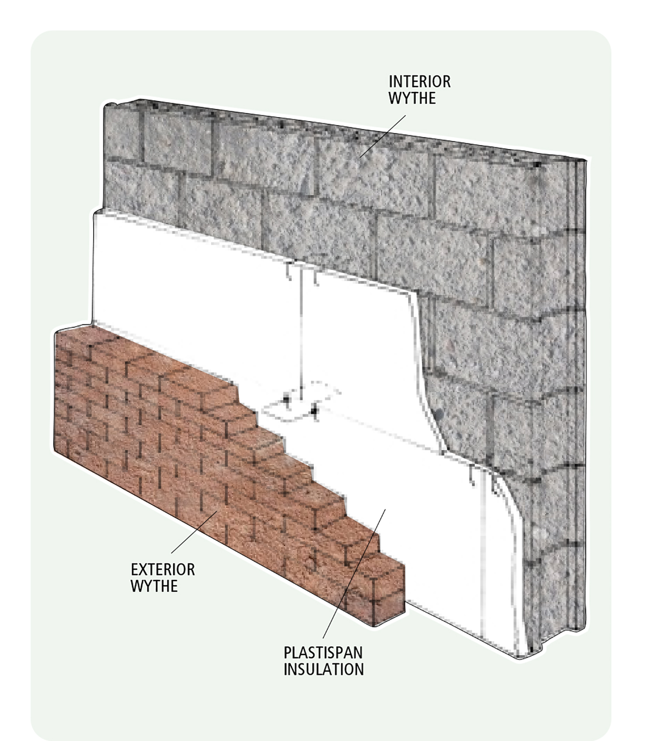
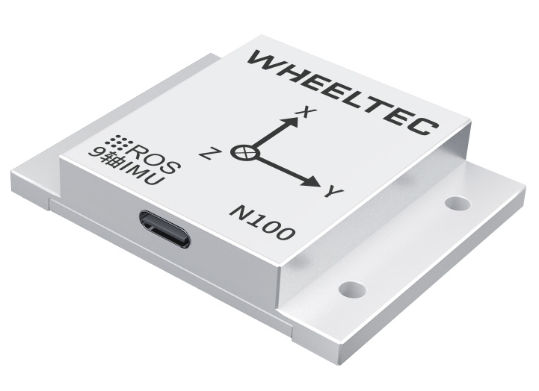

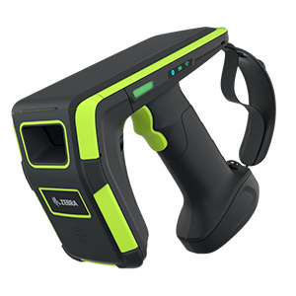
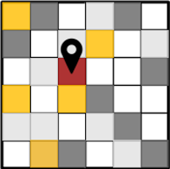
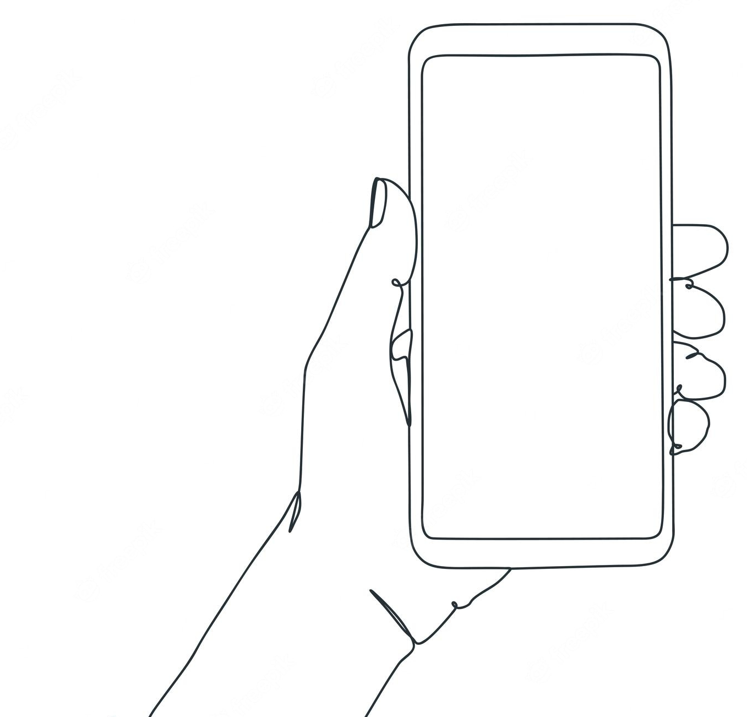
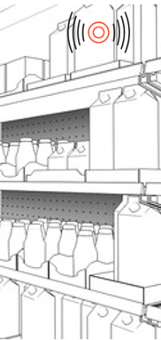
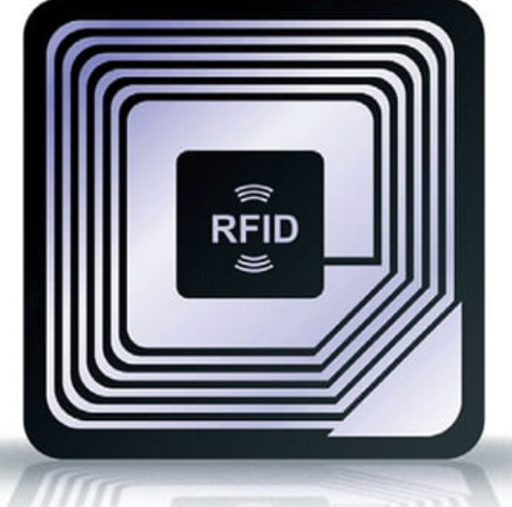




Our Approach
RFID Tag
IMU Data
（Acceleration，Angular velocity）
$$v_{tag}$$
Signal propagation direction
$$α$$
$$v_{at}$$
Data Matching
Location Estimation
RFID Signal Phase
@900MHz
Device moving direction
$$v_{tag}=\cos\left(α\right)v_{at}$$
RFinder combines an IMU data and a COTS RFID reader to estimate the radial velocity $v_{at}$ , and further estimate the AoA $α$ and the location of the tag.
Notes:
本文提出的定位方法的核心原理在于当手持机移动时，IMU捕获到的手持机移动的速度和RFID相位变化的速度之间存在确定性转换关系，也就是RFID相位速度等于手持机运动速度在天线到标签方向上的投影

Slide 9
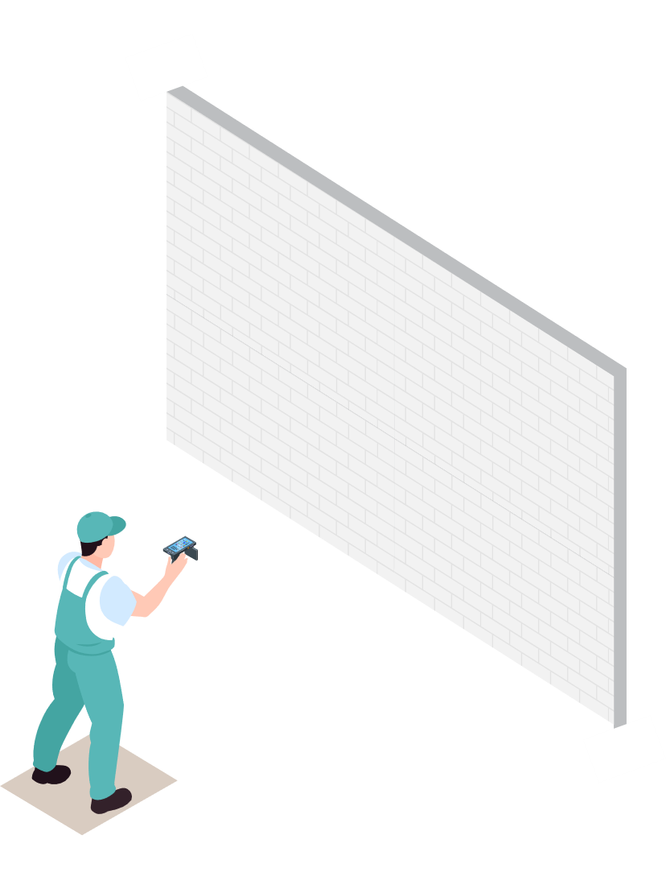
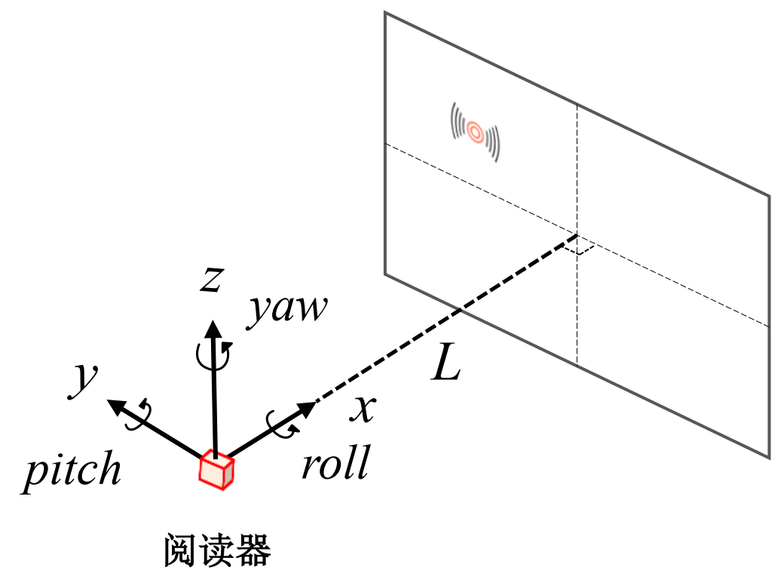


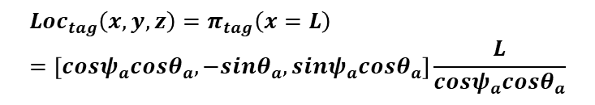
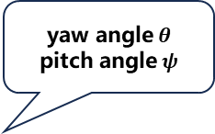

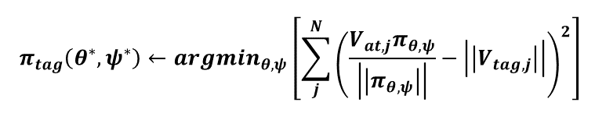


3D AoA Estimation
Searching the AoA of the tag
Calculating the location of the tag
RFID tag
yaw angle$θ$
pitch angle$ψ$
$$z$$
$$θ^{∗}$$
$$ψ^{∗}$$
$$x$$
$$v_{tag}$$
$$y$$
$$v_{at}$$
Trajectory
RFID reader
$$π_{tag}\left(θ^{∗},ψ^{∗}\right)←argmin_{θ,ψ}\left[\sum_{j}^{N}{{\left(\frac{V_{at,j}π_{θ,ψ}}{\left|\left|π_{θ,ψ}\right|\right|}−\left|\left|V_{tag,j}\right|\right|\right)}^{2}}\right]$$
$$Loc_{tag}\left(x,y,z\right)=π_{tag}\left(x=L\right)=\left[cosψ_{a}cosθ_{a},−sinθ_{a},sinψ_{a}cosθ_{a}\right]\frac{L}{cosψ_{a}cosθ_{a}}$$
RFinder estimates the yaw and pitch angle to achieve 3D AoA estimation by searching the optimal result of the projection of the radial velocity.
Notes:
根据以上原理，我们将这个规律推广到了三维空间中，通过枚举IMU速度在空间中所有的方向上的投影去解一个最优化的方程，就能够计算处标签所在的最佳的方位角。这个方位角由俯仰角和偏航角组成，如果我们已知其他的一些信息，比如用户到墙壁的距离，就能够直接计算出构件所在的三维坐标。

Slide 10
Challenge: How to Match IMU and RFID Data
IMU velocity data
RFID velocity data
①
③
②
Noise exists in the velocity data after differentiating RFID phase data.
Sampling frequency of RFID reader is unstable, causing sample loss.
The clocks of RFID reader and IMU sensor are not synchronized.

Slide 11
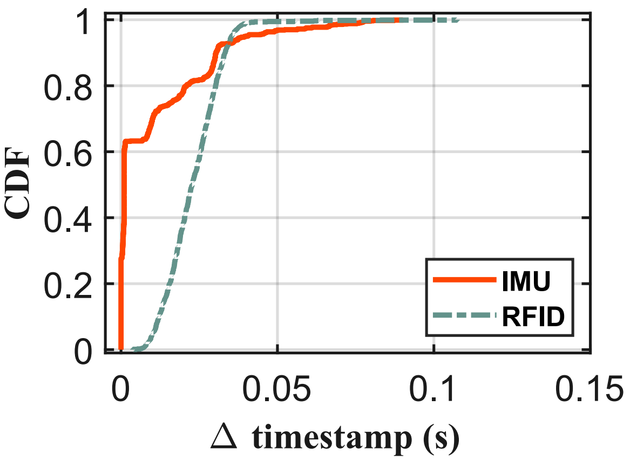
Challenge: How to Match IMU and RFID Data
Reading traces of IMU sensor and RFID reader
The sampling interval of RFID reader and IMU sensor are quite different;
The sampling rates of both the two devices are highly unstable.

Slide 12
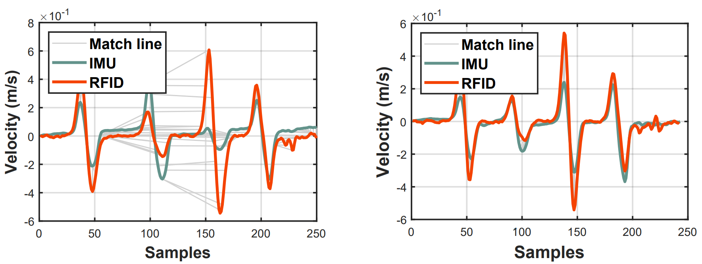


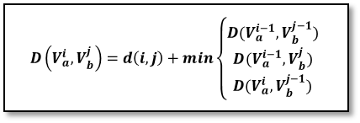
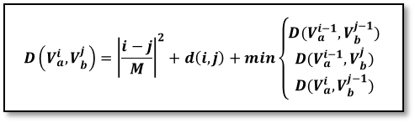
Our solution: TDTW (Time-weighted DTW)
DTW ：Time offset still exists
TDTW ：Compensating Time offset
Match path without compensation
Match path with time compensation
DTW matching result
$$D\left(V_{a}^{i},V_{b}^{j}\right)=d\left(i,j\right)+min\left\{\begin{aligned}D(V_{a}^{i−1},V_{b}^{j−1}) \\ D(V_{a}^{i−1},V_{b}^{j}) \\ D(V_{a}^{i},V_{b}^{j−1})\end{aligned}\right.$$
$$D\left(V_{a}^{i},V_{b}^{j}\right)={\left|\frac{i−j}{M}\right|}^{2}+d\left(i,j\right)+min\left\{\begin{aligned}D(V_{a}^{i−1},V_{b}^{j−1}) \\ D(V_{a}^{i−1},V_{b}^{j}) \\ D(V_{a}^{i},V_{b}^{j−1})\end{aligned}\right.$$
TDTW matching result
Exploiting TDTW can effectively reduce the wrong match between the data of IMU sensor and RFID reader.

Slide 13
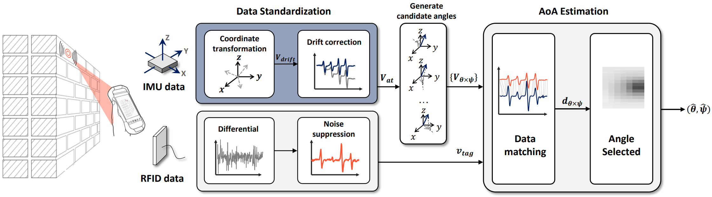
System Overview of RFinder
System overview of RFinder
More details please refer to our paper...

Slide 14
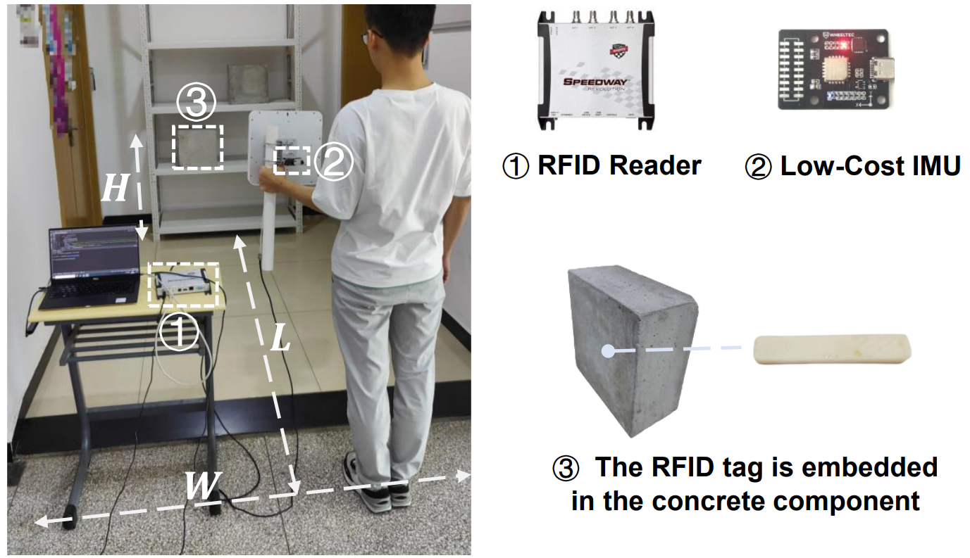
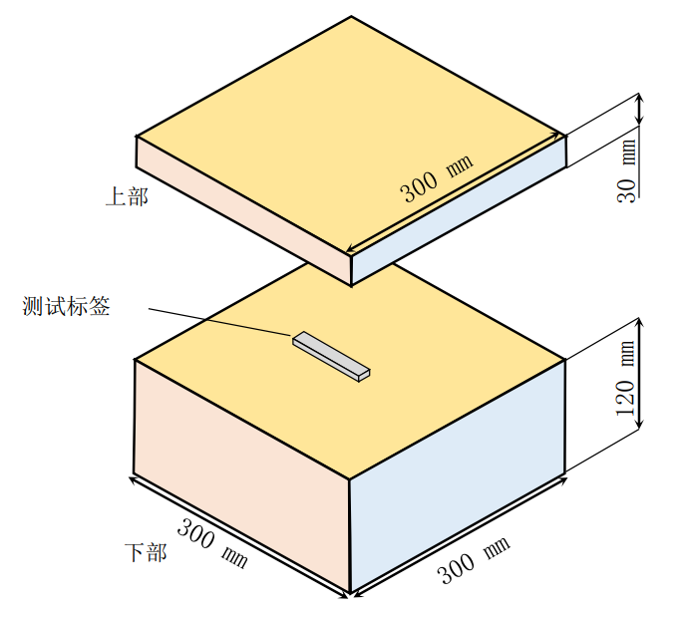
Implementation
RFID Tag
RFID Reader：Impinj R420
IMU: WHEELTEC N200
RFID Tag：Alien H3 9640

Slide 15
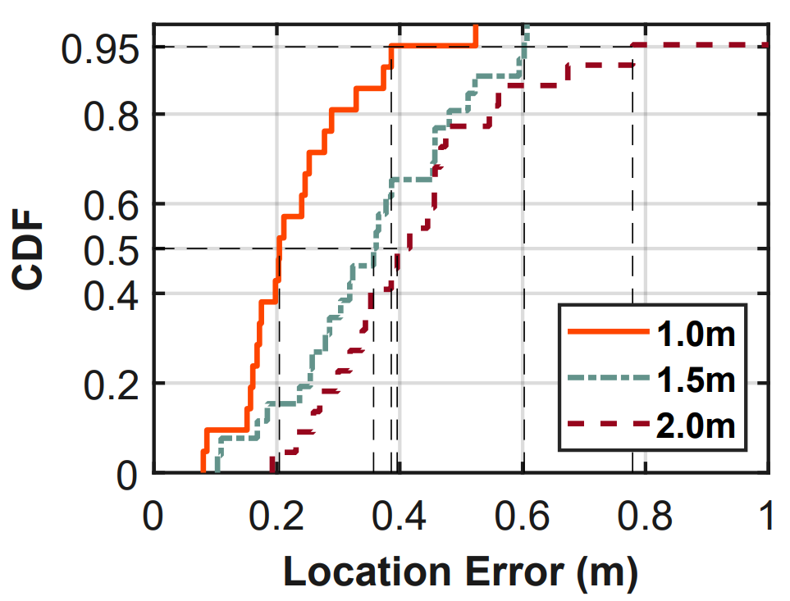
Overall Performance
Overall performance in different distance between the tag and the reader
The median location error is 0.2m, 0.36m and 0.40m, when we set the distance between the tag and the reader at 1m, 1.5m and 2m, respectively.

Slide 16
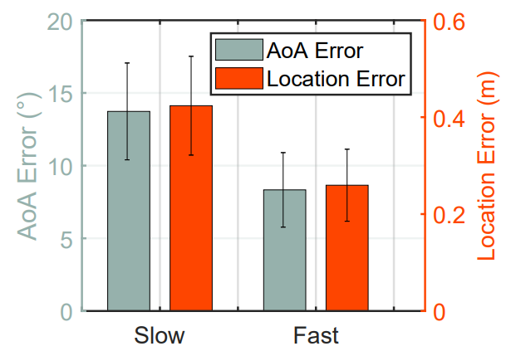
Impacting Factors
Slow: about 0.25 m/s
Fast: about 0.5 m/s
Impact of the moving speed
RFinder achieves a higher accuracy when the user moves the antenna at a fast speed, because IMU and phase signals achieve a higher SNR in this case.

Slide 17
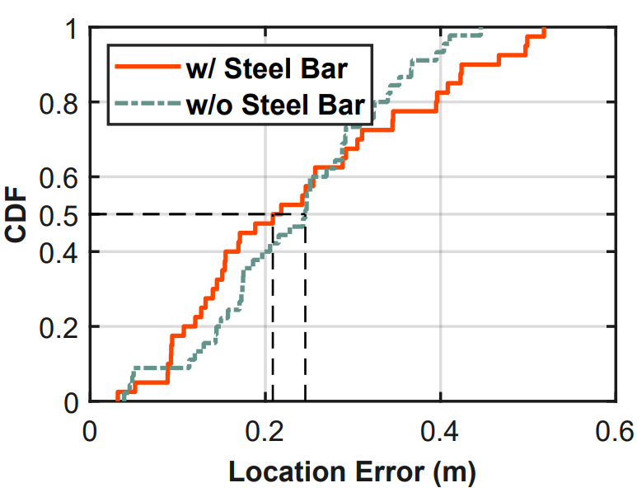
Impacting Factors
Impact of the steel bar in the concrete
The difference between two types of concretes is small, because signal reflected by the metal is very weak and can’t significantly affect reflected signals of the tag.

Slide 18
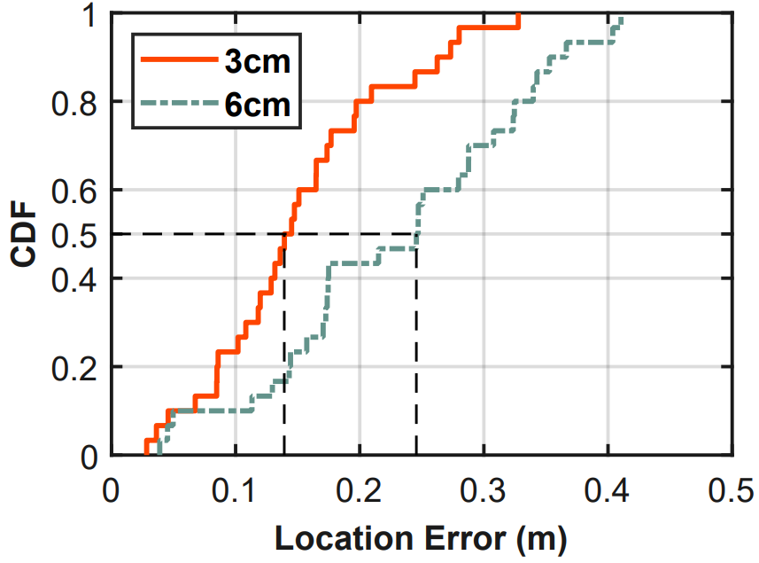
Impacting Factors
Impact of the burial depths of RFID tag
The depth where the tag is buried has a impact on the strength of the reflected signal. Deeper burial depth will lead to higher location error.

Slide 19
Conclusion
RFinder is the first portable RFID localization system that can estimate the AoA of a tag that is embedded in prefabricated buildings.
RFinder overcomes a series of practical challenges including the drifting in the IMU sensor and the misalignment between IMU data and phase measurement.
We envision that RFinder can enable various applications. For instance, locating misplaced items in retail stores and help medical personnel quickly scan and locate medications.

Slide 20
RFinder
Thank You!
Jiacheng Zhang, Meng Jin, Yimiao Sun, Weiguo Wang, Jia Zhang, Xin Na, Xiuzhen Guo, Yuan He*
Please find more details in:
20
http://tns.thss.tsinghua.edu.cn/sun/

