Slide 1
Monty Matlab Project SS 2023
Group 1
Ou Tang, Taiyu Liu, Yiming Shuang, Yiming Shan
15.07.2023

Slide 2

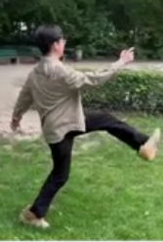
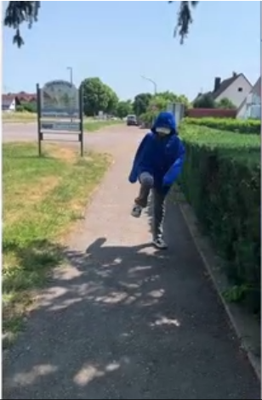
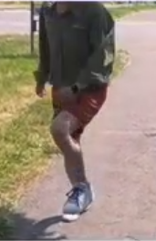
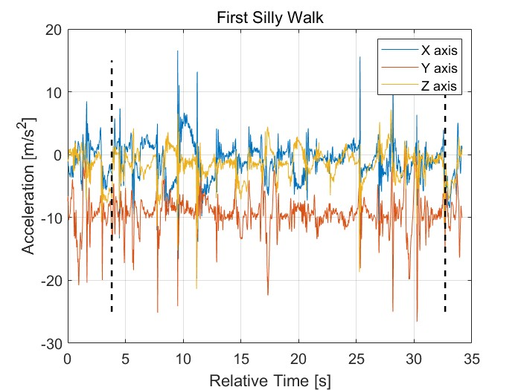
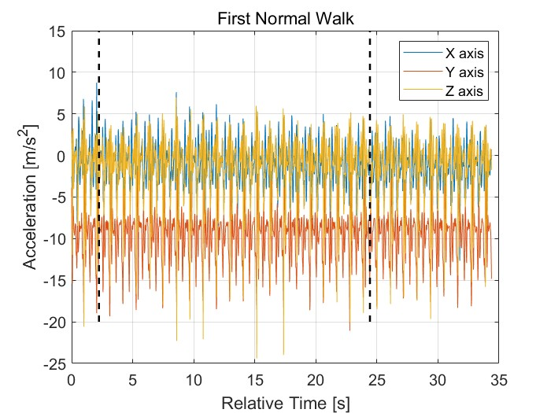
Data Record
132 sets recorded
8 bad sets removed
59 sets of normal walk
65 sets of silly walk
112 sets for training
12 sets for testing
With 60Hz, 50 seconds
Figure 1 ：Data recording photos
Firure 2 ：Visualization of preprocessed data

Slide 3
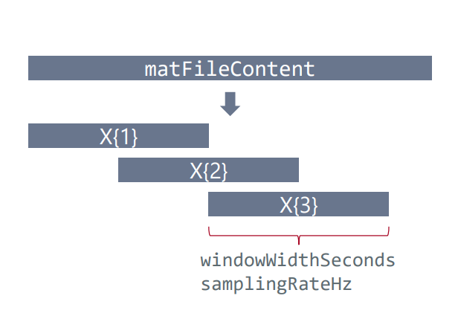
Data extraction
function [X,Y]=extractData(matFileContent,filename,samplingRateHz,windowWidthSeconds)
Resample data
function resampled_data = resampleData(matFileContent, samplingRateHz)
Perform windows
function X = performWindowing(data, samplingRateHz, windowWidthSeconds)
Assign class label
Use categorical function
Figure 3：Principle of data extraction

Slide 4
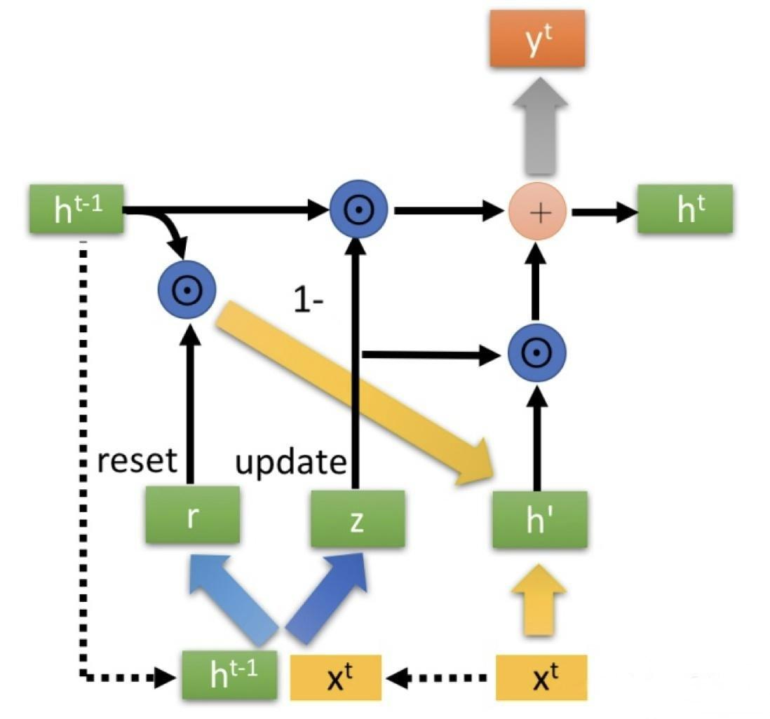
GRU (Principles of Algorithms)
Here gru is used to implement time series classifications.
This is the structure of the detailed algorithm for gru.
GRU is a lightweight model with fewer parameters and faster speed.
Figure 4: The the structure of GRU

Slide 5
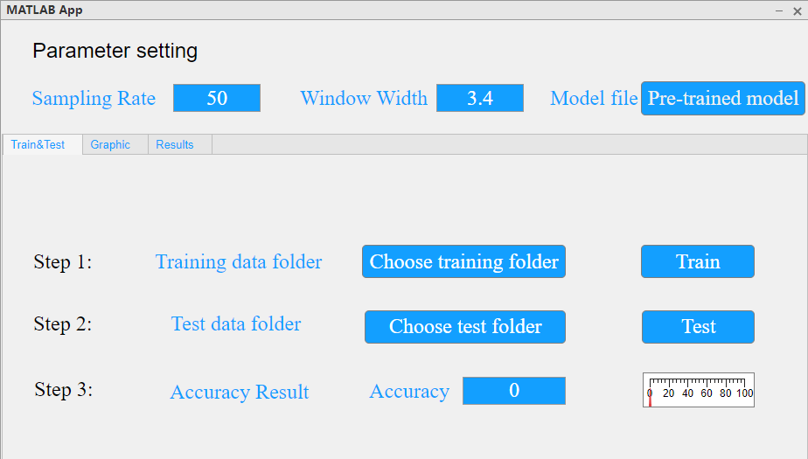
Graphical User Interface
Specify data folder with help of pop-up menu
Modify default value of Sampling Rate and Window Width
Train and display test accuracy in few clicks
Load and test other model with simply choosing test folder, model file and clicking test button
Figure 5: Graphical User Interface

Slide 6
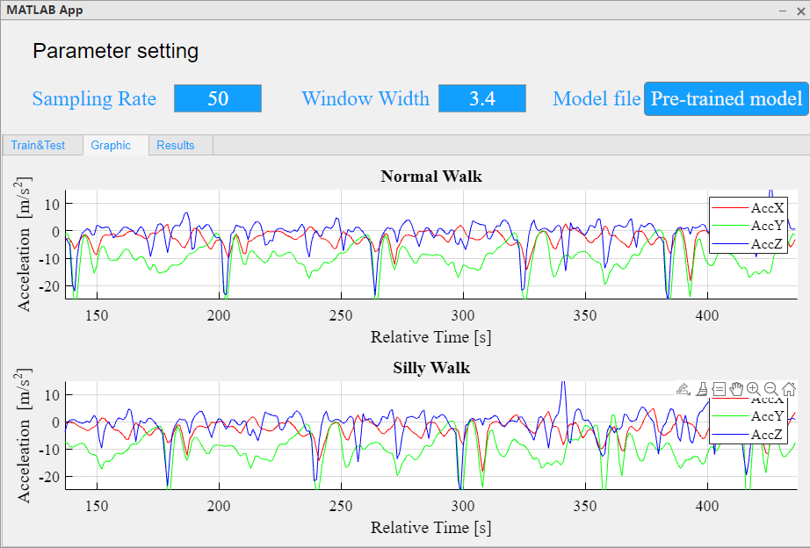
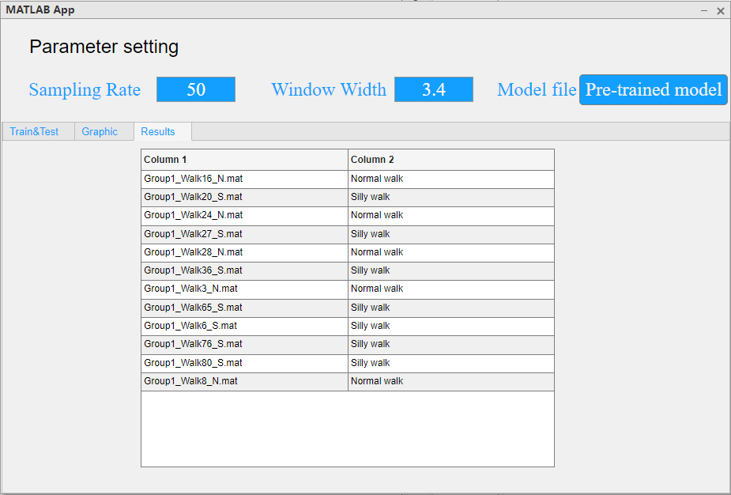
Result of Test
Figure 6: Graphic of Testing data
Figure 7: Result of Testing data

Slide 7

Result of Test
Accuracy
Choose the test folder then klick “Test” button, The Accuracy will be showed on step 3
Figure 8: Accuracy

Slide 8
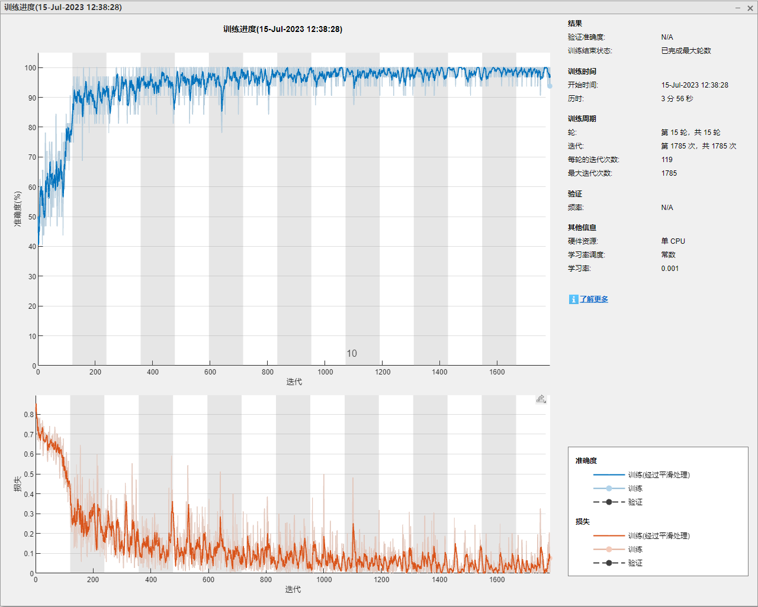
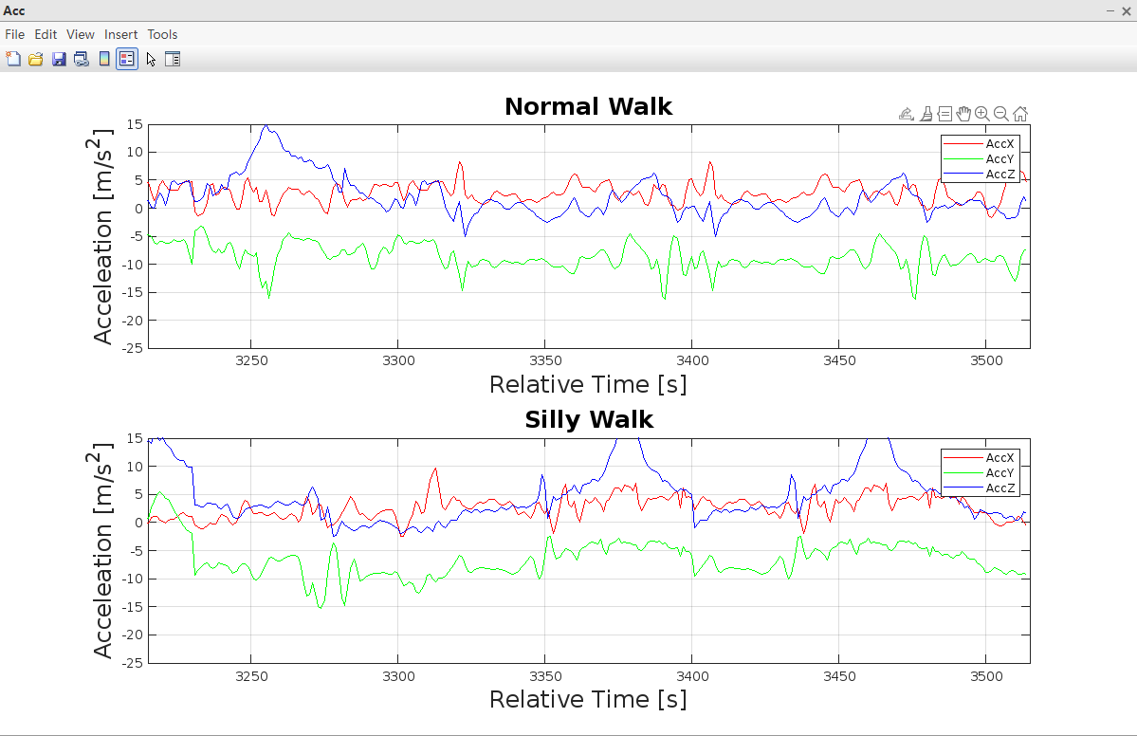
Result of Train
Figure 9: training progress
Figure 10: Graphic of Training data

Slide 9
Thank you for your attention!

