Slide 1
Analysis of annual stock return by evaluating 10-K filings
Yiming Wu

Slide 2
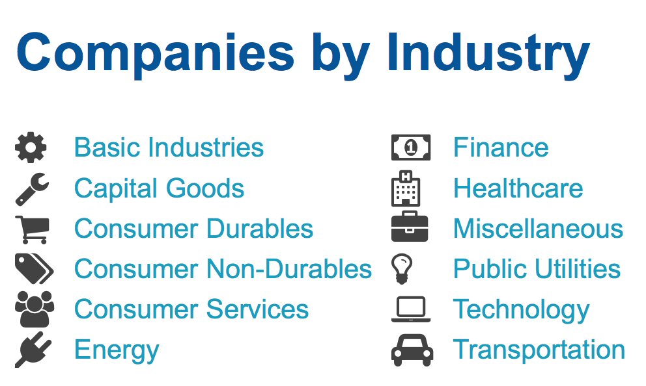
AREAS:
All the listing companies in NASDAQ (4715 listings) in 2016
11 industry sectors:
By evaluating what financial features can I get substantial information about the annual stock return?

Slide 3
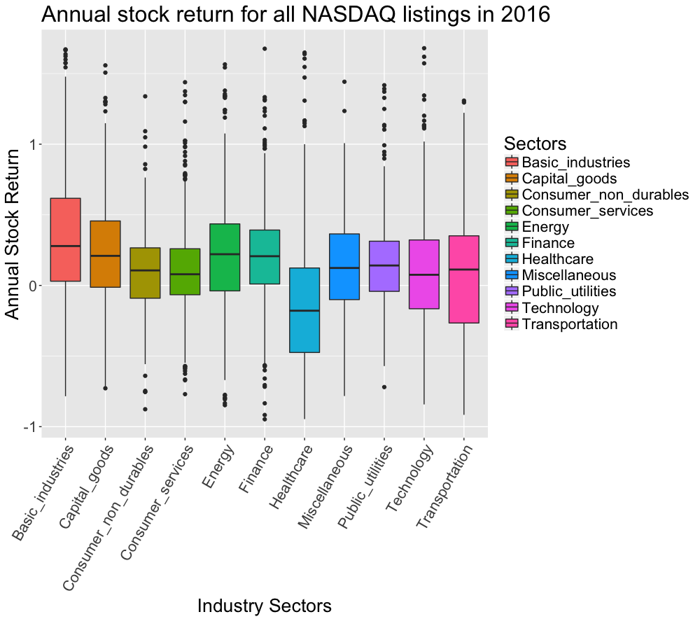

Slide 4
What is the 10-K filings
A 10-K is a comprehensive summary report of a company's performance that must be submitted annually to the Securities and Exchange Commission. Typically, the 10-K contains much more detail than the annual report. It includes information such as company history, organizational structure, equity, holdings, earnings per share, subsidiaries, etc.
The 10-K must be filed within 60 days (it used to be 90 days) after the end of the fiscal year.

Slide 5
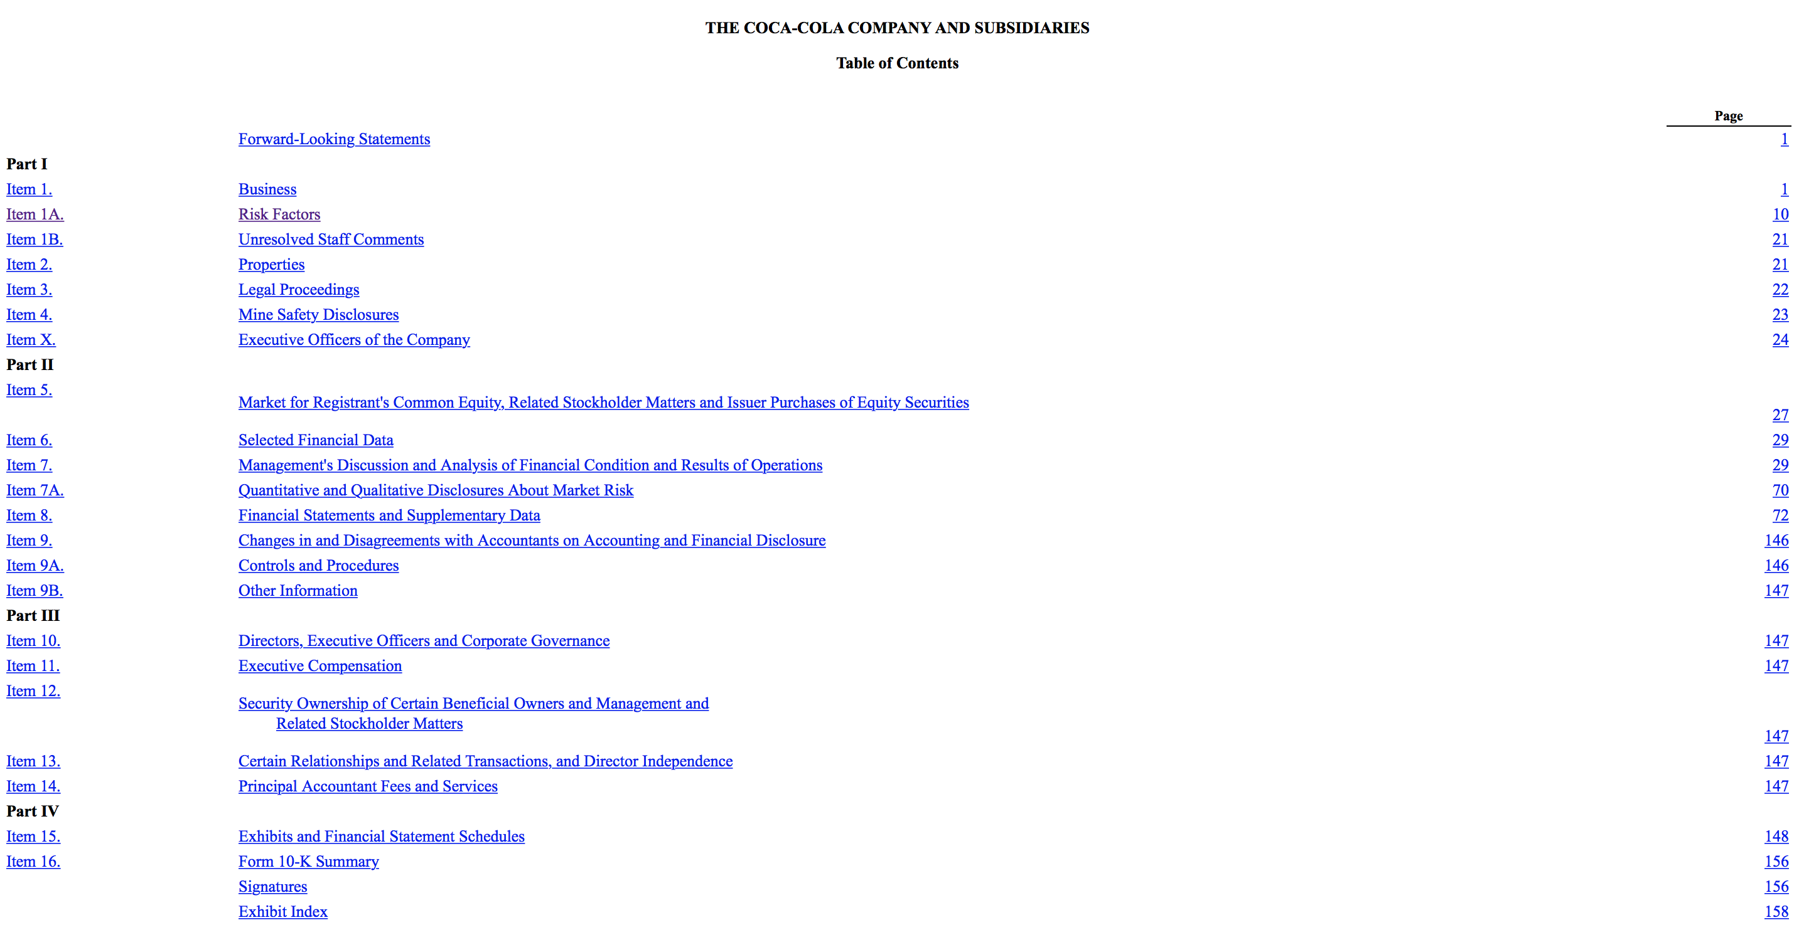

Slide 6
Three indicators used:
Return on assets: Net income / Total assets
Return on assets (ROA) is an indicator of how profitable a company is relative to its total assets. ROA gives an idea as to how efficient management is at using its assets to generate earnings.
Return on equity: Net Income / Shareholder's Equity
Return on equity (ROE) measures a corporation's profitability by revealing how much profit a company generates with the money shareholders have invested.
Current ratio: Current assets / Current liabilities
The current ratio is mainly used to give an idea of the company's ability to pay back its liabilities with its assets, it can be used to take a rough measurement of a company’s financial health.

Slide 7
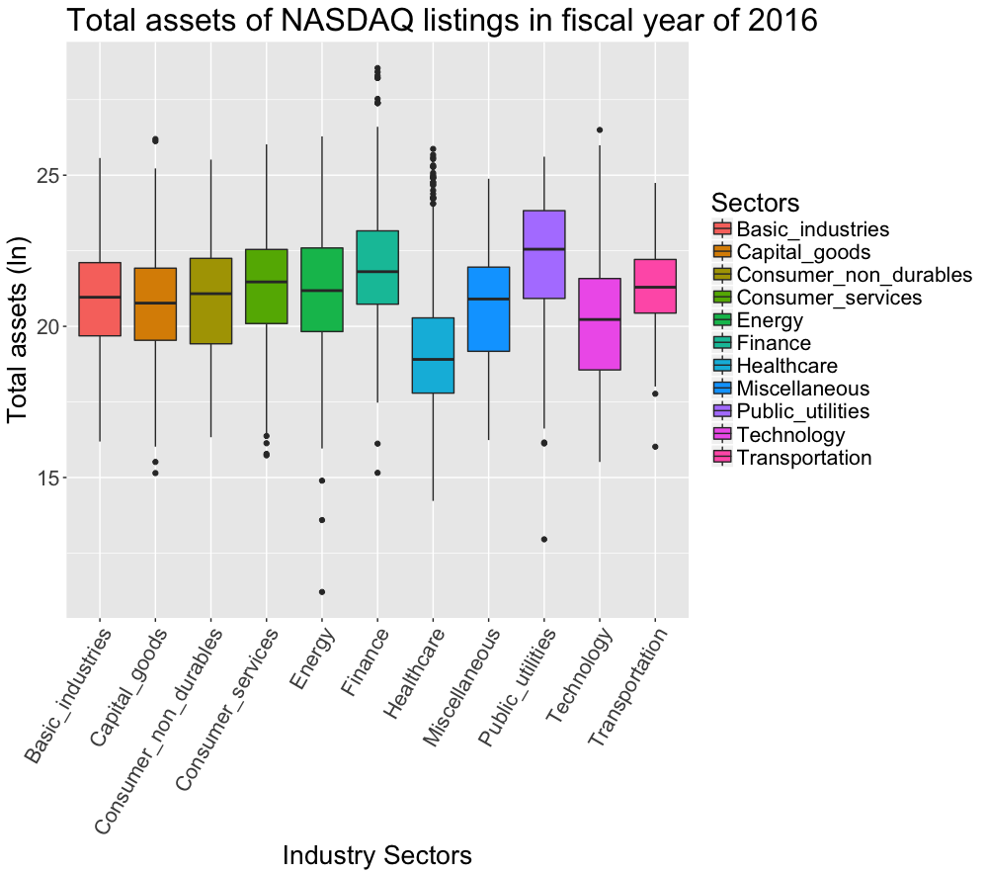

Slide 8
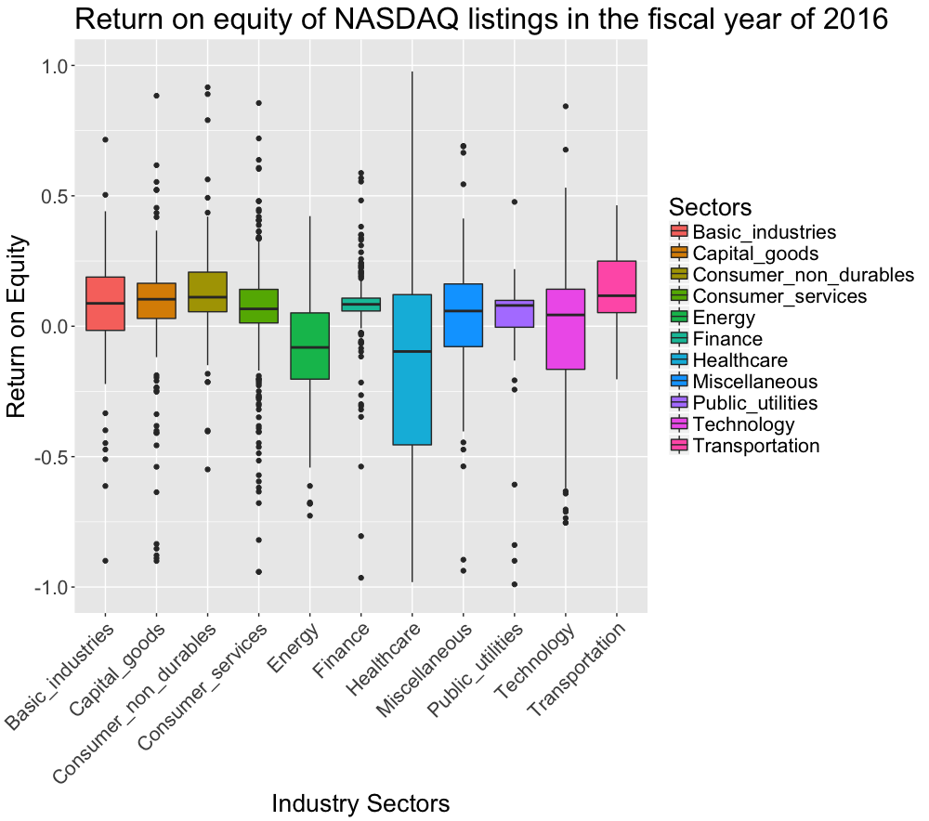

Slide 9
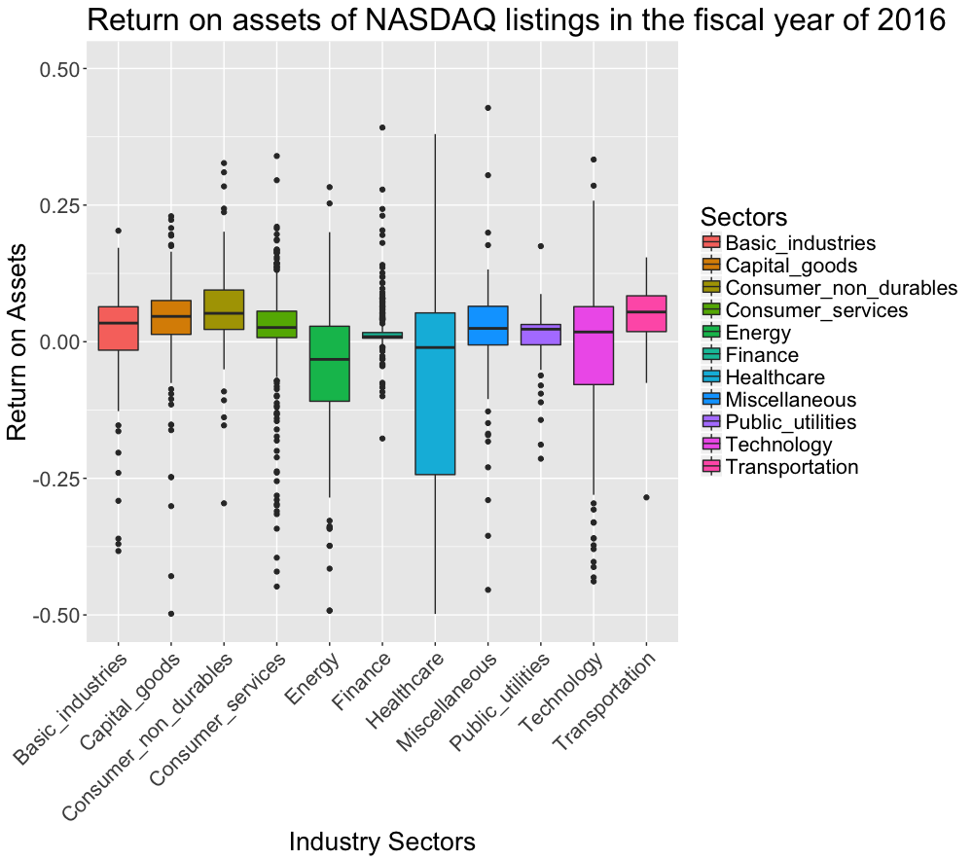

Slide 10
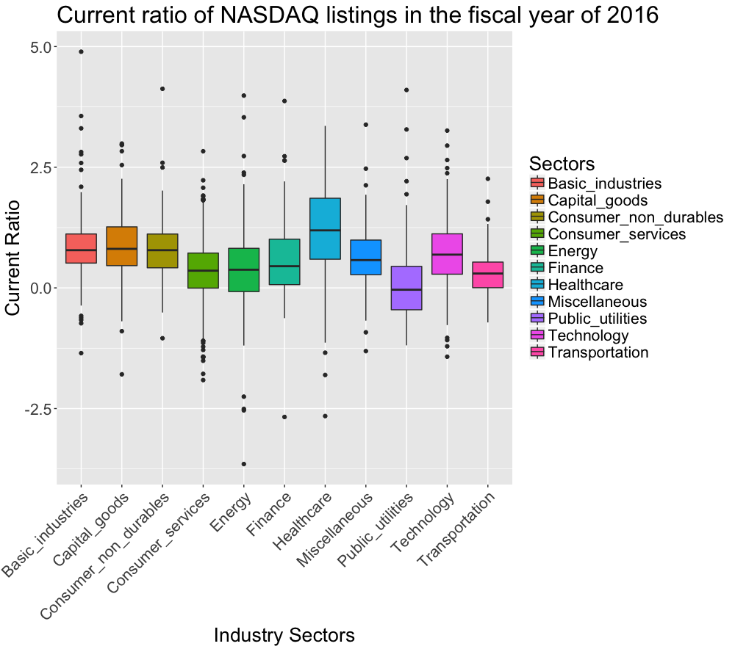

Slide 11
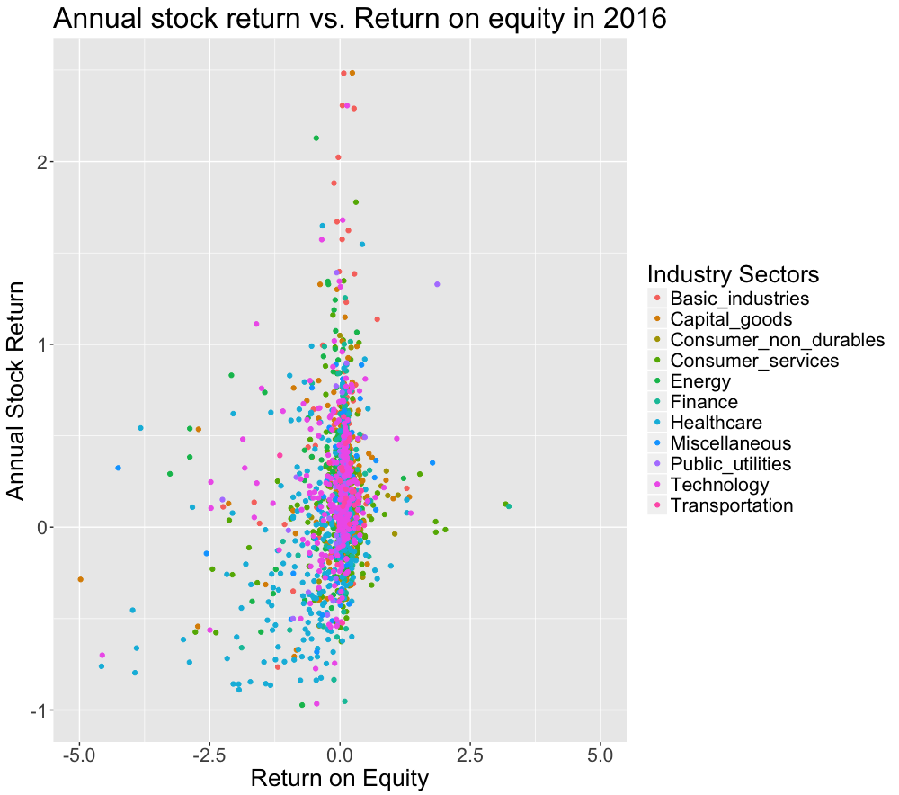

Slide 12
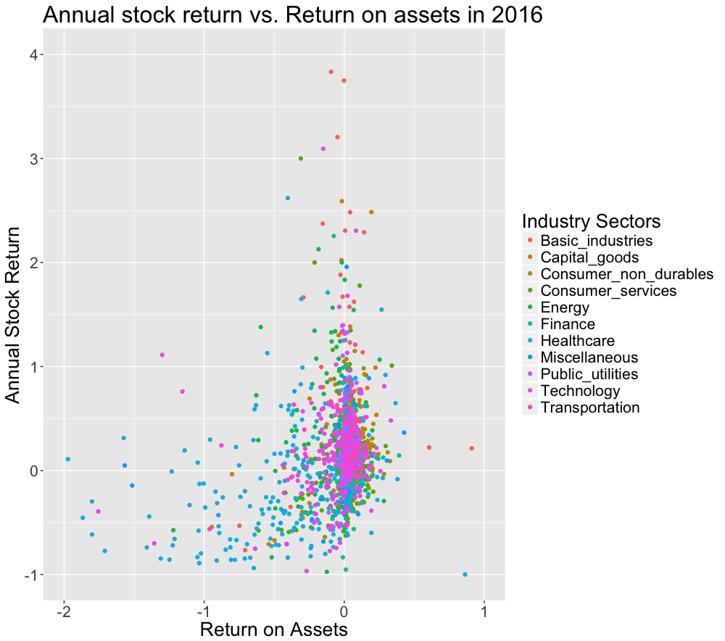

Slide 13
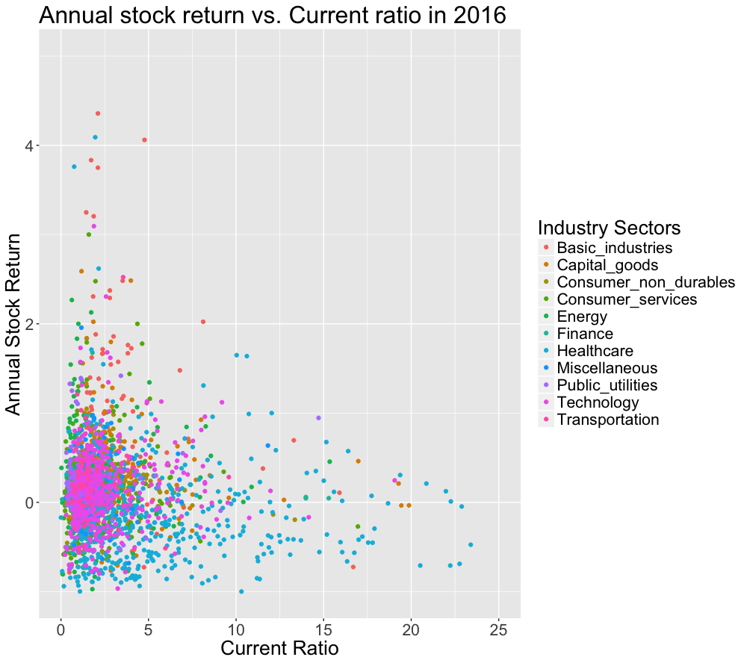

Slide 14
Simple linear regression: Annual stock return vs. Return on equity
Sectors | Intercept | Slope | p-value for Intercept | p-value for slope
Basic Industries | 0.355231621 | 0.18247217 | 1.58E-15 | 0.028546516
Capital Goods | 0.336702101 | 0.126801624 | 4.02E-28 | 0.106128202
Consumer non Durables | 0.225510762 | 0.018302826 | 1.49E-12 | 0.466077375
Consumer services | 0.165893504 | 0.00813999 | 4.33E-30 | 0.494754911
Energy | 0.368675068 | -0.002923266 | 8.07E-10 | 0.855902605
Finance | 0.358726929 | 0.347776918 | 2.06E-60 | 0.006366251
Healthcare | 0.05743789 | 0.200523609 | 0.055878211 | 7.04E-10
Miscellaneous | 0.215358904 | 0.07464239 | 1.89E-05 | 0.231190295
Public Utilities | 0.240638978 | 0.263049961 | 2.72E-12 | 0.000595729
Technology | 0.261536342 | 0.069303433 | 1.04E-22 | 0.095897413
Transportation | 0.373388909 | -0.009137745 | 1.88E-06 | 0.79221854

Slide 15
Simple linear regression: Annual stock return vs. Return on assets
Sectors | Intercept | Slope | p-value for Intercept | p-value for slope
Basic Industries | 0.330594989 | 0.596238709 | 1.66E-15 | 0.004437525
Capital Goods | 0.303064458 | 0.361889481 | 3.36E-30 | 1.58E-05
Consumer non Durables | 0.170056788 | 0.765273808 | 9.45E-07 | 0.012500255
Consumer services | 0.142080656 | 0.69679516 | 7.88E-26 | 1.58E-07
Energy | 0.366266572 | 0.232100176 | 2.70E-13 | 0.281701288
Finance | 0.352035813 | -0.125288529 | 1.03E-71 | 0.72050919
Healthcare | 0.025691108 | 0.299685086 | 0.457359828 | 2.92E-08
Miscellaneous | 0.198963377 | 0.210699384 | 2.89E-05 | 0.156874055
Public Utilities | 0.208522685 | 2.405875682 | 1.58E-14 | 1.31E-06
Technology | 0.252271318 | 0.281154548 | 3.06E-23 | 0.000146544
Transportation | 0.36413647 | -0.229605123 | 4.19E-06 | 0.743215475

Slide 16
Simple linear regression: Annual stock return vs. Current assets
Sectors | Intercept | Slope | p-value for Intercept | p-value for slope
Basic Industries | 0.370656669 | -1.13E-12 | 6.87E-19 | 0.910464037
Capital Goods | 0.305918824 | -2.42E-12 | 7.05E-30 | 0.309531081
Consumer non Durables | 0.215105954 | -1.47E-12 | 2.43E-15 | 0.770846634
Consumer services | 0.167368009 | -2.18E-12 | 2.43E-21 | 0.512133029
Energy | 0.267368348 | 7.92E-13 | 1.51E-10 | 0.940114503
Finance | 0.132306628 | 2.75E-12 | 0.001364733 | 0.497072028
Healthcare | -0.134979771 | 6.94E-12 | 2.72E-07 | 0.096389706
Miscellaneous | 0.238054911 | -6.02E-12 | 1.27E-07 | 0.506012428
Public Utilities | 0.20567902 | 1.01E-11 | 5.27E-13 | 0.245790194
Technology | 0.158163786 | 1.02E-12 | 4.46E-13 | 0.514683949
Transportation | 0.277715154 | 3.14E-13 | 2.53E-06 | 0.985370257

Slide 17
Conclusion
Two financial features can be used to evaluate potential investments:
Return on assets:
Basic Industries / Capital Goods / Consumer non Durables / Consumer services / Healthcare / Public Utilities / Technology;
Return on equity:
Basic Industries / Finance / Healthcare / Public Utilities.
Return on assets is the best way to evaluate a bank.
--Warren Buffett

