Slide 2
From vanilla RAG, we get: INPUT
OUTPUT
Q
P
A
E
A’
Baseline0 – LLM blackbox
gpt3.5,
or 4o,
or 4o-mini,
Or gpt4-turbo
LLM
+ Q
Evidence answer A’
Evidence E
LLM, gpt4-turbo

Slide 3
From vanilla RAG, we get: INPUT
OUTPUT (observation)
Q
P
A
E
A’
S
Jaccard similarity score
Baseline0 – LLM Agent blackbox
gpt3.5
or 4o,
or 4o-mini
S >0.99 or iterate time >= 5:
END
else
LLM
Evaluator
+ Q
Evidence answer A’
Evidence E
LLM, gpt4-turbo
Extra given
Incorect E, A’, S
Ask LLM Evaluator to re-evaluate

Slide 4
From vanilla RAG, we get: INPUT
OUTPUT (observation)
Q
P
A
E
A’
S
Jaccard similarity score
Baseline0 – LLM Agent blackbox
gpt3.5
or 4o,
or 4o-mini
S >0.99 or iterate time >= 5:
END
else
LLM
Evaluator
+ Q
Evidence answer A’
Evidence E
LLM, gpt4-turbo
Giving incorect E, A’, S
Ask LLM Evaluator to analyze reasons for mistankenly generation
(Prompt refine)
Mistakes to avoid
LLM
Reflector

Slide 5
Baseline1 – element search
Q
A
Keep it
Extract its entities, predicates
LLM
gpt3.5
or 4o,
or 4o-mini
+
Search_pool
vectorbase
E
+ Q
Evidenceanswer
search
LLM, gpt4-turbo

Slide 6
From vanilla RAG, we get: INPUT
OUTPUT
Q
P
A
E
A’
Baseline2 – greedy search
Chunk 1
Sentence 1
Iterate over all sentences:
Remove one sentence one time, say sentence i
use left sentences as context for evaluation to get evidence_answer
If evidence_answer == A:
permanently remove sentence I
use updated sentences to continue iterate
Sentence 2
Sentence 3
Chunk 2
…
P
Sentence j
…
…
Sentence k
Chunk 5
…
Finally we get reduced sentences as E
Use Q and E to generate A’
Sentence n

Slide 7
SHT root node
…
SHT node
All ancestor
SHT node
SHT node
SHT node
Sentence w/ keyword
Some adjacent relationships(it, its)
sentence
sentence
sentence

Slide 8
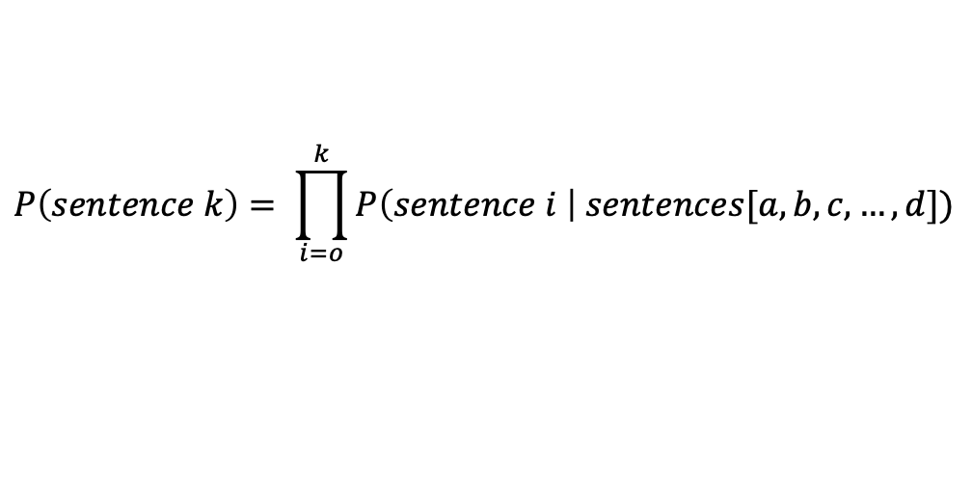
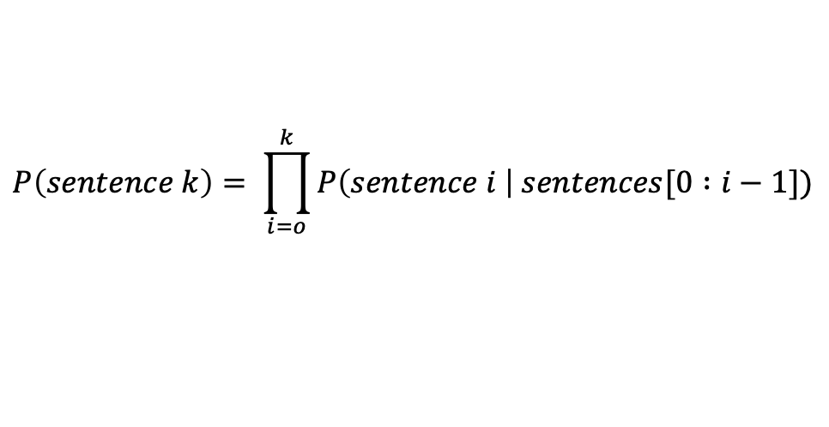
Time step 1
Time step 2
Time step 3
Time step n
*
*
*
Try n times (n is # of sentences)
*
…
*
…
…
…
…
*
Try to remove sentence1, has influence, keep it (star)
Try to remove sentence2, doesn’t have influence, remove it
Try to remove sentence3 given sentence1 has influence, sentence2 no influence. Thus without sentence2 in the context
Obtain ground truth
$$P\left(sentence k\right)= \prod_{i=o}^{k}{P\left(sentence i \right| sentences[0 :i−1])}$$
$$P\left(sentence k\right)= \prod_{i=o}^{k}{P\left(sentence i \right| sentences[a, b, c, …, d])}$$

Slide 9
*
*
Time step 1
…
…
…
…
…
*
Try to remove sentence1, has influence, keep it (star)
Try to remove sentence2, have no prior if sentence1 has influence.
Try to remove sentence3, have no prior if sentence1, 2 have influence.
Try to remove sentencen, have no prior if sentence1:n-1 have influence.
Run in parallel

Slide 10
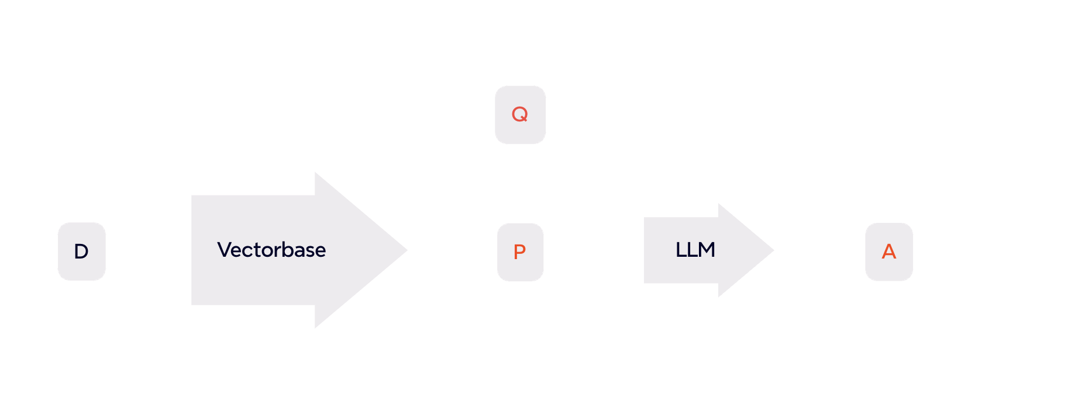
RAG
retrieval
generation
Retrieve relevant context

Slide 11
S1
S2
S3
S4
S5
…
Sn
1. try to remove all the sentences
2. Based on previous result, partition the remaining intervals, try to remove first half and second half of the sentences
1
2
…
[n/2]
[n/2]+1
[n/2]+2
…
n
3. Based on previous result, continue to partition remaining intervals, try to remove each of them
…
…
…
…
... In the final layer, interval degrades to sentence, try each sentence one by one
S1
S2
S3
S4
S5
…
Sn

Slide 12
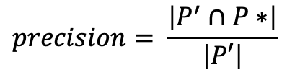
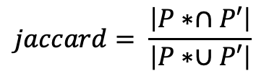
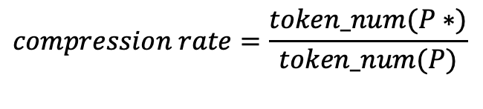
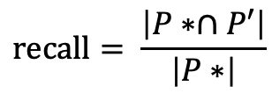
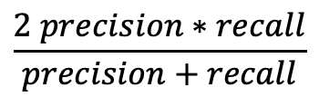
$$compression rate=\frac{token_num(P∗)}{token_num(P)}$$
$$precision= \frac{\left|P^{′}∩P∗\right|}{\left|P′\right|}$$
$$recall= \frac{\left|P∗∩P′\right|}{\left|P∗\right|}$$
$$\frac{2 precision∗recall}{precision+recall}$$
$$jaccard= \frac{\left|P∗∩P′\right|}{\left|P∗∪P′\right|}$$

