Slide 1
Pose 1
Pose 2
Pose 3
Pose 4
Pose 5
Pose 6
Pose 7
Pose 8
End pose 2
End pose 3
End pose 4
End pose 5
End pose 6
End pose 7
End pose 8

Slide 2
Pose 1
Pose 2
Pose 3
Pose 4
Pose 5
Pose 6
Pose 7
Pose 8
End pose 2
End pose 3
End pose 4
End pose 5
End pose 6
End pose 7
End pose 8

Slide 3
Pose 1
Pose 2
Pose 3
Pose 4
Pose 5
Pose 6
Pose 7
Pose 8
End pose 2
End pose 3
End pose 4
End pose 5
End pose 6
End pose 7
End pose 8

Slide 4
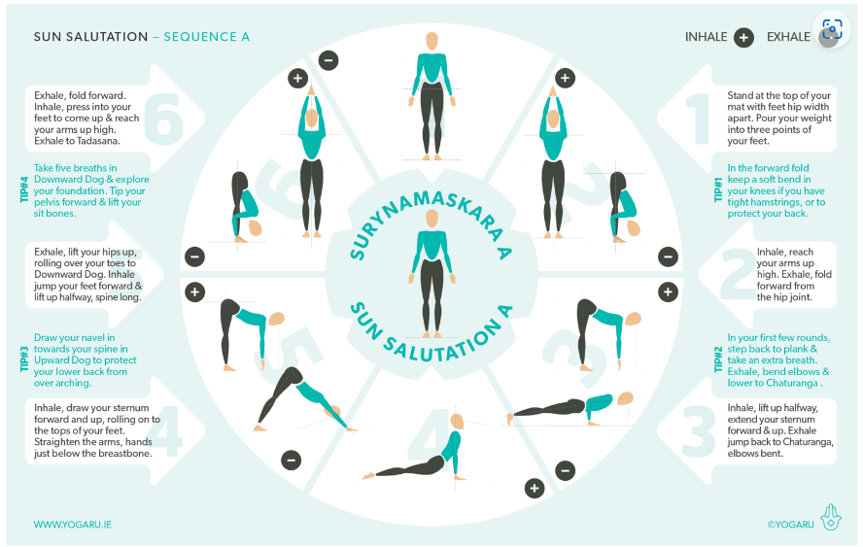
1
2
8
7
3
6
4
5

