Slide 1
What the Fuels and Perimeters Show
LANDFIRE fuels, canopy and disturbance under the dated perimeters and the fireline built on Pioneer 2016, Carr 2018, Camp 2018 and the LNU Lightning Complex 2020
NASA Aerial Wildfire Project | ACERO Disaster Lab working group | 22 October 2026 | For evaluation: what each dataset displays and what it can support

Slide 2
HOW TO READ THESE SLIDES
Three datasets, layered on the same map
LANDFIRE 2016 Remap
Dated perimeters
Fireline and operations
30 m maps of fuel model (Scott and Burgan 40), canopy cover, height, base height, bulk density, vegetation type and recent disturbance. Circa-2016 conditions: pre-fire for Carr, Camp and LNU; post-fire for Pioneer.
NIFC GeoMAC perimeter history for Pioneer (89), Carr (63) and Camp (28); NASA FEDS 12 h satellite perimeters for LNU (180). Light lines are early, dark lines are late. No GOFER.
NIFC Operational Data Archive: completed dozer and hand line, road used as line, safety zones, helispots and landing areas, as they stood on the incident map on one day near the end of each fire.
Read with care: fuel loads are what each fuel model assigns, not measurements, and fuel classifications explain little of measured loading (R2 below 0.30; Keane et al., 2013). Pioneer's LANDFIRE map is after the fire. Fireline dates are when lines were mapped, not when they were cut.
NASA Aerial Wildfire Project | ACERO Disaster Lab | Perimeters and LANDFIRE | 22 October 2026
2

Slide 3
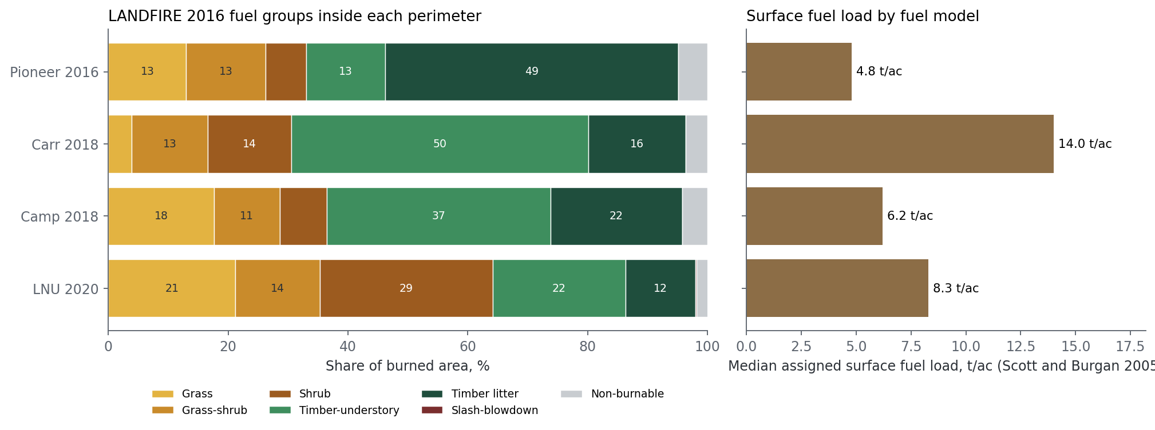
ACROSS THE FOUR FIRES
Timber at Carr and Camp, shrub and grass at LNU
Fire | Canopy area | Cover | CBH | Load
Pioneer | 39% | 25% | 4.1 m | 4.8 t/ac
Carr | 81% | 55% | 1.6 m | 14.0 t/ac
Camp | 71% | 45% | 1.0 m | 6.2 t/ac
LNU | 53% | 45% | 1.5 m | 8.3 t/ac
Carr carries the heaviest assigned surface load (median 14 t/ac) because half its area is TU5, conifer litter under shrubs.
Canopy base heights of 1 to 2 m on the California fires mean low canopy that surface fire can climb.
Pioneer values are post-fire.
NASA Aerial Wildfire Project | ACERO Disaster Lab | Perimeters and LANDFIRE | 22 October 2026
3

Slide 4
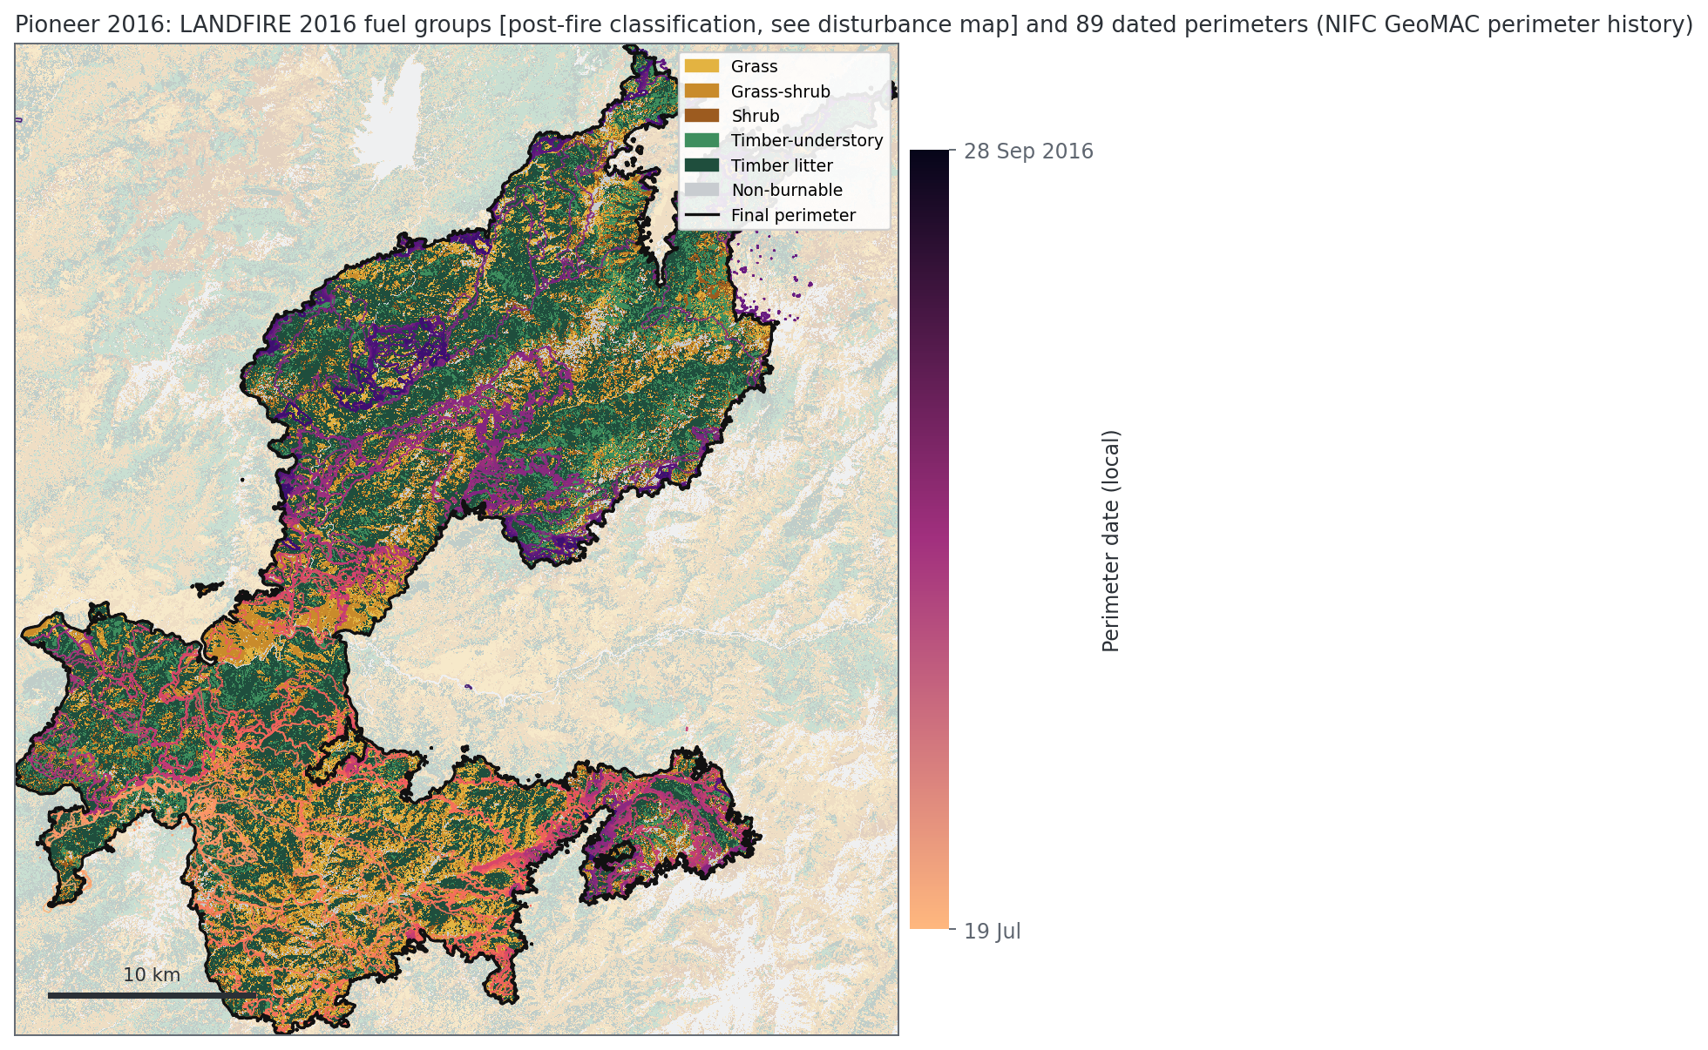
PIONEER 2016 | FUELS AND PERIMETERS
Pioneer: LANDFIRE shows what the fire left, not what it burned
What the picture shows
• LANDFIRE 2016 classifies this area after the fire: the disturbance layer marks 99% of it as burned in the prior 2 to 5 years, and 62% of the vegetation as 'Recently Burned-Herb and Grass Cover'.
• So the fuel models here (TL3 conifer litter 23%, TL6 broadleaf litter 20%, grass and grass-shrub 26%) describe what was left, not what burned.
• The dated perimeters fill the southern lobe first (light) and the northern lobe late (dark), consistent with the late-August northeastward run in the case-study record.
Fuel groups from LANDFIRE LF2016 FBFM40. Perimeter colors run light (early) to dark (late).
NASA Aerial Wildfire Project | ACERO Disaster Lab | Perimeters and LANDFIRE | 22 October 2026
4

Slide 5
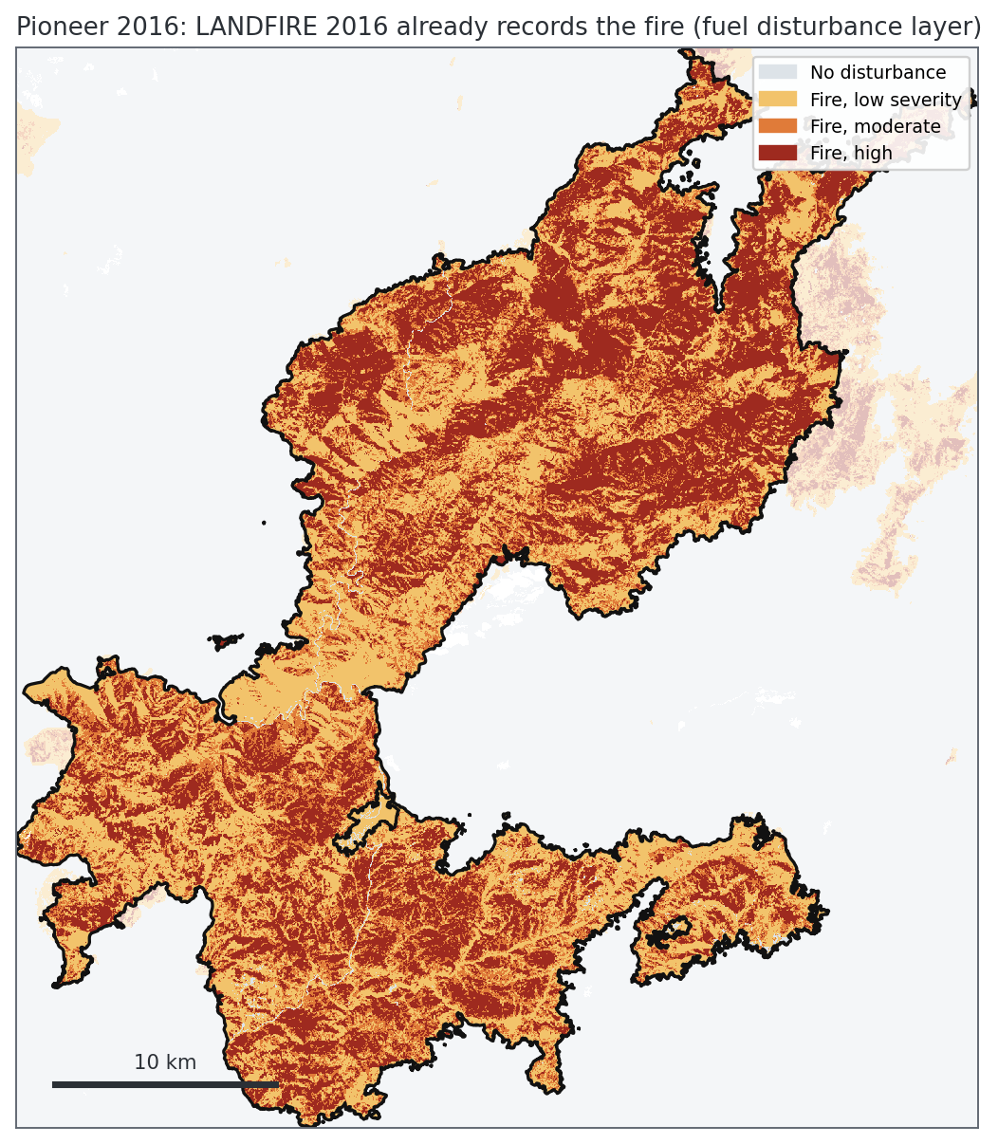
PIONEER 2016 | DISTURBANCE
Pioneer: the 2016 map already records the burn
What the picture shows
• The disturbance map is the evidence: almost every pixel inside the final perimeter carries a fire code, with high, moderate and low severity interleaved.
• A pre-fire picture needs LANDFIRE 2014 (archived; the LANDFIRE viewer, not the image service).
• No public fireline archive exists for 2016; incident GIS has to come through the Pioneer FOIA.
LANDFIRE LF2016 fuel disturbance (FDist), fire severity classes.
NASA Aerial Wildfire Project | ACERO Disaster Lab | Perimeters and LANDFIRE | 22 October 2026
5

Slide 6
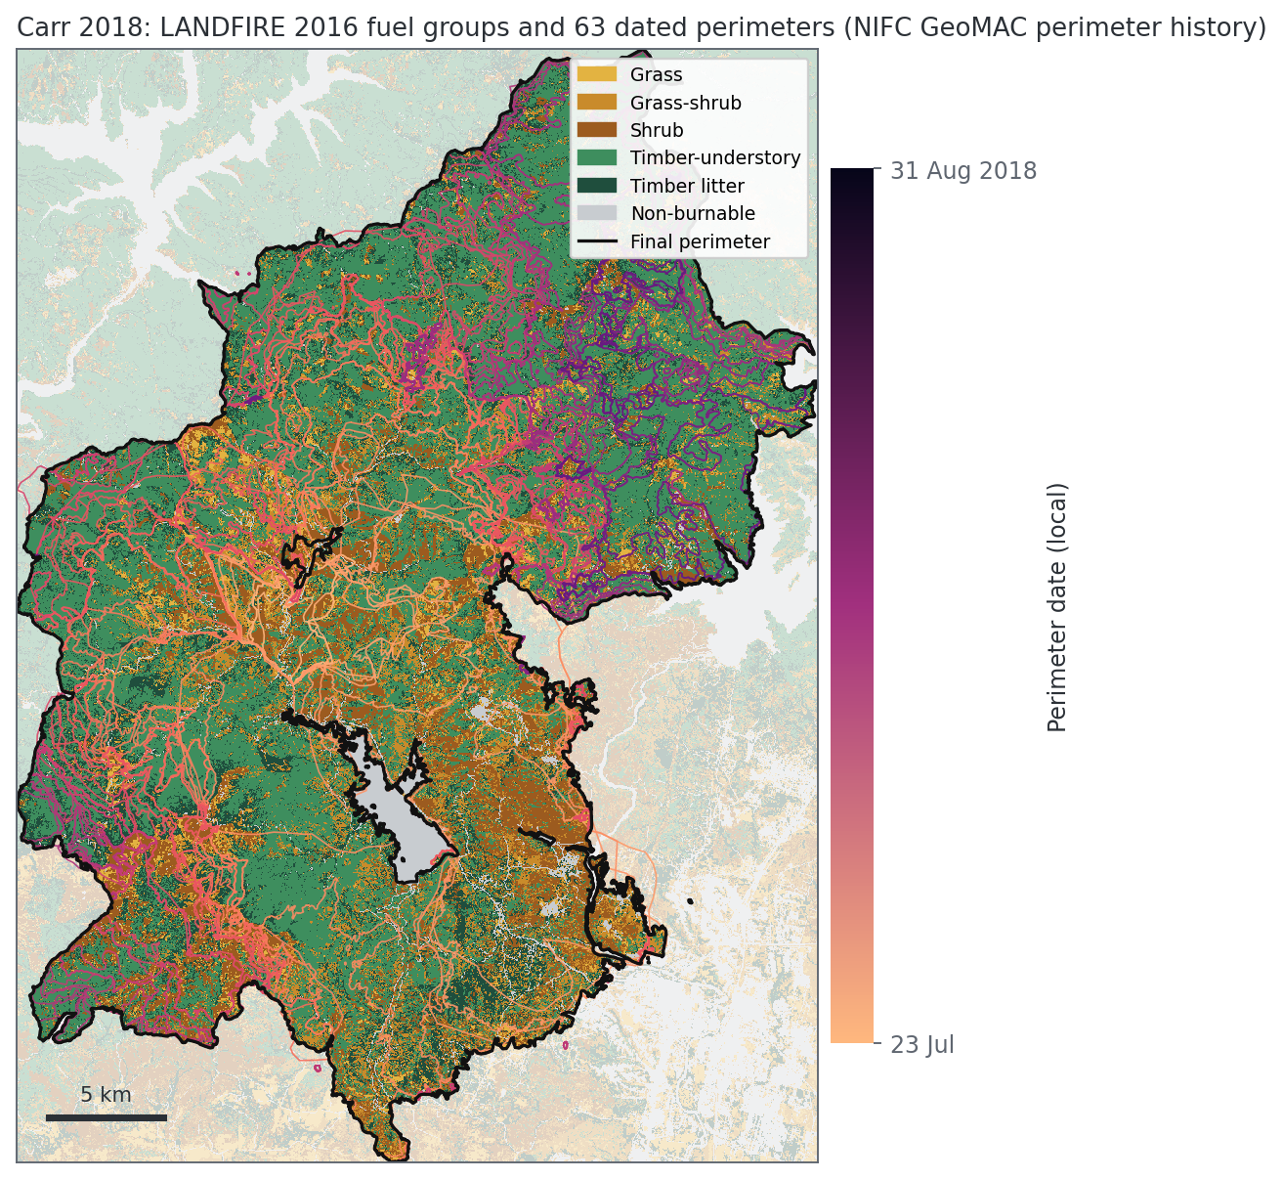
CARR 2018 | FUELS AND PERIMETERS
Carr: heavy timber litter under shrubs, nearly all pre-fire
What the picture shows
• Half the area (49%) is TU5, heavy conifer litter under shrubs and small trees, the heaviest common model here at 14 t/ac assigned surface load.
• Shrub (14%) and grass-shrub (13%) fill the lower slopes; Whiskeytown Lake is the non-burnable hole in the middle.
• The 63 dated perimeters thicken in the south early and expand the north late; LANDFIRE marks 97% of the area as undisturbed in the 10 years before 2016, so this is a pre-fire picture.
Fuel groups from LANDFIRE LF2016 FBFM40. Perimeter colors run light (early) to dark (late).
NASA Aerial Wildfire Project | ACERO Disaster Lab | Perimeters and LANDFIRE | 22 October 2026
6

Slide 7
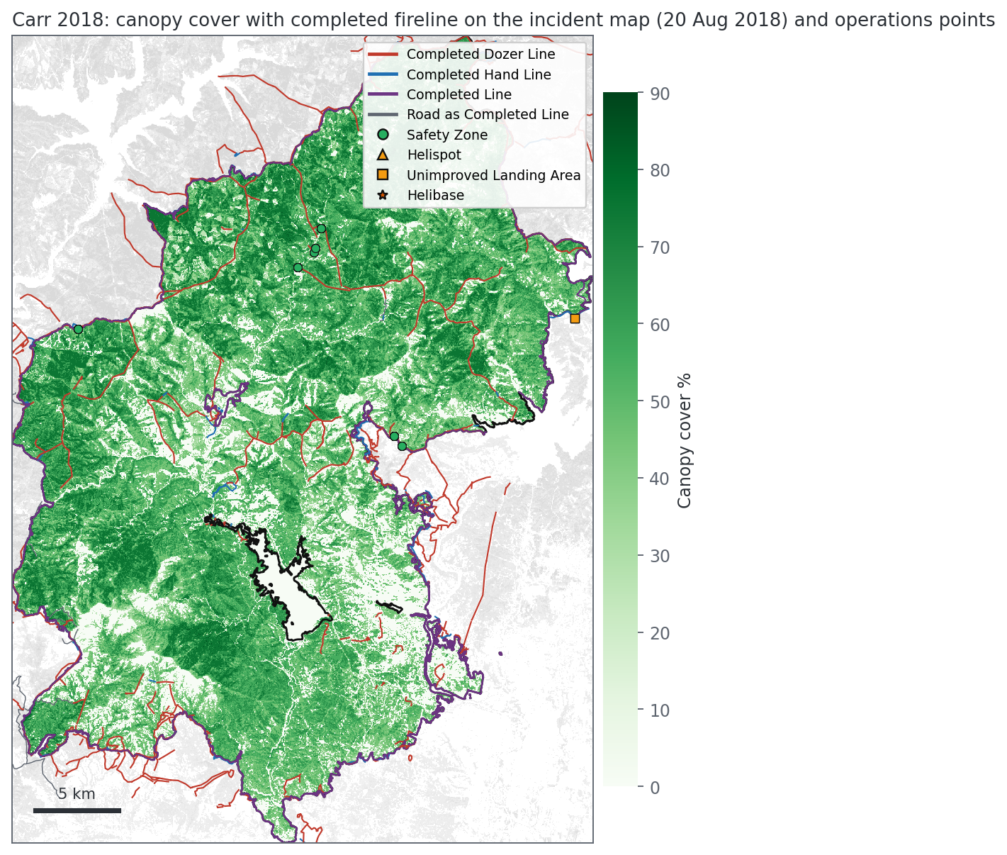
CARR 2018 | CANOPY AND FIRELINE
Carr: dense low canopy and about 306 miles of dozer line
What the picture shows
• Canopy covers 81% of the area (median cover 55%, canopy base height median 1.6 m): low, continuous canopy that lets surface fire climb.
• By 20 Aug the incident map held about 306 mi of completed dozer line and 30 mi of hand line, much of it cut through the interior as well as along the edge.
• The incident map also carried 94 safety zones, 8 helispots and 6 unimproved landing areas (points on the map): ready-made checkpoints for an overhead drone.
Canopy cover from LANDFIRE LF2016. Lines and points from the NIFC Operational Data Archive, as on the incident map on 20 Aug 2018.
NASA Aerial Wildfire Project | ACERO Disaster Lab | Perimeters and LANDFIRE | 22 October 2026
7

Slide 8
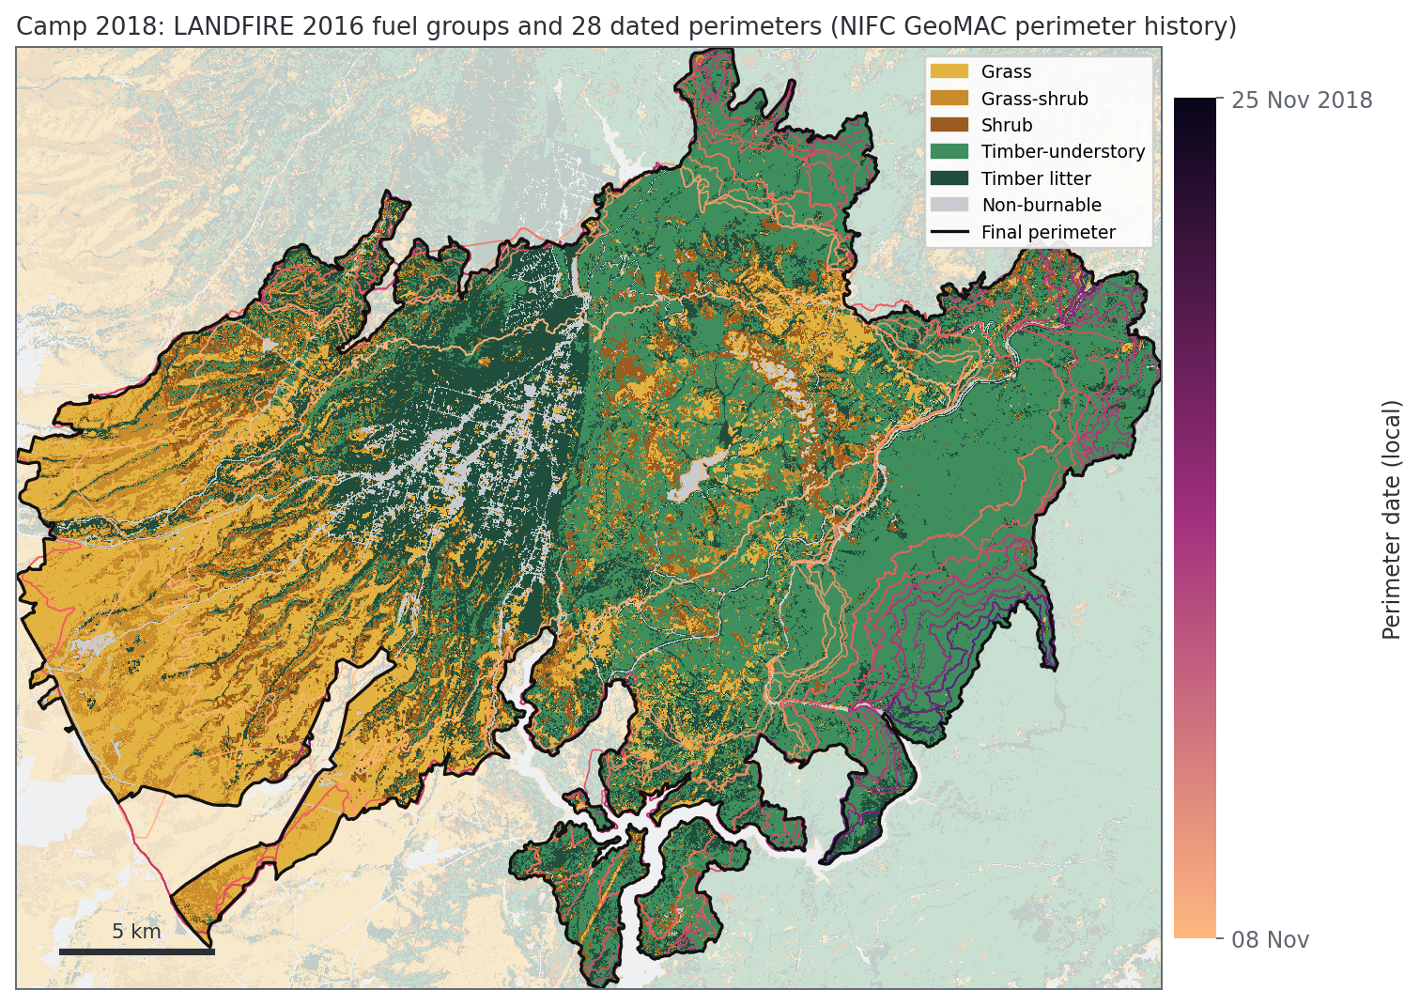
CAMP 2018 | FUELS AND PERIMETERS
Camp: grass to the west, timber to the east
What the picture shows
• Two landscapes: grass and grass-shrub (29% together) on the lower western slopes toward the valley, and timber with shrub understory (TU5, 36%) on the higher eastern ridges.
• A straight north-south boundary in the middle, where timber litter switches to timber-understory, looks like a LANDFIRE map-zone seam, not a real vegetation edge.
• LANDFIRE marks 98% of the area as undisturbed before 2016, so this is a pre-fire picture; the town of Paradise shows as timber and non-burnable (LANDFIRE codes developed land as non-burnable), so structure-to-structure spread is invisible in these fuels.
Fuel groups from LANDFIRE LF2016 FBFM40. Perimeter colors run light (early) to dark (late).
NASA Aerial Wildfire Project | ACERO Disaster Lab | Perimeters and LANDFIRE | 22 October 2026
8

Slide 9
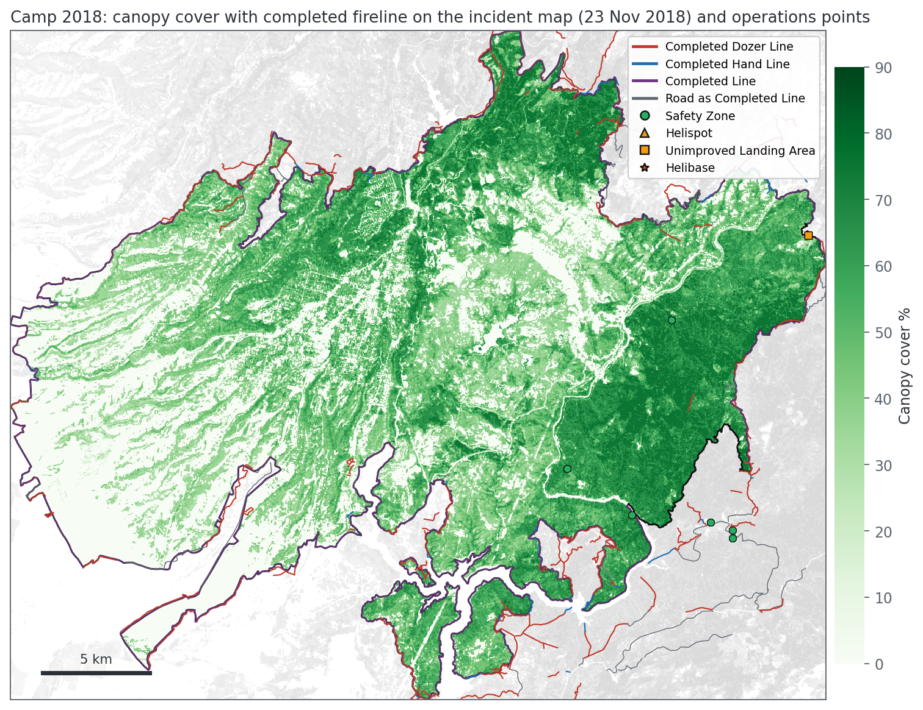
CAMP 2018 | CANOPY AND FIRELINE
Camp: line built where the fire met forest and canyons
What the picture shows
• Canopy covers 71% of the area (median cover 45%) and is densest in the east; the west is open grass.
• By 23 Nov the incident map held about 145 mi of completed dozer line and 16 mi of hand line; dozer line is concentrated on the eastern and southern edges, where the fire met forest and canyons.
• Few operations points are in the archive, and no line features at all from 13 to 18 Nov.
Canopy cover from LANDFIRE LF2016. Lines and points from the NIFC Operational Data Archive, as on the incident map on 23 Nov 2018.
NASA Aerial Wildfire Project | ACERO Disaster Lab | Perimeters and LANDFIRE | 22 October 2026
9

Slide 10
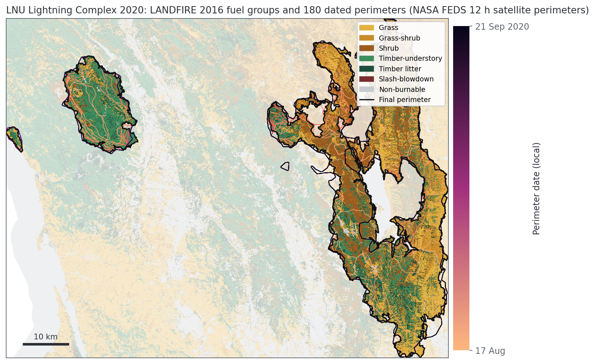
LNU 2020 | FUELS AND PERIMETERS
LNU: chaparral and grass at Hennessey, timber at Walbridge
What the picture shows
• The complex is a mix: shrub (29%), timber-understory (22%), grass (21%) and grass-shrub (14%); Hennessey in the east is grass and shrub (chaparral), Walbridge in the west is timber.
• Assigned surface load is median 8.3 t/ac, with the heavy shrub SH7 (17%) and TU5 (17%) driving the high end.
• The 180 FEDS satellite perimeters (12 h) outline both fires; LANDFIRE marks 88% of the area undisturbed and about 9% as burned in the 2 to 5 years before 2016 (earlier fires inside the footprint).
Fuel groups from LANDFIRE LF2016 FBFM40. Perimeter colors run light (early) to dark (late).
NASA Aerial Wildfire Project | ACERO Disaster Lab | Perimeters and LANDFIRE | 22 October 2026
10

Slide 11
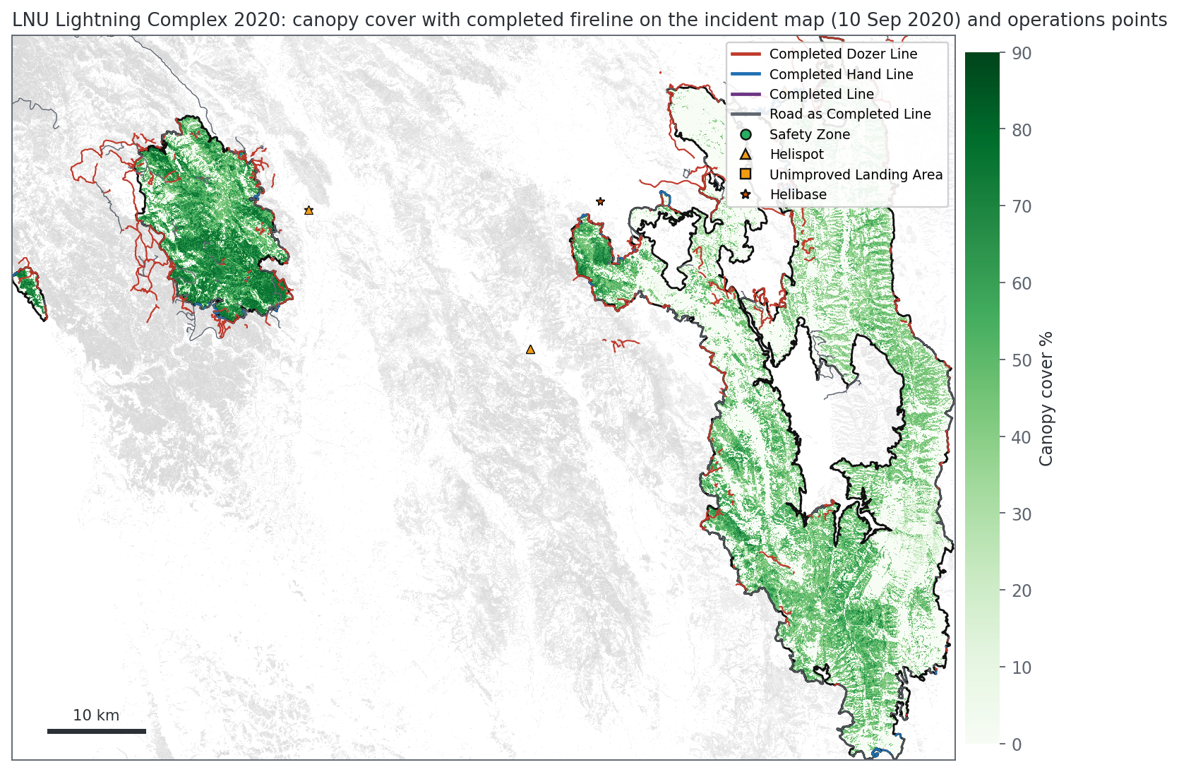
LNU 2020 | CANOPY AND FIRELINE
LNU: dozer line rings Walbridge; roads served as line
What the picture shows
• Canopy covers 53% of the area: dense forest at Walbridge, open woodland and chaparral at Hennessey.
• By 10 Sep the incident map held about 298 mi of completed dozer line, 25 mi of hand line and 239 mi of road used as line; uncontrolled edge had fallen from 486 mi (20 Aug) to zero.
• Walbridge is ringed by dozer line; across the complex 239 mi of road served as containment line.
Canopy cover from LANDFIRE LF2016. Lines and points from the NIFC Operational Data Archive, as on the incident map on 10 Sep 2020.
NASA Aerial Wildfire Project | ACERO Disaster Lab | Perimeters and LANDFIRE | 22 October 2026
11

Slide 12
WHAT THE PICTURE PAINTS
Fuels set where fire could go; the record shows where people worked
Two kinds of landscape
Containment followed access
Timber with a shrub understory (Carr, Camp east, Walbridge) and grass, grass-shrub and chaparral (Camp west, Hennessey). The California fires sit on low canopy over heavy litter.
Completed line hugs roads, ridges and the forest edge: about 306 mi of dozer line at Carr, 145 mi at Camp, 298 mi plus 239 mi of road at LNU.
The data have different clocks
Where drones fit
LANDFIRE is circa 2016, perimeters are hours to a day apart, fireline is when it was mapped. Every comparison has to name its time.
Fuel maps say which flanks run fast (grass, shrub); canopy and slope say where ground crews and line are slow; safety zones and landing areas are already mapped and can be checked from the air.
NASA Aerial Wildfire Project | ACERO Disaster Lab | Perimeters and LANDFIRE | 22 October 2026
12

Slide 13
DATA QUALITY
What these pictures cannot tell us yet
Pioneer is post-fire
Loads are assigned
FCCS 'Bare Ground'
LF 2016 marks 99% of the area fire-disturbed. Need LF 2014.
Scott and Burgan model loads, not field measurements; classification R2 below 0.30.
Most of those pixels carry grass fuel models (56% Camp, 62% LNU).
Map-zone seam
Canopy base height cap
Fireline re-posts
Straight north-south fuel boundary across Camp is an artifact.
p90 is 10 m on every fire: the upper tail is censored.
Daily re-posts inflate totals; we use one-day snapshots. No archive before 2018.
NASA Aerial Wildfire Project | ACERO Disaster Lab | Perimeters and LANDFIRE | 22 October 2026
13

Slide 14
NEXT STEPS
Turning the pictures into measurements
1. Download LANDFIRE 2014 for Pioneer (LANDFIRE viewer) and redo its fuels as pre-fire.
2. Measure miles of fireline built in each fuel group and slope class, per day.
3. Compare LF 2016 with LF 2019 Limited at LNU to capture the 2017 and 2018 fires inside its footprint.
4. Run fire behavior per fuel model with the peak-day fuel moisture already in the project (RAWS, gridMET).
5. Request Pioneer incident GIS (fireline, IAP maps) through the FOIA.
NASA Aerial Wildfire Project | ACERO Disaster Lab | Perimeters and LANDFIRE | 22 October 2026
14

