Slide 1
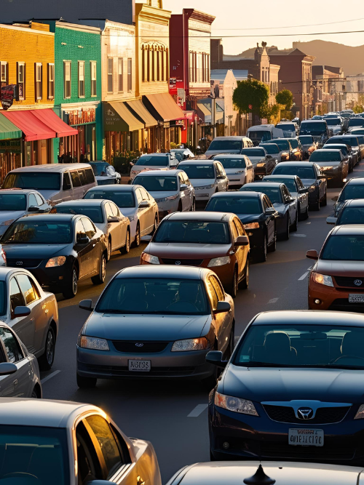
Minnesota Interstate Traffic Volume
An analysis of traffic patterns on interstate highways

Slide 2

Traffic congestion continues to grow… with no end in sight

Slide 3
Analyzing the data in 4 different charts
Monthly Volumes
Viewing the monthly traffic patterns allows us to find any potential trends by Month.
Hourly Volumes
Viewing the hourly traffic patterns allows us to find any potential trends by hour.
Weather Types
Weather can have an impact on many things, including traffic.
Holiday Travel
Our roads may see more travelers (including out of state) than expected.

Slide 4
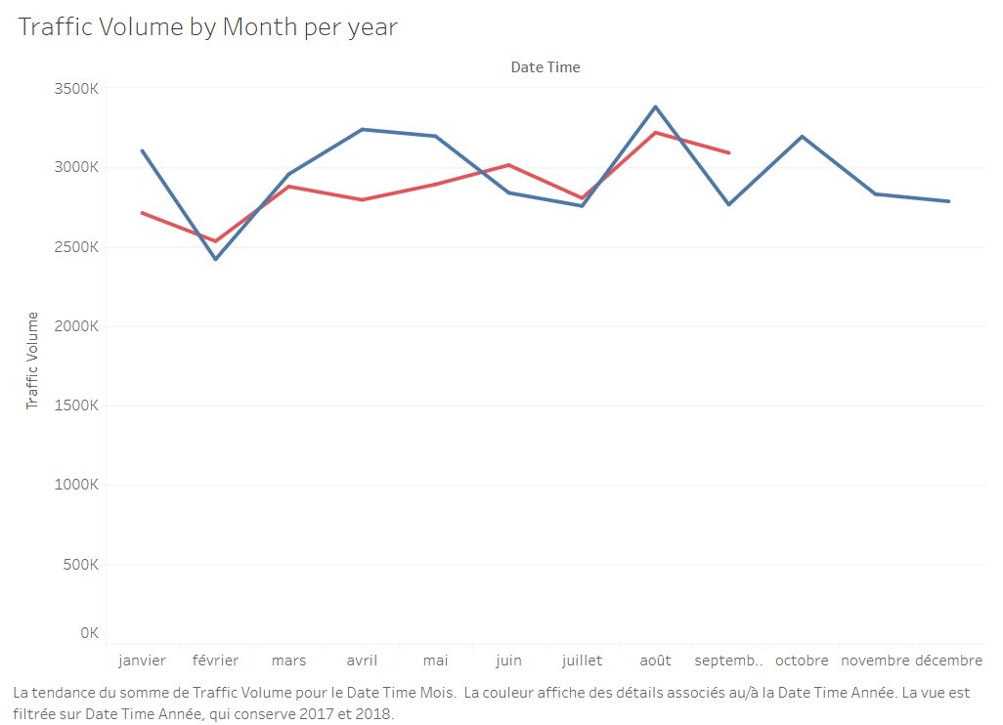
Monthly Traffic Volumes
Insights
Chart
August - Highest volume, possible end of summer seasonal traffic.
February - Lowest volume, best possible month for construction changes.
April - Significant decrease in 2018.
Fairly consistent/predictable patterns.

Slide 5
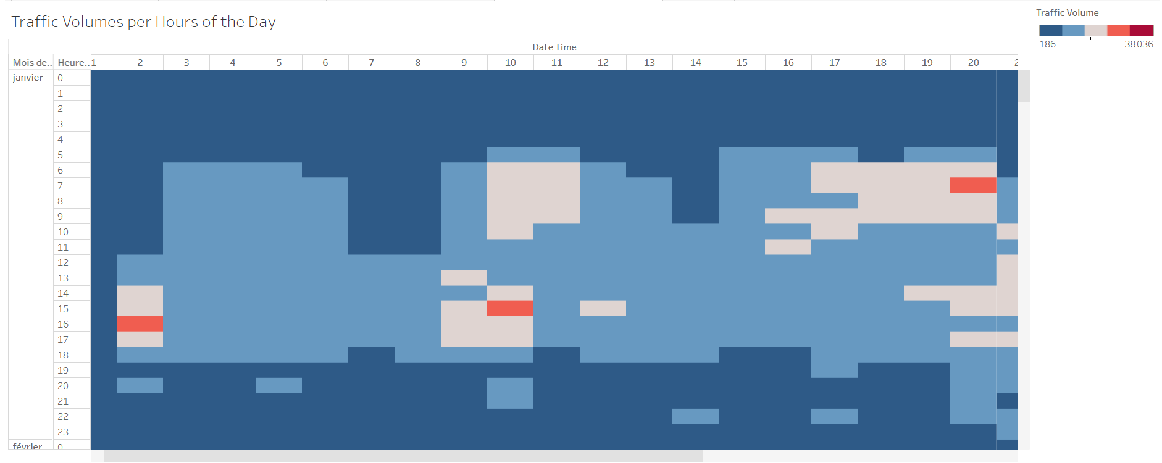
Hourly Traffic Volumes
Insights
Chart
Patterns are reflected during the busiest travel times: rush hours to and from work.
A day with a holiday does not have a significantly higher or lower traffic volume throughout the day.
Holidays do not impact hourly traffic volume.

Slide 6
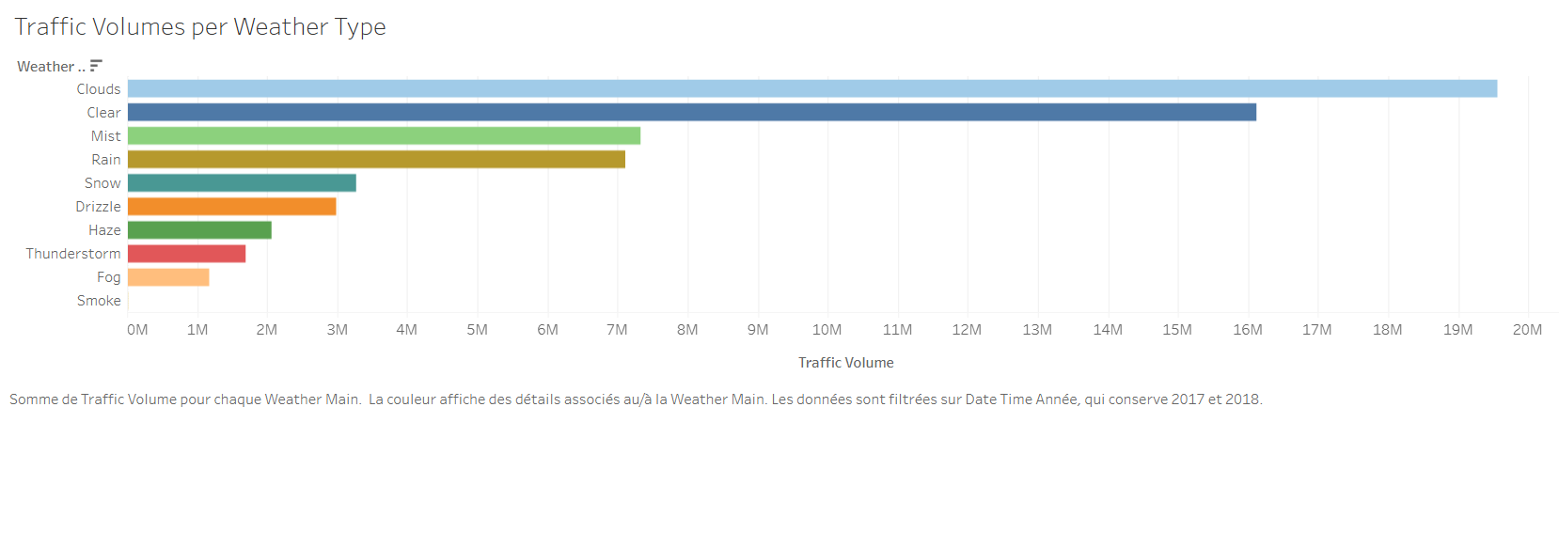
What Role Does Weather Play?
Insights
Chart
Clear/cloudy conditions result in the highest traffic volume.
Low-visibility conditions result in the lowest traffic volume.
Precipitation has a significant impact on traffic volume, though a surprising number of motorists continue to drive in rain.
What can we do to alleviate traffic issues on rainy days?

Slide 7
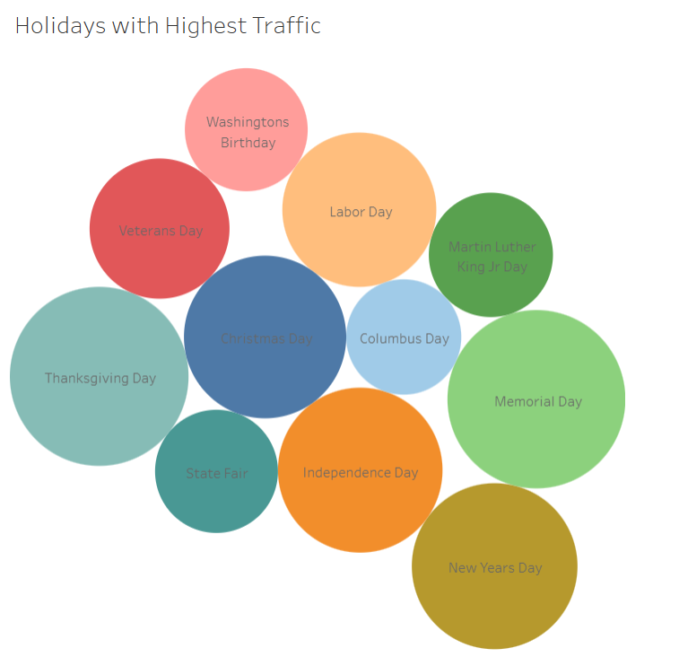
Holiday Travel
Insights
Chart
August - State fair starting in August.
January - High traffic on New Years and Martin Luther King Jr. Day contribute to most of January’s total.
Most holidays have little impact on total traffic volume.

Slide 8
Thank You

