Slide 1

DVF Switch Study Report
Dou Xin
2010-08-09

Slide 2

Table of DVF Switch Study Report
Script usage
Switch generate flow
Script related
CONFIDENTIAL
CONFIDENTIAL

Slide 3
Script usage
1. Do not generate DVF.xls on the swdb server !
2. put DVF.xls on VNC server . please see mine :
[bjslnx16/dp660_vyp1140a_T6719_338] ~ $ ls | grep DVF
DVF.xls
3. go to /vobs/package241/swcmtools/modules/cmdagt/srce
4. DVF.pl -i ~/DVF.xls -p 6719 -l VYP1140A-T6719_E148B_TDV3.3.8
    -i : input file , previous delivery version form (Excel format)
    -p : DDTS product(s) related to this DVF
    -l : label name of the previous project version
    -h : show the help file
CONFIDENTIAL

Slide 4
Table of DVF Switch Study Report
Script usage
Switch generate flow
Script related
CONFIDENTIAL
CONFIDENTIAL

Slide 5
Switch generate flow
A. DVF.pl
B. transfer the Wrapper.pm
C. transfer the Twiddle.pm
D. transfer the DVF_XLS_parser
E. transfer the Switches_audit.pm
F. transfer the Write_Switches_XLS
CONFIDENTIAL

Slide 6
Table of DVF Switch Study Report
Script usage
Switch generate flow
Script related
CONFIDENTIAL
CONFIDENTIAL

Slide 7
Script related
DVF.pl
Wrapper.pm
Twiddle.pm
DVF_XLS_parser.pm
Switches_audit.pm
Write_Switches_XLS.pm
CONFIDENTIAL

Slide 8
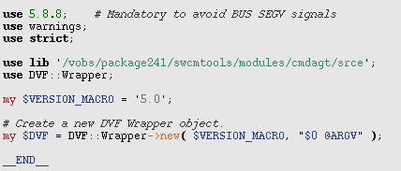
DVF.pl
Set the path
Use the wrapper.pm under DVF directory
CONFIDENTIAL

Slide 9
Script related
DVF.pl
Wrapper.pm
Twiddle.pm
DVF_XLS_parser.pm
Switches_audit.pm
Write_Switches_XLS.pm
CONFIDENTIAL

Slide 10
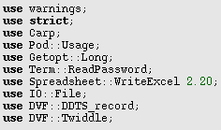
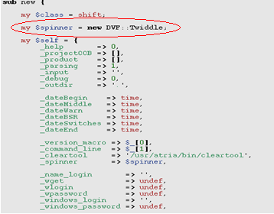
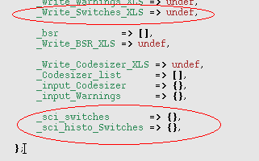
Wrapper.pm
Define
Constructor---------------->switches
CONFIDENTIAL

Slide 11

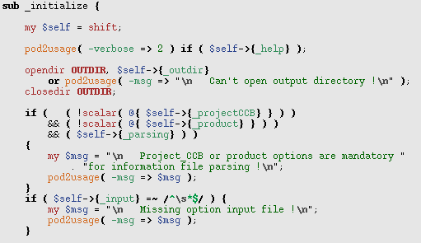
Wrapper.pm
Initialize
check the parameter
CONFIDENTIAL

Slide 12
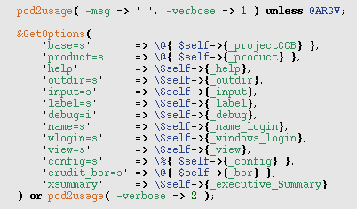
Wrapper.pm
Get parameter
CONFIDENTIAL

Slide 13
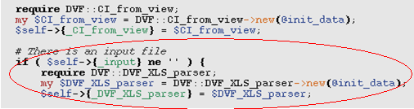
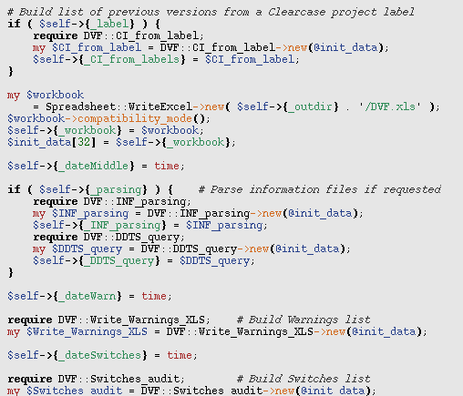

Wrapper.pm
Build list
Transfer more packages
  CI_from_view
  DVF_XLS_parser
  CI_from_label
  Spreadsheet::WriteExcel
  INF_parsing
  DDTS_query
  ……
  Switches_audit
CONFIDENTIAL

Slide 14
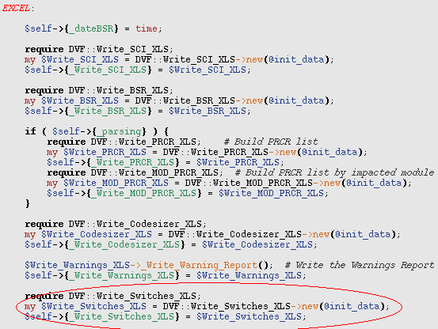
Wrapper.pm
Write information to the EXL
Transfer packages
  Write_SCI_XLS
  Write_BSR_XLS
  Write_PRCR_XLS
  Write_MOD_PRCR_XLS
  Write_Codesizer_XLS
  ……
  Write_Switches_XLS
CONFIDENTIAL

Slide 15
Script related
DVF.pl
Wrapper.pm
Twiddle.pm
DVF_XLS_parser.pm
Switches_audit.pm
Write_Switches_XLS.pm
CONFIDENTIAL

Slide 16

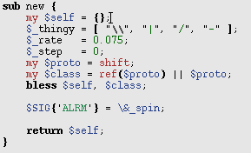
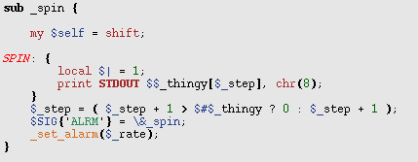
Twiddle.pm
Time::HiRes qw( setitimer getitimer )
Make a twiddle(\,|,/,-)
CONFIDENTIAL

Slide 17
Script related
DVF.pl
Wrapper.pm
Twiddle.pm
DVF_XLS_parser.pm
Switches_audit.pm
Write_Switches_XLS.pm
CONFIDENTIAL

Slide 18
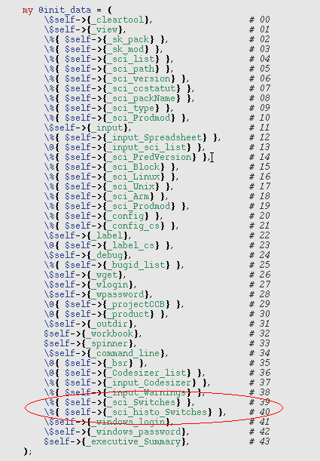
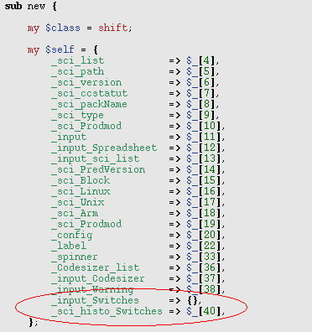
DVF_XLS_parser.pm
Transfer parameter
(from Wrapper.pm)
CONFIDENTIAL

Slide 19
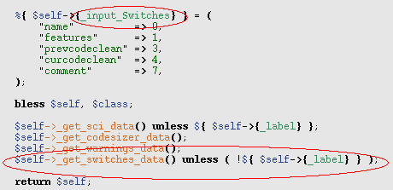
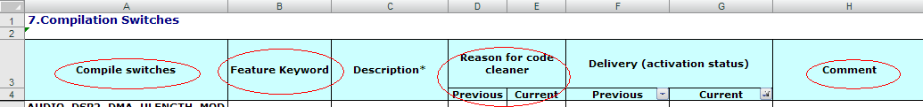
DVF_XLS_parser.pm
Define _input_Switches
CONFIDENTIAL

Slide 20
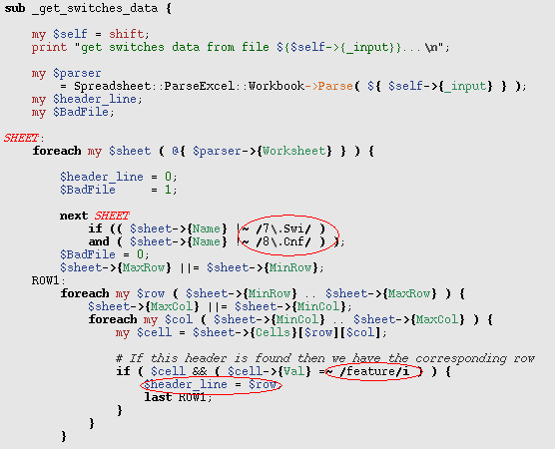
DVF_XLS_parser.pm
Find the right page
----7.Swi/8.Cnf
Find the right row
----Feature Keyword
CONFIDENTIAL

Slide 21
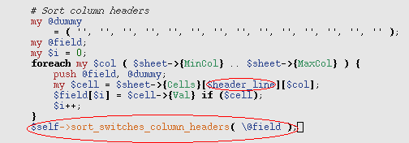
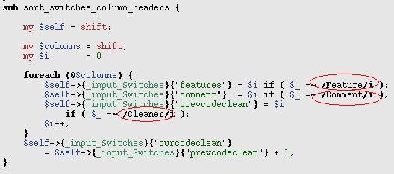
DVF_XLS_parser.pm
Get column headers
  Compile switches
  Feature Keyword
  Reason for code cleaner
  comment
CONFIDENTIAL

Slide 22
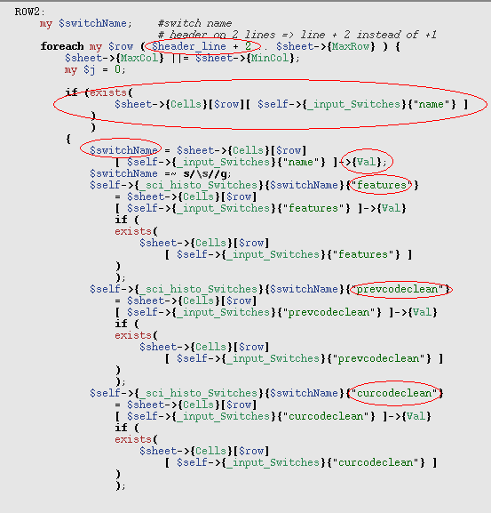
DVF_XLS_parser.pm
Parse four column value
CONFIDENTIAL

Slide 23
Script related
DVF.pl
Wrapper.pm
Twiddle.pm
DVF_XLS_parser.pm
Switches_audit.pm
Write_Switches_XLS.pm
CONFIDENTIAL

Slide 24
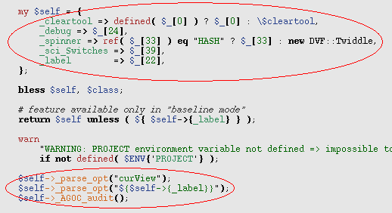
Switches_audit.pm
Transfer parameter
Parse opt files
  From current view
  From label
CONFIDENTIAL

Slide 25
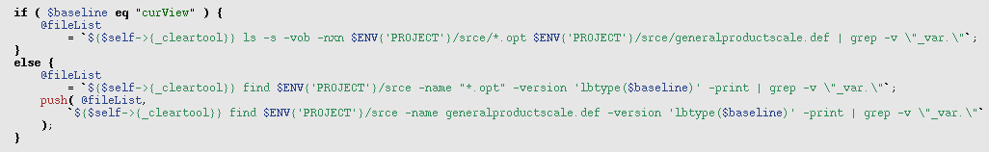
Switches_audit.pm
Get switch file:
  ci_hard.opt
  ci_unix.opt
  generaldebug.opt
  generalfeatures.opt
  generalhardware.opt
  master.opt
  pc_hard.opt
  pc_hard_df.opt
  pc_hard_mv.opt
  targetarm.opt
  targetunix.opt
  tatsimu.opt
  generalproductscale.def
CONFIDENTIAL

Slide 26
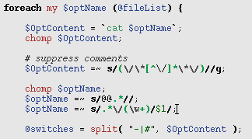
Switches_audit.pm
Get switches from the list
CONFIDENTIAL

Slide 27
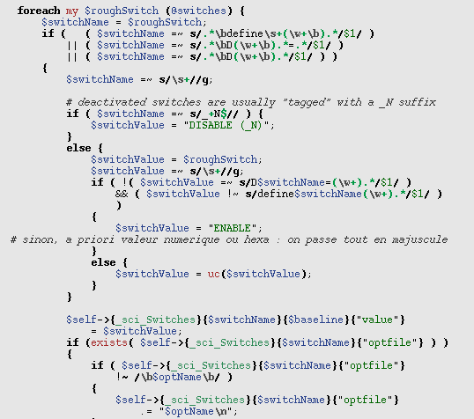
Switches_audit.pm
Parse switches value
  DISABEL (_N)
  ENABLE
Parse Option file
Notice : the first 4 steps run 2 times , one for current view ,another for the label we give to it at the beginning .
CONFIDENTIAL

Slide 28
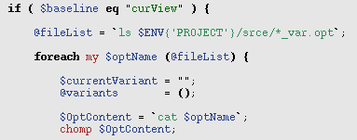
Switches_audit.pm
Get “_var.opt” file list
  generaldebug_var.opt
  generalfeatures_var.opt
  generalhardware_var.opt
  targetarm_var.opt
  targetunix_var.opt
CONFIDENTIAL

Slide 29
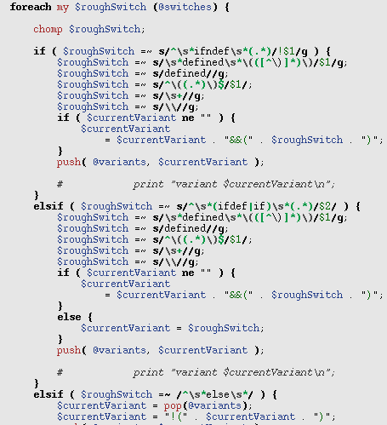
Switches_audit.pm
Get “Current Variant” from “ifndef/ifdef/else/elif/endif”
CONFIDENTIAL

Slide 30
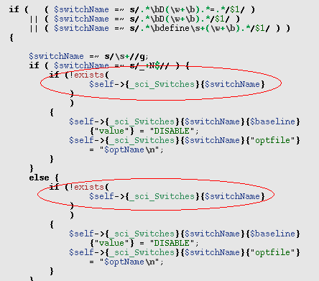
Switches_audit.pm
Parse switches value
  DISABEL
  NOTICE : switches should not exist before!
Parse Option file
CONFIDENTIAL

Slide 31
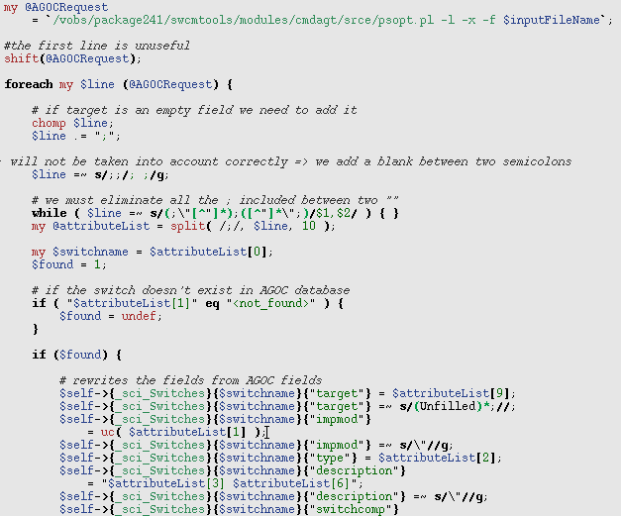
Switches_audit.pm
Get information related to switches
CONFIDENTIAL

Slide 32
Script related
DVF.pl
Wrapper.pm
Twiddle.pm
Switches_audit.pm
DVF_XLS_parser.pm
Write_Switches_XLS
CONFIDENTIAL

Slide 33
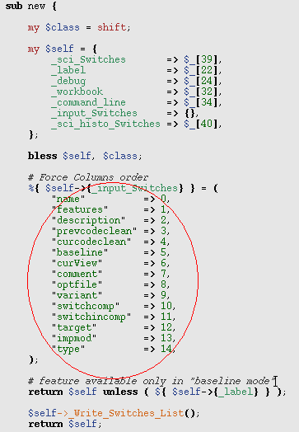
Write_Switches_XLS
Transfer the parameters
Force columns order
Write switches list
CONFIDENTIAL

Slide 34
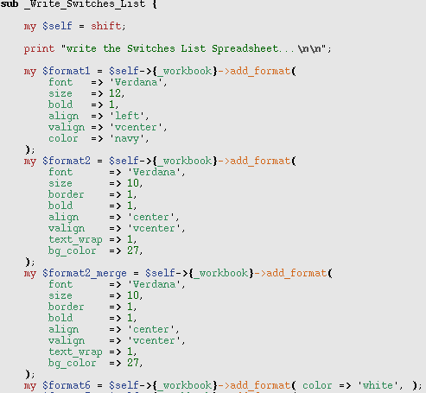
Write_Switches_XLS
Write switches list
Add format for font, size,
color …
CONFIDENTIAL

Slide 35
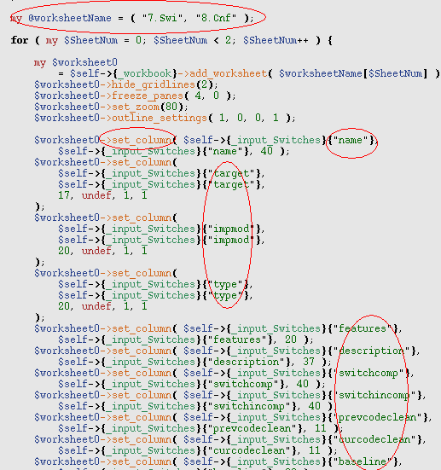
Write_Switches_XLS
Format the 14 column
CONFIDENTIAL

Slide 36
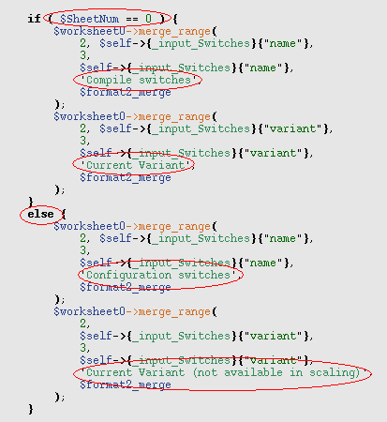
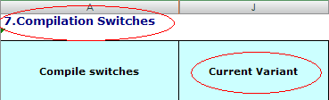
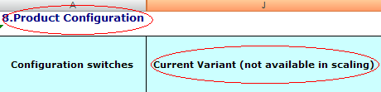
Write_Switches_XLS
Write the page name and Variant
CONFIDENTIAL

Slide 37
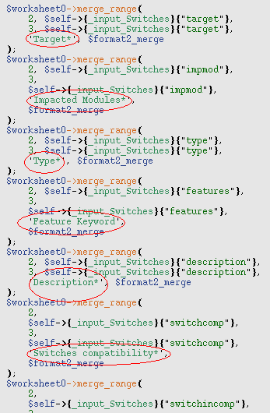
Write_Switches_XLS
Write the other titles
CONFIDENTIAL

Slide 38
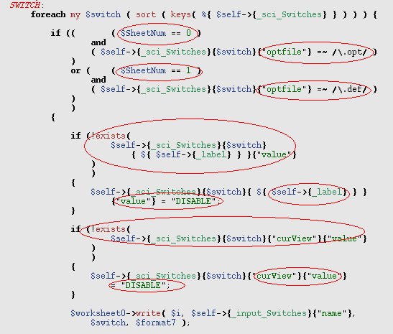
Write_Switches_XLS
Depart the content through optfile
  7.swi content .opt files
  8.cnf content .def files
CONFIDENTIAL

Slide 39
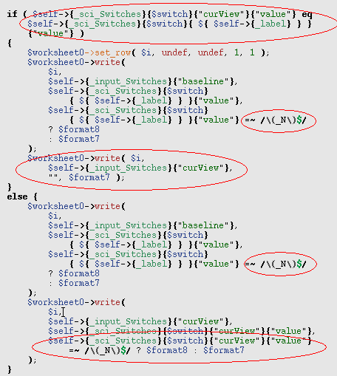
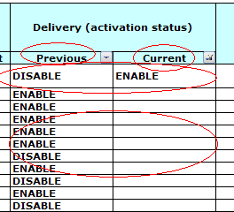
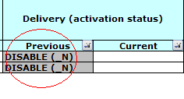
Write_Switches_XLS
Write value
CONFIDENTIAL

Slide 40
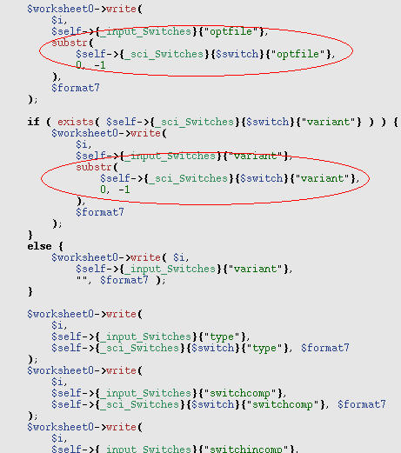
Write_Switches_XLS
Write other information
  Option file
  Current Variant
  Type
  Switches compatibility*
  Switches incompatibility*
CONFIDENTIAL

Slide 41
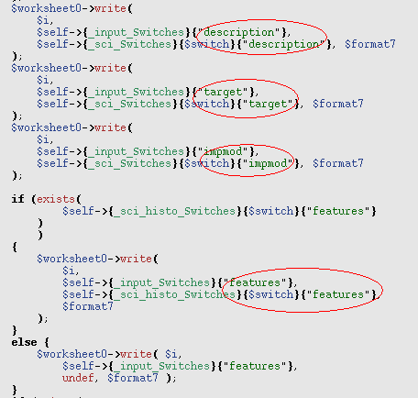
Write_Switches_XLS
Write other information
  Description
  Target
  Impacted Modules
  Feature Keyword
CONFIDENTIAL

Slide 42
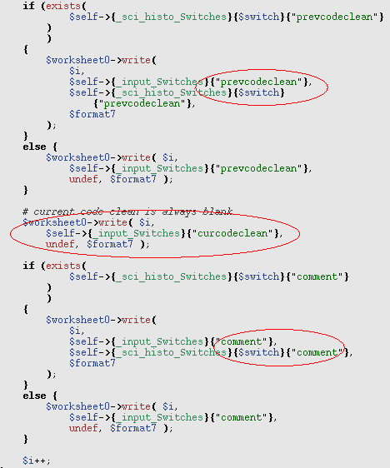
Write_Switches_XLS
Write other information
  Reason for code cleaner
  Comment
CONFIDENTIAL

Slide 43

Write_Switches_XLS
* Information extracted from AGOC
CONFIDENTIAL

Slide 44
THANK YOU

