Slide 1

Data 604 Final Project - Yina Qiao
Simulating Bank Queues to Improve Customer Wait

Slide 2
Problem Statement:
Research Question:
How many tellers are needed to keep wait times short while keep them busy?
Impact:
Ensuring enough tellers to minimize customer wait times while keeping tellers efficiently occupied.
Importance: Smooth bank operations and happy customers.

Slide 3
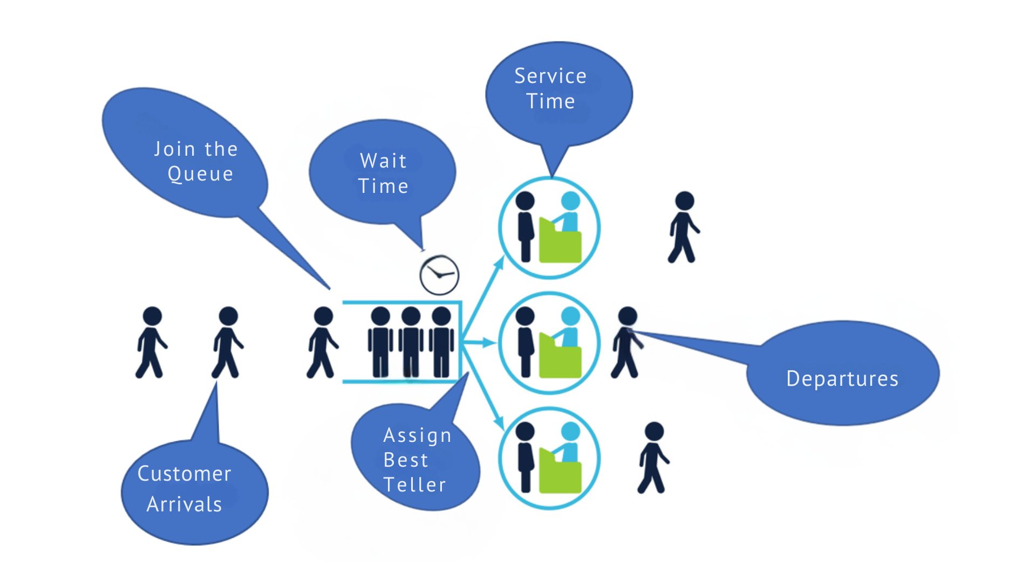
Flow-Chart Model

Slide 4
Simulation Process
Simulating 30 days (9 AM to 5 PM) with 1-4 tellers.
Reflects real-life staffing limits and performance trends.

Slide 5
Model Design
Arrival Rate:
10 customers/hour during peak hour
(11am-1 pm, 3-5pm)
5 during off-peak.
Service Rate:
10 customers/hour.
Queue Management:
Individual queues, no customer leaves
Simulation Time:
Bank operates from 9 AM to 5 PM, runs for 30 days.
Metrics Tracked:
Total and served customers,
waiting times, teller effective times.

Slide 6
Model Validity and Verification
Based on queuing theory principles.
Code correctness verification.
Multiple iterations(30) for consistent results.

Slide 7
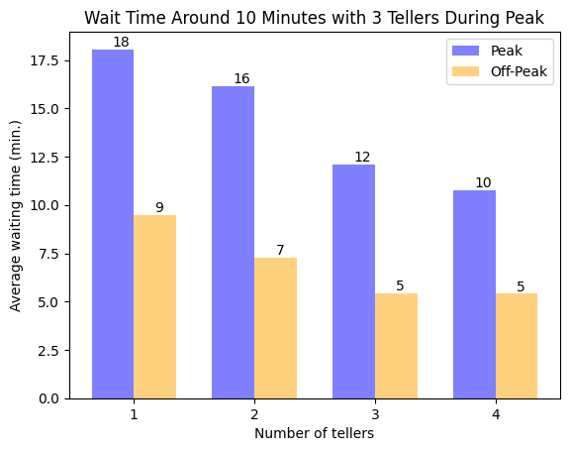
Simulation Results: Waiting Time
1-2 tellers make people wait over 15 min
3 tellers balance wait time and efficiency, with wait times just a little over 10 min

Slide 8
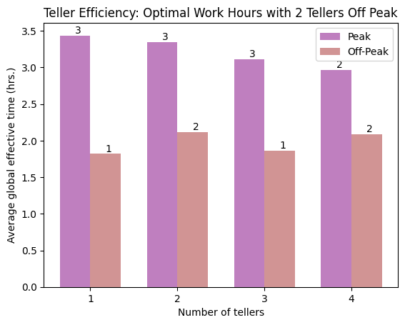
Simulation Results: Teller Efficiency
2-4 tellers work best off-peak.
2 tellers save on staff, therefore better fit.

Slide 9
Bring All Together
Peak Hours: Have 3 tellers. People wait 12 minutes, and tellers work 3 hours effectively, not 2.
Off-Peak Hours: Have 2 tellers. They work well, and we need fewer people.

Slide 10
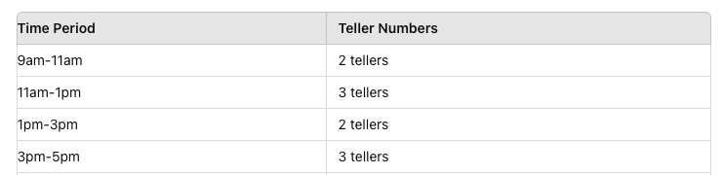
How many tellers are needed to keep wait times short while keep them busy?
Recommended: Optimal teller numbers: 3 during peak hours, 2 during off-peak hours, cross-train staff as needed
Further research could include analyzing customer satisfaction (OSAT score) and running more realistic iterations for 6 months, taking holidays into account.
Conclusion

