Slide 1

What Is The Effect Of The Earth's Temperature on Cyclonic Storms?
Story 5
-Yina Qiao

Slide 2
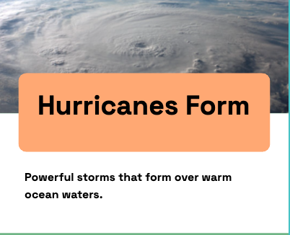

Slide 3


Slide 4
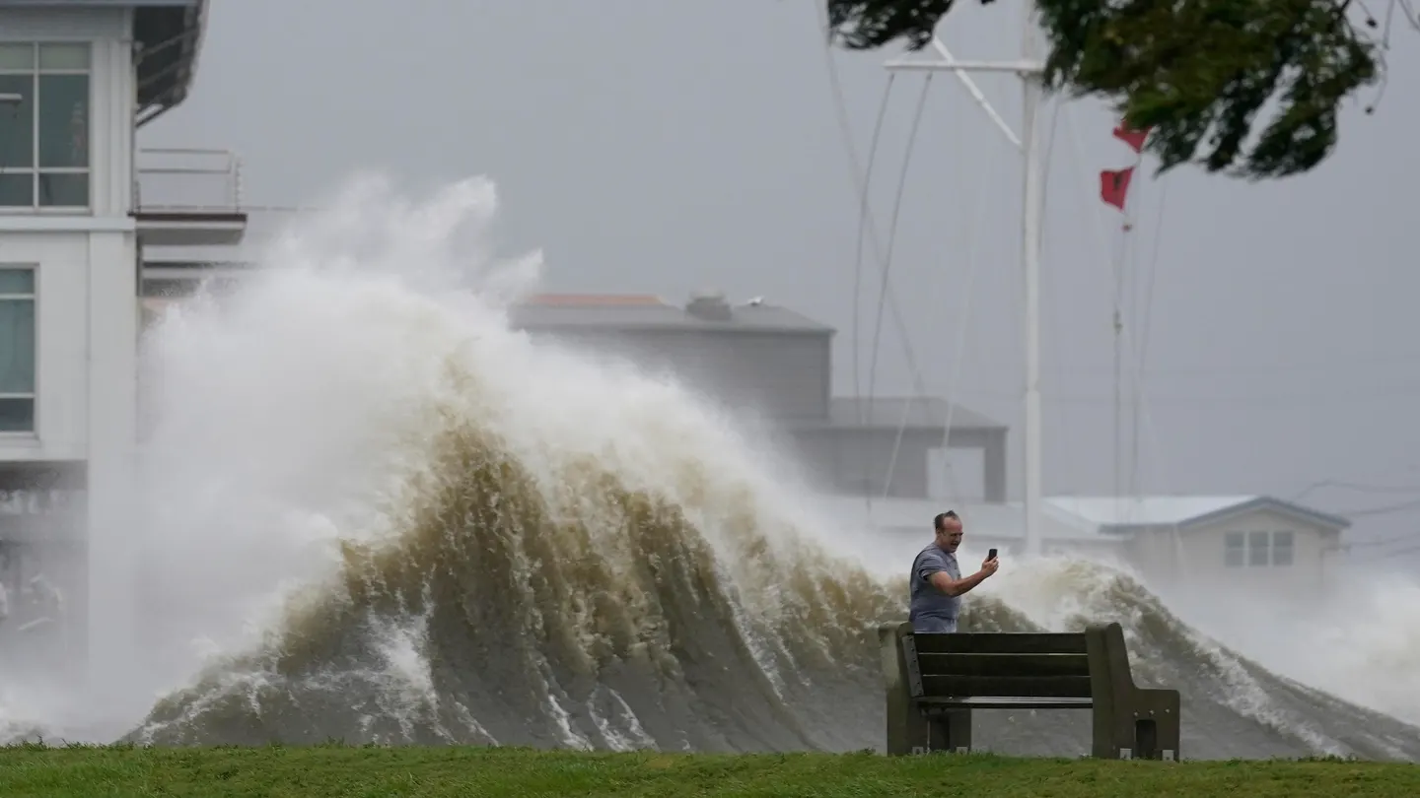

Slide 5
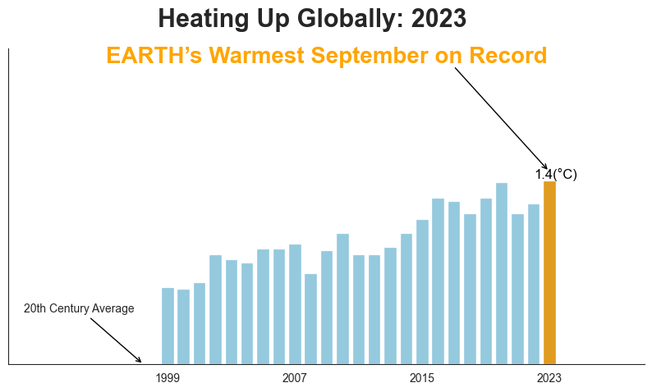

Slide 6
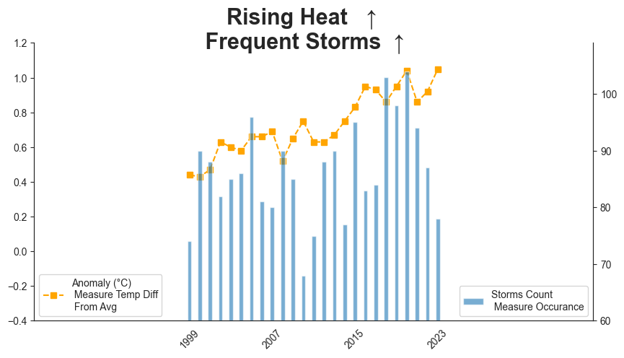

Slide 7
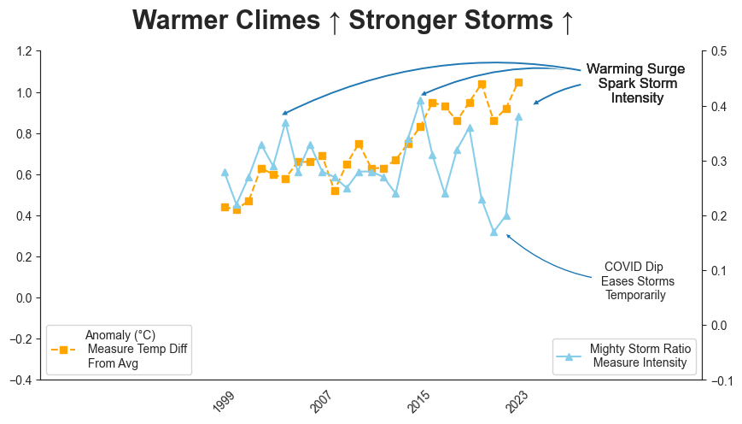

Slide 8
What Is The Effect Of The Earth's Temperature on Cyclonic Storms?
Temperature
Storm Occurrence
Temperature
Storm Intensity
Final Thought: Rising Earth temperatures are associated with an increase in the occurrence and intensity of cyclonic storms. This is likely due to factors like warmer ocean waters providing more energy for storm formation and increased moisture in the atmosphere leading to heavier rainfall.

