Slide 1
Celluloid and Japanese Anime
201857尹达恒
Notes:
Your PPT is colorful, not like me, my PPT is simple, just like my topic celluloid.
Today I’ll introduce a important word in Japanese Anime —— celluloid.
Not only a coloring style, but also an historical material in anime industry.

Slide 2
Celluloid and Anime History
Celluloid’s past
Celluloid in Japanese anime
Celluloid in digital anime
Celluloid in 3D anime
Summary
Notes:
With the development

Slide 3


Celluloid’s past —— era of man-made plastics
Invented in late 19th century
Invented as a substitute for ivory
Become an everyday material after World War II
The basic material of films
Notes:
What is celluloid?
Celluloid, developed in the late 19th century, launched the modern age of man-made plastics.
At first, Celluloid was invented as a substitute for ivory to produce billiards.
But because of its plasticity and easy to produce, it rapidly become an everyday material, just like the hundreds of plastics that would follow after World War II.
The first use of Celluloid in media is as the basic material of the films.

Slide 4
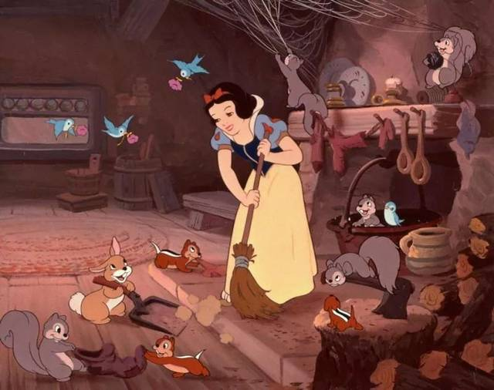
Celluloid in anime —— Limited Animation
Celluloid + Limited Animation technology = Snow White
—— first full-length animation made with Celluloid
Notes:
In 1937, Disney made the first full-length animation in history —— Snow White, with the use of Celluloid.
Celluloid in anime industry is inseparable from Limited Animation technology.

Slide 5
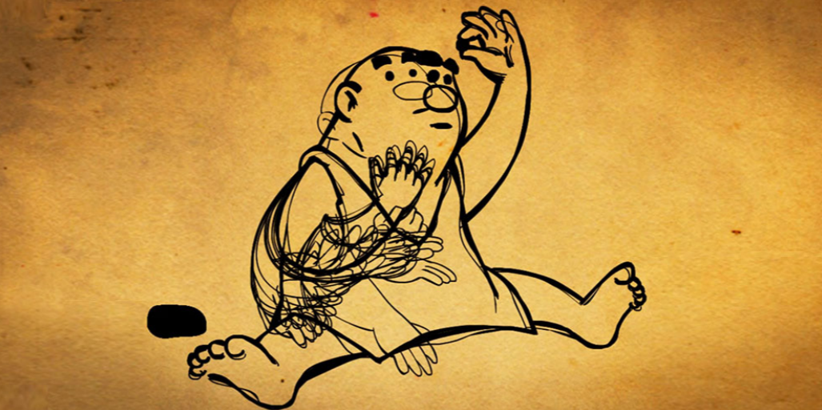
Celluloid in anime —— Limited Animation
Not all the things are moving all the time
Reuse common parts between frames
Nearly impossible without Celluloid
Start point of modern anime industry
Notes:
Limited Animation assume that not all the lines or colors are moving on the screen all of the time.
So when creating animated cartoons, we do not redraw entire frames but variably reuse common parts between frames.
But just redraw those moving parts.
However, when performing Limited Animation, the painter must refer to the content in previous frame, or the lines in the finished product will be unstable.
Before the Celluloid’s invention, it is impossible for the anime producers to find a transparent and cheap canvas to perform such technology.
So we can say that is the Celluloid is the starting point of modern anime industry.

Slide 6
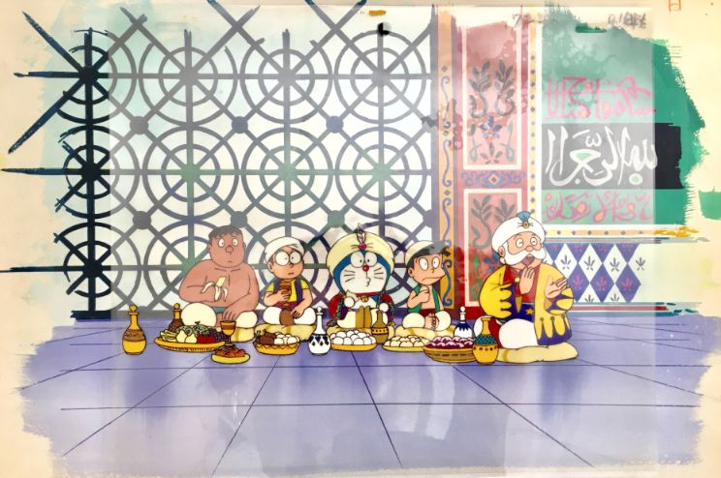
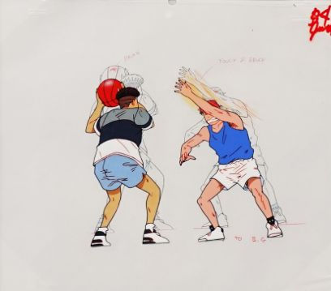
Celluloid in Japanese anime —— a color style
Celluloid —— a color style
Clear line strokes, large color blocks, sharp shadows
Simple to paint
Notes:
Nowadays, when people mentioned Celluloid, they are not refer to plastic, but refer to a widely-used color style in Japanese anime.
This color style is distinctive. Clear line strokes, large color blocks, sharp shadows are its main features.
This color style can be traced back to the early age of Japanese modern anime industry.

Slide 7
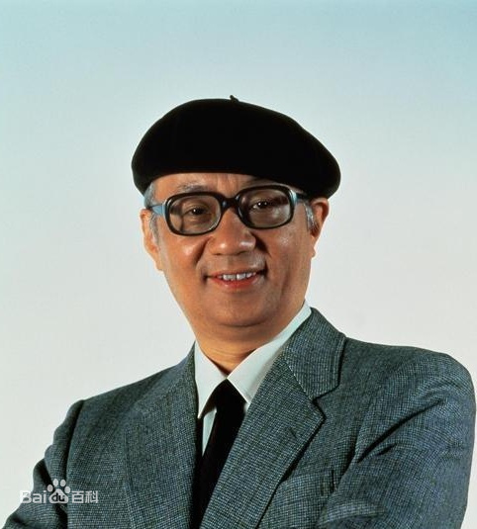
Celluloid in Japanese anime —— a color style
Osamu Tezuka and his company mushi-pro
Celluloid + Celluloid Color Style + Limited Animation
Greatly reduce the production cost of anime
Notes:
This color style is invented by
In 1960s, a Japanese cartoonist Osamu founded mushi-pro, and bring Limited Animation and Celluloid into Japanese anime industry.
But with this tools, anime is still expensive.
In order to reduce the cost, Osamu need to invented a color that is simple enough like Limited Animation, that is what we called Celluloid color style after.
With Limited Animation and Celluloid color style, mushi-pro greatly reduce the production cost of anime,
thus strengthen the Japanese anime and make it a huge industry till today.
So that makes Celluloid color style become famous all over the world.

Slide 8
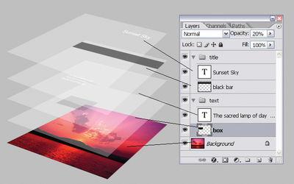
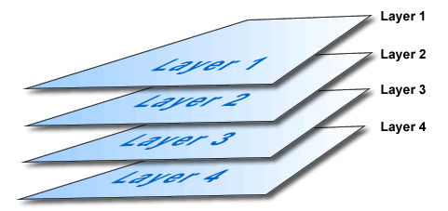
Celluloid in Digital Anime
Celluloid evolved into by Layer in digital age
Celluloid is still a important coloring skills in digital anime industry
Celluloid became the hallmark of the Japanese anime industry
Notes:
With the developing of digital technology, Celluloid gradually evolved into layer in digital graphic software.
With advanced digital technology, producers can make anime in an unprecedented way.
The anime became much more flexible, colorful, and cheaper than before.
Today, although producers no longer need to draw the anime on the pieces of plastic, the Celluloid color style is still a important coloring skills in Japanese digital anime industry, not only because of its cheapness, but also, it became the hallmark of the Japanese anime industry.

Slide 9
Celluloid in 3D Anime —— Cel-Look
look like Celluloid
Use large color blocks and sharp shadows when rendering
Stick clear line strokes onto the edge of the model
Notes:
Even in 3D anime, we can still see the influence of Celluloid.
In 3D anime, there is a technology, what we called Cel-Look, means “look like Celluloid”.
Just like traditional 2D Celluloid, it use large color blocks and sharp shadows, and stick clear line strokes onto the edge of the model.
This model technology can cover up the small flaws of the model.
This method not only make the make the 3D anime looks like 2D Celluloid,
But also makes the 3D anime cheaper, just like Celluloid did in last century.
And it is widely used in today’s anime industry.

Slide 10
Summary
?
Notes:
Celluloid witnessed the rise and fall of the modern anime industry.
It was one of the hallmarks of modern anime industry, it still be. And it will develop further with other graphic technology in the future.

Slide 11
Thanks for listening!
Notes:
That’s all, thanks for listening!

