Slide 1
Keynote Speech
下半部分

Slide 2
SDTCP Mechanism
Notes:
Hello everyone, I’m Howard Yin from CNII, I’ll introduce the SDTCP Mechanism and our experiment results.

Slide 3
Basic Principle of TCP used by SDTCP
Bandwidth of dataflow is controlled by the size of slide window
Receiver change the slide window size according to ACK
SDTCP control the ACK so that control the bandwidth
Control
ACK
Slide window
Data to be sent
Send together
Notes:
The basic principle of the SDTCP is simple.
As we all know, in traditional TCP protocol, the bandwidth of the dataflow was controlled by a slide window, which can be controlled by a window size field in ACK message, so our OF-switches can control the flow from senders by edit the window size in ACK message.

Slide 4
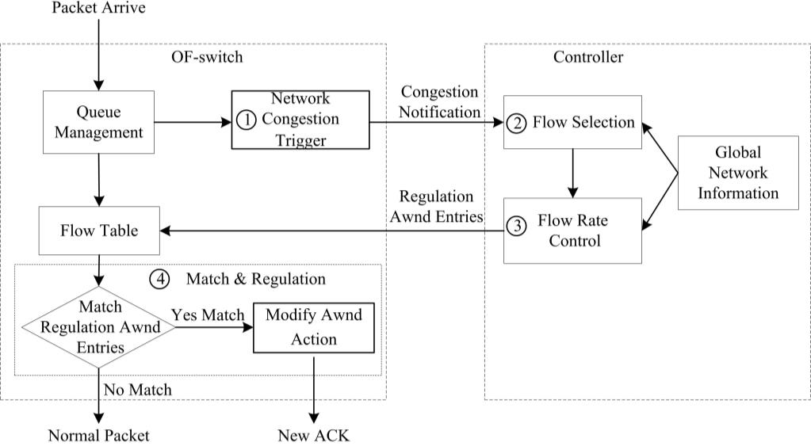
Step 1: Network Congestion Trigger
Detect Congestion
Count the length
Notes:
The first step is network congestion trigger.
We design a network congestion trigger module at the OF-switch.
This module can determine whether the network is congested by counting the queue length in OF-switch’s buffer.
Once it discovered that the network is congested, it will send a congestion notification message to our controller.

Slide 5
Step 2: Flow Selection
Data from many other switch
Data collection & analysis
TTL, Flow size, IP address, TCP flows……
Data
Notes:
The second step is Flow Selection.
This module can analyze all of the TCP flow information, e.g., TTL (time-to-live), flow size, and IP addresses of TCP flows, gained from OF-switches through the OpenFlow protocol. Through this analysis, this module can differentiate the background flows and burst flows.

Slide 6
Step 2: Flow Selection
Select all all of the background flows
Notes:
With this module, our controller will select all of the background flows passing through the OF-switch once received a congestion notification message from a congested OF-switch.

Slide 7
Step 3: Flow Rate Control
congestion level
calculate a desired bandwidth
Notes:
When the background flows have been selected, controller will perform Flow Rate Control.
At this step, a flow rate control module at the controller will at first calculate a desired bandwidth depends on the network congestion level

Slide 8
Step 3: Flow Rate Control
Chosen Background flow
Send these entries to all switches
generates new flow table entries
Bandwidth
information
Notes:
, then estimates the current bandwidth of the chosen background flows and then degrades their bandwidth to the desired one and generates new flow table entries that is used to regulate the background flow bandwidth to our desired one and sends them to the OF-switch.

Slide 9
Step 4: Flow Match and Regulation
Desired window size
Packets from other switch
Modify ACK
Receiver
Modify window size according to ACK
To Receiver
Notes:
Once the flow table entries on the OF-switchs updated, they will start to perform Flow Match and Regulation.
Once TCP ACK packets from the receiver match the regulation entry at OF-switch, the window size field of these packets will be modified to the desired one and then forwarded to the sender.
After receiving these modified ACK packets, the sender will adjust the slide window into the desired size.
In this way, the bandwidth of background flows can be decreased to our desired one.

Slide 10
Experiment Results

Slide 11
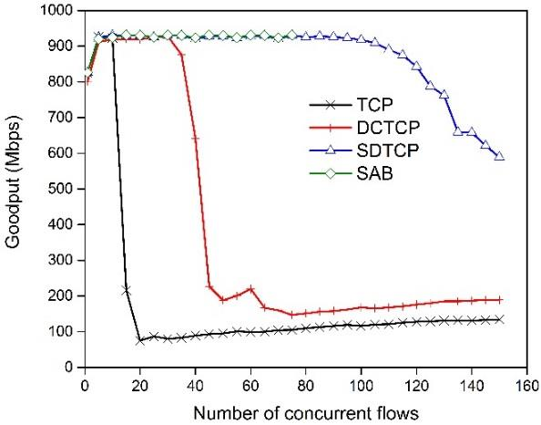
Experiment Results
Notes:
This figure shows the goodput of SDTCP, TCP, DCTCP, and SAB as we vary the number of concurrent flows from 1 to 150.
SDTCP can easily handle 100 concurrent flows and significantly improve the network performance over the incast scenario

Slide 12
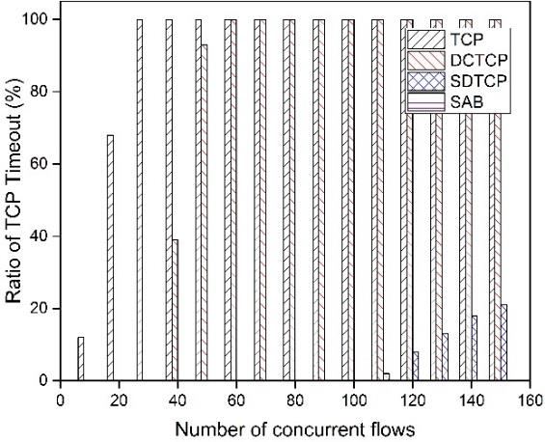
Experiment Results
Notes:
With the same experiment, we also present the timeout ratio for these protocols, as is shown in this figure.
We can see that timeout greatly decreased when performing SDTCP.

Slide 13
Summary
by adjusting the window size of TCP ACK packets
reduces the sending rate of background flows
guarantees high throughput for burst flows effectively
Notes:
With the same experiment, we also present the timeout ratio for these protocols, as is shown in this figure.
We can see that timeout greatly decreased when performing SDTCP.

Slide 14
Thanks for listening!
Notes:
Thank you very much for your attention.

Slide 15
Q&A
Notes:
If there are any questions, please feel free to ask. My partner would be happy to answer any questions.

