Slide 1






$$v_{l}$$
$$f$$
$$Z$$
$$Y_{P}$$
$$Z_{P}$$
$$Y$$

Slide 2
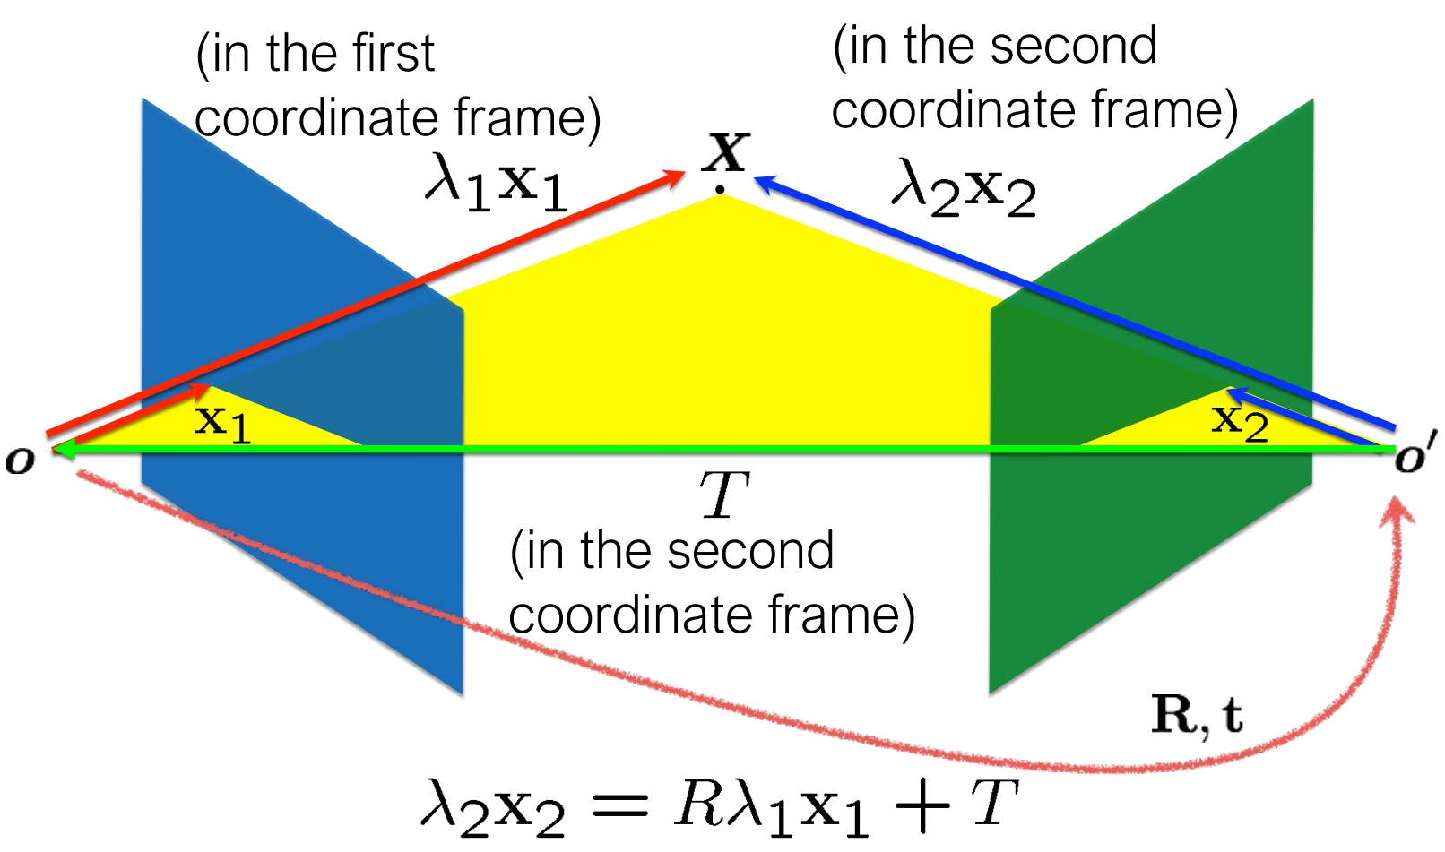
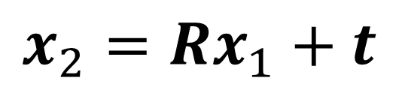

$$t$$
$$x_{2}=Rx_{1}+t$$

