Slide 1
WAEVSR: Enabling collaborative live video super-resolution in wide-area MEC environment
Research Summary & Research Plan
Reporter: Daheng Yin
Affiliation: Southeast University
Email: yindaheng98@seu.edu.cn

Slide 5
Further Research Plan
Insight into the stability of the super-resolution model
Correlation between compressed video and super-resolution
How VSR model leverage inter-frame features
How VSR model extract multi-scale features

Slide 6
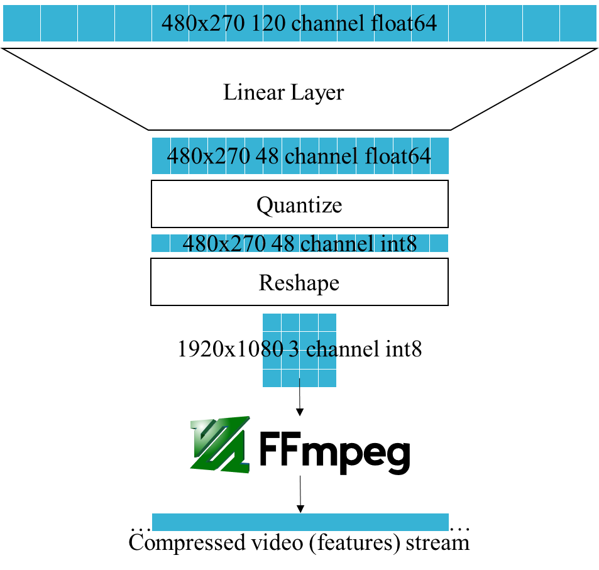
Insight into the stability of the super-resolution model
What impress me
super-resolution models maybe more stable
Model | Seq length | PSNR | Y PSNR | SSIM | Y SSIM
Bicubic |  | 29.79 | 31.32 | 0.8483 | 0.8684
EDVR | 7 | 34.08 |  | 0.9216
TDAN | 5 | 34.13 |  | 0.9240
BasicVSR | 7 | 35.00 | 36.85 | 0.9292 | 0.9415
VRT | 3 | 35.37 | 37.16 | 0.9329 | 0.9450
VRT | 7 | 36.04 | 37.87 | 0.9399 | 0.9514
VRTDv2 | 7 | 35.42 | 37.37 | 0.9344 | 0.9477
VRTDv2 Quantized | 7 | 35.34 | 37.28 | 0.9336 | 0.9469
VRTDv3 | 7 | 35.35 | 37.34 | 0.9345 | 0.9476
VRTDv3 Quantized | 7 | 35.39 | 37.37 | 0.9342 | 0.9474
Quality drop slightly with simple compression and quantization
Quantized model still better than BasicVSR
Notes:
For the stability,
the things that impress is,
the quality drop is not much even the feature compressed from 120 to 48 and quantized from float64 to int8

Slide 7
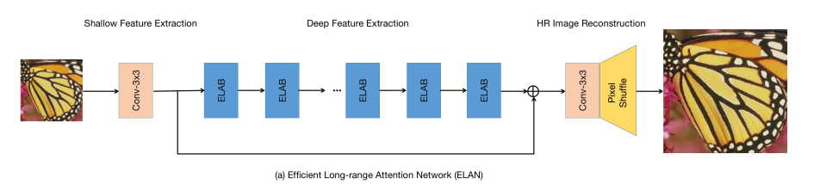
Insight into the stability of the super-resolution model
What impress me
super-resolution models maybe more stable
Quantization experiment on ELAN, a SISR model
Methods | PSNR | SSIM
PyTorch | 31.51 | 0.9232
TensorRT FP16 | 31.51 | 0.9232
PyTorch INT8 (1 train epoch) | 28.36 | 0.8739
TensorRT INT8 QAT (1 fine-tune epoch) | 29.28 | 0.8922
Quality drop slightly after simple QAT
Notes:
The other experiments also shows the same results

Slide 8
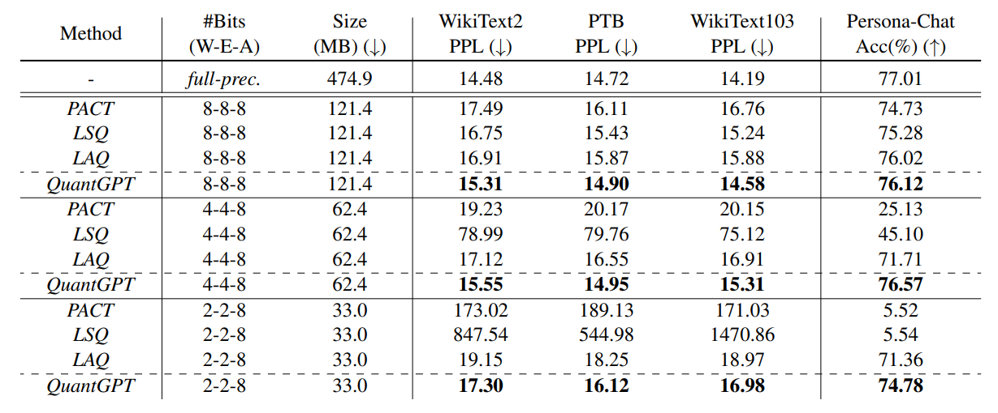
Insight into the stability of the super-resolution model
What impress me
super-resolution models maybe more stable
Quantization experiment on FairMOT, a MOT model, accuracy loss up to 54% when quantize to FP16
[1] C. Tao et al., “Compression of Generative Pre-trained Language Models via Quantization,” in Proceedings of the 60th Annual Meeting of the Association for Computational Linguistics (Volume 1: Long Papers), Dublin, Ireland, 2022, pp. 4821–4836. doi: 10.18653/v1/2022.acl-long.331.
Notes:
The other experiments also shows the same results

Slide 9

Insight into the stability of the super-resolution model
Further Research
Save bandwidth
Reduce computation
480x270 120 channel float64
How the number of channels here correlates with quality?
Linear Layer
(Reduce computation) How small can the model be compressed to?
480x270 48 channel float64
Quantize
How the number of channels here correlates with quality?
480x270 48 channel int8
Reshape
1920x1080 3 channel int8
How lossy compression affects quality?
(Save bandwidth) How small can the features be compressed to?
…
…
Compressed video (features) stream
Notes:
So the further research will still around the bandwidth saving and computation.
For bandwidth saving, we can try some more aggressive compression strategy,
Including here, further reduce the channel
Or here, using lossy compression

Slide 10
Insight into the stability of the super-resolution model
Further Research
Understand the foundation of stability
Is super-resolution model more stable than other types of models? Why?
Understand the stability on feature compression
Where is the limit of feature compression? What cause the limit?
Related Works
[1] H. Choi and I. V. Bajić, “Near-Lossless Deep Feature Compression for Collaborative Intelligence,” in 2018 IEEE 20th International Workshop on Multimedia Signal Processing (MMSP), 2018, pp. 1–6. doi: 10.1109/MMSP.2018.8547134.
[2] A. E. Eshratifar, A. Esmaili, and M. Pedram, “BottleNet: A Deep Learning Architecture for Intelligent Mobile Cloud Computing Services,” in 2019 IEEE/ACM International Symposium on Low Power Electronics and Design (ISLPED), Jul. 2019, pp. 1–6. doi: 10.1109/ISLPED.2019.8824955.
[3] A. Ilyas, S. Santurkar, D. Tsipras, L. Engstrom, B. Tran, and A. Madry, “Adversarial Examples Are Not Bugs, They Are Features,” in Advances in Neural Information Processing Systems, 2019, vol. 32. Accessed: Oct. 17, 2022.
……

Slide 11
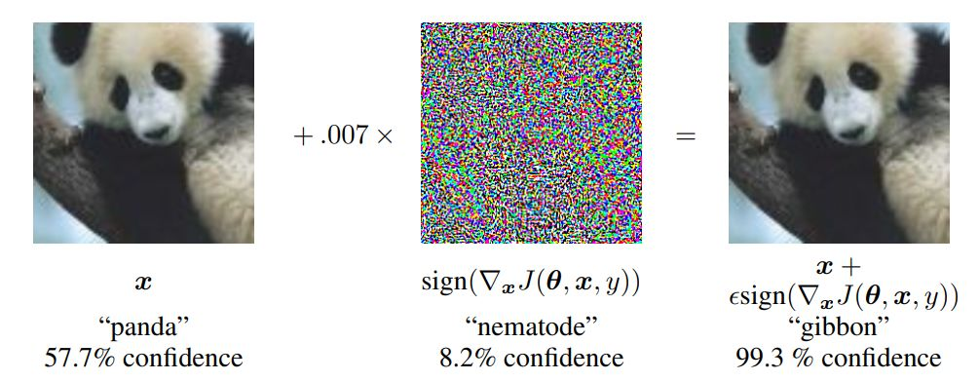
Insight into the stability of the super-resolution model
Further Research
Handle Adversarial Examples?
[1] I. J. Goodfellow, J. Shlens, and C. Szegedy, “Explaining and Harnessing Adversarial Examples,” in 3rd International Conference on Learning Representations, ICLR 2015, San Diego, CA, USA, May 7-9, 2015, Conference Track Proceedings, 2015. Accessed: Oct. 23, 2022.
Adversarial Examples: Add noise to confuse neural networks

Slide 12
Insight into the stability of the super-resolution model
Further Research
Handle Adversarial Examples?
Related Works
[1] A. Ilyas, S. Santurkar, D. Tsipras, L. Engstrom, B. Tran, and A. Madry, “Adversarial Examples Are Not Bugs, They Are Features,” in Advances in Neural Information Processing Systems, 2019, vol. 32. Accessed: Oct. 17, 2022.
Maybe this is why super-resolution models more stable:
Super-resolution depend on the whole image, not only some features

Slide 13
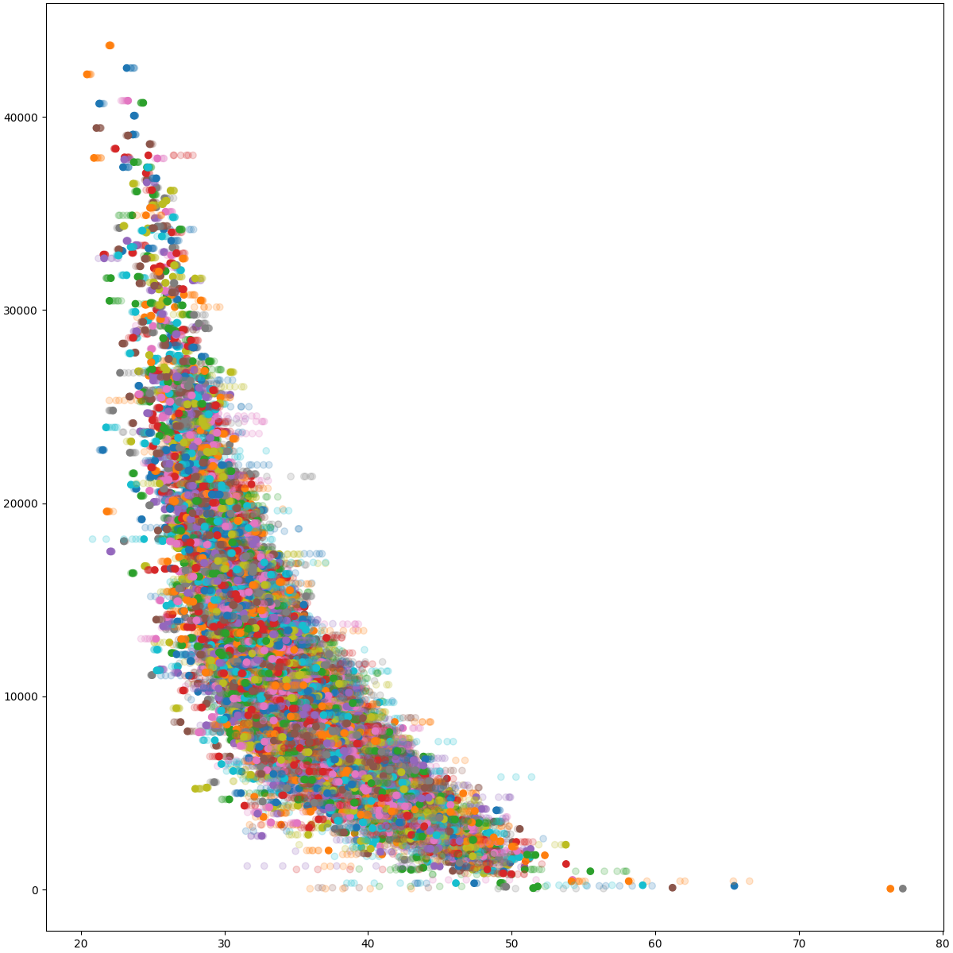
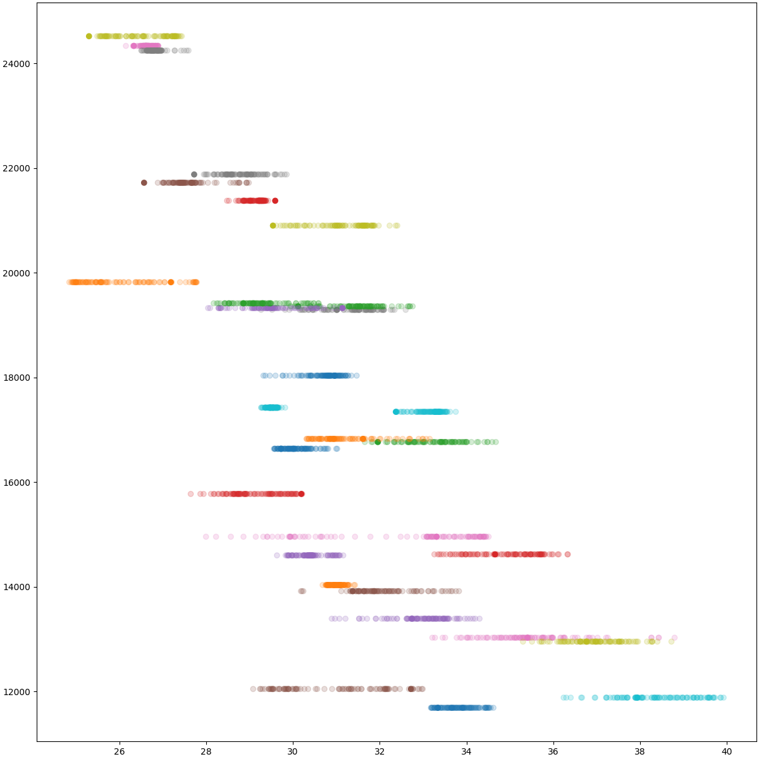
Correlation between compressed video and super-resolution
What impress me
Correlation between PSNR and packet size
Vimeo90k
REDS
Packet Size
PSNR (BasicVSR)

Slide 14
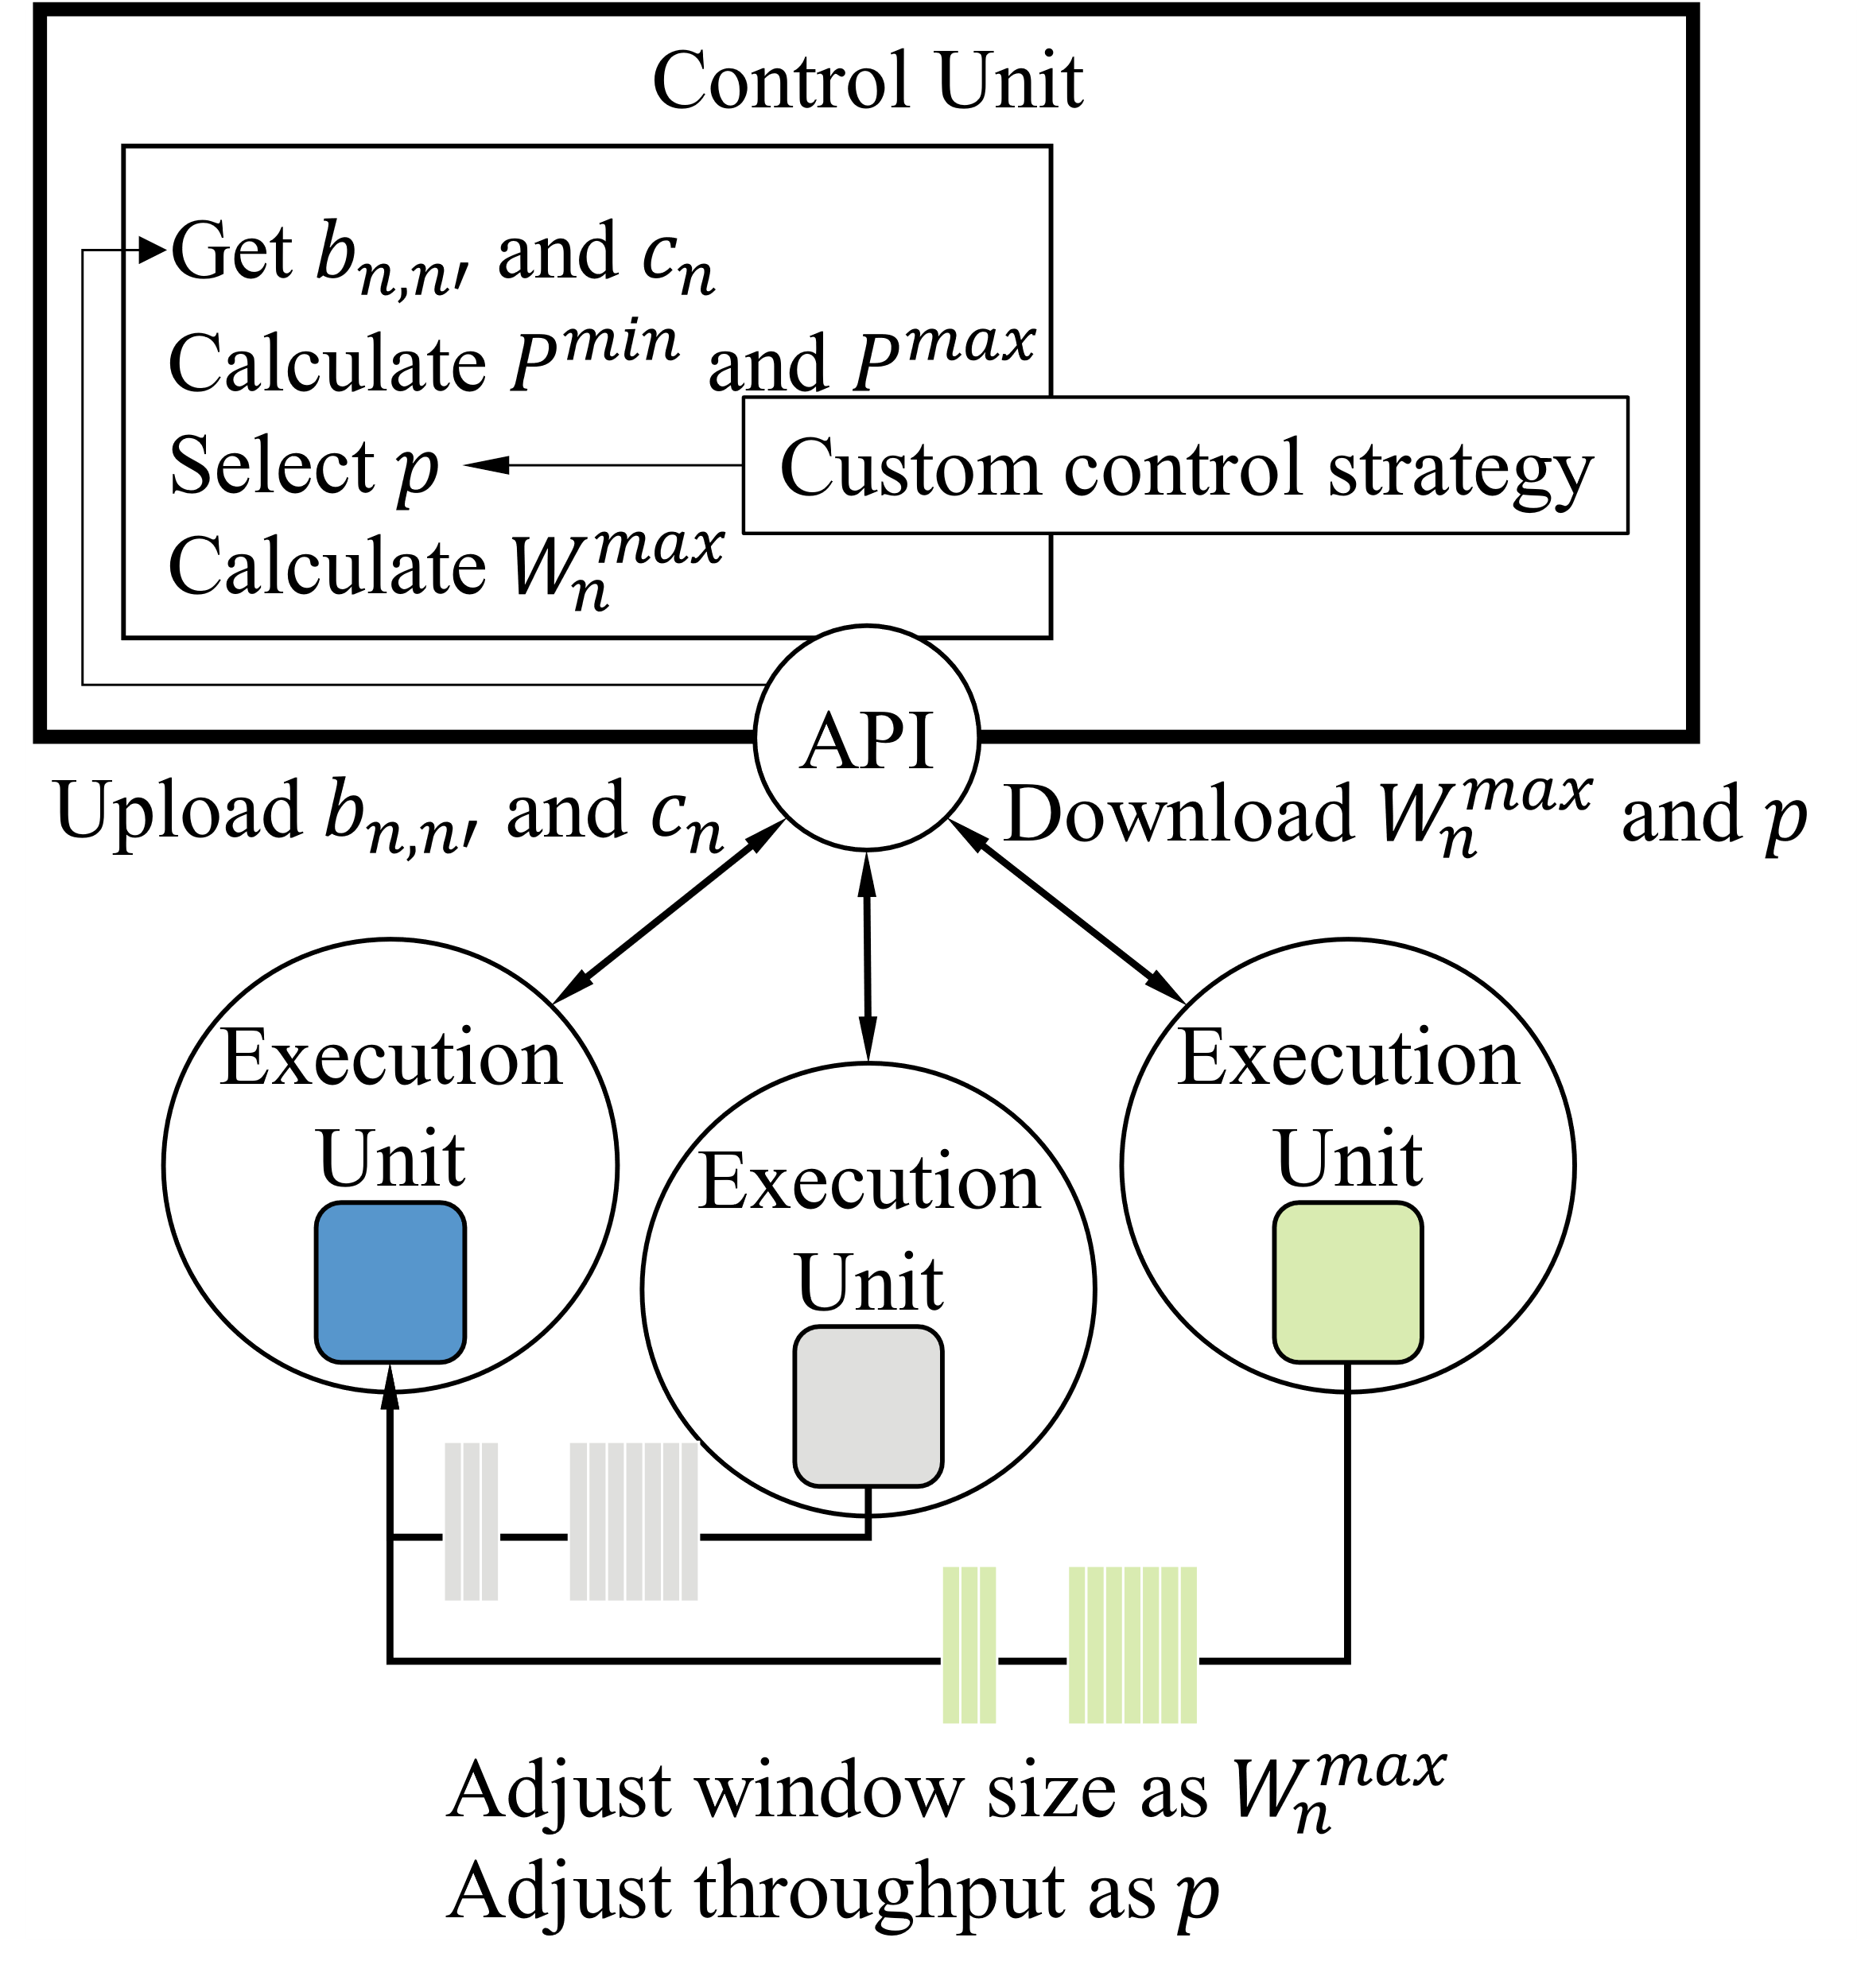
Correlation between compressed video and super-resolution
Further Research
Improve quality
Increase the accuracy of video quality predictions
by access the content of the compressed video

Slide 15
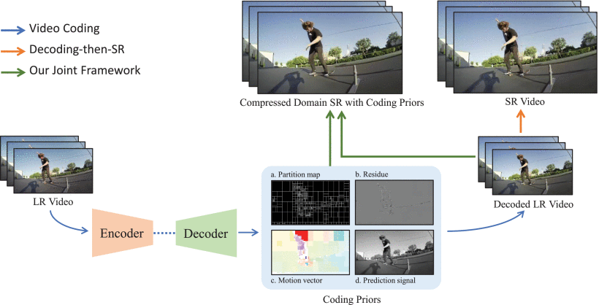
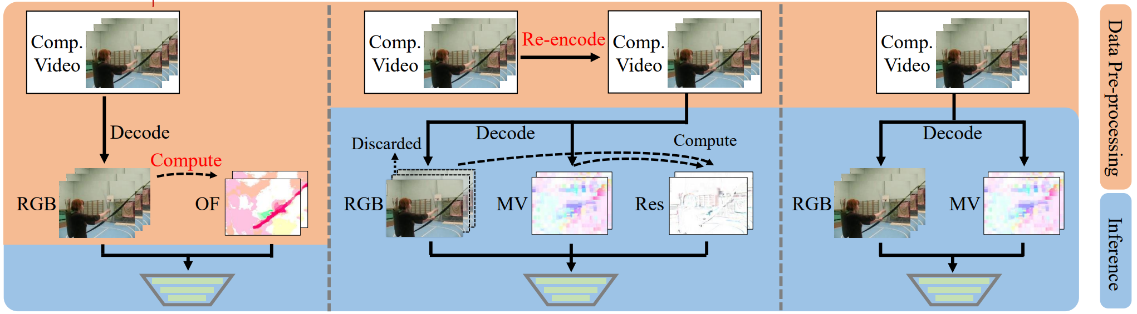
Correlation between compressed video and super-resolution
Further Research
How can video encoder benefit video process?
(not only super-resolution)
Related Works
[1] Y. Huo et al., “Compressed Video Contrastive Learning,” in Advances in Neural Information Processing Systems, 2021, vol. 34, pp. 14176–14187. Accessed: Oct. 15, 2022.
[2] P. Chen, W. Yang, M. Wang, L. Sun, K. Hu, and S. Wang, “Compressed Domain Deep Video Super-Resolution,” IEEE Transactions on Image Processing, vol. 30, pp. 7156–7169, 2021, doi: 10.1109/TIP.2021.3101826.

Slide 16
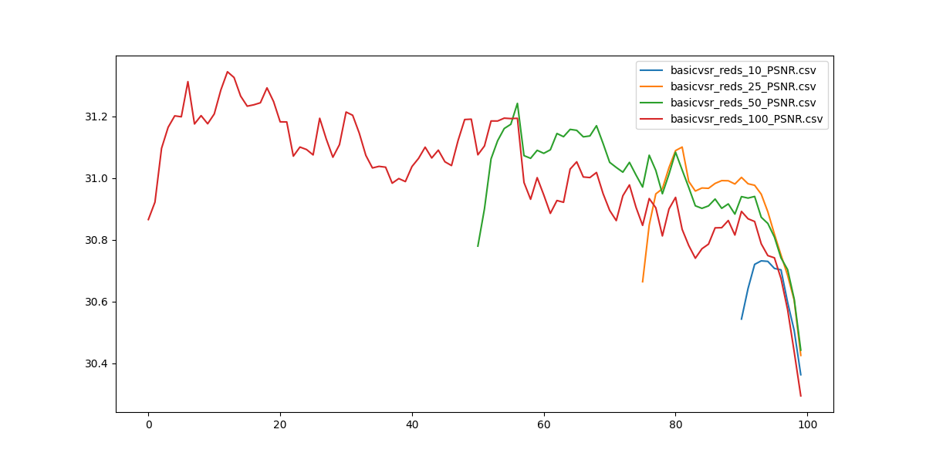
How VSR model leverage inter-frame features
What confuse me
VSR model may not effectively utilize multi-frame features
Quality drop slightly with less sequence length

Slide 17
How VSR model leverage inter-frame features
What confuse me
VSR model may not effectively utilize multi-frame features
Model | Seq length | PSNR | Y PSNR | SSIM | Y SSIM
Bicubic |  | 29.79 | 31.32 | 0.8483 | 0.8684
EDVR | 7 | 34.08 |  | 0.9216
TDAN | 5 | 34.13 |  | 0.9240
BasicVSR | 7 | 35.00 | 36.85 | 0.9292 | 0.9415
VRT | 3 | 35.37 | 37.16 | 0.9329 | 0.9450
VRT | 7 | 36.04 | 37.87 | 0.9399 | 0.9514
Quality drop slightly with less sequence length
Less sequence length still better than BasicVSR

Slide 18
How VSR model leverage inter-frame features
Further Research
Understand how VSR model leverage inter-frame features
Does VSR really utilize multi-frame features?
Or maybe multi-frame features only works in in certain circumstances?
Improve VSR quality
Understand inter-frame features and innovate new VSR algorithm
Related Work
in searching ……

Slide 19
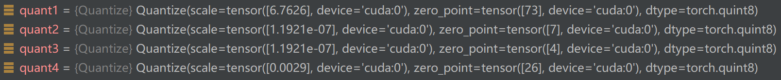
How VSR model extract multi-scale features
Model | PSNR | YPSNR | SSIM | YSSIM
VRT | 36.04 | 37.87 | 0.9399 | 0.9514
VRTDv2 | 35.42 | 37.37 | 0.9344 | 0.9477
VRTDv2 Quantized | 35.34 | 37.28 | 0.9336 | 0.9469
VRTDv3 | 35.35 | 37.34 | 0.9345 | 0.9476
VRTDv3 Quantized | 35.39 | 37.37 | 0.9342 | 0.9474
What confuse me
Different features on different branch
Scale for quantization is different
Features for branch 2 and 3 is nearly 0

Slide 20
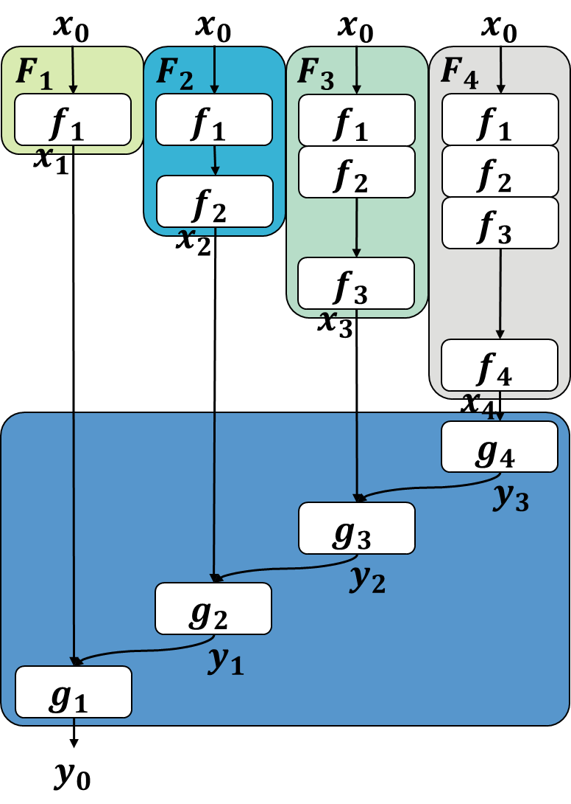
How VSR model extract multi-scale features
What confuse me
Different features on different branch
Model | Seq length | PSNR | Y PSNR | SSIM | Y SSIM
Bicubic |  | 29.79 | 31.32 | 0.8483 | 0.8684
EDVR | 7 | 34.08 |  | 0.9216
TDAN | 5 | 34.13 |  | 0.9240
BasicVSR | 7 | 35.00 | 36.85 | 0.9292 | 0.9415
VRT | 7 | 36.04 | 37.87 | 0.9399 | 0.9514
VRT Only Branch 1 | 7 | 33.59 | 35.43 | 0.9094 | 0.9256
Good quality even have only one branch

Slide 21
How VSR model extract multi-scale features
Further Research
Understand how VSR model extract multi-scale features
Is multi-scale features really important?
How many multi-scale features is best?
Improve VSR quality
Reparameterization for training multi-branch VSR model
Understand inter-frame features and innovate new VSR algorithm

