Slide 1
WAEVSR: Enabling collaborative live video super-resolution in wide-area MEC environment
Research Summary & Research Plan
Reporter: Daheng Yin
Affiliation: Southeast University
Email: yindaheng98@seu.edu.cn

Slide 3
Further Research Plan
Insight into the stability of the super-resolution model
Correlation between compressed video and super-resolution
Efficiency of leveraging inter-frame similarity
Efficiency of extract multi-scale information

Slide 6
Further Research Plan
Insight into the stability of the super-resolution model
Correlation between compressed video and super-resolution
Efficiency of leveraging inter-frame similarity
Efficiency of extract multi-scale information

Slide 7
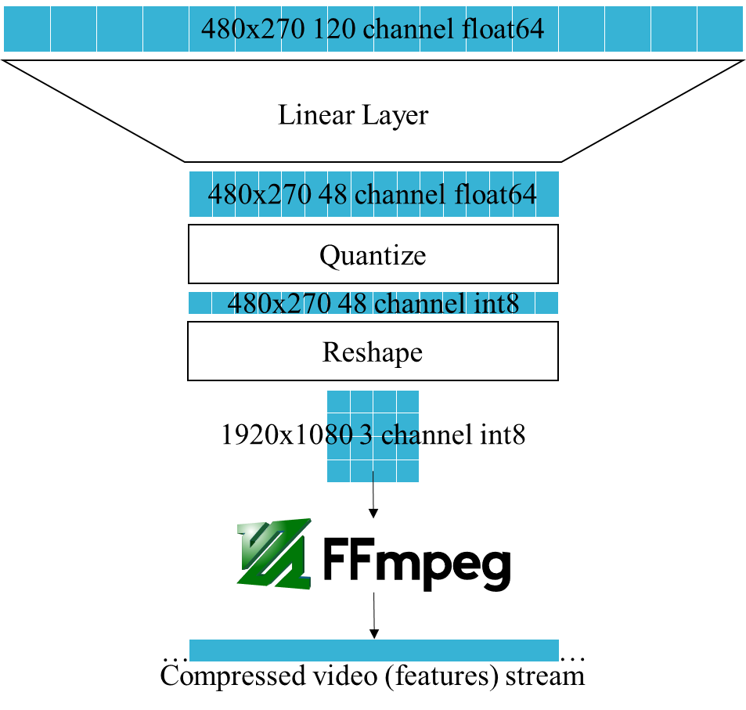
Insight into the stability of the super-resolution model
What impress me: super-resolution models maybe more stable
Model | Seq length | PSNR | Y PSNR | SSIM | Y SSIM
Bicubic |  | 29.79 | 31.32 | 0.8483 | 0.8684
EDVR | 7 | 34.08 |  | 0.9216
TDAN | 5 | 34.13 |  | 0.9240
BasicVSR | 7 | 35.00 | 36.85 | 0.9292 | 0.9415
VRT | 3 | 35.37 | 37.16 | 0.9329 | 0.9450
VRT | 7 | 36.04 | 37.87 | 0.9399 | 0.9514
VRTDv2 | 7 | 35.42 | 37.37 | 0.9344 | 0.9477
VRTDv2 Quantized | 7 | 35.34 | 37.28 | 0.9336 | 0.9469
VRTDv3 | 7 | 35.35 | 37.34 | 0.9345 | 0.9476
VRTDv3 Quantized | 7 | 35.39 | 37.37 | 0.9342 | 0.9474
Quality drop slightly with simple compression and quantization
Quantized model still better than BasicVSR
Notes:
For the stability,
the things that impress is,
the quality drop is not much even the feature compressed from 120 to 48 and quantized from float64 to int8

Slide 8
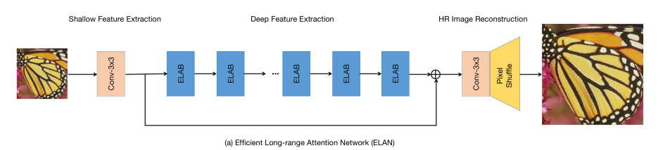
Insight into the stability of the super-resolution model
What impress me: super-resolution models maybe more stable
Quantization experiment on ELAN, a SISR model
Methods | PSNR | SSIM
PyTorch | 31.51 | 0.9232
TensorRT FP16 | 31.51 | 0.9232
PyTorch INT8 (1 train epoch) | 28.36 | 0.8739
TensorRT INT8 QAT (1 fine-tune epoch) | 29.28 | 0.8922
Quality drop slightly after simple QAT
Notes:
The other experiments also shows the same results

Slide 9
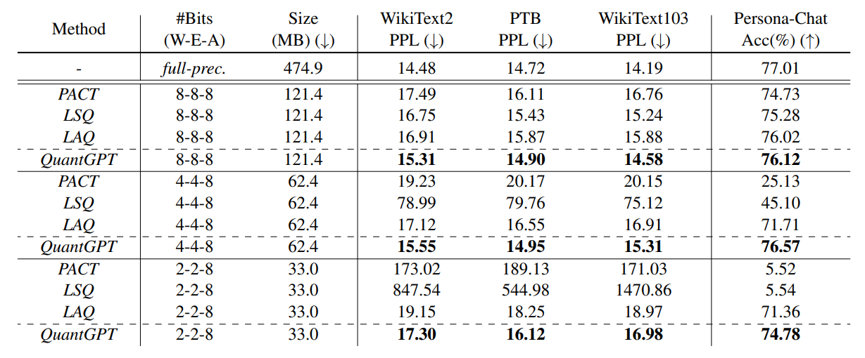
Insight into the stability of the super-resolution model
What impress me: super-resolution models maybe more stable
Quantization experiment on FairMOT, a MOT model, accuracy loss up to 54% when quantize to FP16
[1] C. Tao et al., “Compression of Generative Pre-trained Language Models via Quantization,” in Proceedings of the 60th Annual Meeting of the Association for Computational Linguistics (Volume 1: Long Papers), Dublin, Ireland, 2022, pp. 4821–4836. doi: 10.18653/v1/2022.acl-long.331.
Notes:
The other experiments also shows the same results

Slide 10

Insight into the stability of the super-resolution model
Further Research
Save bandwidth
Reduce computation
480x270 120 channel float64
How the number of channels here correlates with quality?
Linear Layer
(Reduce computation) How small can the model be compressed to?
480x270 48 channel float64
Quantize
How the number of channels here correlates with quality?
480x270 48 channel int8
Reshape
1920x1080 3 channel int8
How lossy compression affects quality?
(Save bandwidth) How small can the features be compressed to?
…
…
Compressed video (features) stream
Notes:
So the further research will still around the bandwidth saving and computation.
For bandwidth saving, we can try some more aggressive compression strategy,
Including here, further reduce the channel
Or here, using lossy compression

Slide 11
Insight into the stability of the super-resolution model
Further Research
Understand the foundation of stability
Is super-resolution model more stable than other types of models? Why?
Understand the stability on feature compression
Where is the limit of feature compression? What cause the limit?
Related Works
[1] H. Choi and I. V. Bajić, “Near-Lossless Deep Feature Compression for Collaborative Intelligence,” in 2018 IEEE 20th International Workshop on Multimedia Signal Processing (MMSP), 2018, pp. 1–6. doi: 10.1109/MMSP.2018.8547134.
[2] A. E. Eshratifar, A. Esmaili, and M. Pedram, “BottleNet: A Deep Learning Architecture for Intelligent Mobile Cloud Computing Services,” in 2019 IEEE/ACM International Symposium on Low Power Electronics and Design (ISLPED), Jul. 2019, pp. 1–6. doi: 10.1109/ISLPED.2019.8824955.
[3] A. Ilyas, S. Santurkar, D. Tsipras, L. Engstrom, B. Tran, and A. Madry, “Adversarial Examples Are Not Bugs, They Are Features,” in Advances in Neural Information Processing Systems, 2019, vol. 32. Accessed: Oct. 17, 2022.
……

Slide 12
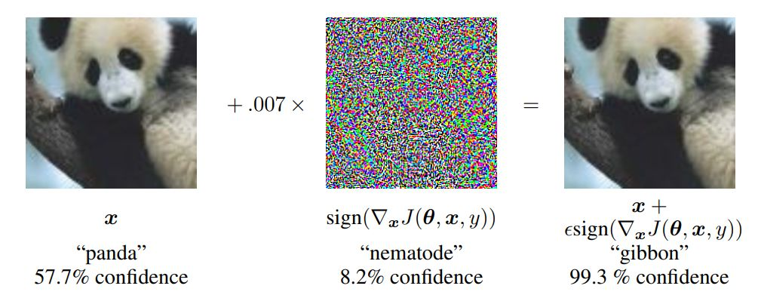
Insight into the stability of the super-resolution model
Further Research
Handle Adversarial Examples?
[1] I. J. Goodfellow, J. Shlens, and C. Szegedy, “Explaining and Harnessing Adversarial Examples,” in 3rd International Conference on Learning Representations, ICLR 2015, San Diego, CA, USA, May 7-9, 2015, Conference Track Proceedings, 2015. Accessed: Oct. 23, 2022.
Adversarial Examples: Add noise to confuse neural networks

Slide 13
Insight into the stability of the super-resolution model
Further Research
Handle Adversarial Examples?
Related Works
[1] A. Ilyas, S. Santurkar, D. Tsipras, L. Engstrom, B. Tran, and A. Madry, “Adversarial Examples Are Not Bugs, They Are Features,” in Advances in Neural Information Processing Systems, 2019, vol. 32. Accessed: Oct. 17, 2022.
Maybe this is why super-resolution models more stable

Slide 14
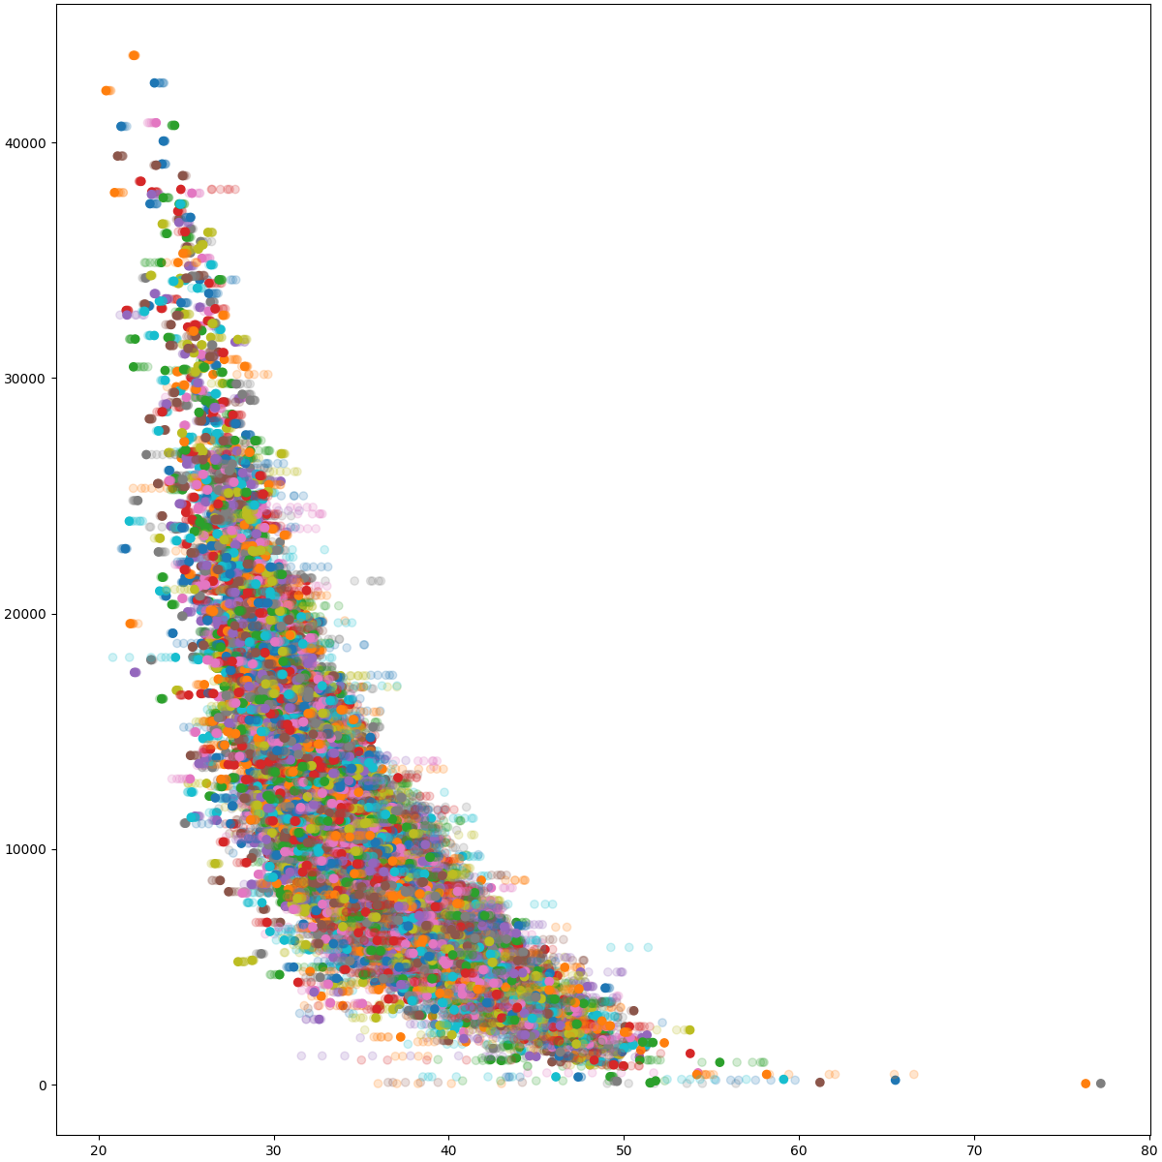
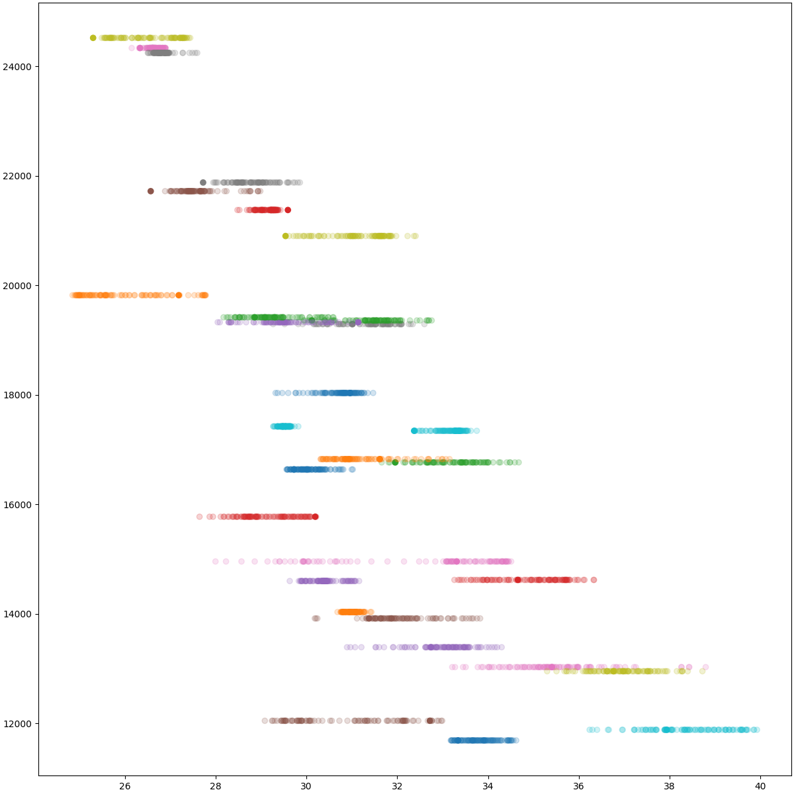
Correlation between compressed video and super-resolution
What impress me
Correlation between PSNR and packet size
Vimeo90k
REDS
Packet Size
PSNR (BasicVSR)

Slide 15
Correlation between compressed video and super-resolution

Slide 16
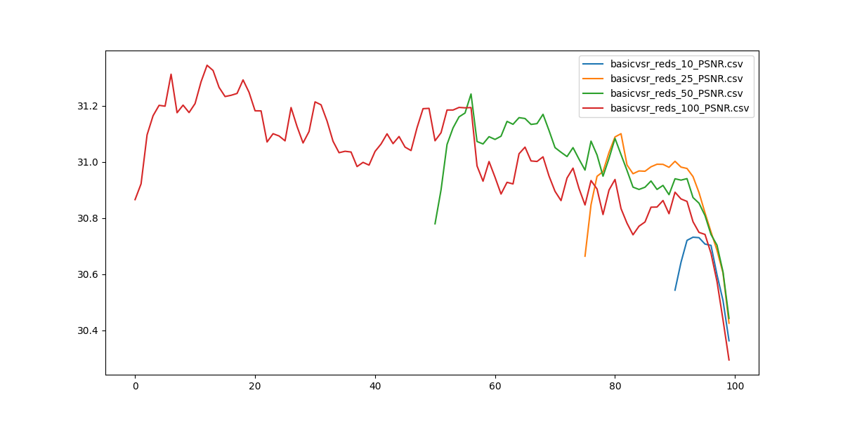
Efficiency of leveraging inter-frame similarity
What confuse me
Model | Seq length | PSNR | Y PSNR | SSIM | Y SSIM
Bicubic |  | 29.79 | 31.32 | 0.8483 | 0.8684
EDVR | 7 | 34.08 |  | 0.9216
TDAN | 5 | 34.13 |  | 0.9240
BasicVSR | 7 | 35.00 | 36.85 | 0.9292 | 0.9415
VRT | 3 | 35.37 | 37.16 | 0.9329 | 0.9450
VRT | 7 | 36.04 | 37.87 | 0.9399 | 0.9514
VRTDv2 | 7 | 35.42 | 37.37 | 0.9344 | 0.9477
VRTDv2 Quantized | 7 | 35.34 | 37.28 | 0.9336 | 0.9469
VRTDv3 | 7 | 35.35 | 37.34 | 0.9345 | 0.9476
VRTDv3 Quantized | 7 | 35.39 | 37.37 | 0.9342 | 0.9474

Slide 17
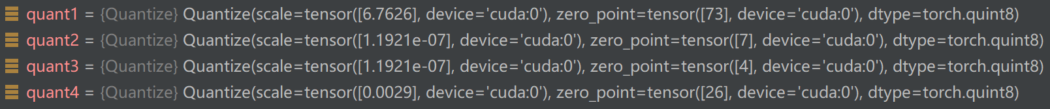
Efficiency of extract multi-scale information
What confuse me
Model | Seq length | PSNR | Y PSNR | SSIM | Y SSIM
Bicubic |  | 29.79 | 31.32 | 0.8483 | 0.8684
EDVR | 7 | 34.08 |  | 0.9216
TDAN | 5 | 34.13 |  | 0.9240
BasicVSR | 7 | 35.00 | 36.85 | 0.9292 | 0.9415
VRT | 3 | 35.37 | 37.16 | 0.9329 | 0.9450
VRT | 7 | 36.04 | 37.87 | 0.9399 | 0.9514
VRT Only Branch 1 | 7 | 33.59 | 35.43 | 0.9094 | 0.9256

Slide 19
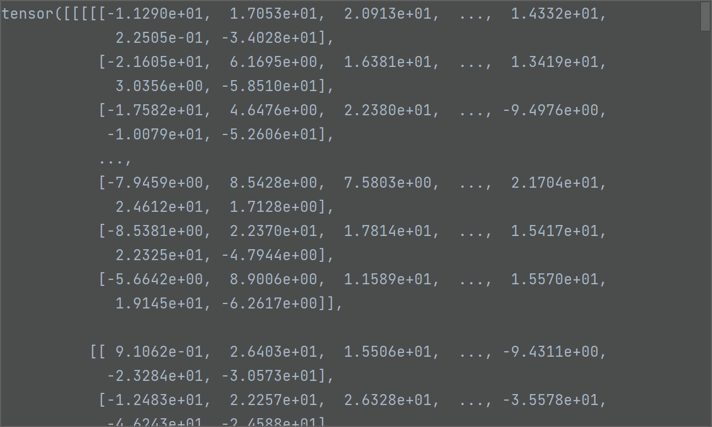
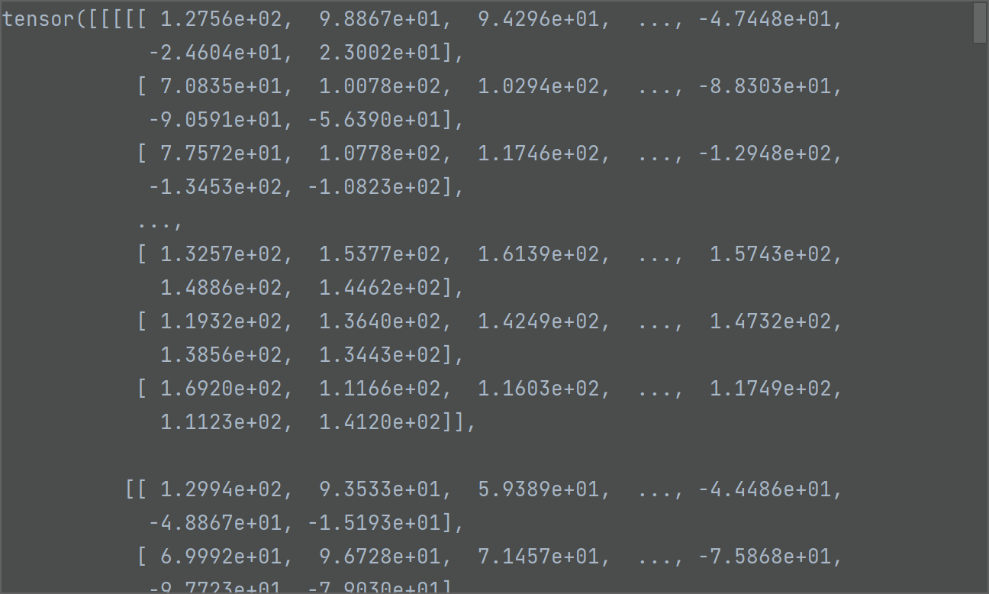
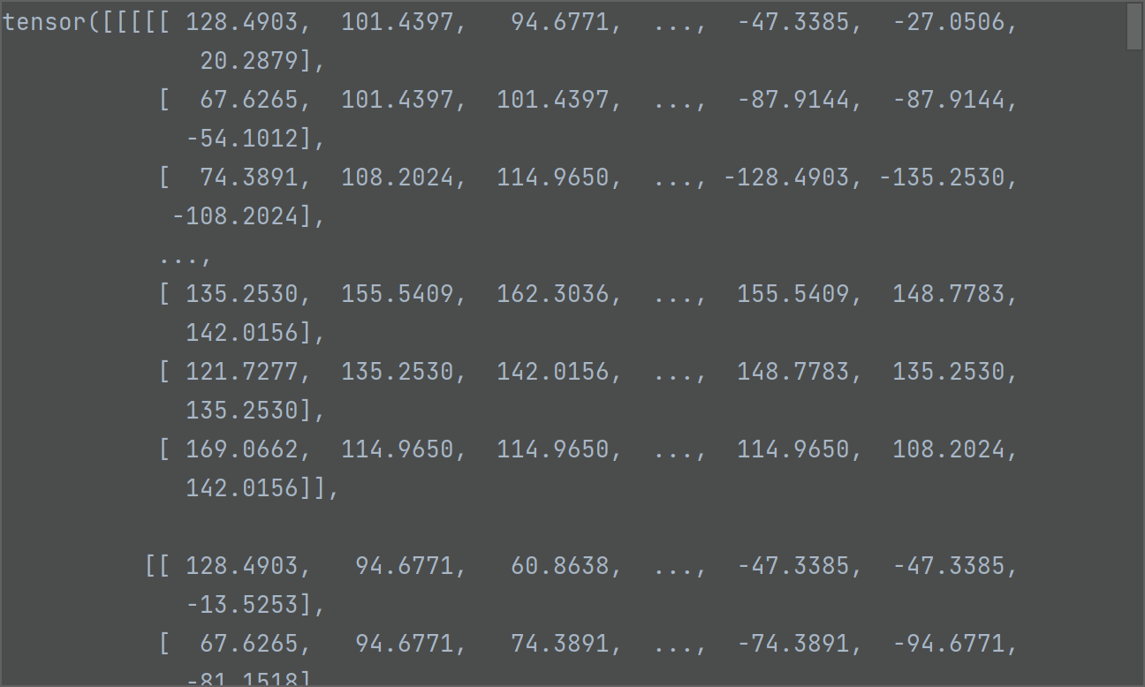
X1 , X1 Compressed
X1 Quantized

Slide 20
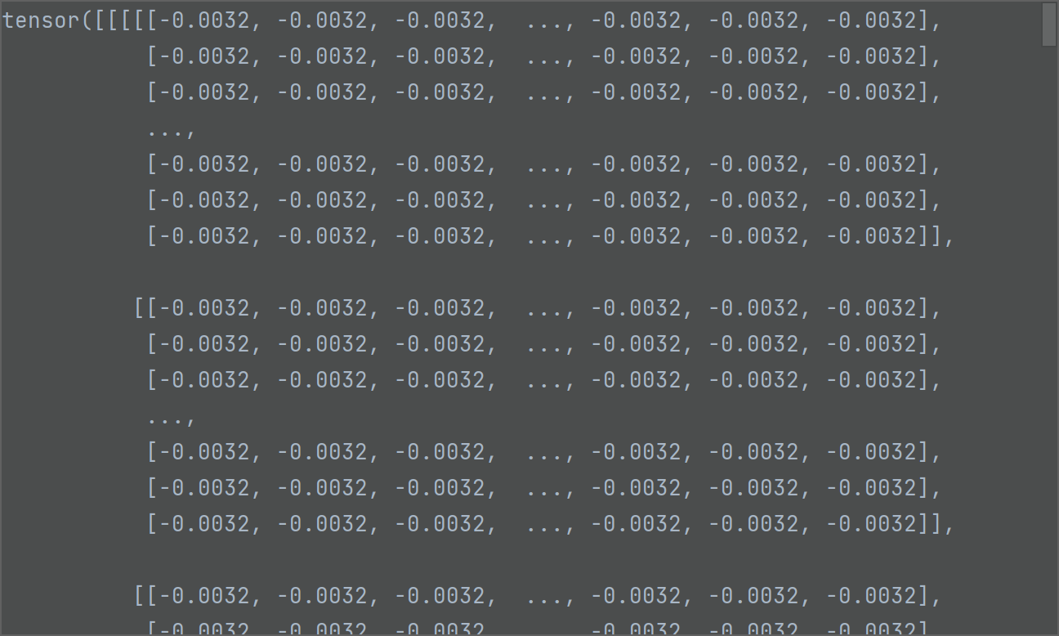
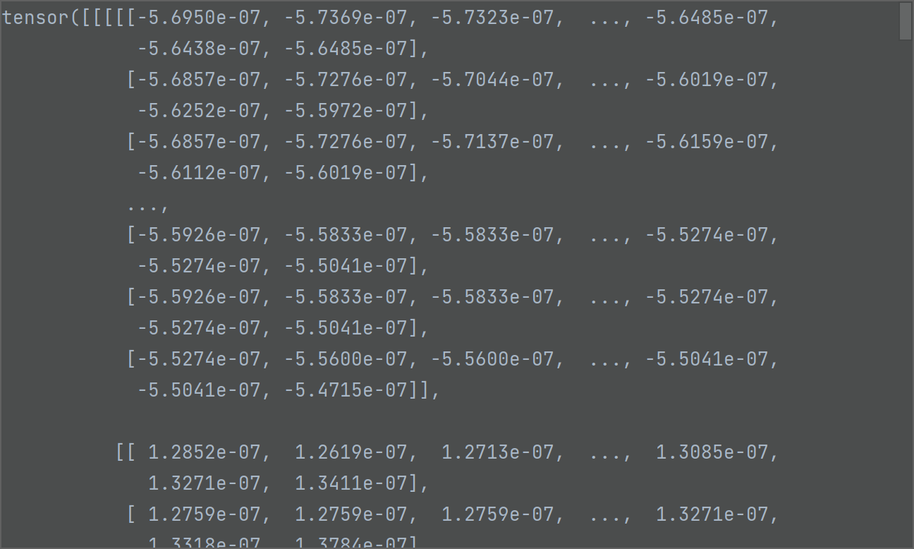
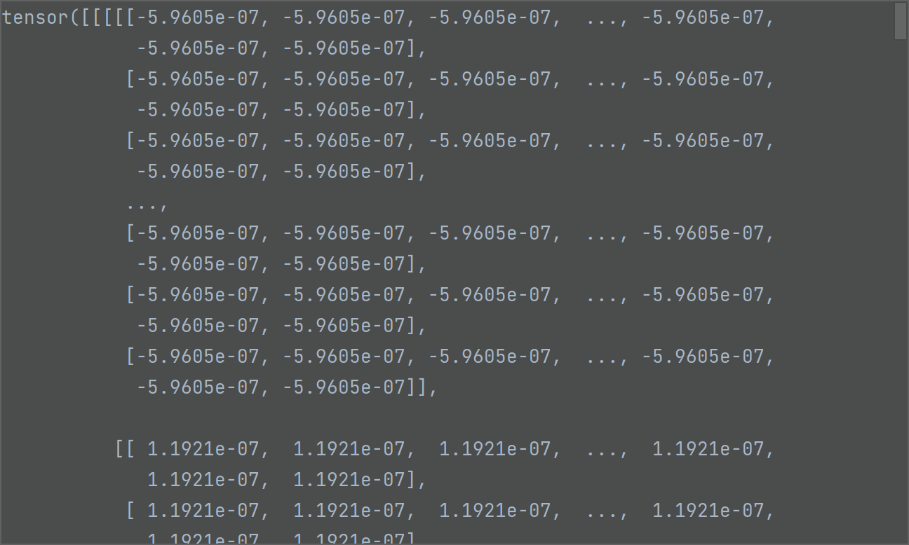
X2 , X2 Compressed
X2 Quantized

Slide 21
X3 , X3 Compressed
X3 Quantized

Slide 22
