Slide 1





ME688- ADVANCED MACHINING PROCESSES
A PRESENTATION ON
ELECTROCHEMICAL DISCHARGE MACHINING
(ECDM) FOR CONDUCTING AND NON-CONDUCTING CERAMICS
INDRAJEET SINGH YADAV (214103221)
NIKHIL D RAJ
(214103225)
PHUL BABU (214103228)
PRATEEK PATEL (214103229)
Group no. 17
MTech – Manufacturing Science and Engineering, Department of Mechanical Engineering, Indian Institute of Technology Guwahati

Slide 2
Introduction
ECM
EDM
ECDM
ECDM
Hybrid of ECM & EDM
Micromachining of brittle materials
2 Material removal mechanisms:
    Spark erosion
    Chemical reaction
Other names for ECDM
ECSM – Electrochemical spark machining
ECAM – Electrochemical anode machining
DMNC – Discharge machining of Non-conductors
SAE – Spark assisted etching
SACE – Spark assisted chemical engraving

Slide 3
Introduction
History of ECDM
1968 – First drilling of glass
1988 –
First micro holes drilled in steel plate
1996 – First time machining of partially
conductive piezo – electric ceramic reported
2007 – Characterization of micro holes of glass
2015 – Machining of Aluminum oxide

Slide 4
Introduction
Ceramics
Inorganic solid made up of either metal or non-metal compounds, shaped and hardened by heating to high temperatures.
Strength to weight ratio
Comes from Greek word meaning pottery
Traditional and Advanced ceramics
Conducting and Non-conducting ceramics
Ionic and electronic conduction
Eg. Doped Tin oxide, doped Zinc oxide etc.

Slide 5
Working Principle
A DC power supply is applied between tool (cathode) and anode.
Electro-Chemical reaction takes place as :
  Reactions at anode & electrolyte interface are
M → M^{z+} + Z^{e-}
M^{z+} + Z(OH)⁻ → M(OH)_{z}
2H₂O → O₂ + 4H⁺ + 4e⁻ (In acidic solution)
4(OH)⁻ → O₂ +2H₂O + 4e⁻ (in alkaline solution)
  Reactions at cathode and electrolyte interface are
  2H⁺ + 2e⁻ →H₂ (In acidic solution)
2H₂O + 2e⁻ → 2(OH) + H₂ (in alkaline solution)

Slide 6
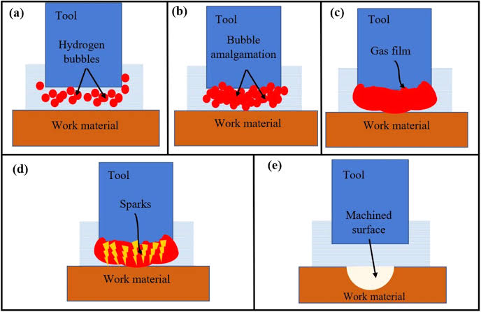
Working Principle
Generation of hydrogen gas bubble takes place around the tool
Gas bubble generation depends on applied voltage
Due to gas bubble coalescence, a thin gas film is formed on tool surface
Gas layer acts as a dielectric which insulate tool surface and electrolyte for a short period of time
The electric discharge action takes place between tool and workpiece due to breakdown of insulating layer of gas bubble
Sparking or electric discharge is occurs due to switching action (Basak & Ghosh)
When applied voltage reaches a critical voltage, conducting bridges are become very narrow and current density is very high cause instant boiling
Boiling blows the bridges and current is dipped to zero at high voltage and very high temperature, hence spark is generated
Material removal mechanism are spark erosion and chemical dissolution or etching
Fig.1: Schematic representation

Slide 7
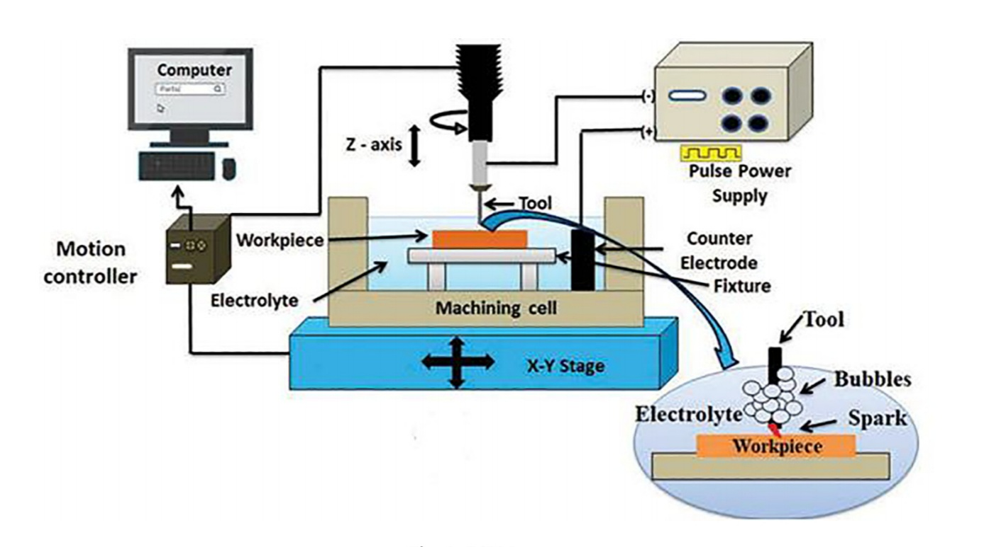
Machine Setup
Power Supply – Simple DC or Pulsed DC
Main tool and/or Auxiliary tool
Electrolytes – NaCl ,NaOH, KOH,etc
Feed control system- continuous electrolyte flow & flush the debris
Fig.2: Machine setup

Slide 8
Literature Review
Yang and his group added SiC abrasives in the electrolyte and found increased performance in terms of overcut quality. It was found that stronger pulse current has better machining effect while slicing glass and quartz. Also the difference between weight loading mechanism and reciprocating mechanism was studied.
Cao Xuan and his team have worked on stabilizing the gas films necessary to control the sparking by reducing the required voltage. They studied micro-ECDM in order to improve the machining of 3D microstructures of glass.
They concluded that the use of a load cell and small immersion depth of the tool help reduce the
required voltage. As a result, high aspect ratio structures with high resolution in a glass workpiece
can be easily machined

Slide 9
Literature Review
Cheng et al. aimed to study an alternative spark-based micro machining method for fabricating micro holes and micro channels. Quality of gas film is a dominant factor for machining quality. It depends on the size of bubbles formed. This experiment studied the effect of voltage on size of bubble formation. The experimental results showed that a stable and dense gas film could be obtained when the applied voltage exceeded the critical voltage or transition voltage.
Bhattacharya et al. conducted a detailed experiment on how different parameters affected MRR and the quality of surface finish. They reported that the MRR depends on conductivity of electrolyte, applied voltage and tool size. Variation of tool shape did not affect the material removal. Alumina as workpiece produced effective results when the electrolyte was NaOH. It was also observed that if applied voltage exceeds a critical value, micro-cracks were developed.

Slide 10
Process Parameters
Applied voltage
Stand off distance
Electrolyte concentration
Pulse on time
The main process parameters are

Slide 11
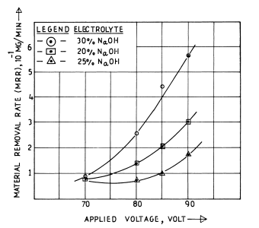
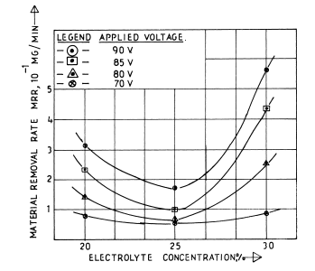
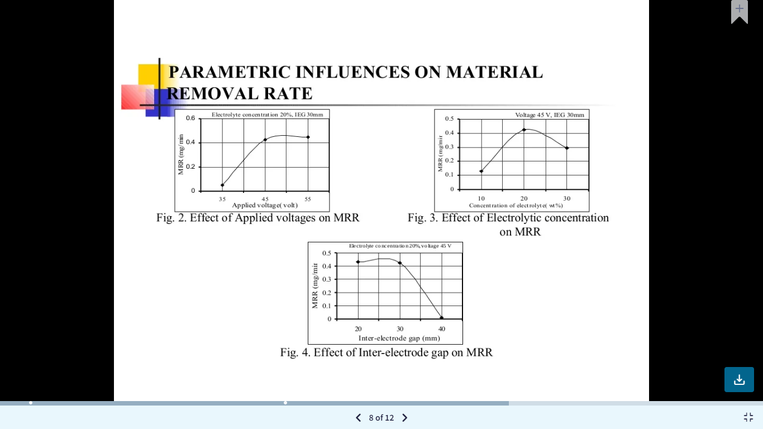
Process Parameters: Influence on MRR
MRR = $\frac{Weight of workpiece before machining −weight of workpiece after machining}{time of machining}$
Fig.3: MRR vs Voltage
Fig.4: MRR vs Electrolyte concentration
Fig.5: MRR vs inter electrode gap

Slide 12
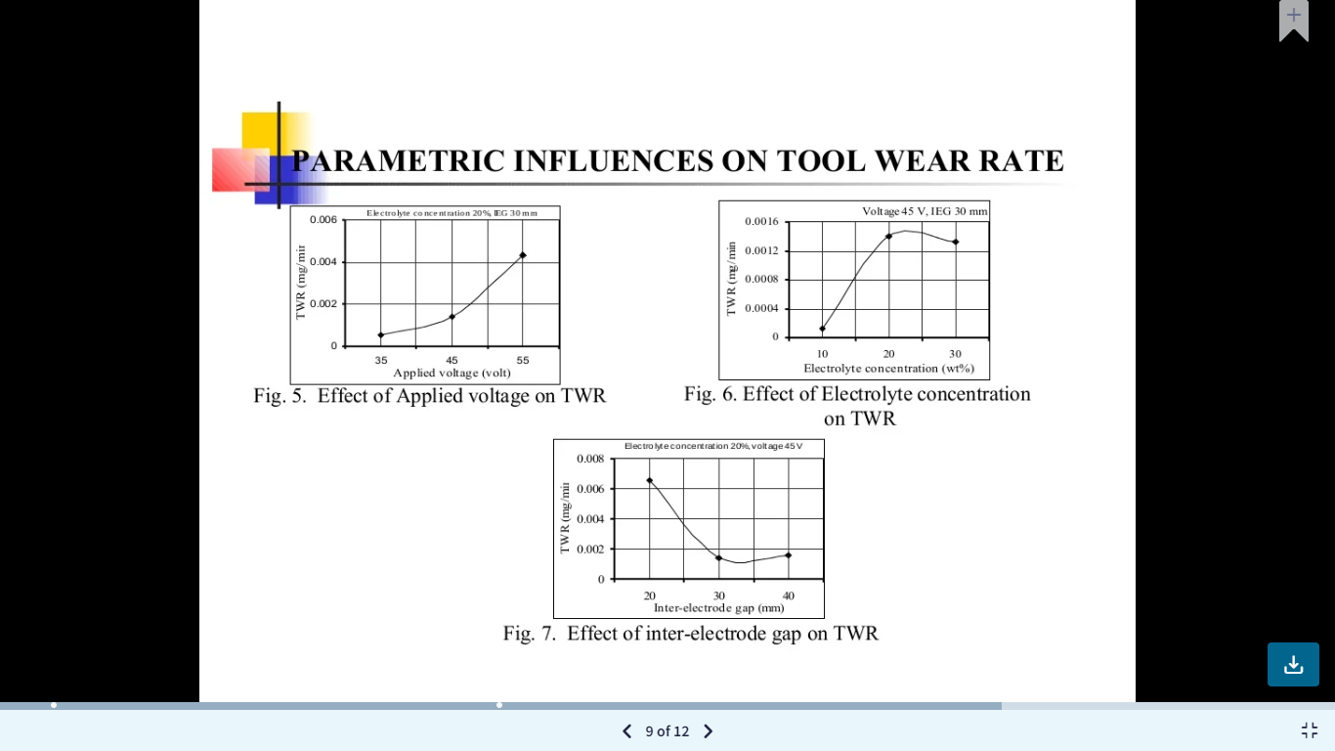
Process Parameters: Influence on tool wear rate
Fig.6: TWR vs Voltage
Fig.7: TWR vs Electrolyte concentration
TWR = $\frac{Weight of tool before machining −weight of tool after machining}{time of machining}$
Fig.8: TWR vs inter-electrode gap

Slide 13
Advantages & Disadvantages
1. The surface obtained is very smooth
2. Suitable for non-conductive materials
3. Highly accurate
4. Methods does not leave any chips or burrs
5. Less power consumption
6. Set-up is not costly and can be developed or fabricated on existing facility through modification and attachments
1. Chances of electrode wear and tear
2. Thickness of ceramic material can be machined is limited to 1.5mm
3. Radial overcut
4. Noisy

Slide 14
Applications
Through and blind micro-holes
Micro-grooves
Micro-slots
Micro-channels and complex shapes produced in conducting and non-conducting materials (Quartz, glass & ceramics etc.)
Miniature features of turbine blades
Filters for food and textiles industries
Micro-electro seam welding
Industrial applications like bearings, computer parts, artificial joints,
cutting tools, electrical and thermal insulators etc.
Trueing and dressing of grinding wheels

Slide 15
Results and Discussions
It is observed from all the literatures that most influencing parameters are voltage and electrolyte concentration in the given order.
The least influencing parameter is inter electrode gap.
Material removal rate with pulse on time increases because pulse on time increase cutting rate.
It is found that ECDM is applicable largely for non-conducting materials.

Slide 16
Conclusion
ECDM process can effectively be utilized against machining of glass, fibre reinforced composite.
An optimum voltage, concentration of electrolyte and inter electrode gap exist, which leads to optimum material removal rate.
Deposition on tool during the machining process takes place due to electrochemical reactions.
High level of electrolyte results in heat affected zone formation and damages the work sample.

Slide 17
References
Amitabha Ghosh et al., “ECDM: Principle and possibilities”, Saadhana, Vol. 22, Part 3, June 1997, pp 435-447
Ankit D. Oza, Ashish Goyal, Vyomesh Buch and Manoj Kumar, “Electrochemical discharge machining process: A review on process parameters and future scope”, 2021, pp 1-5.
B. Bhattacharyya, B.N. Doloi and S.K. Sorkhel et al., “Experimental investigation into electrochemical discharge machining (ECDM) of non-conductive ceramics materials”, November 1998, pp 146-153.
C.T.Yang et al .“Improving machining performance of wire-ECDM by adding SiC abrasive to electrolyte” , January, 2006 pp 2-6
Chih-Ping Cheng et al., “Study of gas film quality in electrochemical discharge machining”, April, 2010 pp 1-10
Manpreet singh, sarbjit singh and Sanjeev et al., “Experimental investigation for generation of micro holes on silicon wafer using electrochemical discharge machining process””, September 2019, pp 1684-1689.
Rajendra Kumar Arya et al., “Investigation on quantification and replenishment of vapourized electrolyte during deep microholes drilling using pressurised flow-ECDM process”, October, 2018, pp 2-12
Sadashiv bellubbi et al, “Optimization of process parameters in electrochemical discharge machining of silica glass through analysis of means”, 2021, IOP Conf. ser. pp 1-5.
Sanjay k. CHAK et al., “Electro chemical discharge machining: process capabilities”, volume- 4, issue-10, October, 2016.
Tarlochan Singh et al. “Developments in electrochemical discharge machining: A review on electrochemical discharge machining, process variants and their hybrid methods”, March, 2016 pp 3-12
Tianyu Geng et al., “ECDM for fabricating holes in conductive materials: A review”, April, 2021, pp 1-12
Xuan Doan Cao et al., “Micro structuring of glass with features less than 100 micrometers by ECDM”, January, 2009 pp 2-6

Slide 18
Thank You

