Slide 1
Final exam
Final exam will cover all material covered in course – i.e., all compiler phases
Focus will be on after-midterm material
There will be some questions on special topics
100 minutes exam, similar in format to midterm

Slide 2
Optimization Frameworks

Slide 3
Roadmap
Last time:
Optimization overview
Soundness and completeness
Simple optimizations
Peephole
LICM
This time:
More Optimization
Analysis frameworks
3

Slide 4
Outline
Review Dominators
Introduce some more advanced concepts
Static single assignment (SSA)
Dataflow propagation
4

Slide 5
Dominator review
5

Slide 6
Dominator terms
Domination (A dominates B):
to reach block B, you must have gone through block A
Strict Domination (A strictly dominates B)
A dominates B and A is not B
Immediate Domination (A immediately dominates B)
A immediately dominates B if A dominates B and has no intervening dominators
6

Slide 7
Dominator example
A
B
C
D
E
7

Slide 8
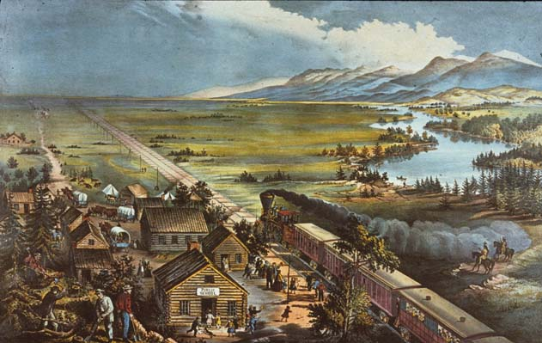
Dominance frontier
Definition: For a block x, the dominance frontier of x is the set of nodes Y such that
x dominates an immediate predecessor of Y
x does not strictly dominate Y
8

Slide 9
Example
A
B
C
D
E
9

Slide 10
Static single assignment
10

Slide 11
Goal of SSA Form
Build an intermediate representation of the program in which each variable is assigned a value in at most 1 program point:
x = 1
z = 2
y = 3
x = y
z = y
w = z
x = 1
x = 2
y = 3
i = 0;
while( i < 10){
k = i + 1;
}
Statically: There is at most one assignment statement that assigns to k
Dynamically: k can be assigned to multiple times
11

Slide 12
Conversion
We’ll make new variables to carry over the effect of the original program
x = 1
x = x
y = x
x₁ = 1
x₂ = x₁
y₁ = x₂
12

Slide 13
Benefits of SSA Form
There are some obvious advantages to this format for program analysis
Easy to see the live range of a given variable x assigned to in statement s
The region from “x = …;” until the last use(s) of x before x is redefined
In SSA form, from “x_{i} = …;” to all uses of x_{i}, e.g., “… = f(…, x_{i}, …);”
Easy to see when an assignment is useless
We have “x_{i} = …;” and there are no uses of x_{i} in any expression or assignment RHS
“‘x_{i} = …;’ is a useless assignment”
“‘x_{i} = …;’ is dead code”
In other words, some useful information is pre-computed, or at least easily recoverable from SSA form
Warning 1: Dead code = useless assignments + unreachable code
13

Slide 14

Optimizations Where SSA Helps
At “if (b < 4)”, b is only reached by “b = 2;”
Therefore, the else branch is unreachable
(dead), and can be removed
Dead-Code Elimination
int a = 9;
int b = 2;
if (g < 12){
a = 1;
} else { if (b < 4){
a = 2; } else {
a = 3; }
}
b = a;
return 2;
int a₁ = 9;
int b₁ = 2;
if (g₁ < 12){
a₂ = 1;
} else { if (b₁ < 4){
a₃ = 2; } else {
a₄ = 3; }
a₅ = $φ$(a₃, a₄);
}
a₆ = $φ$(a₂, a₅);
b₂ = a₆;
return 2;
14

Slide 15
Optimizations Where SSA Helps
Constant-propagation/constant-folding
6
int a = 30;
int b = 9 - (a / 5);
int c;
c = b * 4;
if (c > 10) {
c = c - 10;
}
return c * (60 / a);
int a = 30;
int b = 3;
int c;
c = 12;
if (true) {
c = 2;
}
return 4;
int a = 30;
int b = 3;
int c;
c = b * 4;
if (c > 10) {
c = c - 10;
}
return c * 2;
int a = 30;
int b = 3;
int c;
c = 12;
if (c > 10) {
c = c - 10;
}
return c * 2;
int a = 30;
int b = 3;
int c;
c = 12;
if (true) {
c = 2;
}
return c * 2;
true
12
2
2
4
return 4;
15

Slide 16
What About Conditionals?
x = 5
x = x – 1
x < 3
x₁ = 5
x₂ = x₁ – 1
x₂ < 3
y = x * 2
w = y
y = x - 3
y₁ = x₂ * 2
w₁ = y₁
y₂ = x₂ - 3
w = x - y
z = x + y
w₂ = y - x
z = x + y
Which y to use?
16

Slide 17

Phi Functions ($φ$)
We introduce a special symbol Φ at such points of confluence
Φ’s arguments are all the instances of variable y that might be the most recently assigned variant of y
Returns the “correct” one
Do we need a Φ for x?
No!
x₁ = 5
x₂ = x₁ – 1
x₂ < 3
y₁ = x₂ * 2
w₁ = y₁
y₂ = x₂ - 3
y₃ = Φ(y₁,y₂)
w₂ = y - x
z = x + y
w₂ = y₃ – x₂
z₁ = x₂ + y₃
17

Slide 18
Computing Phi-Function Placement
Intuitively, we want to figure out cases where there are multiple assignments that can reach a node
To be safe, we can place a Φ function for each assignment at every node in the dominance frontier
x₁ = 5
x₂ = x₁ – 1
x₂ < 3
y₁ = x₂ * 2
w₁ = y₁
y₂ = x₂ - 3
y₃ = Φ(y₁,y₂)
w₂ = y – x₂
z₁ = x₂ + y₃
y₃
18

Slide 19
Pruned Phi Functions
This criterion causes a bunch of useless Φ functions to be inserted
Cases where the result is never used “downstream” (useless)
Pruned SSA is a version where useless Φ nodes are suppressed
19

Slide 20
Dataflow Analysis
20

Slide 21
Dataflow framework idea
Many analyses can be formulated as how data is transformed over the control flow graph
Propagate static information from:
the beginning of a single basic block
the end of a single basic block
The join points of multiple basic blocks
21

Slide 22
Dataflow framework idea
Meet Lattice
Transfer function
How data is propagated from one end of a basic block to the other
Meet operation
Means of combining lattice between blocks
22

Slide 23
Dataflow analysis direction
Forward analysis
Start at the beginning of a function’s CFG, work along the control edges
Backwards analysis
Start at the end of a function’s CFG, work against the control edges
Continuously propagate values until there is no change
23

Slide 24
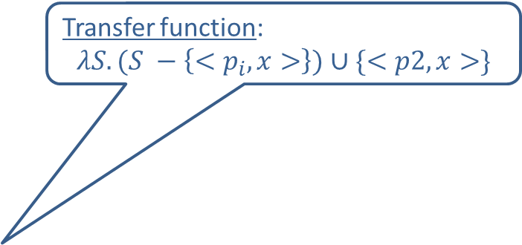
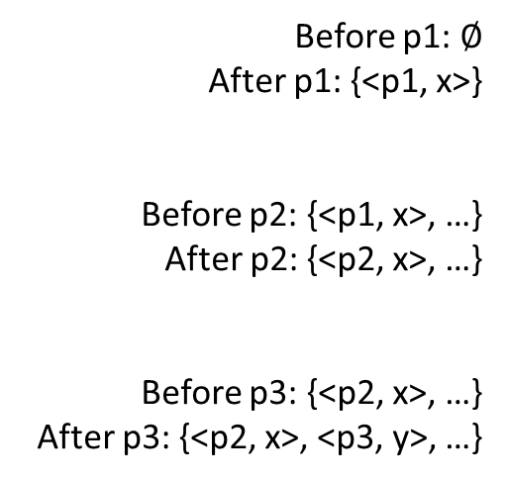
Dataflow-Analysis Example 1
Reaching definitions
Transfer function:
$$λS.(S −\left\{<p_{i},x>\right\})∪\{<p2, x>\}$$
Before p1: $∅$
After p1: {<p1, x>}
Before p2: {<p1, x>, …}
After p2: {<p2, x>, …}
Before p3: {<p2, x>, …}
After p3: {<p2, x>, <p3, y>, …}
p1: x = 1;
. . .
p2: x = 2;
. . .
p3: y = x;
Data: sets of <program-point, variable> pairs
Note: for expository purposes, it is convenient to assume we have a
statement-level CFG rather than a basic-block-level CFG.
24

Slide 25
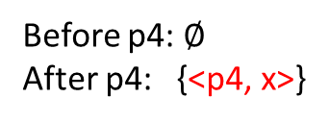
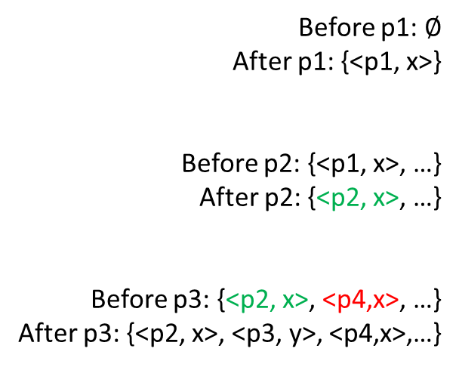
Dataflow-Analysis Example 1
Reaching definitions
Meet operation: Union of sets (of <program-point, variable> pairs)
Before p1: $∅$
After p1: {<p1, x>}
Before p2: {<p1, x>, …}
After p2: {<p2, x>, …}
Before p3: {<p2, x>, <p4,x>, …}
After p3: {<p2, x>, <p3, y>, <p4,x>,…}
p1: x = 1;
. . .
p2: x = 2;
. . .
p3: y = x;
Before p4: $∅$
After p4: {<p4, x>}
p4: x = 7;
Note: for expository purposes, it is convenient to assume we have a
statement-level CFG rather than a basic-block-level CFG.
25

Slide 26
Dataflow-Analysis Example 1
Reaching definitions: Why is it useful?
Answers the question “Where could this variable have been defined?”
Before p1: $∅$
After p1: {<p1, x>}
Before p2: {<p1, x>, …}
After p2: {<p2, x>, …}
Before p3: {<p2, x>, <p4,x>, …}
After p3: {<p2, x>, <p3, y>, <p4,x>,…}
p1: x = 1;
. . .
p2: x = 2;
. . .
p3: y = x;
Before p4: $∅$
After p4: {<p4, x>}
p4: x = 7;
26

Slide 27
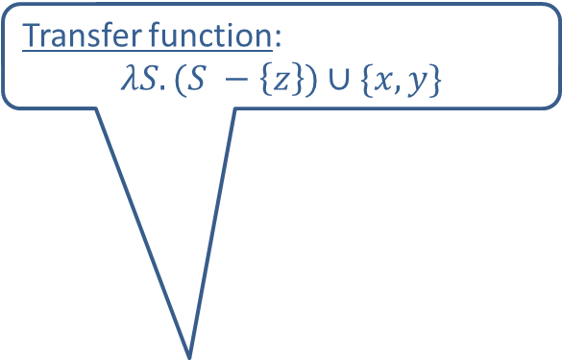
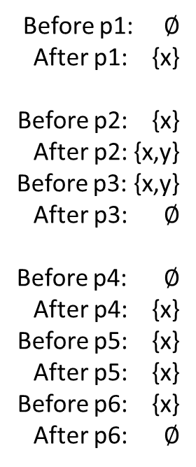
Dataflow-Analysis Example 2
Transfer function:
$$λS.(S −\left\{z\right\})∪\{x,y\}$$
Live Variables
Before p1: $∅$
After p1: {x}
Before p2: {x}
After p2: {x,y}
Before p3: {x,y}
After p3: $∅$
Before p4: $∅$
After p4: {x}
Before p5: {x}
After p5: {x}
Before p6: {x}
After p6: $∅$
p1: x = 1;
if (…) {
p2: y = 0;
p3: z = x + y;
}
p4: x = 2;
p5: z = 3;
p6: cout << x;
Data: sets of variables
z is not live after p5, and thus p5 is a useless assignment (= dead code)
27

Slide 28
The end: or is it?
Covered a broad range of topics
Some formal concepts
Some practical concepts
What we skipped
Linking and loading
Interpreters
Register allocation
Performance analysis / Proofs

