Slide 1
SPH Fluid Simulation
Presented by Yuzhu QIN, Atulit Kumar

Slide 2
Outline
1
Introduction
2
Method
3
Result
4
Discussion

Slide 3
Introduction
SPH method
Smooth kernel
Basic Idea – treat the fluid as a lot of particles
Forces – pressure, viscosity, surface tension, gravity

Slide 4
Outline
1
Introduction
2
Method
3
Result
4
Discussion

Slide 5
Method
Particle is a class
Initial many particles at the beginning.
Apply force to the particle every frame.
Calculate the position of particles.
Draw the particles on the screen.

Slide 6
Method
2. Force
Key Point:
Force Scope: hard to find a “good value”.
Parameters: Pressure, Viscosity, Surface tension, Gravity need a balance. But, balance is one of the most difficult thing in the world. Really difficult!

Slide 7
Method
3. Collision
Need a boundary to hold the fluid.
Implement by collision.
If the particles reach the boundary, set its velocity in that direction to 0, set its accelerate in that direction to 0.

Slide 8
Method
4. Change gravity direction
In order to let the fluid move again after it is stable, we can change the direction of the gravity.

Slide 9
Outline
1
Introduction
2
Method
3
Result
4
Discussion

Slide 10
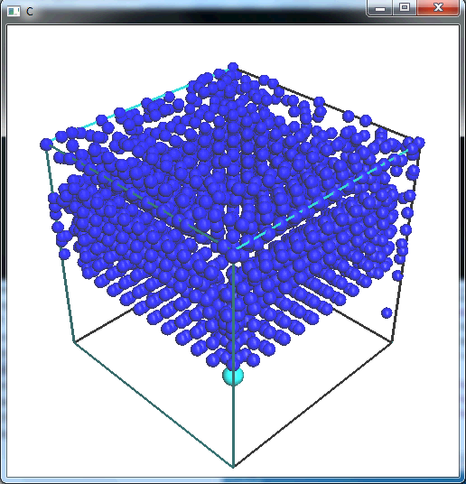
Result

Slide 11
Outline
1
Introduction
2
Method
3
Result
4
Discussion

Slide 12
Discussion
Still not very accurate to control the position by using force.
Try to move the rendering part to GPU, but failed unluckily.
No time for rendering the surface. It’s another topic. We thought it too simple.
Take a long time to become stable.

Slide 13
Thank you

