Slide 1
UMD Alumni Association Dataset Analysis
Presented by:
Project team 0506_15
- Ying Chai
- Wenxi Wu
- Zahabiya Halela
- Rajesh Reddy

Slide 2
Agenda
· Introduction
· Methods
· Findings
· Recommendation
· Future work

Slide 3
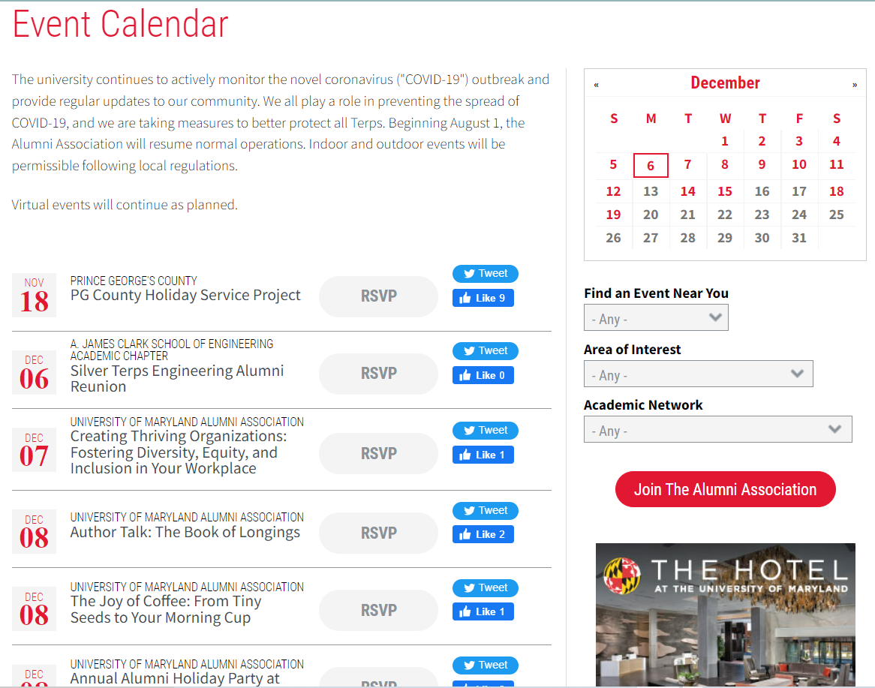
Introduction
Provide business analytics (BA) consulting to the University of Maryland Alumni Association
Alumni Association :
In College Park, The UMD Alumni Association was formed in 1989. It is an association for the alums that hosts various events like social, fund rising, etc throughout the year. They serve over 400,000 alumni worldwide. To be a part of the association, they charge a membership fee which is given on their website.
Mission Objectives:
Based on the variables provided in the dataset, how can
we get more first time attendees to attend events?
Based on the variables provided in the dataset, how can
we get more major gift prospects to attend events?

Slide 4
Methodology
1
2
3
Data Importing
Data Understanding
Data Cleaning
Data Preprocessing
Exploratory Data Analysis
Summary statistics
Visualizations
Answering the mission objectives
Summarising Findings
Recommendations

Slide 5
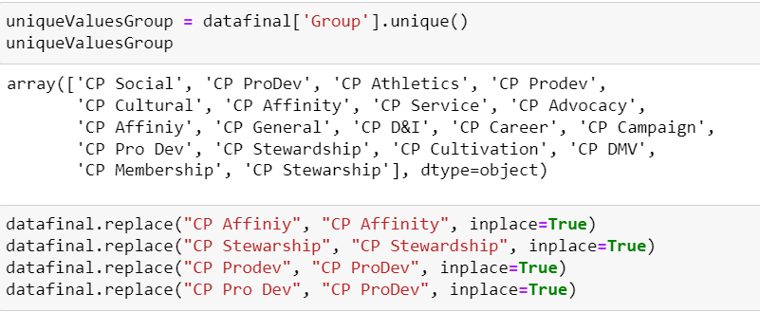
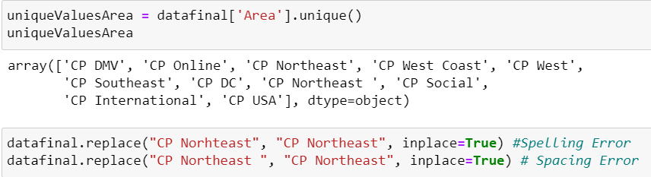
Data Cleaning & Processing
Python processing to split Location Description & Group description
Python processing to convert and standardize the names of event and location groups

Slide 6
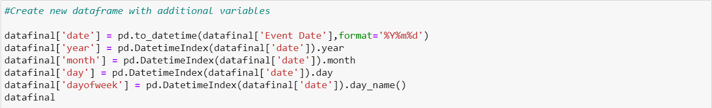
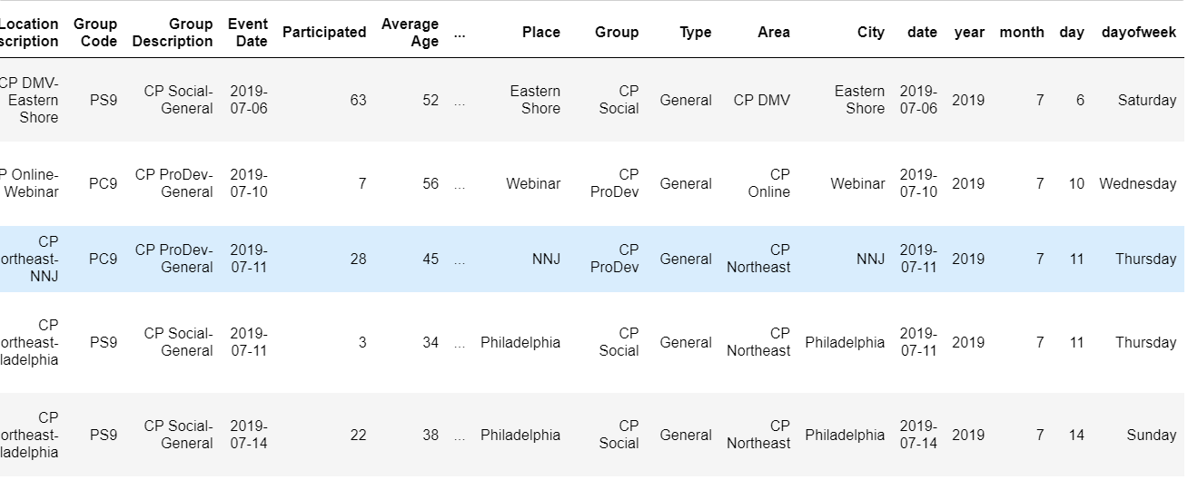
Breaking Down the Date Column
Converting the ‘Event Date’ column and breaking it into years, months and days of the week for further analysis
Data Snippet
Additional variables

Slide 7

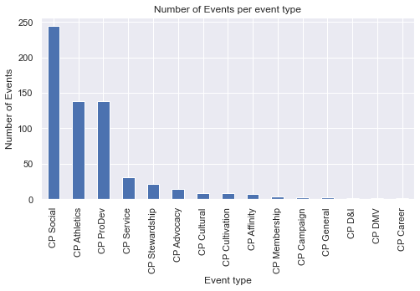
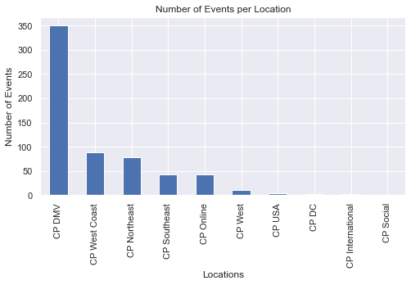
Simple analysis -- Event types and locations
Event types
Event locations
Specific types of events and locations have a higher number than the rest

Slide 8
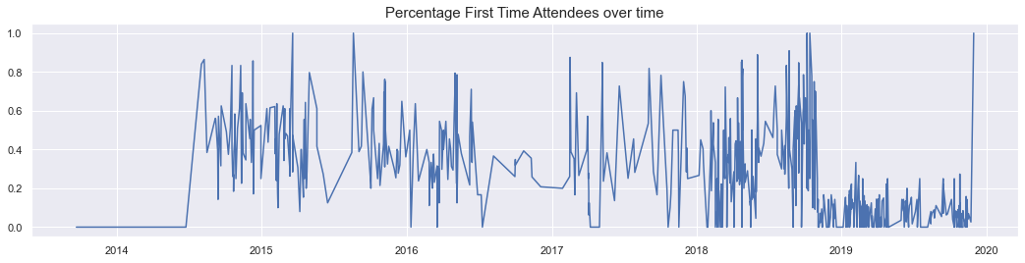
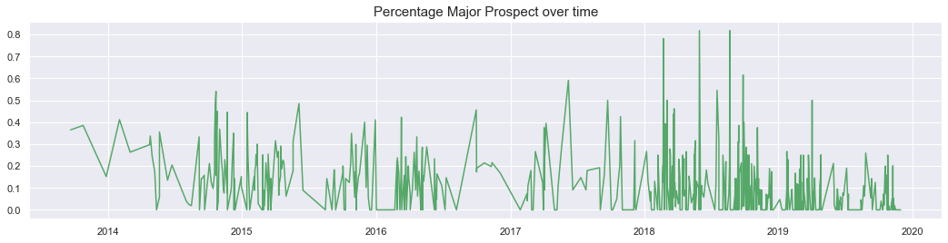
Simple analysis -- Time series for 1st time attendee and Major prospects

Slide 9
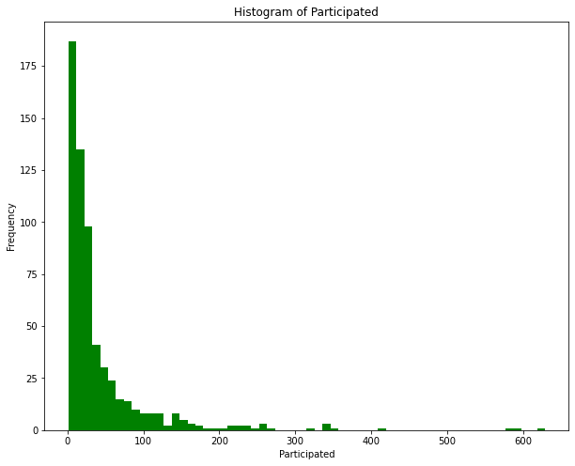
Simple analysis -- Distribution of Participated
Generally, most events held are small-scale events (Fewer than 100 participated)

Slide 10
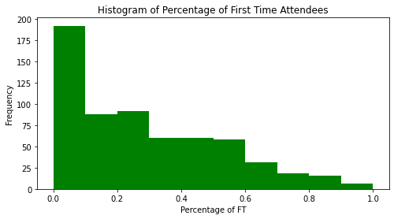
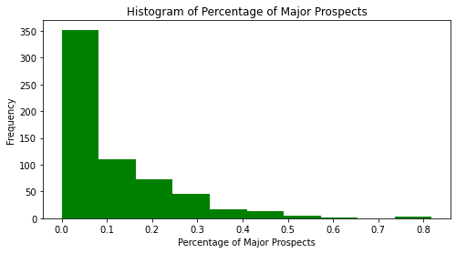
Simple analysis -- Distribution of First time attendees and Major prospects
Left skewed charts

Slide 11
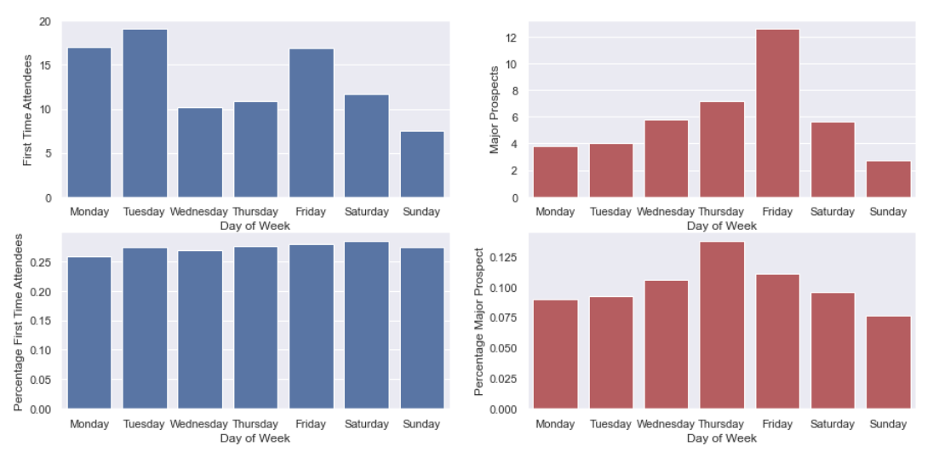
Simple analysis - Day of week
Day of week V.S. First time attendees
Day of week V.S. Major Prospects

Slide 12
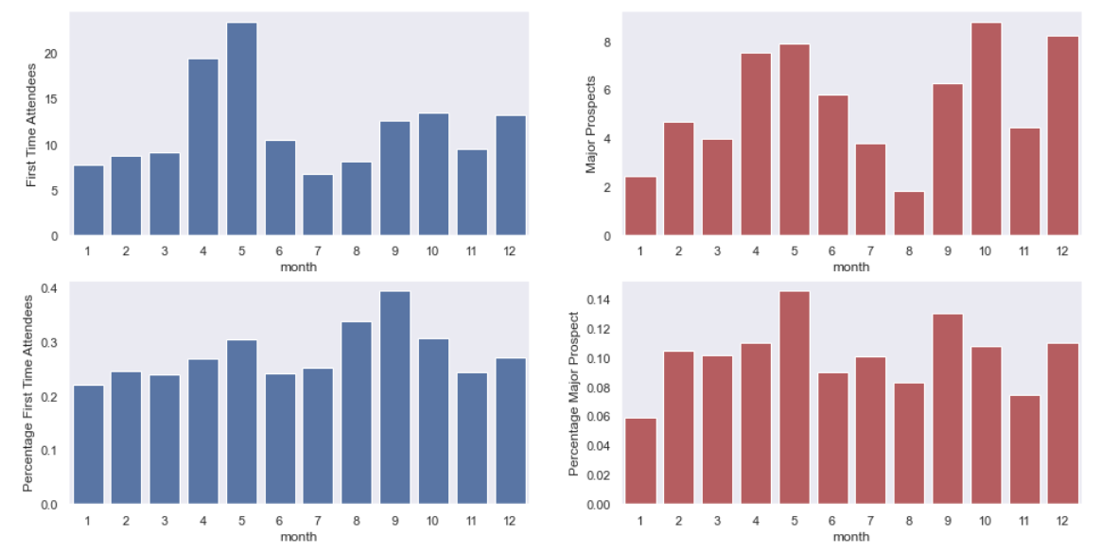
Simple analysis - Month
First time attendees per month
Major prospects per month
Notes:
Frequency of events
Percentage changes
Trend (Not really have)

Slide 13
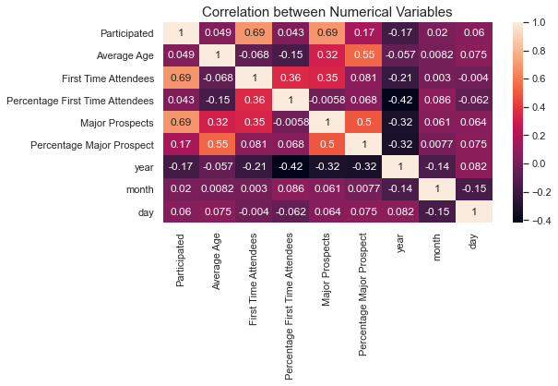
Simple analysis - Correlations

Slide 14
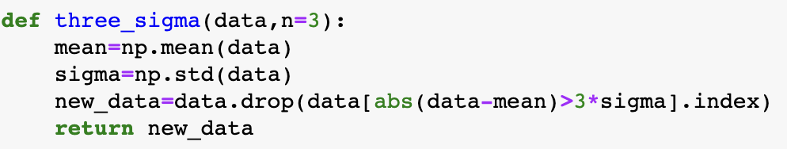
Outlier Function
Notes:
Frequency of events
Percentage changes
Trend (Not really have)

Slide 15
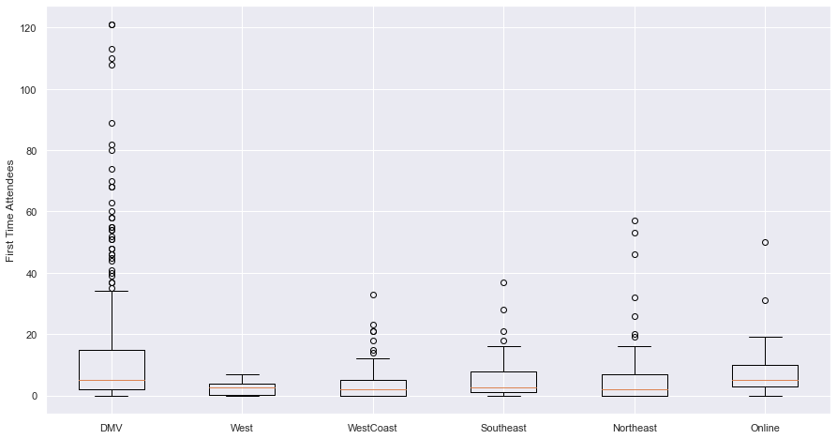
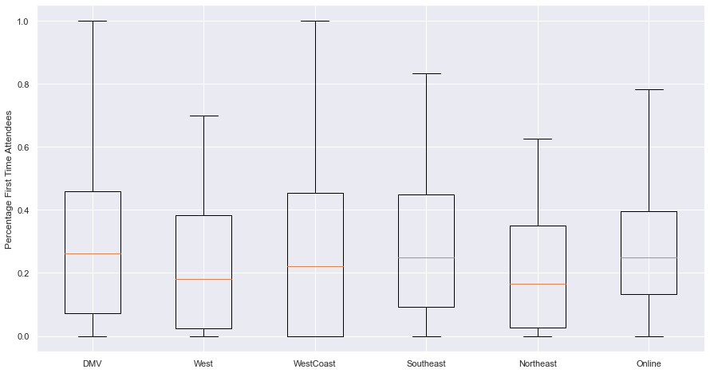
Regions
The relation between Regions and first-time attendees, percentage first time attendees, major prospects, percentage major prospects
Conclusion: Activities in the DMV region can attract more first-time attendees

Slide 16
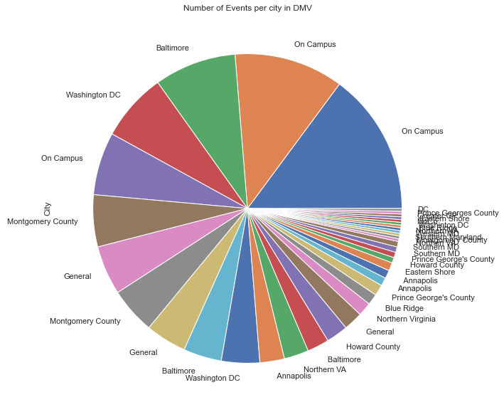
Simple analysis -- Events in DMV
Conduct more on campus events

Slide 17
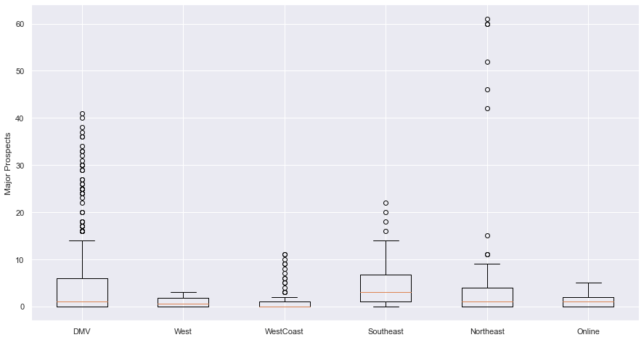
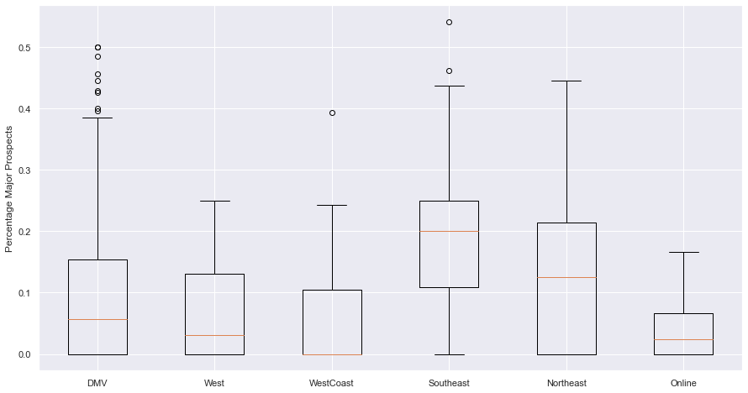
Regions
The relation between Regions and first-time attendees, percentage first time attendees, major prospects, percentage major prospects
Conclusion: Activities in the Southeast region can attract more major potential gift prospect attendees

Slide 18
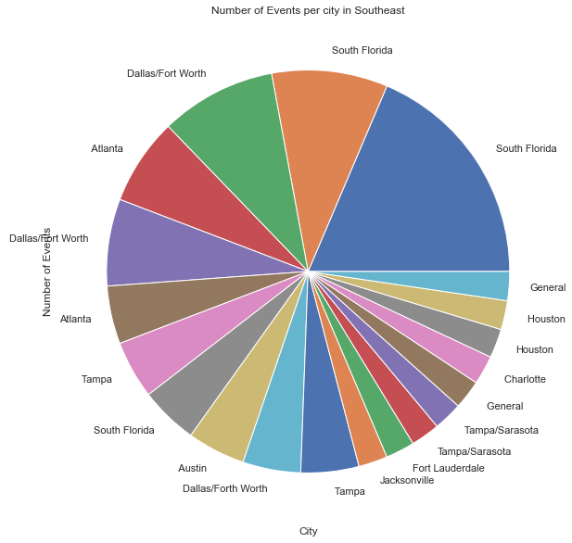
Simple analysis -- Events in Southeast
Conduct events in South Florida, Dallas, and Atlanta.

Slide 19
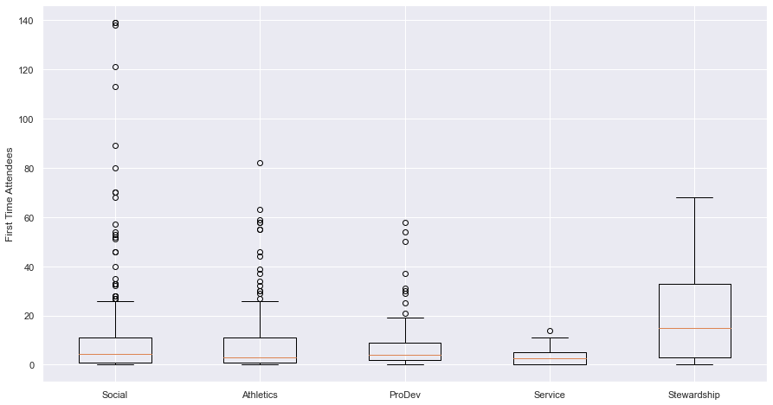
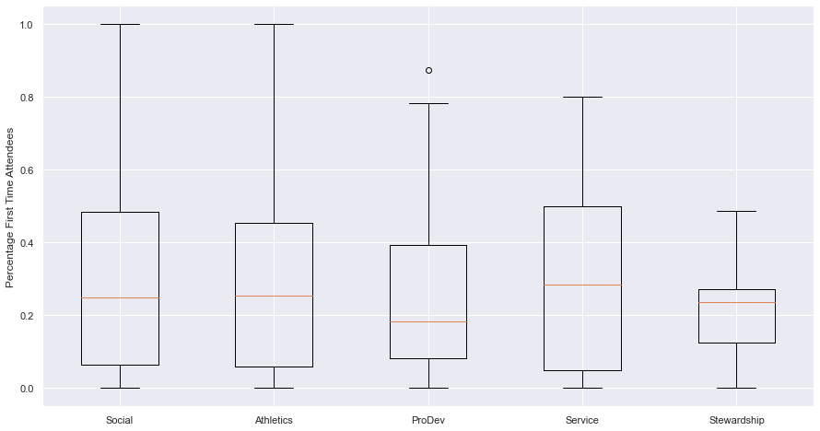
Type of Events
Relation between Types of Events and First time attendees, percentage first time attendees, Major Prospects and Percentage Major Prospects

Slide 20
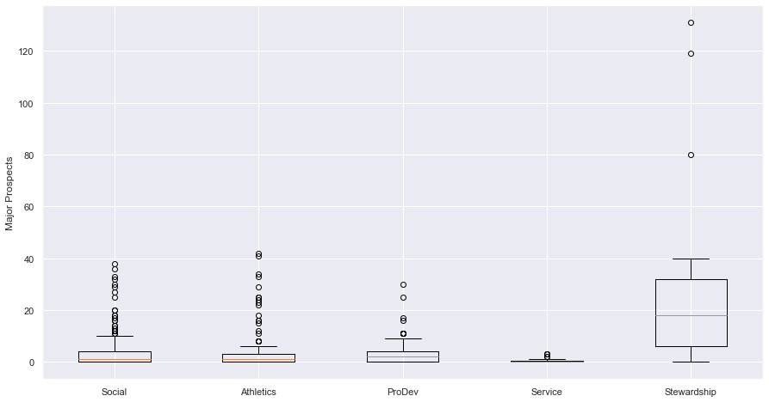
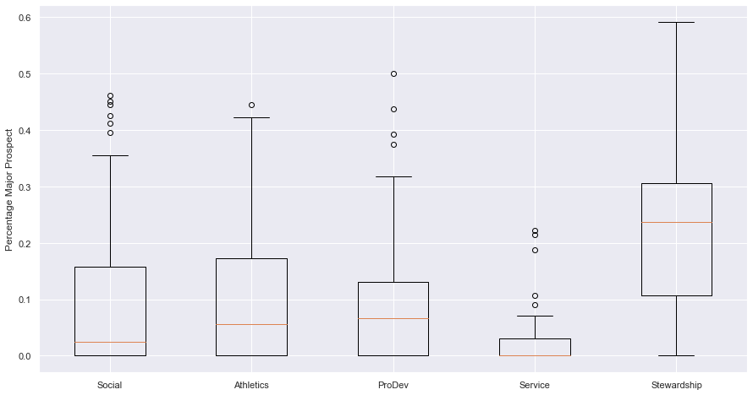
Type of Events
Relation between Types of Events and First time attendees, percentage first time attendees, Major Prospects and Percentage Major Prospects

Slide 21
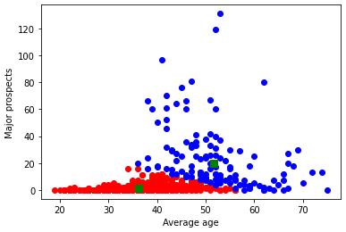
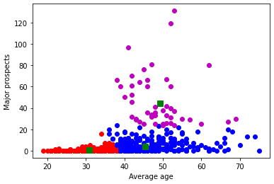
The relation between average age and major prospects
We use K-mean clustering and let k =2 and 3:

Slide 22
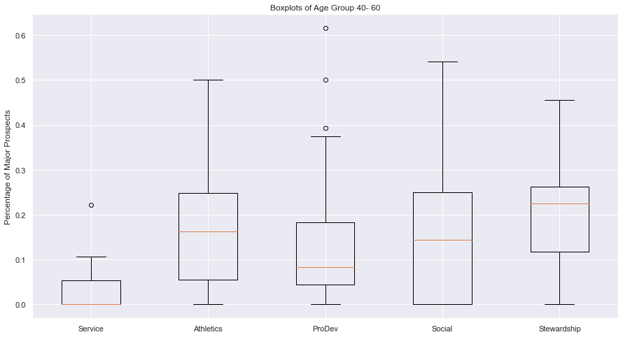
What event attracts people around 40-60
Median value of Stewardship category is higher, giving us the idea that we can have more of these kind of events for age group 40-60 members

Slide 23
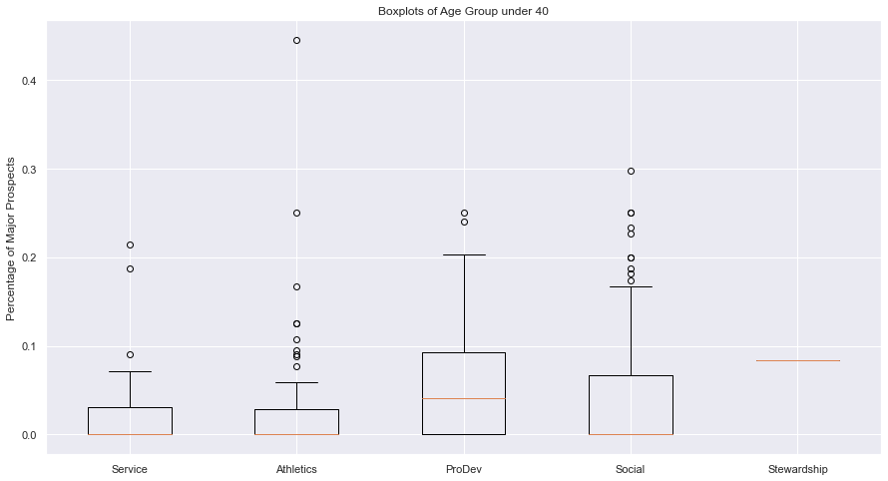
What event attracts people under 40
Median value of ProDev category is higher giving us the idea that we can have more of these kind of events for age group under 40
One single row entry

Slide 24
Recommendations
We can recommend that the association to hold events primarily on Thurs, Fri & Saturday, based on our analysis these days attract a higher percentage of major prospects and first time attendees
In terms of location, we found that activities in the DMV region attract more first time attendees. For major prospects, events should be more centered around the Southeast region
Additionally, overall participation of events is highest in the months of April, May & June but July, August, Sept might increase the chance of attracting major prospects and first time attendees as per history data
On of the thing we found that Alumni Association could also implement is clustering the members by Age and sending them specific invites to different types of events. This will help increase major prospects
The gap between events has reduced from year to year

Slide 25
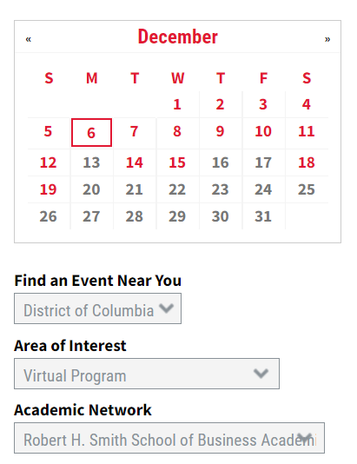
Future Work
USE CASE 1 :
Time series forecasting for number of participated members based on different locations
SCOPE :
Build a simple time series forecasting system to help the Alumni association predict the number of people attending future events, categorical features such as type of event can also be included
HOW IT HELPS:
Having an idea of the number of people who are going to attend the event in the future gives the association time to plan several activities, such as ordering the amount of food(to eliminate food wastage), print out promotional stuff, order merchandise as gifts etc
USE CASE 2:
Targeted campaigns based on member segmentation
SCOPE :
A classification and clustering algorithm that divides all members of the association into various sub groups
HOW IT HELPS:
Having sub groups makes it easier for the Alumni association to build targeted ad campaigns to market events

Slide 26
Questions?

