Slide 1








Prediction of Potential
Vehicle Insurance Fraud
Team 05
Ying Chai
Jingping Guo
Jing Lin
Yifei Li
Shenger Zhang

Slide 2

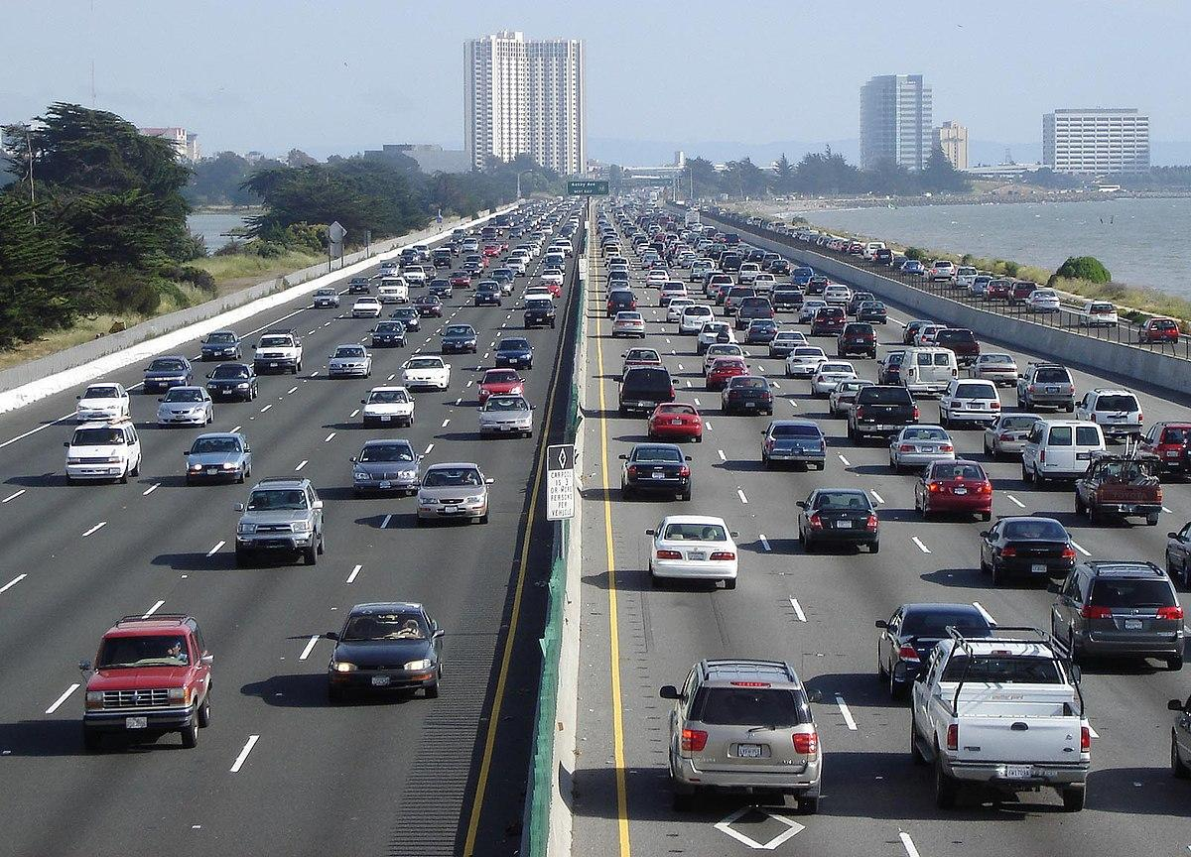

AGENDA
Introduction
Research Question
Data Processing
Modeling
Analysis and Finding
Model Selection
Conclusion
Team
Prediction of Potential Vehicle Insurance Fraud

Slide 3

INTRODUCTION
ABOUT VEHICLE INSURANCE FRAUD
$1,000
$80 Billion
$29 Billion
1893 Cases
average household pays
Stolen in US annually
Insurance companies lost
in Maryland annually
Introduction

Slide 4

What are we interested in?
What the target features are ?
How to improve the insurance screening rate?
What algorithms do we need to use?
Research Question

Slide 5
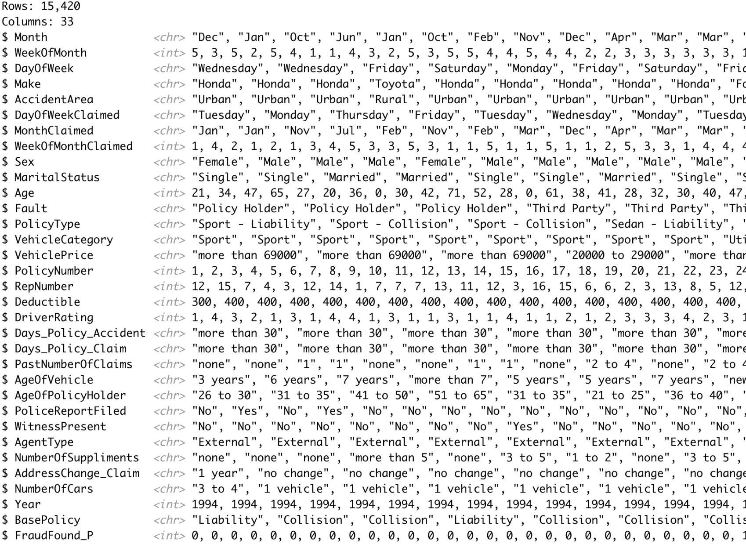

Feature Data
33 features including target variable
Sample size: 15,420
Training 70%, Testing 30%
Most of them are categorical
Fraud are classified into 2 classes
Fraudulent and Not Fraudulent
Data Source
Kaggle: Vehicle Insurance Fraud Detection
https://www.kaggle.com/datasets/shivamb/vehicle-claim-fraud-detection
Original data: Oracle
Data Processing

Slide 6
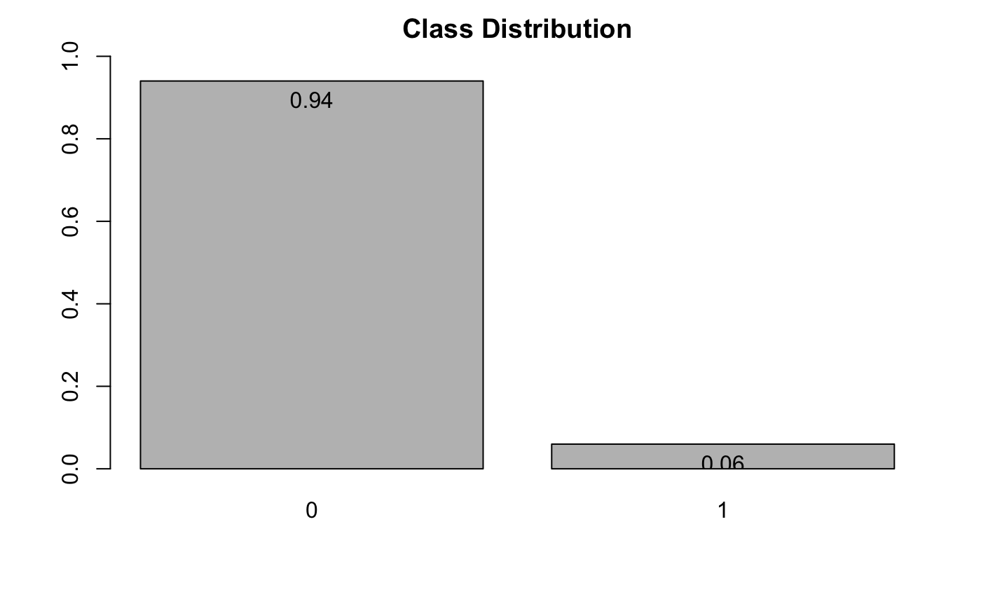

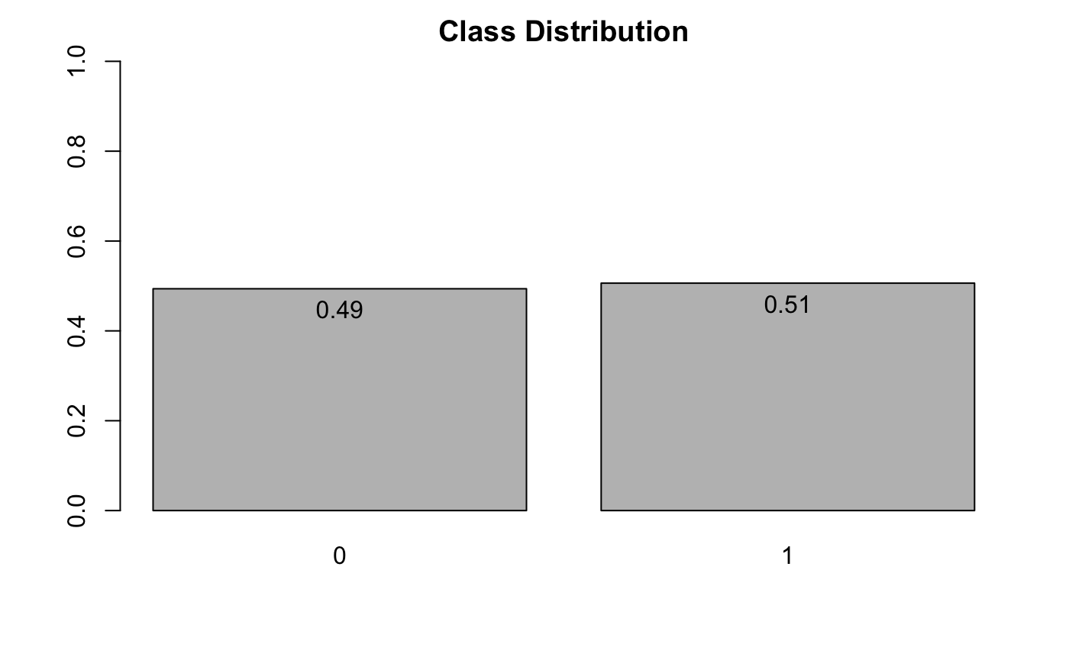

Data Pre-process
Remove records with any missing values and Replace invalid data
1 Record DayOfWeekClaimed = 0 & MonthClaimed = 0
320 Records (Age = 0)
Convert all character type to factor
Imbalance Data
Class Proportion: 6% of Fraud and Not Fraud 94%
Upsample training data
Duplicating the minority class many times
Data Processing(Cont.)

Slide 7






Methodology
WHAT MODEL DID WE USE
Logistic
Regression
Classification
Tree
Random
Forest
Boosting
XGBoost
MODEL 1
MODEL 2
MODEL 3
MODEL 4
MODEL 5
Modeling

Slide 8

Model1
Upsampling works
Low accuracy (0.65)
High sensitivity (0.83)
LOGISTIC REGRESSION
Analysis and Finding(Cont.)

Slide 9
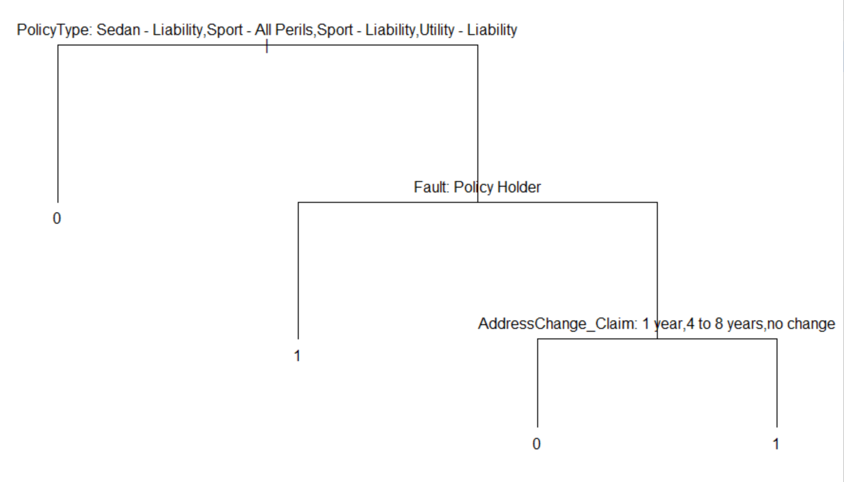

Model 2
CLASSIFICATION
TREE
Growing a full tree -> Pruned tree
Low Accuracy (0.6）
High sensitivity (0.96)
Analysis and Finding(Cont.)

Slide 10
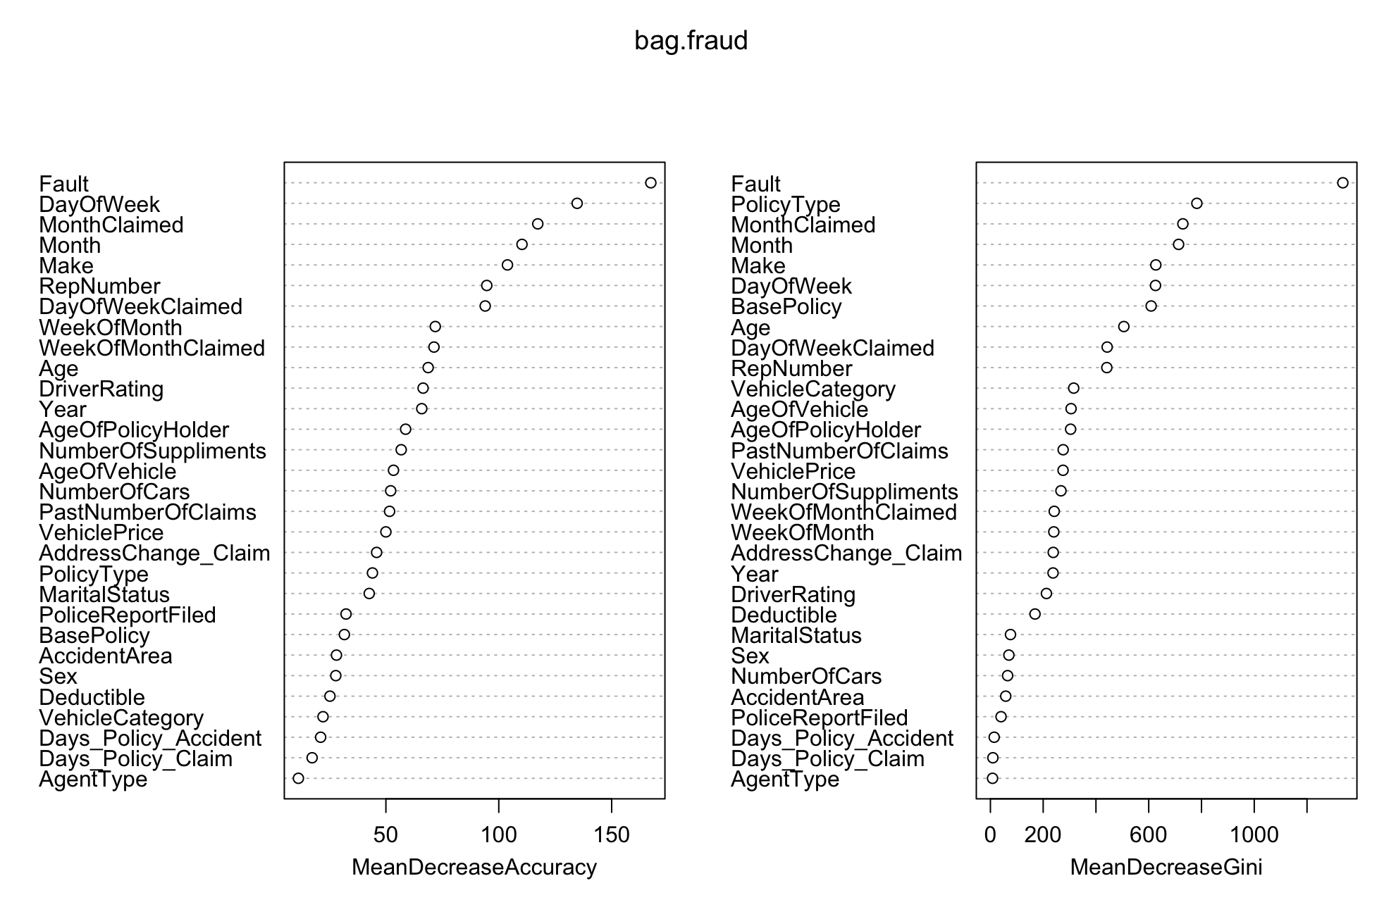

Model3
RANDOM FOREST
Intelligent algorithm: comprehensive & randomness
High Accuracy (0.94）
High sensitivity (0.05): Not applicable in reality
Analysis and Finding(Cont.)

Slide 11
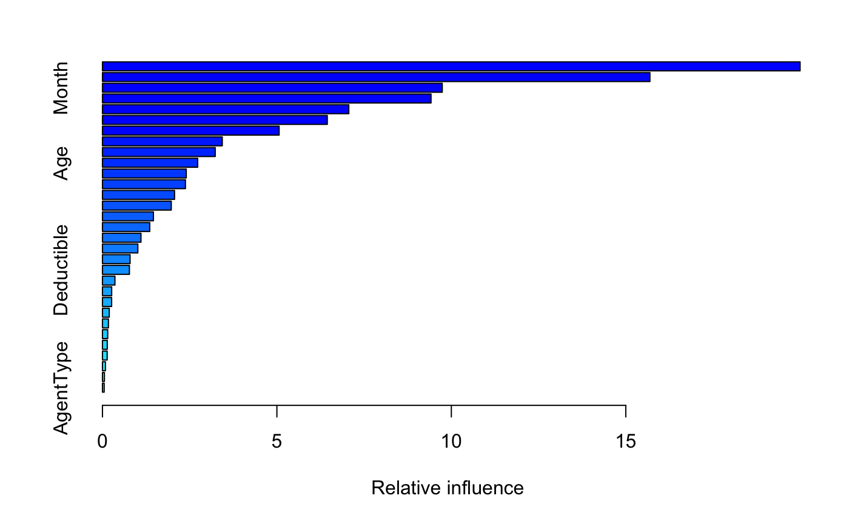

Model 4
BOOSTING
“upweights” misclassified data points
parameter: learning rate=0.001(default)
tree number=5000
High accuracy(0.93), low sensitivity(0.21)
important variables
Analysis and Finding(Cont.)

Slide 12
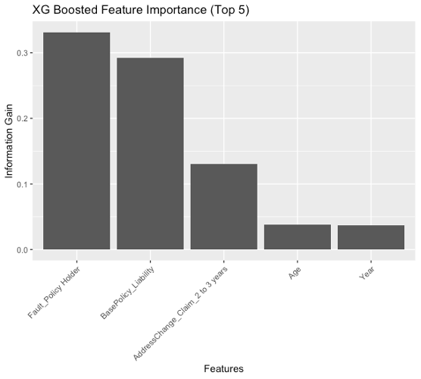

regularization techniques
parameter:
logistic regression for classification
maximum depth of the tree=4
Low accuracy(0.66), high sensitivity(0.87)
important variables
Model 5
XGBOOST
Analysis and Finding(Cont.)

Slide 13
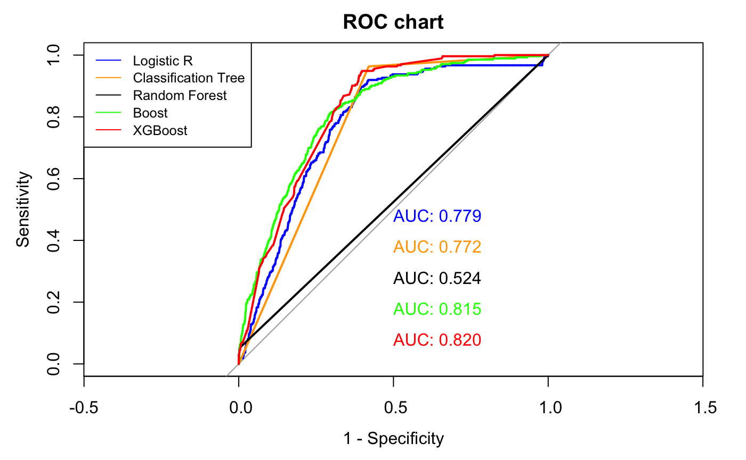
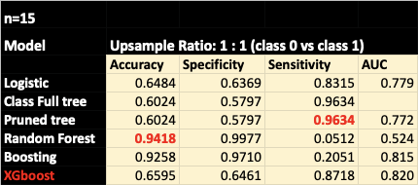

Sensitivity best: Classification Tree
Accuracy best: Random Forest
Overall best (Relatively) : XGBoost
Model Selection

Slide 14



Conclusions
We selected the best predictive models based on different indicators:
We figured out some important features that probably affect a claim is fraud or not:
Sensitivity best: Classification Tree
Accuracy best: Random Forest
Overall best : XGBoost
Fault Which day of week
Which month it’s claimed The policy type
The make of car
Improvement
To find a better way when upsampling instead of simply duplicating data
To find a method to merge some features or decrease some categories (too many features lead to reduced validity）
To prove whether or not there is a better way to trade off the accuracy and sensitivity in this case (more model to try)
Prediction of Potential Vehicle Insurance Fraud

Slide 15
THANKS
FOR YOUR LISTENING!

