Slide 1
Stock Prediction
Dong Huang Chen
Ying Chen

Slide 2
Motivation / Background
The stock market plays an important role in the economy.
A passive and potential way to build wealth.
People do not know what is the best strategy of the investing.

Slide 3
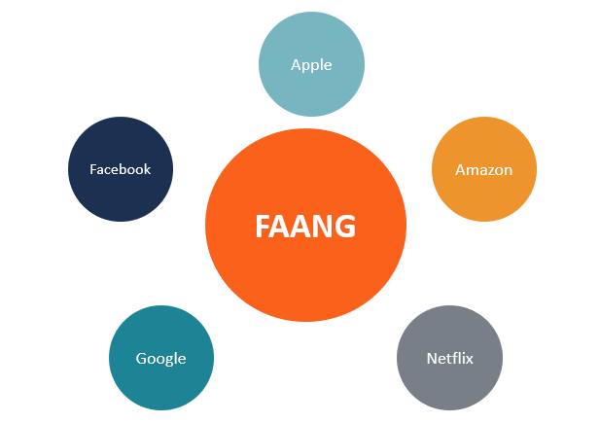
Motivation / Background
Analyzing the stocks of several FAANG companies.
An algorithm that can determine peak and deep of the stock market.

Slide 4
Data
Originally, we were thinking about using the dataset from Nasdaq, Dow Jones and S&P 500.
Now, our dataset is from New York Stock Exchange that provides stock data of various companies.

Slide 5
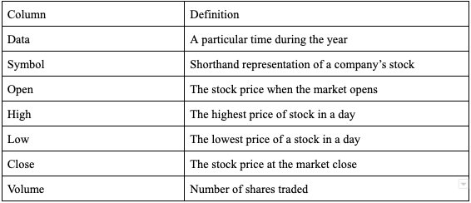
Data Dictionary

Slide 6
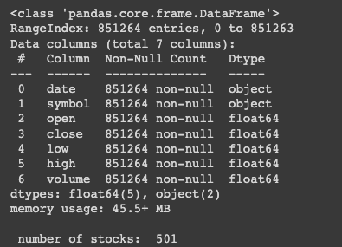
Exploratory Analysis
There are 501 unique symbols (companies)
A total range index of 851264 rows and 7 columns
No NULL values

Slide 7




Visualization ( FAANG Stocks)
We will be using few FAANG stocks

Slide 8
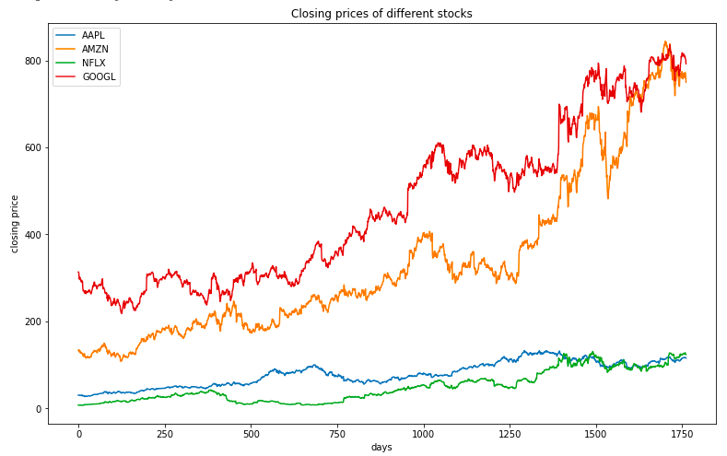
Visualization ( FAANG Stocks)
Here is plot of the closing prices of the FAANG stocks. (2010 - 2016)

Slide 9
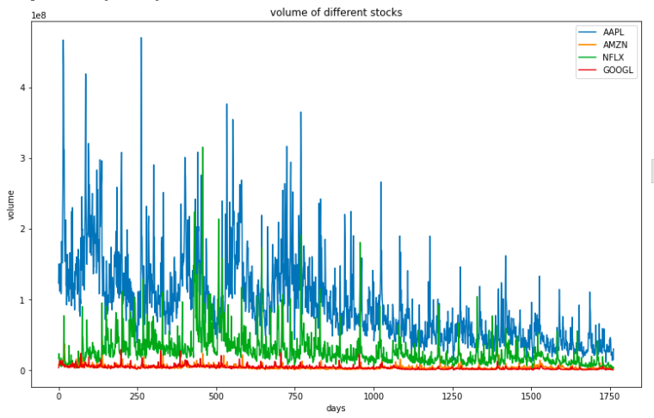
Visualization ( FAANG Stocks)
Here are the volumes of the stocks (2010 - 2016)

Slide 10
Models
Linear Regression model with the features: ‘open’, ‘low’, ‘high, ‘volume’
Our target that we were trying to predict is the ‘close’ value of the stocks
Splitting our training and test data with an 80/20 split:
X train/test shape: (1409, 4) (353, 4)
Y train/test shape: (1409, ) (353, )

Slide 11
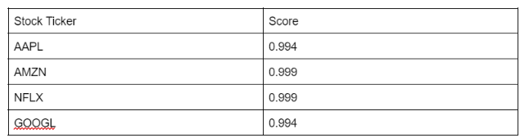
Models
The accuracy score of our predictions for our FAANG stocks

Slide 12
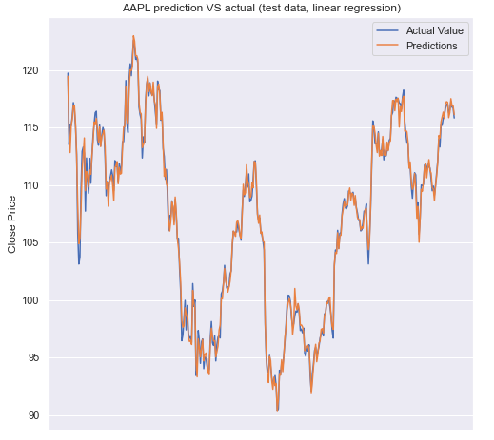
Models
Plotting the target ‘close’ testing data against the predictions: AAPL

Slide 13
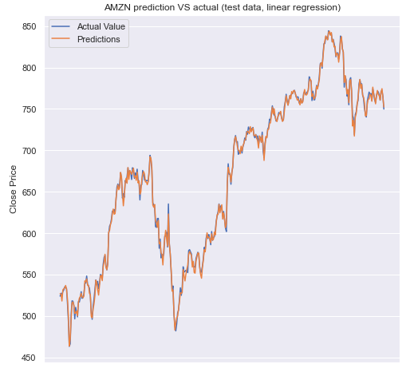
Models
Plotting the target ‘close’ testing data against the predictions: AMZN

Slide 14
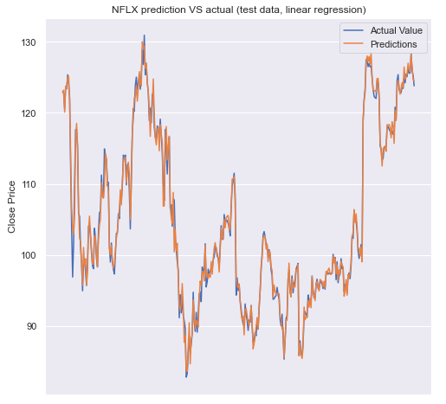
Models
Plotting the target ‘close’ testing data against the predictions: NFLX

Slide 15
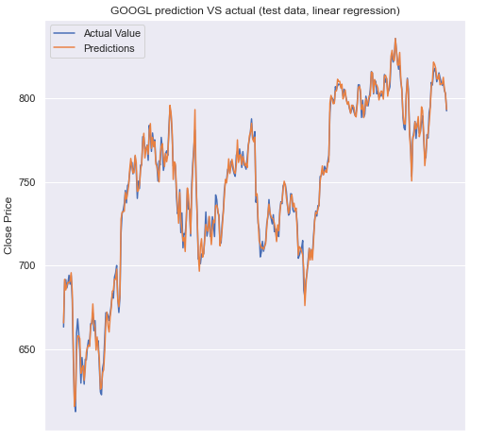
Models
Plotting the target ‘close’ testing data against the predictions: GOOGL

Slide 16
Evaluation
Our features are just too close to the target values.
The models perform incredibly well.
Choosing features is important.
In real world, we wouldn’t have those features before the stock value become history.

Slide 17
Future Work
We would like to try and label stocks on certain dates as buy or sell.
We would like to perform sentiment analysis on wall street bets post.
The features will be a date, stock ticker and descriptions from the highest rated posts about our stock that day, and with what we have.

Slide 18
Future Work
With the features, we can try to put some “fake money” and visualize with past data.
Using top rated posts in Wall Street bets to determine to label a stock as buy or sell.

Slide 19
Conclusion
Overall, we feel that the stock market is tough.
It’s difficult to determine what signals and features are truly important.

Slide 20

Thank you!

