Slide 1
Analysis Report on
”Stock Market Shock”
Of Early 2022
Yinghao Wang
Section B1

Slide 2
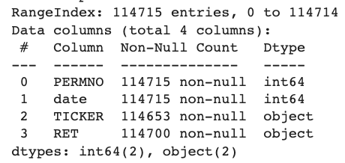
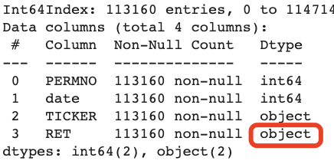
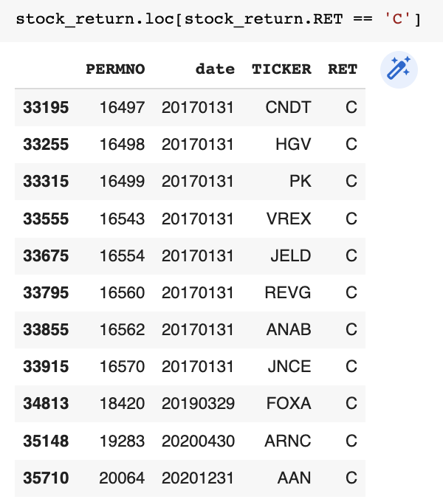
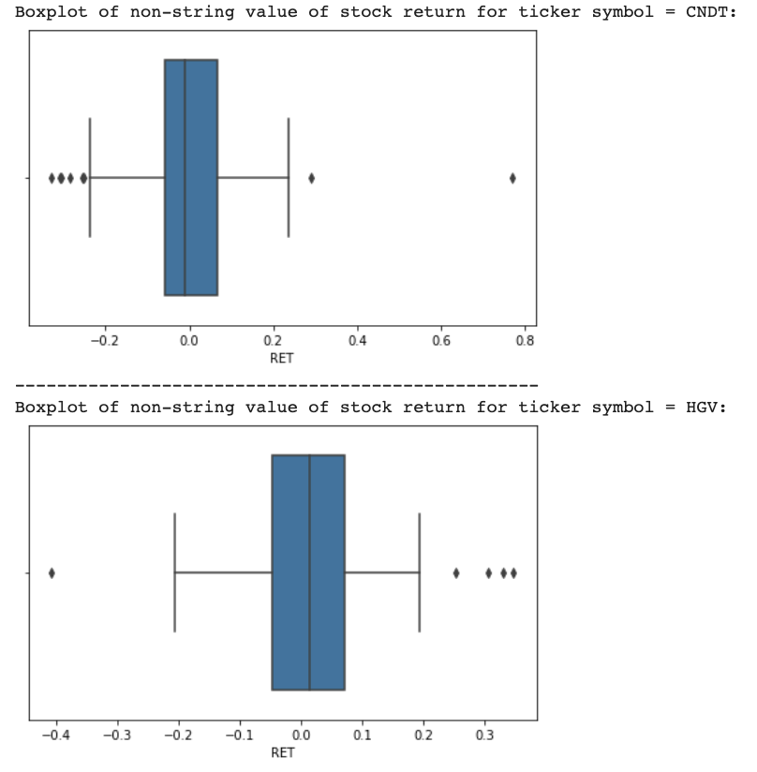
Step (1) of Analysis - Risk Exposures
Before subsetting
After subsetting
Sample Size:
Should be 60 * 1886 = 113,160 entries
Subset to extract rows only if their TICKER values is in unique value of Ticker column in ProjectTickers.csv
No missing values detected
Abnormal Observations:
Notice the DataType of RET column is `object`.
Detect 13 rows with RET == ‘C’
Based on the other 59 non-string corresponding ticker’s RET distribution, choose to replace ‘C’ with median
boxplots for ticker’s non-string RET
2 examples
Abnormal obs
Notes:
Asdas
Discuss data, sample size, missing observations, outliers
(“C” value)
Downloaded data contains missing values, but the total number of rows is greater than the number we are expecting to collect. Expect to generate 60 monthly holding period return for 1886 ticker symbols

Slide 3
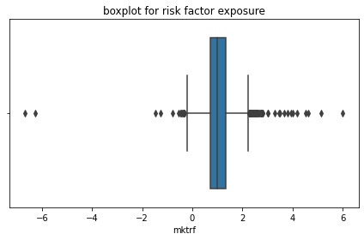
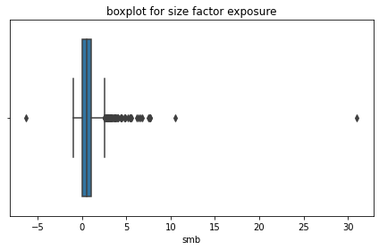
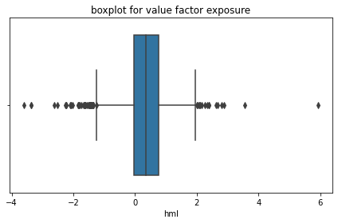
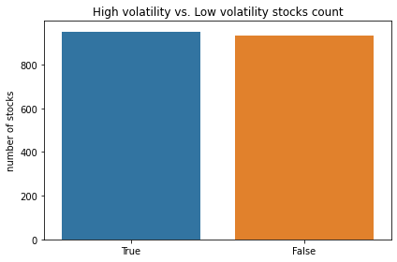
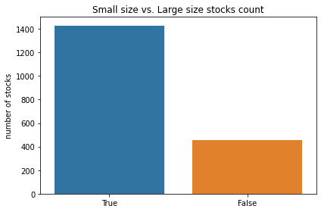
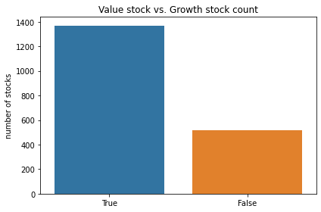
Step (1) of Analysis - Risk Exposures
mean 1.065369
std 0.624558
min -6.676723
max 6.002016
mean 0.667275
std 1.232195
min -6.286219
max 31.005941
mean 0.317248
std 0.699352
min -3.593321
max 5.919490
With above statistics, and count of stock number below/above corresponding benchmark, we can describe the risk exposure as follows:
On average, market exposure is similar to the benchmark but slightly excess,
most of the stocks are of small companies,
more stocks are value ones.
Notes:
Sample statistics
Description of vars,
Graphs to summarize data

Slide 4
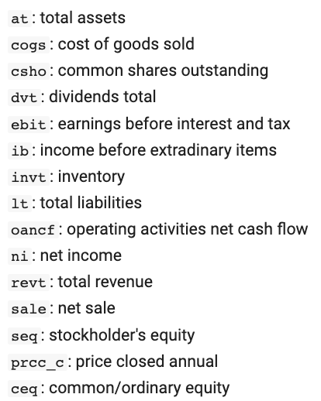
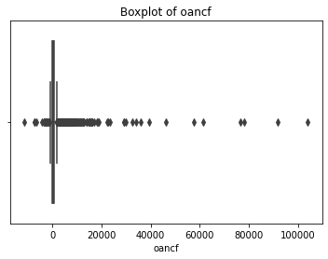
Step (2) of Analysis - Financial Ratios
Selected Ratios:
Profitability Ratios: ROA, ROE, Net Profit Margin
Solvency Ratio: Financial Leverage
Activity Ratio: Inventory Turnover
Valuation Ratios: Dividend Payout Ratio, Dividend Yield,
P/E, P/B, P/EBIT, P/Sales, P/CF
No Liquidity Ratios selected:
Over 400 missing values exist in current assets/current liabilities
Over 200 missing values exist in total debt
Missing values exist in the following financial data items:
dvt 9
invt 34
lt 5
oancf 1
Filled with mean/median based on non-null values’ distribution & statistics.
mean 1372.937724
std 5540.675045
min -11525.000000
25% 58.318000
50% 229.153000
75% 805.869000
max 104038.000000
Notes:
Discuss the data and 10+ ratios,
Why did you select these ratios
Sample size, missing values, outliers

Slide 5
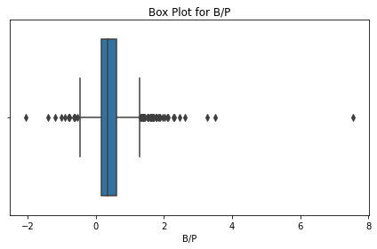
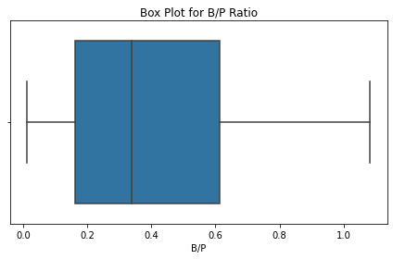
Step (2) of Analysis - Financial Ratios
Take the reciprocal of following ratios for better model performance:
P/B, P/E, P/EBIT, P/Sales, P/CF, Financial Leverage
Otherwise contain either inf or -inf values that cannot be input data of regression model
Check outliers of each financial ratio:
Observe skewness & extreme outliers
Winsorization to limit extreme values to reduce the effect of possibly spurious outliers
Winsorize at 5% & 95% level
mean 0.422120
std 0.424100
min -2.056645
25% 0.161112
50% 0.337004
75% 0.613868
max 7.547555
mean 0.411993
std 0.309511
min 0.010871
25% 0.161112
50% 0.337004
75% 0.613868
max 1.082827
Quartiles remain the same, while the range is shrinked.
Notes:
Sample statistics,
description of variables,
Does each of 10 ratios make sense

Slide 6
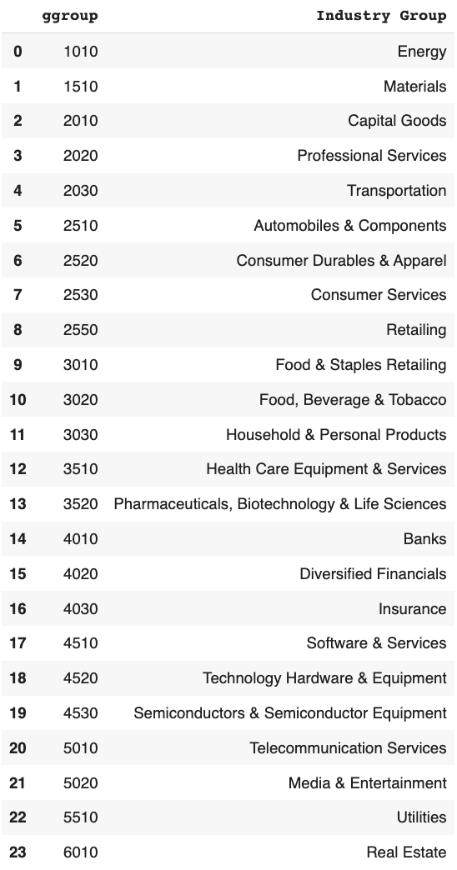
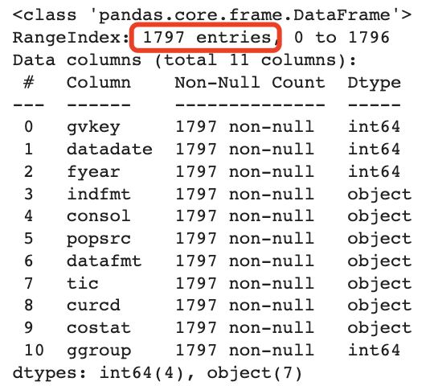
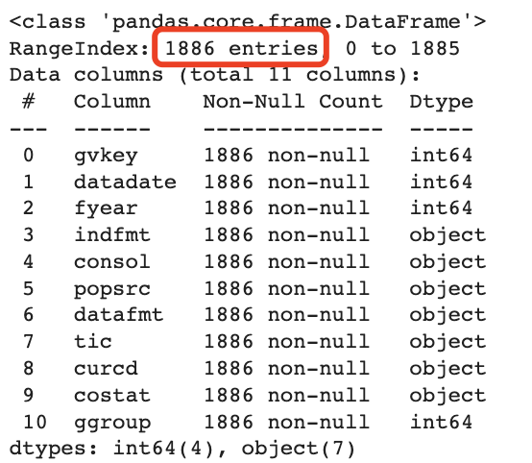
Step (3) of Analysis - Industries
Industry Identifier data:
Calendar date returns 1886 non-null values ✅
Fiscal date returns 1797 non-null values
Fiscal Date
Calendar Date
Number of Industries:
24 unique industry indicators,
Each indicator represents an industry group, as the chart on the right side
Notes:
Discuss data, (sample size, how to deal with missing value, what are the industries)
No missing value, 24 unique industry indicators

Slide 7
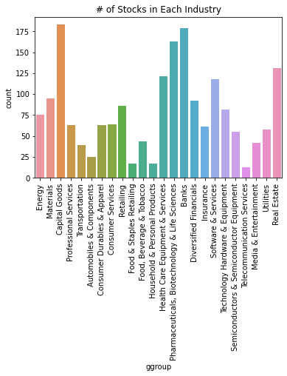
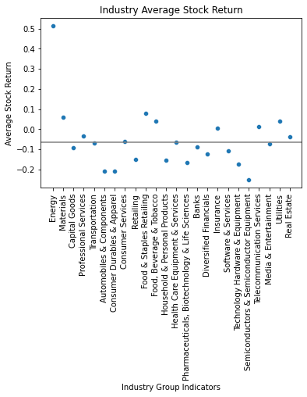
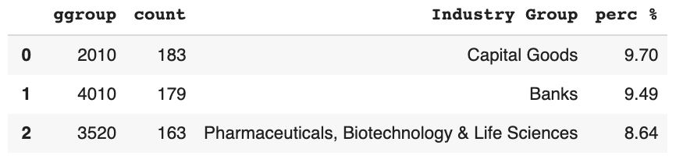
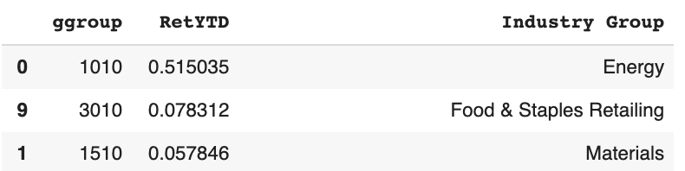
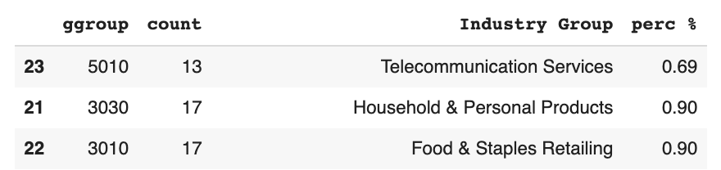
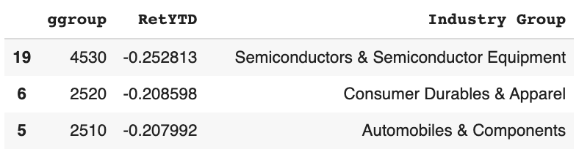
Step (3) of Analysis - Industries
Average of all: -0.06
Of total:
10 industries above average, 14 below average
Energy is the highest which is about 0.52,
Semiconductors & Semiconductor Equipment is the lowest which is about -0.25.
Capital Goods occupies 9.7% of total in our datasets,
Telecommunication Services occupies only 0.69% of total
Notes:
Sample statistics,
# stocks in each industries,
Graphs to summarize data

Slide 8
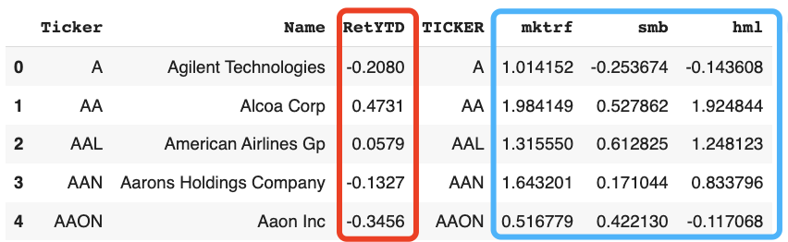
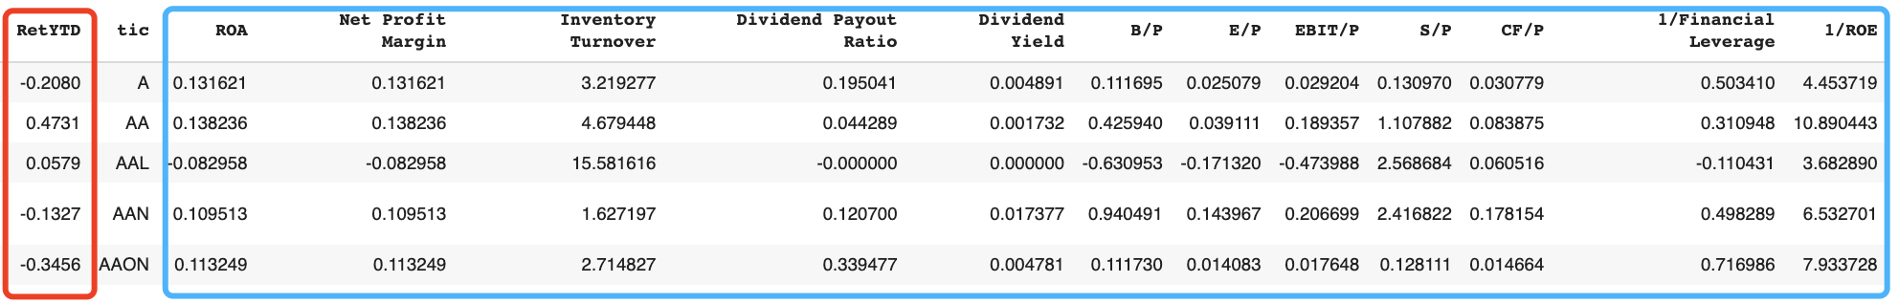
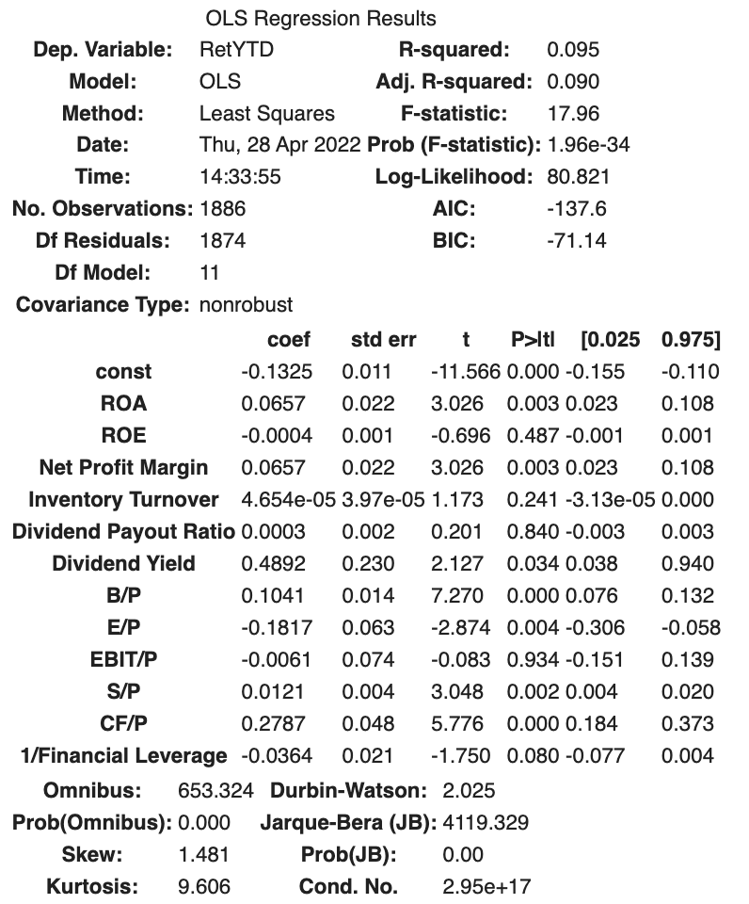
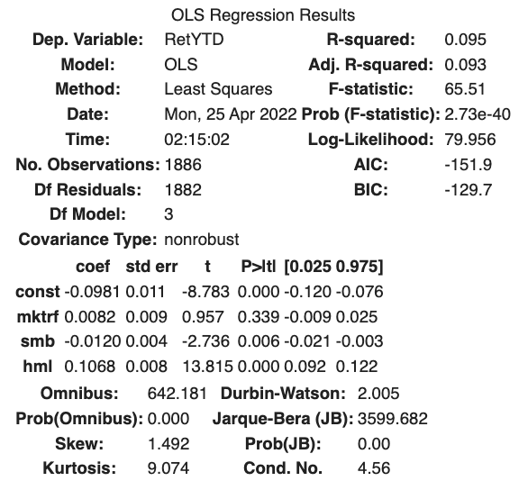
Regression Analysis - Risk Exposure & Financial Ratios
Neither of the two regression models captures more than 10% of the variance of stock return changes in early 2022;
Low correlation between predictors and dependent variable (RetYTD);
Low explanatory power can be caused by uncertainty (still under the covid-19 pandemic, and the intensity of political situations.
not statistically
significant
R Squared: 9.5%
Adj R Squared: 9.3%
R Squared: 9.5%
Adj R Squared: 9.0%
Notes:
companies has lower volatility, with larger size and valued stock tend to generate higher stock return in early 2022;

Slide 9
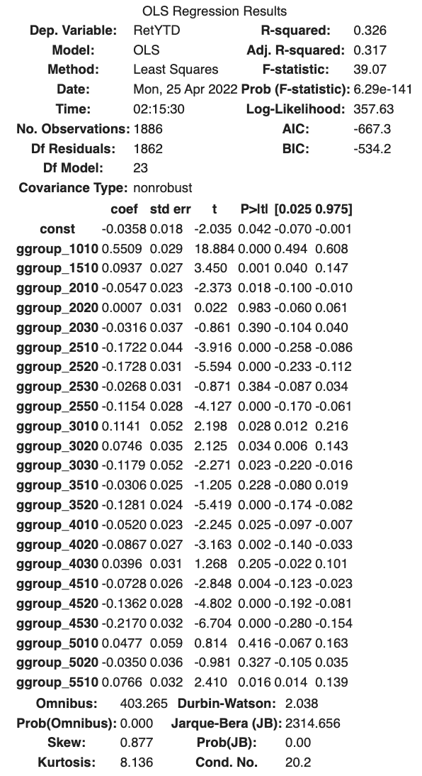
Regression Analysis - Industry Dummies
R Squared: 32.6%
Adj R Squared: 31.7%
Remove ggroup_6010 (Real Estate), to use it as baseline for comparison.
The explanatory power of industry indicators of 2021 for early 2022's stock return relatively high if compared with other two regression models.
Several dummy variables are not statistically significant:
Commercial & Professional Services,
Transportation, Retailing,
Health Care Equipment & Services,
Insurance,
Telecommunication Services,
Media & Entertainment
not statistically significant
Notes:
This is because ultimate stock price is driven by the supply and demand at the time in the market, and the industry indicators do better in terms of capturing these supply and demand changes in early 2022.

Slide 10
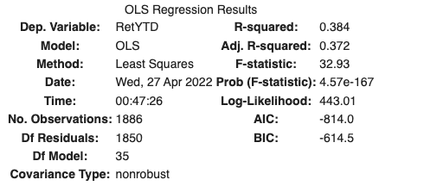
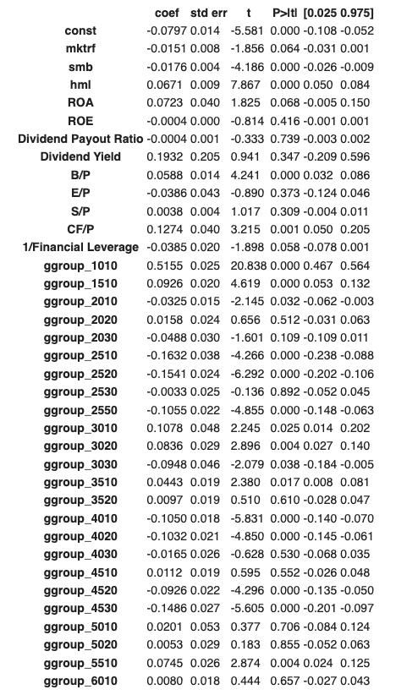
Regression Analysis - Combined One
R Squared: 38.4%
Adj R Squared: 37.2%
Removed 3 financial ratios
Inventory Turnover, EBIT/P and Net Profit Margin
Still many financial ratios are not statistically significant
6 out of 9 financial ratios with p-value > 0.05
The explanatory power of 35 predictors of 2021 for early 2022's stock return slightly higher than fixed effect regression of industry dummies.
Adj R Squared increased by 6%
not statistically significant
Notes:
:
instead of taking all previously available features as Xs.
the new terms (risk exposure & financial ratios) improves the model more than would be expected by chance.

Slide 11
Conclusions & Recommendations
Conclusions:
A company’s stock return in early 2022 tends to be largely influenced by its corresponding industry sector
Many financial ratios are not statistically significant when running regression on stock return, because these ratios can only explain the operating performance of companies, but cannot capture the uncertainties outside the stock market
Recommendations for Investors:
To minimize the loss when there is a “stock market shock” caused by externally unpredictable factors outside the market, better to
Diversify your own stock portfolio to weather market ups and downs and maintain the potential for growth
Select dividends-paying stocks (strong positive correlation with stock return in early 2022)
Choose high-quality stocks (valued stocks are more prone to generate a higher stock return in early 2022)

Slide 12
Thanks
Any question?

