Slide 1




Internship Project Presentation
Data Analysis of VAED Dataset
Presented by:
Yinghao Zhang | Master of Information Systems
Data Analyst Intern | Data-Driven Research Hub
Victorian Comprehensive Cancer Centre (VCCC)
Resume:
https://github.com/yinghaoz1/online-resume/blob/master/my-resume.pdf/
Linkedin:
https://www.linkedin.com/in/yinghaoz1/
Github:
https://github.com/yinghaoz1

Slide 2
Agenda
PART I: Project Overview
- Dataset Overview
- Data Analysis Process
- Data Analysis Tools
PART II: Data Wrangling
- Why Data Wrangling
- Data Wrangling Results
PART III: Exploratory Data Analysis (EDA)
- Why EDA
- EDA Result 1-3
- Conclusion
Notes:
Women who develop diabetes during pregnancy

Slide 3

PART I: Project Overview

Slide 4


Dataset Overview
Victorian Admitted Episodes Dataset (VAED)
Contains demographic, clinical and administrative details for admitted episode
Provides funding to public hospitals, support health service planning, policy formation and epidemiological research, and meet national data reporting requirements
Uses ICD-10-AM coding system to standardize the data
BioGrid Australia
A federated data sharing platform for collaborative translational health and medical research
links real-time coded and de-identified health data across institutions, jurisdictions and diseases to assist researchers and clinicians improve their research and clinical outcomes
Notes:
Women who develop diabetes during pregnancy

Slide 5
Data Analysis Process
Project Proposal
Data Gathering
Data Wrangling
Exploratory Data Visualisation (EDA)
Communication
Project Scope
Project Stakeholders
Risk Analysis
Diagnosis Record Dataset
Episode Dataset
ICD-10-AM Mapping Table
Data Assessment
Data Cleaning
Univariate Exploration
Bivariate Exploration
Key Insights
Conclusion and recommendations
Notes:
Women who develop diabetes during pregnancy

Slide 6

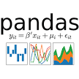






Data Analysis Tools
Data wrangling for a large volume of data
(from 1 million to 1 billion observations)
Programming Analysis Tools
Flexible data visualisation tools
Non-programming Analysis Tools
Collaboration Tools
Notes:
Women who develop diabetes during pregnancy

Slide 7
PART II: Data Wrangling

Slide 8
Why Data Wrangling
Dirty Data
(either low-quality or untidy)
Clean Data
(both high-quality and tidy)
Missing values
Data Quality Principle:
Completeness: The dataset has no missing rows, columns, and cells
Validity: The dataset should conform to a schema, or the a set of rules related to real-world and table-specific constraints.
Accuracy: The dataset should not contain valid but wrong data.
Consistency: The format representing the data should be standard.
Wrong values
Data Wrangling
Wrong data types
Data Tidiness Principle:
Each variable forms a column.
Each observation forms a row.
Each type of observational unit forms a table.
Messy structure
Notes:
Women who develop diabetes during pregnancy

Slide 9
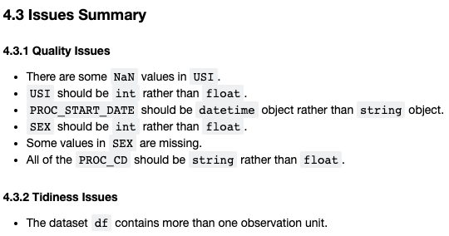
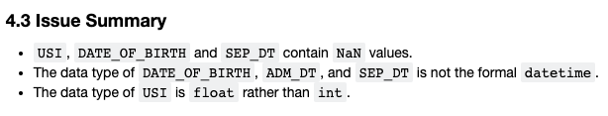
Data Wrangling Results
Identified and fixed 6 quality issues and 1 tidiness issue
DIAGNOSIS_RECORD datasets (from fiscal year 13/14 to 15/16)
Identified and fixed 3 quality issues
EPISODE datasets
(from fiscal year 13/14 to 15/16)
Notes:
Women who develop diabetes during pregnancy

Slide 10
PART III: Exploratory Data Visualisation (EDA)

Slide 11
Why EDA
Univariate Exploration
Discover the pattern for each variable concerned
Bivariate Exploration
Discover the relationship between two variables
Multivariate Exploration
Discover the relationship among 3 or more variables
EDA
Notes:
Women who develop diabetes during pregnancy

Slide 12
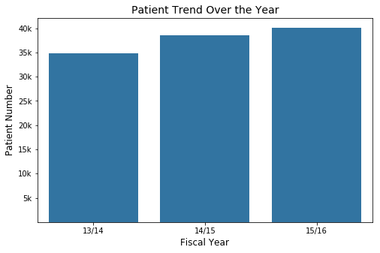
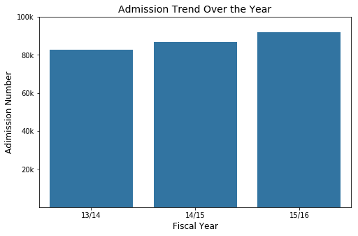
EDA Result 1: Patient Patterns
From the fiscal year 13/14 to 15/16, there is a steady increase in the number of both patients and admissions, with an 5,000 increase in cancer patients and 10,000 increase in admissions.
Notes:
Women who develop diabetes during pregnancy

Slide 13
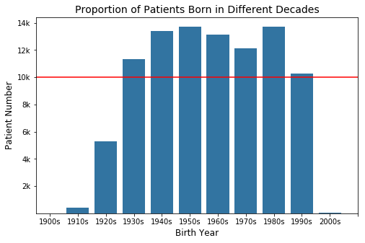
EDA Result 1: Patient Patterns
The number of cancer patients born in each decade from 1920s to 1990s exceeds 10,000, accounting for the major proportion of cancer patients.
People born in 1980s account for the largest proportion of cancer patients. Young people are suffering from cancer now.
The reason may be that people born at 1980s have a larger population than other generations, or they have more working stress which causes them to suffer from cancer.
Notes:
Women who develop diabetes during pregnancy

Slide 14
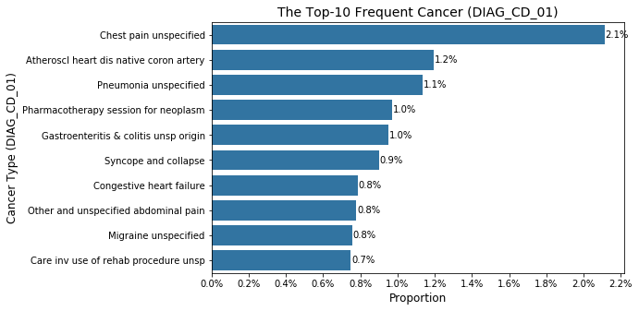
EDA Result 2: Cancer Patterns
The most frequent cancer is chest pain unspecified, as twice as the second most frequent one.
Notes:
Women who develop diabetes during pregnancy

Slide 15
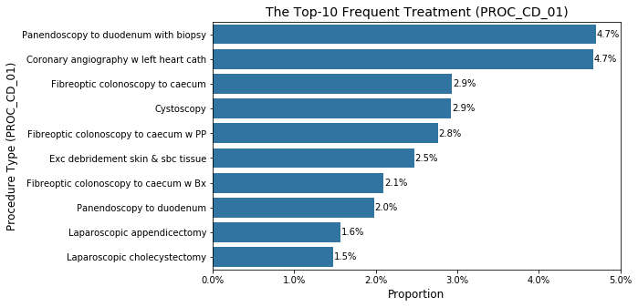
EDA Result 2: Cancer Patterns
The most two frequent treatments are panendoscopy to duodenum with biopsy and coronary angiography w left heart cath, as twice as the third and forth ones.
Notes:
Women who develop diabetes during pregnancy

Slide 16
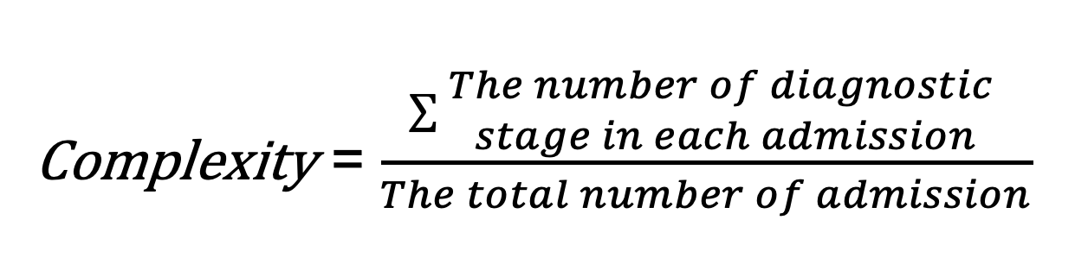
EDA Result 3: Cancer Complexity
Cancer Type PZ491
UNIQUE_KEY | DIAG_CD_01 | DIAG_CD_02 | DIAG_CD_03 | DIAG_CD_04 | DIAG_CD_05 | DIAG_CD_06
1000001 | PZ491
1000002 | PZ491
1000003 | PZ491
Complexity = (1+1+1) / 3 = 1
Cancer Type PB551 is more complicated than PZ491
Cancer Type PB551
UNIQUE_KEY | DIAG_CD_01 | DIAG_CD_02 | DIAG_CD_03 | DIAG_CD_04 | DIAG_CD_05 | DIAG_CD_06
1000004 | PB551 | CA499 | CL251 | CY222 | CX836 | CP267
1000006 | PB551
Complexity = (6+1) / 2 = 3.5
How to calculate complexity:
Complexity = $\frac{\sum{\begin{aligned}The number of diagnostic \\ stage in each admission\end{aligned}}}{The total number of admission}$
Notes:
Women who develop diabetes during pregnancy

Slide 17
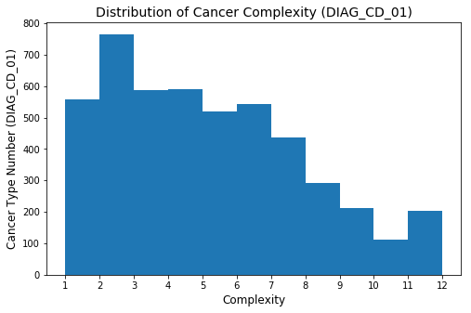
EDA Result 3: Cancer Complexity
Overall, the more complicated the cancer is, the less the number of the cancer type is.
The cancer with the complexity of 11 to 12 has 200 types. These cancer types are suggested to be focused on the future research because they are likely to convert into other types of cancer.
Notes:
Women who develop diabetes during pregnancy

Slide 18
Conclusion
There are an increasing trend of cancer diagnosis over the year, and a large proportion of young people suffer from cancer. Thus, the reason for this cancer trend should be discovered in order to help with the prevention.
The cancer type of ‘Chest pain unspecified’ is the most prevalent one among population. Researchers are suggested to put weight on this cancer type.
There are nearly 200 types of the cancer with the complexity of 11-12 within the dataset. These types should be focused on because these types are easily to evolve into other cancer types or forms in morphology.
Future researches can also be focused on the correlation between the diagnosis and treatment.
Notes:
Women who develop diabetes during pregnancy

Slide 19
Thank You
Resume:
https://github.com/yinghaoz1/online-resume/blob/master/my-resume.pdf/
Linkedin:
https://www.linkedin.com/in/yinghaoz1/
Github:
https://github.com/yinghaoz1

