Slide 1
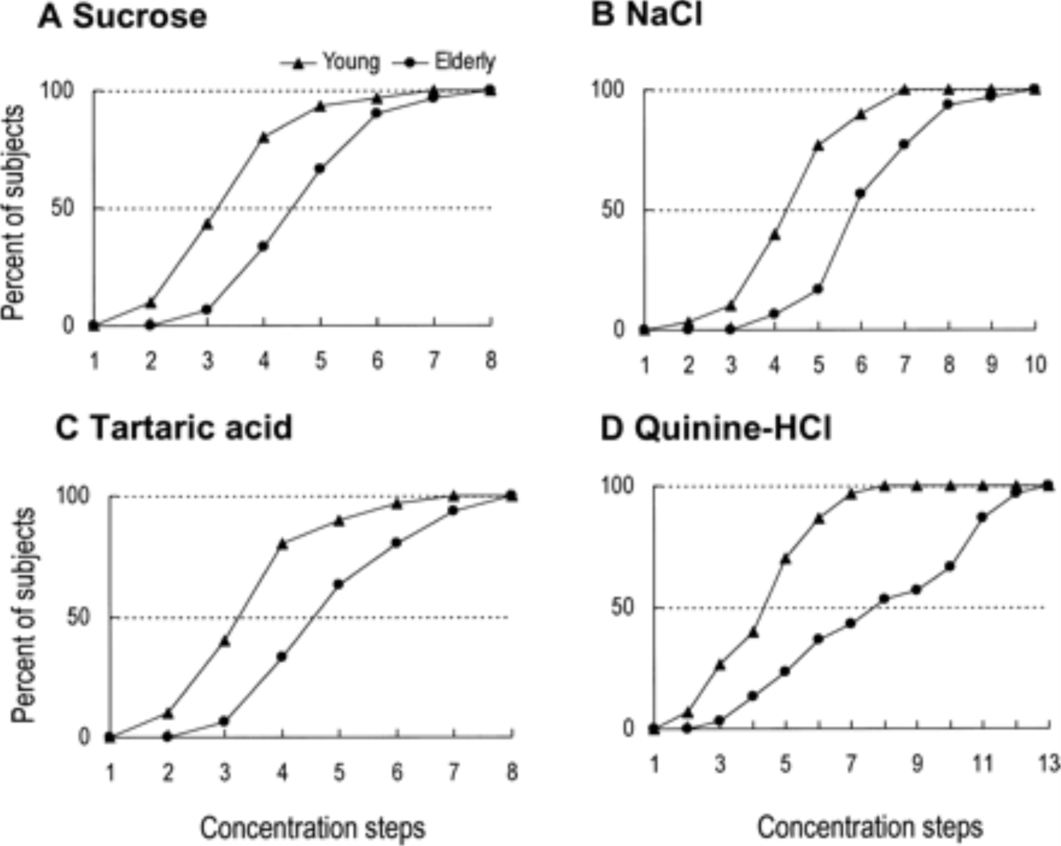
From: Influences of Aging on Taste Perception and Oral Somatic Sensation
J Gerontol A Biol Sci Med Sci. 2005;60(1):109-113. doi:10.1093/gerona/60.1.109
J Gerontol A Biol Sci Med Sci | The Gerontological Society of America
Notes:
Figure 1. The cumulative recognition threshold curves of sucrose, sodium chloride, tartaric acid, and quinine hydrochloride representing sweet, salty, sour, and bitter tastes, respectively, in young and elderly persons

