Slide 1
GraphPrior: Mutation-based Test Input Prioritization for Graph Neural Networks
Collaboration Project

Slide 2
Motivation and Objectives
In company with excellent effectiveness on classifying graph-structured data, GNNs could also exhibit incorrect behaviour that may lead to severe consequences. The importance of GNN testing
Therefore, efficient testing of GNNs is highly desirable to detect incorrect GNN behaviors and improve GNN quality.
However, labelling test inputs to check the correctness of GNNs is expensive and time-consuming, seriously affecting the efficiency of GNN testing and GNN development process.
Existing test optimisation approaches mainly focus on DNN models.
We propose a test input prioritization approach GraphPrior for GNNs to label more bug-revealing test inputs (i.e., test inputs that are more likely to be incorrectly predicted by the GNN) earlier for a limited time.
node4
node6
Original ranking
node4
node6
Our goal is to prioritize mispredicted datasets
New ranking

Slide 3
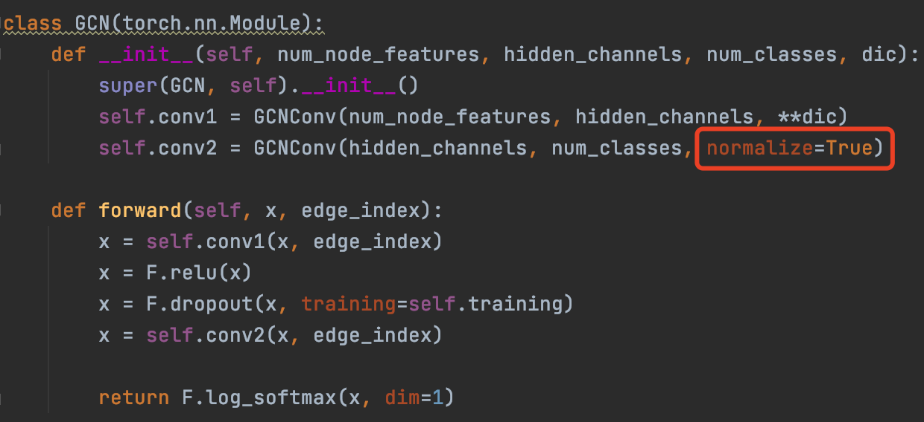
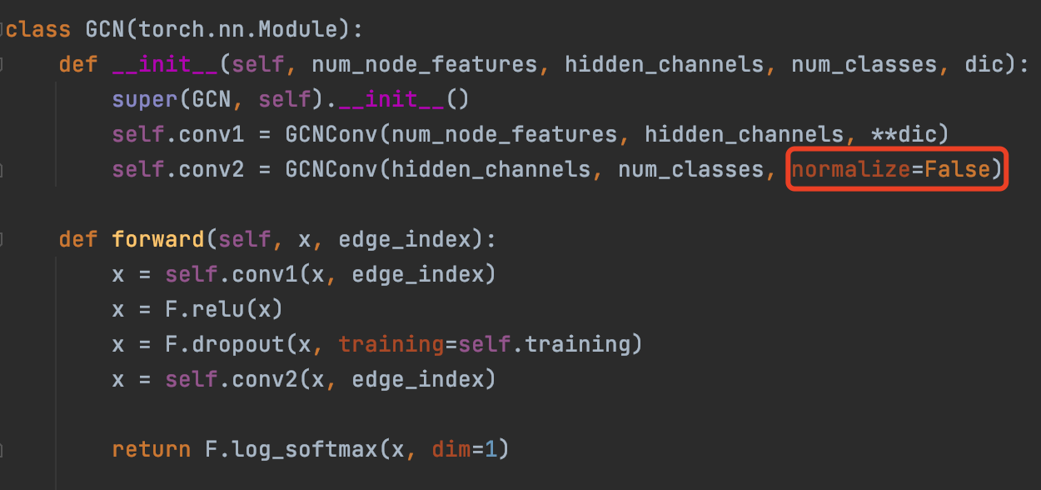
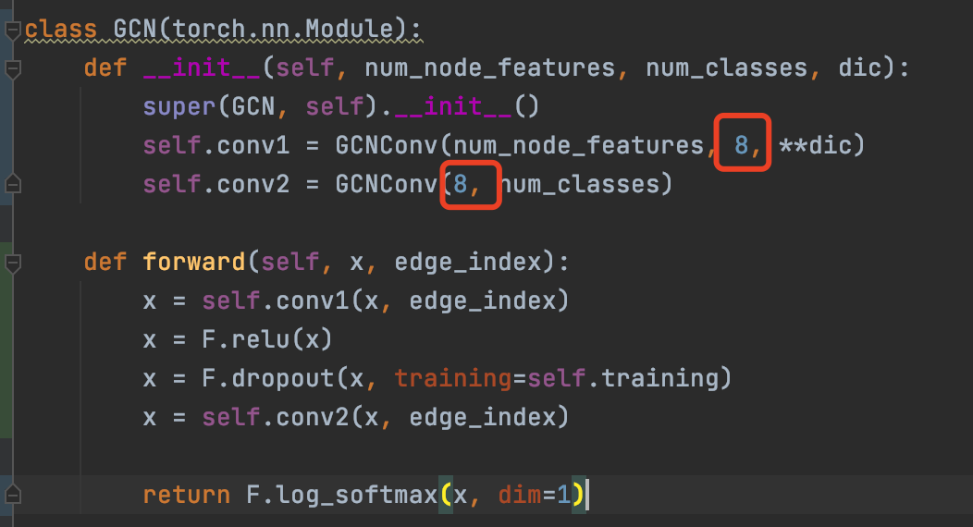
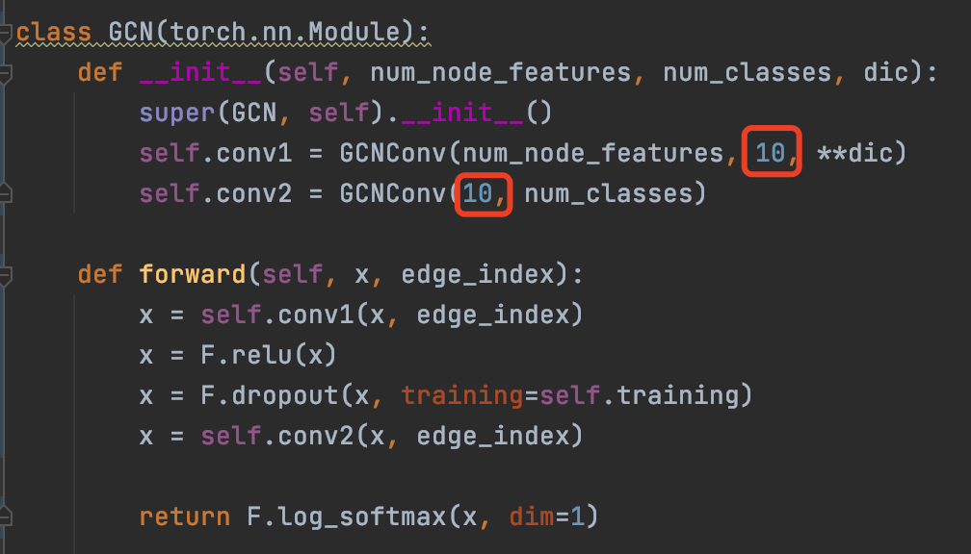
Mutation model
Original model code
mutation model code

Slide 4
class GCN(torch.nn.Module): def __init__(self, num_node_features, hidden_channels, num_classes): super().__init__() self.conv1 = GCNConv(num_node_features, hidden_channels) self.conv2 = GCNConv(hidden_channels, num_classes, normalize=True)
…
class GCN(torch.nn.Module): def __init__(self, num_node_features, hidden_channels, num_classes): super().__init__() self.conv1 = GCNConv(num_node_features, hidden_channels) self.conv2 = GCNConv(hidden_channels, num_classes, normalize=False)
…

Slide 5







Original GNN model
D
A
C
D
A
B
C
Prioritized
graph test set
Graph test set
to be labeled
B
Feature
extraction
Features
Ranking models
labeling
Mutant GNN models
Original GNN model
Mutation rules
Developers

Slide 6
GraphPrior
Original model
Mutation model 1
Mutation model 2
Mutation model 3
node1
woman
woman
woman
woman
node1 score = 0
node2
woman
man
woman
man
node2 score = 2
node3
woman
man
woman
woman
node3 score = 1
Original ranking
node1
node2
node3
New ranking
node2
node3
node1
The higher the score, the easier the node is to predict wrong.

Slide 7
GraphPrior
Original model
Mutation model 1
Mutation model 2
Mutation model 3
node1
0
0
0
0
node2
0
1
0
1
node3
0
1
0
0
Node1 vector = [0, 0, 0]
Node2 vector = [1, 0, 1]
Node3 vector = [1, 0, 0]
Node1 = 0.1
Node2 = 0.7
Node3 = 0.3
->
LR/RF/LGBM/DNN
->
Original ranking
node1
node2
node3
New ranking
node2
node3
node1
The higher the value, the easier the node is to predict wrong.

Slide 8
GraphPrior
KMGP
KMGP refers to the Killing Mutants-based GNN Prioritization approach
LRGP
LRGP refers to the Logistic Regression-based GNN Prioritization approach.
RFGP
RFGP refers to the Random Forest-based GNN Prioritization approach.
LGGP
LGGP refers to the LightGBM-based GNN Prioritization approach.
DNGP
LRGP refers to the DNN-based GNN Prioritization approach.
Existing Method: DeepGini, Least Confidence, Margin, Random

Slide 9
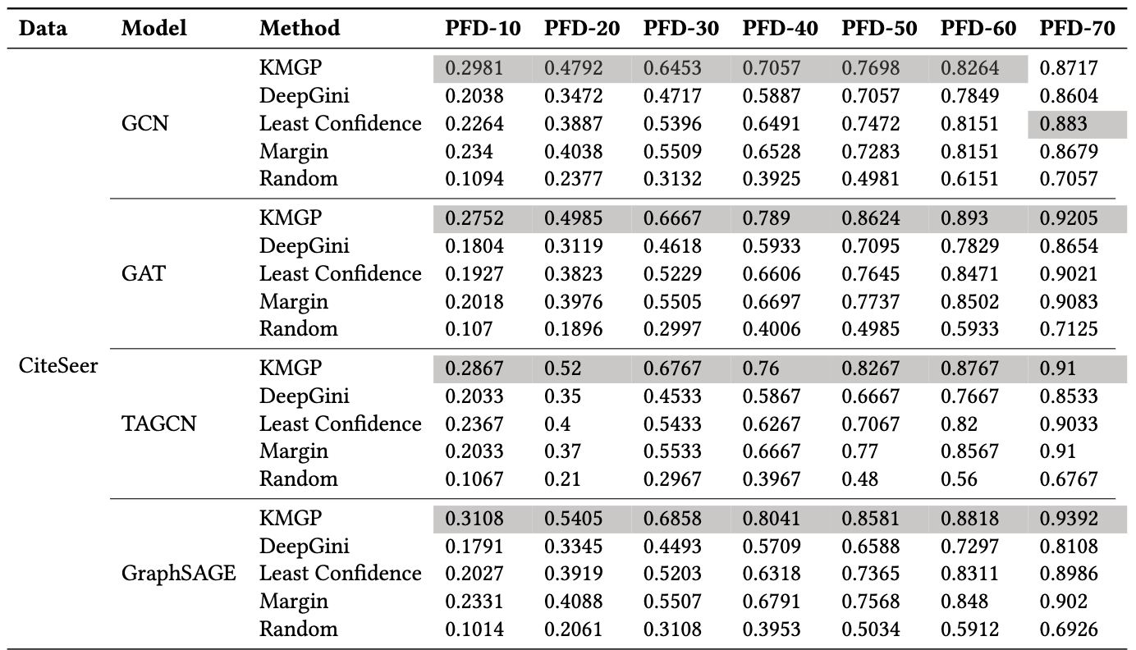
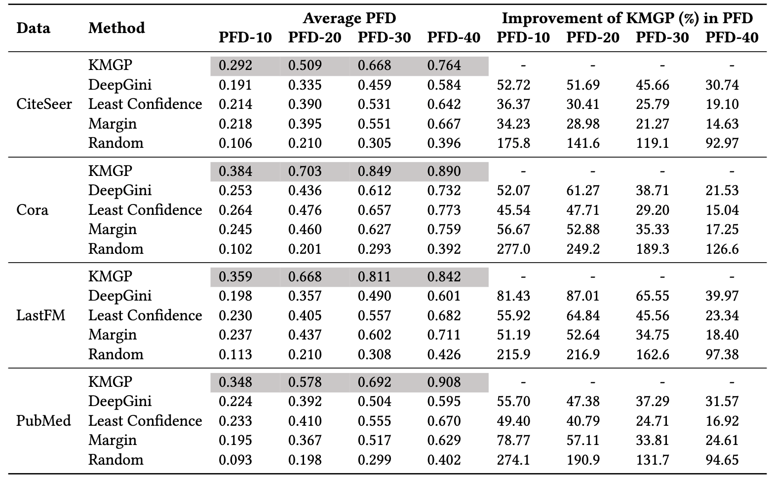
RQ1: How does KMGP perform in prioritizing test inputs for GNNs?
Our proposed KMGP prioritize test inputs based on the number of mutated GNN models killed by each test.
Evaluation metric
The larger the value, the better the method
PFD: Percentage of Fault Detected
KMGP perform the best among all the compared approaches
PFD refers to the ratio of detected misclassified test inputs (in the prioritized tests) among all the misclassified tests
PFD-10 = detedted misclassified tests(10% data) / all the misclassified tests
PFD-20 = detedted misclassified tests(20% data) / all the misclassified tests

Slide 10
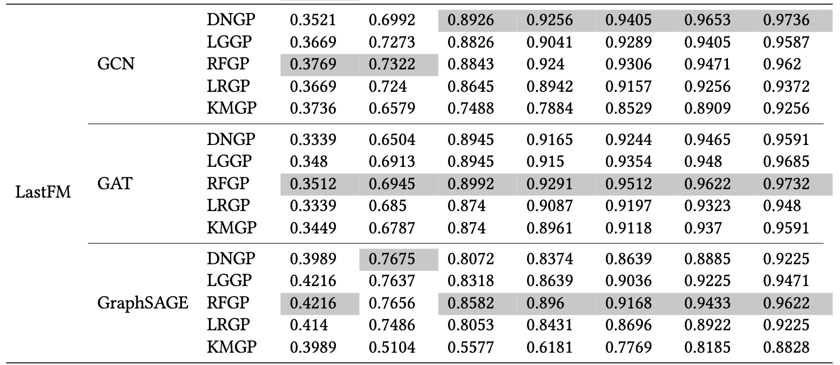
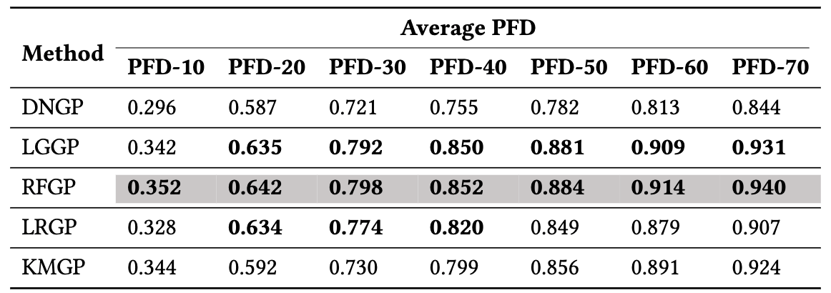
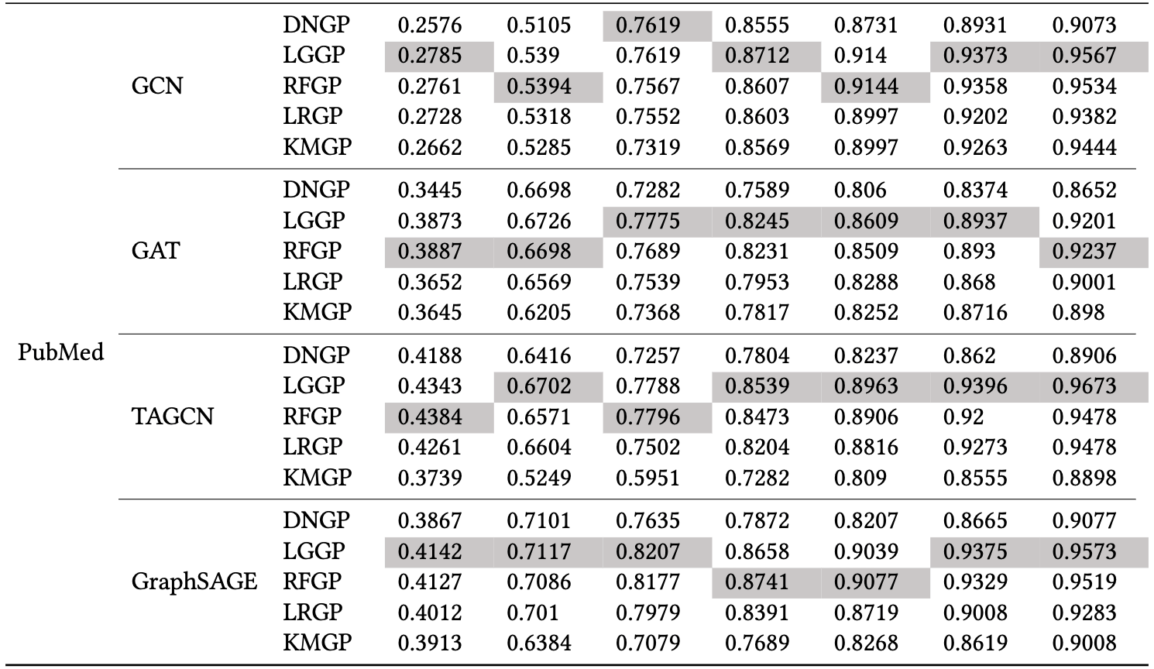
RQ2: Effectiveness of feature-based approaches in GraphPrior
Across all the feature-based approaches, RFGP and LGGP performs better than KMGP

Slide 11
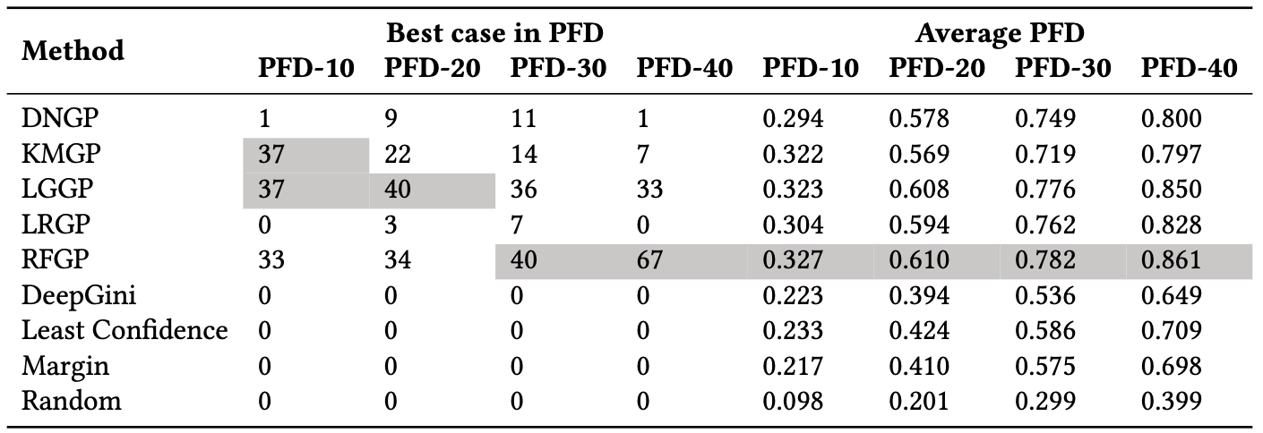
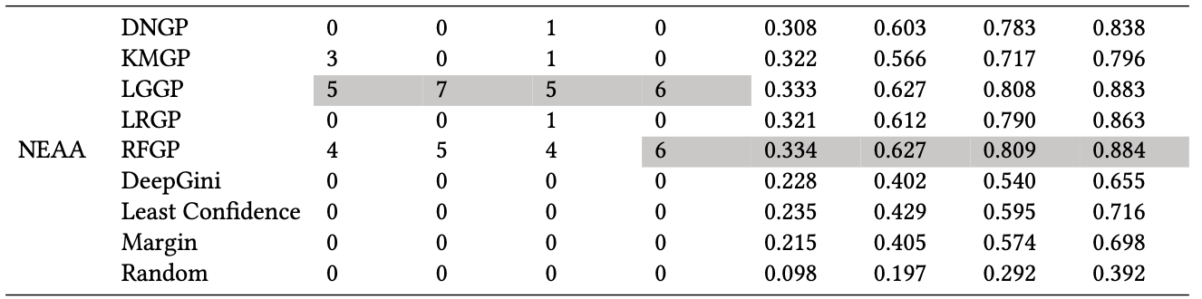
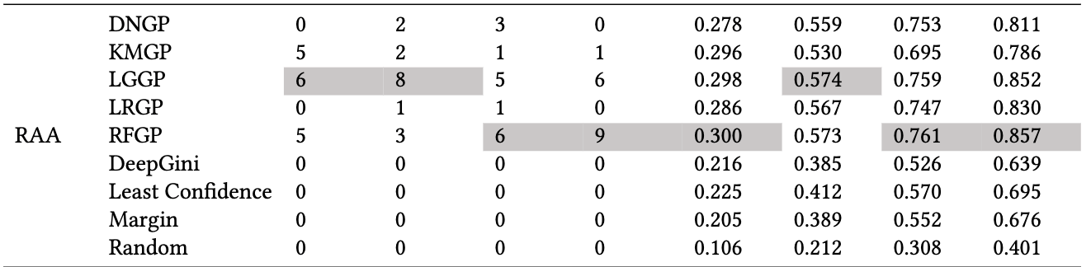
RQ3: Effectiveness of GraphPrior on adversarial test inputs
108 cases
8 attack techniques
(data-1, GNN-Model-1, Attack-1) = case1
(data-1, GNN-Model-1, Attack-2) = case2
(data-2, GNN-Model-2, Attack-1) = case3
…
RFGP and LGGP performs better than others

Slide 12
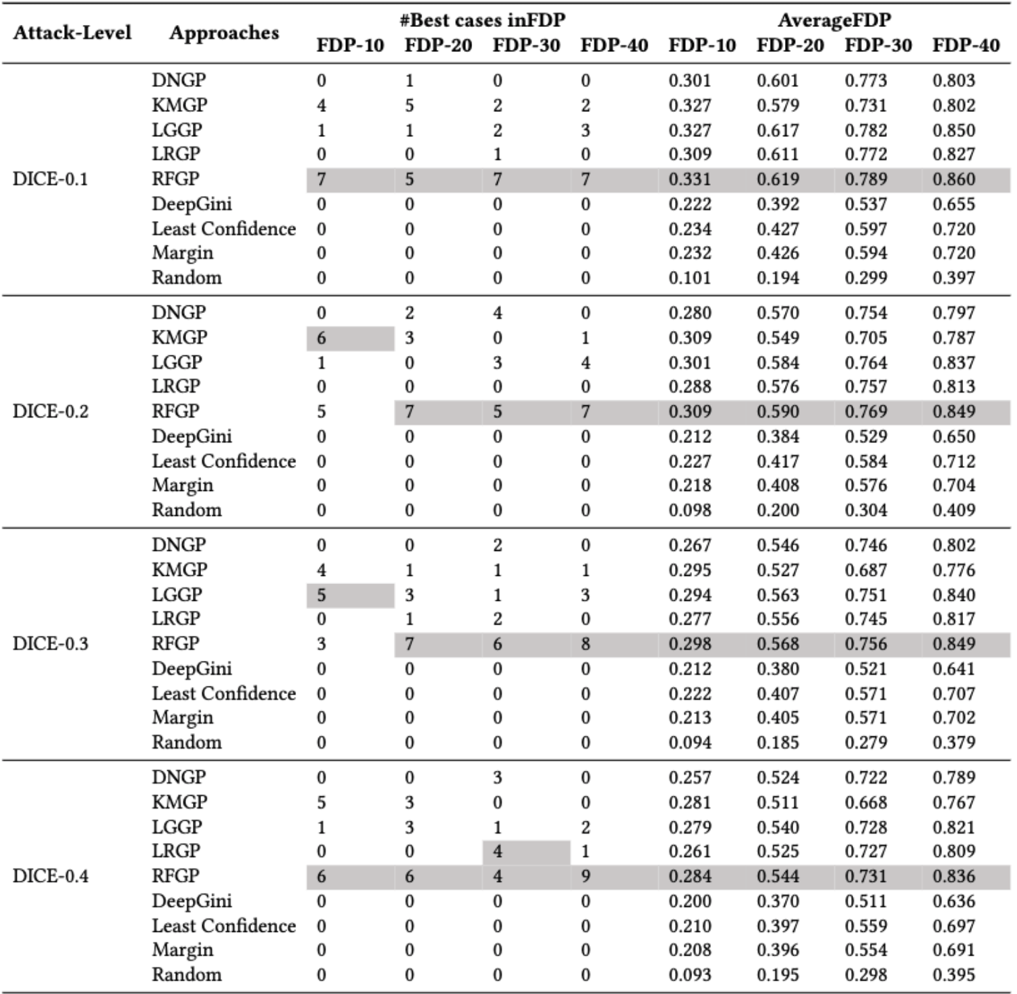
RQ4: How does the effectiveness of GraphPrior affected by different attack level?
GraphPrior outperforms all the compared approaches (i.e., DeepGini, Least Confidence, Margin and Random) on the adversarial test inputs generated from different attack
levels.
On average, RFGP performs the best across different attack levels. KMGP and LGGP behave
well for some specific attack levels

Slide 13
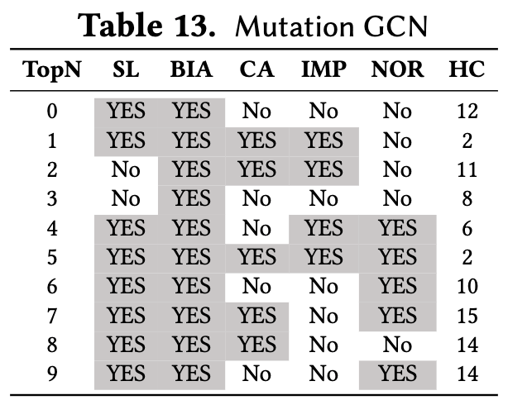
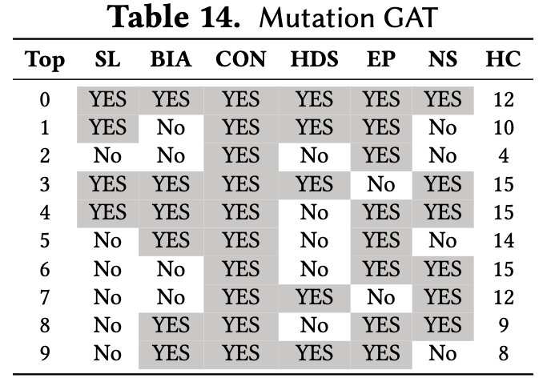
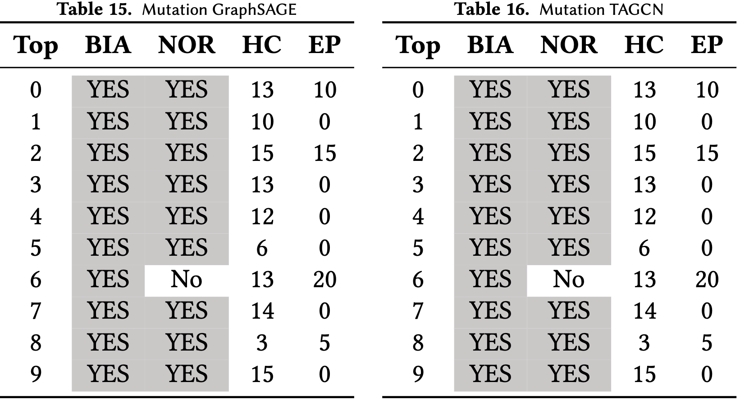
RQ5: Which mutation rules contributes more to feature-based prioritization approaches?
The mutation rules SL and NOR contributes more to GCN. The mutation rules CON and EP contributes more to GAT. The mutation rules BIA and NOR contributes more to GraphSAGE and TAGCN.

