Slide 1
NodeRank
Yinghua LI

Slide 2
Goal
We propose a test input prioritization approach NodeRank for GNNs to label more bug-revealing test inputs (i.e., test inputs that are more likely to be incorrectly predicted by the GNN) earlier for a limited time.
node4
node6
Original ranking
node4
node6
Our goal is to prioritize mispredicted samples
New ranking

Slide 3
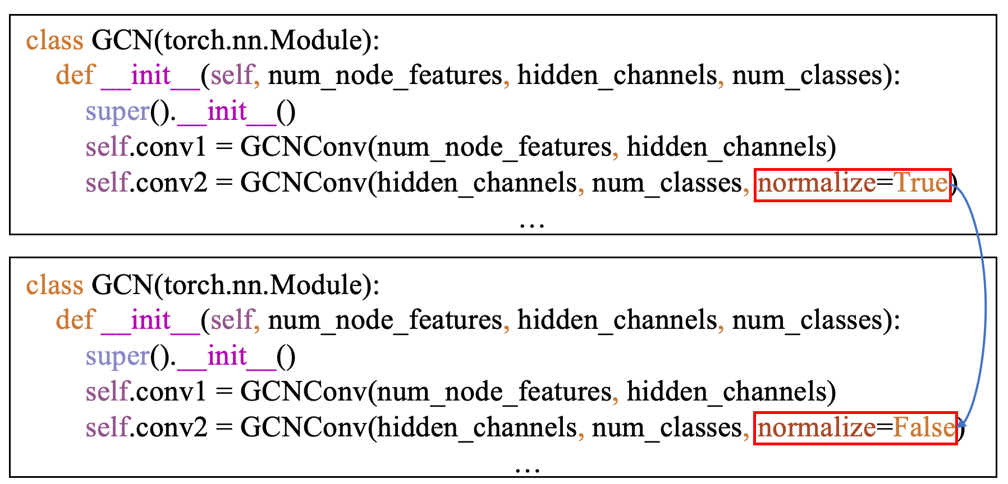
Mutation rules
Graph structure mutation slightly changes the structure of an input graph by randomly adding edges
A
A
Graph structure
Graph structure
node feature mutation slightly changes the features of targeted nodes to make their feature vectors offset in the dimensions
(0 0 1 0 1)
(0 1 1 0 1)
Node feature
Node feature
GNN model mutation sightly changes the training parameters of a given GNN model. We present GMM rules as follows.
GNN model mutation

Slide 4
Feature extraction from mutation results
A
A1
A2
A3
A4
(0 1 1 0)
0
1
1
0
0:
The prediction result of the original node is the same as the prediction result of the mutated node
The prediction result of the original node is
different from the prediction result of the mutated node
1:

Slide 5
Feature extraction from mutation results
Machine learning model
Graph structure
mutation
(0 1 1 0)
concat
Node feature
mutation
(0 0 1 0)
(0 1 1 0 0 0 1 0 0 0 0 1)
A
Graph model
mutation
(0 0 0 1)
0.7
value
The larger the value, the easier it is to be wrongly predicted by the original model.
We sort the values from large to small.

Slide 6
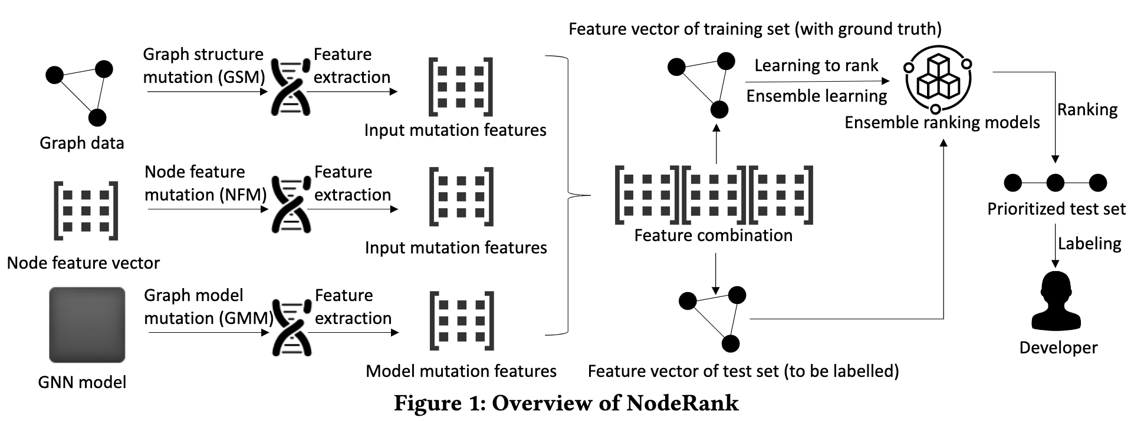
Overview

Slide 7
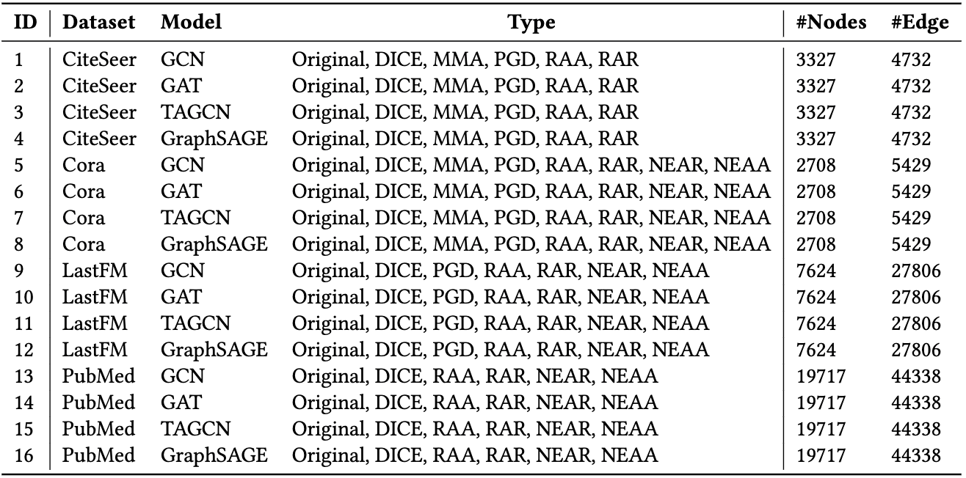
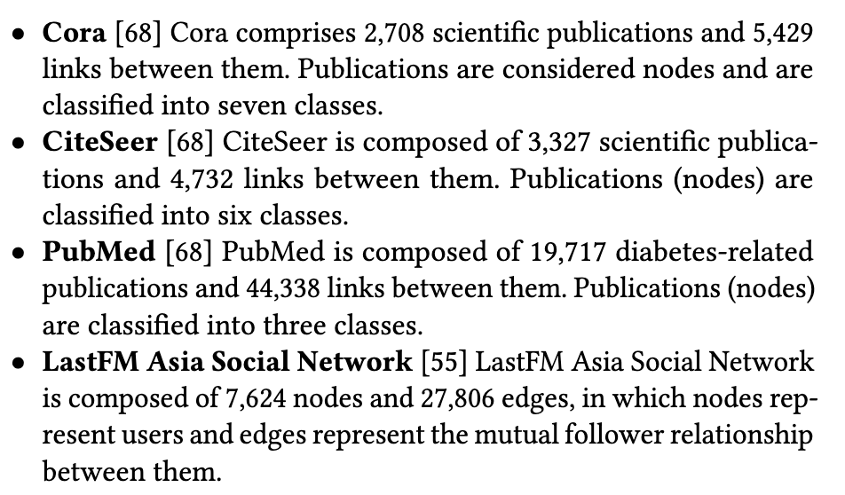
GNN models and datasets
4 datasets, 4 GNN models, 7 attack techniques

Slide 8
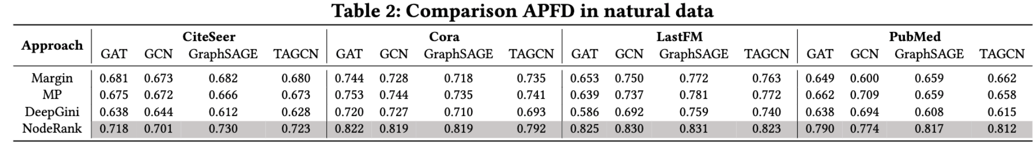
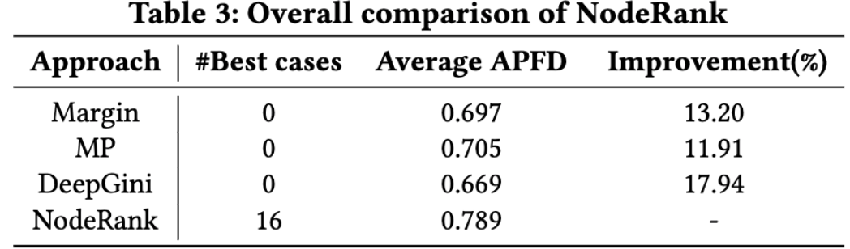
RQ1: Effectiveness of NodeRank
On natural inputs, NodeRank performs the best across all the subjects in terms of APFD, with the average improvement of 11.91%--17.94% compared with DeepGini, MP and Margin.

Slide 9
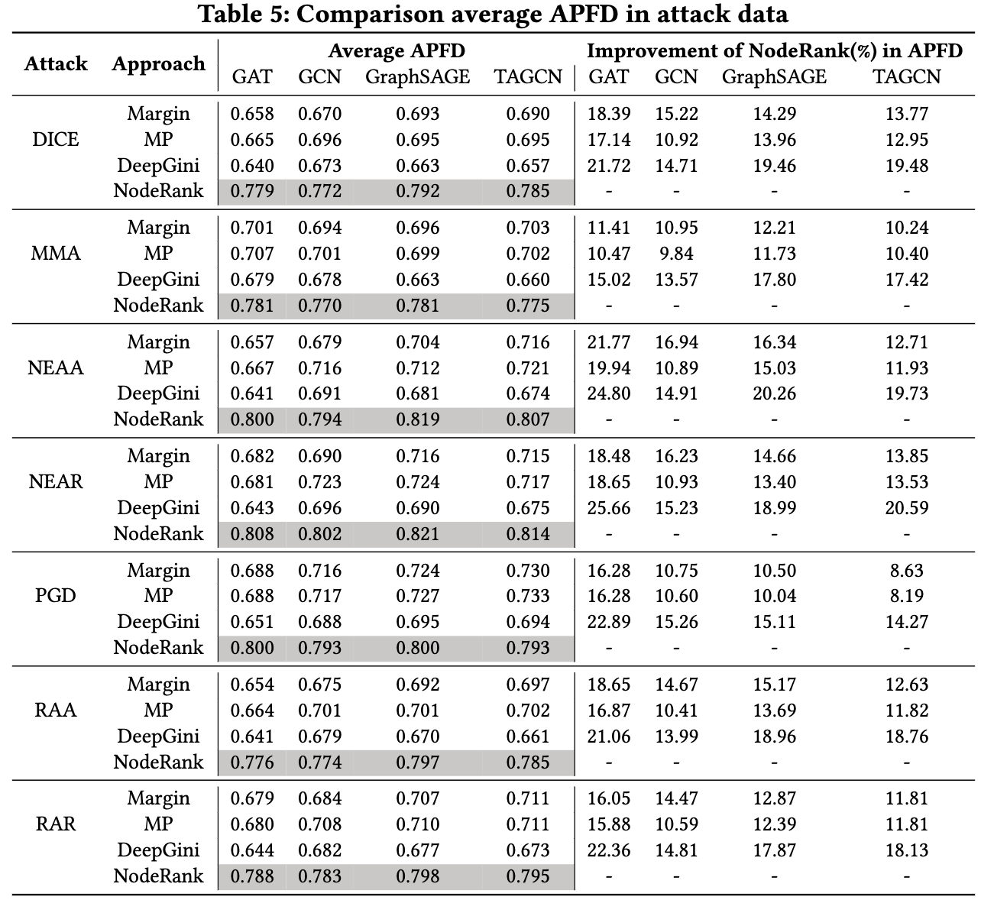
RQ2: Effectiveness of NodeRank on Graph Adversarial Data
On graph adversarial inputs, NodeRank performs the best across all the subjects in terms of APFD, with the average improvement of 8.19% ~25.66% compared with existing approaches

Slide 10
All nodes are sorted according to the score from large to small.
RQ3: Influence of Ensemble Learning Methods
Ranking Models: Logistic Regression (LR), Random Forest(RF), XGBoost(XGB), LightGBM(LGB)
Each model will output a score value (0<score<1).
The larger the value, the more likely the node is to be predicted incorrectly
Round(0.3) = 0
Round(0.8) = 1
A
NodeRank_M:
LR_score + RF_score + XGB_score + LGB_score = Node_score
NodeRank_W:
APFD_LR * LR_score + APFD_RF * RF_score + APFD_XGB * XGB_score + APFD_LGB * LGB_score = Node_score
NodeRank_V:
Round(LR_score) + Round(RF_score ) + Round(XGB_score ) + Round(LGB_score) = Node_score
NodeRank_S:
Original mutation vector
New mutation vector
A
1 0 1 0 1
0.1 0.4 0.6 0.3
ML model
Node_score
LR_score
RF_score
XGB_score
LGB_score

Slide 11
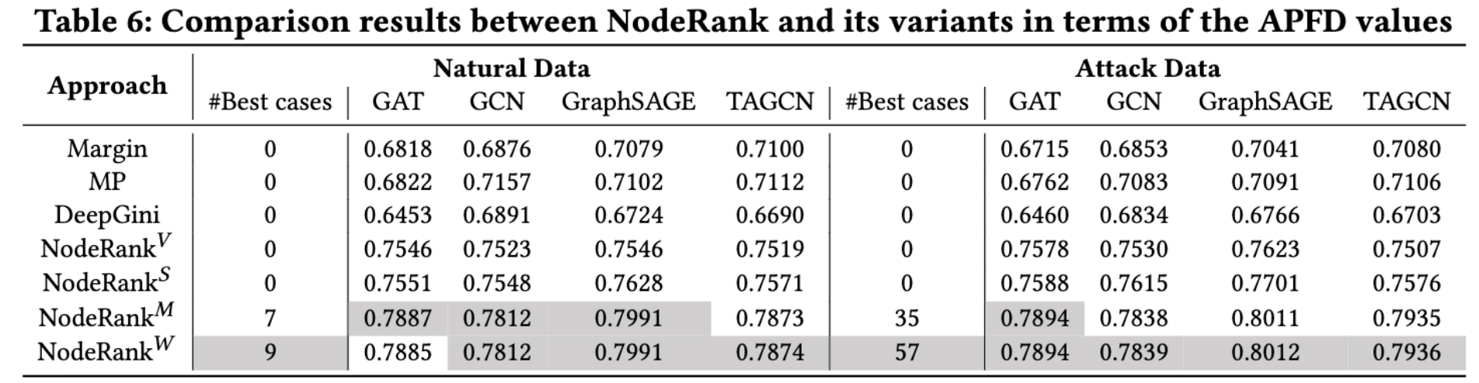
RQ3: Influence of Ensemble Learning Methods
NodeRank_𝑊 and NodeRank_𝑀 perform the best in terms of APFD.

Slide 12
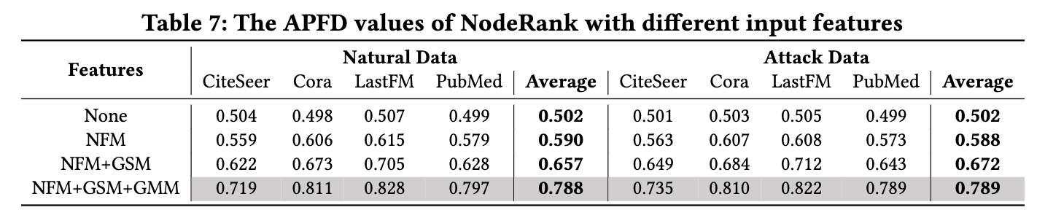
RQ4: Contributions of each type of mutation rules to NodeRank
On natural and adversarial datasets, all the
three categories of mutation features contribute to NodeRank

Slide 13





Step 1
Step 2
Feature vector of training set
(with ground truth)
Step 3
Graph structure
mutation (GSM)
Feature
extraction
Learning to rank
Ensemble learning
Ranking
Input mutation features
Ensemble ranking models
Graph data
Node feature
mutation (NFM)
Feature
extraction
Prioritized test set
Input mutation features
Feature combination
Labeling
Node feature vector
Graph model
mutation (GMM)
Feature
extraction
Developer
GNN model
Model mutation features
Feature vector of test set
(to be labelled)
Overview of NodeRank

Slide 14
Mutation rule

